Slide 1
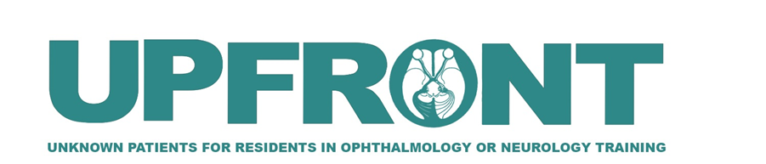

Isolated Abducens Palsy in a
Patient with Poorly Controlled Diabetes
Fradah E Gold, MD,
Department of Ophthalmology & Visual Science, Montefiore Medical Center/ Albert Einstein College of Medicine, Bronx, New York.
Tova R Goldstein, MD,
Department of Ophthalmology & Visual Sciences, Montefiore Medical Center/ Albert Einstein College of Medicine, Bronx, New York.
Alexander H Levitt, MD,
Department of Radiology, Jacobi Medical Center/ / Albert Einstein College of Medicine, Bronx, New York..
Hong Li, MD,
Department of Radiology, Columbia University Medical Center, New York, NY.
Scott W Gorthey, MD
Department of Surgery (Otolaryngology, Head & Neck), Jacobi Medical Center/Albert Einstein College of Medicine, Bronx, New York
Joyce N Mbekeani MD, FRCS, FRCOphth,
Department of Surgery (Ophthalmology), Jacobi Medical Center/ Albert Einstein College of Medicine, Bronx, New York.
Notes:
Hello my name is Fradah Gold and we present, “Isolated Abducens Palsy in a Patient with Poorly Controlled Diabetes,” an Upfront case presentation brought to you by the North American Neuro-Ophthalmology Society and the Journal of Neuro-ophthalmology

Slide 2
91-year-old male with diplopia and facial pain
CC/HPI:
  Presented to ED with four days of binocular horizontal diplopia worse on left gaze and left facial pain
POHx:
  RD repair right eye, years ago
PMHx:
  poorly controlled hypertension (BP 200s/100s mmHg)
  poorly controlled type II diabetes mellitus (HbA1c 8.3%)
  left malignant otitis externa with hospitalization including long-term IV antibiotics and biopsy of “verrucous” lesion obstructing the left external auditory canal (biopsy reported as benign). No ear pain/drainage one month prior per ENT evaluation
Social Hx:
  No smoking/alcohol/drug use
Notes:
The case is a 91-year-old male who presented to the emergency room with four days of binocular horizontal diplopia worse on left gaze and left facial pain. The patient had multiple vascular risk factors including hyperlipidemia, poorly controlled hypertension and type II diabetes mellitus (HbA1c 8.3%). Full Neurology evaluation revealed intact neurological system and negative giant cell arteritis workup, in the ED, were unremarkable and Ophthalmology service was consulted for diplopia.
He had a past history of left malignant otitis externa which required hospitalization for long term intravenous (IV) antibiotics that was completed four months prior to presentation. During this prior hospitalization, the patient was noted to have a “verrucous” lesion obstructing his left external auditory canal. Biopsy of the lesion was reported as benign. The patient was scheduled for a canaloplasty, but the procedure was cancelled due to persistently elevated blood pressure (201/115mmHg to 183/98mmHg). One month prior to the presentation, he was re-assessed by Otolaryngology and noted to be doing well without ear pain or drainage, and with minimal left external auditory canal debris.

Slide 3
Ophthalmology Exam
 | OD | OS
BCVA | 20/25 | 20/25
Pupils | RR, no RAPD | RR, no RAPD
IOP | 14 mmHg | 16 mmHg
cVF | Full | Full
Color (Ishihara) | 11/11 | 11/11
External | WNL | Lesion at ear with drainage
Anterior Segment | NS, otherwise, WNL | NS, otherwise, WNL
Disc | Sharp & Pink, C/D 0.4 | Sharp & Pink, C/D 0.4
Dilated Fundus Exam | Retina tear barricaded by laser burns, otherwise WNL | WNL
Notes:
Ophthalmic examination on presentation revealed best corrected visual acuities of 20/25 bilaterally. Pupils were equally round and reactive without afferent pupillary defect. Intraocular pressures were 14mmHg (right) and 16mmHg (left).
Anterior segment exam aside from cataracts was otherwise unremarkable, posterior exam had a sharp and pink optic nerve.

Slide 4
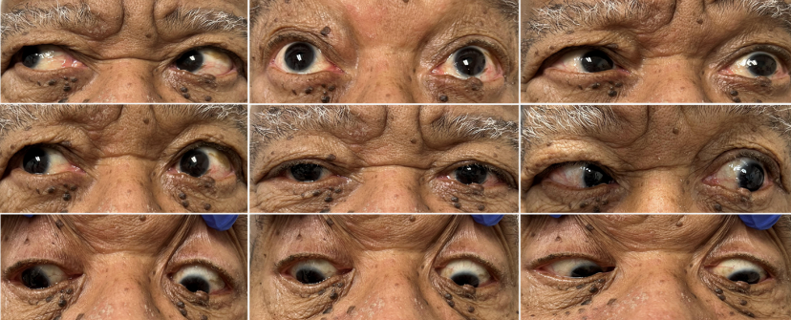
Ophthalmology Exam
How would you describe this 9-gaze image?
Notes:
How would you describe this 9-gaze photo of eye movements?

Slide 5
Ophthalmology Exam
Observed to have a manifest left head turn at distance and near
Notes:
Orthoptic assessment in primary gaze exposed 20 prism diopters (PD) esotropia at distance and 10PD esotropia at near. On left distance gaze the esotropia increased to 45-50PD.
Also, the patient had left head turn and extraocular movement evaluation revealed a left eye abduction deficit
Full neurologic evaluation and investigations for giant cell arteritis were unremarkable.

Slide 6
What is your differential diagnosis for
isolated cranial nerve VI palsy?
Notes:
What is your differential diagnosis?

Slide 7
Isolated CN VI palsy
Vascular
Trauma
Autoimmune/
Inflammatory
Tumor
Infections
Increased
intracranial pressure
Notes:
The differential diagnosis of isolated cranial nerve VI palsy is broad and includes
vascular etiologies, trauma, autoimmune/inflammatory, tumor, infections, and increased ICP

Slide 8
Isolated CN VI palsy
Vascular
Trauma
Autoimmune/
Inflammatory
Tumor
Infectious
Increased
intracranial pressure
Microvascular ischemia
Stroke
Blunt
Penetrating
Vasculitis
Sarcoidosis
Multiple sclerosis
Myasthenia gravis
NPA
Clivus chordoma/meningioma
CPA tumor
Metastases
Syphilis
Tuberculosis
Lyme
Viral
Fungus
Space-occupying lesion
Pseudotumor cerebri/ IIH
NPA= Nasopharyngioma
CPA= cerebellopontine angle
IIH= idiopathic intracranial hypertension
Notes:
The differential diagnosis of isolated sixth nerve palsy is broad and includes
vascular etiologies - microvascular ischemia, stroke
trauma - blunt, penetrating
autoimmune/inflammatory - vasculitis (such as giant cell arteritis), sarcoidosis, multiple sclerosis, myasthenia gravis
Tumors – nasopharyngioma, clival tumors, cerebellopontine angle tumors and metastases.
infectious - syphilis, TB, Lyme, viral and fungi – including mucormycosis since patient is an uncontrolled diabetic
increased ICP - space occupying lesions both benign and malignant, pseudotumor cerebri

Slide 9
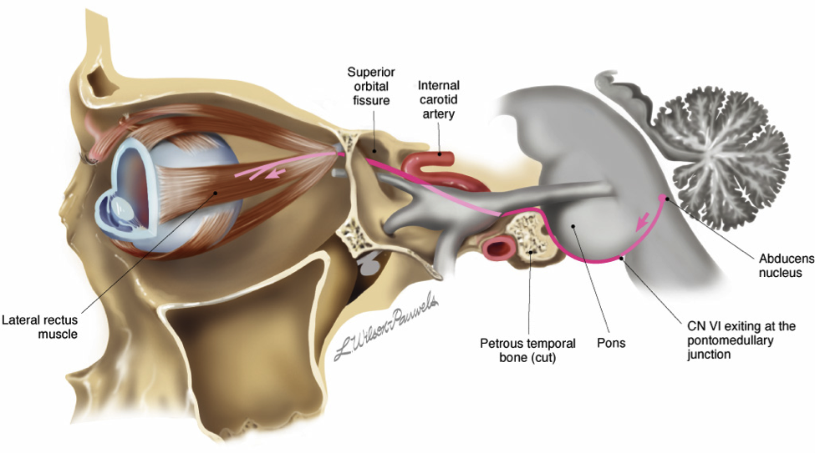
Cranial Nerve VI Course
From its nucleus in the pons, the abducens nerve travels vertically towards the clivus, turning 90 degrees to enter Dorello’s canal, a bony enclosure within the petrous temporal bone.
From the petrous apex, the nerve travels through the cavernous sinus and finally exits into the orbit through the superior orbital fissure and travels forward to innervate the medial aspect of the lateral rectus muscle.
From: https://eyewiki.org/Gradenigo_Syndrome; Accessed 6/27/2026.
Notes:
Originating from its nucleus in the pons, the sixth cranial nerve exits the brainstem at the pontomedullary sulcus. It then travels superiorly, anteriorly and slightly laterally towards Dorello’s canal, a CSF filled bony enclosure within the petrous portion of the temporal bone. From the petrous apex, the nerve travels through the cavernous sinus where it has close association with the IIIrd, IVth, first two branches of Vth cranial nerves, ocular sympathetics and internal carotid artery. It then exits the cavernous sinus travelling forward to enter the orbit in the intraconal space from where it innervates the lateral rectus from the medial surface.
Depending on the location of the lesion, other contiguous structures may be involved resulting in various presentations. Treatment of VIn palsy depends on associated underlying conditions. Typically, underlying systemic conditions are simultaneously managed.

Slide 10
How is Cranial Nerve VI Palsy Localized?
Notes:
How is CN VI palsy localized?

Slide 11
CN VI Palsy Localization
Brainstem
Intracranial hypertension (subarachnoid space)
Petrous apex syndrome
Cavernous sinus syndrome
Orbital
Isolated CN VI Palsy
Notes:
The location of the lesion, in the course of cranial nerve VI, determines the syndromic presentation. There are several syndromes from the brainstem to the orbit.
Contiguous structures contribute to the clinical manifestation.
There are six CNVI palsy syndromes:
Brainstem
Intracranial hypertension (subarachnoid space)
Petrous apex syndrome
Cavernous sinus syndrome
Orbital
Isolated

Slide 12
CN VI Palsy Localization
Brainstem
Intracranial hypertension (subarachnoid space)
Petrous apex syndrome
Cavernous sinus syndrome
Orbital
Millard-Gubler
    VIn palsy, ipsilateral VIIn palsy and contralateral hemiparesis
Foville
    VIn palsy, ipsilateral Vn, VIIn and VIIIn palsies, ipsilateral Horner’s syndrome, andhorizontal gaze palsy
Raymond’s syndrome
    VIn palsy and contralateral hemiparesis
Cerebellopontine angle lesions
    VIn palsy, ipsilateral Vn, VIIn and VIIIn palsies and ataxia
Intracranial hypertension --> downward displacement of the brainstem --> stretching at tethered points in the pons and within Dorello’s canal
Gradenigo Syndrome
Petrous temporal osteomyelitis
Inflammation/infection within Dorello’s canal
  VIn, IIIn, IVn, V (ophthalmic and maxillary branches) palsy
    Nasopharyngeal carcinoma
    Meningioma
    C-C fistula
    Internal carotid aneurysm
    Tolosa-Hunt syndrome
  Proptosis, chemosis, optic disc edema, and optic atrophy
  Orbital apex involvement:
    frozen globe with associated IIIn, IVn, V (ophthalmic and maxillary branches) palsy and Horner’s syndrome
Notes:
Brainstem Syndrome:
Millard-Gubler
VIn palsy, ipsilateralVIIn palsy and contralateral hemiparesis
Foville
VIn palsy,ipsilateral Vn, VIInand VIIIn palsies, ipsilateral Horner’s syndrome,and horizontal gazepalsy
Raymond’s syndrome
VIn palsy and contralateral hemiparesis
Cerebellopontine angle lesions
VIn palsy, ipsilateral Vn, VIInand VIIIn palsies and ataxia
Intracranial hypertension (subarachnoid space): Intracranial hypertension --> downward displacement of the brainstem -->stretching at tethered points in the pons and within Dorello’s canal
Petrous apex syndrome: Gradenigo Syndrome = Inflammation/infectionwithin Dorello’s canal
Cavernous sinus syndrome – VIn, IIIn, IVn, V(ophthalmic and maxillary branches) palsy
Nasopharyngeal carcinoma
Meningioma
C-C fistula
Internal carotid aneurysm
Tolosa-Hunt syndrome
Orbital: proptosis, chemosis, optic disc edema, and optic atrophy
Orbital apex involvement:
frozen globe with associated IIIn, IVn,V(ophthalmic and maxillary branches) palsy and Horner’s syndrome
Isolated VIn palsy covered previously; Isolated VIn is the most common ocular motor nerve palsy. In adults, the most common etiology is microvascular disease. Full Neurology and Ophthalmic examinations revealed our patient has isolated left cranial nerve VI palsy.
Microvascular, associated with hypertension, DM and hyperlipidemia
Post-infectious (e.g post-viral, Lyme, syphilis)
Immunologic
Trauma
Complicated migraine

Slide 13
Which action would you take next?
Observe for resolution of presumed microvascular abducens palsy and send to PCP for management of hypertension and poorly-controlled diabetes
Neuroimaging
Prescribe Fresnel lenses to relieve diplopia
Obtain Acetylcholine receptor (AChR) and muscle-specific kinase (MuSK) antibodies
Notes:
Given this information, what would be your next step for this unilateral isolated VIn palsy?

Slide 14
Which action would you take next?
Observe for resolution of presumed microvascular abducens palsy and send to PCP for management of hypertension and poorly-controlled diabetes.
Neuroimaging
Prescribe Fresnel lenses to relieve diplopia.
Obtain Acetylcholine receptor (AChR) and muscle-specific kinase (MuSK) antibodies
Notes:
Although isolated CNVI palsy in the absence of other neurological findings is often attributed to microvascular disease, the best next step in this patient is neuroimaging.

Slide 15
B. Neuroimaging
Patients presenting with lateral rectus (abducens/VIn) palsy in the absence of other neurologic findings are classified as “isolated sixth nerve palsy”
  Often attributed to microvascular disease from vascular risk factors (e.g., hypertension, diabetes mellitus, hyperlipidemia)
Neuroimaging (choice B) is indicated when patients are under 45years old and 45-55years old without vascular risk factors, with nerve palsy accompanied by pain or another neuropathy.¹
Prospective studies of isolated ocular nerve palsies, including sixth nerve palsy, have reported 1%-16.5% non-microvascular causes in older patients with presumed microvascular palsy.²
Notes:
Despite being in an older age group and having multiple microvascular risk factors, this patient also had a history of ipsilateral otitis and associated facial pain, warranting neuroradiologic assessment.

Slide 16
Neuroimaging in Isolated Cranial Nerve VI Palsy
In one multi-center prospective study of patients older than 50 years of age, with isolated ocular motor nerve palsies, Tamhankar et al found that 61% of cases had microvascular risk factors and 16.5% had potentially treatable non-microvascular causes.
Isolated sixth nerve palsy was the most frequent ocular motor nerve palsy and had the highest association with non-microvascular causes including giant cell arteritis, cavernous sinus B-cell lymphoma, and petro-clival meningioma.²
The authors advocated brain MRI and laboratory investigations in the initial workup of all patients including older patients with microvascular risk factors.
Notes:
A recent multi-center prospective study found that 16.5% of patients older that 50yrs of age with microvascular risk factors also had other causes amenable to therapy. The authors have advocated neuroimaging for all patients including those who are older and have known microvascular risk factors.

Slide 17
Other choices
In this case, the patient’s significant past ENT history and associated facial pain, forgoing neuroimaging and instead referring the patient to his PCP for better management of blood pressure and diabetes (Choice A) could have potentially devastating outcomes.
Patients with diplopia from isolated cranial nerve VI palsy can be managed with prisms (Choice C), occlusion patches, botulinum toxin (if myasthenia ruled out), and surgery. Surgery is considered for patients with 6 months of stable orthoptic measurements.
Even when a patient does meet criteria for an “isolated sixth nerve palsy,” not requiring neuroimaging, it is critical to consider conditions which can mimic lateral rectus palsy such as thyroid eye disease, myasthenia gravis (Choice D), and giant cell arteritis.
Notes:
Management of poorly controlled intercurrent medical problems (Choice A) and investigation of to rule out other causes of isolated lateral rectus weakness (presumed CN VI palsy) should be conducted simultaneously (Choice D) but not as the sole management plan at the expense on neuroimaging. Occlusion to prevent diplopia may be offered at the outset (Choice C) however botulinum toxin, prism lenses and surgical correction typically are offered for stable orthoptic measurements over several months. Botox is only considered if myasthenia gravis has been ruled out.

Slide 18
Neuroimaging obtained:
CT scan
MRI
Although this patient is older and had known vascular risk factors for microvascular sixth nerve palsy, the history of complicated otitis externa and presence of associated ipsilateral facial pain prompted admission and neuroimaging with scrutiny of the complete sixth nerve course and comparison with past studies.
Notes:
Although this patient was older and had known vascular risk factors for microvascular sixth nerve palsy, the history of complicated otitis externa and presence of associated ipsilateral facial pain prompted neuroimaging with scrutiny of the complete sixth nerve course and comparison with past studies.

Slide 19
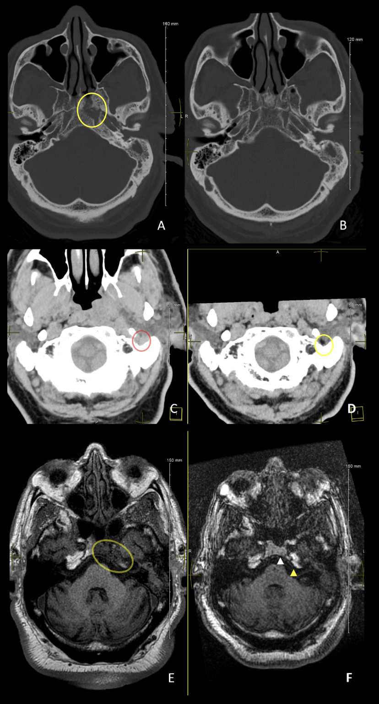
Bone window CT without contrast
Skull Base
new cortical erosions along the left anterior margin of the clivus and posterior margin of the left pterygoid
Presentation Seven months prior
Notes:
CT scans revealed new cortical erosions of the central skull base
Compilation axial non-contrast neuroimages of the head. (A) and (B) Bone window CT scans at the level of the skull base, at the time of presentation (A) and 7months prior (B) demonstrating new cortical erosions along the left anterior margin of the clivus and posterior margin of the left pterygoid (circle).

Slide 20
CT
normal fat
asymmetric infiltration
of the fat below the left stylomastoid foramen
Presentation Seven months prior
Notes:
CT images at the same level (C) demonstrate asymmetric infiltration of the fat below the left stylomastoid foramen (red oval), which is new compared the prior study, 7months prior (D); normal fat on CT is dark (yellow oval).

Slide 21
MRI - Axial T1 pre-contrast
new hypointense signal involving the left clivus and petrous apex in the expected region of Dorello’s canal
clivus
petrous apex
Presentation Seven months prior
Notes:
MRI scans revealed corresponding marrow infiltration
Axial T1 pre-contrast MRI images at the time of presentation (E) and 7months prior (F) demonstrate new hypointense signal involving the left clivus and petrous apex (yellow oval) in the expected region of Dorello’s canal.
There was enhancement in this region after the administration of intravenous contrast (not shown), consistent with marrow infiltration.
Note the normal bright signal in the clivus (white arrowhead) and petrous apex (yellow arrowhead) on the prior study that are lost in the presenting image (E)

Slide 22
How would you summarize this presentation?
Notes:
How would you summarize the case presentation so far?

Slide 23
Case Summary
Elderly male with history of poorly controlled diabetes mellitus, hypertension and complicated otitis externa presenting with ipsilateral facial pain and isolated ipsilateral cranial nerve VI palsy.
Comparison of current and previous neuroradiology revealed progressive intracranial infiltration of prior otitis.
Found to have ipsilateral petrous temporal osteomyelitis or Gradenigo syndrome.
Notes:
We described an elderly male with complicated otitis externa presenting with ipsilateral facial pain and ipsilateral cranial nerve VI palsy found to have cortical erosions of the central skull base with marrow infiltration

Slide 24
What is petrous temporal osteomyelitis or Gradenigo syndrome?
Notes:
What do you know about petrous temporal osteomyelitis, also known as Gradenigo syndrome?

Slide 25
Gradenigo Syndrome
Triad:
  otitis media
  facial pain
  ipsilateral sixth nerve palsy
Notes:
Gradenigo syndrome is a clinical triad comprising otitis media, facial pain, and ipsilateral sixth nerve palsy, often results from intracranial progression of untreated otitis media and is potentially life-threatening. Our patient originally had otitis externa not otitis media thus this case represents atypical Gradenigo syndrome.

Slide 26
Gradenigo Syndrome
Often results from progression of untreated otitis media.
Prior to the advent of antibiotics, intracranial complications resulting from extension of ear infections including meningitis, labyrinthitis, venous sinus thrombosis and intracranial abscesses occurred in 2.3-6.4%.
With the introduction of antibiotics and enhanced imaging techniques, these complications have decreased significantly.
In the post-antibiotic era, Gradenigo Syndrome exceedingly rare (2 per 100,000), and may present without manifesting the full triad.^{4,10}
Other causes of Gradenigo syndrome include inflammation and neoplasia.
Notes:
Prior to the advent of antibiotics, intracranial complications resulting from the extension of ear infections including meningitis, labyrinthitis, venous sinus thrombosis and intracranial abscesses occurred in 2.3-6.4% of patients. With the introduction of antibiotics and enhanced imaging techniques, these complications have decreased significantly. Gradenigo syndrome is exceedingly rare (2 per 100,000) in the post-antibiotic era and may present without manifesting the full triad.2,4

Slide 27
What would you do next?
Notes:
What would you do next?

Slide 28
Laboratory Studies Summary
Normal:
WBC, Plt, normocytic anemia as baseline, age-corrected ESR, CMP
Blood culture, Quantiferon, syphilis, Lyme, Aspergillus Galactomannan Antigen, Fungitell B-D glucan
ACE, ANCA, IgG4, ANA
Vitamin B12/folate, MMA, Homocysteine, Vitamin B6, iron studies, clotting profile
Abnormal:
CRP (12 mg/L; normal <10mg/L)
Notes:
Patient was admitted for multidisciplinary management. Laboratory tests were unremarkable.

Slide 29
Tissue biopsy and culture
ENT assessment and subsequent left canaloplasty with removal of a “verrucous” lesion.
Histopathology revealed reactive squamous mucosa with edema and active chronic inflammation.
Tissue cultures grew Staphylococcus lugdunensis.
Notes:
The patient was assessed by Otolaryngology and subsequently underwent a left canaloplasty with the removal of a verrucous lesion. He received daily drainage and topical aural drops. Histopathology revealed reactive squamous mucosa with edema and active chronic inflammation. Tissue cultures grew Staphylococcus lugdunensis.
There was no evidence of mucormycotic infection on ENT clinical and microbiologic assessments.

Slide 30
What do you know about Staphylococcus lugdunensis?
Notes:
What do you know about Staphylococcus lugdunensis?

Slide 31
Staphylococcus lugdunensis
Rare and virulent gram (+), coagulase-negative, skin commensal bacterium.
Often infection of middle-aged and elderly patients.
Associated with up to 40% mortality in patients with infective endocarditis.^{6,11}
Has been associated with cases of suppurative otitis media and temporal bone osteomyelitis.¹²
To our knowledge, this is the first report of its association with Gradenigo syndrome.
Notes:
You can see here what we know about this particular Staphylococcus; it is rare and associated with high mortality. It has yet to be reported in patients with Gradenigo syndrome.

Slide 32
How would you manage this patient with Staphylococcus lugdunensis – associated Gradenigo syndrome?
Notes:
How would you manage this case?

Slide 33
Our Patient with Gradenigo Syndrome
The patient was treated with a course of IV Meropenem and topical Ciprofloxacin eardrops with good effect.
Multidisciplinary management:
  Internal medicine – management of poorly controlled HTN and DM II
  Infectious Diseases – assessment and suggestion of 2 weeks of IV therapy. Long-term oral levofloxacin therapy was prescribed for 2 months post-discharge.
  ENT – post-op daily drainage of aural cavity
  Ophthalmology initial assessment and monitoring of eye movements
  Neurology initial assessment and monitoring.
Notes:
Our patient was treated with IV Meropenem, daily drainage of the left aural cavity and topical ciprofloxacin for 2 weeks. He was discharged on long-term oral Levofloxacin.

Slide 34
Case Summary
Elderly male with history of poorly controlled HTN, DM II, and complicated otitis externa.
Presenting with isolated cranial nerve VI palsy and ipsilateral facial pain.
Found to have cortical erosions of the central skull base with marrow infiltration.
Tissue culture revealed Staphylococcus lugdunensis infection.
Diagnosis: Atypical Gradenigo syndrome
Treatment: Surgical excision and drainage and IV, oral and topical antibiotics
Notes:
In summary, we had an elderly male with history of complicated otitis externa presenting with ipsilateral facial pain and ipsilateral cranial nerve VI palsy found to have cortical erosions of the central skull base with marrow infiltration with . Verrucous tissue excision revealed chronic inflammation and culture grew Staphylococcus lugdunensis
This case represents atypical Gradenigo syndrome resulting from otitis externa as opposed to otitis media.
Gradenigo syndrome with predisposing auditory canal verruca was deemed the most likely diagnosis. Management with IV and topical antibiotics resulted in resolution of symptoms and signs.

Slide 35
Patient Outcome
A high index of suspicion and appropriate laboratory and neuroradiologic investigations with timely surgical and medical management helped to avert a poor outcome.
Despite a potentially lethal infection with a virulent bacterium, this patient had an uncomplicated hospital course and completed a two-week course of intravenous antibiotics.
He was discharged home on oral levofloxacin with planned close ENT and Ophthalmology follow up.
At his last outpatient appointment, three months post-discharge, the patient had full resolution of left facial pain and lateral rectus palsy.
Notes:
Despite a potentially lethal infection with a virulent bacterium, this patient had an uncomplicated hospital course and completed a two-week course of intravenous antibiotics. He was discharged home on oral levofloxacin with planned close Otolaryngology and Ophthalmology follow up. At his last outpatient appointment, three months post-discharge, the patient had full resolution of aural discharge, left facial pain and ipsilateral sixth nerve palsy.

Slide 36
Learning Points
Otologic symptoms or history should prompt scrutiny of the petrous apex, clivus, Dorello’s canal, cavernous sinus and skull base.
Malignant otitis externa can produce an atypical Gradenigo syndrome.
Consider neuroradiologic investigation for all isolated cranial nerve palsy especially for atypical presentations despite advanced age and known microvascular risk factors.
Notes:
Investigations including neuroradiological assessment can help to expose interval changes and rare and serious diagnoses such as Gradenigo syndrome. Timely intervention can help avert potentially devastating outcomes. We agree with Tamhankar et al in recommending investigations of all patients with isolated ocular motor nerve palsies, even when patients are elderly with microvascular risk factors.

Slide 37
References
Chi, Sulene L, Bhatti, M Tariq. The diagnostic dilemma of neuro-imaging in acute isolated sixth nerve palsy. Current Opinion in Ophthalmology. 2009;20(6):423-429.
Tamhankar MA, Biousse V, Ying GS, Prasad S, Subramanian PS, Lee MS, Eggenberger E, Moss HE, Pineles S, Bennett J, Osborne B, Volpe NJ, Liu GT, Bruce BB, Newman NJ, Galetta SL, Balcer LJ. Isolated third, fourth, and sixth cranial nerve palsies from presumed microvascular versus other causes: a prospective study. Ophthalmology. 2013 Nov;120(11):2264-9.
Kline LB, Bhatti MT, Chung SM, Eggenberger E, Foroozan R. Basic and clinical science course; Neuro-ophthalmology. San Francisco: American Academy of Ophthalmology; 2010-2011.
Azarmina M, Azarmina H. The six syndromes of the sixth cranial nerve. J Ophthalmic Vis Res. 2013 Apr;8(2):160-71. PMID: 23943691; PMCID: PMC3740468.
Thurtell MJ, Tomsak RJ, Daroff RB. What do I do now? Neuro-ophthalmology. Oxford, New York; 2011.
Von Noorden GK. Binocular Vision and Ocular Motility: Theory and Management of Strabismus, Third ed. 1985.
Silverman IE, Liu GT, Volpe NJ, Galetta SL. The crossed paralyses. The original brain-stem syndromes of Millard-Gubler, Foville, Weber, and Raymond-Cestan. Arch Neurol. 1995;52:635–638.
Kurbanyan K, Lessell S. Intracranial hypotension and abducens palsy following upper spinal manipulation. Br J Ophthalmol. 2008;92:153–155.
Valles JM, Fekete R. Gradenigo Syndrome: Unusual Consequence of Otitis Media. Case Reports in Neurology. 2014;6:197-201.
Hafidh MA, Keogh I, Walsh RM, Walsh M, Rawluk D. Otogenic intracranial complications. a 7-year retrospective review. Am J Otolaryngol. 2006;27(6):390-5.
Heilbronner S, Foster TJ. Staphylococcus lugdunensis: A Skin Commensal with Invasive Pathogenic Potential. Clin Microbiol Rev. 2020;34(2):e00205-20.
Thomas S, Hoy C, Capper R. Osteomyelitis of the ear canal caused by Staphylococcus lugdunensis. J Infect. 2006 Nov;53(5):e227-9.
Notes:
These are our references.

Slide 38
Acknowledgment
The authors wish to thank the patient for consent to present his case, clinical course and images for educational purposes and publication.
Notes:
We are grateful to the patient for providing written consent for this presentation.

