Slide 1

Upfront case
Wake Me Up Before You Go Go
Nicholas Demas, MD
Gabriela Keeton, MD
Nathan Shelman, MD
Douglas Lukins
Padmaja Sudhakar, MD
Department of Ophthalmology and Neurology
University of Kentucky

Slide 2
24 year-old Caucasian woman Presentation
1-week of severe headaches thought to be due to stress working as a CNA
New onset seizure: behavioral arrest with bilateral arm extension and stiffening, and tongue biting
Auditory and visual hallucinations
Transient visual obscurations
Pulsatile tinnitus
Photophobia
No recent fevers or preceding illnesses
PMH: polycystic ovarian syndrome (PCOS), HTN, migraines
FMH: non-contributory
Social Hx: vaping, energy drinks and 5 cups of coffee daily
Notes:
Capitalize "p" in presentation – done
"behavioral arrest with bilateral arm extension [and], stiffening, and tongue biting – done
Add photophobia to presentation symptom – done

Slide 3
Initial Evaluation
Vital signs within normal limits
Unremarkable cardiovascular and respiratory exams
Neurologic exam:
  Alert & oriented but intermittent hallucinations
  Non-focal exam
Fundus exam deferred due to photophobia
Received migraine cocktail, started on levetiracetam after witnessed generalized tonic clonic seizure before transfer to our facility
Notes:
Would put bullet/asterisk of "had received migraine cocktail..." after the exam as the last bullet point on the slide – done
"cardiovascular and respiratory exams“ – done
Fundus exam deferred due to photophobia [take out "+photophobia" this should be in history on previous slide – done

Slide 4
Initial Work-Up
Unremarkable CBC, CMP, UA, UDS
Negative pregnancy urine test and COVID-19 PCR
EEG: rhythmic theta-delta slowing of the left frontotemporal lobe but no seizures
What differential would you consider at this point ?
What additional tests would you order ?
Do you want imaging?
Notes:
Should a differential come up before imaging? – added a sentence
Perhaps "what additional tests would you order" rather than just imaging – changed
Would show MRI with contrast or at minimum state the study was unremarkable not just FLAIR/T2 - FLAIR/T2 was showed to reflect no PRES- changes made
Confirm that the MRI did not confirm the edema seen on the NCHCT – done

Slide 5
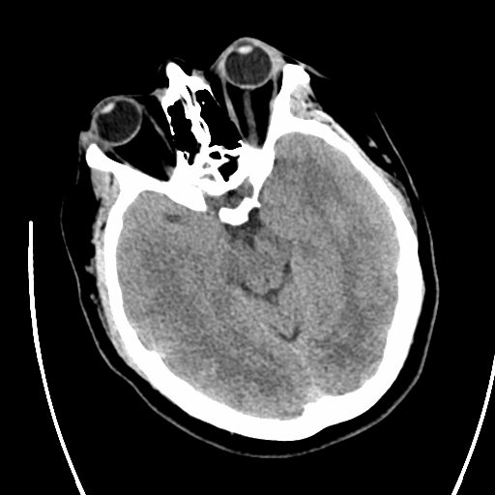
Imaging: CT head
Vasogenic edema in the occipital lobes
Concern for PRES but BP was normal and no inciting medications noted

Slide 6
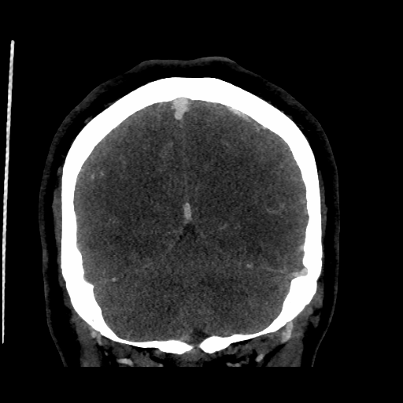
Imaging: CTV
Severe stenosis at right transverse/sigmoid sinus junction (red arrow)
Moderate stenosis on the left (yellow arrow)

Slide 7
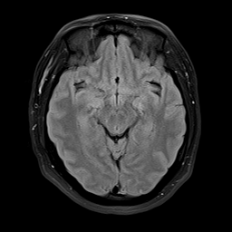
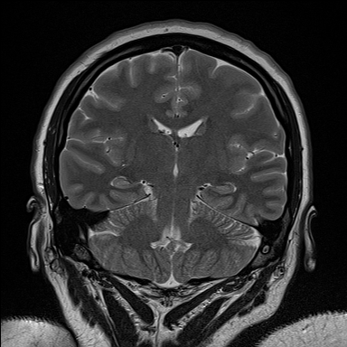
Imaging: MRI head with and without contrast
Axial T2 FLAIR
Coronal T2
MRI head with and without contrast unremarkable
MRI did not show the edema seen on the NCHCT

Slide 8
Hospital Course
Remained on levetiracetam, headache abortive treatment prn.
5 days after presentation: developed stupor, mutism, and oral dyskinesias
Exam:
  Fundus Exam: OU grade 4 disc edema
  Unable to assess visual acuity due to stupor
  No other focal findings on exam
What additional work-up do you want?
EEG showed no seizures
Notes:
Was patient treated with anything over the five days between imaging and LP? Progressive or acute decline - would clarify – was continued on levetiracetam and symptomatic headache treatment.
Any other focality on neurological exam? No, mentioned it
Any changes on EEG if still connected? Would state explicitly – done

Slide 9
Lumbar Puncture (LP)
Elevated opening pressure 54 cmH2O
Lymphocytic pleocytosis (225 cells- 91% lymphocytes)
Elevated protein (54) (ref: 15-45)
Negative for gram stain and culture, viral studies
Cytology/flow cytometry was negative for malignancy
What is the possible diagnosis and treatment?
Meningoencephalitis
Neurosarcoidosis
autoimmune/paraneoplastic encephalitis
Carcinomatous meningitis
Cerebral vasculitis
Lupus cerebritis
Notes:
Were cytology/flow cytometry performed on CSF – yes, mentioned.
Add autoimmune/paraneoplastic encephalitis, carcinomatous meningitis? vasculitis, autoimmune/lupus, to differential?- added.

Slide 10
Hospital Course
Concern for viral meningoencephalitis
  Started on IV acyclovir and acetazolamide 500 mg bid for intracranial hypertension (after LP)
  Remained on levetiracetam
Episode of worsening stupor with apnea and bradycardia
  Subsequent intubation and ICU upgrade
Continued oral automatisms and new left gaze preference
What workup do you want?
Any medication changes?
Notes:
First bullet needs space after hypertension and take away space after parenthesis – done
Would clarify /repeat what medications patient is on ?still levetiracetam - now mentioned.

Slide 11
Further Work-up
Repeat MRI Head with and without contrast: no acute findings
Repeat EEG did not show epileptiform activity
Levetiracetam increased to 1500mg BID with concern for ongoing seizures causing hemodynamic instability
Serial LPs
  Opening pressure persistently elevated (>55, 45, 30 cm H2O)
  Lumbar drain placed and removed in 72 hours
Acetazolamide dose increased to 1500 mg bid
No significant improvement in mental status
Since patient was obtunded additional symptoms of intracranial hypertension could not be elicited.
She was monitored with serial neurological exams.
Important additional history obtained from family
  Thoughts on possible history?
Notes:
Were there any abnormalities on the MRI ? FLAIR hyperintensities? Enhancement ? Stigmata of intracranial hypertension? Would show here- none noted.
Added sentence about symptoms of elevated ICP

Slide 12
Further History and Work-up
Patient’s mom reported prior dermoid tumor removal from both ovaries of the patient about 9 years prior to presentation
  What is concerning in patient’s history with this new information?
    What work-up do you want?
Notes:
Extra space between "both" and "ovaries" could also just say about 9 years prior to presentation rather than age of surgery – changed.

Slide 13
Further Work-up
CT chest/abdomen/pelvis: demonstrated 12 mm fat-containing nodule on patient’s left ovary
  What are you concerned for?
  Any medication changes?

Slide 14
Further Work-up
Started IV methylprednisolone 1000mg daily for 5 days
IV immunoglobulin (IVIG) 2 grams/kg
Serum NMDA antibody (-)
CSF NMDA antibodies (+)
Underwent diagnostic laparoscopy, left oophorectomy, partial left salpingectomy, and lysis of adhesions
  Biopsy taken of left ovarian nodule
    What pathology do you suspect?

Slide 15
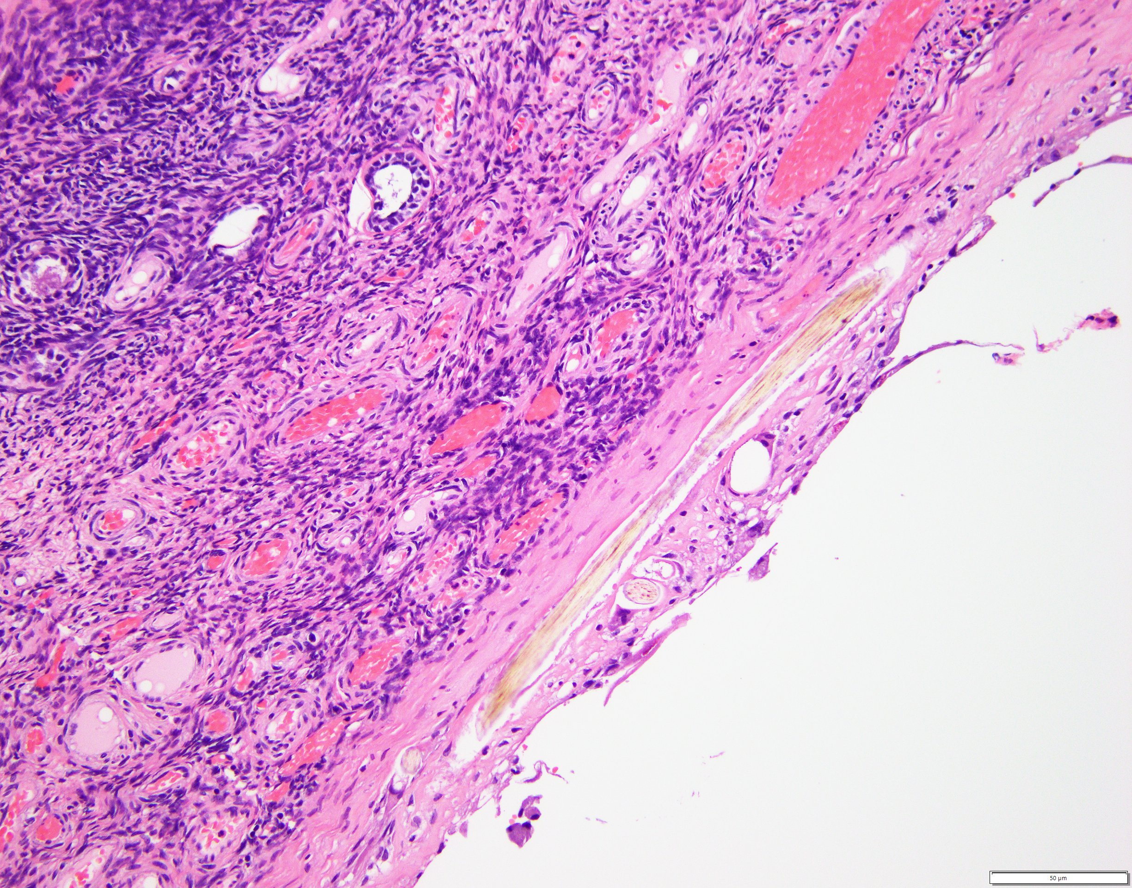
Pathology
Pathology confirmed mature cystic teratoma of left ovary
Denuded cyst lining with embedded hair and adjacent ovarian stroma
*
Asterisk – Hair embedded within cyst lining
Arrow heads – Ovarian stroma

Slide 16
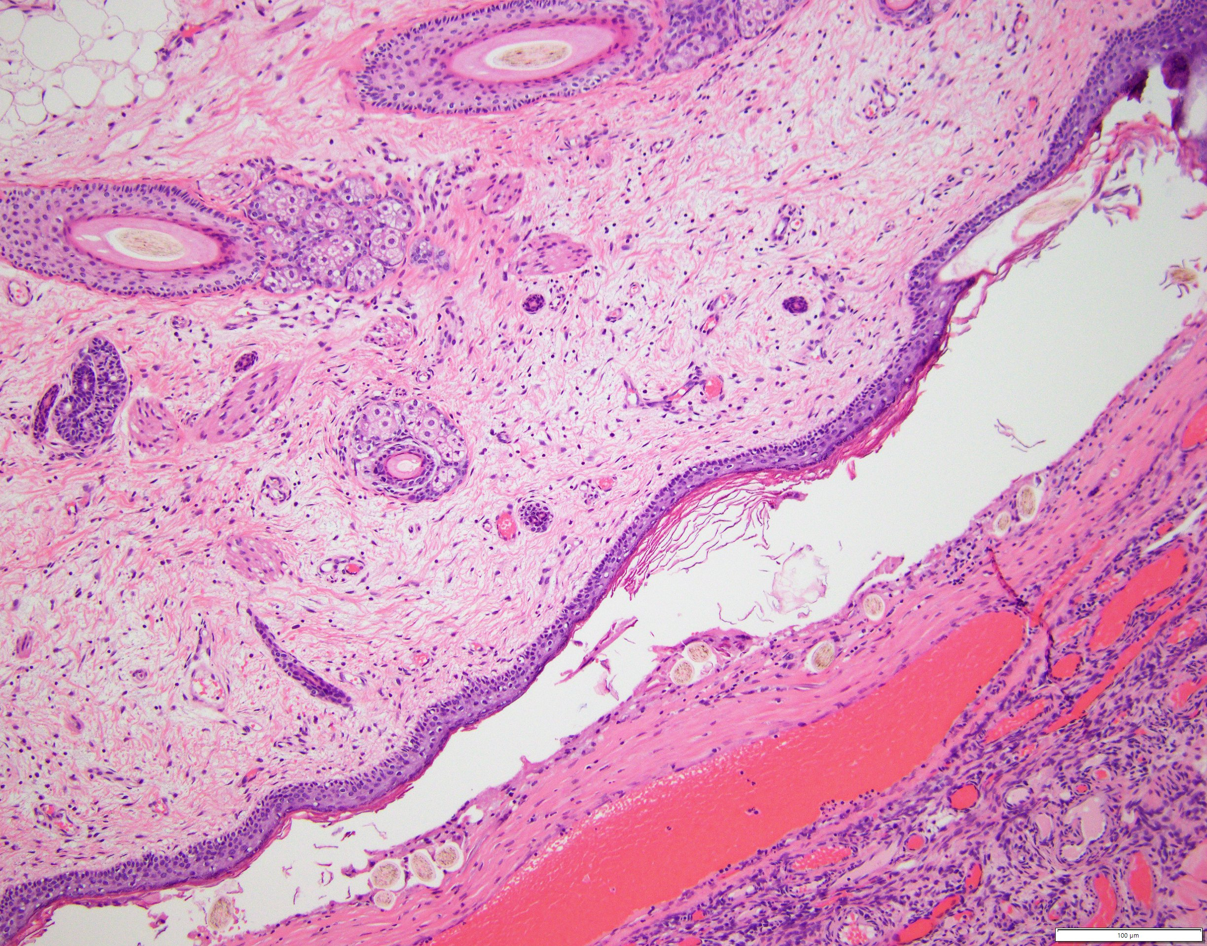
Pathology
Asterisks: cyst components
White Arrows: cyst lining
Arrowheads: fully formed cyst components
  Black: hair follicles
  Blue: sebaceous glands
  Green: erector pili-type muscle
  Orange: deep adipose tissue
*
*
Notes:
IS THE SECOND USE OF ARROWS SUPPOSED TO BE ARROWHEADS? – no
If possible would make asterisks a more contrasted color to the light background – unable to change.
Don't see black arrowheads – next to hair follicle above green and blue arrow heads
Don't see orange arrowheads – far left – it is the top most arrowhead
But do see white and gray arrowheads that are not labeled - no white or gray arrowhead shown

Slide 17
Final Diagnosis
Anti-NMDA Receptor Encephalitis with Intracranial Hypertension

Slide 18
Further Hospital Course
Remained on levetiracetam with negative repeat EEG
Tracheostomy and feeding tube placement
Gradual daily improvement noted with eventual tracheostomy and feeding tube reversal
Discharged to rehab facility
Initiated on Rituximab as outpatient after discharge from rehab
Continued on acetazolamide
Notes:
CAN YOU, WHEN YOU DICTATE AFTER REVISIONS ALL DONE, INCLUDE IN NARRATION THE TIME COURSE- HOW LONG FROM INITIATION OF RITUXIMAB UNTIL WAS ABLE TO BE DISCHARGED? – rituximab was only initiated as outpatient
Third bullet .."with eventual tracheostomy and feeding tube reversal“ – done
Continued acetazolamide? - mentioned
What happened to lumbar drain? – removed in 72 hours – mentioned in slide 11

Slide 19
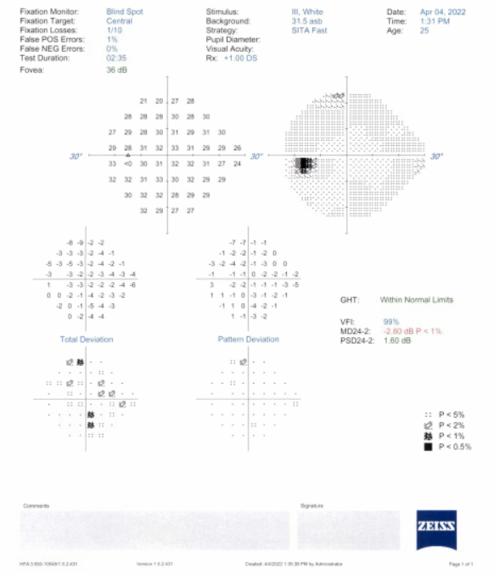
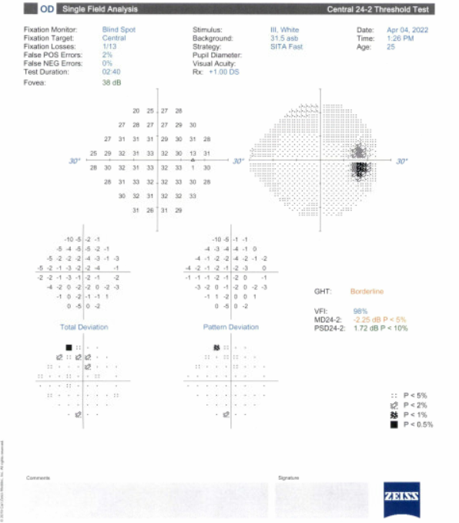
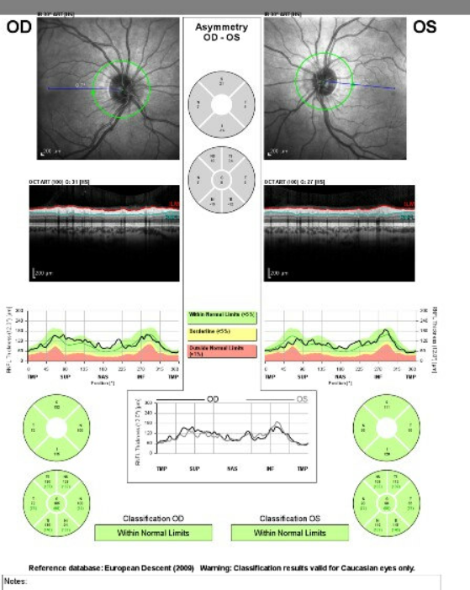
Clinic Follow-up
Neuro-ophthalmology exam (10 weeks after discharge)
  Visual Acuity: OD 20/20, OS 20/20
  Color vision: OU 14/14 Ishihara plates
  Pupils RTL, no APD
  IOP OU normal and anterior segment OU normal
  Fundus: OU healthy optic discs and no retinal abnormalities
  OCT OU robust RNFL, intact Ganglion cell analysis
  Patient appeared to be back to cognitive baseline
Notes:
Back to cognitive baseline? Yes , mentioned.

Slide 20
Further Follow-up
Neuro-ophthalmology exams stable without papilledema
  Acetazolamide stopped
Repeat MRI head with and without contrast at 9 months from symptom onset normal
OBGYN clinically monitoring teratoma, no recurrence

Slide 21
Anti-N-methyl-D-aspartate receptor (NMDAR) encephalitis
Rare autoimmune encephalitis, 1st described by Dalmau et al. in 2007.
Typically: acute psychiatric disturbances, insomnia, neurological deficits (seizures, dyskinesias) and autonomic instability(tachycardia, hyperthermia, bradycardia , asystole– may require permanent cardiac pacemaker) and central hypoventilation requiring mechanical ventilation.
About 80% are women.
Involves IgG antibody formation against GluN1 subunit of the NMDA receptor (crucial in synaptic transmission and plasticity)in the serum and CSF of the patients.
The sensitivity of NMDAR antibody testing is higher in CSF than in serum.
Notes:
Dalmau J, Gleichman AJ, Hughes EG et al: Anti-NMDA-receptor encephalitis: Case series and analysis of the effects of antibodies. Lancet Neurol, 2008; 7: 1091–98.
Extra space after "Typically" in second bullet – done
Extra space after pacemaker before close parenthesis second bullet – done
Would just clarify whether for this patient the bradycardia and subsequent intubation due to Cushing reflex or autonomic instability- I see it is later in slide 25 so perhaps can disregard here

Slide 22
Associations
Associated with certain tumors, most notably ovarian teratomas (Dalmau J, Gleichman AJ, Hughes EG et al Lancet Neurol, 2008; 7: 1091–98).
Dalmau et al noted ovarian teratoma predominantly in 12 young women in his case series.
Ovarian teratomas express NMDAR and become immunological trigger for the development of NMDAR antibodies.
Other associations: after HSV encephalitis, preceding appearance of neoplasm, rare cases after vaccination against H1N1 influenza and one patient after a booster vaccination against DPT(diphtheria, pertussis, tetanus)and poliomyelitis, can occur without any underlying neoplasm.
Notes:
Dalmau J, Tüzün E, Wu HY et al: Paraneoplastic anti-N-methyl-D-aspartate receptor encephalitis associated with ovarian teratoma. Ann Neurol, 2007; 61: 25–36
Bullet 1 I think can just have the reference rather than include Dalmo 12 young women who predominantly had ovarian teratoma or state that 11/12 had in his series – done
Extra space after "NMDAR" bullet 2 – done
Extra space after "associations" bullet 3 before colon – done
Do you mean following HSV encephalitis rather than preceding it (HSV is the trigger for developing the Ab), preceding appearance of neoplasm, rare cases after vaccination (reported H1N1 and DPT) - would fix spacing here as well – all changes made.

Slide 23
Management of NMDAR Encephalitis
Definitive treatment: immunotherapy, and detection and management of tumors, especially ovarian teratoma.
1st line immunotherapy: PLEX, IVIG and or IVMP.
2nd line immunotherapy: cyclophosphamide, rituximab.
Prognosis is good with early immunotherapy and resection of teratomas, 75% recover with mild residual neurological deficits.
Notes:
Spell out what Rx means (prescription vs. resection vs. treatment?) – done
Would take out "etc" from 2nd line therapy 3rd bullet – done
Would spell out resection fourth bullet – done
Residual mild neurological deficits – done

Slide 24
Intracranial Hypertension complicating the picture
Intracranial hypertension is an atypical and underrecognized finding that may present a diagnostic or management challenge in anti-NMDAR encephalitis.
Could be related to the dysregulation of glutaminergic transmission leading to vasodilation of cerebral blood vessels.
Transient and self limited, incidence remains unknown.
Intracranial hypertension is believed to contribute to the autonomic instability and hemodynamic instability, as seen in Cushing’s reflex (characterized by hypertension, bradycardia, and apnea secondary to raised ICP).
Notes:
Would flip bullet points 3 and 4 (I believe you are saying the intracranial hypertension is transient and self limited though would clarify if it is meant to be the contribution to autonomic instability is transient and self limited – done
What does it mean that clinical significance is unknown - seems like this patient had symptoms from it – removed it.

Slide 25
Intracranial Hypertension complicating the picture
There are very few reports (only 5 articles), including 2 case reports that report elevated ICPs in anti-NMDAR encephalitis, none have documented papilledema.
A retrospective study on 35 cases indicated about 42.86% had elevated ICP.
Noting elevated ICP during spinal tap may help to identify patients who are more prone for severe or refractory autonomic instability.
Notes:
DO YOU HAVE ANYTHING THAT DOCUMENTS THE DISC EDEMA IN THIS CASE? PHOTOS? OCT? MRI CUTS? – unfortunately no
Have MRI cuts showing widened perioptic CSF spaces and posterior disc flattening- no
Yuan J, Peng B, Guan HZ et al: Immunotherapy strategy for 35 cases of severe anti-N-methyl-D-aspartate receptor encephalitis. Zhonghua Yi Xue Za Zhi, 2016; 96: 1035–39
Need space after "reports" before parenthesis bullet 1 – done

Slide 26
Teaching Points
In cases of meningoencephalitis, autoimmune etiologies such as anti-NMDAR encephalitis should be considered early in the diagnosis.
Unless thought about, testing for this antibody might not be included in ordered CSF studies.
Early immunotherapy within 4 weeks promotes early recovery.
Getting a detailed history in PCOS, especially regarding ovarian masses or other known problems is encouraged.
Intracranial hypertension is rarely reported in anti-NMDAR encephalitis and is under recognized, mechanisms are not well understood.
Notes:
Could the elevated CSF protein be contributing to the intracranial hypertension – not sure but possible, valid point.

Slide 27
References
Dalmau J, Gleichman AJ, Hughes EG et al: Anti-NMDA-receptor encephalitis: Case series and analysis of the effects of antibodies. Lancet Neurol, 2008; 7: 1091–98.
Gresa-Arribas N, Titulaer MJ, Torrents A et al: Antibody titres at diagnosis and during follow-up of anti-NMDA receptor encephalitis: A retrospective study. Lancet Neurol, 2014; 13: 167–77
Dalmau J, Tüzün E, Wu HY et al: Paraneoplastic anti-N-methyl-D-aspartate receptor encephalitis associated with ovarian teratoma. Ann Neurol, 2007; 61: 25–36
Lee M, Lawn N, Prentice D, Chan J: Anti-NMDA receptor encephalitis associated with ictal asystole. J Clin Neurosci, 2011; 18: 1716–18
Titulaer MJ, McCracken L, Gabilondo I et al: Treatment and prognostic factors for long-term outcome in patients with anti-NMDA receptor encephalitis: An observational cohort study. Lancet Neurol, 2013; 12: 157–65
Dalmau J, Lancaster E, Martinez-Hernandez E et al: Clinical experience and laboratory investigations in patients with anti-NMDAR encephalitis. Lancet Neurol, 2011; 10: 63–74
Chawla R, Zukas AM, Pitcher JH et al: Autonomic instability and asystole: Broadening the differential diagnosis of cardiac arrhythmias. Int J Cardiol, 2016; 220: 665–67 13.
Lim SY, Panikkath R, Mankongpaisarnrung C et al: Anti-N-methyl-D-aspartate receptor encephalitis. Am J Med Sci, 2013; 345: 491–93.
Yuan J, Peng B, Guan HZ et al: Immunotherapy strategy for 35 cases of severe anti-N-methyl-D-aspartate receptor encephalitis. Zhonghua Yi Xue Za Zhi, 2016; 96: 1035–39
Salehi N, Yuan AK, Stevens G, Koshy R, Klein WF. A Case of Severe Anti-N-Methyl D-Aspartate (Anti-NMDA) Receptor Encephalitis with Refractory Autonomic Instability and Elevated Intracranial Pressure. Am J Case Rep. 2018 Oct 12;19:1216-1221. doi: 10.12659/AJCR.911165. PMID: 30310049; PMCID: PMC6196582.
Agrawal A, Timothy J, Cincu R et al: Bradycardia in neurosurgery. Clin Neurol Neurosurg, 2008; 110: 321–27.

