Slide 1
An Introduction to PublishOne
–
Wolters Kluwer Legal and Regulatory, International Group
February 2022

Slide 2
INTRODUCTION
Based on author feedback and previous experiences, the International Group of Wolters Kluwer Legal and Regulatory is continuously striving to improve its services and modernize its publishing processes
As part of this exercise, we are happy to announce our partnership with DiskAd to use their state of the art ‘PublishOne’ platform to automate and systematize the workflow for selected books and content updates and production
With the present document, we would like to introduce the system, highlight some features and benefits and outline the implementation process moving forward, including communications to contributors and support from Wolters Kluwer

Slide 3
WHAT IS PUBLISHONE?
PublishOne is a online tool enabling authors to update their work in a MS Word environment.
Authors have the ability to work offline and can visualize their content in a final layout.
The formatting of the content is automated which enables Wolters Kluwer to deliver authors’ updates more quickly to customers.

Slide 4
FEATURES OF PUBLISHONE
MS Word environment
Full compatibility with the main internet browsers Chrome and Firefox
Permanent and secure access
Content enrichment
Ability to work offline
Ability to preview content in final layout (PDF or XML format)

Slide 5
BENEFITS
Visibility – immediate and up-to-date overview of the status of all the documents comprising the publication
Accuracy – significant reduction of the risk of document version errors for all parties involved
Speed – significant reduction of production turn-around times, resulting in a faster publishing process overall
Ease of use – an intuitive design and user-friendly interface

Slide 6
IMPLEMENTATION PROCESS
High-level introduction to the system, objective of the present communication
Follow-up email to all individual contributors
explanation of process
delivery of full documentation, including step-by-step installation instructions and user instructions (instruction videos)
delivery of user login details
communication of deadlines
Depending on contributor feedback, further live demo sessions will be organized when necessary
live demo of the system, using own publication/content
questions & answers

Slide 7
SUPPORT
For all publishing related queries - e.g. questions about planning, content and publication strategy - please continue to contact your dedicated Content Manager at Wolters Kluwer
For all technology related queries - i.e. how-to questions relating to the system – please contact your dedicated Content Manager at Wolters Kluwer

Slide 8
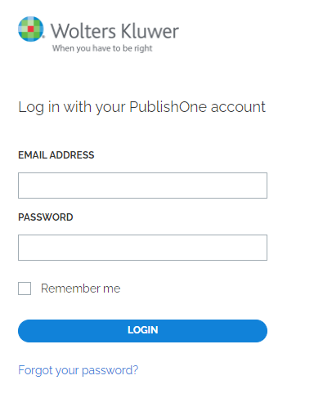
SNAPSHOT: ONLINE ACCESS

Slide 9
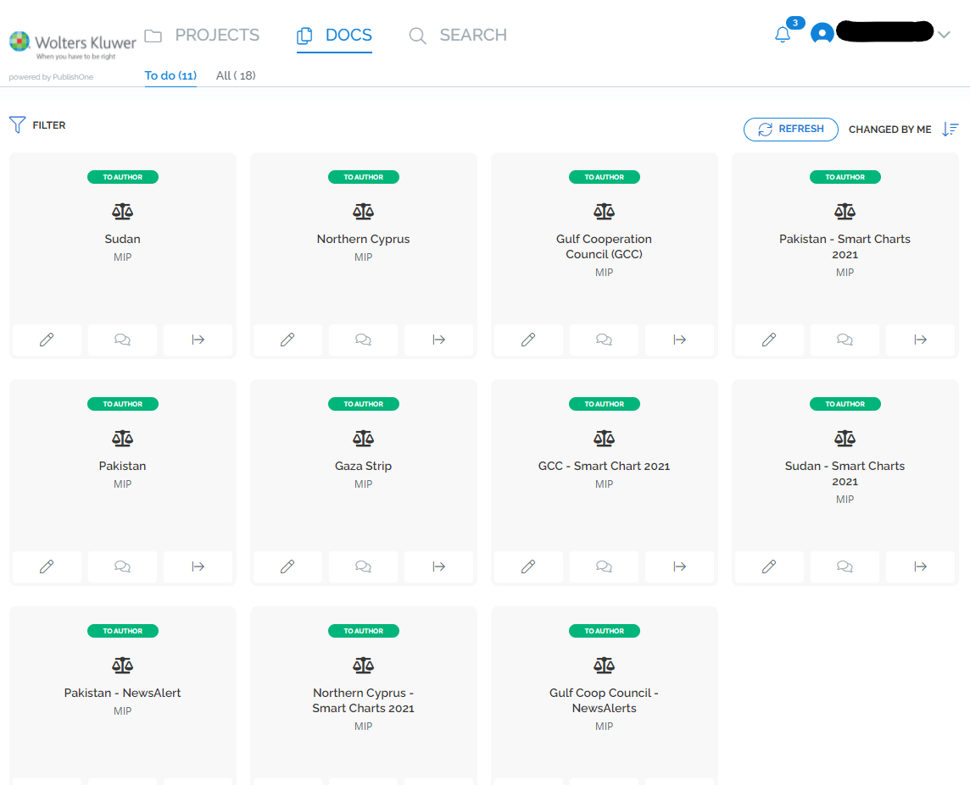
SNAPSHOT: CLEAR OVERVIEW OF YOUR WORK

Slide 10
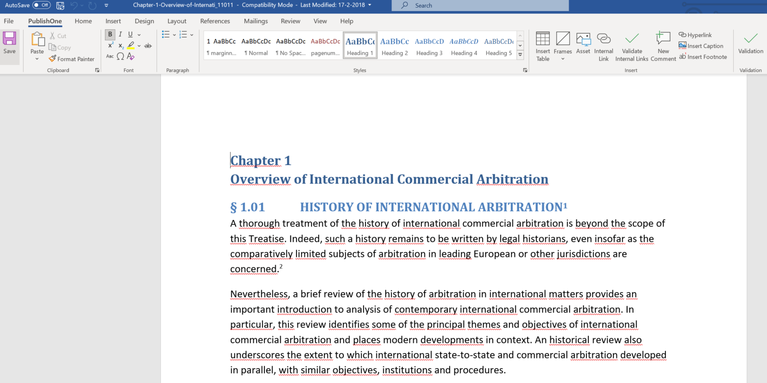
SNAPSHOT: WORKING IN A WORD ENVIRONMENT

Slide 11
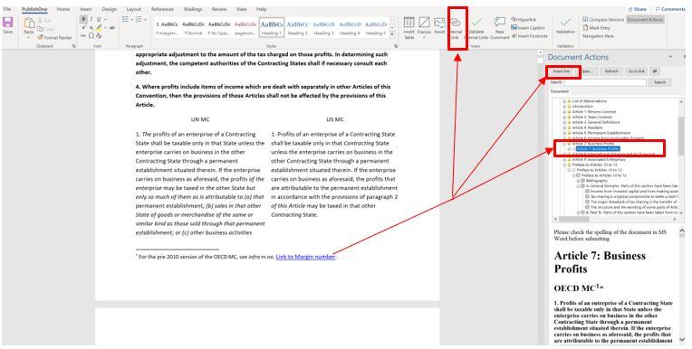
SNAPSHOT: ADDING INTERNAL LINKS

