Slide 1


Re-evaluation of Patient Diagnosed with Atypical Multiple Sclerosis and Retinovascular Disease
Matthew S. Wieder MD, Department of Ophthalmology & Visual Sciences, Montefiore Medical Center/AECOM, Bronx, NY.
Joyce N. Mbekeani MD, FRCS, FRCOphth, Dept of Surgery (Ophthalmology), Jacobi Medical Center, Bronx, NY.
Phyllis L. Faust MD, PhD, Department of Pathology and Cell Biology, Columbia University, NY, NY.
David J. Monoky MD, Department of Radiology, Hackensack University Health Network, NJ.
Andria L. Ford MD, MSCI, Department of Neurology, Washington University School of Medicine, St. Louis, Missouri.
John P. Atkinson MD, Department of Medicine, Division of Rheumatology, Washington University School of Medicine, St. Louis, Missouri.
Thomas L. Slamovits MD, Department of Ophthalmology & Visual Sciences Dept of Neurology, and Dept of Neurological Surgery, Montefiore Medical Center/AECOM, Bronx, NY.
Notes:
Hello, this is Matt Wieder presenting a case of presumed multiple sclerosis as an Upfront case presentation brought to you by the North American Neuro-Ophthalmology Society and the Journal of Neuro-ophthalmology. Our case details the re-evaluation of a case of atypical multiple sclerosis that disclosed a rare multisystemic disease.

Slide 2
Referred to Neuroophthalmology for re-evaluation (2019)
54 YO F was referred for progression of ocular and neurologic symptoms while receiving management for retinal vasculopathy and presumed multiple sclerosis (MS).
HPI:
  18 months before consultation, she noted visual distortions.
  Retinal evaluation for her visual complaints revealed bilateral vasculitis-type venous occlusions managed with series of an intravitreal VEGF agent.
  Developed slurred speech, headaches and handwriting changes.
  Brain MRI was initially normal. Subsequent MRI - new left frontal T2-hyperintense, periventricular, corona radiata lesion; MS diagnosed.
POHx: None
PMHx: Hypertension
Medications: Valsartan, Zoloft, Glatiramer, baby aspirin, Claritin, Flonase, vitamin D₃, biotin, alpha-lipoic acid, and vitamin B₁₂
Social Hx: 3-4 glasses of wine/week; occ smoker
Family Hx: mother had macular degeneration and died after a CVA; father with bladder/renal cancer; one of 3 siblings has breast cancer.
Notes:
A 54YO female with a history of hypertension was referred by a Retina specialist for re-evaluation or retinal vasculopathy and progressive neurologic deficits. The retinal features were being treated with sequential anti-VEGF injections. Neuroimaging for the neurologic features revealed new white matter lesions. A full assessment and investigations by a neurologist was unrevealing and she was diagnosed with atypical MS. She was unresponsive to disease-modifying treatment for MS and retina and neurologic symptoms and signs continued to progress. The rest of her history is detailed here. Of note her mother had the diagnosis of macular degeneration and died after a CVA.

Slide 3
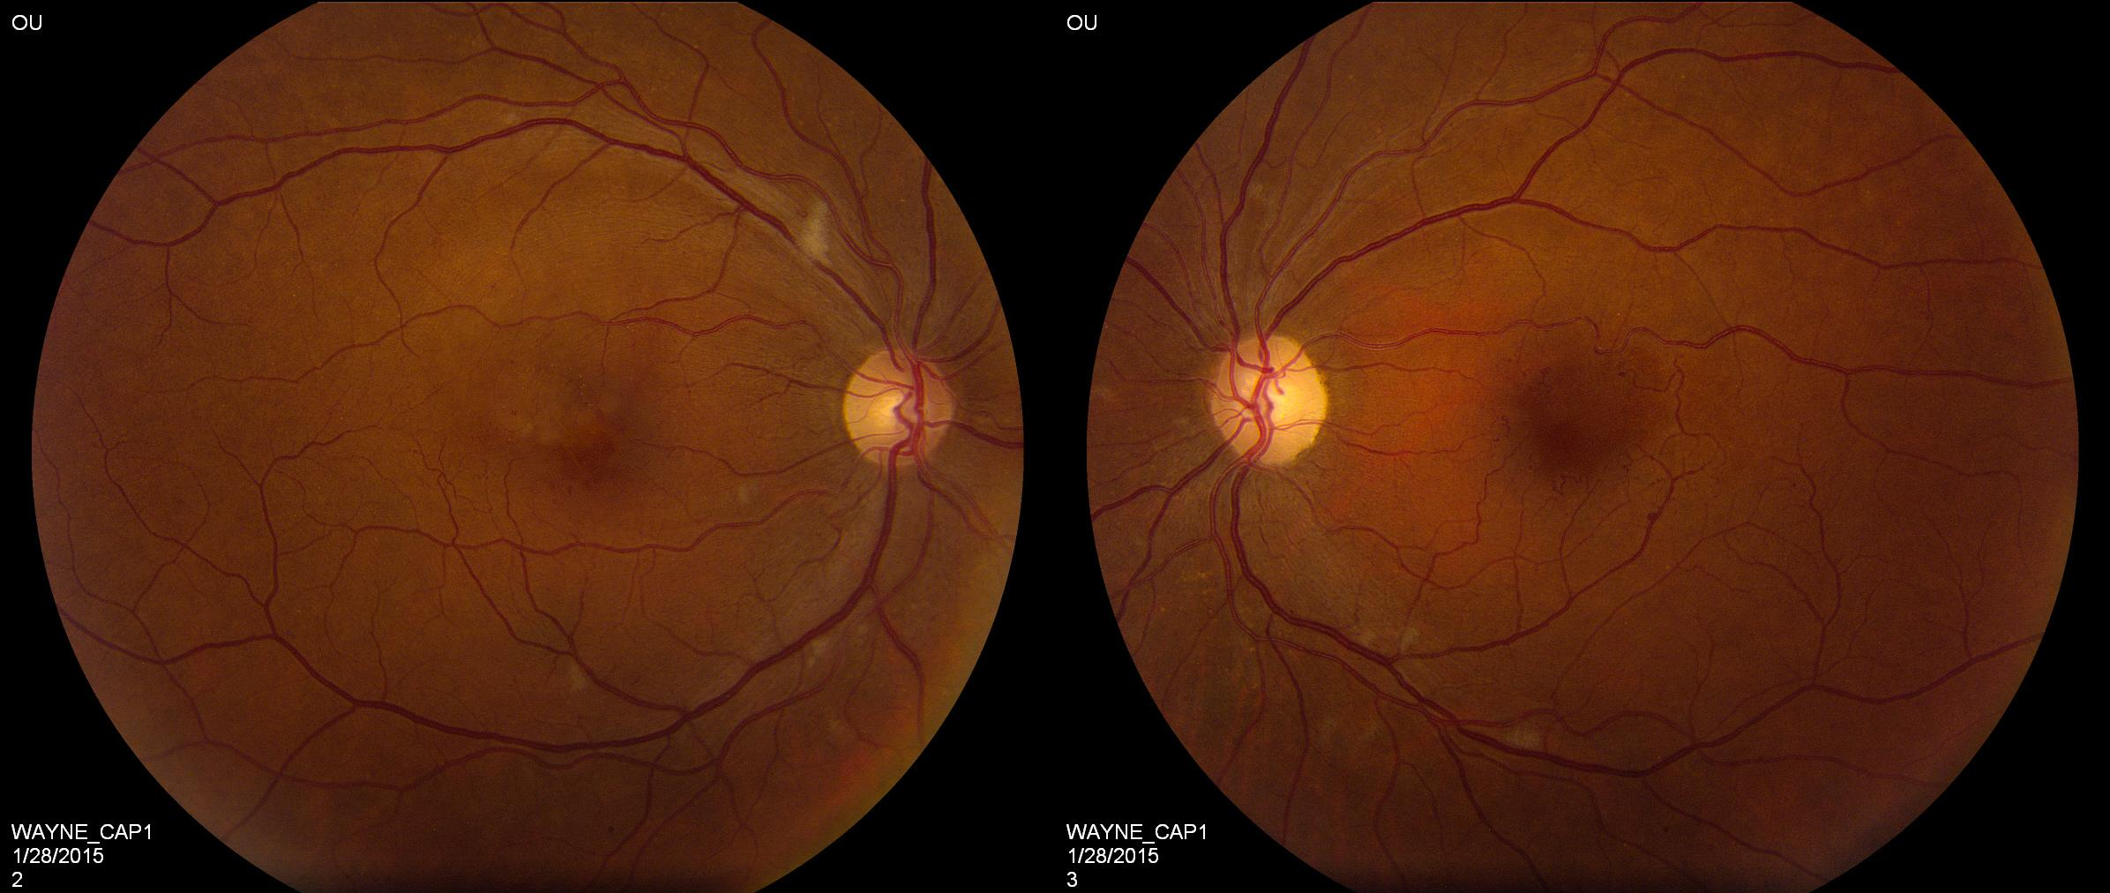
Retina Evaluation - Fundus Photography (2015)
Notes:
This story begins in 2015 when a then 51-year-old woman with HTN presented with visual distortions. Presented are her fundus at presentation showing in the right eye clear media with a blunted foveal reflex (blue circle) with a few small microaneurysms, and perifoveal telangiectatic vessels along with scattered cotton wool spots (CWS) an index of vascular disruption and resulting retinal infarctions. In the left eye again clear media with perifoveal telangiectatic vessels (green circle) and scattered CWS (blue arrows).

Slide 4
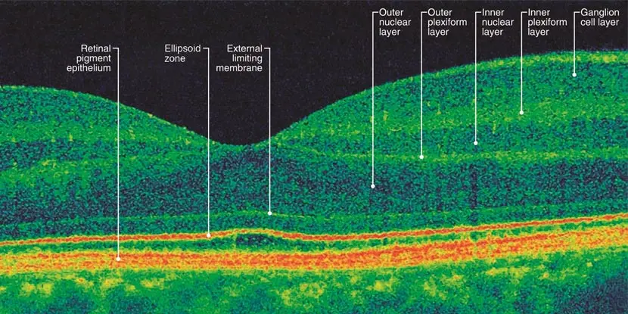
Optical Coherence Tomography (OCT)
Normal optical coherence tomography image through the macula depicting the various retinal layers in a patient with a normal retinal architecture. From https://www.aao.org/eye-health/treatments/what-is-optical-coherence-tomography. (Accessed 04-15-2026).
Notes:
OCT is a non-invasive, painless imaging investigation that uses light waves to capture cross sectional images of the retina; images detail the ordered layering of cells that make up the retina. It helps identify anatomic and vascular disruptions of the retina, optic nerves and vitreous. Visual distortions usually suggest macular disease and fundus photos showed abnormalities at both maculae. Thus, macula OCT was performed by the retina specialist on the same day.

Slide 5
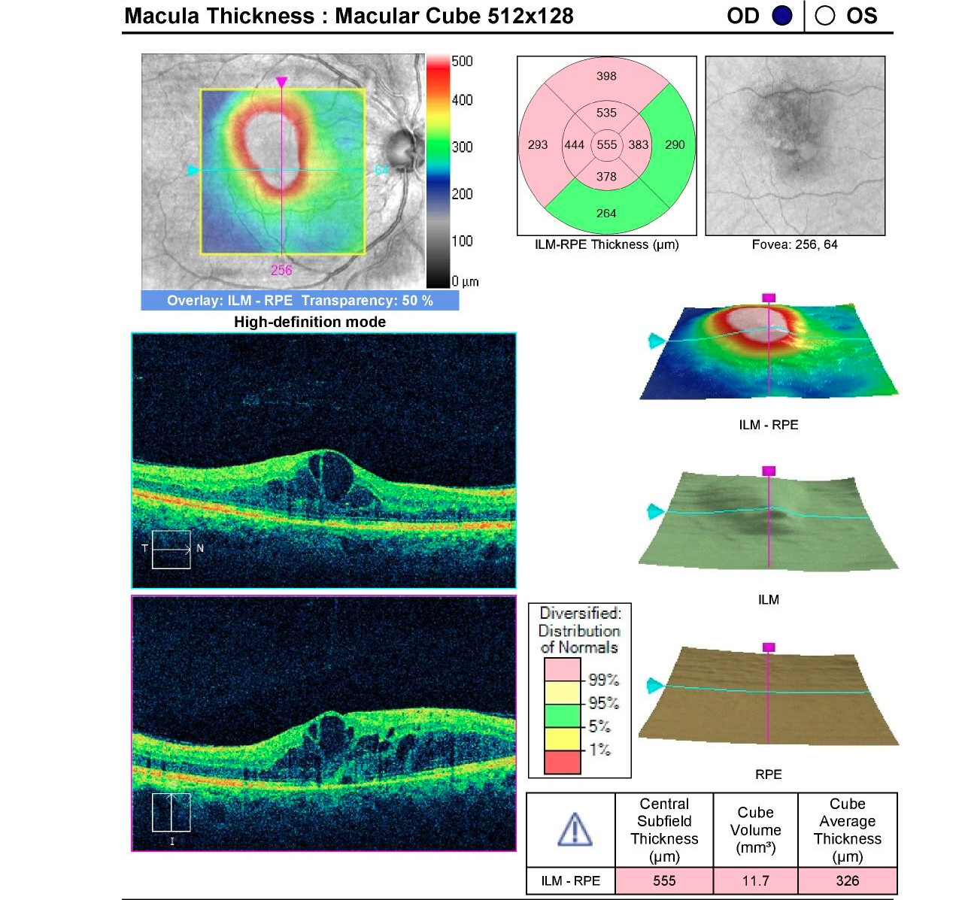
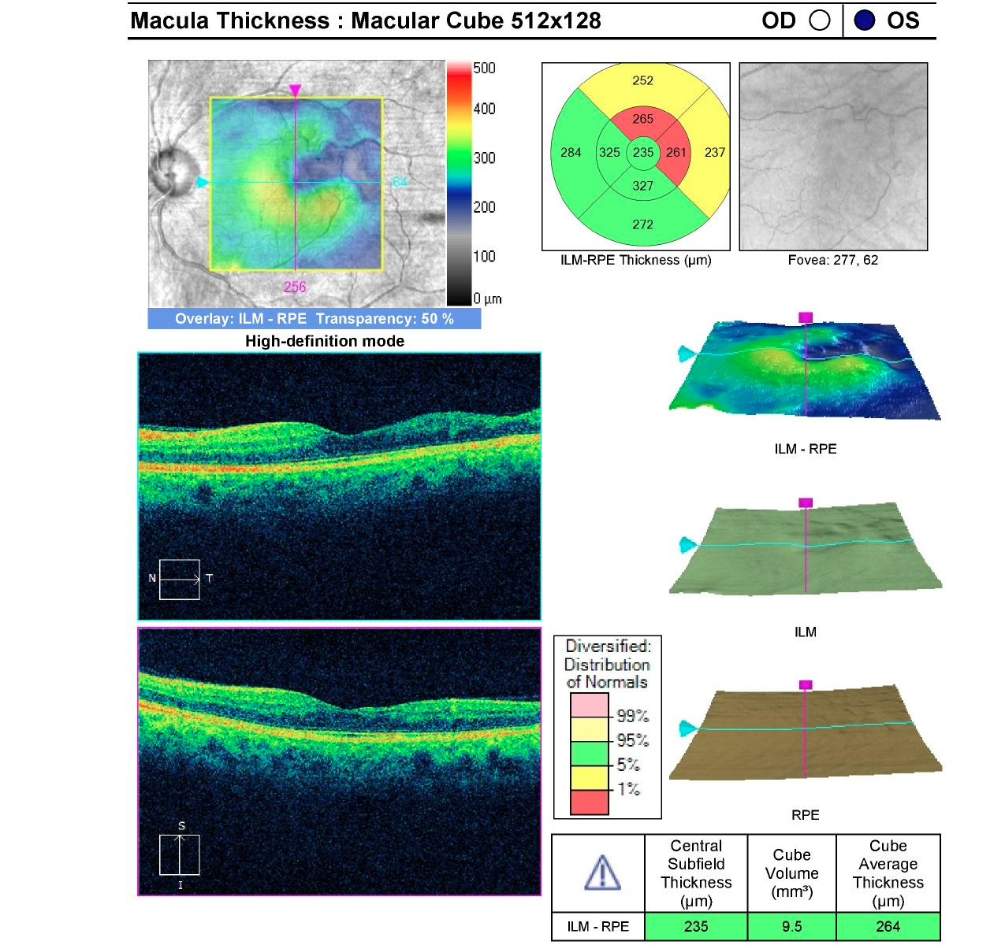
Macular Optical Coherence Tomography (OCT)
OCT: optical coherence tomography with abnormal macular architecture in both eyes.
Notes:
Macula OCT showed in the right eye cystic edema (yellow arrow) and small pocket of subretinal fluid (blue arrow) in the area that appeared blunted in the right retinal image. The left showed altered foveal contour and intraretinal disorganization and atrophy temporal macular atrophy. The patient is started on ranibizumab injections and the edema improves.

Slide 6
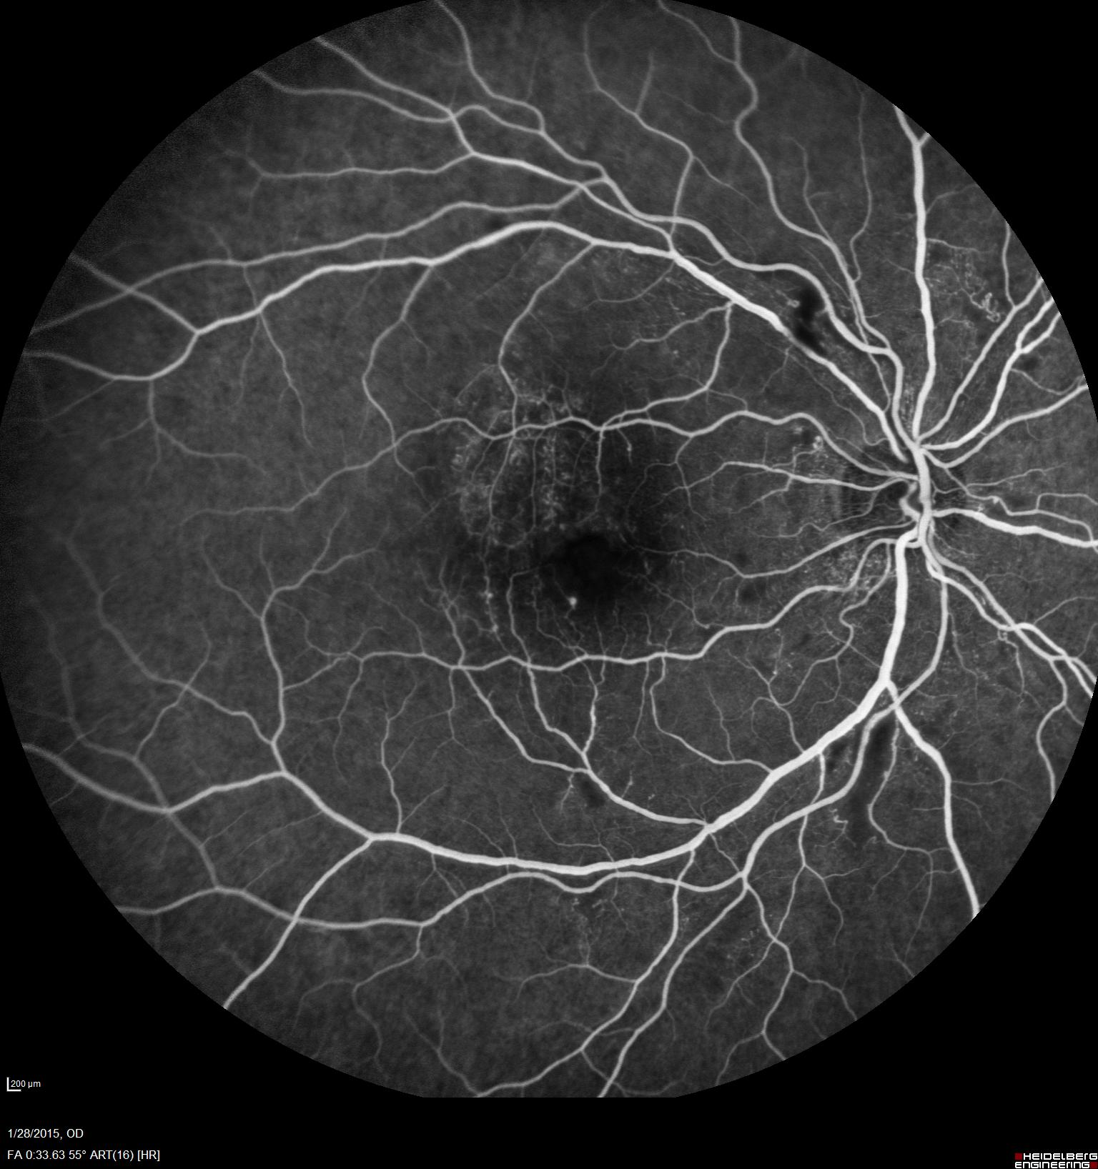
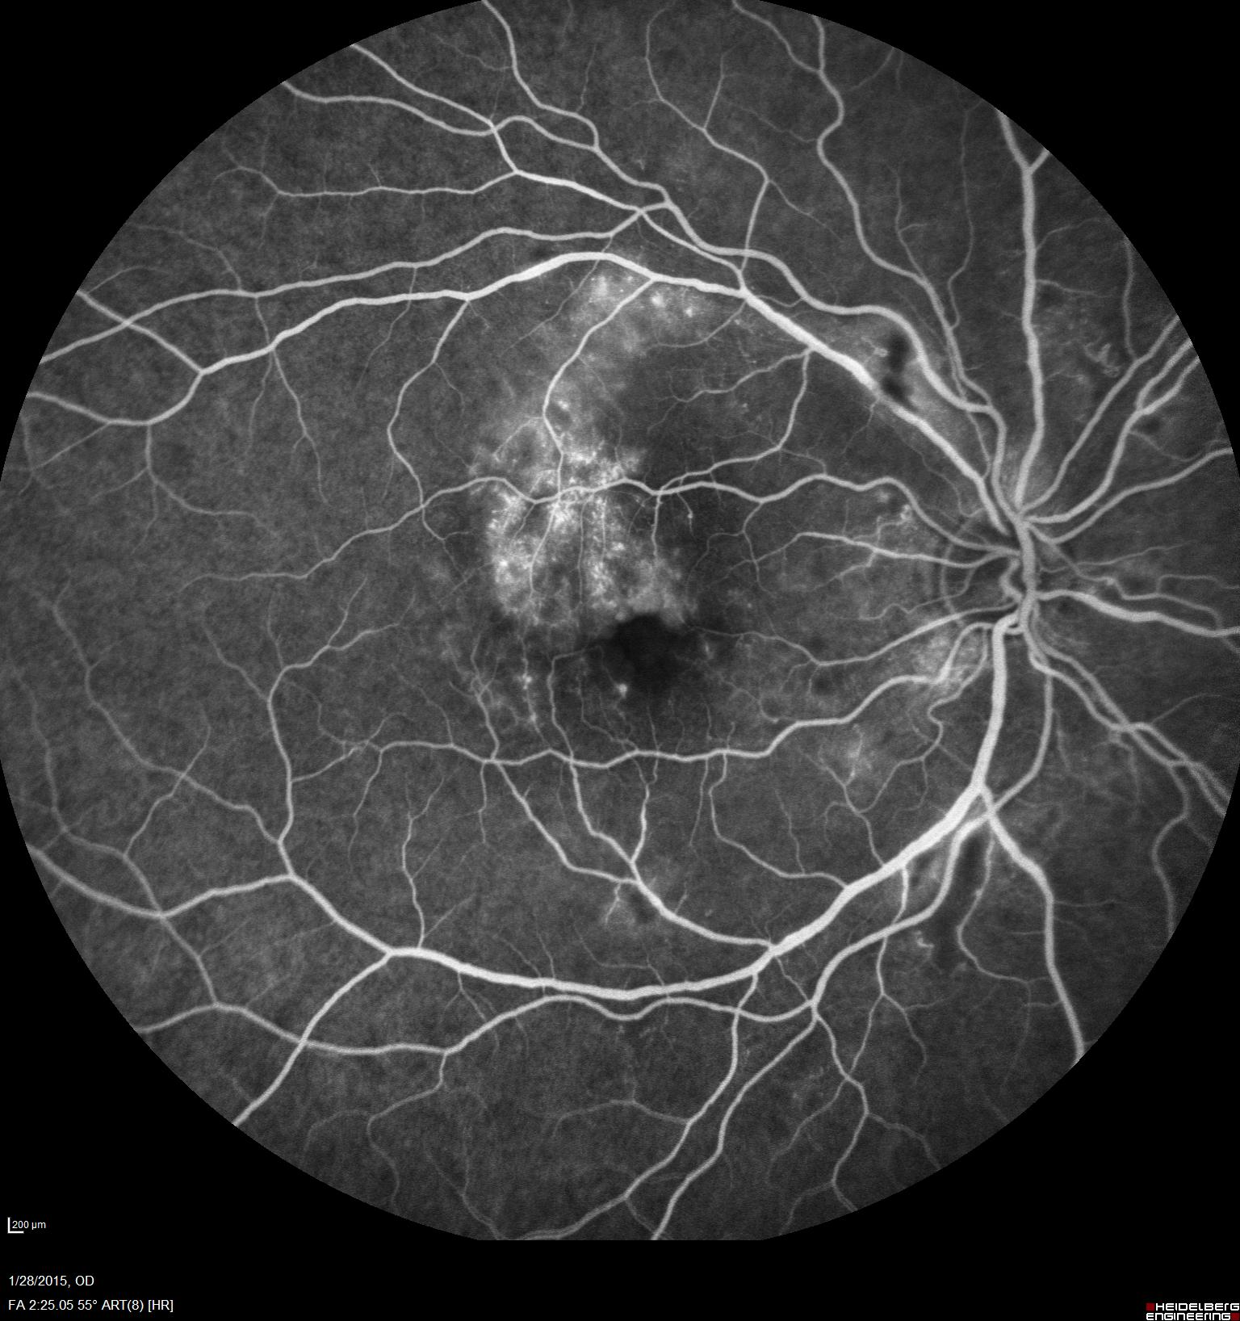
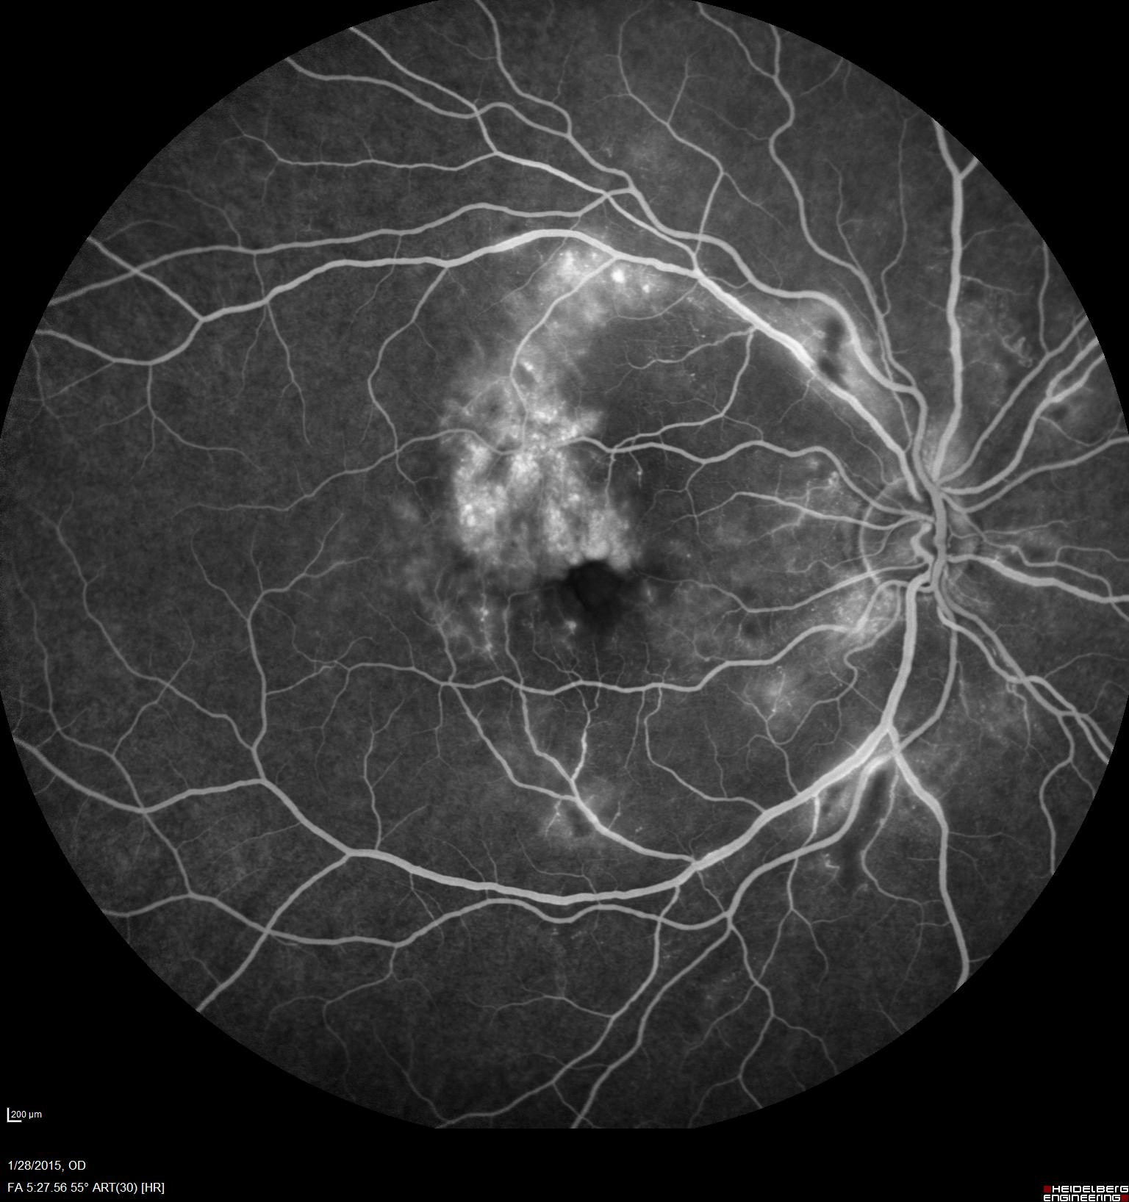
Right Fundus fluorescein angiography (FFA) 2015
FFA: Fundus fluorescein angiography showing gradual leakage of dye with time in right superotemporal retina (red circle).
Notes:
Fundus fluorescein angiography (FFA) is an invasive dynamic diagnostic imaging test that uses fluorescein dye injected intravenously to visualize retinal blood vessels and determine their structural integrity. It highlights vascular leakages, occlusions and anormal new vessel formation. FFA was performed to detail all vascular anomalies. Right eye: First frame displayed is at 33 seconds. The eye had normal transit time. in the early phases we see few areas of blockage in the locations of the CWS seen on the prior fundus photos. Additionally, we see a single microaneurysm inferiorly and lacy hyperfluorescence in the ST macula as well as perifoveal telangiectatic vessels especially superiorly. In the later frames on the right eye, we see leakage from the telangiectatic vessels and some vessel staining superiorly and inferiorly which continues to leak in later stages (yellow arrows).

Slide 7
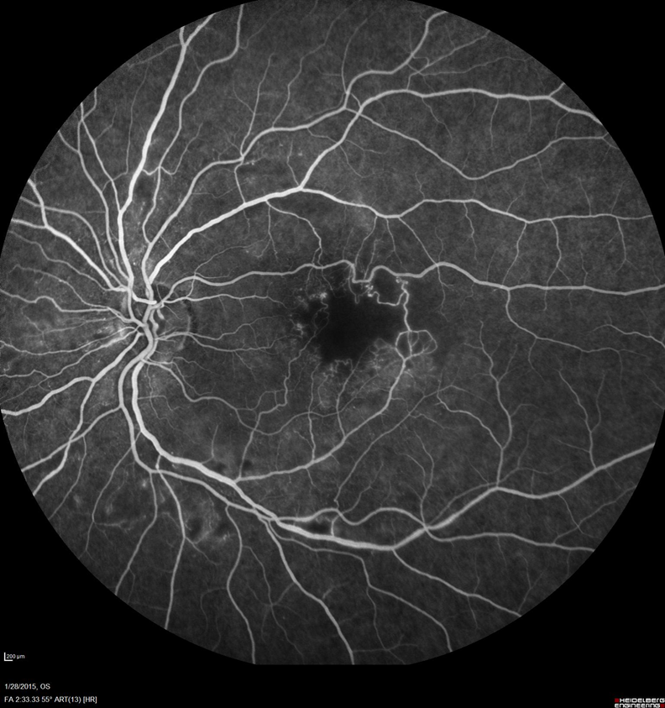
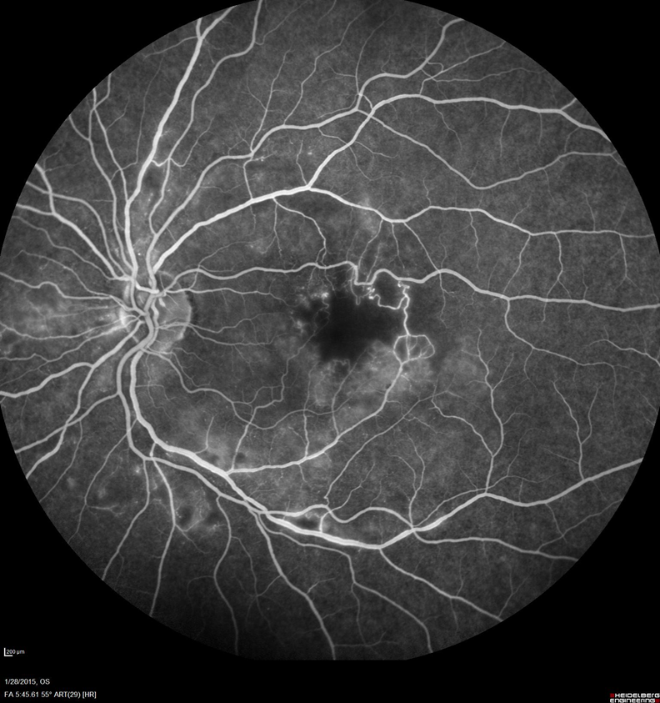
Left Fundus fluorescein angiography 2015
FFA: Fundus fluorescein angiography
Notes:
Left eye demonstrates an enlarged foveal avascular zone (FAZ) (blue arrow), with ischemic changes and a shunt vessel (yellow arrow) crossing the horizontal raphe, later phases with some leakage nasally and inferiorly

Slide 8
Differential Diagnosis
Retinal Vein Occlusion
Macular Telangiectasia Spectrum
Inherited Retinal Vasculitis/Vasculopathy
Acquired Retinal Vasculitis/Vasculopathy
The diagnosis of the treating retina physician at the time was atypical venous occlusions secondary to vasculitis.
Notes:
The differential diagnosis was wide but was felt to be atypical vein occlusion possibly related to a vasculitis of unknown etiology.

Slide 9
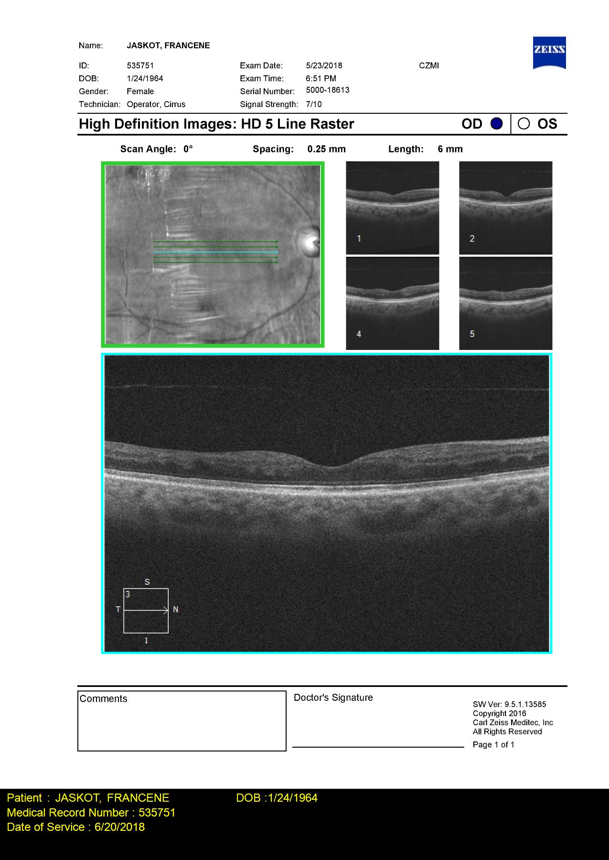
After Ranibizumab – Right OCT
Notes:
There was a good response to intra-vitreous injection of Ranibizumab, an anti-vascular endothelial growth factor (anti-VEGFagent), with resolution of cystoid macular edema ( right image-yellow arrow) and subretinal fluid (right image-blue arrow). Subsequently the left eye developed similar retinopathy which also was treated successfully with intravitreal anti-VEGF therapy.

Slide 10
The story continues (2017)
She subsequently developed slurred speech, headaches and handwriting changes in addition to her visual symptoms.
Next Steps?
Notes:
Two years later, she developed focal neurological features. What would you do at this point?

Slide 11
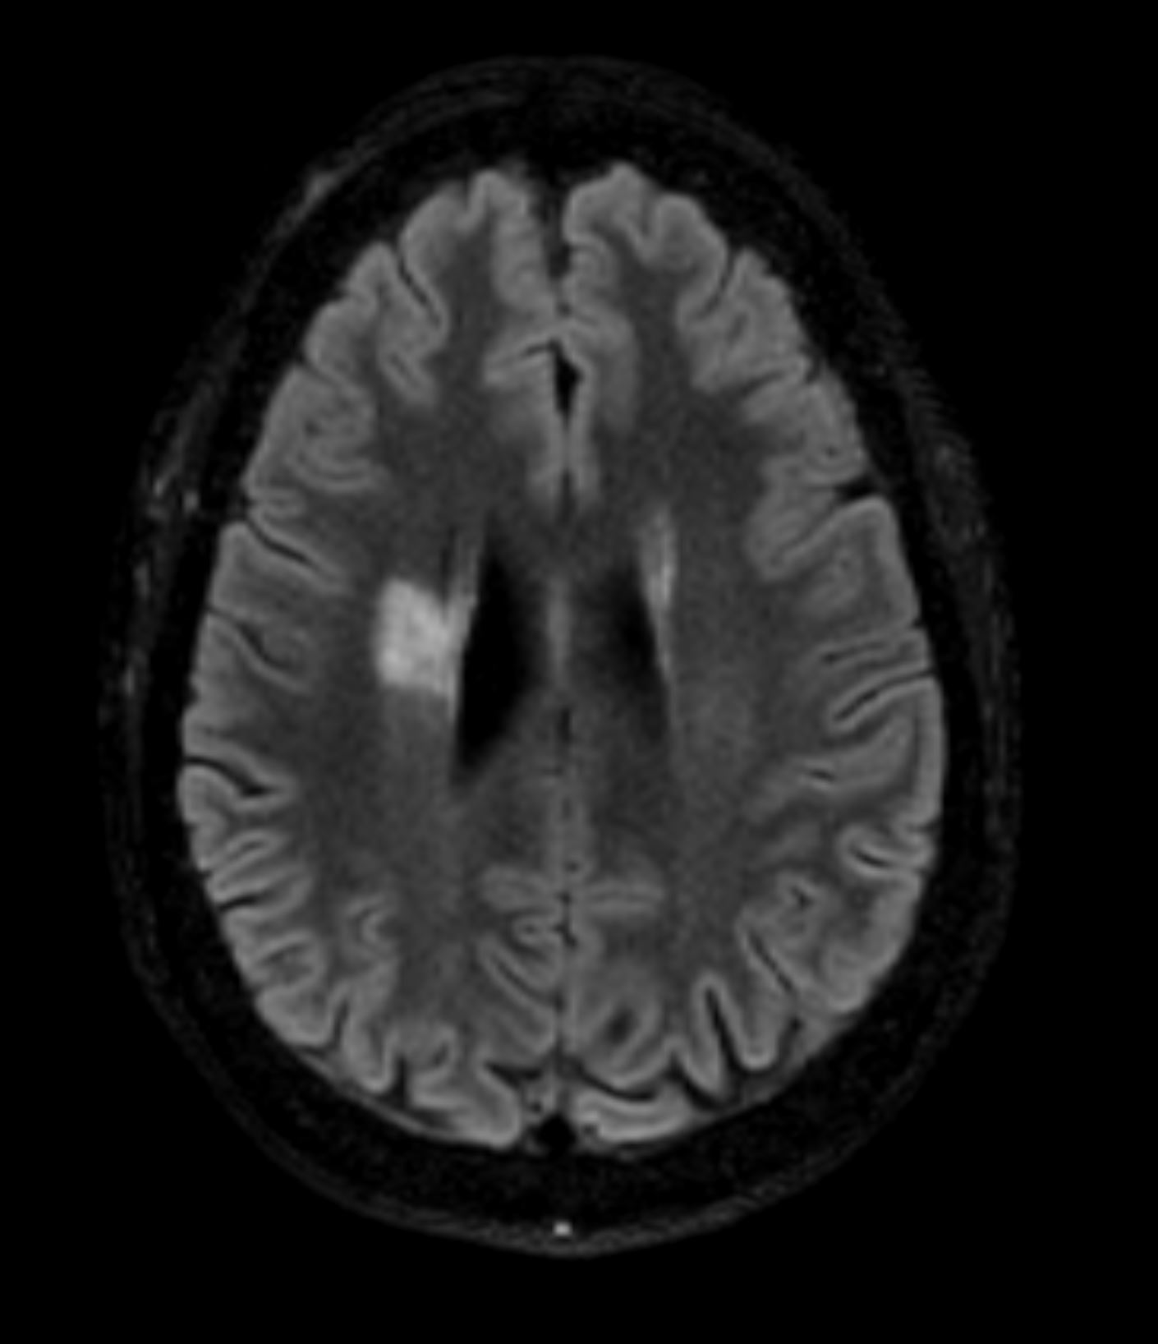
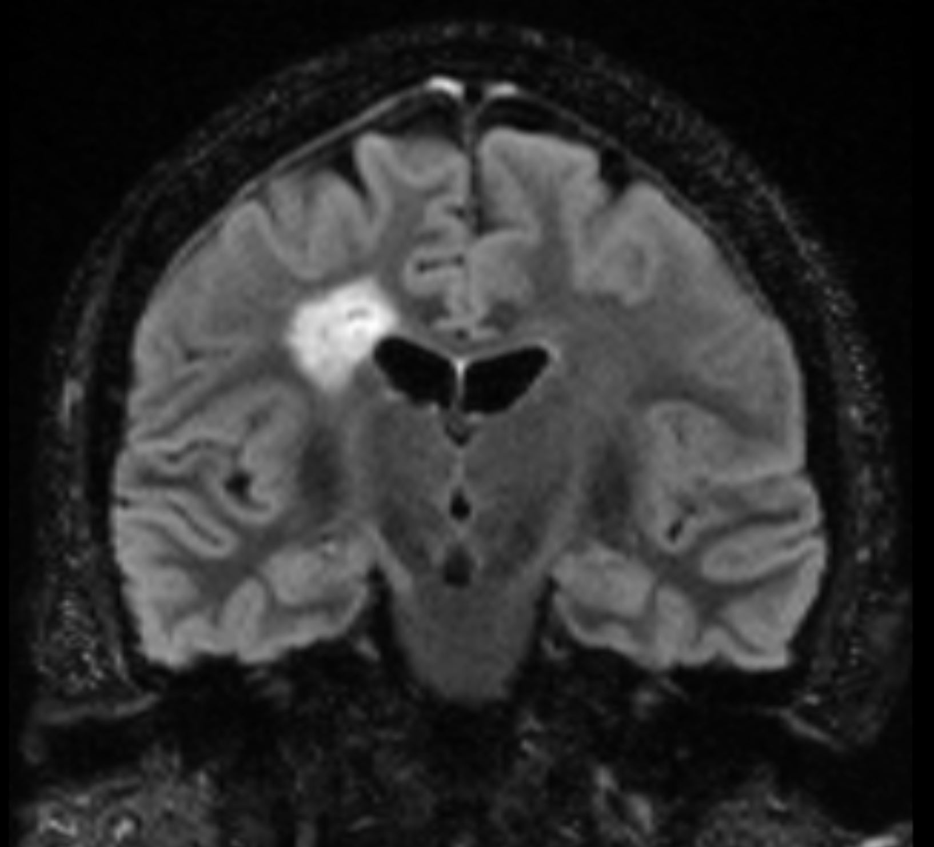
Repeat MRI – T2/FLAIR (9/12/17)
Notes:
MRI (2016) was reported as normal. Repeat MRI brain and spinal cord (2017) - Axial and Coronal sections demonstrate multifocal T2/FLAIR hyperintense lesions distributed primarily within periventricular white matter tracts, which spare gray matter and subcortical U-fibers, the largest within the right frontal periventricular and corona radiata white matter. Spinal cord MRI was negative for any lesions. Because of symptoms and white matter lesions, Neurology service felt this might represent multiple sclerosis and Glatimer management was commenced. There was minimal response to MS therapy.

Slide 12
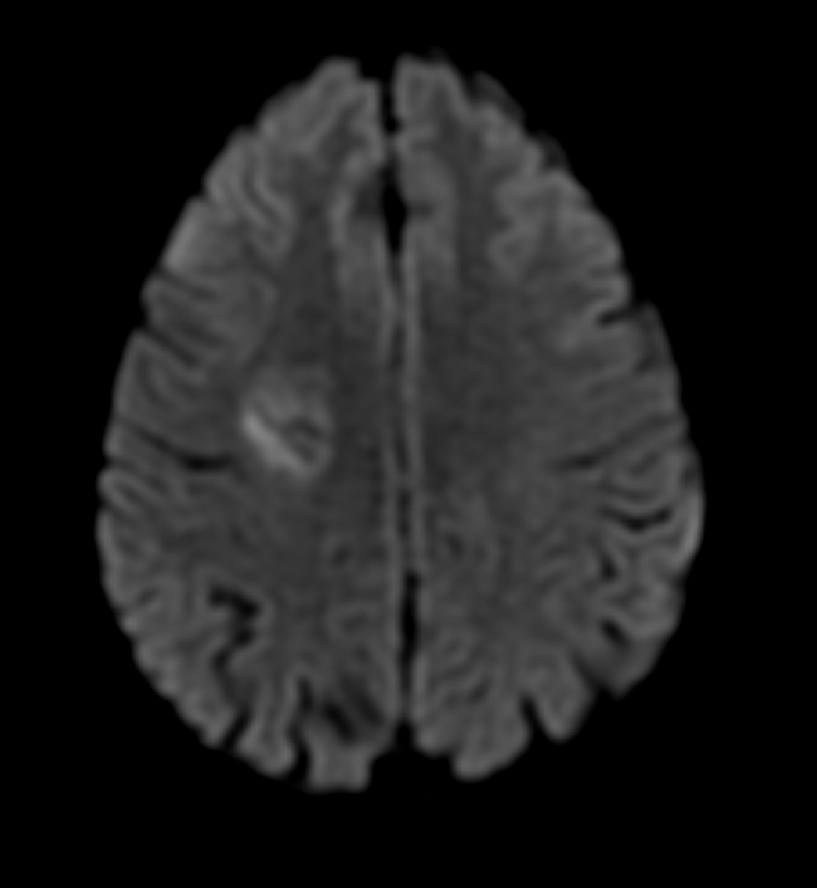
MRI – DWI (9/12/17)
DWI: diffusion weighted imaging
Notes:
Diffusion weighted image shows heterogeneous diffusion restriction within the dominant lesion.

Slide 13
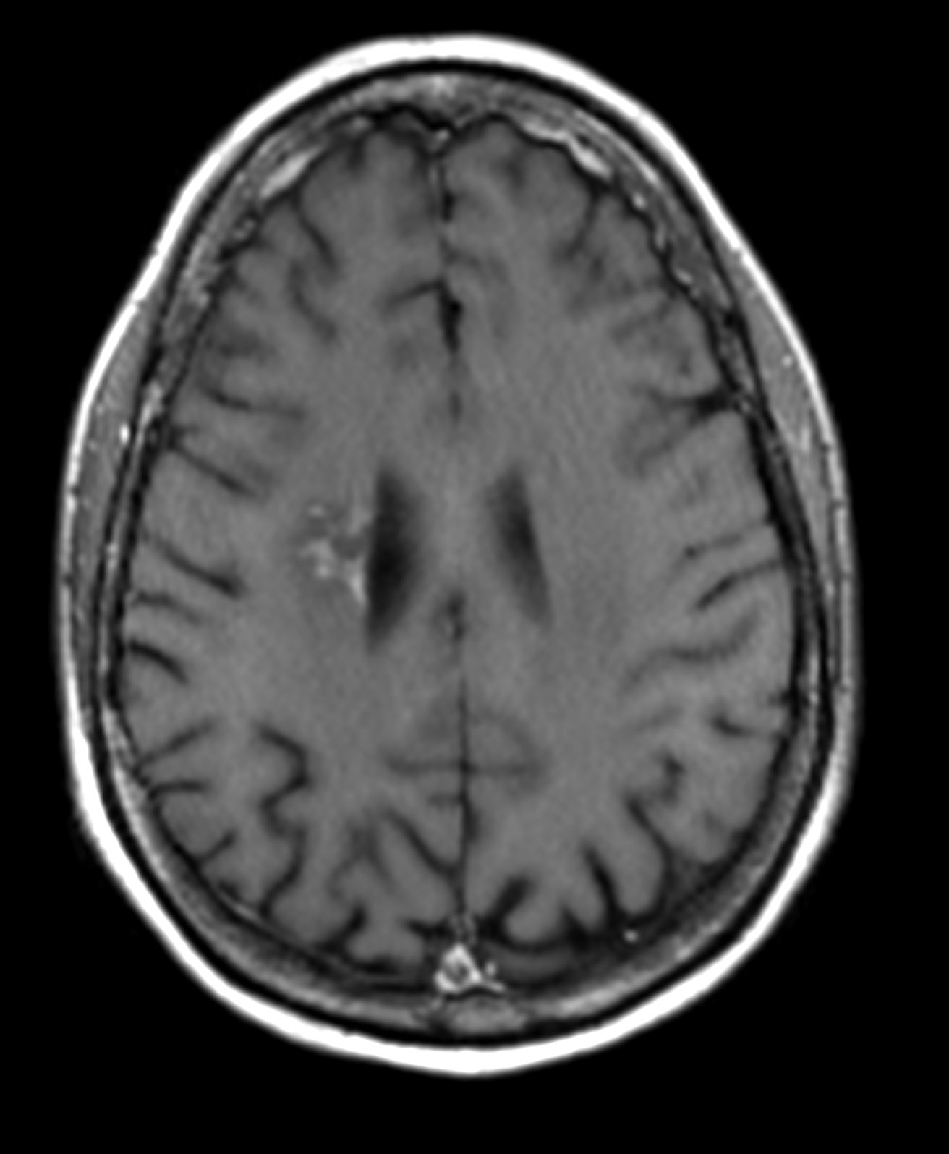
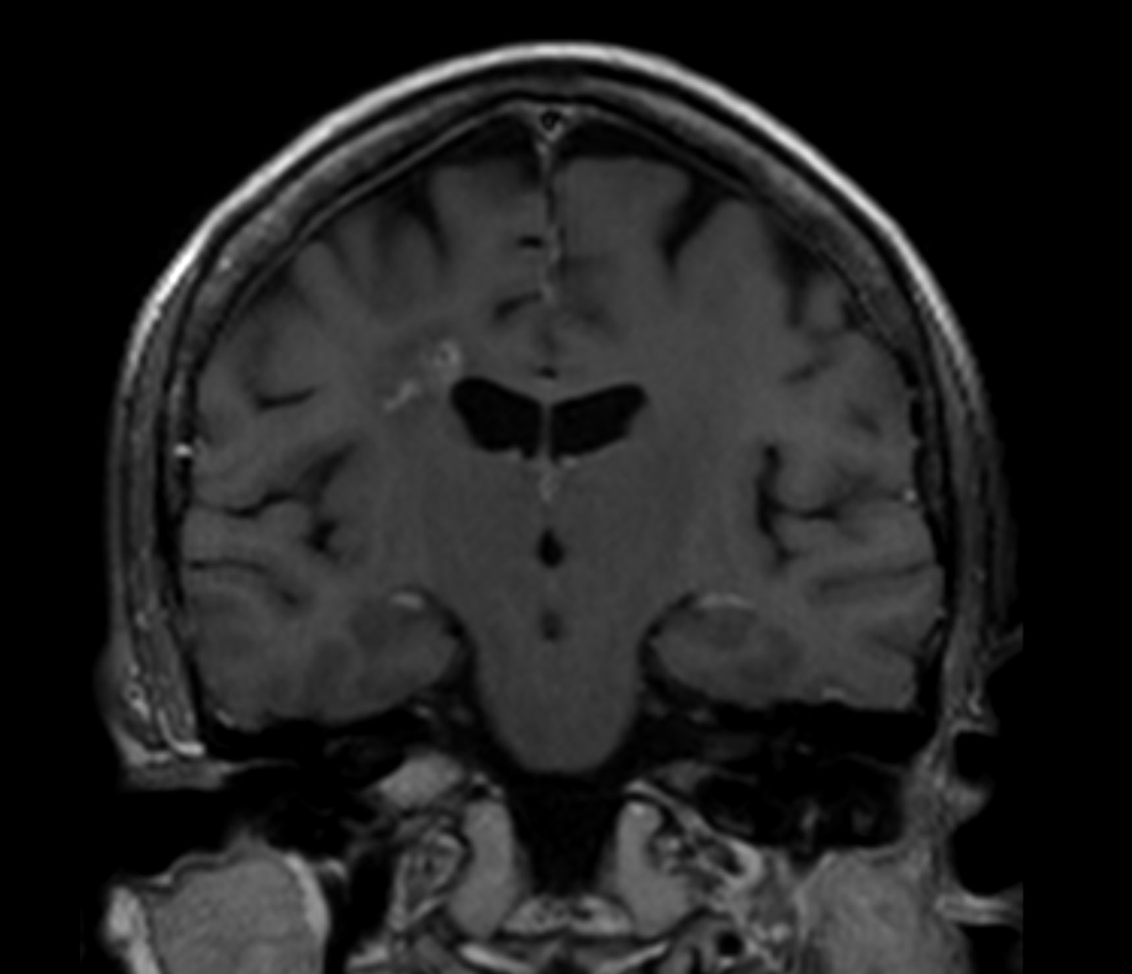
MRI - Post-Contrast T1 (9/12/17)
Notes:
Axial and coronal post contrast gadolinium enhanced T1 weighted sequences demonstrated associated patchy, heterogeneous enhancement pattern.

Slide 14
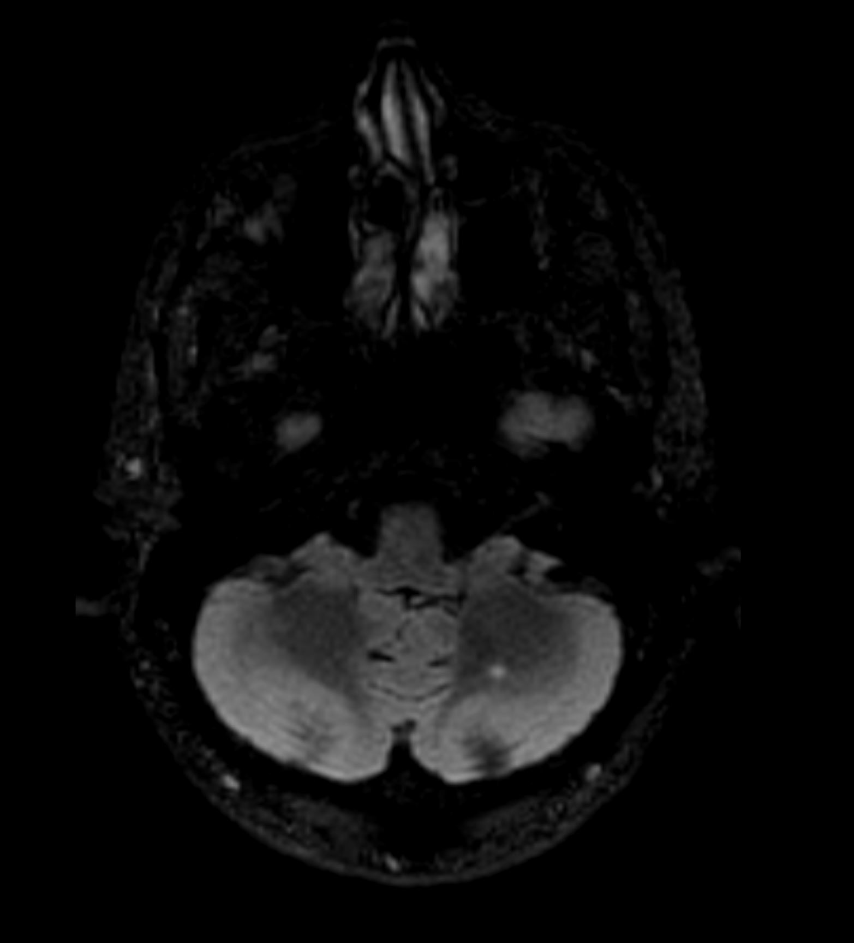
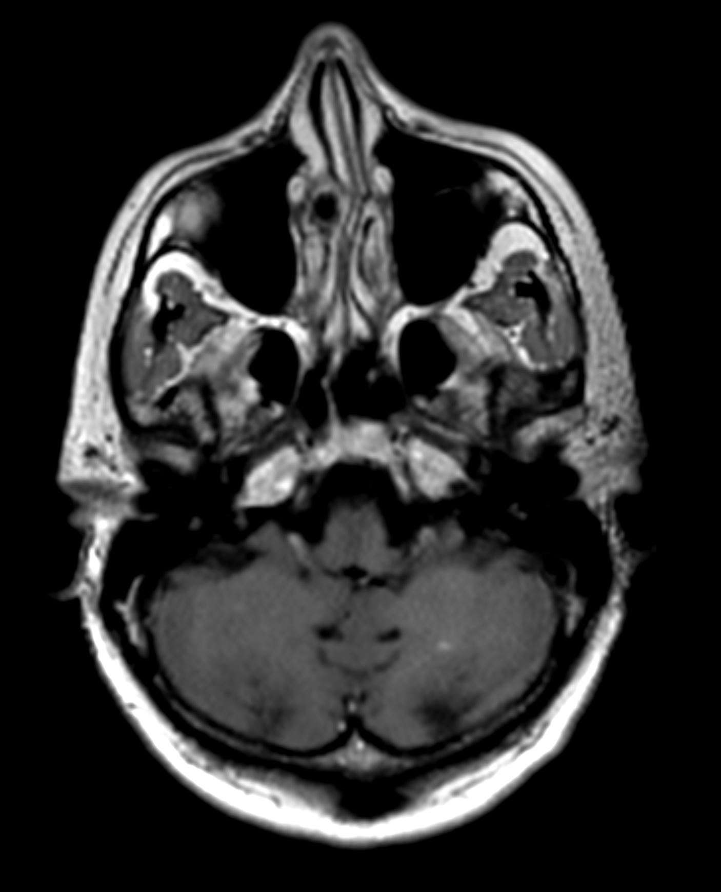
MRI - Axial T2-FLAIR and Post-contrast T1 (9/12/17)
Notes:
Additional cerebellar FLAIR hyperintense lesions were also identified (Left), also demonstrating corresponding enhancement on post contrast sequences (Right). Differential diagnostic considerations based on these findings include multiple sclerosis, primary CNS vasculitis, CADASIL, and neoplasm, among other considerations.

Slide 15
Diagnosis: Presumed Multiple Sclerosis
Evaluated at a Multiple Sclerosis Center
Full blood and serologic work up done, reported as negative.
CSF with standard MS analyses (-).
  Oligoclonal bands (-).
Based on symptoms and predominantly white matter lesions, patient diagnosed with atypical MS.
Glatiramer commenced.
  No effect on progression of neurological symptoms and signs.
Notes:
A diagnosis of atypical MS was made, and she was managed at an MS Center without any effect.

Slide 16
Next Steps?
Notes:
What would you have done at this stage?

Slide 17
Next Steps?
Repeat MRIs
Brain biopsy
Repeat FFA
Notes:
Repeat brain MRI was performed, followed by brain biopsy and repeat FFA

Slide 18
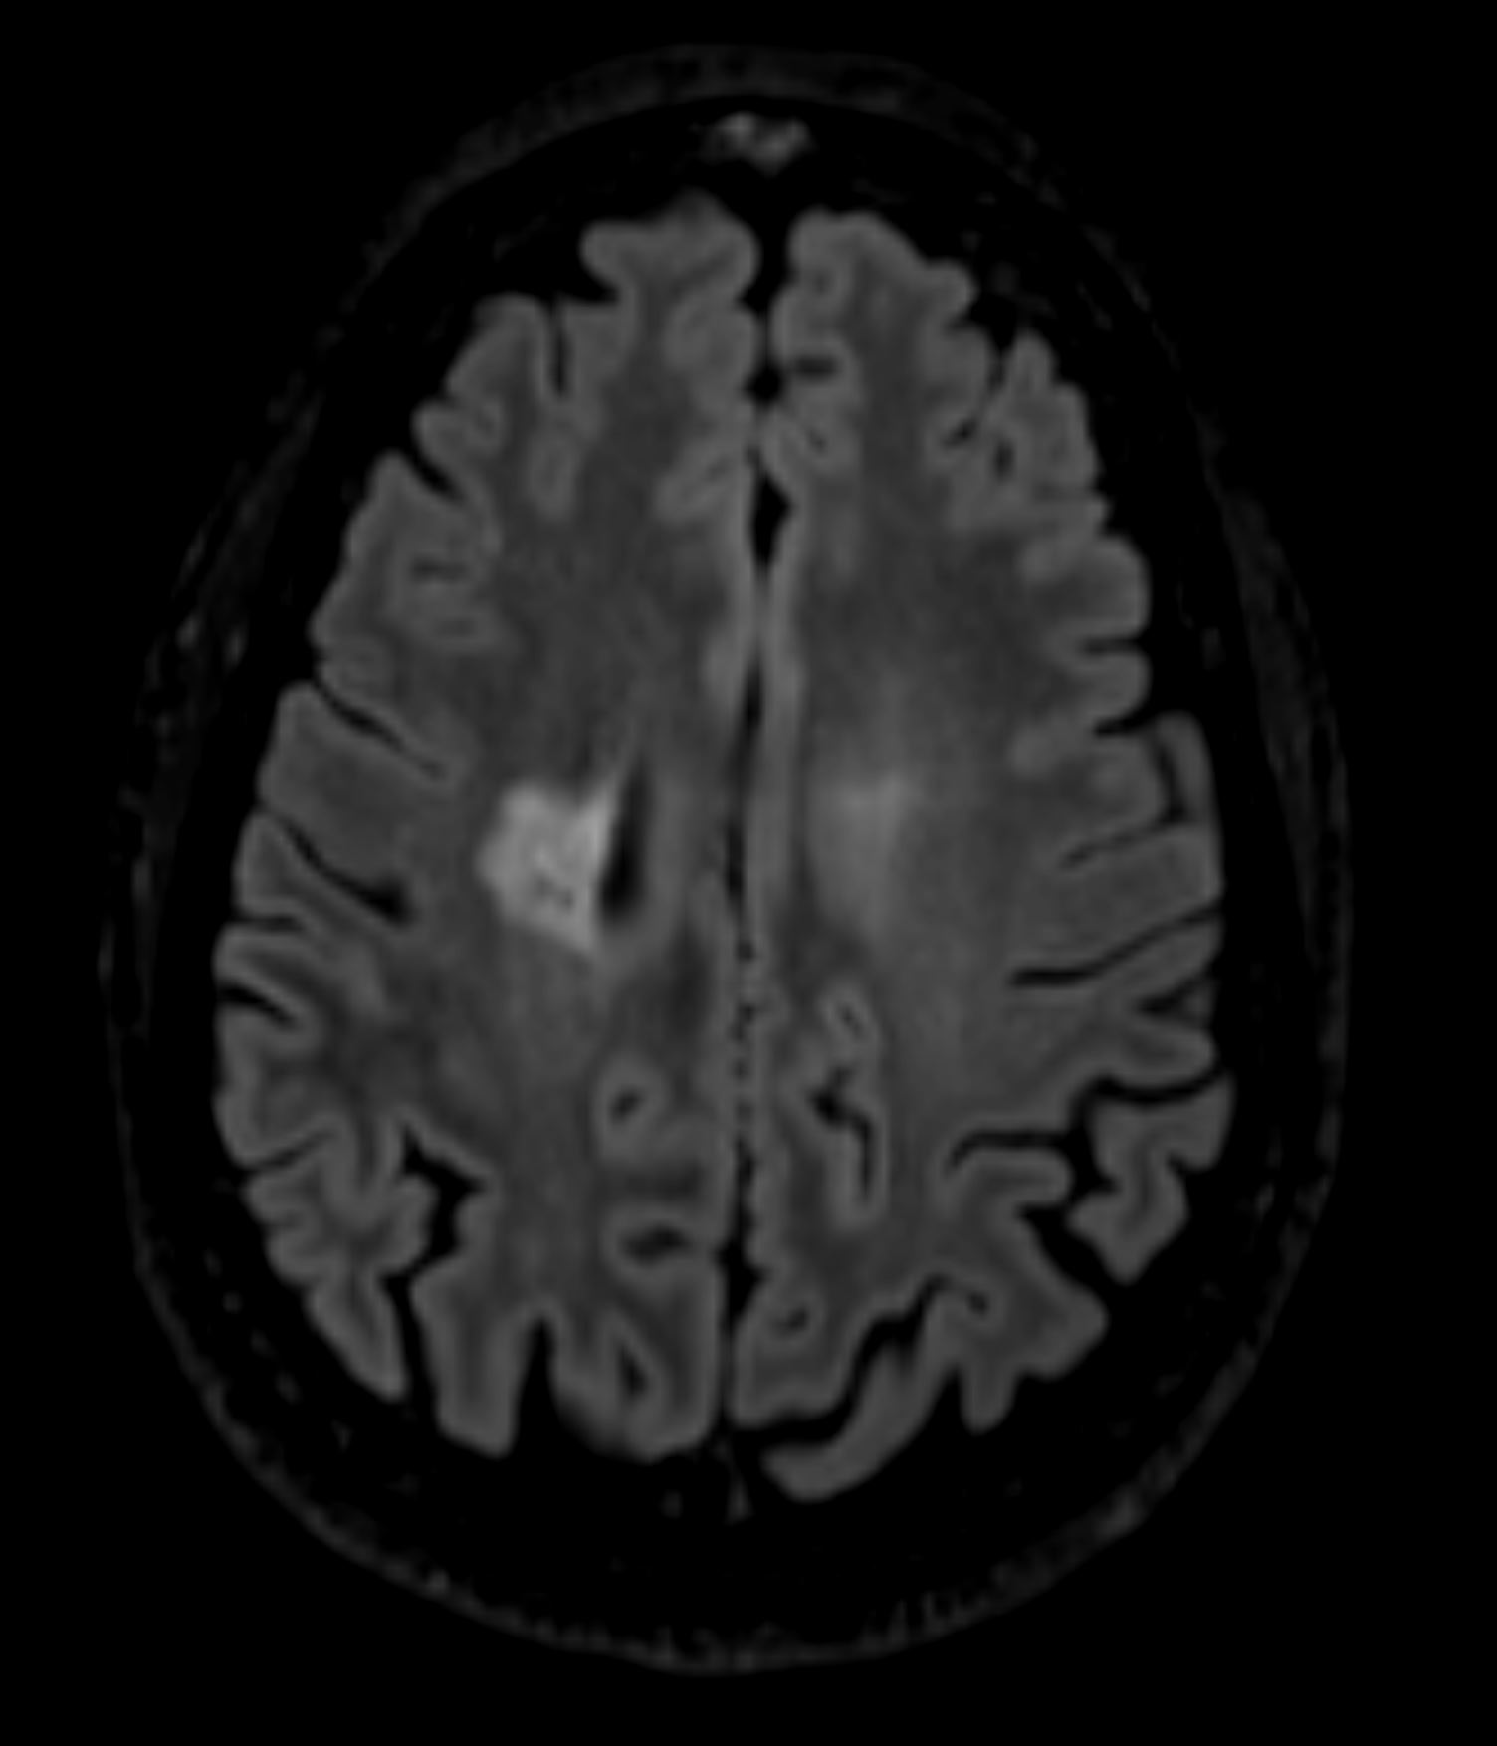
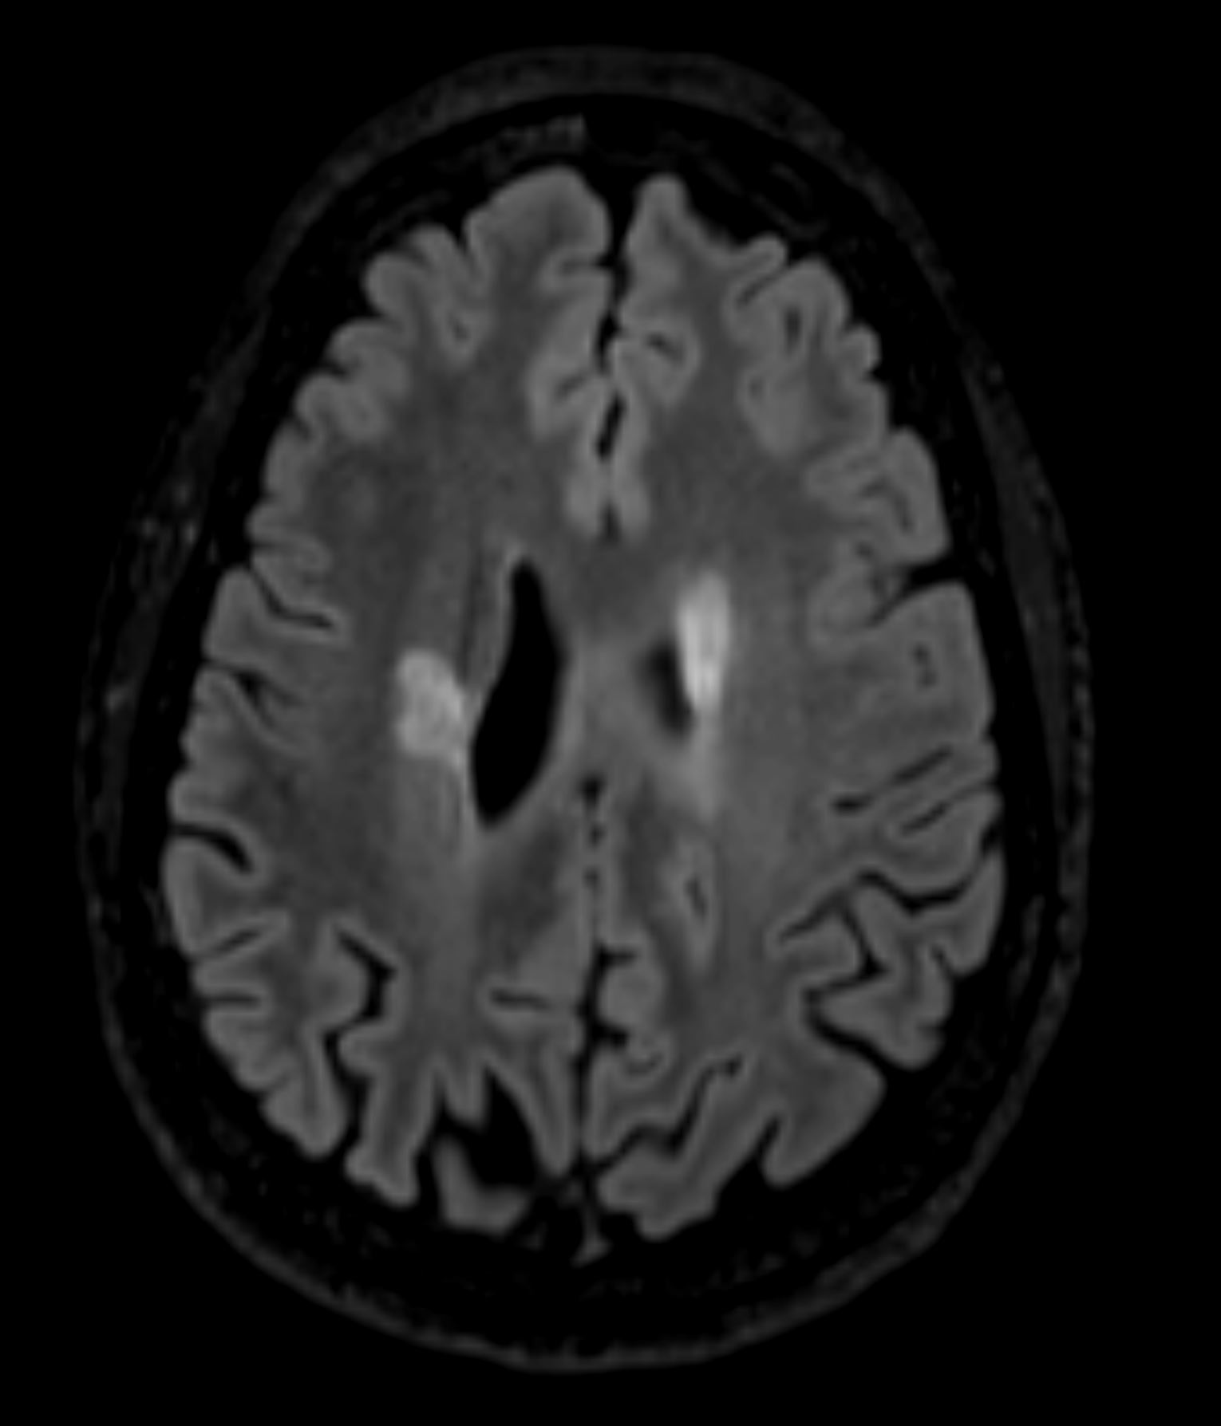
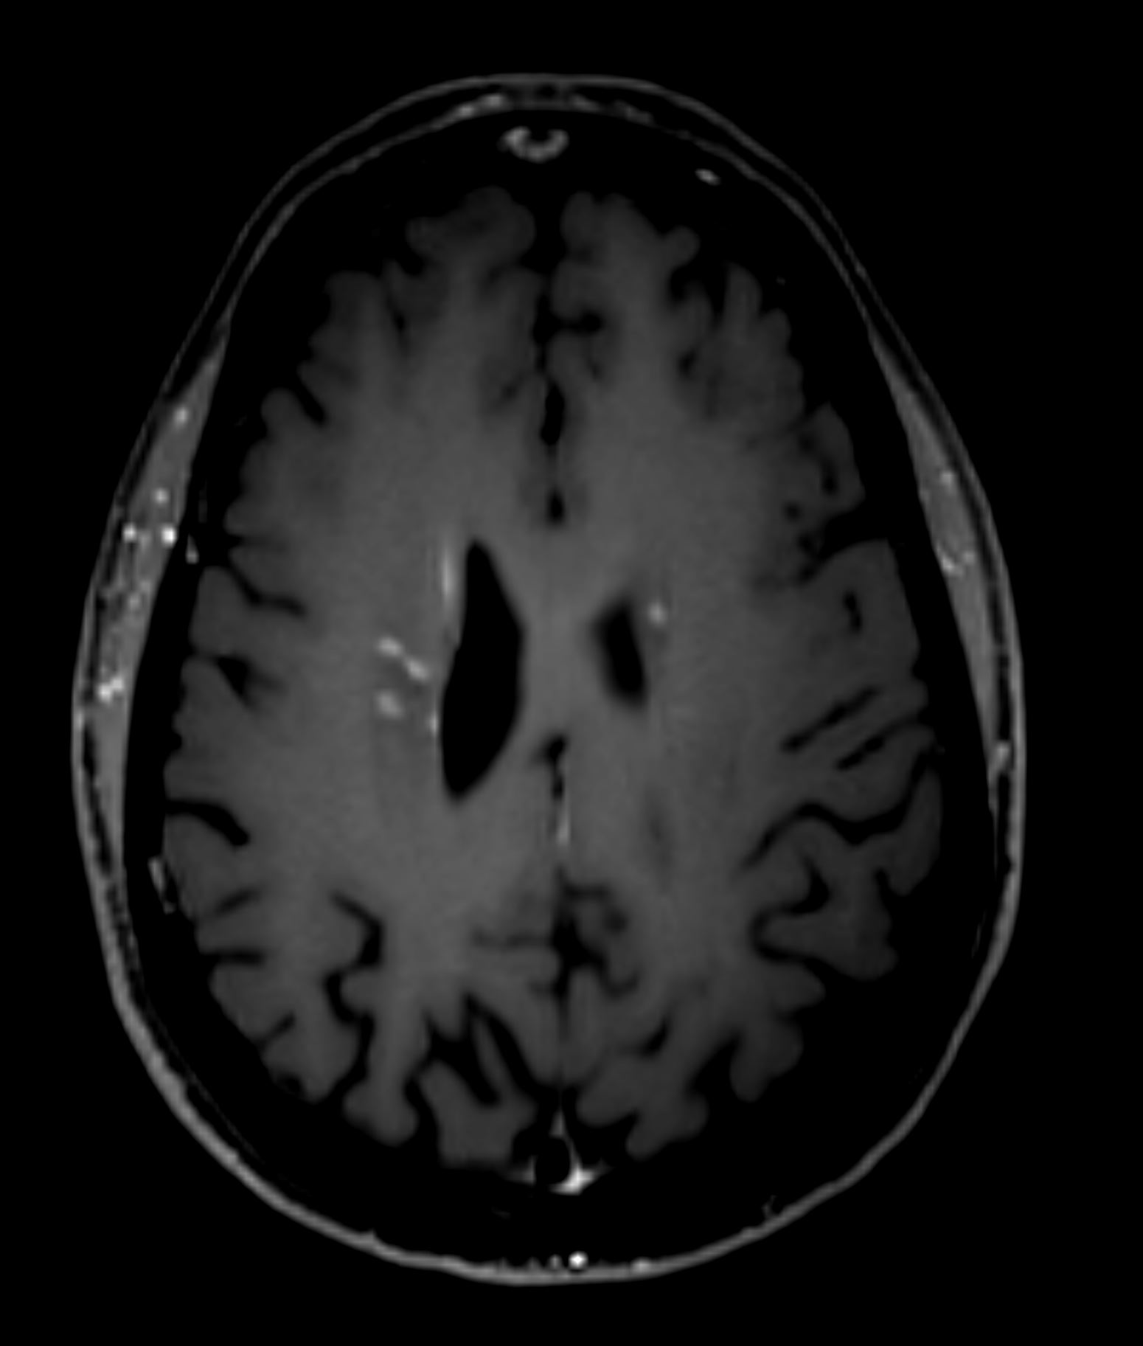
MRI - Axial T2-FLAIR 3.0T magnet (1/4/18)
Notes:
Follow up brain MRI performed on 1/4/18 demonstrated slight decrease in size of the dominant FLAIR hyperintense lesion within the right frontal lobe white matter (Left image), which demonstrated persistent heterogeneous, nodular enhancement (Right image), and interval increased size of a FLAIR hyperintense lesion within the left frontal periventricular white matter (Middle image), with new nodular enhancement (Right image).

Slide 19
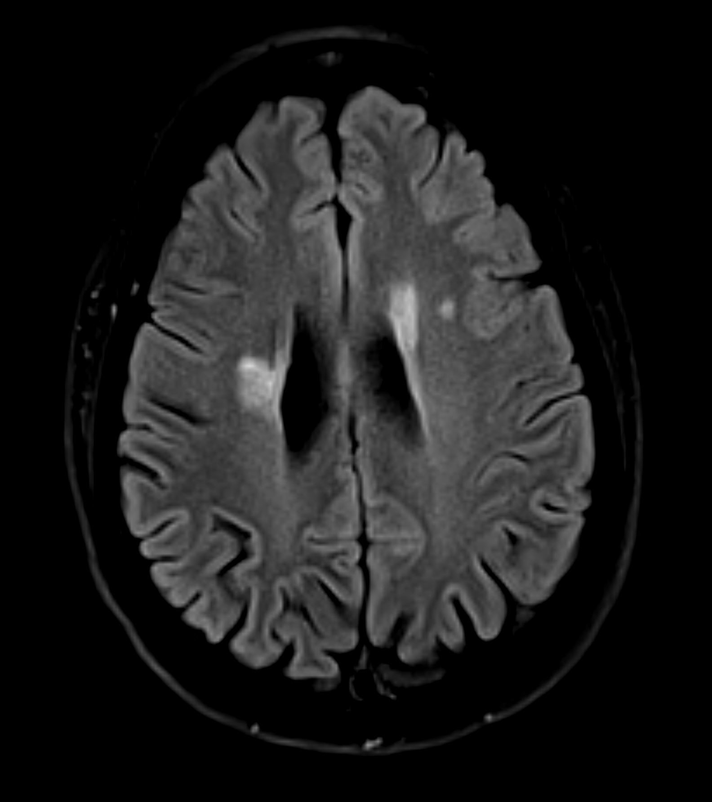
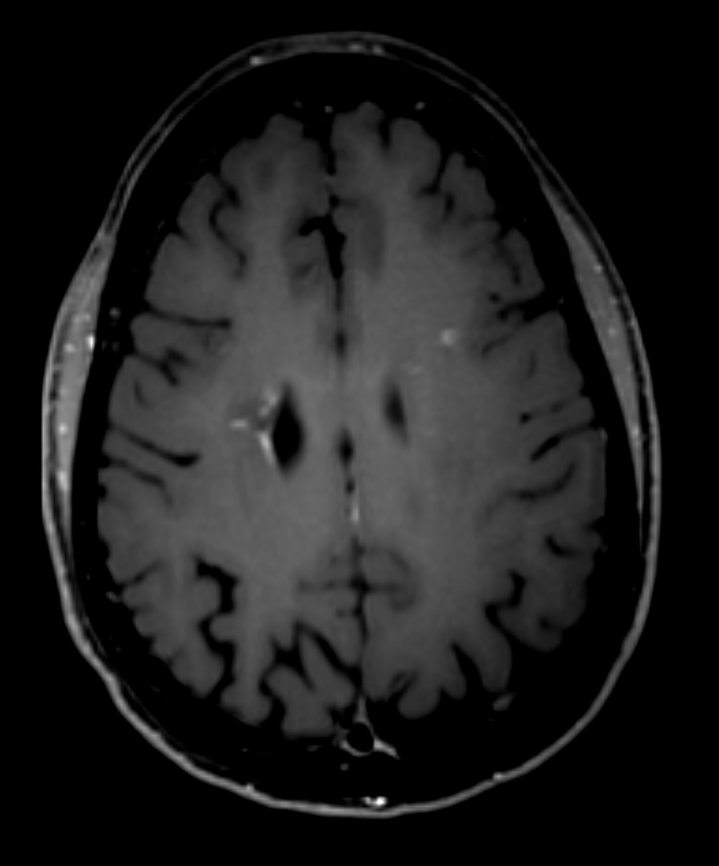
MRI - Axial T2-FLAIR 3.0T magnet (4/9/18)
Notes:
Subsequent follow up brain MRI performed on 4/9/18 demonstrated persistent FLAIR hyperintense lesions within the right and left frontal periventricular white matter, both of which demonstrate persistent nodular enhancement, atypical for demyelinating disease, and with a new smaller FLAIR hyperintense lesion within the left frontal corona radiata white matter (Left) which demonstrates corresponding nodular enhancement (Right).

Slide 20
BRAIN HISTOPATHOLOGY (2018)
Pathology of brain biopsy from right posterior frontal periventricular white matter: A. H&E (40x) demonstrates reactive and sclerotic vasculature, perivascular and parenchymal lymphohistiocytic infiltrates and an area of cavitation. B. H&E (100x) with area of parenchymal rarefaction and cavitation, reactive and thickened vessel walls, and astrocytosis. C&D. Luxol fast blue-H&E stain (40x, 100x) - Myelin loss in area of cavitation and macrophages with cytoplasmic myelin debris. E. Immunohistochemistry against phosphorylated neurofilament (40x) demonstrates axonal loss in the area of cavitation (right side). Axonal spheroids and swollen axons are highlighted (inset), indicative of axonal damage. F. H&E (100x) Prominent perivascular and patchy parenchymal infiltration by foamy macrophages. G. CD68 immunostain (100x) – Highlights numerous perivascular and parenchymal macrophages. H. CD3 Immunostain (40x) demonstrates predominantly perivascular T cell infiltrates. I. GFAP immunostain (100x) highlights the dense reactive astrogliosis within the biopsy. The reactive and sclerotic small vessels with perivascular lymphohistocytic infiltrates stand out as unstained areas.
Notes:
Above is the brain biopsy histopathology and immunohistochemistry. In summary, there was reactive inflammation and sclerotic vessels with areas of parenchymal axonal damage and loss with cavitation. Specific staining failed to disclose demyelinating disease or malignancy.

Slide 21
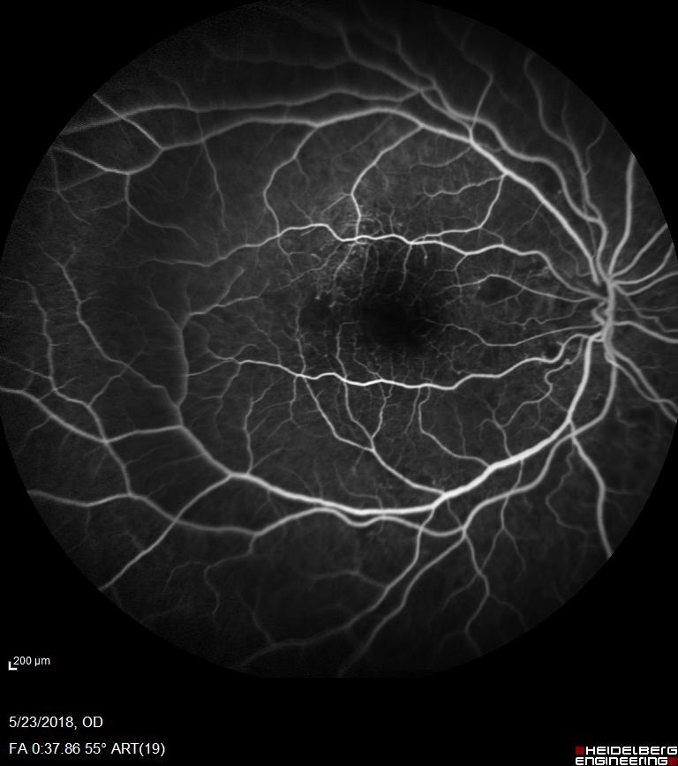
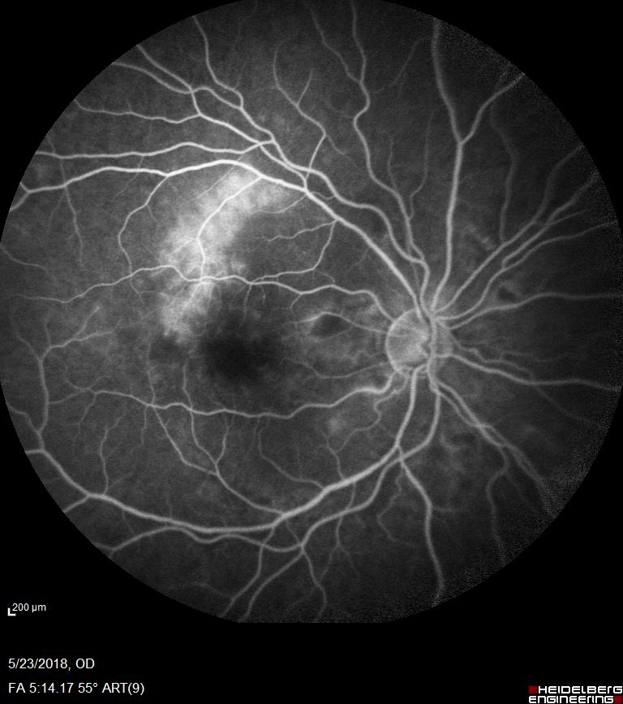
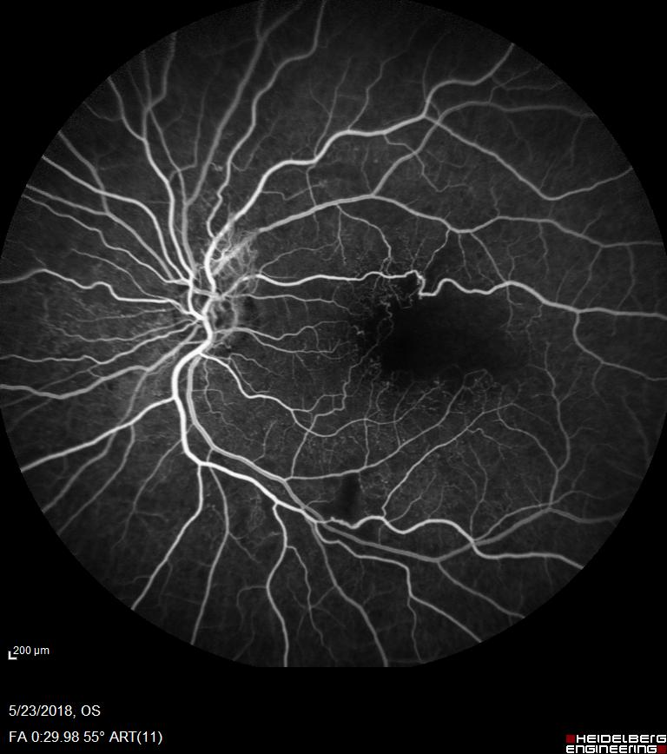
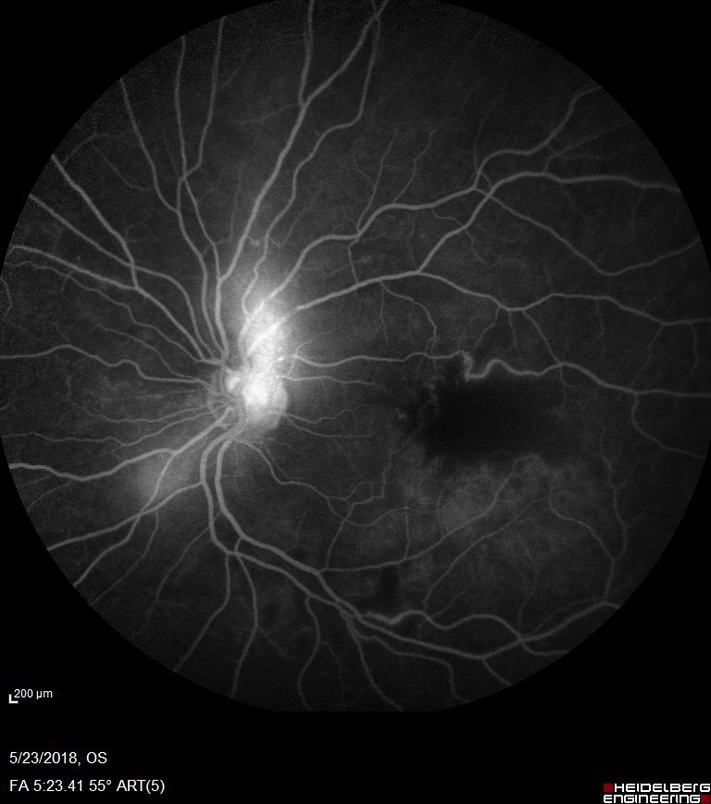
Repeat FFA – 3 years Post-presentation (2018)
Right
Left
Notes:
Simultaneous ocular evaluation - 3 years later
FFA in the right eye again demonstrates telangiectatic vessels now with perifoveal capillary dropout which in later frames again demonstrates leakage superiorly. The left eye also displayed an enlarging FAZ and similar perifoveal capillary dropout, with new neovascularization at the disc (NVD) as displayed by the progressive leakage of dye at the optic nerve. No longer seen are the shunt vessels in the left eye. Previous vessel staining no longer seen.

Slide 22
What are likely diagnoses?
Notes:
What are the likely diagnoses for this patient’s progressive retinal vasculopathy and not-specific white matter disease.

Slide 23
Differential Diagnosis
Diagnosis | Supporting Features | Unsupportive Features
Multiple sclerosis | Progressive neurological deficits MRI predominately white matter lesions | MRI and retinal changes are atypical Serology and CSF analyses (-) Poor response to Glatiramer therapy
Brain Tumor | Progressive neurological deficits MRI tumefaction lesions | Retinal changes are atypical Brain biopsy histopathology and immunohistochemistry unsupportive
Vasculitis | Progressive neurological deficits Retinal lesions can occur MRI tumefaction lesions | Initial blood/CSF tests for infection/autoimmunity unsupportive Brain biopsy histopathology and immunohistochemistry unsupportive
CADASIL (Cerebral autosomal dominant arteriopathy with subcortical infarcts and leukoencephalopathy; NOTCH 3 mutation) | Progressive neurological deficits with small vessel disruption Typical MRI findings (may mimic MS) and predominately display white matter lesions | Histopathology: small arterial wall thickening with intimal hyperplasia and smooth muscle cell degeneration and GOM (non-amyloid, granular osmiophilic material accumulation of brain, skin and muscle biopsy Retinovasculopathy rarely occurs
Susac’s syndrome (Autoimmune disease of unknown etiology) | Progressive neurological deficits with arterial disruption Retinal vasculopathy MRI predominantly white matter disease | Even after 3yrs did not have full triad: BRAO (branch retinal artery occlusion), sensorineural hearing loss and neurologic dysfunction Typically starts 20-40yr of age MRI with typical corpus callosum and pericallosal lesions.
Notes:
Frontal lobe lesion biopsy did not reveal any neoplastic changes and was interpreted as non-specific, representing either ischemia/stroke or demyelination. The differential diagnoses of MS. autoimmune vasculitis, brain tumor, Susac’s syndrome or CADASIL were not supported by clinical or histopathology findings. At this point, she carried two separate diagnoses that were the best fit, one of retinal vasculitis and the other of multiple sclerosis. *GOM= non-amyloid, granular osmiophilic material.

Slide 24
What would you do now?
Notes:
What would you do now?

Slide 25
Neuro-ophthalmology Examination (2019)
 | OD | OS
VA near cc | 20/40 | 20/40
Pupils | RR, no RAPD | RR, no RAPD
IOP | Normal | Normal
HVF 24-2 | Infranasal defect (MD = - 8.55) | Infranasal defect (MD = -11.93)
Color (Ishihara) | Test plate | Test plate
EOM | Full, Ortho | Full, Ortho
External | WNL | WNL
Slit Lamp Exam | WNL | WNL
Disc | Pale without obvious NVD | Pale without obvious NVD
Dilated Fundus Exam | No obvious vascular occlusion; macular drusen and CWS | No obvious vascular occlusion; macular drusen and CWS
Notes:
She was referred to Neuroophthalmology for re-evaluation. Neuroophthalmic exam remarkable for normal Snellen but abnormal color vision; HVF showed vague inferonasal defects left>right; SLE was normal and DFE revealed pale optic nerves without obvious neovascularization. Macular drusen and scattered CWS were noted. The was no evidence of occlusive vasculopathy.

Slide 26
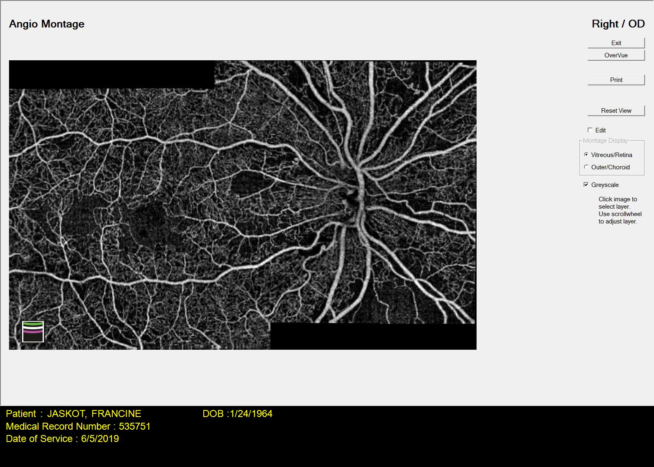
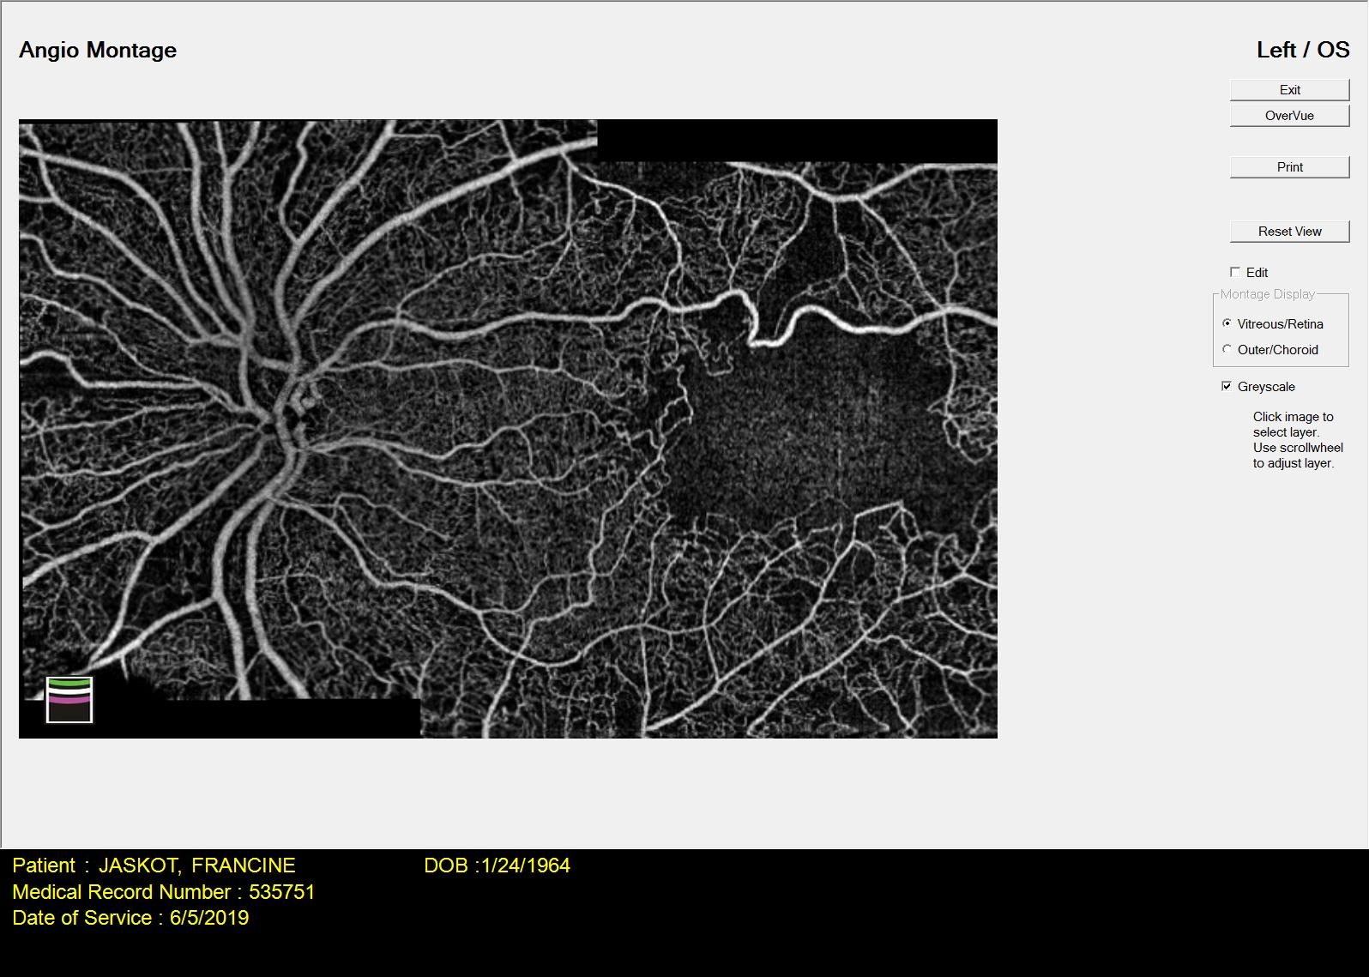
Optical Coherence Tomography-Angiography (2019)
OCTA: Optical Coherence Tomography-Angiography showing areas of capillary non-perfusion (yellow arrows) and larger than normal foveal avascular zones (red arrows) in both eyes.
Notes:
OCTA: Optical Coherence Tomography-Angiography is a quick non-invasive, new technology that uses laser light reflectance that differentiates moving red blood cells from immobile surrounding tissue This testing generates a high-resolution image of the vast network of optic nerve, choroid and retinal vessels. It accurately depicts these vessels without the need for intravenous fluoresceine dye.
Neuroopthalmology ordered OCT-Angiography. The swept field OCT-angiography revealed obvious capillary dropout (yellow arrows) and increase in the size of the capillary free foveal avascular zone (FAZ) bilaterally especially in the left eye. Although the FAZ in the center of the macula is a normal anatomical feature, these zones were notable for their increased size.

Slide 27
What testing would help make the diagnosis?
Notes:
Neuroophthalmology re-evaluation at one month revealed her examination overall was unchanged. Visual fields revealed inferonasal changes on the right and a nasal defect on the left, densest inferiorly. It was felt, instead of two diagnoses, there was a likely unifying diagnosis for retino-vasculopathy and brain lesions. What testing would you order at this time?

Slide 28
Genetic testing
The coexistence of progressive retino-vasculopathy and leukoencephalopathy led us to suspect cerebral leukoencephalopathy and systemic manifestations (RVCL-S).
Genetic testing was ordered and was positive for TREX-1, three prime repair exonuclease -1 enzyme gene mutation (Chromosome 3: V235Gfs*6).
TREX-1 gene encodes for three prime repair exonuclease 1 enzyme. This enzyme helps remove incorrect or damaged nucleotides from DNA and is required to maintain the integrity of genetic material.
Notes:
The neuroophthalmologist felt there was likely one diagnosis unifying the progressive retinovascular and cerebrovascular manifestations. This patient’s clinical manifestations and course resembled a condition first described by Grand et al in 1988. Also, the previous FFAs and OCTA revealed large FAZ. Although not pathognomonic , these findings are typical in cerebral leukoencephalopathy and systemic manifestations (RVCL-S). Genetic testing was ordered and was positive for a common variant of TREX-1 mutation and RVCL-S

Slide 29
Case Summary
54YO female with progressive retino-vasculopathy and neurological dysfunction over 3 years.
Retinal changes responsive to anti-VEGF series but neurologic deficits were unresponsive to MS therapy.
Neurologic symptoms were progressive with new mostly white matter lesions on sequential brain MRI.
Brain biopsy was non-specific and exhibited:
  White matter gliosis, lymphohistiocystic infiltration
  Variably reactive and sclerotic small vessels and parenchymal cavitation
  Immunohistochemistry confirmed perivascular and parenchymal inflammation and absence of demyelination and malignancy
TREX-1 mutation was detected.
Diagnosis: Retinal vasculopathy with cerebral leukoencephalopathy (RVCL-S) resulting from a autosomal dominant frame shift mutation in the TREX-1 gene.
Notes:
In summary, a middle-aged female with a history of hypertension was referred for progressive retino-vasculopathy disease with vascular occlusion and neovascularization neurologic deficits with increased white matter lesions. Genetic testing revealed a TREX-1 mutation and diagnosis of RVCL-S was made.

Slide 30
Retinal Vasculopathy with Cerebral Leukoencephalopathy and Systemic Manifestations (RVCL-S)
First described by Grand et al in 1988 under the name cerebral leukoencephalopathy.
Subsequently published under various other names (CRV, HRV, HERNS and HAS) prior to being recognized as one inherited disorder.
In 2016, these were unified and recognized as one, rare autosomal dominant condition resulting from a truncated chromosome 3 TREX-1 gene.
100% penetrance and phenotypic variation between families and within one pedigree Currently, less than 50 families identified worldwide.
Presents between 30-50yrs of age with retinal vasculopathy, neurologic complaints.
Causes progressive retina, brain and various systemic microangiopathy.
Clinical features usually asynchronous and may occur at any time in the disease course.
Notes:
First described in 1988 as a cerebral leukoencephalopathy, RVCL-S has also been named: cerebroretinal vasculopathy (CRV), hereditary vascular retinopathy (HVR), Hereditary systemic angiopathy (HSA), hereditary endotheliopathy, retinopathy, nephropathy and stroke (HERNS) and retinal vasculopathy with cerebral leukodystrophy (RVCL). Patients with this disorder have a chromosome 3p211.-p21.3 heterozygous C-terminal frameshift and present in middle age with retina, brain and various systemic manifestations. Phenotypic variability within one pedigree has been reported..

Slide 31
RVCL-S Clinical Manifestations
Retina
Brain
Common Systemic Manifestations
Other Systemic
Vascular retinopathy: hemorrhages, microaneurysms, CWS, and telangiectasia.
FFA: microvascular anomalies, focal and extensive ischemia and perifoveal capillary occlusion and wide FAZ, and neovascularization.
OCTA: deep and superficial capillary occlusion; wide FAZ - also present in those with pre-symptomatic RVCL-S.
Focal/global dysfunction:
Stroke-like episodes
Headaches
Seizure disorder
Gait imbalance
Cognitive impairment
MRI: punctate/nodular T2 hypersensitivity and rim-enhancing WML “pseudotumors” with mass effects +/- edema, prolonged contrast enhancement and DWI; mostly fronto-parietal and peri-ventricular.
CT Scan: calcified WML
Renal
Hepatic
Hypertension
Raynaud’s phenomenon
Anemia
Sub-clinical hypothyroidism
Gastrointestinal bleeds
Psychiatric disorders
Microvascular Nephropathy: Nephrosclerosis and glomerulosclerosis -> Elevated creatinine and proteinuria
Usually mild
ESRD (rare)
Microvascular Hepatic disease: elevated alkaline phosphatase and gamma-glutamyl transferase
Usually mild -modest
Cirrhosis (rare)
CWS: cotton wool spot; FFA: Fundus fluorescein angiogram; OCTA: optical coherence tomogram – angiography; WML: white matter lesions; DWI: Diffusion weighted imaging; ESRD: end-stage renal disease); FAZ: foveal avascular zone.
Notes:
Common clinical manifestations of RVCL-S are retina and brain lesions. Additional systemic features are renal and hepatic insufficiency, anemia, hypertension and Raynaud’s phenomenon. Currently, there are no known pathognomonic clinical, radiologic or histopathology findings nor a consensus of criteria of clinical symptoms/signs to suggest RVCL-S and prompt genetic testing.

Slide 32
Retinal Vasculopathy with Cerebral Leukoencephalopathy and Systemic Manifestations (RVCL-S)
RVCL-S often is misdiagnosed as MS, brain tumor, autoimmune vasculitis or CADASIL.
RVCL-S is likely under-recognized and underdiagnosed.
High index of suspicion from constellation of symptoms/signs with genetic testing is best means for diagnosing RVCL-S.
Early retinal changes in pre-symptomatic patients with TREX-1 mutation noted on OCTA analysis.
  Decreased retinal vascular density
  Enlarged FAZ
Currently, there is no treatment; manage with a multi-disciplinary team for all clinical manifestations.
  Corticosteroids and immunosuppressants are not effective
  Thrombolytic therapy (e.g. TPA) not indicated – not thromboembolic disease
Premature death often occurs 5-10 years after onset of symptoms from complications of neurologic or systemic disease.
Early recognition important for:
  Management of complications
  Prevention of misdiagnosis and inappropriate management or unnecessary biopsies.
  Genetic counselling
  Detailing disease course, characterizing pathogenesis, identifying biomarkers and for trials of possible disease-modifying intervention
CADASIL (Cerebral autosomal dominant arteriopathy with subcortical infarcts and leukoencephalopathy; OCTA: Optical Coherence Tomography – Angiography; FAZ: foveal avascular zone; TPA: Tissue Plasminogen Activator
Notes:
RVCL-S often is misdiagnosed as MS, brain tumor, autoimmune vasculitis or CADASIL (cerebral autosomal dominant arteriopathy with subcortical infarcts and leukoencephalopathy).
Constellation of symptoms and signs with genetic testing only means for diagnosis; FFA and OCTA findings of large FAZ and lost decr retinal vascular density are suggestive and may found in pre-symptomatic patients and undiagnosed relations. There are no recognized treatments, and premature death occurs within 10yrs. For various reasons, early recognition is important not least of which is to avoid unnecessary procedures like brain biopsy.

Slide 33
What would you do next?

Slide 34
Referral to RVCL-S Center and Family Members Identification
There is no identifiable treatment for this condition, however, autosomal dominant inheritance means 50% of the extended family may be affected.
Family history from patient and collected data from a databank, stored at Washington University in St Louis, was detailed.
Previously unlinked family members in other parts of USA were identified, and a family tree was constructed.
Family members suspected of having the mutation were also identified, including the one unifying case at top of pedigree.
Notes:
We referred this patient to an established RVCL-S center for assistance with management and help with constructing a family tree.

Slide 35
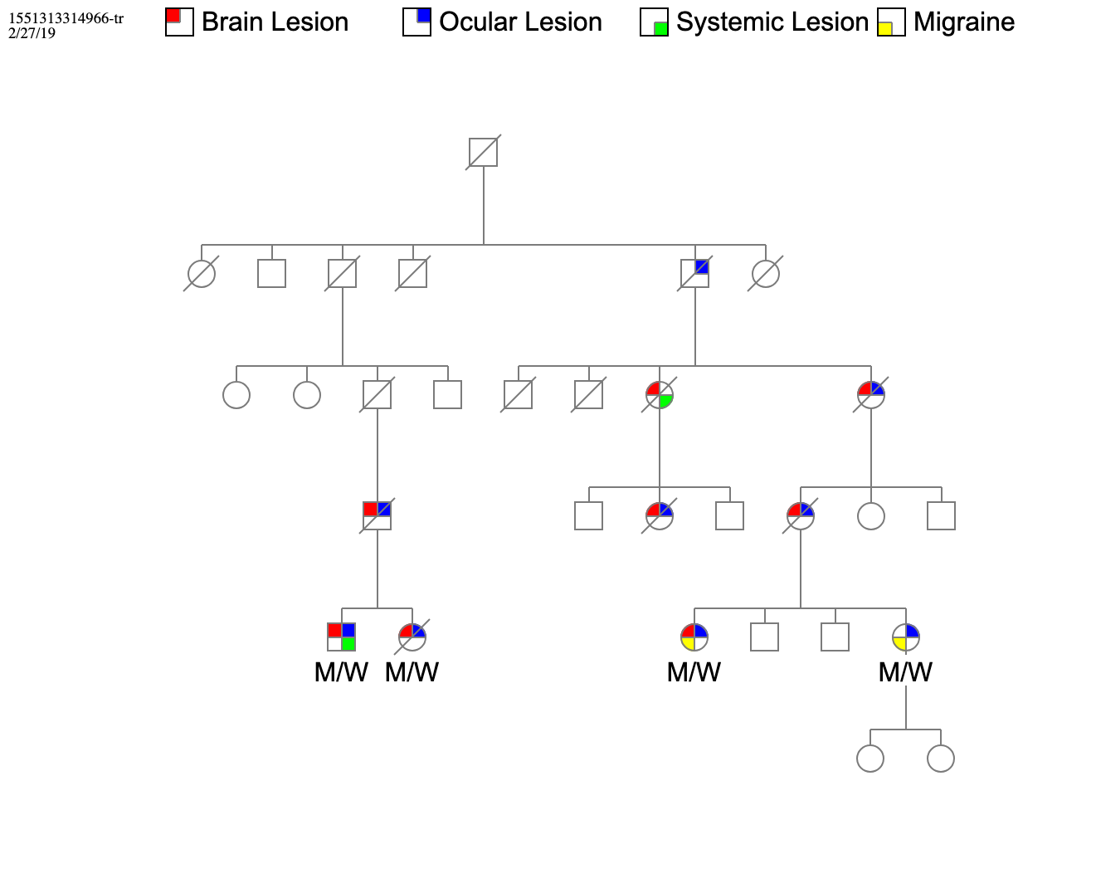
Patient’s Pedigree
*
M – Mutation
W- Wild Type
*
*
*
*
*
*
*
*
Notes:
A family tree was constructed with information accumulated at Washington University RVCL-S center. Here is the pedigree of the proband’s (arrow →) immediate and extended 30-member family traced back to their unifying ancestor. 1 of 3 siblings also tested positive for the TREX-1 mutation (M/W) along with 2 others in the extended family. Suspected TREX-1 positive family members are labeled with an asterisk (*). All confirmed and suspected members are labeled by color with the organ systems affected by RVCL-S: Red – Brain lesion, Blue – Ocular lesion, Green – Systemic lesion, Yellow – Migraines. Three other members are suspected of having had RVCL-S, although currently, we lack clinical histories. Most patients with RVCL-S in this pedigree, had ocular manifestations that frequently were the initiating disorder. Of note her mother had a history of “macular degeneration” and died after a CVA. 13 of 30 members of this family have confirmed or suspected RVCL-S. Phenotypic variation has been reported in other pedigrees and is obvious in this extended family.

Slide 36
Clinical Course of Our Patient
Care transferred to the RVCL-S Research Center at Wash U, St Louis.
Placed on trial drug: Crizanlizumab (ADAKVEO) 10 mg/mL solution (2019-2021).
  Crizanlizumab is an FDA-approved humanized monoclonal P-selectin antibody used in sickle cell pain crises.
  Reduces microvascular occlusion by preventing leukocyte-endothelium interactions and ischemia that results in microvasculopathy.
  Phase II studies have shown reduced progression of retina nonperfusion in the second year of treatment.
Series of clinical examinations, MRI and FFA were performed.
Followed off medication (2021-2023).
Failed to respond to this therapy and had similar ocular and neurologic symptoms and signs as at presentation.
Lost to follow up since 2023.
Notes:
She was placed in a clinical trial with Crizanlizumab, an FDA-approved drug used for painful sickle cell crises. It works by mitigating microvascular ischemia. Although this drug has been shown to reduce retinal nonperfusion in RVCL-S, our patient failed to respond at the end of her treatment course. She has been lost to follow up since 2023.

Slide 37
Summary
Challenges in this case stemmed from the initial assumption that the patient’s findings were due to two separate disorders, retino-vasculopathy and atypical multiple sclerosis, treated by different physicians.
Malignancy and multiple sclerosis are among the known misdiagnoses in patients with RVCL-S and both were initially considered in our patient.
RVCL-S is a very rare autosomal dominant disease, making the diagnosis elusive in this patient. All symptoms, signs and most importantly the retinal findings were considered as manifestations of one disease, prompting genetic testing for the TREX-1 gene mutation and thus arriving at the correct unifying diagnosis.
Construction of the family tree revealed a new pedigree with 13 of 30 members with confirmed or suspected RVCL-S. Phenotypic variation, which has been reported in other pedigrees, was noted in this family.
Notes:
RVCL-S was a challenging diagnosis to make. Often underdiagnosed or misdiagnosed, genetic testing when confronted with progressive non-specific retinal vasculopathy and white matter disease, may disclose this rare condition. Exploration of the family tree exposed a new pedigree and revealed phenotypic variation.

Slide 38
Teaching Points
RVCL-S is a very rare monogenetic disorder with autosomal dominant inheritance that likely is under-recognized and often misdiagnosed.
Currently there is no consensus on the diagnostic criteria.
Diagnosis can be challenging due to rarity, phenotypic variations and the lack of pathognomonic clinical, neuroradiologic or histopathologic features.
Coexistence of progressive white matter brain disease resembling multiple sclerosis or neoplasia and retinal vasculopathy and possible systemic disorders should raise suspicion for RVCL-S and prompt genetic testing for the TREX-1 mutation.
Notes:
RVCL-S is a rare monogenetic disorder affecting small blood vessels. Currently, there are no diagnostic criteria nor pathognomonic features to suggest genetic testing. The constellation of retino-vascular disease, white matter disease +/- systemic disorders should prompt testing for TREX-1 mutation to diagnose RVCL-S.

Slide 39
ACKNOWLEDGMENTS
The authors wish to thank the patient for consenting to the presentation of her case and Madonna Bogacki and Lorraine Schwartz from RVCL-S Research Center, WashU, St Louis, for providing information for the pedigree construction and for update of the patient’s clinical course.
Notes:
Listed here are our acknowledgements.

Slide 40
References
Grand MG, Kaine J, Fulling K, Atkinson J, Dowton SB, Farber M, Craver J, Rice K. Cerebroretinal vasculopathy. A new hereditary syndrome. Ophthalmology. 1988;95(5):649-59.
Gutmann DH, Fischbeck KH, Sergott RC. Hereditary retinal vasculopathy with cerebral white matter lesions. Am J Med Genet.1989;34:217-220.
Triplett JD, Qiu J, O'Brien B, Gopinath S, Trewin B, Spring PJ, Shaffi M, Ip J, Chan F, Chen L, Wilson I, Muller C, Beadnall HN, Boggild M, Van der Walt A, Roxburgh R, Seery N, Kalincik T, Barnett MH, Parratt JDE, Reddel SW, Tsang B, Hardy TA. Diagnosis, differential diagnosis and misdiagnosis of Susac syndrome. Eur J Neurol. 2022;29(6):1771-1781.
Jen J, Cohen AH, Yue Q, Stout JT, Vinters HV, Nelson S, Baloh RW. Hereditary endotheliopathy with retinopathy, nephropathy, and stroke (HERNS). Neurology. 1997 Nov;49(5):1322-30.
Stam AH, Kothari PH, Shaikh A, et al. Retinal vasculopathy with cerebral leukoencephalopathy and systemic manifestations. Brain. 2016;139:2909-2922.
Richards A, van den Maagdenberg AM, Jen JC, et al. C-terminal truncations in human 3′-5′ DNA exonuclease TREX1 cause autosomal dominant retinal vasculopathy with cerebral leukodystrophy. Nature genetics. 2007;39(9):1068-1070.
Liszewski KM and Atkinson JP. Retinal Vasculopathy with Cerebral Leukodystrophy. Available at: https://rarediseases.org/rare-diseases/retinal-vasculopathy-cerebral-leukodystrophy/. Accessed Oct 17, 2018. (Updated November, 2018).
Pelzer N, Hoogeveen ES, Haan J, Bunnik R, Poot CC, van Zwet EW, Inderson A, Fogteloo AJ, Reinders MEJ, Middelkoop HAM, Kruit MC, van den Maagdenberg AMJM, Ferrari MD, Terwindt GM. Systemic features of retinal vasculopathy with cerebral leukoencephalopathy and systemic manifestations: a monogenic small vessel disease. J Intern Med. 2019;285(3):317-332.
Hoogeveen ES, Pelzer N, de Boer I, van Buchem MA, Terwindt GM, Kruit MC. Neuroimaging Findings in Retinal Vasculopathy with Cerebral Leukoencephalopathy and Systemic Manifestations. AJNR Am J Neuroradiol. 2021;42(9):1604-1609..
Ford AL, Chin VW, Fellah S, Binkley MM, Bodin AM, Balasetti V, Taiwo Y, Kang P, Lin D, Jen JC, Grand MG, Bogacki M, Liszewski MK, Hourcade D, Chen Y, Hassenstab J, Lee JM, An H, Miner JJ, Atkinson JP. Lesion evolution and neurodegeneration in RVCL-S: A monogenic microvasculopathy. Neurology. 2020 Oct 6;95(14):e1918-e1931. Erratum in: Neurology. 2021;96(19):919.
Wilms AE, de Boer I, Terwindt GM. Retinal Vasculopathy with Cerebral Leukoencephalopathy and Systemic manifestations (RVCL-S): An update on basic science and clinical perspectives. Cereb Circ Cogn Behav. 2022;3:100046.
Wang WX, Spiegelman D, Rao PK, Rhee RL, Ford AL, Miner JJ, Apte RS. Crizanlizumab for retinal vasculopathy with cerebral leukoencephalopathy in a phase II clinical study. J Clin Invest. 2024 May 7;134(12):e180916.. Erratum in: J Clin Invest. 2024 Dec 16;134(24):e189023.
Notes:
Here is a list of some of references we used for this presentation. Thank you for your attention.

