Slide 1


Alternating Bilateral Painful Ophthalmoplegia
Shonar Singh, MBBS DNB, Wilmer Eye Institute, Johns Hopkins University School of Medicine, Baltimore, MD, USA
Andrew R. Carey, MD, Wilmer Eye Institute, Johns Hopkins University School of Medicine, Baltimore, MD, USA

Slide 2
51-year-old F presented in ER
New onset sudden constant horizontal diplopia and drooping of right eye lid from last 2 weeks.
She was not able to move the eye in any direction.
Intermittent right side frontal headache from last 1 month.
Denies vision changes, eye pain, pain with eye movements, amaurosis, scalp tenderness, jaw claudication, weight loss, myalgia, neurological deficit, recent infection.
No significant past medical history.
No history of recent illness, trauma, insect bite.
No history of recent travel.

Slide 3
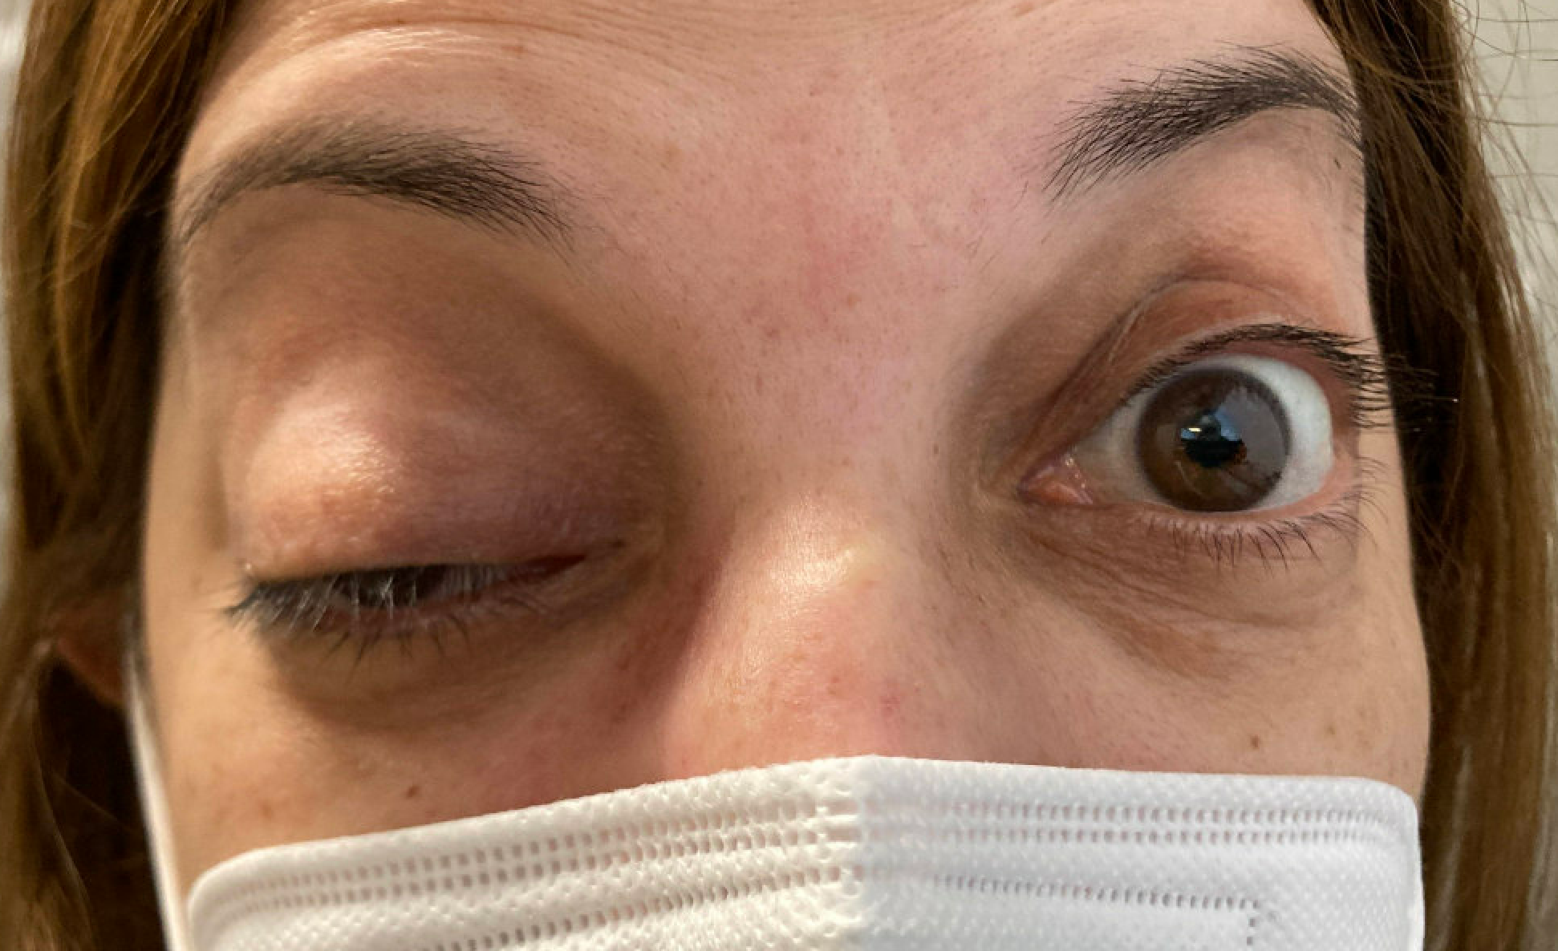
At presentation

Slide 4
Exams
 | OD | OS
Vision | 20/25-2 | 20/20-2
Pupils | Normal size, shape, reaction, no anisocoria, no RAPD | Normal size, shape, reaction, no anisocoria, no RAPD
Colors | 10/10 | 10/10
EOM | Complete ophthalmoplegia | Full
IOP | 14 | 15
HVF | Full | Full
Cranial nerve examination is normal except for Right 3rd, 4th and 6th.

Slide 5
Exams
 | OD | OS
External exam | Frontalis overaction | Normal
Lids | Complete ptosis | Normal
Conjunctiva/ sclera | Normal | Normal
Cornea | Clear | Clear
Anterior Chamber | Deep and quiet | Deep and quiet
Iris | Normal | Normal
Lens | Nuclear sclerosis 1+ | Nuclear sclerosis 1+
Disc | Normal | Normal
C:D | 0.4 | 0.4
Macula | Normal | Normal
Vessels | Normal | Normal
Periphery | Normal | Normal

Slide 6
Where do you localize the lesion at this point?
Brainstem
CSF / Dural-meninges
Cavernous sinus
Superior orbital fissure
Orbital apex
Neuro muscular junction disorder

Slide 7
What differentials should be kept in mind?
Infection- Cavernous sinus infection, Herpes zoster ophthalmicus, mucormycosis, post covid Miller Fischer syndrome, peri orbital cellulitis
Inflammation- Thyroid eye disease, Sarcoidosis, Nonspecific orbital inflammation (NSOI), IgG4 related sclerosing disease, ANCA associated vasculitis.
Vascular – Cavernous Sinus thrombosis, Carotid cavernous fistula, carotid aneurysm, Ophthalmic artery occlusion.
Neoplastic – Lymphoma, Meningioma, Histiocytic disease and Metastatic disease.
Neuro muscular junction disorder – Myasthenia Gravis

Slide 8
What investigations should be done at this point?
Blood tests –Complete blood count, Erythrocyte sedimentation rate, Complete metabolic profile, Angiotensin converting enzyme, Anti- neutrophil cytoplasmic antibody, Thyroid stimulating Hormone, T3, T4, Lyme, syphilis, QuantiFERON- Tb gold, HIV, IgG subclass antibody.
Imaging- MRI brain and orbits w/wo contrast, Chest X ray.
CSF studies – cell count w differentials (depending upon the MRI findings)

Slide 9
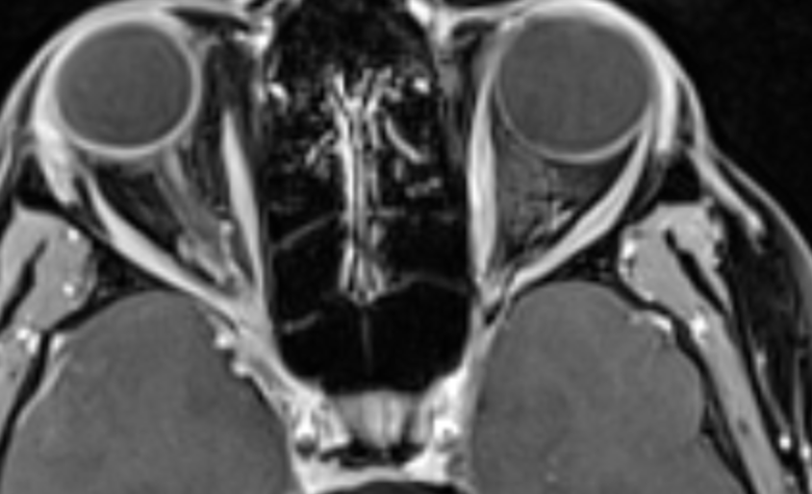
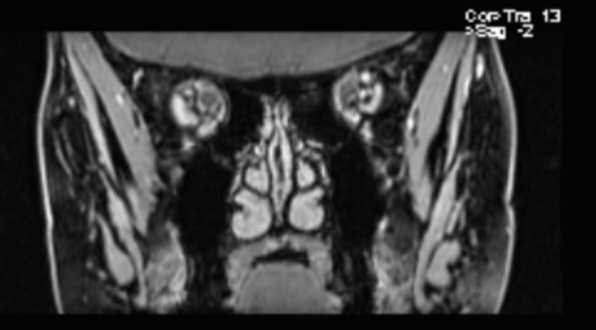
MRI Orbits with and without contrast
T1 post contrast coronal view: Right posterior optic nerve sheath enhancement
T1 post contrast axial view: Right posterior optic nerve sheath enhancement

Slide 10
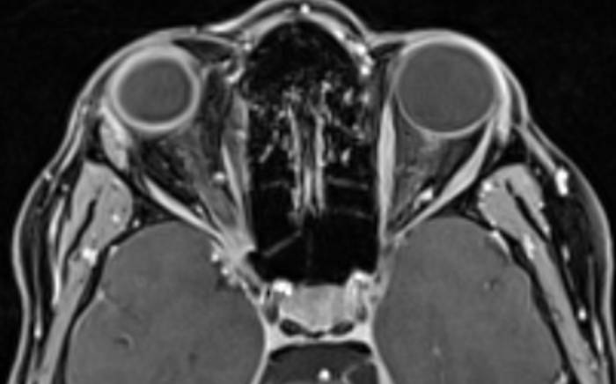
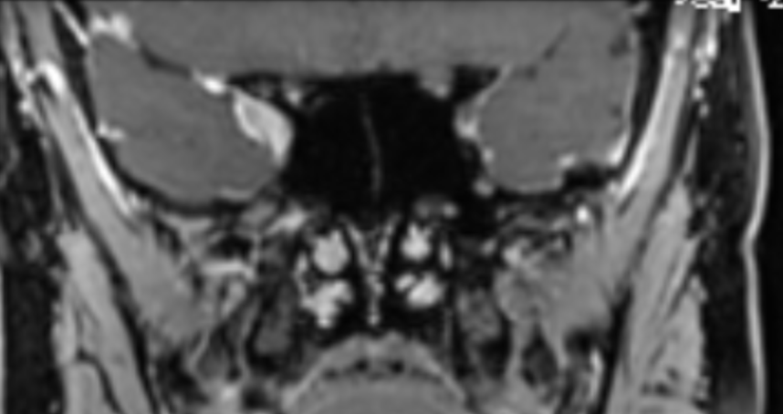
T1 post contrast axial view: Right orbital apex thickening and enhancement
T1 post contrast coronal view: Right orbital apex thickening and enhancement

Slide 11
Labs Results
Unremarkable:
Lyme, Syphilis, Tb, HIV C, Hepatitis panel
Erythrocyte sedimentation rate, C- Reactive protein, Angiotensin converting enzyme, Anti- neutrophil cytoplasmic antibody, Thyroid, IgG panel, Ds DNA, ACA, Sjogren's, Rheumatoid factor, Serum protein electrophoresis, Beta-2 glycoprotein 1 antibodies, HbA1c (glycated hemoglobin)
CSF studies

Slide 12
How do you treat the patient?
High dose steroids

Slide 13
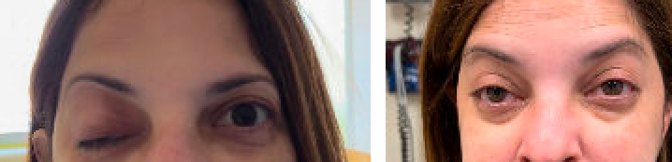
Ongoing history
Significant improvement in symptoms on the second day of intravenous steroid.
Discharged home with slow prednisolone taper over 3 weeks.
March 8th March 30
At Presentation
After day 2 of I/V steroids

Slide 14
Clinic follow up at 8 weeks after initial presentation
Diplopia nearly resolved ( slight only in right gaze)
Intermittent right temple throbbing headache from last 5 days, scale (3-5/10), improves with naproxen.
Scalp tenderness and right ear pain.
Denies vision changes/ jaw pain/ TVO.
Off Prednisone for last 4.5 weeks.

Slide 15
Exam
 | OD | OS
Vision | 20/20-1 (with Ph) | 20/20-2
Pupils | Normal size, shape, reaction, no anisocoria, no RAPD | Normal size, shape, reaction, no anisocoria, no RAPD
Colors | 10/10 | 10/10
EOM | Trace abduction deficit (-0.5) | Full
IOP | 14 | 15
HVF | Full | Full
Cranial nerve examination is normal except for 6th.

Slide 16
Exam
 | OD | OS
External exam | Normal | Normal
Lids | No obvious ptosis, 5/5 Orbicularis action | Normal
Conjunctiva/ sclera | Normal | Normal
Cornea | Clear | Clear
Anterior Chamber | Deep and quiet | Deep and quiet
Iris | Normal | Normal
Lens | Nuclear sclerosis 1+ | Nuclear sclerosis 1+
Disc | Normal | Normal
C:D | 0.4 | 0.4
Macula | Normal | Normal
Vessels | Normal | Normal
Periphery | Normal | Normal

Slide 17
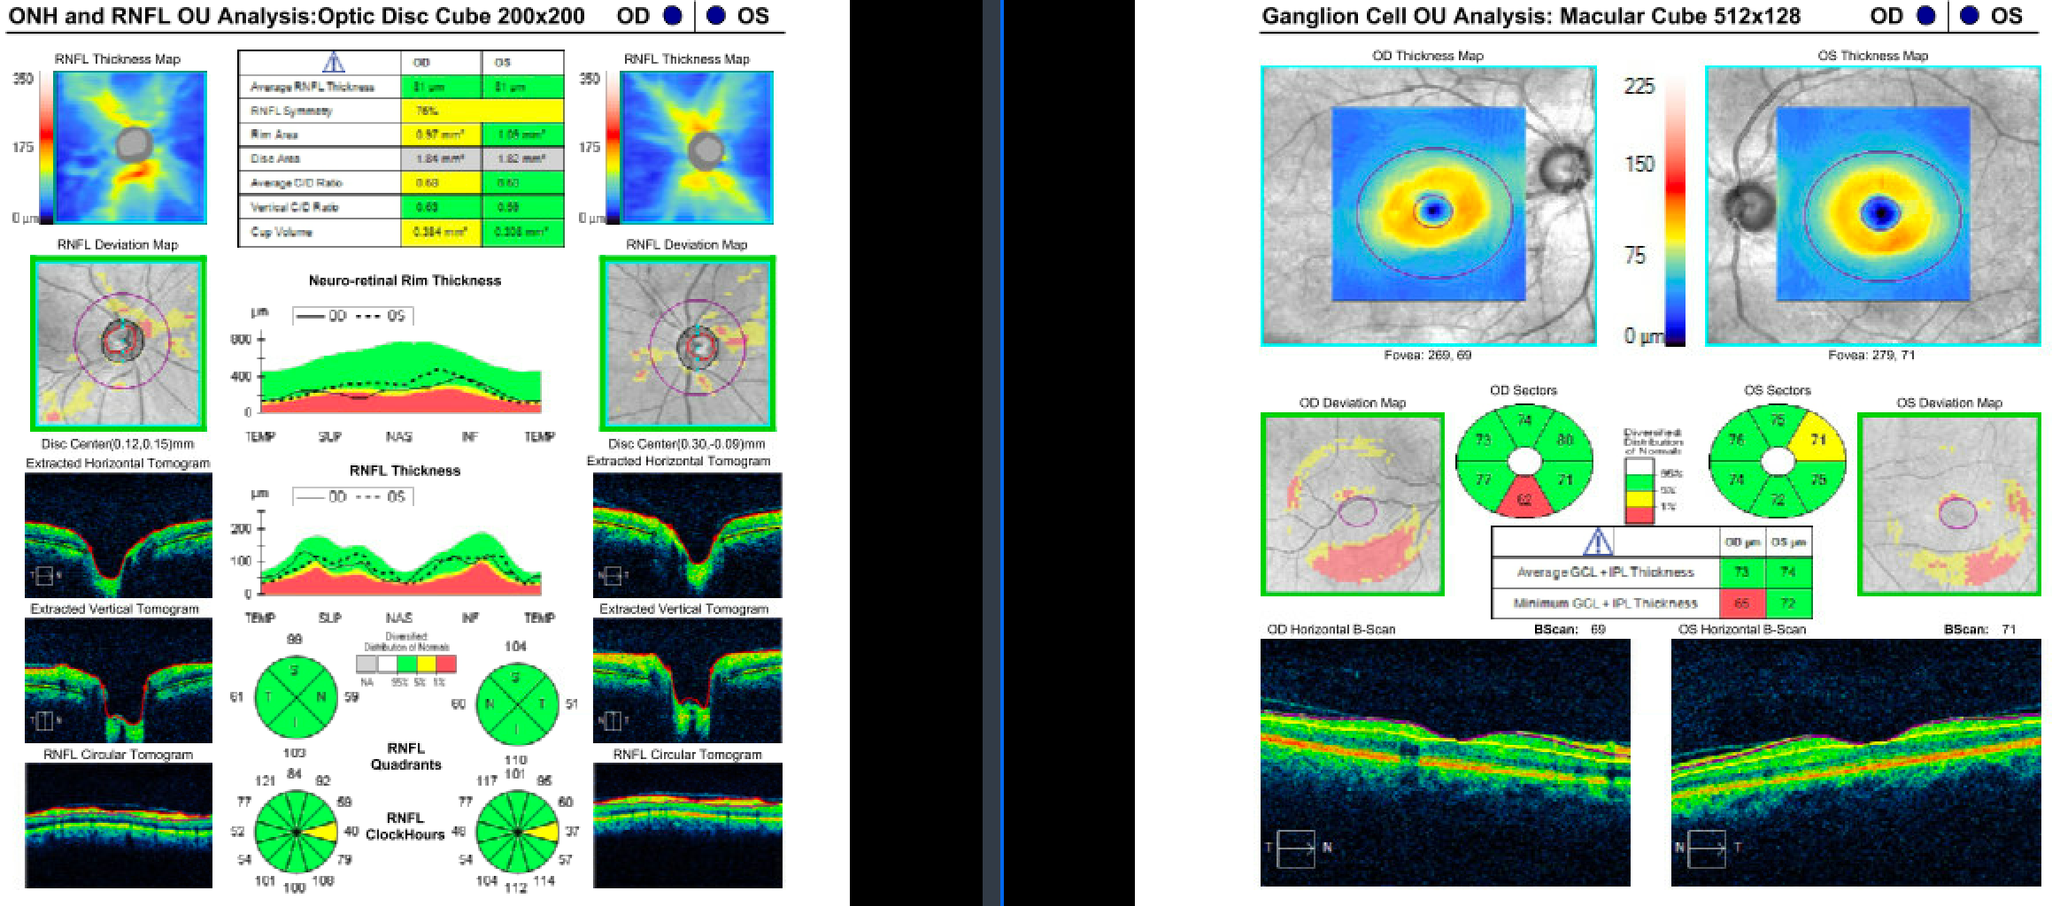
OCT RNFL within normal limits (both eyes)
OCT GCC within normal limits (both eyes)

Slide 18
Any additional investigations at this point?
Repeat ESR & CRP given new Headaches.
Check labs for MOG (myelin oligodendrocyte glycoprotein) Abs which has known to be been associated with orbital inflammation.

Slide 19
How do you want to treat?
Restart prednisone 20 mg and taper by 2.5 every 2 weeks
Symptoms completely resolved with prednisone

Slide 20
ER visit 3 months later
New onset worsening diplopia and outward deviation of the right eye from last 2 days
Bulging of left eye with dull pain from last 1 day
Denies visual acuity changes/ TVO/ headache/ jaw pain/ scalp tenderness/ recent illness/ focal neurological deficit.

Slide 21
Exam
 | OD | OS
Vision | 20/20-2 | 20/20-2
Pupils | Normal size, shape, reaction, no anisocoria, no RAPD | Normal size, shape, reaction, no anisocoria, no RAPD
Colors | 10/10 | 10/10
EOM | Full | Adduction deficit (-2), abduction deficit (-3.5) with LHT 8PD
IOP | 14 | 15
HVF | Full | Full
Exophthalmometry | 23 | 24

Slide 22
Exam
 | OD | OS
External exam | Normal | Normal
Lids | No Ptosis | No Ptosis
Conjunctiva/ sclera | Normal | Normal
Cornea | Clear | Clear
Anterior Chamber | Deep and quiet | Deep and quiet
Lens | Nuclear sclerosis 1+ | Nuclear sclerosis 1+
Disc | Normal | Normal
C:D | 0.4 | 0.4
Macula | Normal | Normal
Vessels | Normal | Normal
Periphery | Normal | Normal

Slide 23
What will you do next?
Repeat infectious and inflammatory workup
Repeat MRI
Repeat LP
PET-CT

Slide 24
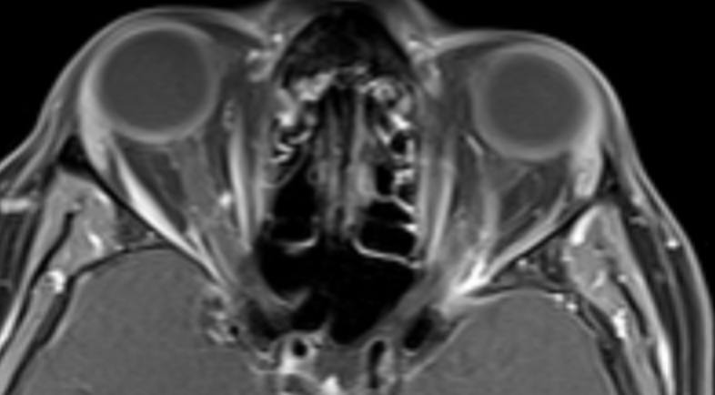
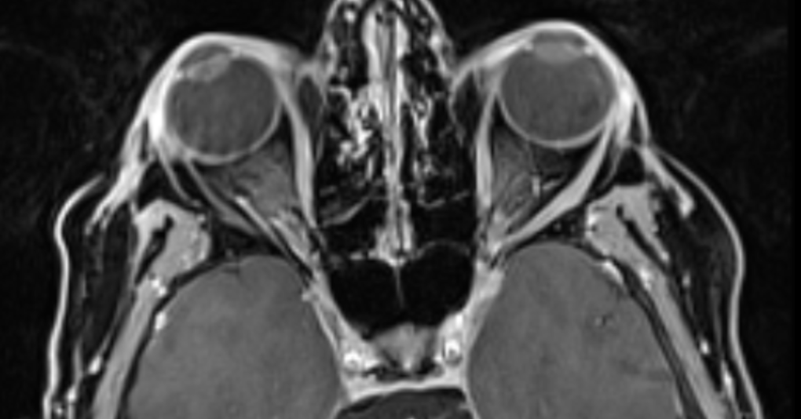
MRI Orbits with and without contrast
T1 post contrast axial view: Left posterior optic nerve sheath enhancement
T1 post contrast axial view: SOF dural thickening, extends to cavernous sinus & foramen ovale

Slide 25
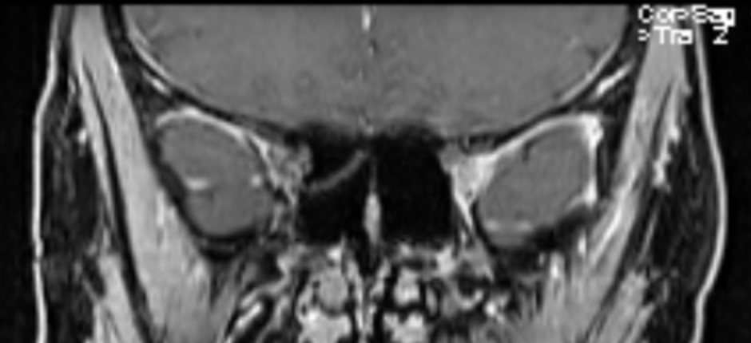
MRI Orbits with and without contrast
T1 post contrast coronal view: Left orbital apex thickening and enhancement

Slide 26
PET scan
Asymmetric relative increased FDG activity is noted of the left ocular muscles & posterior globe. No other suspicious foci.

Slide 27
What do want to do next?
With negative infectious work up start high dose steroids followed by oral taper.

Slide 28
Clinic 1 month follow up
Patient reports significant improvement in her symptoms since her visit in ED.
Still see diagonal diplopia in far-right gaze. No diplopia in primary and down gaze.
No headache/ eye pain/ swelling/ redness. Denies any decrease in vision.
Tapering prednisolone by 10mg every week, taking 30mg/day
Patient was started on mycophenolate 10 weeks after the last flare in consultation with neurology.

Slide 29
Exam
 | OD | OS
Vision | 20/20-1 (with Ph) | 20/20-2
Pupils | Normal size, shape, reaction, no anisocoria, no RAPD | Normal size, shape, reaction, no anisocoria, no RAPD
Colors | 10/10 | 10/10
EOM | Full | Full
IOP | 14 | 15
HVF | Full | Full

Slide 30
Exam
 | OD | OS
External exam | Normal | Normal
Lids | No obvious ptosis, 5/5 Orbicularis action | Normal
Conjunctiva/ sclera | Normal | Normal
Cornea | Clear | Clear
Anterior Chamber | Deep and quiet | Deep and quiet
Iris | Normal | Normal
Lens | Nuclear sclerosis 1+ | Nuclear sclerosis 1+
Disc | Normal | Normal
C:D | 0.4 | 0.4
Macula | Normal | Normal
Vessels | Normal | Normal
Periphery | Normal | Normal

Slide 31
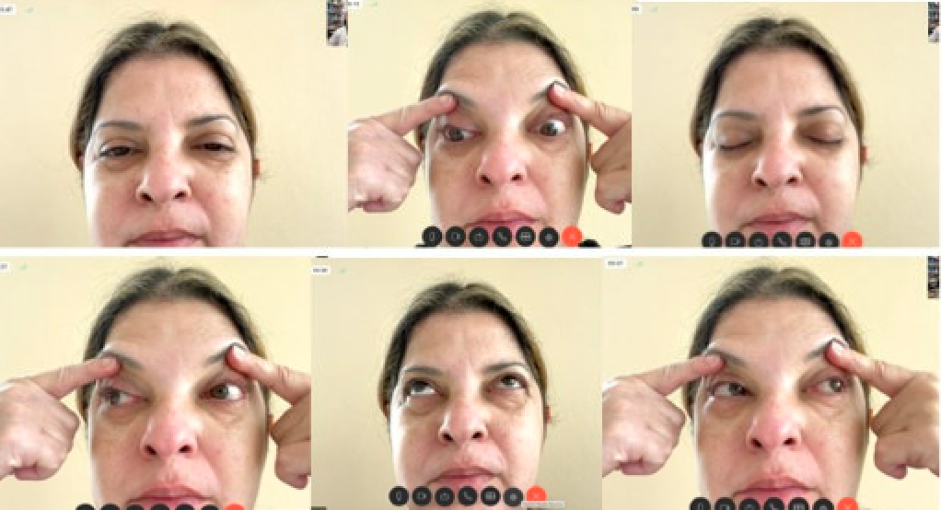
Picture showing Improved EOMs
1 month after the second ER visit

Slide 32
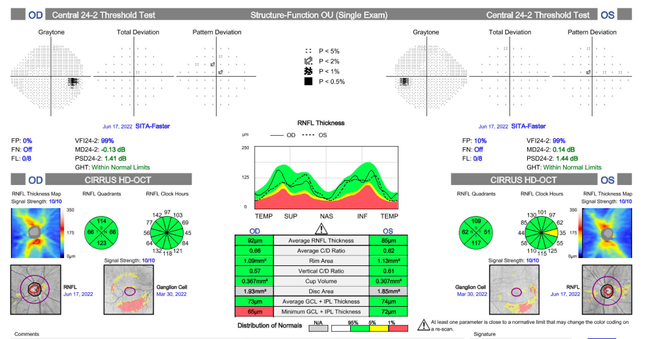

Slide 33
Tolosa Hunt Syndrome
First described in the year 1954 by Dr. Eduardo Tolosa¹, a Spanish neurosurgeon as severe and unilateral periorbital headache associated with painful and restricted eye movements.
Seven years later, Hunt et al² defined a clinical entity “of somewhat obscure aetiology” on the basis of six patients. In one patient surgical exploration of the parasellar region showed all structures to be “intact and healthy”. The authors thought that this syndrome of painful ophthalmoplegia was caused by an inflammatory lesion in the cavernous sinus, as described by Tolosa.
In 1966, Smith and Taxdal³ were the first to apply the eponym “Tolosa-Hunt syndrome” to this entity.

Slide 34
Hunt et al² diagnostic criteria:
Steady pain behind the eye often described as “gnawing” or “boring” may precede the ophthalmoplegia by several days, or may not appear until some time later
Neurological involvement is not confined to the third cranial nerve, but may include the fourth, sixth, and first division of the fifth cranial nerves. Periarterial sympathetic fibres and the optic nerve may be involved.
Symptoms last for days to weeks.
Spontaneous remissions occur, sometimes with residual neurological deficit.
Attacks recur at intervals of months or years.
Exhaustive studies, including angiography and surgical exploration, have produced no evidence of involvement of structures outside of the cavernous sinus. There is no systemic reaction.

Slide 35
Pathogenesis
Usually idiopathic and is thought to be from non-specific inflammation in the region of the cavernous sinus and/or superior orbital fissure¹.
The inflammation produces pressure and secondary dysfunction of the structures within the cavernous sinus, including cranial nerves III, IV, and VI, as well as the superior divisions of cranial nerve V².
While reports of intracranial extension of the inflammation exist¹, there are no reports of systemic involvement⁴.

Slide 36
Epidemiology
The annual estimated incidence is about one case per million per year⁴.
No geographical or racial or gender preponderance.
The average age of onset is 41 years according to the National Organization for Rare Disorder.
Although usually unilateral, either side can be affected, and there have been case reports about bilateral simultaneous/ sequential involvement (approximately 5%)^{5.}

Slide 37
Evaluation
Clinical presentation, neuroimaging studies, and response to steroids.
Laboratory tests and cerebrospinal fluid (CSF) studies - ruling out other causes of ophthalmoplegia.
Tissue biopsy is diagnostic but is considered the procedure of the last choice and rarely performed, given high risk and technical difficulties of cavernous sinus surgery.

Slide 38
International Headache Society (IHS) Diagnostic Criteria
Unilateral headache
Includes both of the following:
Presence of granulomatous inflammation of the cavernous sinus, superior orbital fissure or orbit, as seen on MRI or biopsy
Palsies of one or more of the cranial nerves (III, IV, and/or VI) on the same side
Corroboration of the cause as evidenced by both of the following:
Palsies of cranial nerves III, IV, and/or VI have followed headache in two weeks or less, or have developed simultaneously with a headache
Localization of a headache is ipsilateral to granulomatous inflammation.

Slide 39
Diagnosis
Clinical Diagnosis
Hemicranial headache followed by involvement of one or more of the third, fourth and/or six cranial nerves strongly suggest a lesion in cavernous sinus or subarachnoid space.
Only one nerve may be involved, most likely the sixth cranial nerve, which is the only one not protected within the dural wall of the cavernous sinus.
Neuroimaging
MRI brain with contrast, especially the coronal view, is a crucial diagnostic study.
MR angiography, CT angiography, digital subtraction angiography for vascular abnormalities

Slide 40
Blood study
Complete blood count, Complete metabolic profile, HbA1c (glycated hemoglobin)
Erythrocyte sedimentation rate, C- Reactive protein, Angiotensin converting enzyme, Anti-nuclear antibody, Anti-neutrophil cytoplasmic antibody, Anti-double standard Antibody, Anti- smith Antibody, Rheumatoid factor.
Lyme, Tuberculosis, HIV
CSF studies include glucose, protein, cell count and differential, cytology, culture and gram stain.

Slide 41
Differential Diagnosis
Ischemic disease: Hemorrhage, ischemic mononeuropathy
Infectious process: post viral syndrome, chronic inflammation of petrous bone (recurrent ear infections), syphilis, basal meningitis
Anatomical malformation: aneurysm, AVM, carotid-cavernous fistula, cavernous sinus thrombosis, pseudotumor cerebri, Duane syndrome/Moebius syndrome, Chiari malformation
Inflammatory disease: Sarcoidosis, granulomatosis with polyangiitis (formerly Wegener's), Behcet’s disease, IgG4 Disease
Autoimmune condition: thyroid disease, lupus
Neoplastic disease: meningioma, neurogenic tumor, hemangioma, lymphoma/leukemia, schwannoma, pituitary adenoma, metastasis, CPA lesion, nasopharyngeal carcinoma, chordoma, chondrosarcoma, brain stem glioma in children
Demyelinating disease: MS
Others: Diabetes mellitus, Head trauma, BBPV, Meniere’s, ophthalmoplegic migraine

Slide 42
Treatment of Tolosa Hunt
Glucocorticoids have been the primary treatment for Tolosa-Hunt syndrome since its initial description. However, there is a lack of specific data to provide recommendations regarding dosage, duration, or administration method⁵.
Typically, treatment involves initiating high-dose glucocorticoid therapy for several days, followed by a gradual taper over weeks to months, guided by symptom resolution⁶.
Follow-up imaging studies, such as MRI, may show improvement, but this often lags behind symptomatic relief by a few weeks.
Cranial nerve palsies usually improve over two to eight weeks.
Relapses occur in approximately 40% to 50% of patients and can involve the same side, the opposite side, or both sides. They are more common in younger patients².
Each relapse should be thoroughly investigated, as Tolosa-Hunt syndrome is a diagnosis of exclusion⁷.
For cases resistant to initial treatment, immunosuppressive therapies can be considered, and in refractory cases or those intolerant to these therapies, radiation therapy may be an option.

Slide 43
Follow up
Close clinical follow-up is necessary to be sure the glucocorticoid treatment remains effective, and no evidence of another etiology develops.

Slide 44
How to rule out Sarcoidosis?
Sarcoidosis is a multi-system inflammatory disease that can present similarly to Tolosa-Hunt syndrome, making it crucial to differentiate between the two.
Sarcoidosis may exhibit pulmonary symptoms (dyspnea, cough), skin lesions (erythema nodosum), and ophthalmic manifestations (ophthalmoplegia, uveitis).
Diagnostic differentiation can be aided by lab tests (ACE, lysozyme), PET or Gallium scan, and biopsies.

Slide 45
IgG4 related ocular disease
IgG4 disease closely resembles THS (Tolosa Hunt syndrome) in its eye related symptoms. However, in addition to ocular manifestations, tumefactive lesions are often observed in multiple organs beyond the eyes.
Ophthalmological manifestations of IgG4 disease commonly affects structures such as the orbits, lacrimal gland, and extraocular muscles. Moreover, conditions like hypophysitis and hypertrophic pachymeningitis are other conditions of interest.
Unlike THS, systemic symptoms typically coincide with neuro-ophthalmological manifestations in IgG4 disease. This differentiation became evident as previous cases diagnosed as THS were later identified as IgG4 related due to broader involvement.
A key distinguishing characteristic is its progressive nature and favorable response to immunomodulatory treatment.

Slide 46
References
Tolosa E. Periarteritic lesions of the carotid siphon with the clinical features of a carotid infraclinoid aneurysm. J Neurol Neurosurg Psychiatry 1954;17:300–2.
Hunt WE, Meagher JN, Le Fever HE, et al. Painful ophthalmoplegia. Its relation to indolent inflammation of the cavernous sinus. Neurology 1961;11:56–62.
Smith JL, Taxdal DSR. Painful ophthalmoplegia. the Tolosa-Hunt syndrome. Am J Ophthalmol 1966;61:1466– 72.
Iaconetta G, Stella L, Esposito M, Cappabianca P. Tolosa-Hunt syndrome extending in the cerebello-pontine angle. Cephalalgia. 2005 Sep;25(9):746-50.
Kline LB, Hoyt WF. The Tolosa-Hunt syndrome. J Neurol Neurosurg Psychiatry. 2001 Nov;71(5):577-82.
Sugano H, Iizuka Y, Arai H, Sato K. Progression of Tolosa-Hunt syndrome to a cavernous dural arteriovenous fistula: a case report. Headache. 2003 Feb;43(2):122-6.
Förderreuther S, Straube A. The criteria of the International Headache Society for Tolosa-Hunt syndrome need to be revised. J Neurol. 1999 May;246(5):371-7.
Kapila AT, Ray S, Lal V. Tolosa-Hunt Syndrome and IgG4 Disease in Neuro-Ophthalmology. Ann Indian Acad Neurol. 2022 Oct;25(suppl 2);S83-S90. doi: 10.4103/aian.aian_457_22.Epub 2022 Oct 19. PMID:36589035; PMCID. PMC9795703

