Slide 1


Progressive Blurry Vision & Hearing Loss in a Young Male Patient
Marko Oydanich, MD, MS
Resident Physician
Larry Frohman, MD
Professor of Ophthalmology
Department of Ophthalmology & Visual Science,
Rutgers New Jersey Medical School

Slide 2
26-Year-Old Male with Progressive Blurry Vision
& Hearing Loss
Presents to emergency department with a 2 month history of left-sided blurry vision that is progressive in nature and left-sided hearing loss.

Slide 3
26 year old male with left-sided blurry vision
PMH: Autism spectrum disorder, Asthma, ADHD, HTN
POH: Strabismus surgery at 3 years old with amblyopia of right eye
Medications: Ritalin
Family Hx: Huntington’s disease in mother, maternal aunt, and maternal grandmother
Social Hx: No alcohol or drug use, no recent travel
Patient was previously evaluated by ENT one month prior for hearing loss. Hearing loss was diagnosed as sensorineural and the initial CT scan was read as negative

Slide 4
26 year old male with left-sided blurry vision
ROS
(+) L sided hearing loss
(-) Headache
(-) Lethargy
(-) Weakness
(-) Fevers
(-) Transient visual
obscurations
(-) Diplopia

Slide 5
Initial Evaluation by Ophthalmology
Visual acuity (corrected): 20/80, 20/400
Ishihara Color plates: R: 6/6, L: 4.5/6
Pupils: R: 5=>4, L: 5.5=> 4.5 +1 left APD
EOMs: Ortho in primary gaze, right eye has -1 elevation deficit, left eye normal
IOP: 23, 20
Slit-lamp exam:
  R: narrow interpalpebral fissure (approximately 9 mm) when compared to L, no corneal pathology, anterior/posterior cortical lens changes, vitreous clear
  L: supraorbital lipoma (above left eyebrow), no corneal pathology, lens pigment present on lens capsule
Dilated fundus exam:
  R: Florid disc edema with extension along superior arcade
  L: Florid disc edema, chorioretinal scarring observed in periphery superiorly, temporally, and inferiorly (most likely a chronic finding and not significant). Inferior lesion surrounded by retinal exudates.

Slide 6
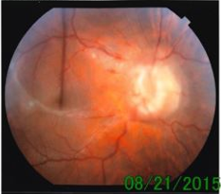
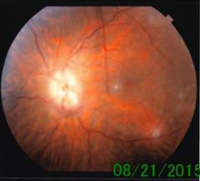
Emergency Room Fundus Exam
Right Eye
Left Eye
What other tests would you like to order?
Optic Disc Edema

Slide 7
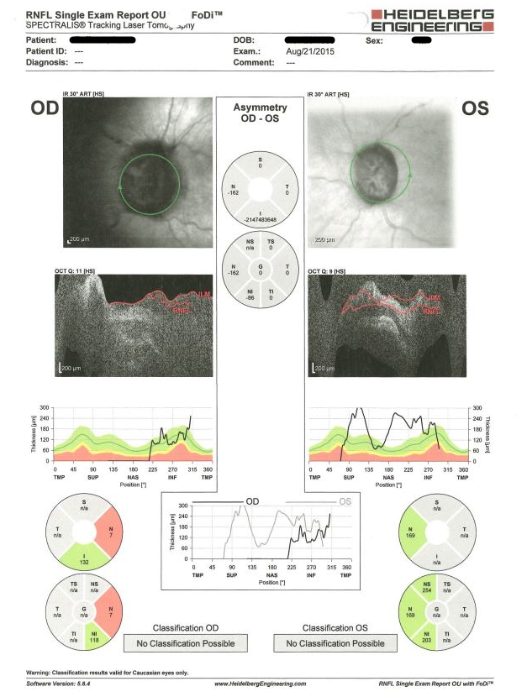
Optical Coherence Tomography – Optic Nerve
Poor quality images due to significant disc edema causing distortion. Poor patient compliance with exam as well.
Elevation of the nerve is appreciated

Slide 8
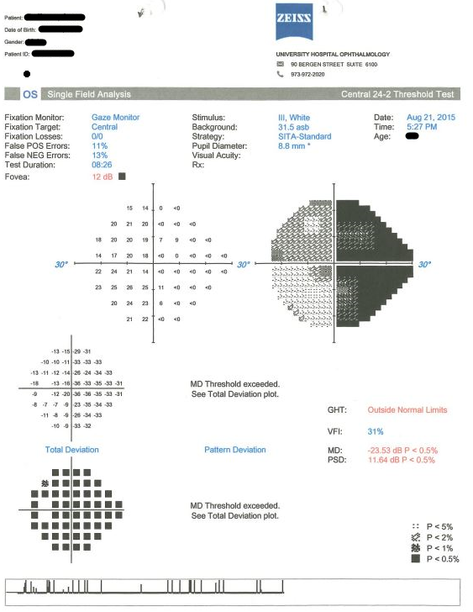
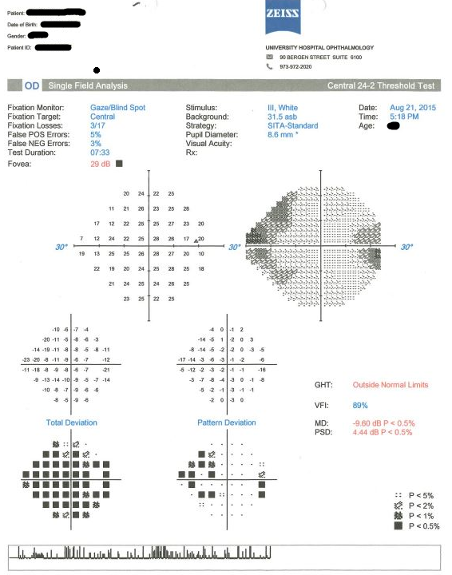
Visual Field Testing
How would you interpret these fields?
Asymmetric nasal defects worse in the left eye than right eye

Slide 9
Lab Results
CBC: WBC 15.5, Hgb 14.9, Plts 338
BMP: Na 137, K 4.4, Cl 100, CO2 22, BUN 8, Cr 0.7
PT/PTT: WNL
ESR: 8
CRP: 13
Lyme: negative
Quantiferon TB Gold: negative
RPR: negative
Any neuroimaging?

Slide 10
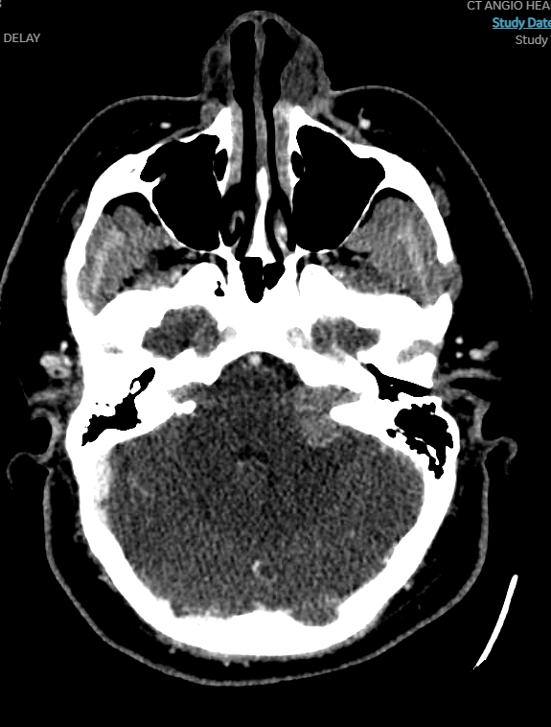
Imaging: CT Head with Contrast
What do you see here?
Vestibular Schwannoma
Vestibular
Schwannoma
It should be stated that this patient was extremely claustrophobic and would only agree to a stand-up MRI to be done at an outside facility

Slide 11
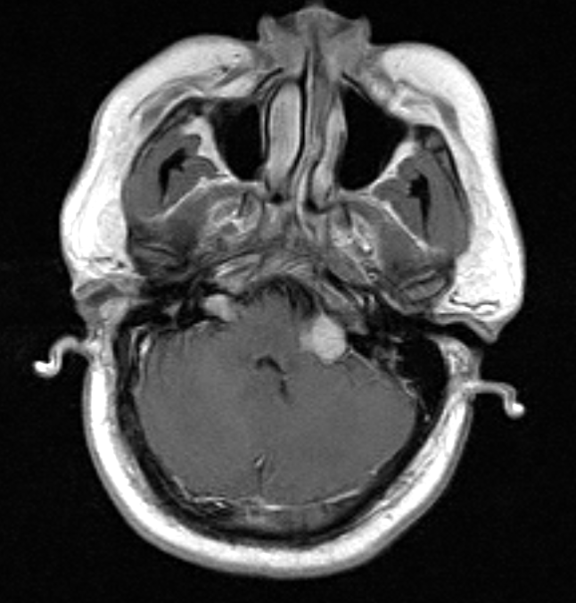
Imaging: Stand-Up MRI Brain w/ & w/o Contrast
Axial T1
Bilateral Vestibular
Schwannomas

Slide 12
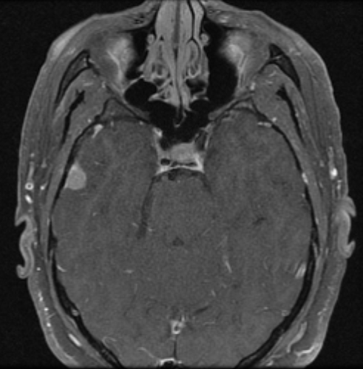
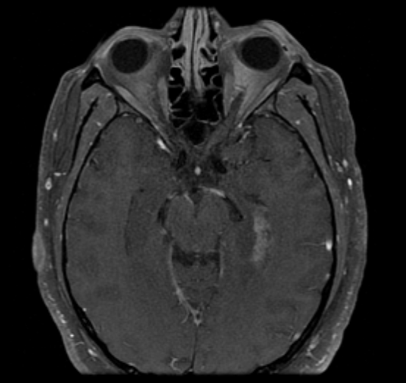
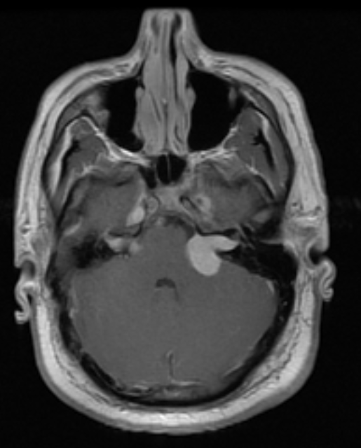
Imaging: Stand-Up MRI Brain w/ & w/o Contrast
Axial T1 (IAC)
Meningioma
Intraventricular Meningioma
Additional meningioma

Slide 13
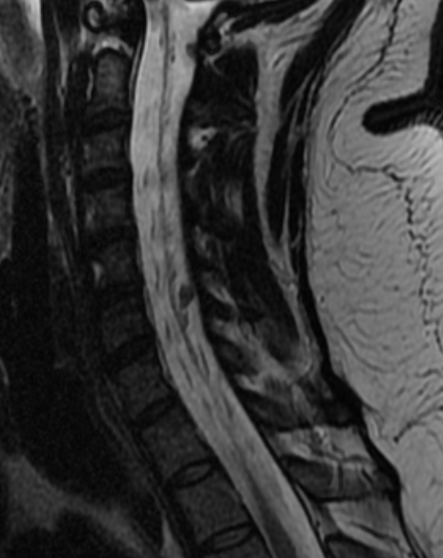
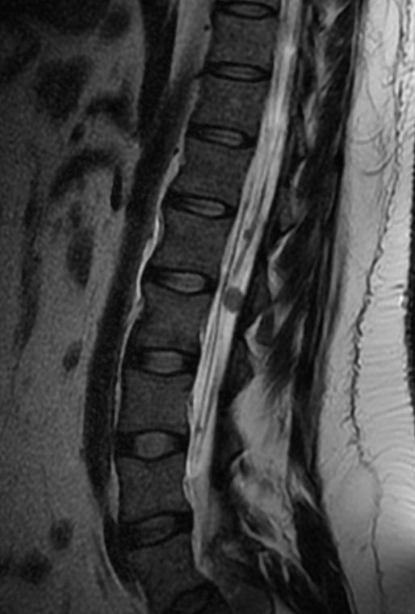
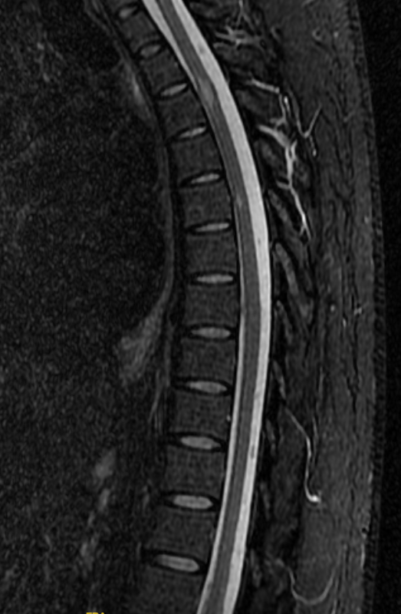
Imaging: MRI of the Cervical, Thoracic, and Lumbar Spine With & Without Contrast
Schwannomas
Intramedullary Ependymomas

Slide 14
Lumbar Puncture
Lumbar puncture (LP) was attempted
Clear cerebrospinal fluid (CSF) was obtained, however, only 1-2 drops of fluid were collected
No opening pressure was obtained and there was not enough fluid for CSF analysis
Given all of this information what is your differential diagnosis?

Slide 15
Differential Diagnoses
Neurofibromatosis Type 2
Multiple meningiomatosis
Tuberous sclerosis
Other brain tumor or metastasis
Venous sinus thrombosis or stenosis
Jugular vein compression
Choroid plexus papilloma

Slide 16
Hospital Course
Plan:
  Patient was started on 500 mg Diamox BID due to bilateral optic disc swelling which was believed to be caused by interference with venous sinus drainage by intracranial masses
  Referral to neurosurgery was made for further evaluation and intervention with the decision to proceed with resection of the left vestibular schwannoma through a retrosigmoid transtemporal skull-base approach

Slide 17
Post-operative Visit (1 Month Post-op)
Visual acuity (corrected): 20/40, 20/150
Pupils: R: 6=>4, L: 6.5=> 4.5 +2 left APD
Color plates: R: 6/6, L: 1.5/6
Dilated fundus exam:
  Defervescing disc edema

Slide 18
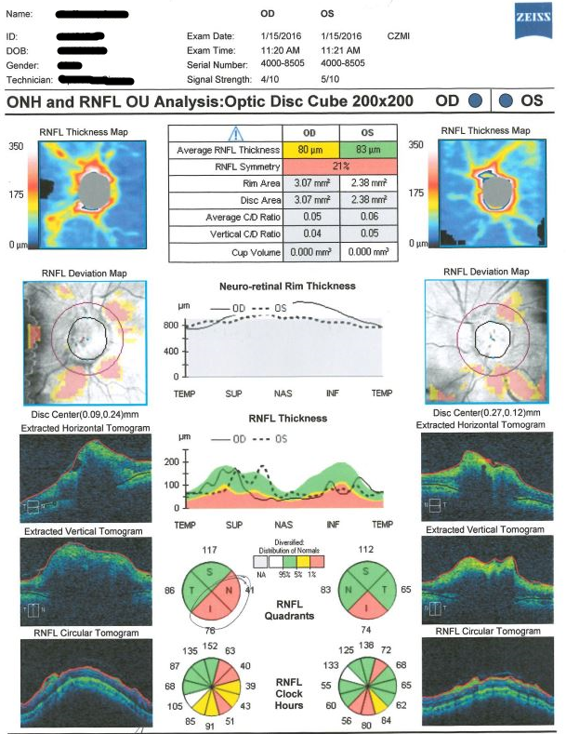
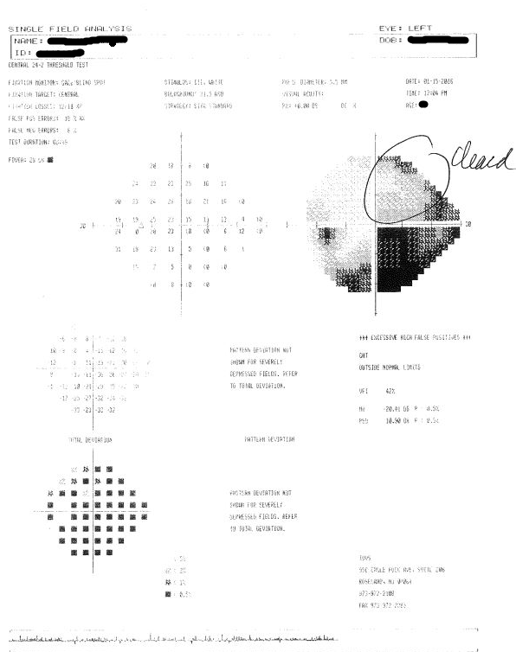
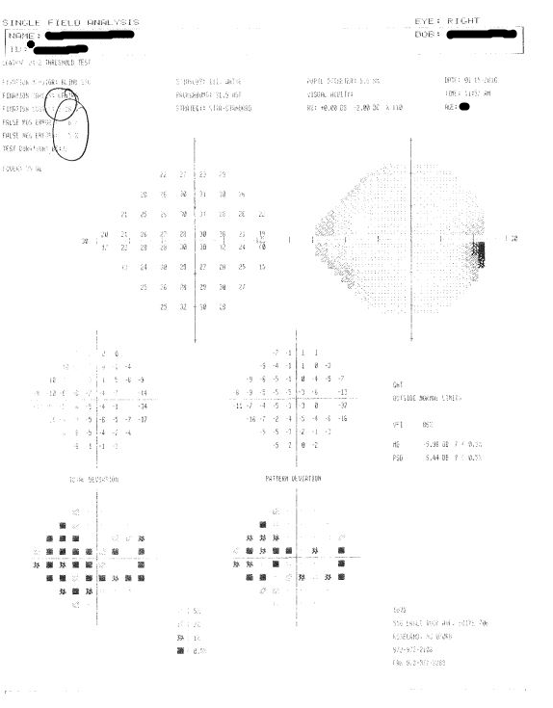
Post-operative 1-Month Testing

Slide 19
Neurofibromatosis Type 2
  Autosomal dominant disorder characterized by the development of multiple tumors involving the CNS
  Common features of NF-2 include bilateral vestibular acoustic neuromas, spinal and cerebral tumors including meningiomas & ependymomas, and early onset cataracts (usually bilateral)
  Patients usually present with tinnitus, sensorineural hearing loss, and increased intracranial pressure depending on the size of the CNS tumors

Slide 20
Etiology & Epidemiology
  Mutation of the tumor suppressor gene NF2, located on chromosome 22q12
  This gene encodes the protein merlin which regulates various mitogenic signaling pathways including PI3K and MAP kinase
  Birth incidence of 1 in 25-33,000

Slide 21
Back to the case: Clinical Course
Patient was re-evaluated 2 months postoperatively
Subjectively, patient felt vision was improving. Denied any headaches, hearing loss, tinnitus, or TVOs
BCVA: 20/40, 20/100
Pupils: R: 6=>4, L: 6=> 4 +2 left APD
Color plates: R: 5.5/6, L: 1.0/6 (unchanged from previous)
Dilated fundus exam:
  No optic nerve swelling appreciated
  Optic nerve pallor observed OU
Plan: Follow-up in 4 months and be evaluated by oncologist for further management
Is there any additional therapy we can give post-operatively?

Slide 22
Management & Treatment
  Often requires multidisciplinary management including ophthalmologists, neurosurgeons, oncologists, and neuroradiologists
  Surgical resection of large symptomatic vestibular schwannomas is the primary treatment. Spinal cord ependymomas are usually low-grade tumors and are monitored until symptoms appear
  Bevacizumab (Avastin), a monoclonal antibody against vascular endothelial growth factor (VEGF) has been shown to induce tumor regression and control symptoms in patients with NF2 (partial volumetric tumor response seen in 39% of treated NF2 patients, Morris et al. 2016)

Slide 23
Back to the case: Clinical Course
Patient was started on IV Avastin (5mg/kg) therapy 4 months post-operatively (managed by his oncologist). He received bi-weekly treatments and annual MRI scans for tumor surveillance
MRI scans consistently showed stable tumors and his ophthalmic exams showed improvement.

Slide 24
Back to the case: Clinical Course
Visual acuity stabilized to 20/40, 20/100 with stable color vision and fundus findings
Fundus exam showed pale nerves OU with no evidence of swelling
OCT-N and HVF testing while grossly unreliable for left eye stabilized with no change or worsening of visual field defects

Slide 25
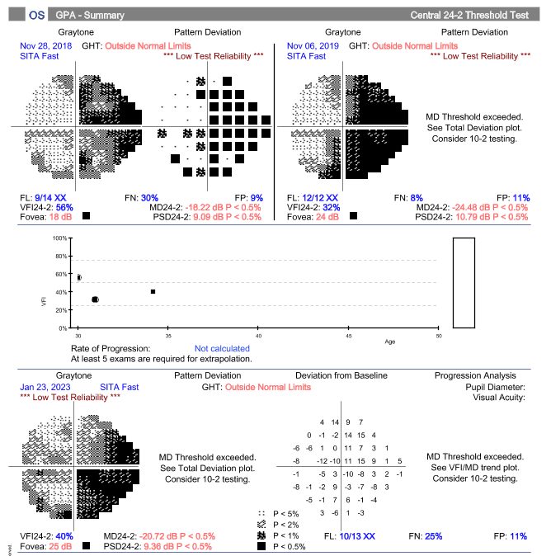
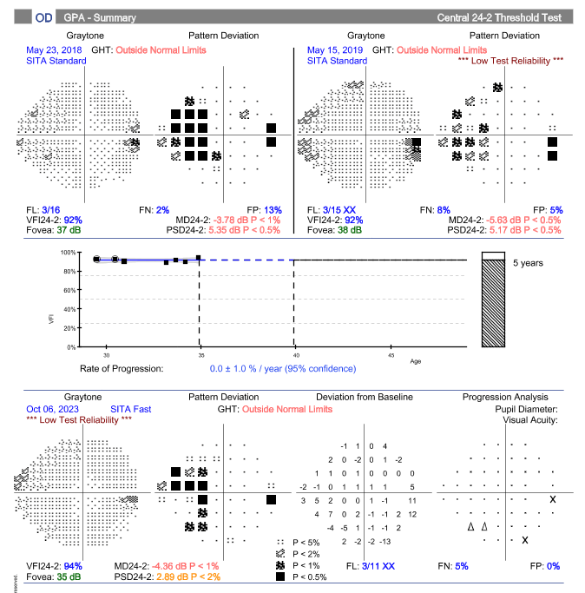
Back to the case: Clinical Course
Although poor reliability, judged to have stable visual fields

Slide 26
Back to the case: Clinical Course
After being treated with Avastin for 6 years the patient began to develop hypertension and a rising creatinine level
Avastin was discontinued due to nephrotoxicity, confirmed on elective renal biopsy
After being off Avastin for 8 months, patient began to experience hearing loss on right side (consistent with enlarging, right-sided acoustic neuroma not removed surgically) and was referred to radiation oncology for further management
Patient was recommended to undergo CyberKnife radiosurgery of right acoustic neuroma due to tumor enlargement

Slide 27
Summary: Neurofibromatosis type 2 may present with signs of intracranial pressure, providing a pivotal role for neuro-ophthalmology
Although papilledema is not always a presenting sign for patients with NF-2, patients should be frequently evaluated for visual changes that may suggest optic nerve swelling and receive the appropriate imaging and multidisciplinary care.

Slide 28
References
Dinh CT, Nisenbaum E, Chyou D, Misztal C, Yan D, Mittal R, Young J, Tekin M, Telischi F, Fernandez-Valle C, Liu XZ. Genomics, Epigenetics, and Hearing Loss in Neurofibromatosis Type 2. Otol Neurotol. 2020 Jun;41(5):e529-e537. doi: 10.1097/MAO.0000000000002613. PMID: 32150022; PMCID: PMC7547625.
Gürsoy S, Erçal D. Genetic Evaluation of Common Neurocutaneous Syndromes. Pediatr Neurol. 2018 Dec;89:3-10. doi: 10.1016/j.pediatrneurol.2018.08.006. Epub 2018 Aug 10. PMID: 30424961.
Asthagiri AR, Parry DM, Butman JA, Kim HJ, Tsilou ET, Zhuang Z, Lonser RR. Neurofibromatosis type 2. Lancet. 2009 Jun 6;373(9679):1974-86. doi: 10.1016/S0140-6736(09)60259-2. Epub 2009 May 22. PMID: 19476995; PMCID: PMC4748851.
Morris KA, Golding JF, Axon PR, Afridi S, Blesing C, Ferner RE, Halliday D, Jena R, Pretorius PM; UK NF2 Research group; Evans DG, McCabe MG, Parry A. Bevacizumab in neurofibromatosis type 2 (NF2) related vestibular schwannomas: a nationally coordinated approach to delivery and prospective evaluation. Neurooncol Pract. 2016 Dec;3(4):281-289. doi: 10.1093/nop/npv065. Epub 2016 Jan 7. PMID: 29692918; PMCID: PMC5909937.
Mautner VF, Nguyen R, Kutta H, Fuensterer C, Bokemeyer C, Hagel C, Friedrich RE, Panse J. Bevacizumab induces regression of vestibular schwannomas in patients with neurofibromatosis type 2. Neuro Oncol. 2010 Jan;12(1):14-8. doi: 10.1093/neuonc/nop010. Epub 2009 Oct 20. PMID: 20150363; PMCID: PMC2940556.
Morris KA, Golding JF, Axon PR, Afridi S, Blesing C, Ferner RE, Halliday D, Jena R, Pretorius PM; UK NF2 Research group; Evans DG, McCabe MG, Parry A. Bevacizumab in neurofibromatosis type 2 (NF2) related vestibular schwannomas: a nationally coordinated approach to delivery and prospective evaluation. Neurooncol Pract. 2016 Dec;3(4):281-289. doi: 10.1093/nop/npv065. Epub 2016 Jan 7. PMID: 29692918; PMCID: PMC5909937.

