Slide 1


Spin Class Spins Unexpected Diagnosis
Frances M de la Camara, MD
Caitlin Tedeschi, BS
Timothy Martin, MD
Notes:
Hello. This case is brought to you by the Journal of Neuro-ophthalmology and the North American Neuro-ophthalmology society. My name is Frances de la Camara and I am an ophthalmology resident at Atrium Wake Forest Baptist Medical center. This case is about a young patient with vision changes in spin class.

Slide 2
27 year old female presents to the ED with vision change in her left eye
Patient describes an episode of bright sparking lights in the left eye, worse with exertion and relieved with rest during spin class. After class the patient noted the vision was gray in her left eye which prompted ED visit.

Slide 3
History continued:
Patient noted headaches the week prior, which she attributed to upcoming exams. Hx of a single migraine years prior with visual aura, not on abortive medications, not following with Neurology. Had a headache night prior to presentation however no headache on day of presentation.
No pain with EOMs
No floaters, no recent trauma
Ocular history: myopia, wears corrective lenses and CL
Family history: mother with RP

Slide 4
Neuro-ophthalmic exam:
Visual Acuity: 20/20 OD, 20/20 OS
External Examination:
  Right pupil: 6 (dark) --> 4 (light)
  Left pupil: 4 (dark) --> 3 (light)
  1.5 mm left ptosis
  No facial anhidrosis
EOMs full in all gazes OU
Slit Lamp Examination: WNL OU
Confrontation Visual Fields: normal OU
Fundus Examination: normal OU
Given these findings, which pupil is abnormal?

Slide 5
Pupil with difference greater in darkness suggests smaller pupil is abnormal

Slide 6
What is your leading diagnosis?

Slide 7
Acute Left Horner Syndrome
...What would you like to do next?
CTA head and neck OR MRA head and neck with T1 MRI of neck is required in evaluation of an acute Horner syndrome
Notes:
Do you want to say “or MRA”

Slide 8
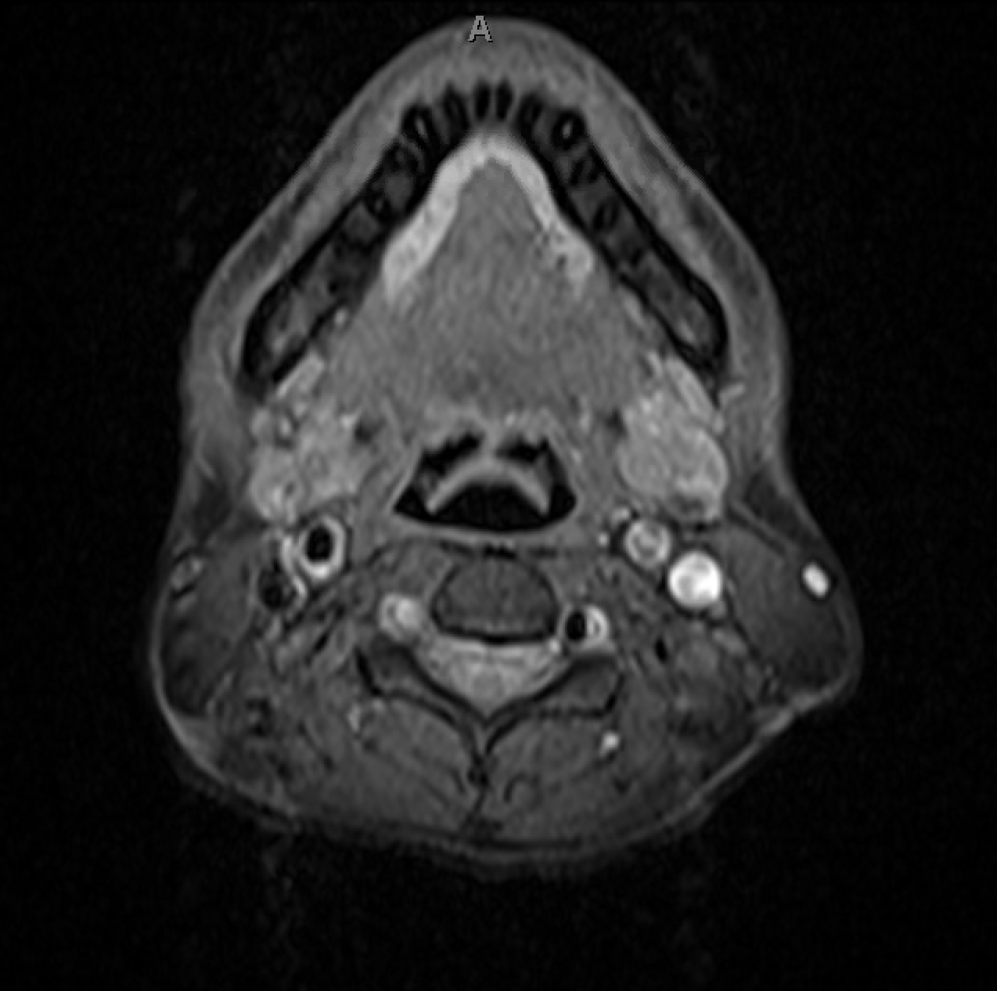
MRA from our patient. What do you notice? If not sure, compare left and right sided structures

Slide 9
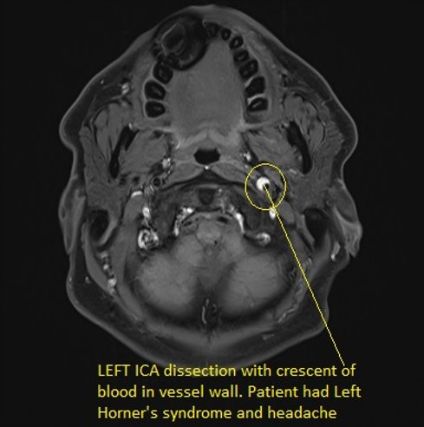
Representative image from a patient with Horner syndrome and headache:

Slide 10
Evaluation:
CTA: left cervical internal carotid dissection
MRI: small L frontal lobe cortical infarct
Labs: CBC, CMP, A1C, lipids, RPR, ESR, CRP, homocysteine, C3, C4, ANA, UDS, anca, HIV- all within normal limits
Genetic testing: TGF8R2 (uncertain significance)
  Associated with AD Loeys-Dietz syndrome 2 (rare; connective tissue disorder) and non-syndromic thoracic aortic aneurysms
Notes:
r/o infectious causes of hypercoagulable state
homocysteine was collected to rule out homocystineuria as cause of thromboembolic dz/vascular dz
C3/C4, ESR, CRP were collected to evaluate for auto immune etiology of hypercoagulable state

Slide 11

What is the classic triad of a Horner syndrome?

Slide 12
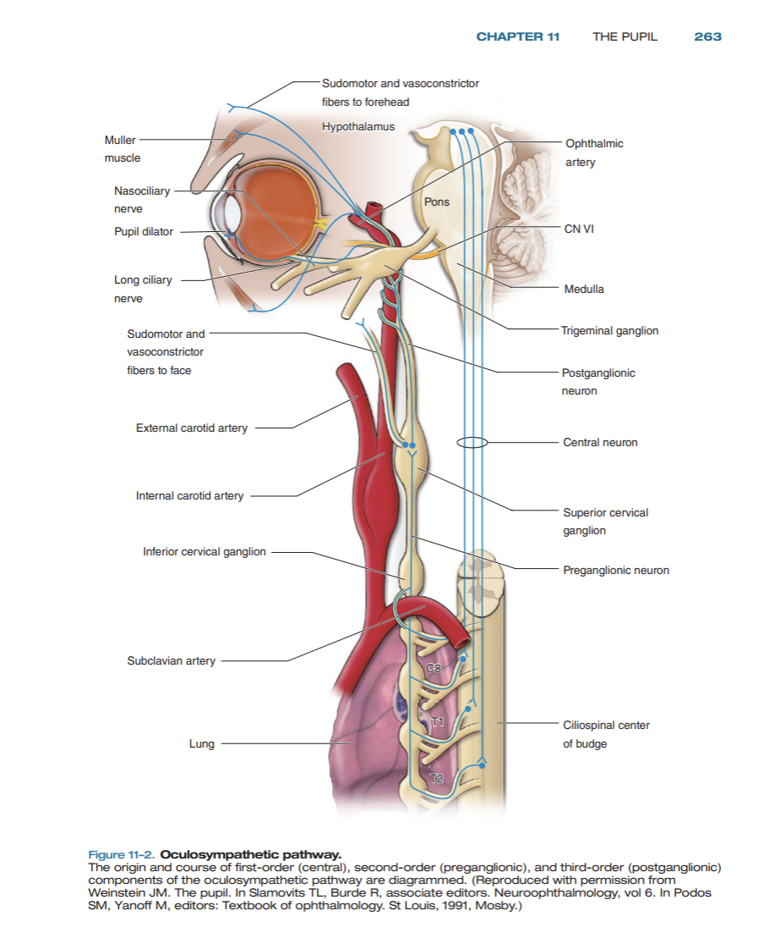
Horner Syndrome, Oculo-sympathetic paresis:
Classic triad of (1) miosis, (2) ptosis (3) facial anhidrosis
Anisocoria most prominent in the dark – small pupil with dilation lag
  Dilation lag: In the dark, the normal pupil dilates; the Horner pupil will also dilate, but very slowly, as the constrictor muscle is “turned off”. After 5-10 seconds in the dark anisocoria is most notable. Eventually, the anisocoria slowly diminishes as the sympathetically-denervated pupil continues to dilate approaching the size of the normal pupil.
  Ptosis: secondary to paresis of Muller's muscle
  Anhidrosis: interruption of sympathetic pathway at level of superior cervical ganglion or more proximally as it may interrupt vasomotor and sudomotor innervation to the face

Slide 13
The Oculo-sympathetic pathway is a 3 neuron chain. Where would you expect an internal carotid dissection to be located on the oculo-sympathetic chain?

Slide 14
In the Oculo-sympathetic Chain:
First order neuron runs from posterolateral hypothalamus, through the brainstem, to the ciliospinal center of budge (~C8-T2)
Second order neuron (pre-ganglionic) runs from ciliospinal center of budge, exits spinal cord around T1 around the apex of the lung, courses around the subclavian artery, and finally arrives to the superior cervical ganglion at the carotid bifurcation (C3-C4).
Third order neuron (post-ganglionic) travels from the superior cervical ganglion through the cavernous sinus and then ultimately reaches the pupil. Some fibers travel along the external carotid to supply vasomotor and sudomotor innervation to the face

Slide 15
Internal Carotid Dissection:
Pathology located at post-ganglionic neuron/third order neuron
Occurs when tears in the intimal layer of the vessel allow blood to dissect the arterial wall creating a false lumen, narrowing the lumen and ultimately occluding arterial branches
Symptoms include (but are not limited to): neck pain, throat pain, facial pain, or headache, and pain may be migratory. If left untreated, the dissection continues to propagate, distal branches may become fully occluded and possible stroke may occur. Prompt identification is crucial.

Slide 16
Acquired Horner Syndrome ddx:
First order:
  Tumor, hemorrhage or infarction in hypothalamus, mesencephalon, pons
  Demyelinating lesion in spinal cord, syringomyelia
  Stroke in medulla – Wallenburg syndrome
Second order:
  Thoracic cavity: Pancoast tumor, metastatic disease, mediastinal mass, chest surgery, thoracic aneurysm, central vascular access
  Neck: Trauma, abscess, LAD, thyroid neoplasm, thyroidectomy, radical neck surgery, central vascular access
Third order:
  Carotid artery plexus, superior cervical ganglion: Carotid artery dissection or thrombosis, trauma
  Cavernous sinus, superior orbital fissure, orbit: CC-fistula, nasopharyngeal carcinoma
  Cluster HA, microvascular ischemia, GCA, autonomic neuropathies

Slide 17

Pharmacologic testing:
Apraclonidine testing:
  Mechanism of action (MOA): ?
  What signifies a (+) test?
Cocaine testing:
  Mechanism of action (MOA): ?
  What signifies a (+) test?
Notes:
the evaluation of a horner syndrome includes pharmacologic testing.

Slide 18

Pharmacologic testing
Apraclonidine testing:
  MOA: apraclonidine is a direct alpha adrenergic receptor agonist. It has weak alpha 1 affinity in a normal eye. However, it will dilate a pupil in an eye with a Horner's due to upregulation of post junctional adrenergic receptors in the sympathetically denervated pupillary dilator muscles. In other words, apraclonidine causes reversal of anisocoria. Testing may be falsely negative early in the course as it takes a few weeks for upregulation of receptors.
  Test is (+) if there is reversal of anisocoria (pupil will dilate)
Cocaine testing:
  MOA: Norepinephine (NE) is the neurotransmitter at the synapse of the 3rd order neuron and iris dilator muscle. Topical cocaine blocks reuptake of NE. If there is no NE in the synapse --> pupil won't dilate. Cocaine tells you there is a defect somewhere in the chain; testing accurate immediately unlike apraclonidine.
  Test is (+) if the abnormal pupil fails to dilate as much as normal pupil

Slide 19
Take home message:
The oculo-sympathetic pathway is a long path from the brain to the pupil; which in turn creates a long and broad differential for a Horner syndrome
An acute Horner syndrome warrants emergency imaging (such as CTA head and neck or MRA head and neck) to evaluate for etiology and obtain further imaging as indicated. As in our case, MRI brain was obtained.
Although a Horner syndrome is a triad of ptosis, miosis, and anhidrosis, as in our patient, anhidrosis is not always present if the lesion is distal to the superior cervical ganglion

Slide 20
References:
ACS Chem. Neurosci. 2018, 9, 2, 177–186. Publication Date: December 20, 2017
Martin T, Corbett J. Practical Neuroophthalmology. McGraw Hill Professional; 2013.
Sung-Min Cho, Rodica Di Lorenzo, Jason Mathew, Andrew B. Buletko. Neurology Oct 2017, 89 (14) e174-e175; DOI: 10.1212/WNL.0000000000004540
M.D. DDO. Carotid dissection. Stroke Medicine for Stroke Physicians and Neurologists. Accessed October 11, 2023. https://neurovascularmedicine.com/carotiddissection.php.
Galapp C. Sympathetic pathway. American Academy of Ophthalmology. December 6, 2013. Accessed October 11, 2023. https://www.aao.org/education/image/sympathetic-pathway-3.
Notes:
These are references where you can learn more about the oculo-sympathetic pathway

