Slide 1


Sequential Optic Neuritis hic…hic…hic…
Daisy Liu MD and Imran Jivraj MD, FRCSC (Department of Ophthalmology and Visual Science, University of Alberta)
Acknowledgement - Dr. Scott Haines for contributing MRI images in Discussion

Slide 2
44-Year-Old Man with Severe Vision Loss
CC: 3 weeks of painful eye movement and 1 week of decreasing vision in right eye

Slide 3
44-Year-Old Man with Severe Vision Loss
Past Medical History
  Seropositive ocular myasthenia gravis with thymectomy (2009), in remission
  Episode of intractable hiccups lasting >24 hours 4-5 years ago which prevented him from boarding a flight, never investigated
Medications
  Mestinon (60mg/d) BID
  Vitamins C and D, omega-3, Zinc
Family history
  Benign paroxysmal positional vertigo (mother)
  No neurologic or autoimmune disorders
Social history
  South Asian with frequent travel to India, non-smoker, married with three children

Slide 4
44-Year-Old Man with Severe Vision Loss
HPI
June 2020 – Patient presented to On-Call Ophthalmologist for urgent assessment
  Painful eye movements, darkening of vision in the right eye for the past week
On examination:
  VA: Counting Fingers OD, 20/20 OS
  Pupils: 3+ relative afferent pupillary defect OD
  Ishihara Color Plates: 0/17 OD, 17/17 OS
  Peripheral confrontational visual fields full in both eyes; dense central scotoma OD
  Full extraocular movements with pain OD in all gazes, worse with left gaze
  Moderate disc edema OD, otherwise normal fundus examination OU
Timeline
Right Vision Loss
June 2020

Slide 5
What is your next step?
A. Take to the OR for orbital decompression surgery
B. Order an MRI Brain and Orbits with and without contrast
C. Obtain a spinal tap for cerebrospinal fluid analysis
D. Perform intravitreal injection of anti-VEGF molecule

Slide 6
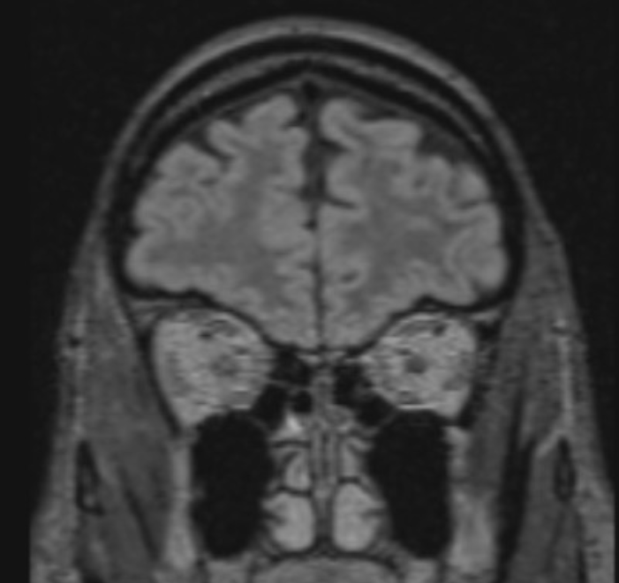
Answer: B! MRI Brain and Orbits
Coronal T2-FLAIR without contrast
July 2020
Unfortunately, MRI was performed without contrast
Coronal FLAIR images shows mild central hyperintensity in right optic nerve
Few scattered white matter lesions including juxtacortical lesions and subtle linear lesion within deep white matter of left parietal lobe
Raised concern for possible demyelinating process
Slight hyperintensity of right intraorbital optic nerve (arrow) on non-contrast coronal FLAIR MRI

Slide 7
Diagnosis: Right Optic Neuritis
Treated with IV 1g Methylprednisolone daily x 3 days immediately following presentation with oral prednisone 40mg daily with taper
Workup :
  Anti-Aquaporin-4 (cell-based assay) – negative, MOG – negative
  Sarcoid, Syphilis, Autoimmune panel – negative
  Lumbar puncture – normal cell count, protein, cultures, no oligoclonal bands
Timeline
3 days IVMP
June 2020

Slide 8
Follow-Up: Right Optic Neuritis
Poor visual recovery (V_{A} = Counting Fingers) with persistent central scotoma OD two months following presentation (August 2020)
Referred to Neuro-Ophthalmology
  NMO/MOG Panel Repeated, normal
Treated with 6 sessions of Plasmapheresis (August 2020)
Timeline
Referred to Neuro-Ophthalmology, Plasmapheresis
August 2020

Slide 9
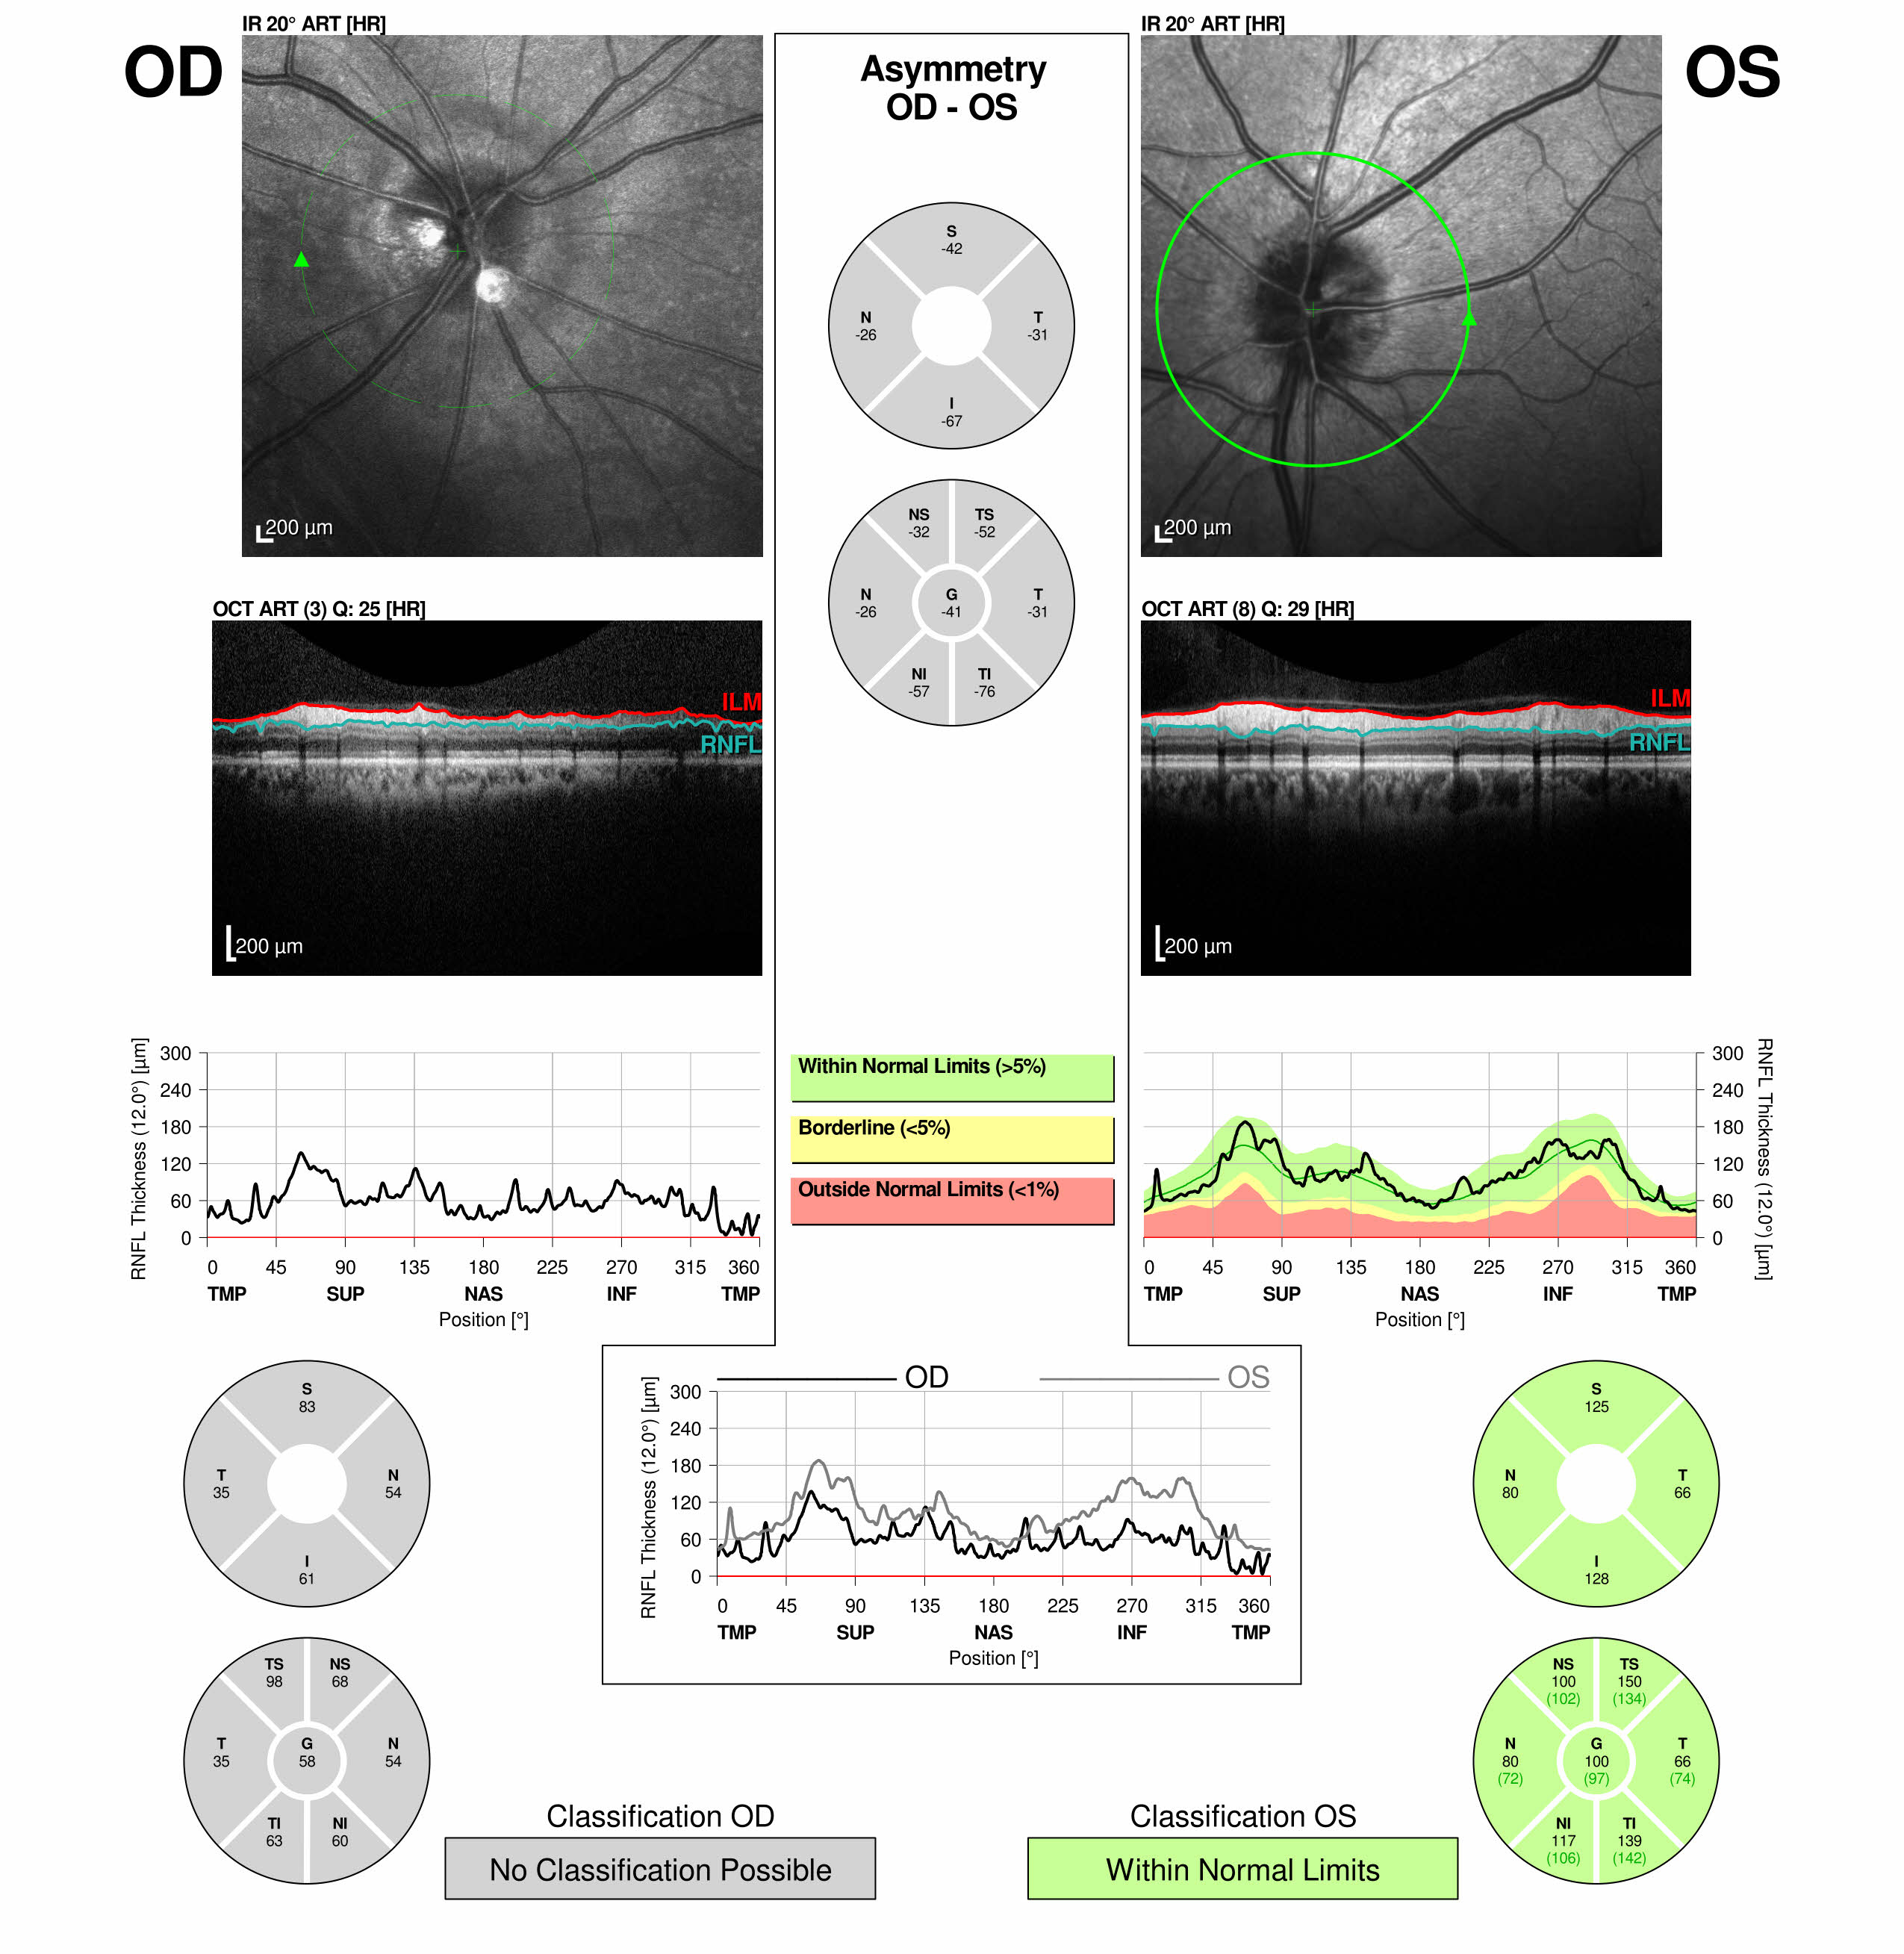
December 2020
- “My vision has not improved in the right eye!”
- Vision 20/400 OD and 20/20 OS
- Persistent 3+ Right APD
- Development of right optic disc pallor
Note: OCT unable to perform peri-papillary RNFL measurements on the right (absent green circle) because of poor fixation as a result of patient’s central scotoma

Slide 10
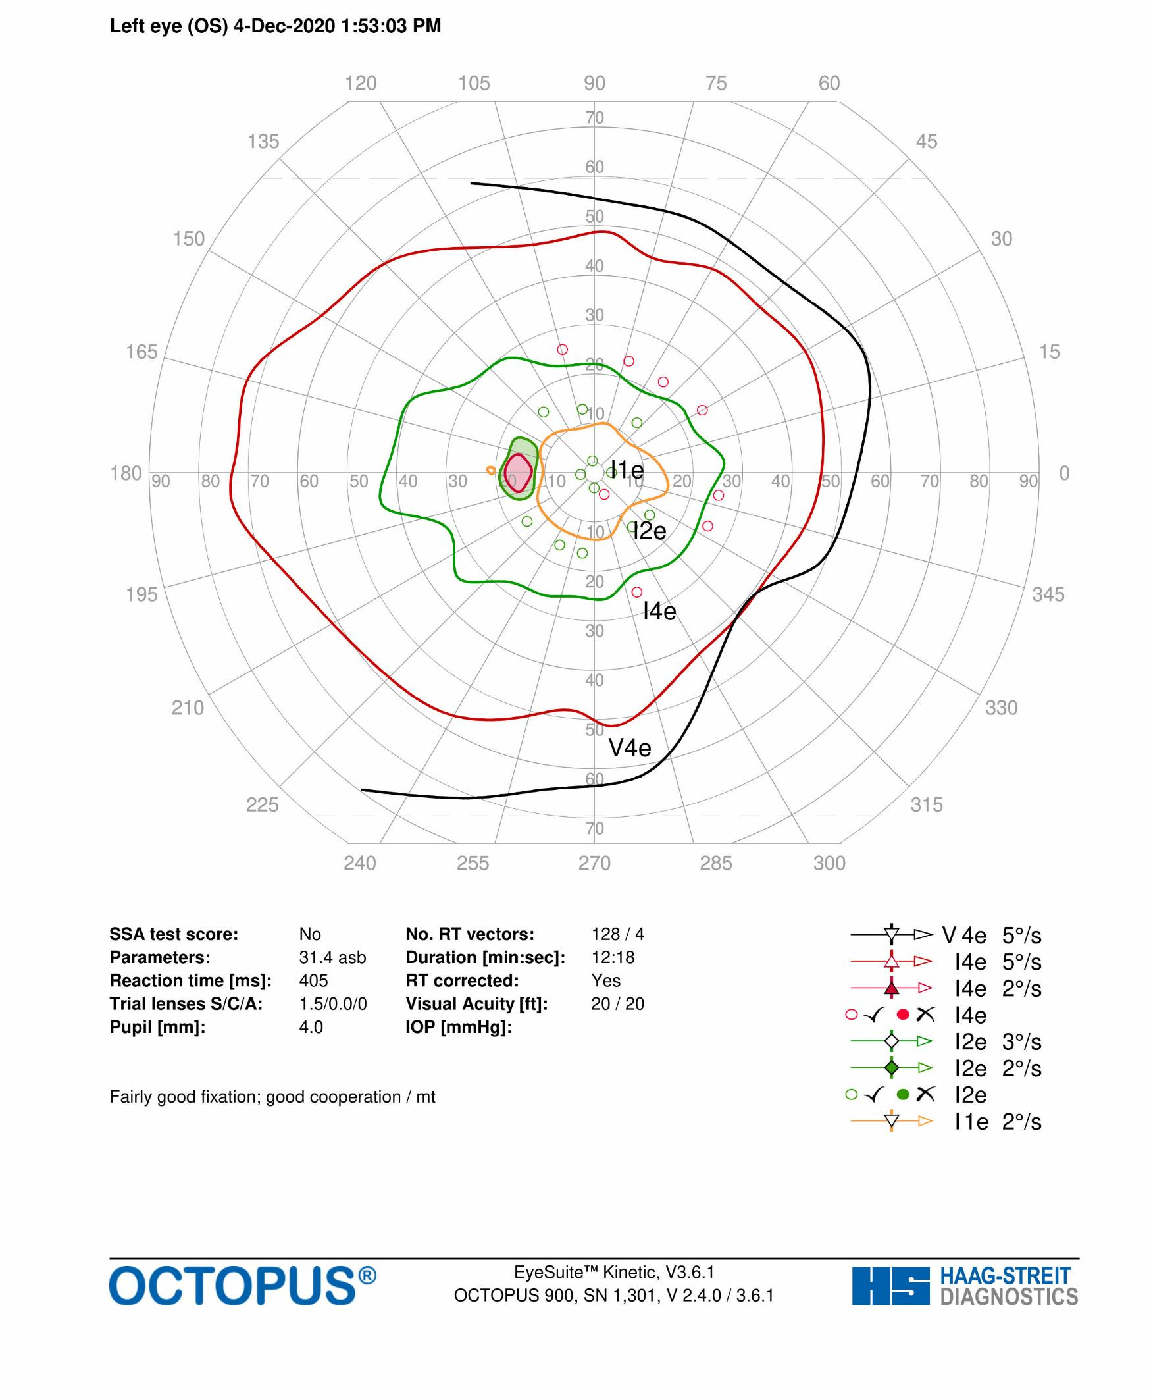
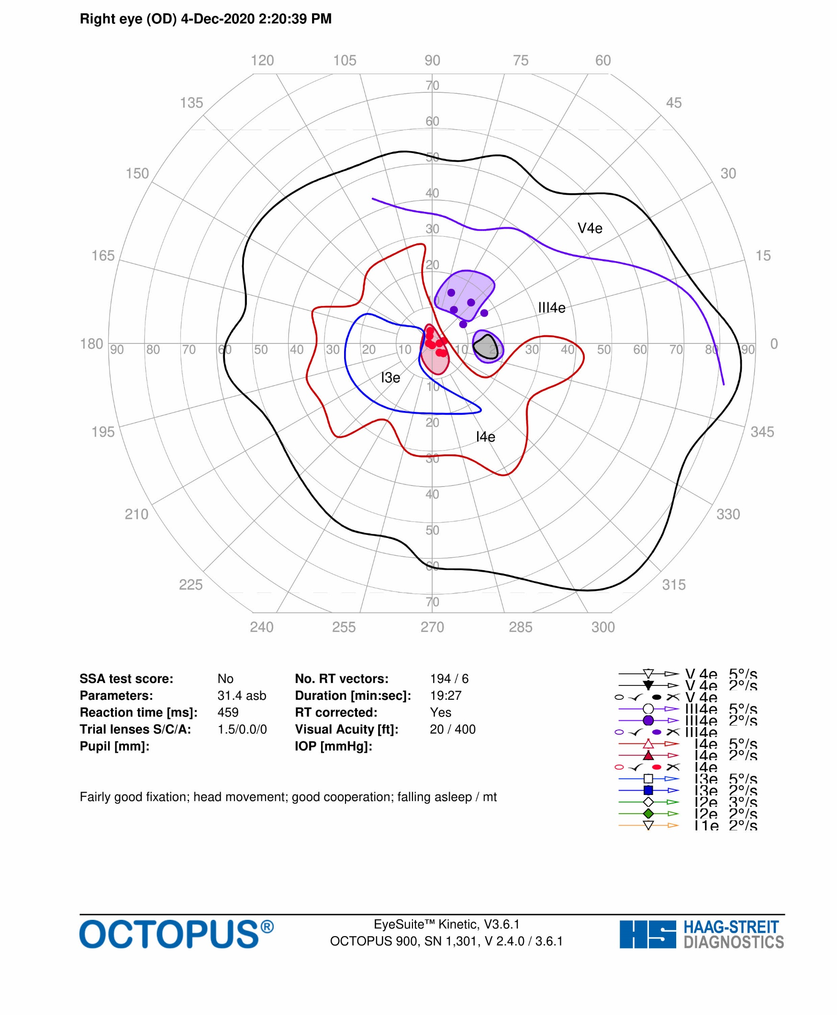
Octopus Visual Fields
(December 2020)
The left field appears normal. On the right, there is a central scotoma (arrow showing red circle of decreased sensitivity) with decreased sensitivity supero-temporally (constricted I4e red isopter and purple shaded regions)

Slide 11
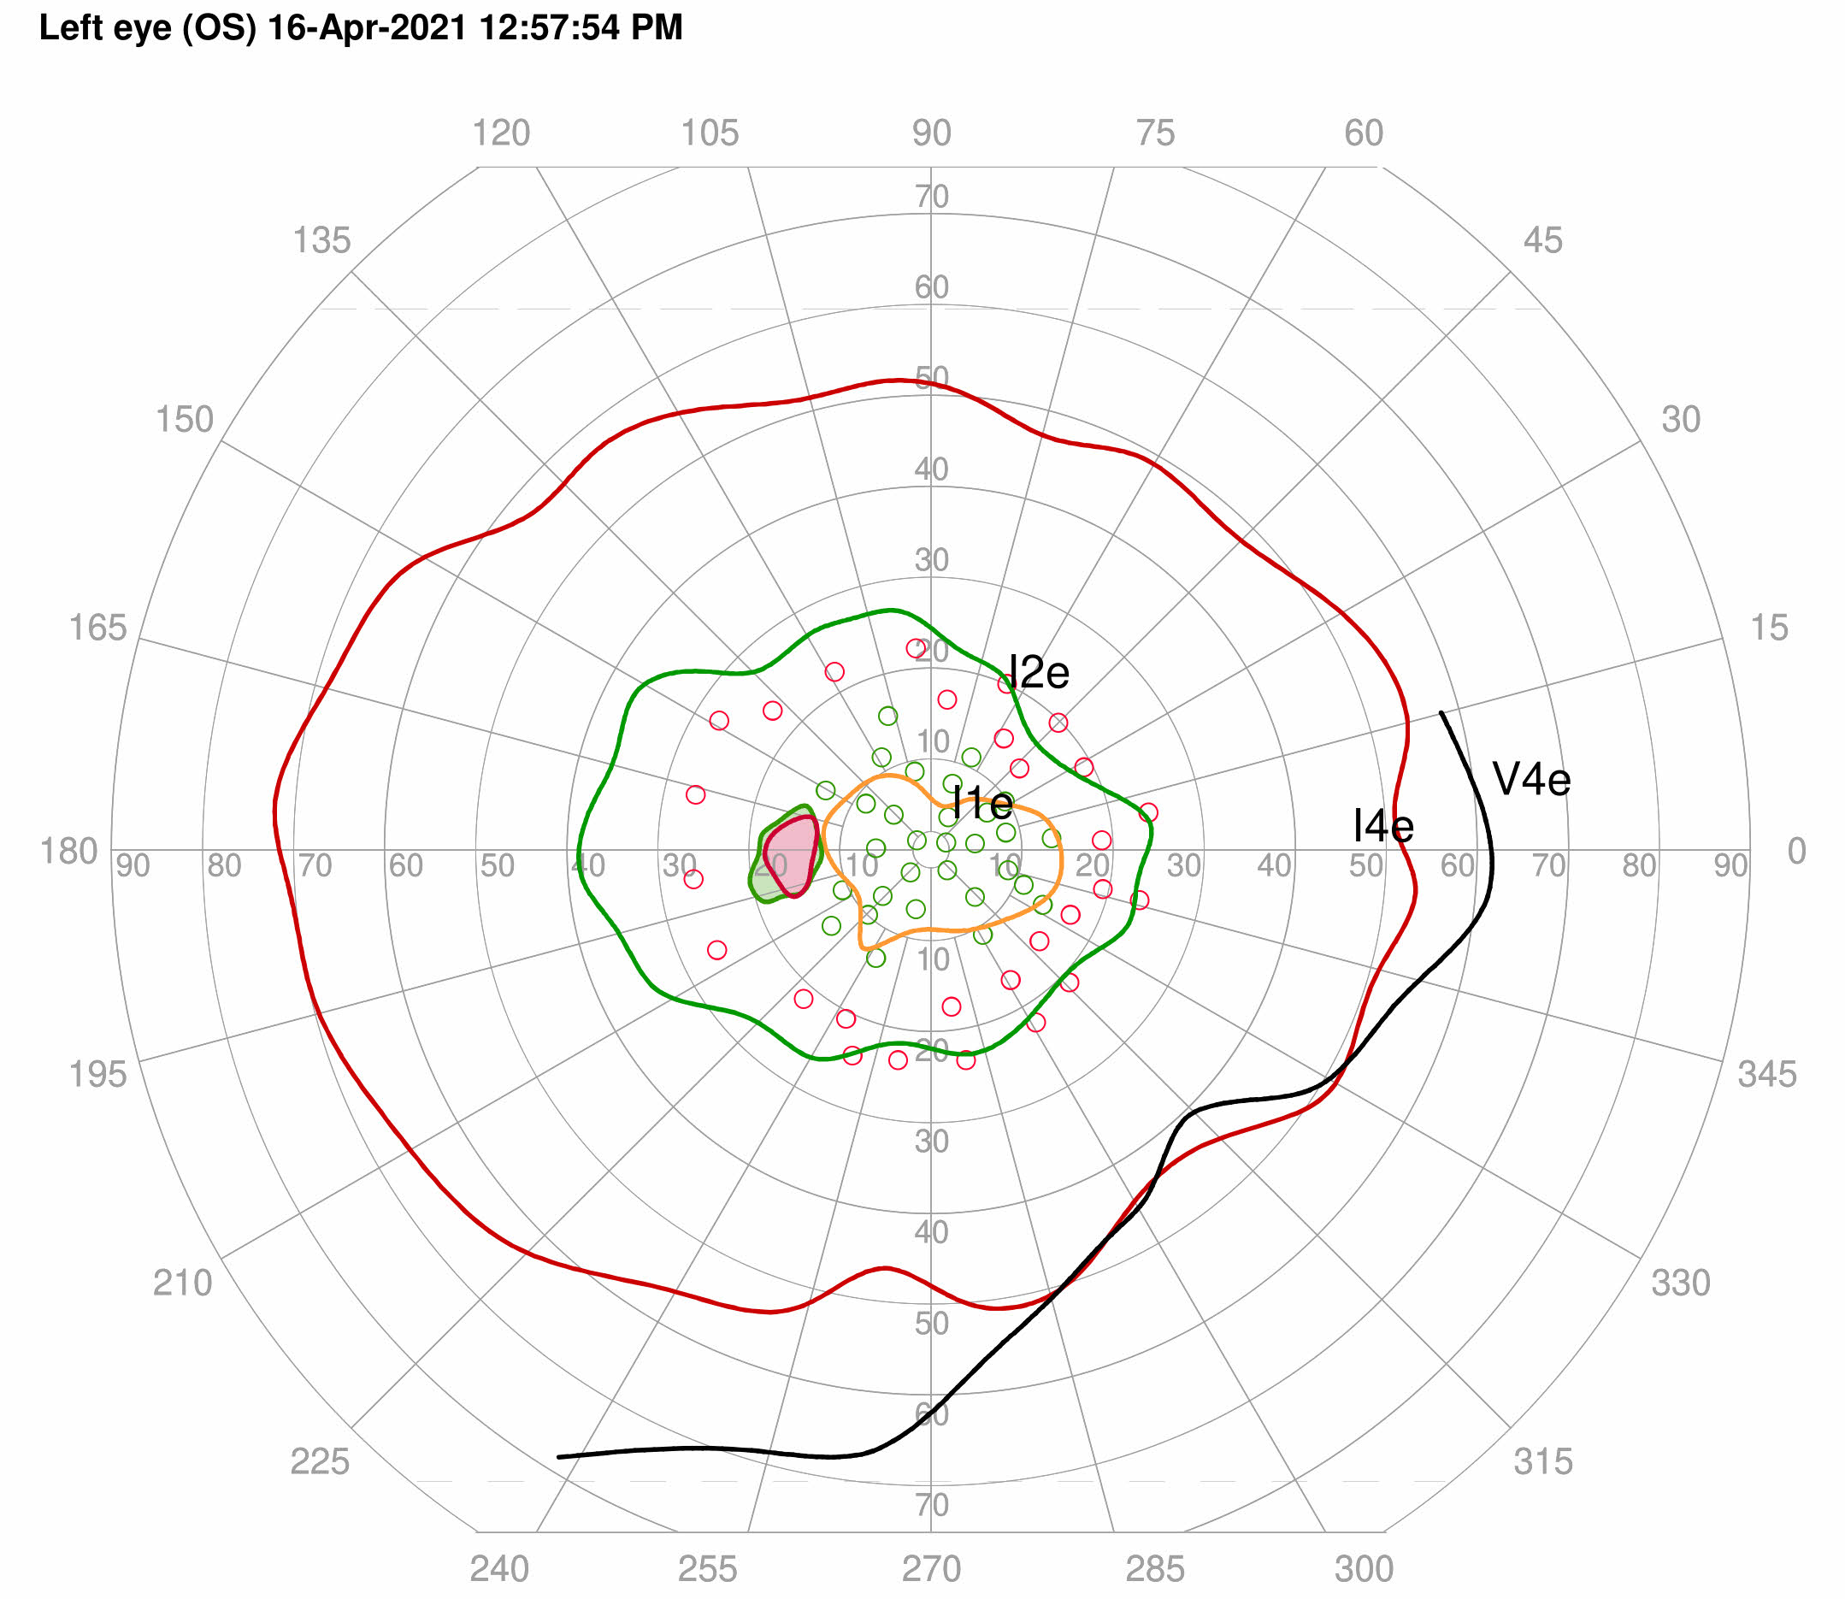
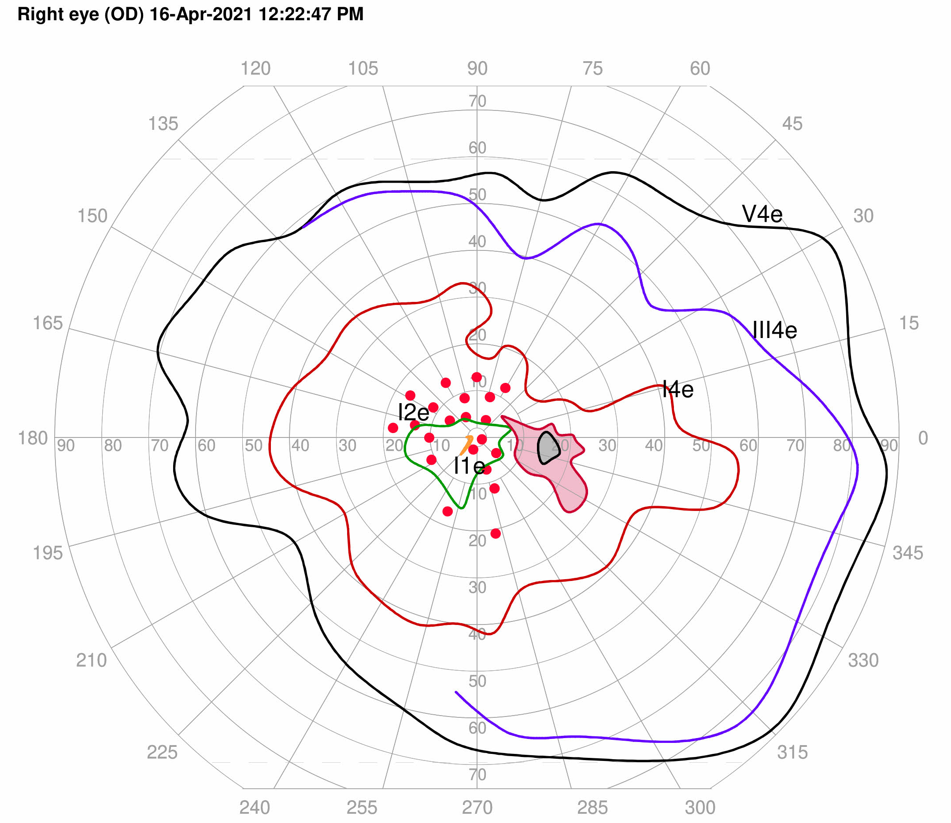
Four months later - April 2021
Gradual improvement in visual acuity OD
No new neurologic concerns
Ophthalmic Examination –
  VA 20/30 OD, 20/20 OS
  Colour vision Ishihara plates 1/17 OD, 17/17 OS
  Stable pallor of the right optic nerve
Timeline
Gradual Recovery of vision OD
April 2021

Slide 12
1.5 years later… February 2022
Presents with new left sided pain with eye movements and blurred vision of the left eye
On Examination
  VA 20/40 OD, 20/25 OS
  Right RAPD
  Colour vision Ishihara plates 1/17 OD, 17/17 OS
  Stable pallor of the right optic nerve
Timeline

June 2020
Right Optic neuritis
New Left Sided Symptoms
February 2022

Slide 13
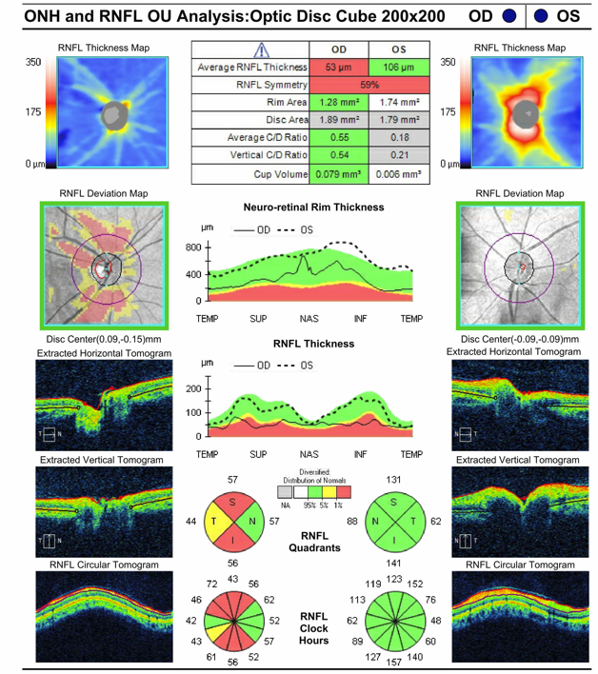
February 2022
OCT shows superior, inferior, and temporal RNFL thinning OD from previous right optic neuritis.
Left OCT largely within normal limits, but there is subtle RNFL elevation (*)
*
Note: Slight elevation in left RNFL thickness is seen inferiorly (*); this was not seen on previous OCT (slide 9, December 2020)

Slide 14
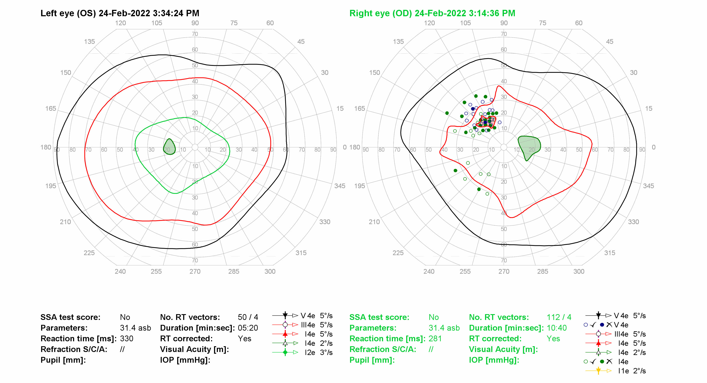
Octopus Visual Fields February 2022
The left visual field is normal. The right visual field has decreased sensitivity supero-nasally in right eye (red arrow), enlarged blind spot (purple arrow), and absent I4e isopter (missing green circle) indicating a persistent central scotoma, all remnants of previous right optic neuritis

Slide 15
Previous right optic neuritis, new left sided pain!
The patient had right optic neuritis with a slow recovery and optic atrophy. Now he has left sided symptoms but normal vision and a normal visual field.
What would you do next?

Slide 16
What is your next step?
Reassurance that his vision is normal despite the new pain with eye movement
Organize a lumbar puncture to look for neurosarcoidosis
Offer systemic NSAID for posterior scleritis
Arrange an MRI Brain and Orbits with and without contrast and administer IV Steroids for sequential Optic Neuritis

Slide 17
Answer: Option D!
Concern for left optic neuritis with impending vision loss.
Initiated 3 days of IV steroids followed by Prednisone 60mg PO daily

Slide 18
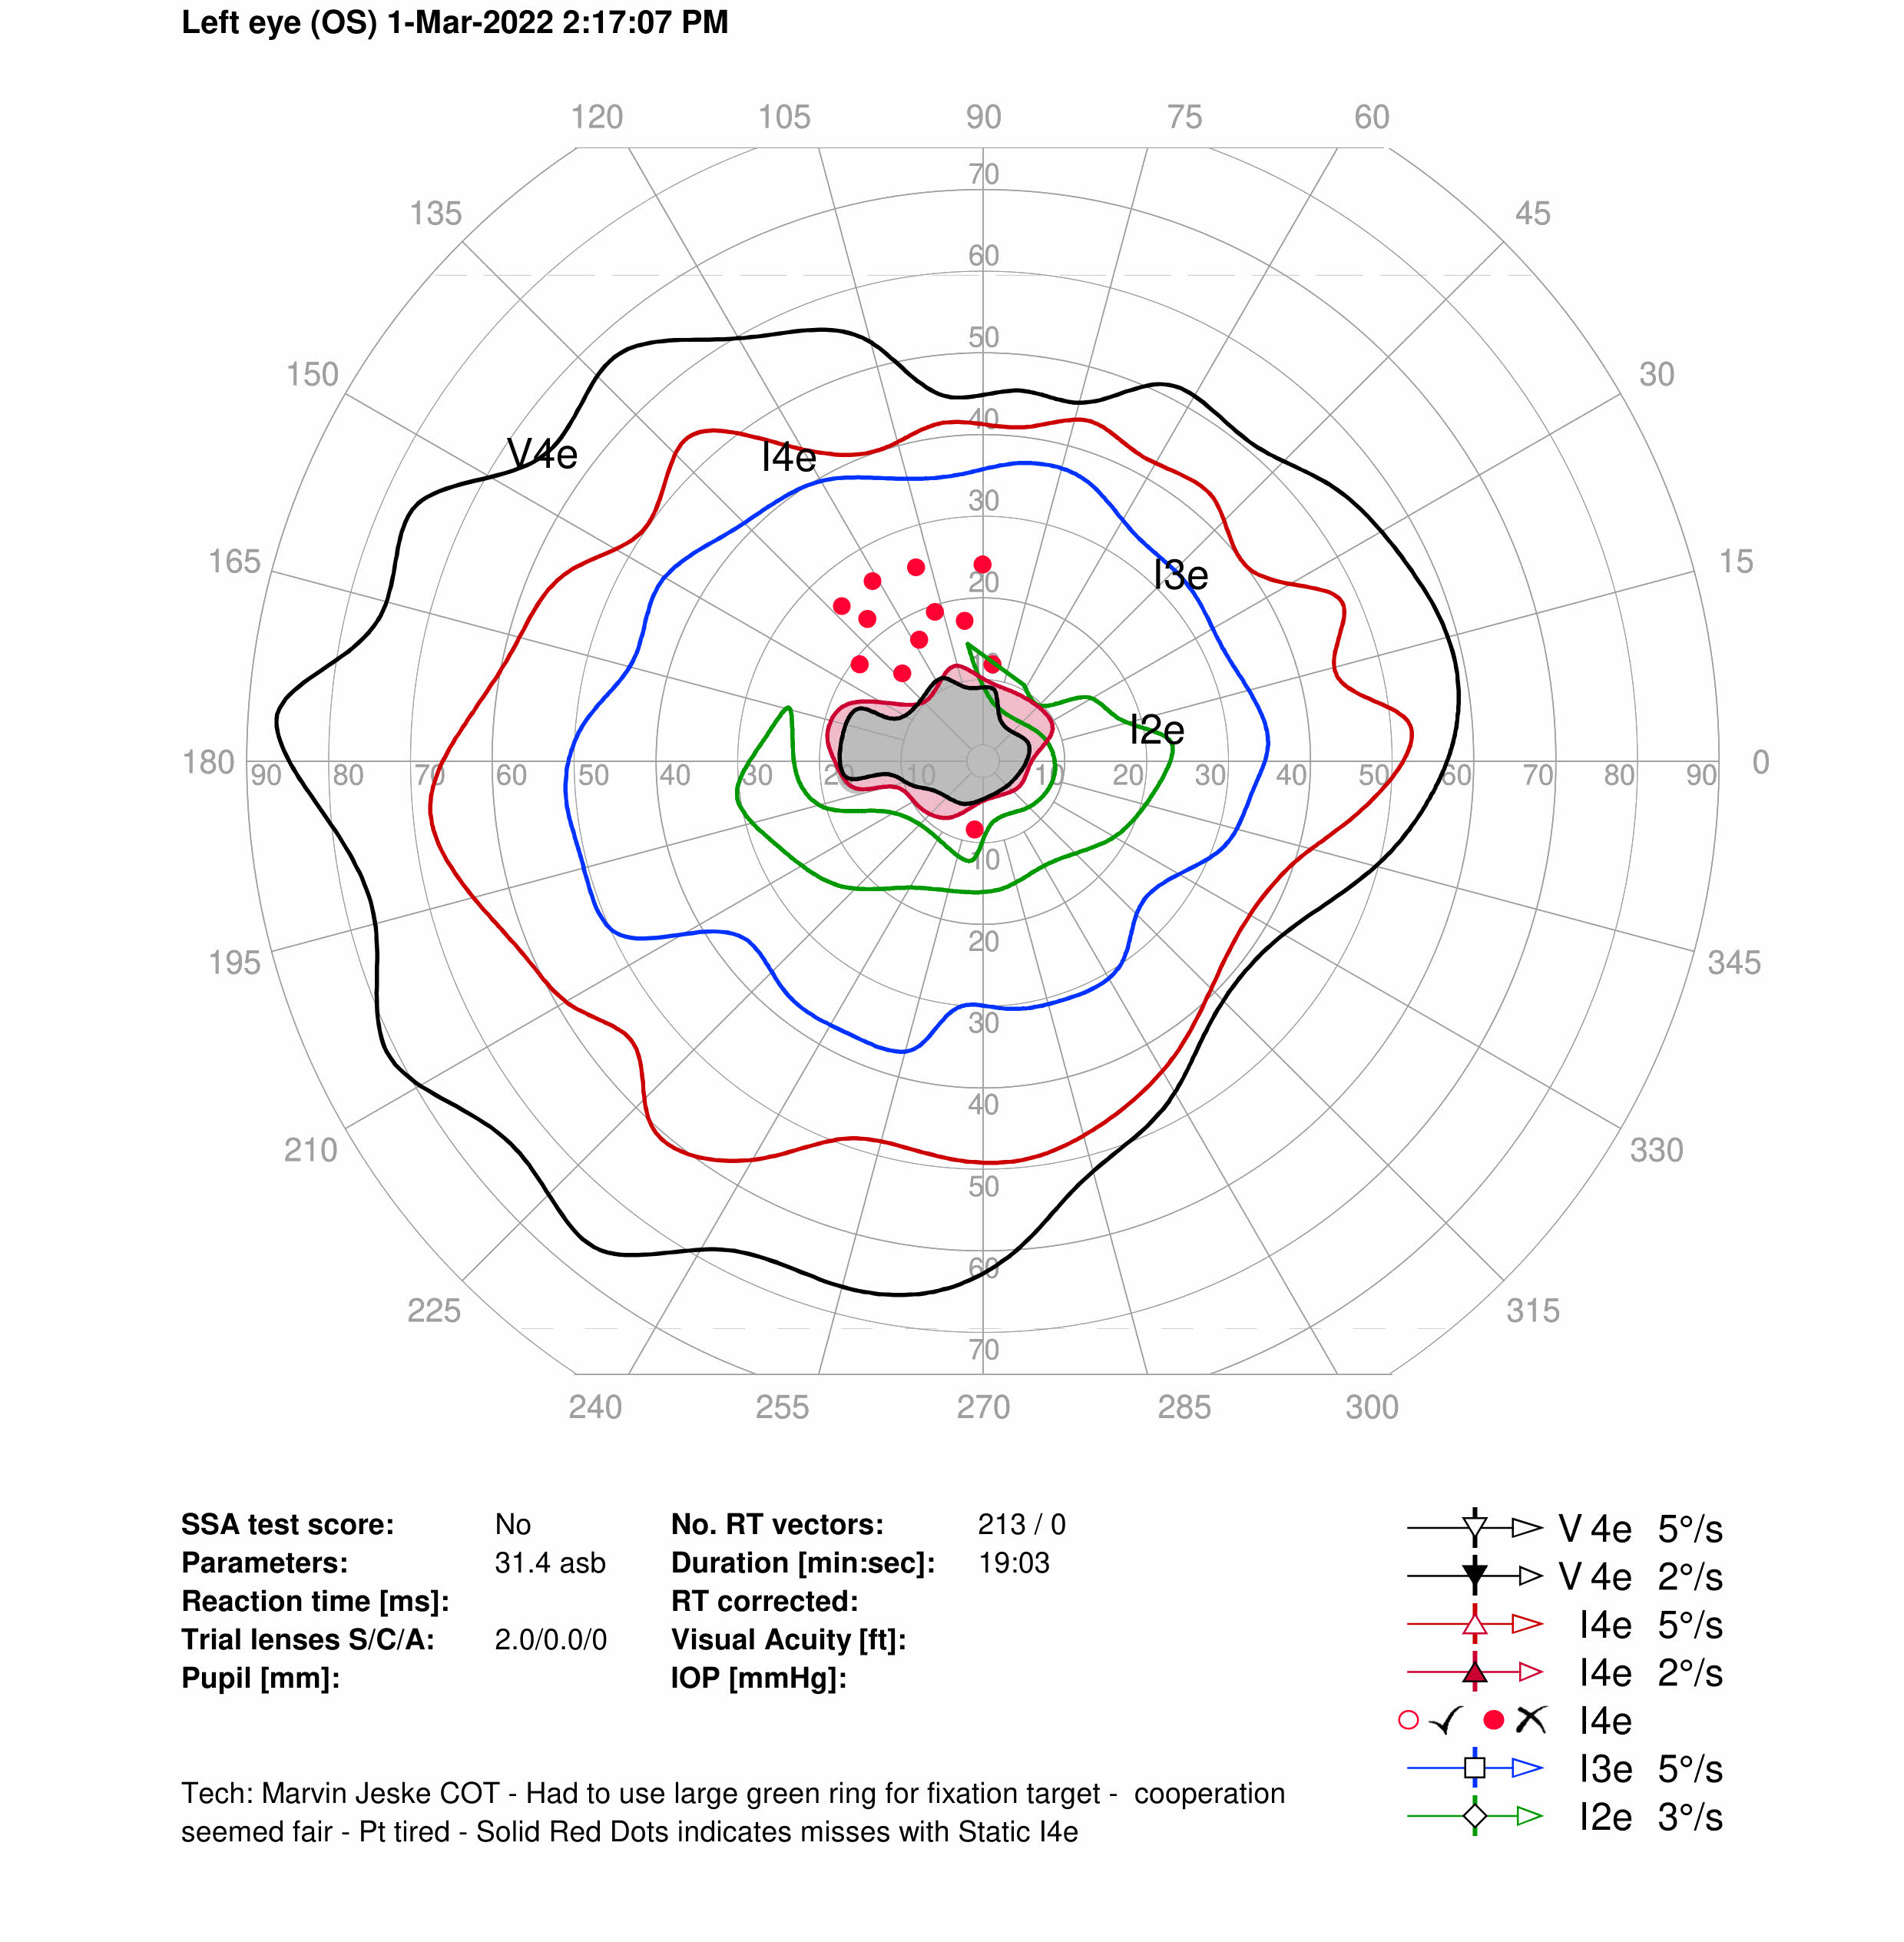
Few Days later…
Following 3 days of IV Steroids, patient reports worsening vision in the left eye
VA 20/30 OD, 20/100 OS
RAPD OD
Colour vision Ishihara plates 1/17 OD, 9/17 OS, new left central scotoma
Impression: Progression of left optic neuritis despite IV Steroids
Plan: Admission to Hospital, Completion of Seven Days of IV Steroids followed immediately by Plasmapheresis
Timeline

IV Steroids Plasmapheresis
February 2022

Slide 19
We decide to repeat his bloodwork
March 2022 Investigation Results
Serum ACE, ANA, anti-dsDNA, ANCA, syphilis serology, Quantiferon TB, ENA, RF, paraneoplastic panel – all negative
Genetic testing for Leber’s Hereditary Optic Neuropathy negative
Chest X-ray for sarcoidosis negative
Serum Anti-Aquaporin 4 antibodies (Anti-Aq4) HIGHLY POSITIVE
Anti-myelin oligodendrocyte glycoprotein (Anti-MOG) antibodies negative
Lumbar Puncture: acellular, no oligoclonal bands, negative Anti-Aq4 and Anti-MOG antibodies

Slide 20
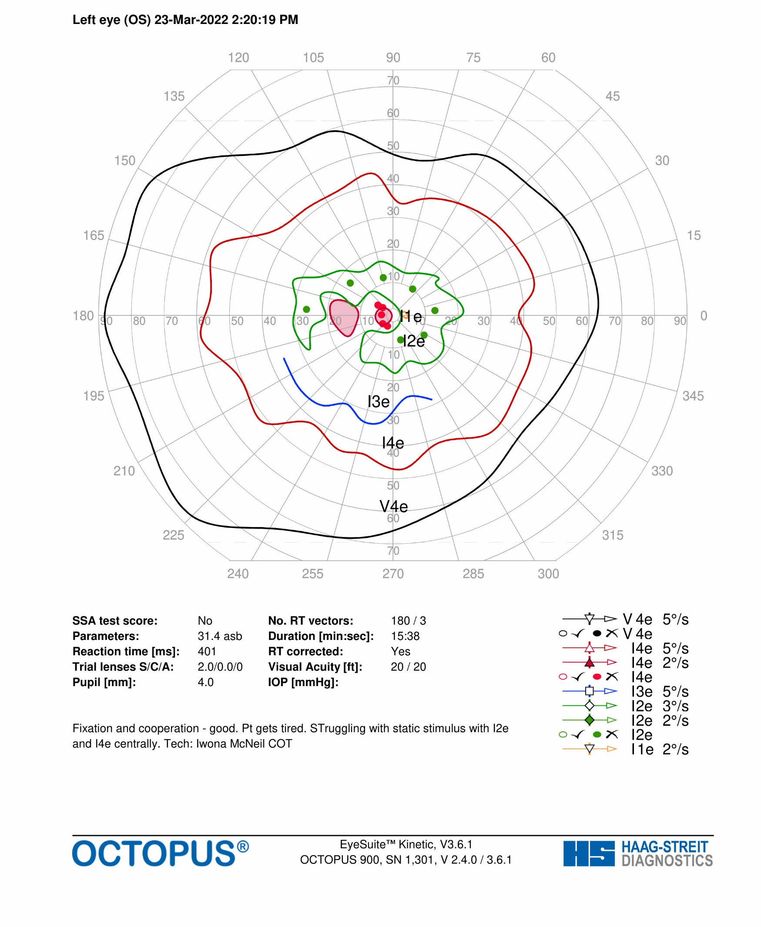
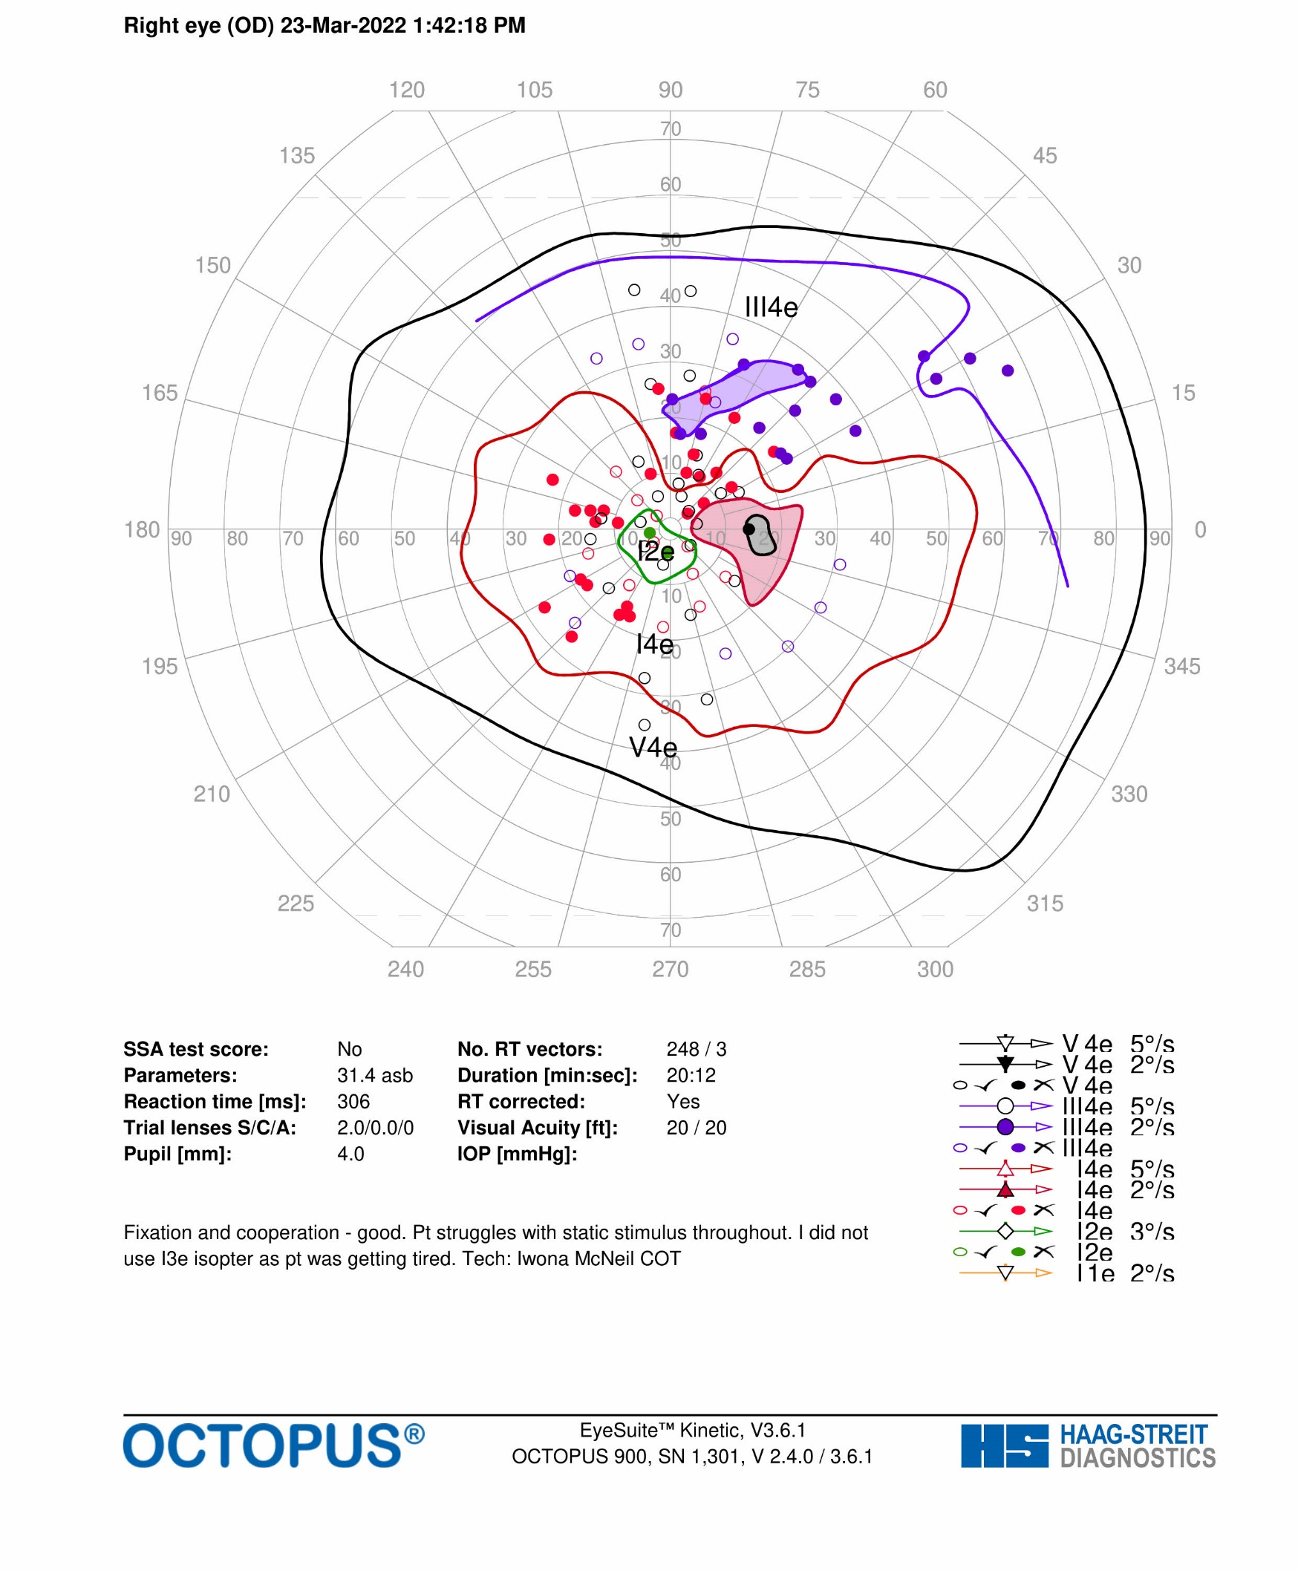
Visual Fields March 2022
Improving Central Scotoma
Persistent superior depression and reduced central sensitivity on the right

Slide 21
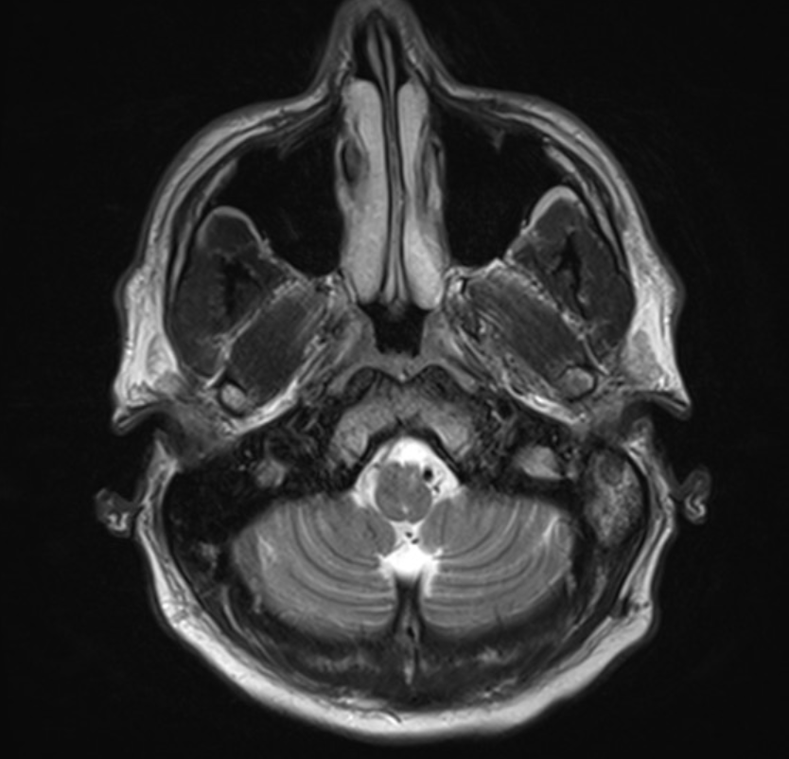
MRI Brain and Spine with and without contrast
March 2022
While contrast was administered, no orbital fat suppressed images were performed, therefore optic nerve enhancement could not be identified
On FLAIR images, right optic nerve mildly hyperintense suggestive of atrophy, consistent with previous optic neuritis. Left optic nerve appears within normal limits
New lesion in left medulla more suggestive of demyelination (arrow)
No evidence of area postrema lesion
No cervical or thoracic spine lesions
T2 weighted axial MRI

Slide 22
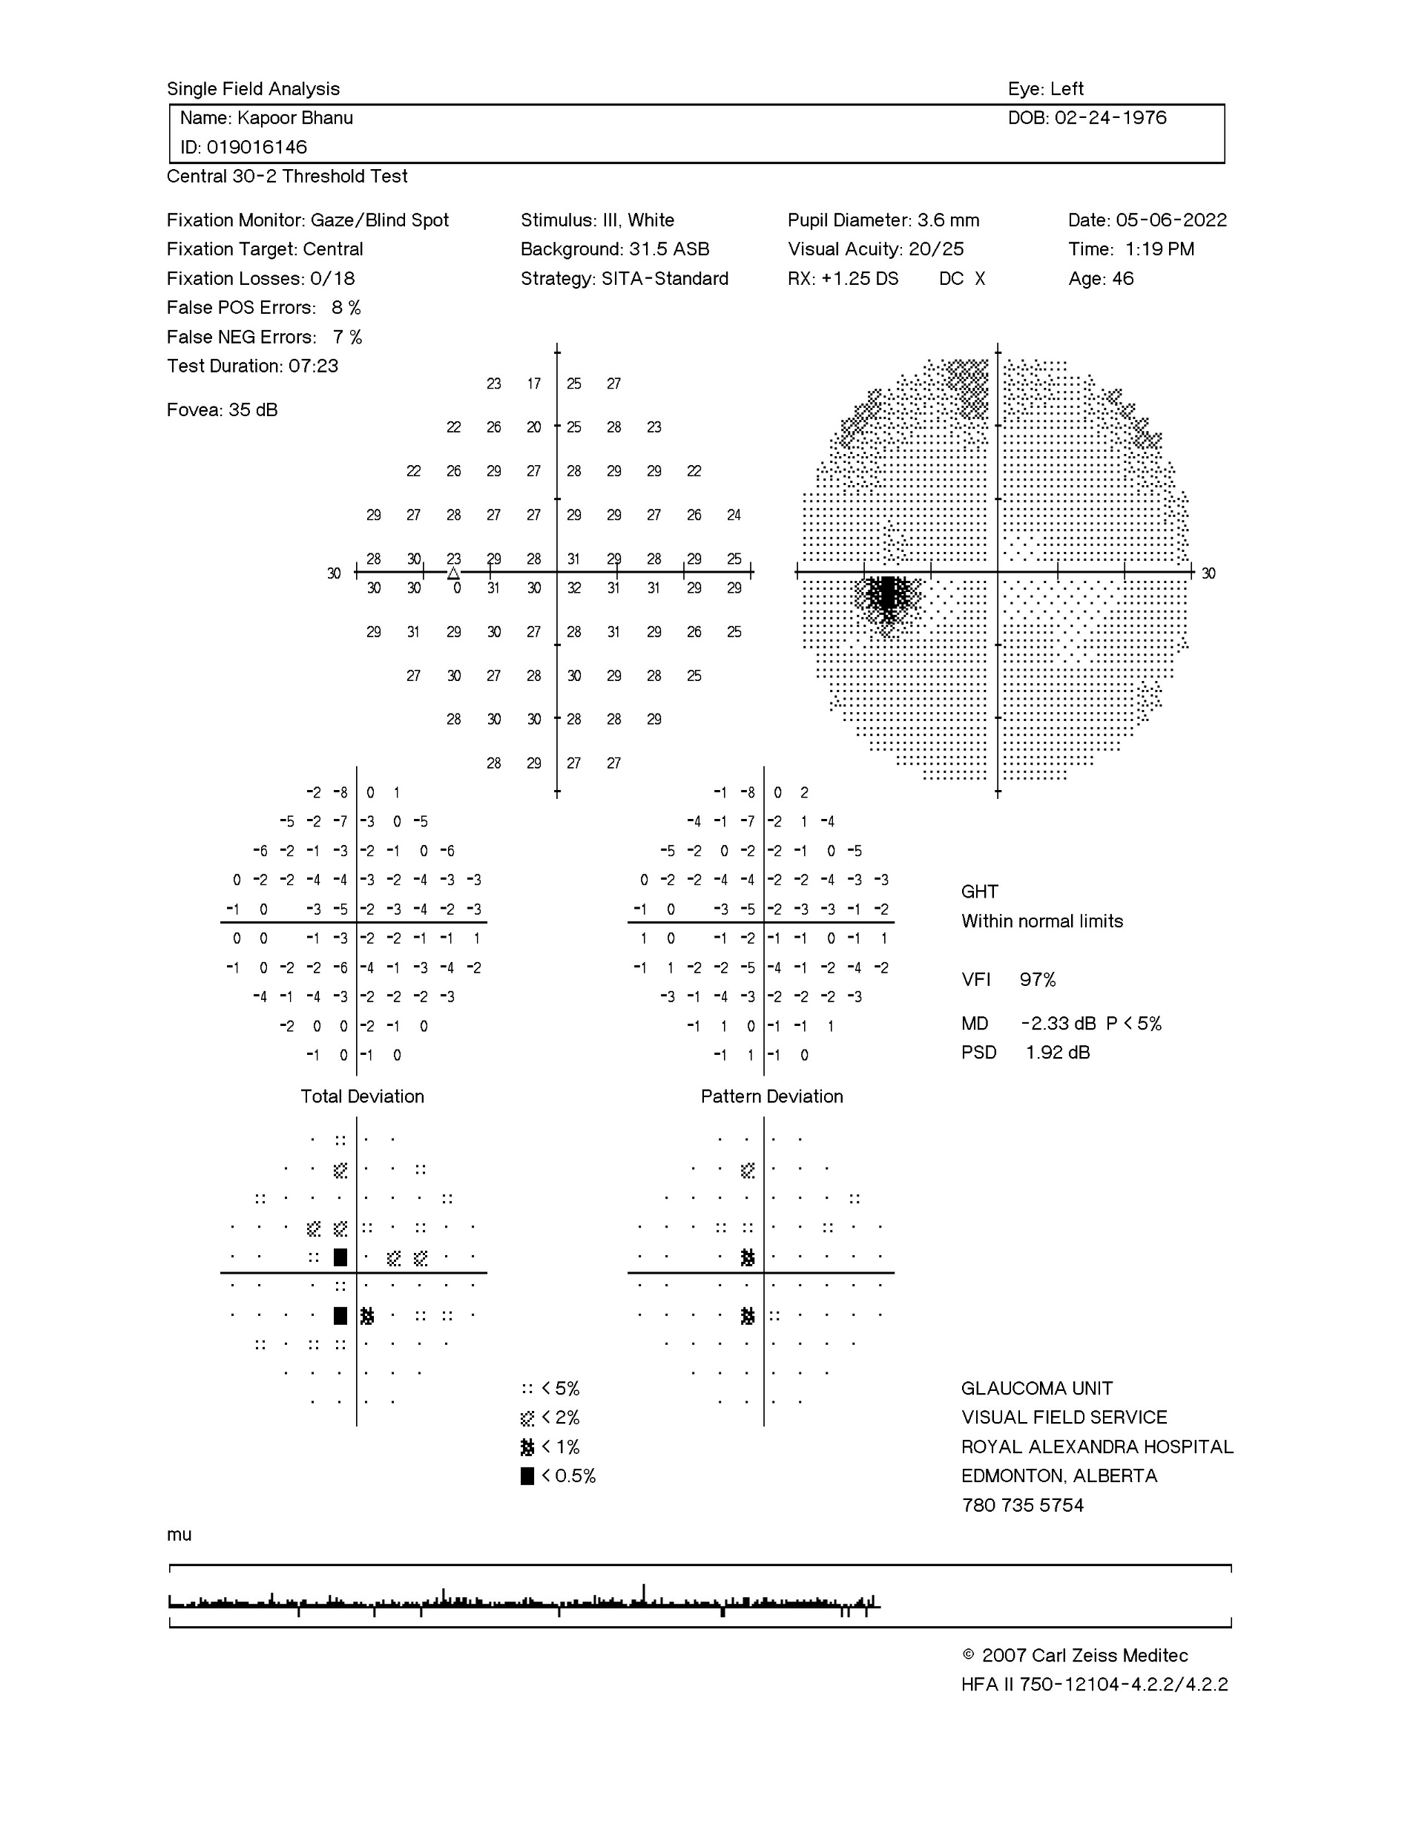
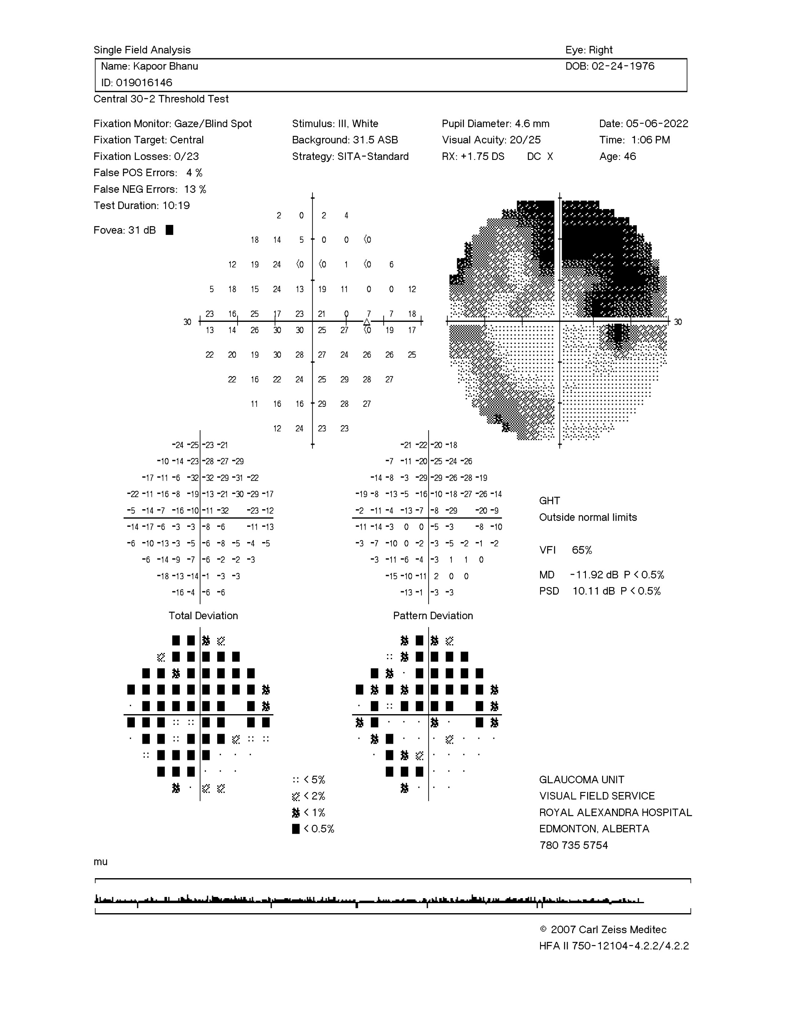
May 2022
Final Follow Up
Patient reported improving vision in the left eye
VA 20/25 OD, 20/20 OS
RAPD OD
Ishihara 2.5/17 OD, 17/17 OS
Resolving central scotoma OS (red arrow), persistent superior and pericentral visual field loss OD

Slide 23
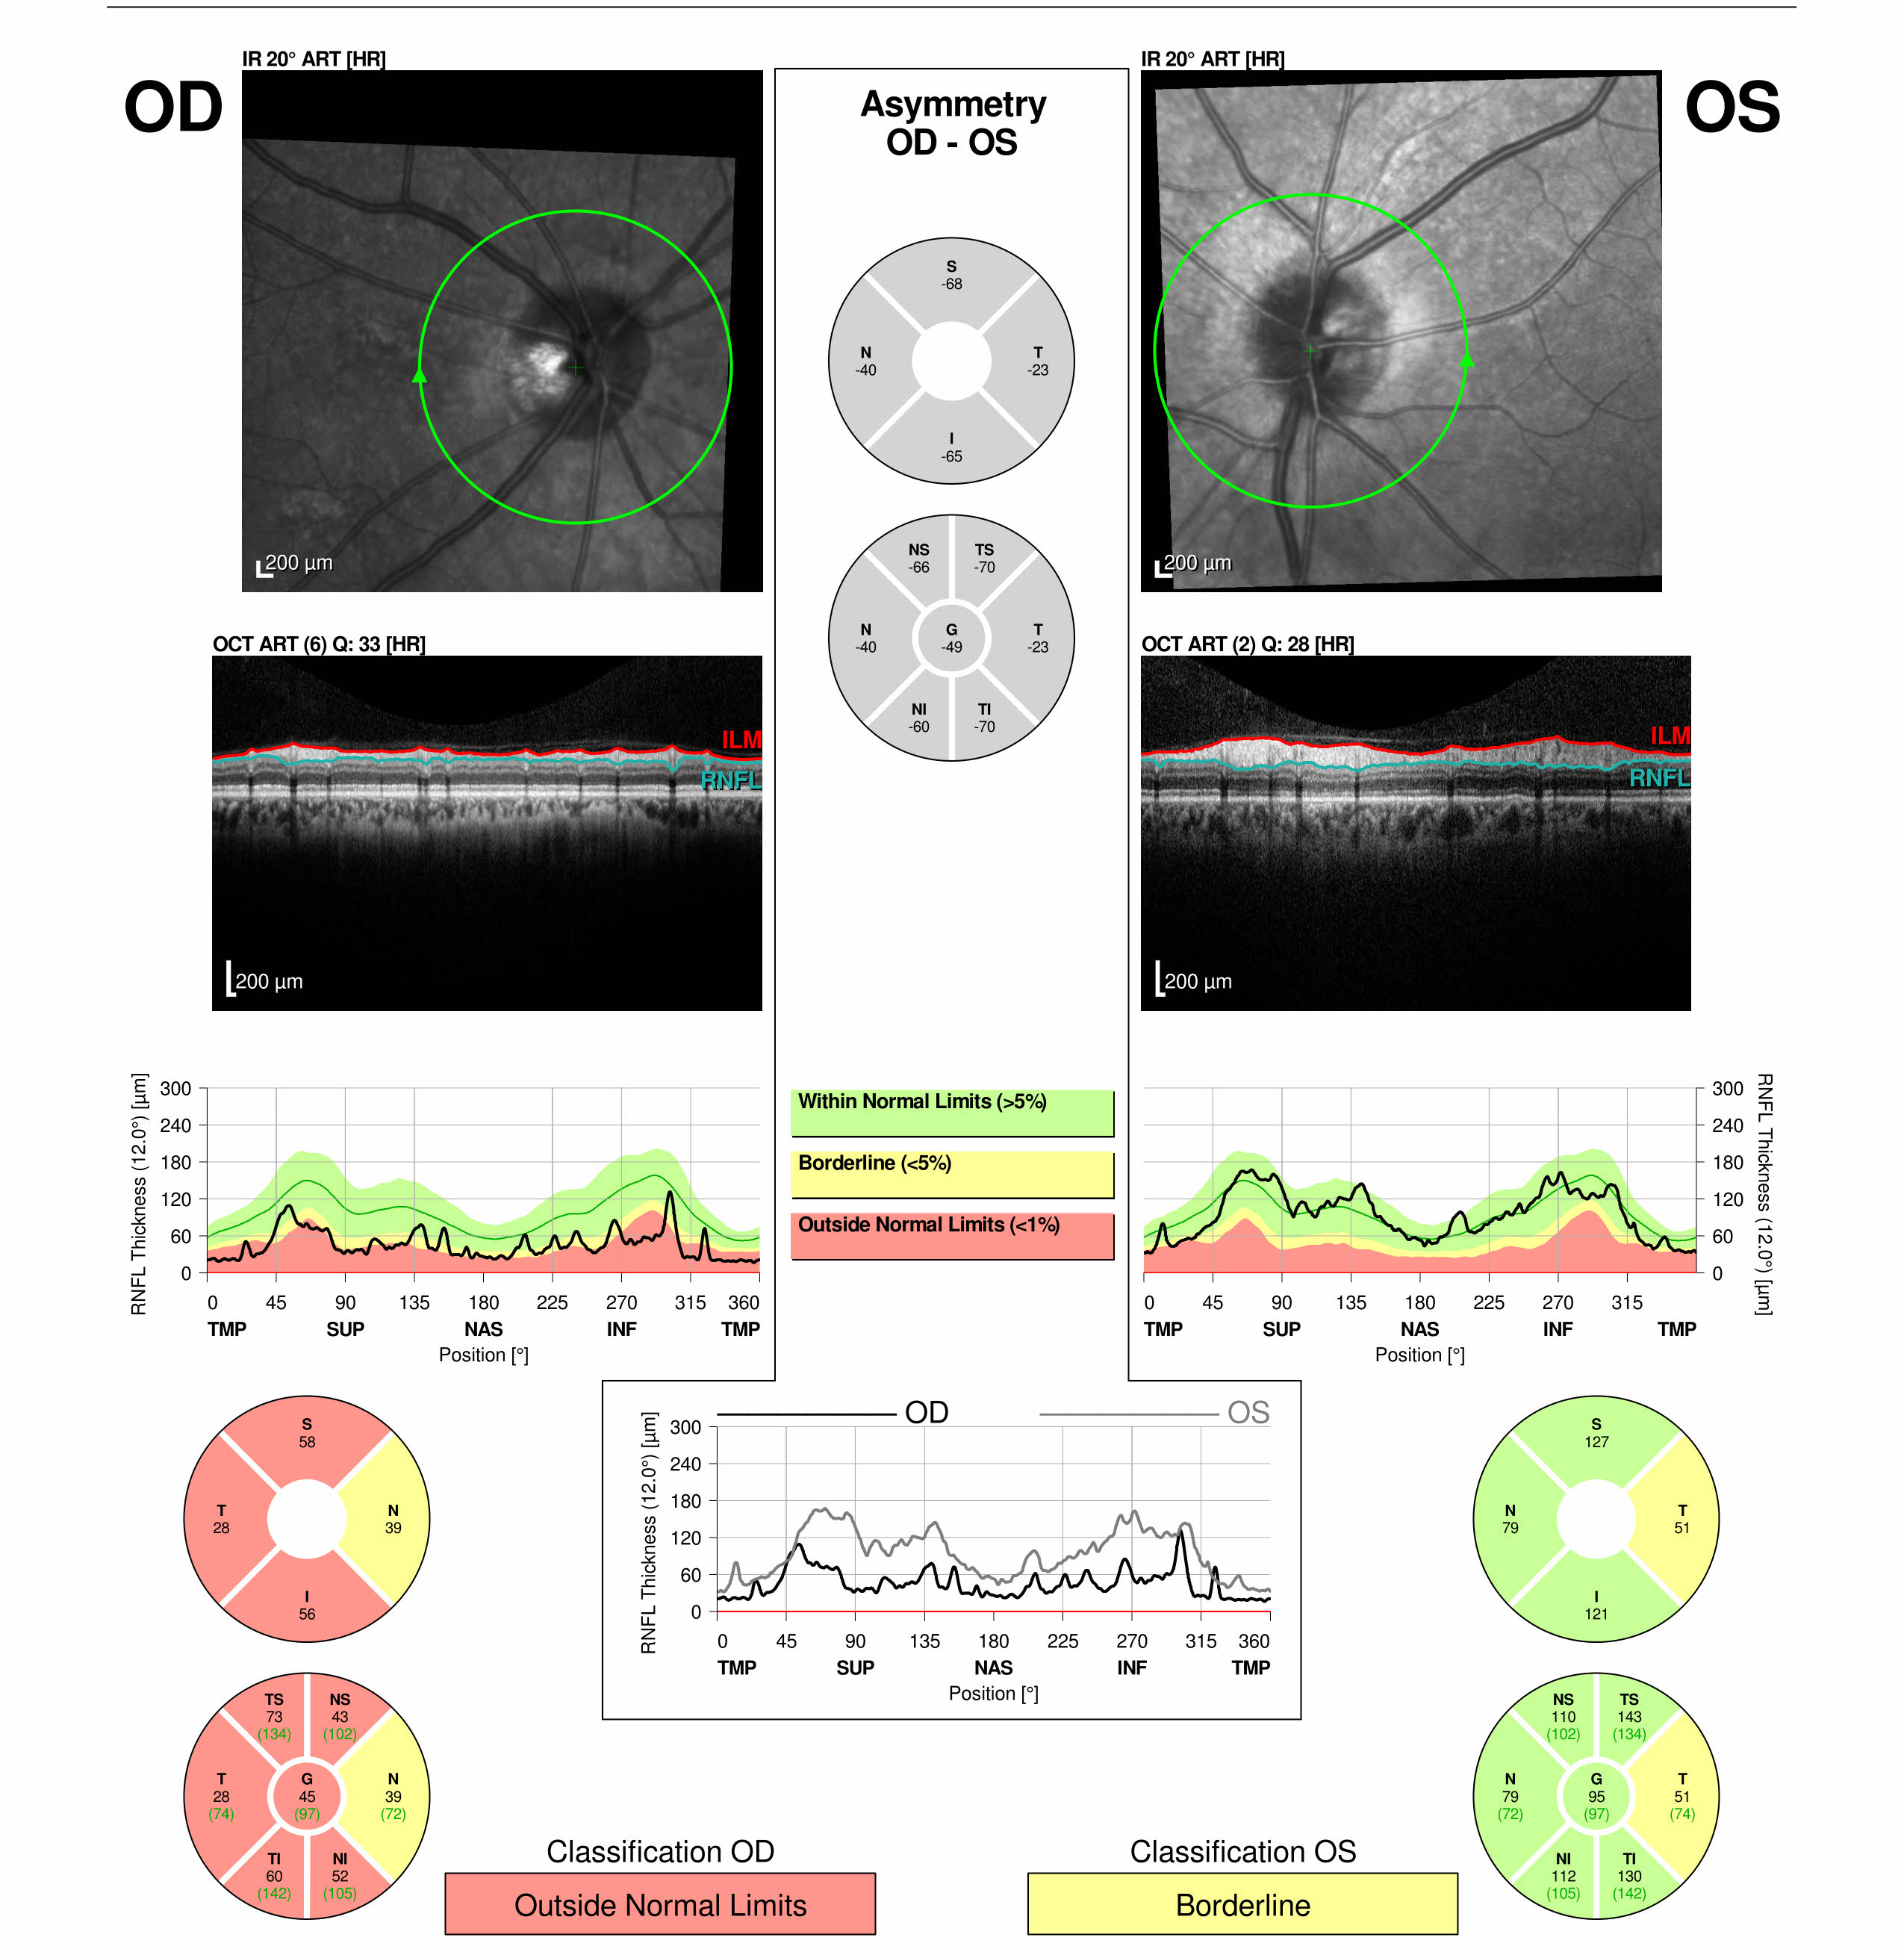
OCT
May 2022
Diffuse Optic nerve atrophy OD
Temporal RNFL thinning OS

Slide 24
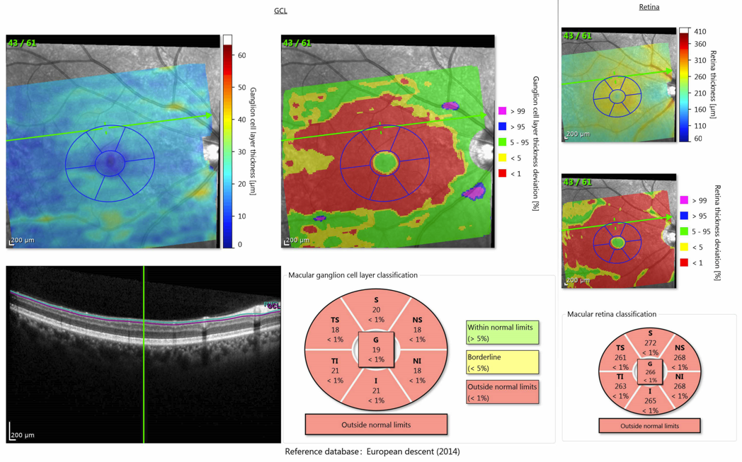
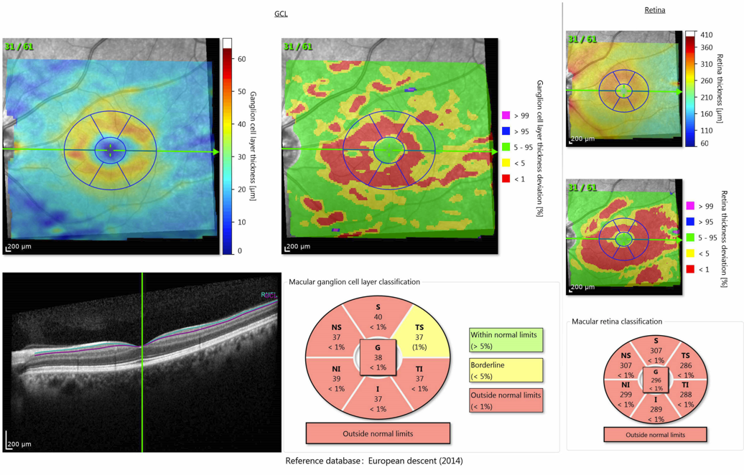
Ganglion Cell Analysis May 2022
OD
OS
Bilateral ganglion cell loss, worse on the right
(the GCL analysis measures the retinal layer containing the cell bodies of the optic nerve axons)

Slide 25
Diagnosis: Neuromyelitis Optica (NMO)
Severe demyelinating inflammatory disease affecting the optic nerves, brainstem, and spinal cord
More common among women, patients with Asian or African descent; mean age of onset 35-37 years ¹
Clinical features include severe or bilateral simultaneous optic neuritis, relapsing course, longitudinally extensive transverse myelitis and area postrema syndrome as well as acute brainstem syndromes, symptomatic cerebral syndromes¹

Slide 26
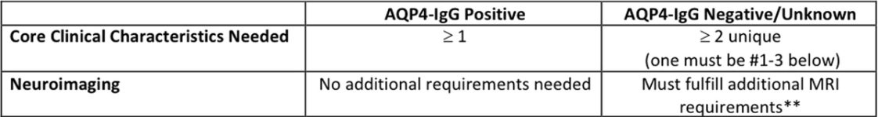
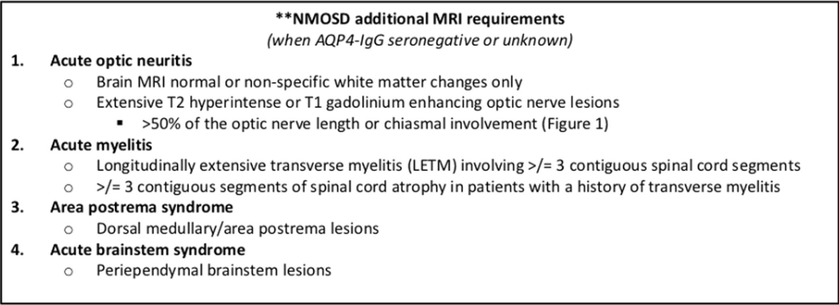
Diagnosing NMO
Suspected Neuromyelitis Optica spectrum disorder (NMOSD)
Clinical supplemented by serology and MRI
Tables from Abel et al. 2019

Slide 27
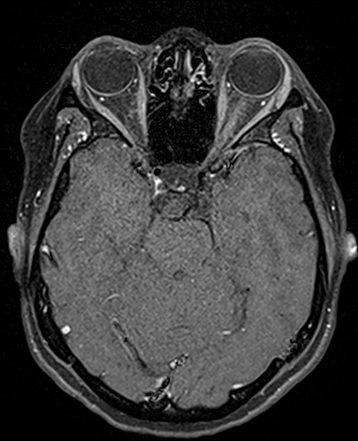
Optic Neuritis in NMO
May present as a severe optic neuritis with painful eye movement and subacute vision loss with poor recovery, frequent relapses, and subsequent neurologic morbidity³
MRI findings:
  Longitudinal enhancement of the optic nerve(s) involving half of the optic nerve (or ≥ 2 segments of the optic nerve versus < 1 segment in optic neuritis from MS)
  More likely to be bilateral (25%)³
  More likely to involve the chiasm (25%) and optic tracts (18%)³
MRI T1 fat suppressed enhanced image showing longitudinal left optic nerve enhancement in NMO (kindly contributed by Dr. Scott Haines)

Slide 28
Clinical Testing for Neuromyelitis Optica
Associated with anti-AQP4 antibodies
  Aquaporins are a family of water transport channels located on cell membranes
  Aqp-4 is the most common aquaporin within the central nervous system and is found in the brain, spinal cord, and optic nerve
    Located on astrocyte foot processes
    Concentrated at the blood brain barrier

Slide 29
Early diagnosis and treatment are crucial
Early initiation of high dose IV steroids followed by urgent plasmapheresis is associated with improved clinical outcomes in NMO spectrum disorder^{5,6}
Plasma exchange should be initiated as early as possible following optic neuritis if NMO is suspected
Our patient’s poor visual outcome on the right and excellent outcome on the left side emphasizes the importance of timely and aggressive treatment

Slide 30
Long Term Treatment for NMO
Long term treatment involves immunosuppression^{2, 7-9}:
  Rituximab (CD20 mediated B cell depletion)
  Tocilizumab (competitive binding to IL6 receptor)
  Eculizumab (inhibition of complement protein C5 cleavage)
  Satralizumab (IL6 receptor antagonist)
  Inebilizumab (CD19 receptor mediated apoptosis of B cells)
Our patient was started Rituximab infusions and has been stable for two years

Slide 31
Transverse Myelitis in NMO
Focal inflammation of the spinal cord
  Longitudinally Extensive Transverse Myelitis (LETM) is defined as extensive spinal inflammation showing hyperintensity across ≥3 vertebral segments on T2-weighted MRI¹⁰
  LETM incorporated into diagnostic criteria for NMO
  CSF: oligoclonal bands rare in NMO¹¹
Neurological signs include weakness, sensory deficits, and bladder and bowel autonomic dysfunction
  Early diagnosis and treatment can mitigate future disability^{10,11}

Slide 32
Brain Lesions in NMO
MRI frequently will reveal lesions surrounding the third ventricles and cerebral aqueduct^{1,3,12}
  including thalamus, hypothalamus, and brainstem

Slide 33
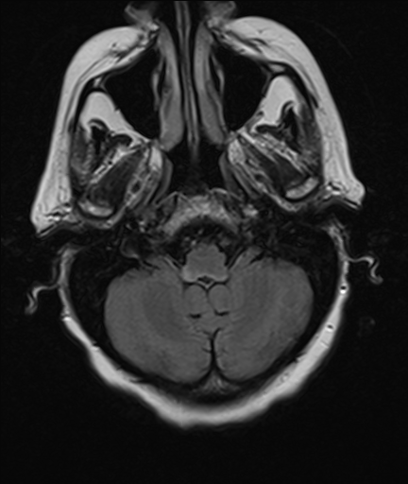
Area Postrema Syndrome
– Uncontrolled Hiccups!
Area postrema: an emetic reflex center which also contains chemo-sensitive neurons that mediate hiccups
  Location: floor of the 4th ventricle
Lesions of this region may lead to intractable vomiting, nausea and hiccups (i.e. area postrema syndrome)
This region is dense in AQP4, and is a frequent target of NMO-associated demyelination
  Up to 30% of NMO patients will experience area postrema syndrome¹²
FLAIR images showing hyperintense signal in area postrema in a patient with NMO (kindly contributed by Dr. Scott Haines)

Slide 34
Serological Testing for NMO
AQP4 antibody tests can be cell-based or tissue-based assays
  Cell based (preferred): 70-80% sensitive, >99% specific¹³
  Tissue based: 48-53% sensitive, 100% specific¹³

Slide 35
Seroconversion in Neuromyelitis Optica
Aquaporin 4 IgG-mediated NMOSD may test negative initially
If high clinical suspicion or based on imaging, repeat testing after 3-6 months^{1,14}
Patients may remain seronegative for many years until seroconversion¹⁵
Seroconversion is most likely during acute attack or during treatment-free intervals¹⁶
  Our patient tested negative in the year following his initial episode of right optic neuritis, but tested positive acutely after the second episode of optic neuritis

Slide 36
Learning Points
When a patient presents with optic neuritis with severe vision loss, bilateral vision loss, or poor recovery following ON, suspect an atypical form of optic neuritis such as NMO (others should also be considered such as MOG or other infectious, inflammatory causes)
Acutely, an MRI of the brain and orbits with T1 post-contrast and orbital fat suppressed images may show typical findings of NMO-Optic Neuritis such as longitudinal optic nerve involvement, chiasmal, or optic tract involvement and demyelinating lesions atypical for multiple sclerosis. Order the correct MRI and discuss with your radiologist!

Slide 37
Learning Points
Cell-based assays for NMO based on serum have high specificity for NMO but have moderate sensitivity. Seropositivity is most likely to be detected during an acute episode.
  A negative or pending test for NMO should not prevent appropriate treatment in a convincing clinical scenario.
Clinical suspicion for NMO-optic neuritis should prompt urgent administration of IV corticosteroids followed by plasma exchange, and consideration of long-term immunosuppression to prevent severe neurologic morbidity

Slide 38
References
Abel, Anne, et al. “Critical Review: Typical and Atypical Optic Neuritis.” Survey of Ophthalmology, 2019, doi:10.1016/j.survophthal.2019.06.001.
Brod SA. Review of approved NMO therapies based on mechanism of action, efficacy and long-term effects. Mult Scler Relat Disord. Published online 2020. doi:10.1016/j.msard.2020.102538
Mealy, Maureen, et al. “Differentiating NMO and MS-Associated Optic Neuritis by MRI (S63.002).” Neurology, vol. 82, no. 10 Supplement, Apr. 2014, p. S63.002, http://n.neurology.org/content/82/10_Supplement/S63.002.abstract.
Dutra, Bruna Garbugio, et al. “Neuromyelitis Optica Spectrum Disorders: Spectrum of MR Imaging Findings and Their Differential Diagnosis.” Radiographics, 2018, doi:10.1148/rg.2018170141.
Nakamura M, Nakazawa T, Doi H, et al. Early high-dose intravenous methylprednisolone is effective in preserving retinal nerve fiber layer thickness in patients with neuromyelitis optica. Graefe’s Arch Clin Exp Ophthalmol. Published online 2010. doi:10.1007/s00417-010-1344-7
Bonnan M, Valentino R, Debeugny S, et al. Short delay to initiate plasma exchange is the strongest predictor of outcome in severe attacks of NMO spectrum disorders. J Neurol Neurosurg Psychiatry. Published online 2018. doi:10.1136/jnnp-2017-316286
Tahara M, Oeda T, Okada K, et al. Safety and efficacy of rituximab in neuromyelitis optica spectrum disorders (RIN-1 study): a multicentre, randomised, double-blind, placebo-controlled trial. Lancet Neurol. Published online 2020. doi:10.1016/S1474-4422(20)30066-1Beh, Shin C., et al. “Transverse Myelitis.” Neurologic Clinics, 2013, doi:10.1016/j.ncl.2012.09.008.
Barreras P, Vasileiou ES, Filippatou AG, et al. Long-term Effectiveness and Safety of Rituximab in Neuromyelitis Optica Spectrum Disorder and MOG Antibody Disease. Neurology. Published online 2022. doi:10.1212/WNL.0000000000201260
Wang Y, Chang H, Zhang X, Yin L. Efficacy of rituximab in the treatment of neuromyelitis optica spectrum disorders: An update systematic review and meta -analysis. Mult Scler Relat Disord. Published online 2021. doi:10.1016/j.msard.2021.102843
Lim, Pete A. C. “Transverse Myelitis.” Essentials of Physical Medicine and Rehabilitation: Musculoskeletal Disorders, Pain, and Rehabilitation, 2018, doi:10.1016/B978-0-323-54947-9.00162-0.
Eslam Shosha et al. (2018) Area of Postrema Syndrome, Neurology, 91 (17) e1642-e1651; DOI: 10.1212/WNL.0000000000006392
Kim HJ, Paul F, Lana-Peixoto MA, et al. MRI characteristics of neuromyelitis optica spectrum disorder: An international update. Neurology. Published online 2015. doi:10.1212/WNL.0000000000001367
Melanie Truong-Le & Bart Chwalisz (2020) Antibody Testing in Atypical Optic Neuritis, Seminars in Ophthalmology, 35:5-6, 287-295, DOI: 10.1080/08820538.2020.1820047
Chen, J. (2019, June 3). Optic Neuritis in the Era of Biomarkers. MCL Education. Retrieved August 14, 2022, from https://news.mayocliniclabs.com/2019/06/03/optic-neuritis-in-the-era-of-biomarkers/
Levin, Marc H. “Advances in Neuromyelitis Optica: Take Them to the Clinic.” Journal of Neuro-Ophthalmology, 2017, doi:10.1097/WNO.0000000000000509.
Ogawa, Yu, et al. “A Case of Recurrent Refractory Bilateral Optic Neuritis with Positivity for Anti-AQP4 Antibody at the Third Test.” Neuro-Ophthalmology Japan, 2015.

