Slide 1


Sequential vision loss in a 67 year-old patient
Mariana Arroyo, MD
Resident Physician in Neuro-Ophthalmology, Asociación para Evitar la Ceguera en México, I.A.P.
Juan Manuel García-Gomez, MD
Resident Physician in Neuro-Ophthalmology, Asociación para Evitar la Ceguera en México, I.A.P.
Claudia Beatriz Hubbe-Tena, MD
Attending Rheumatologist, Asociación para Evitar la Ceguera en México, I.A.P.
Jorge Cárdenas-Belaunzarán, MD, MSc
Professor of Neuro-Ophthalmology, Department Chair, Asociación para Evitar la Ceguera en México, I.A.P.

Slide 2
67-Year-Old Male with Sequential Vision Loss
Progressive (days), diffuse, painless vision loss in right eye (OD), first noted 1 year prior to presentation
Progressive (days), diffuse, painless vision loss in left eye (OS), first noted 6 months prior to presentation

Slide 3
67-Year-Old Male with Sequential Vision Loss
PMH: obesity, hypertension, former smoker
Denies alcohol or drug abuse
Denies ocular or head injury
Denies family history
ROS:
  Diplopia (-)
  Oscillopsia (-)
  Vertigo (-)
  Seizures (-)
  Cough (+)
  Meds (-)
  Headache (+)
  Fever (-)
  Weight Loss (-)
  Sensory or motor abnormalities (-)
Headache: bilateral compressive frontotemporal, moderate-severe, 3-4 per week.
Cough: chronic, no established diagnosis.

Slide 4
Relevant Neuro-ophthalmic Examination
Best-corrected visual acuity: No light perception OD, Counting fingers at 3 feet OS
Slit Lamp Examination: normal OU
Pupillary reactivity: equal in size in light and dark, relative afferent defect 2+ OD, amaurotic pupil OS
Optic Discs: to describe in next slide

Slide 5
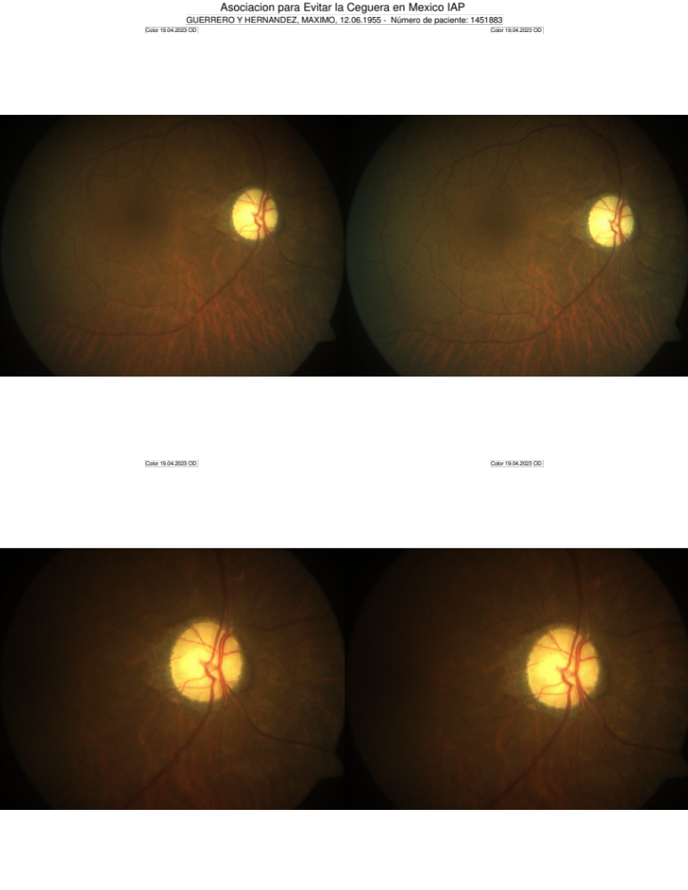
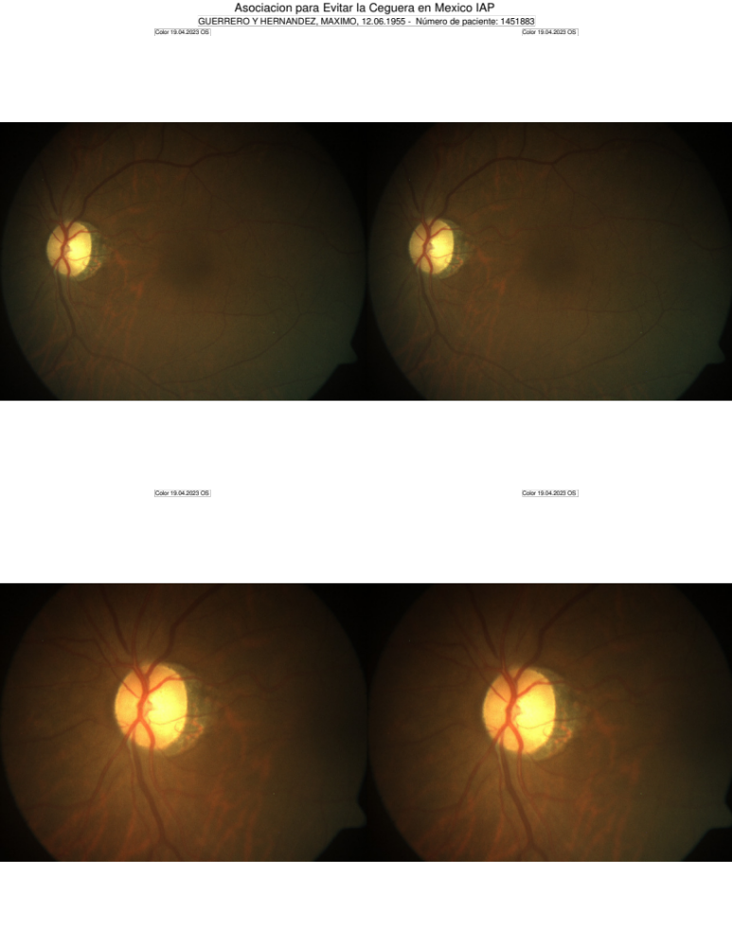
Ophthalmoscopy
What testing would you order now?
Notes:
In the posterior segment: sharp, flat and yellow optic disc nerves. The retina was unremarkable in both eyes.
What testing would you order now?

Slide 6
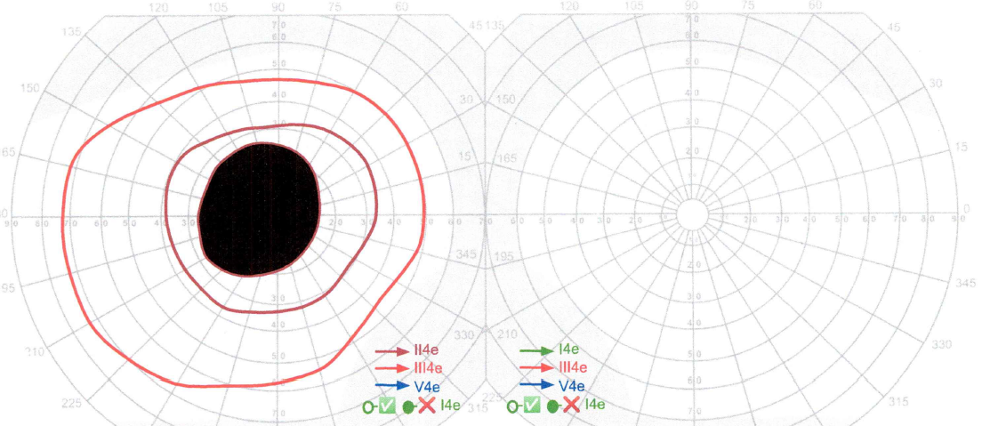
Goldmann Visual Field
OS
OD
What visual field abnormality do you see?

Slide 7

Differential diagnosis and approach
Decreased visual acuity
Decreased color vision
Visual field defect
RAPD
Optic disc: normal, edema or atrophy
Neuroimaging (MRI)
OPTIC NEUROPATHY
★
OPTIC NEURITIS
<40
>40
Anterior ischemic optic neuropathy (NAION)
Age
Painless (90%)
Unilateral
Sudden onset
Altitudinal visual field defect
May not show evident decreased color vision
Small cup
Vasculopathic risk factors
Neuroretinitis
Traumatic optic neuropathy
Radiation optic neuropathy
Macular Star?
Trauma?
Radiation?
★
Yes
★
No
Yes
★
No
Neuroimaging (MRI)
Structural lesion: Compressive optic neuropathy
Inflammation: Infection, autoimmune
No visible lesion: Toxic, hereditary or nutritional
★ = Specific approach must continue
= Not the pathway in our patient
Adapted from Smith SV, 2019
Notes:
First AION may not have color vision abnormalities that are evident in standard color testing.
Then, the way I interpret the chart, the only case that are to be neuroimaged are those leading to the box at the bottom middle, meaning a non-sophisticated user may think we do not image optic neuritis, traumatic optic neuropathy… I think the slide needs be reworked or have additional text added to clarify
We understand the concern, we add clarification. Always remembering the objective of the presentation

Slide 8
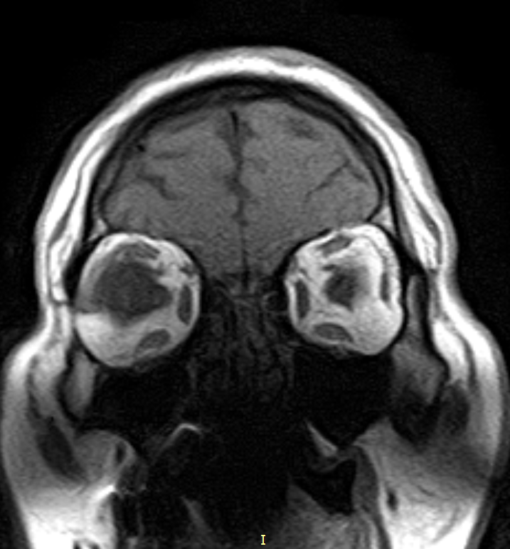
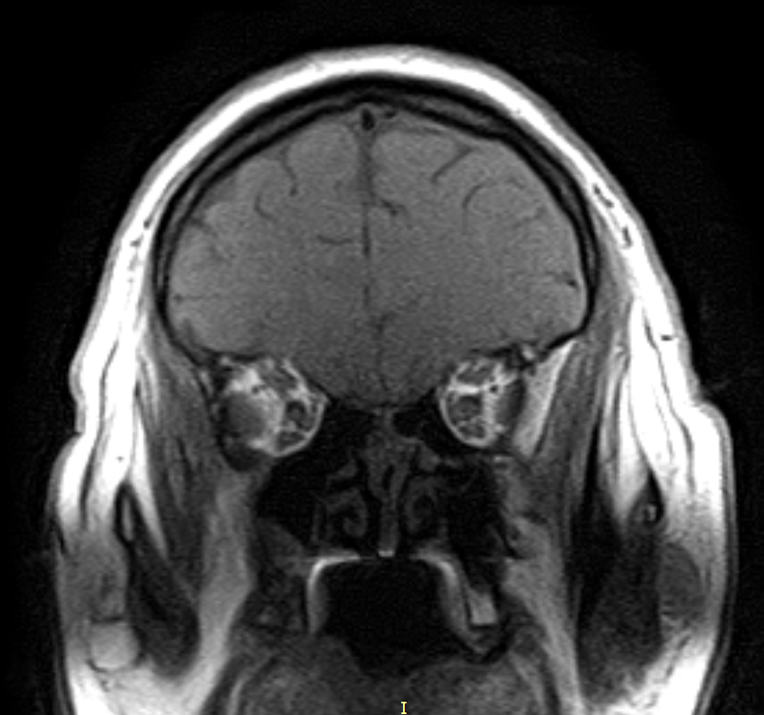
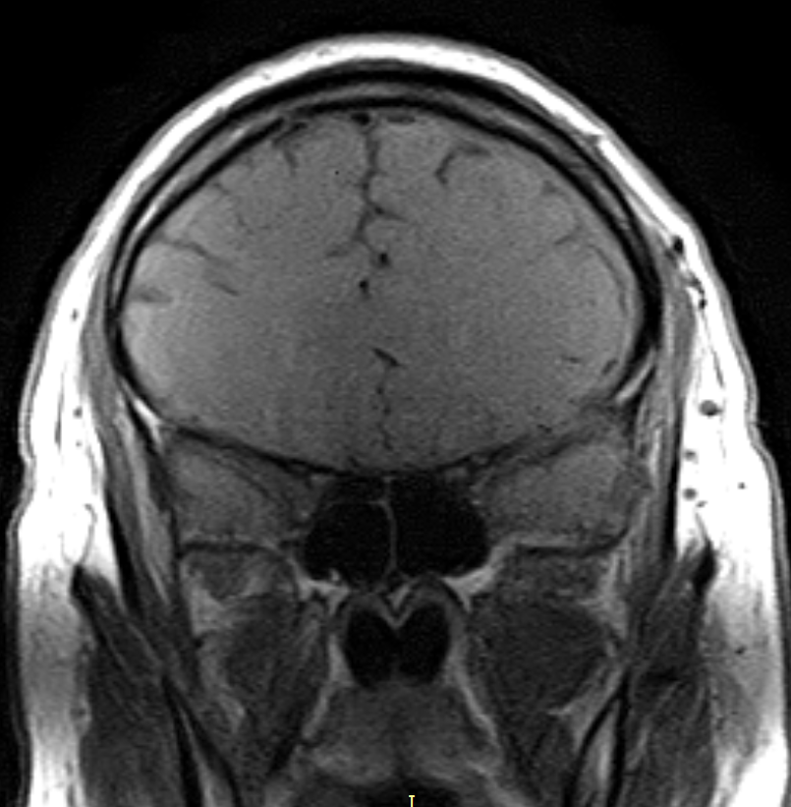
MRI, T1 non-contrast
Notes:
I think slides 8,9,10 would be better if they had arrows flying in pointing out what the user should observe
Have been added

Slide 9
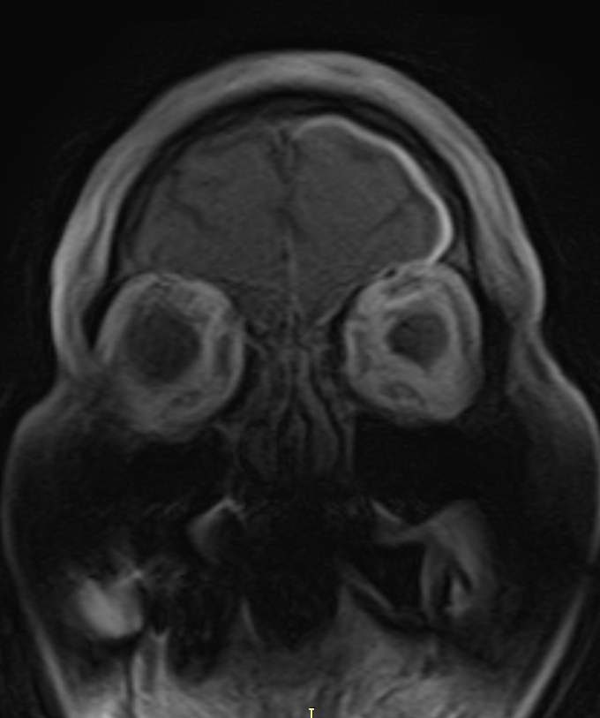
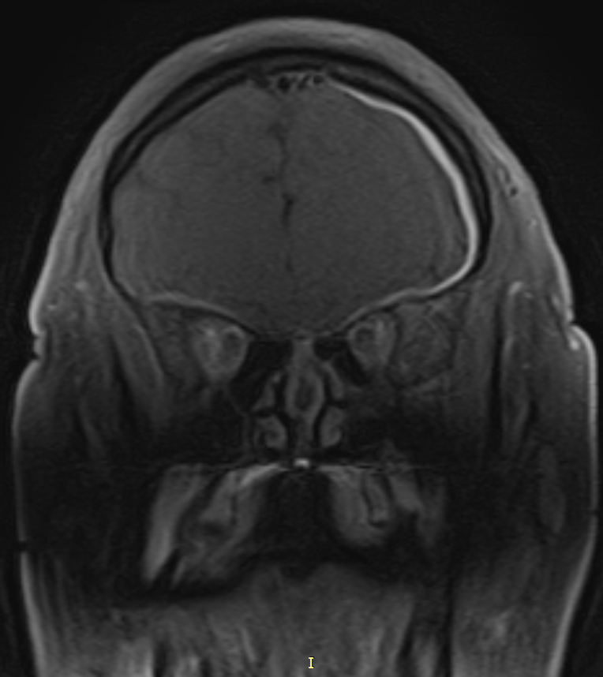
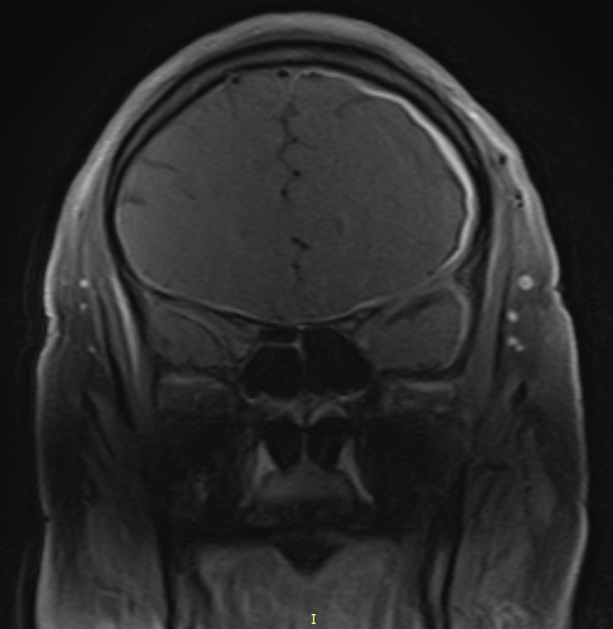
MRI, post-contrast T1-weighted sequence
What abnormality do you see?
Notes:
I think slides 8,9,10 would be better if they had arrows flying in pointing out what the user should observe
Have been added

Slide 10
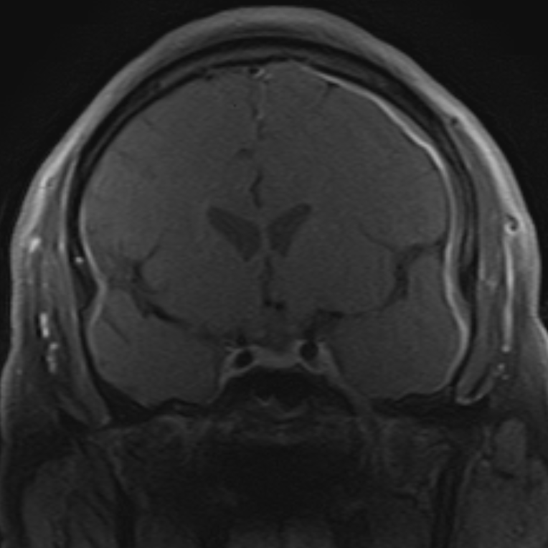
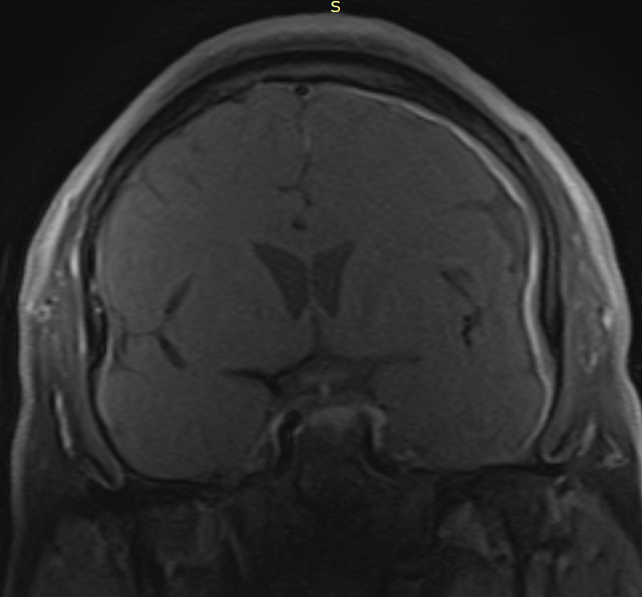
What mechanism could cause an optic neuropathy in this case?
Notes:
I think slides 8,9,10 would be better if they had arrows flying in pointing out what the user should observe
Have been added

Slide 11
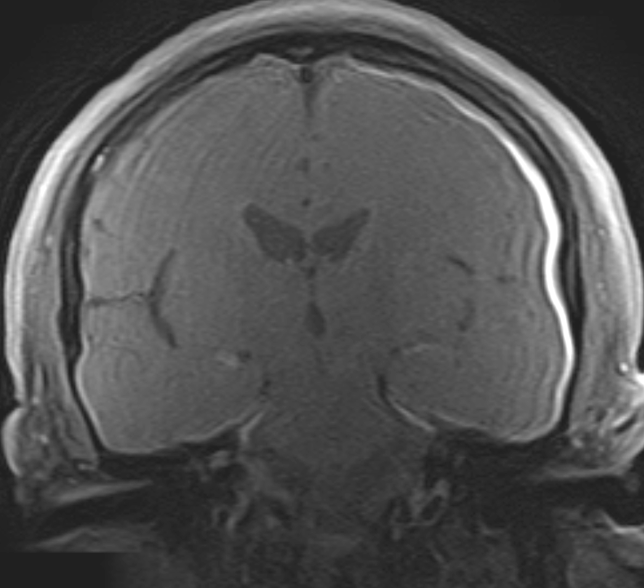
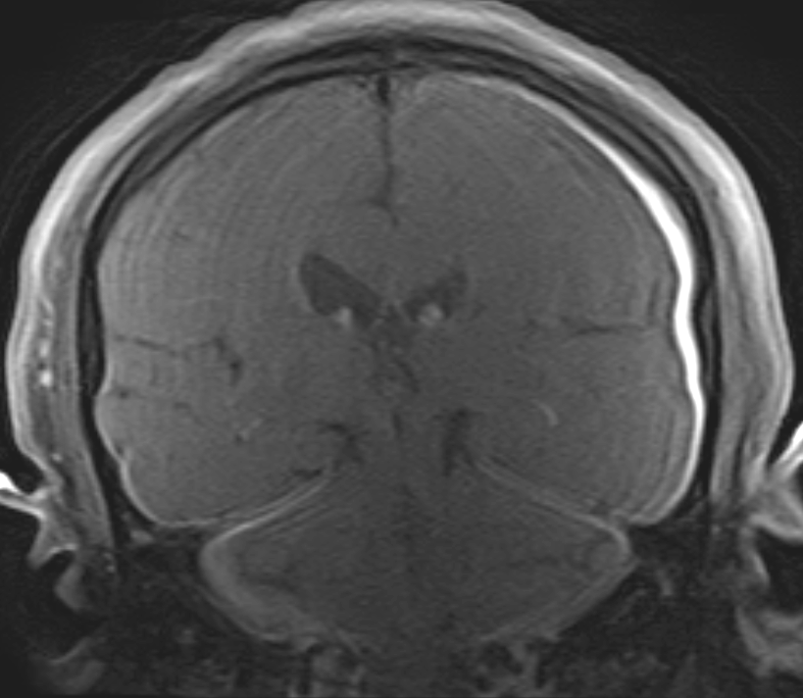
Are those findings supratentorial or infratentorial and how does the pattern affect the differential?

Slide 12
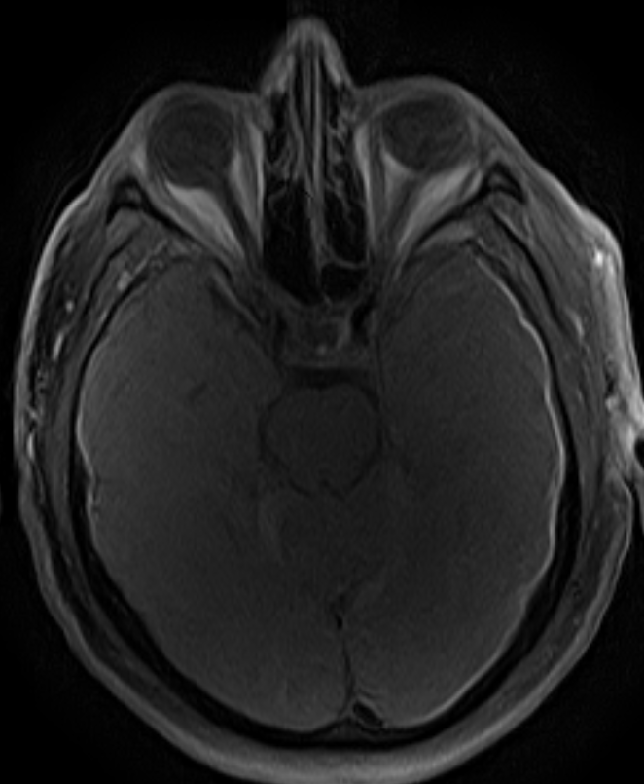
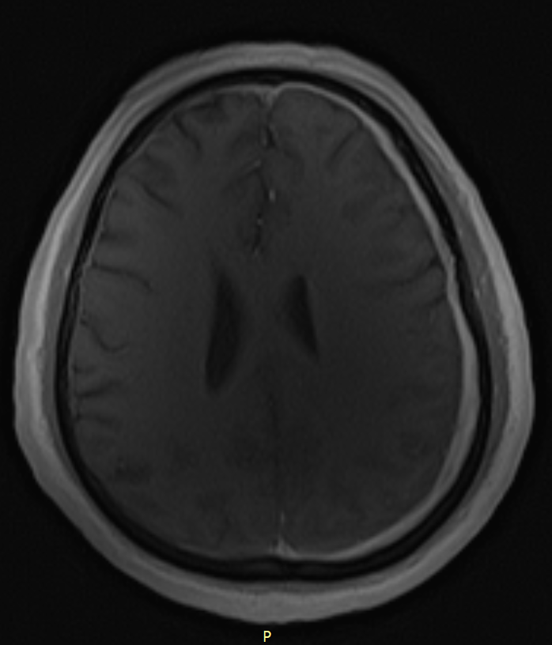
Why is it not leptomeningitis?
Notes:
Slide 12- narration will, I hope include differentiating pacyhy from leptomengitis?
This was exactly the idea of the narration for this slide.

Slide 13
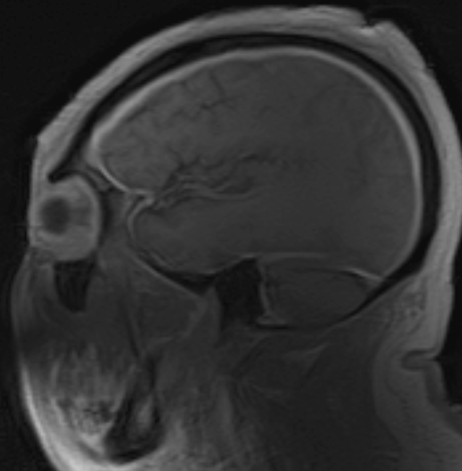
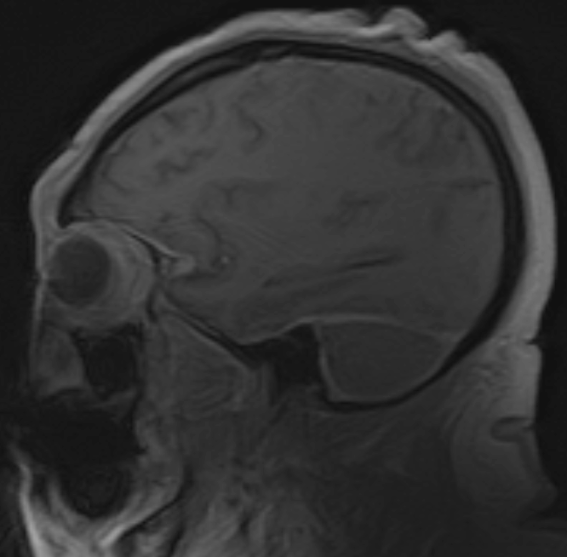
What diseases could be the cause of this radiological syndrome?

Slide 14
Main causes of hypertrophic pachymeningitis
Inflammatory | Infectious
IgG4-related disease | Tuberculosis
Granulomatosis with polyangiitis | Syphilis
Sarcoidosis | Fungal infections
Rheumatoid arthritis | Sinusitis complication
Sjögren syndrome | Neoplasic
Systemic lupus erythematosus | Lymphoma
Giant-cell arteritis | En plaque meningioma
Behçet’s syndrome | Carcinomatous meningitis
Relapsing polychondritis | Histiocytosis
 | Other
Idiopathic | Previous surgical procedure
 | Cerebrospinal fluid hypotension (eg. post spinal tap, CSF fistula)
Notes:
The main causes of pachymeningitis are classified as: inflammatory, idiopathic, infectious, neoplastic and others etiologies. The differential must be guided by the age, sex, course of the disease and a detailed history of the patient

Slide 15
Differential Diagnosis
Hypertrophic Pachymeningitis
Granulomatosis with polyangiitis
  Vasculitis associated with anti-neutrophil cytoplasmic antibody (ANCA).
  Involvement of the respiratory tract and kidney.
Sarcoidosis
  Noncaseating granulomas in any organ.
IgG4-related disease
  Fibroinflammatory disease that can affect any organ, but most frequent: lacrimal and salivary glands, the pancreas and biliary tree and the retroperitoneal space.
Idiopathic pachymeningitis
  Exclusion of the others
Notes:
Slide 15- I think “sarcoidosis” is indented when it should not be
Thank you for the observation. We remove the indentation

Slide 16
Further Evaluation – Etiologic investigation
Sequential Vision loss + Bilateral optic atrophy + Pachymeningitis
Erythrocyte sedimentation rate: 23 mm/h
C-reactive protein: Positive 39.35 (0.10-3.0)
Serum VDRL: Negative
Rheumatoid factor: Positive (1:16)
Serum ANA indirect immunofluorescence (nuclear): Positive (1:640)nuclear homogeneous
MPO- ANCA ELISA: Positive (152.14 UR/mL) (<20 Negative)
PR3-ANCA: Negative (<2.00 UR/mL) (<20 Negative)
ACE: 31.0 (13.3-63.9)
Not completed due to lack of resources
HIV serology
PCR for Mycobacterium tuberculosis
PPD
Serum IgG4
FTA-abs
Spinal tap
Notes:
Slide 16- homogeneous is not spelled correctly
Thank you for the observation. It is now spelled correctly

Slide 17
ANCA-associated Vasculitis (AAV)
 | MPA | GPA | EGPA
cANCA/PR3 | 10-20% | 80-95% generalized 40-75% localized | 0-10%
pANCA/MPO | 60-85% | 0-10% | 30-60%
MPA - Microscopic polyangiitis
GPA - Granulomatosis with polyangiitis
EGPA - Eosinophilic granulomatosis with polyangiitis

Slide 18

However, for the appointment when he brought these last results, the examination changed…
Best-corrected visual acuity:
  No light perception OD
  No light perception OS
Former: No light perception OD, Counting fingers at 3 feet OS.
What would you do?

Slide 19
TREATMENT
Sight threatening disease
IV Methylprednisolone 1,000 mg/day for five days followed by prednisone 1mg/kg.
IV Cyclophosphamide 1,000mg every 2-3 weeks, four doses.
Methotrexate: subcutaneous weekly 17.5mg was started at the end of cyclophosphamide cycles.
Oral Prednisone: 7.5 mg qd
19

Slide 20
Follow-up
 | Visual Acuity OS
First visit | Counting fingers at 3 feet
Second visit | No light perception
After pulses | Hand movement
One week after methylprednisolone pulses | Counting fingers at 3 feet
Nine months after methylprednisolone pulses | Counting fingers at 3 feet
What additional tests would you order for this patient’s follow-up?

Slide 21
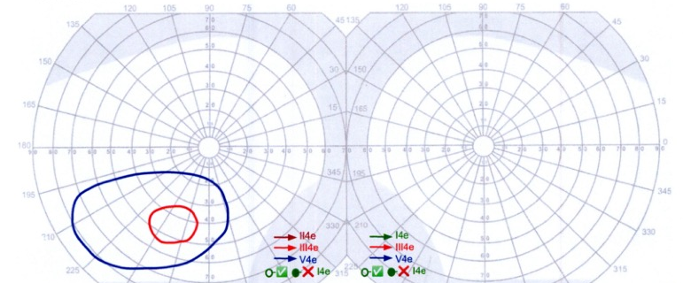
Goldmann Visual Field
One week after pulses
OS
OD

Slide 22
Follow-up
 | Visual Acuity OS | C reactive protein
First visit | Counting fingers at 3 feet | NA
Second visit | No light perception | 39.35 (0.10-3.0)
After pulses | Hand movement | NA
One week after methylprednisolone pulses | Counting fingers at 3 feet | 1.67 (0.10-3.0)
Nine months after methylprednisolone pulses | Counting fingers at 3 feet | NA

Slide 23
Differential Diagnosis
Systemic vasculitis – ANCA associated vasculitis (AAV)
Sarcoidosis
IgG4-related disease
Idiopathic pachymeningitis
Infectious
Neoplastic
Can you eliminate any differential diagnosis at this point?
Notes:
Is it possible to eliminate any of the differential diagnoses at this point? The incomplete paraclinical testing in our patient lack of economic resources didn’t allow us to ruleout some of them. However, with the clinical history, the MRI, positive MPO/pANCA and rheumatology assessment, we leaned towards the diagnosis of a MPO positive vasculitis.

Slide 24
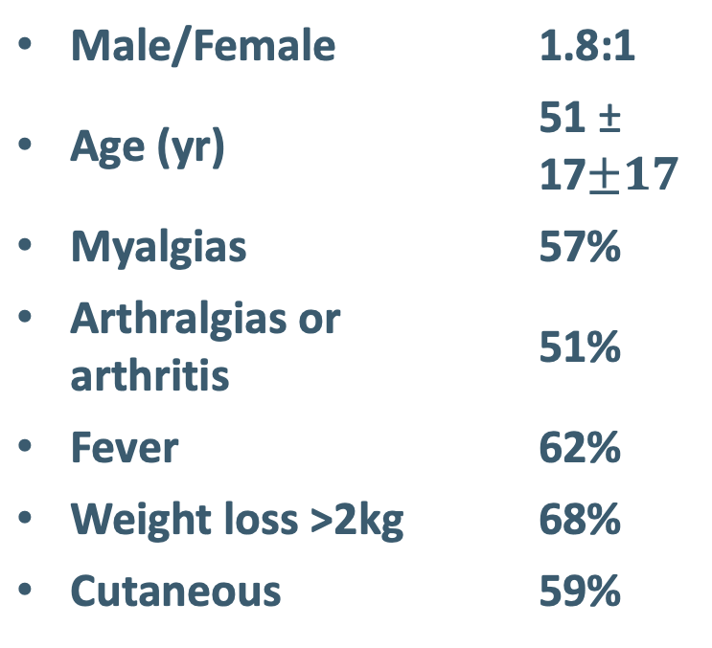
MPO+ Vasculitis
Systemic Manifestations
Male/Female | 1.8:1
Age (yr) | 51 ± 17$±17$
Myalgias | 57%
Arthralgias or arthritis | 51%
Fever | 62%
Weight loss >2kg | 68%
Cutaneous | 59%
Ear, nose and throat | 5%
Chest | 15%
Cardiovascular | 23%
Abdominal | 45%
Renal | 49%
Nervous system | 75%

Slide 25
Microscopic polyangitis - anti-MPO immunoassay
Meta-analysis report
Sensitivity is 58.1% (34.6% to 78.5%)
Specificity is 95.6% (92.0% to 97.6%)
A biopsy remains the most reliable way to diagnose AAV. However, considering that a biopsy is invasive for the patient and not always possible, ANCA serology takes an important place in the workup for the diagnosis of AAV.
Guchelaar NAD, 2021

Slide 26
Maintenance treatment
Methotrexate (20-25 mg/week)
Azathioprine (2-3 mg/kg/day)
Mycophenolate mofetil (500-2,000 mg/day)
Refractory: rituximab

Slide 27
Summary
Etiologic diagnosis of chronic pachymeningitis is a challenge, but when it is made promptly it creates a window of opportunity for treatment that is crucial to avoid permanent symptoms.
Work-up includes
  Initial: MRI (brain and orbits) with contrast.
  Etiologic work-up: Serum IgG4, ANCA, ANA, Rheumatoid factor, Serum VDRL , FTA, HIV serology, PCR for Mycobacterium tb, Galactomannan, hypophysis survey, Sinus CT, Abdominal MRI, Cervical US, long bones radiology
Dural biopsy is the gold standard test.
Multidisciplinary assessment and management with rheumatology.
Notes:
Etiologic diagnosis of a chronic pachymeningitis remains a challenge. However, when made promptly, it gives an opportunity for specific treatment which is crucial to avoid incapacitating sequelae. Pachymeningitis syndromes work-up include brain MRI (With contrast), serum IgG4 levels, ANCA, ANA, rheumatoid factor, serum VDRL, treponemal tests, HIV serology, PCR for Mycobacterium tb, Galactomannan, hypophysis survey, Sinus CT, Abdominal MRI, Cervical US and long bones radiographies. Ultimately, dural biopsy is the gold standard, but is rarely done, and multidisciplinary assessment and management with rheumatology specialist is crucial. AND DO NOT FORGET, an OPTIC NEUROPATHY CAN BE THE PRESETING COMPLAINT OF A SYSTEMIC INFLAMMATORY DISEASE

Slide 28
References
Abrantes FF, Moraes MPM, Rezende Filho FM, Pedroso JL, Barsottini OGP. A clinical approach to hypertrophic pachymeningitis. Arq Neuropsiquiatr. 2020 Dec;78(12):797-804. doi: 10.1590/0004-282X20200073. PMID: 33295420.
Hellmich B, Sanchez-Alamo B, et al. EULAR recommendations for the management of ANCA-associated vasculitis: 2022 update. Ann Rheum Dis. 2023 Mar 16:ard-2022-223764. doi: 10.1136/ard-2022-223764.
M.J. Kupersmith, V. Martin, G. Heller, A. Shah, H.J. MitnickId Idiopathic hypertrophic pachymeningitis Neurology Mar 2004, 62 (5) 686-694; DOI: 10.1212/01.WNL.0000113748.53023.B7
Xiao X, Fu D, Feng L. Hypertrophic Pachymeningitis in a Southern Chinese Population: A Retrospective Study. Front Neurol. 2020 Nov 17;11:565088. doi: 10.3389/fneur.2020.565088. PMID: 33281701; PMCID: PMC7705170.
Guchelaar NAD, Waling MM, Adhin AA, van Daele PLA, Schreurs MWJ, Rombach SM. The value of anti-neutrophil cytoplasmic antibodies (ANCA) testing for the diagnosis of ANCA-associated vasculitis, a systematic review and meta-analysis. Autoimmun Rev. 2021 Jan;20(1):102716. doi: 10.1016/j.autrev.2020.102716. Epub 2020 Nov 13. PMID: 33197574.
Mekinian A, Maisonobe L, Boukari L, Melenotte C, Terrier B, Ayrignac X, Schleinitz N, Sène D, Hamidou M, Konaté A, Guilpain P, Abisror N, Ghrenassia E, Lachenal F, Cevallos R, Roos-Weil R, Du LTH, Lhote F, Larroche C, Bergmann JF, Humbert S, Fraison JB, Piette JC, Guillevin L, Dhote R, Amoura Z, Haroche J, Fain O. Characteristics, outcome and treatments with cranial pachymeningitis: A multicenter French retrospective study of 60 patients. Medicine (Baltimore). 2018 Jul;97(30):e11413. doi: 10.1097/MD.0000000000011413. Erratum in: Medicine (Baltimore). 2018 Aug;97(33):e12063. PMID: 30045263; PMCID: PMC6078725.
Smith SV, Lee AG, Brazil PW. Clinical Pathways in Neuro-Ophthalmology. 3rd ed. Thieme Medical Publishers, New York, 2019

