Slide 1


Vision loss and difficulty walking in a pediatric sexual assault victim
James M. Harris, MD, PhD (Massachusetts Eye and Ear)
Leyla Yavuz Saricay, MD, FEBO (Massachusetts Eye and Ear)
Austin T. Gregg, BS (Harvard Medical School)
Amy Armstrong-Javors, MD (Massachusetts General Hospital)
Anne Fulton, MD (Boston Children’s Hospital)
Eric D. Gaier MD, PhD (Boston Children’s Hospital)
Notes:
My name is Austin Gregg and on behalf of my co-authors at Boston Children’s Hospital and Harvard Medical School, we present this UPFRONT clinical case outlining the workup and treatment of vision loss and difficulty walking in a pediatric sexual assault victim.

Slide 2
11-year-old girl with history of sexual trauma presents with concern for functional vision loss
  Age <6: Motor, social, and language delay, but never received early intervention services.
  Age 6: Insomnia, headaches, difficulties at school (inattention, acting up, unable to complete tasks; ADHD suspected). Failed vision screen with PCP, and referred to optometry where BCVA 20/50, 20/40 (LEA). Normal DFE. Physiologic hyperopic astigmatism, treated with eye-glasses.
Notes:
The patient is an 11-year-old girl who presented for neuro-ophthalmic consultation with concerns for functional vision loss attributed to her history of sexual trauma.
Prior to age 6, she was noted to have motor, social, and language delays. She began suffering from insomnia, headaches and difficulties at school. After failing a vision screen with her PCP, she was referred to optometry where her best corrected visual acuity was 20/50 OD and 20/40 OS using LEA ( a visual acuity test designed for children who do know how to read letters). She had physiologic hyperopic astigmatism which was treated with glasses

Slide 3

11-year-old girl with history of sexual trauma presents with concern for functional vision loss
  Age 7: Worsening visual function, sitting close to screens and squinting. BCVA: unable to see Feinbloom chart (see below) at 1 foot. Describes shape when letter is presented. Ddx: functional vision loss vs visual processing disorder.
  Age 8: Presented to emergency department after sexual assault. HIV prophylaxis (lamivudine and lopinavir/ritonavir) initiated. Became withdrawn with decreased verbal engagement.
www.kornfeldlowvision.com/
Feinbloom Chart for low visual acuity
Notes:
One year later, her family suspected worsening visual function. On repeat exam, she was unable to see the Feinbloom chart for low vision at 1 foot. She described shapes when letters were presented. At this time, the differential diagnosis included functional vision loss or a visual processing disorder.
At age 8, she presented to the emergency department after suffering sexual assault and became more socially withdrawn at home and school.

Slide 4
11-year-old girl with history of sexual trauma presents with concern for functional vision loss
  Age 9: Formally diagnosed with ADHD, started on amphetamine-dextroamphetamine.
  Age 10: BCVA 5/700 (Feinbloom). Otherwise unremarkable eye exam.
  Age 11: Neurology: progressively worsening shuffling gait and fatigue. Worsening stutter. Unable to perform heel to toe, jump or walk on toes
Notes:
At 9 years old, she was formally diagnosed with ADHD.
One year later, her BCVA was 5/700 in both eyes on Feinbloom and the rest of her eye exam remained unremarkable.
At the age of 11, she displayed progressive worsening of neurologic symptoms including gait abnormalities, prominent stutter and was unable to perform heel-toe walk, jump, or walk on her toes.

Slide 5
11-year-old girl with history of sexual trauma presents with concern for functional vision loss
  Age 11: BCVA 20/160 OU (LEA at 3ft), unable to see Feinbloom or count fingers. Jerky EOMs. Vision loss out of proportion to exam. Streff syndrome (functional vision loss) suspected. Advised second opinion with ophthalmology.
  Age 11: Below age expectation for neuropsychiatric evaluation. Diagnosed with autism spectrum disorder. Neurologic exam with bradykinesia and gait abnormalities. Progressive cognitive decline.
Notes:
That same year, her BCVA improved to 20/160 in both eyes from LEA at 3 feet, but she was unable to see Feinbloom or count fingers. She displayed jerky extraocular movements. Her vision loss appeared out of proportion to her eye exam. Streff Syndrome, a form of functional vision loss triggered by stress, was suspected. She was referred to pediatric neuro-ophthalmology for a second opinion by her neurologist.
She also underwent a neuropsychiatric evaluation and performed below age expectation leading to a diagnosis of autism. Neurologic exam showed bradykinesia and gait abnormalities.

Slide 6
Past Medical History
  Insomnia, learning disability, ADHD
  Sexual assault (Age 8)
  Umbilical hernia, atrial septal defect
  Contact dermatitis
Past Ocular History
  Hyperopic astigmatism, treated with eye-glasses
  Streff syndrome (functional vision loss)
  Allergic conjunctivitis
Notes:
Additional past medical history included an umbilical hernia, atrial septal defect, and contact dermatitis.
Her past ocular history incudes hyperopic astigmatism treated with glasses, suspected functional vision loss, and allergic conjunctivitis.

Slide 7
Family History
  Paternal family members with ADHD, learning disability, seizures.
  Maternal grandmother and great-grandmother with brain aneurysms and migraines.
  Brother with ADHD and learning disability.
  Lives with mother and 3 maternal half siblings. Finished 5th grade on an individualized educational program.
Social History
Notes:
Her paternal family history included ADHD, learning disability, and seizures and her maternal side included family members with brain aneurysms and migraines. Her brother has ADHD and a learning disability.
The patient lives at home with her mother and three maternal half siblings. She finished fifth grade on an individualized educational program.

Slide 8
Initial Exam
 | Right Eye | Left Eye
Visual acuity | Blinks to light, 20/2700 OU
Cycloplegic Refraction | Plano +1.50 x090 | Plano +1.50 x090
External | Eccentric fixation with “overlooking” (eyes directed above the fixation target)
Pupils | Sluggish pupillary reflex, No relative afferent pupillary defect | Sluggish pupillary reflex, No relative afferent pupillary defect
Confrontational visual fields | Unable due to limited cooperation | Unable due to limited cooperation
Sensorimotor | Highly variable exophoria, no nystagmus
Anterior exam | Unremarkable | Unremarkable
Patient presented in wheelchair with difficulty following directions
Notes:
On presentation, her visual acuity was 20/2700 OU and she blinked in response to light. Her cycloplegic refraction showed mild physiologic hyperopic astigmatism. She has an eccentric fixation gaze where her eyes were directed above the point of fixation. Her pupils were sluggish, but she did not have a relative APD. She was unable to perform confrontation visual field testing. Her sensorimotor exam was notable for a highly variable exophoria without signs of nystagmus, and her anterior eye exam was unremarkable.
Of note, while this patient previously had gait abnormalities, at this visit she required a wheelchair at this visit and had difficulty following verbal directions.

Slide 9
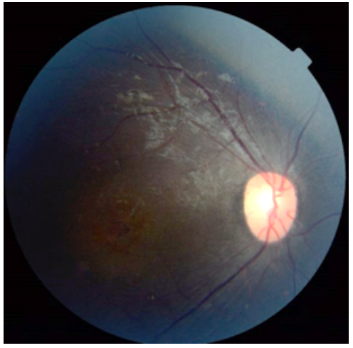
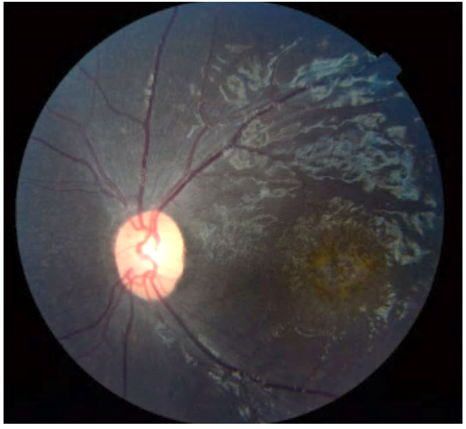
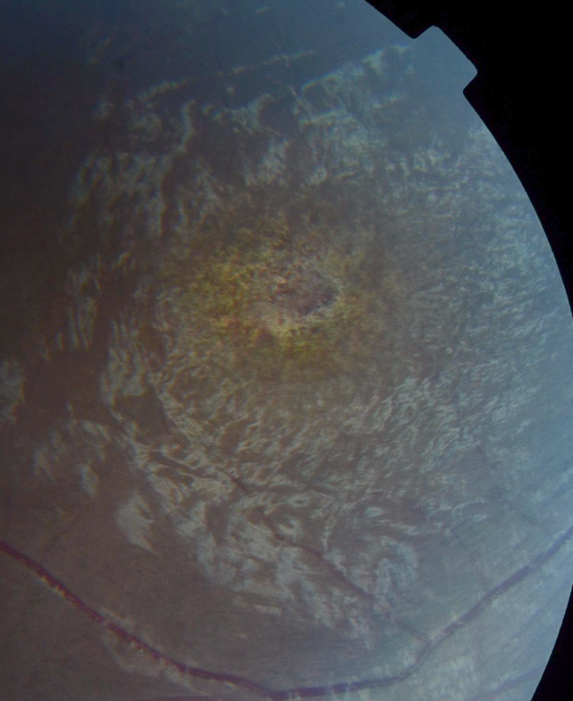
Fundus Photography
What ophthalmic testing would help narrow the differential?
Optic nerve pallor
Retinal vascular attenuation
Diffuse retinal pigment epithelium mottling
Macular orange pigment deposition
Wrinkled cellophane-like macular surface with central retinal atrophy
Notes:
On dilated fundus exam, she had mild optic nerve pallor, retinal vascular attenuation, diffuse retinal pigment epithelium mottling, macular orange pigment deposition, and wrinkled cellophane-like macular surface with central retinal atrophy.
What ophthalmic testing at this time would help narrow your differential?

Slide 10
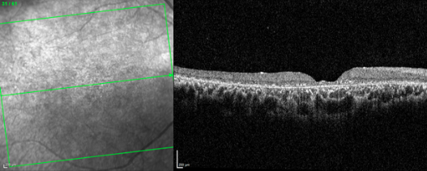
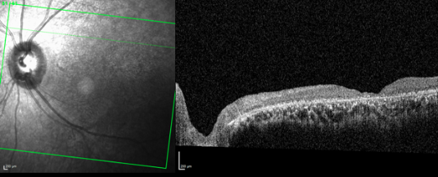
Optical Coherence Tomography Macula
Markedly reduced thickness of all retinal layers
Multiple hyperreflective granules at the level of the retinal pigment epithelium
Abnormal homogenous optical reflectivity of inner retinal layers including the inner nuclear layer
What is the differential for retinal atrophy with progressive neurologic decline in a child?
Notes:
OCT imaging was performed and showed markedly reduced thickness of all retinal layers, multiple hyperreflective granules at the level of the retinal pigment epithelium, and abnormal homogenous optical reflectivity of the inner retinal layers including the inner nuclear layer.
What is the differential for retinal atrophy with progressive neurologic decline in a child?

Slide 11
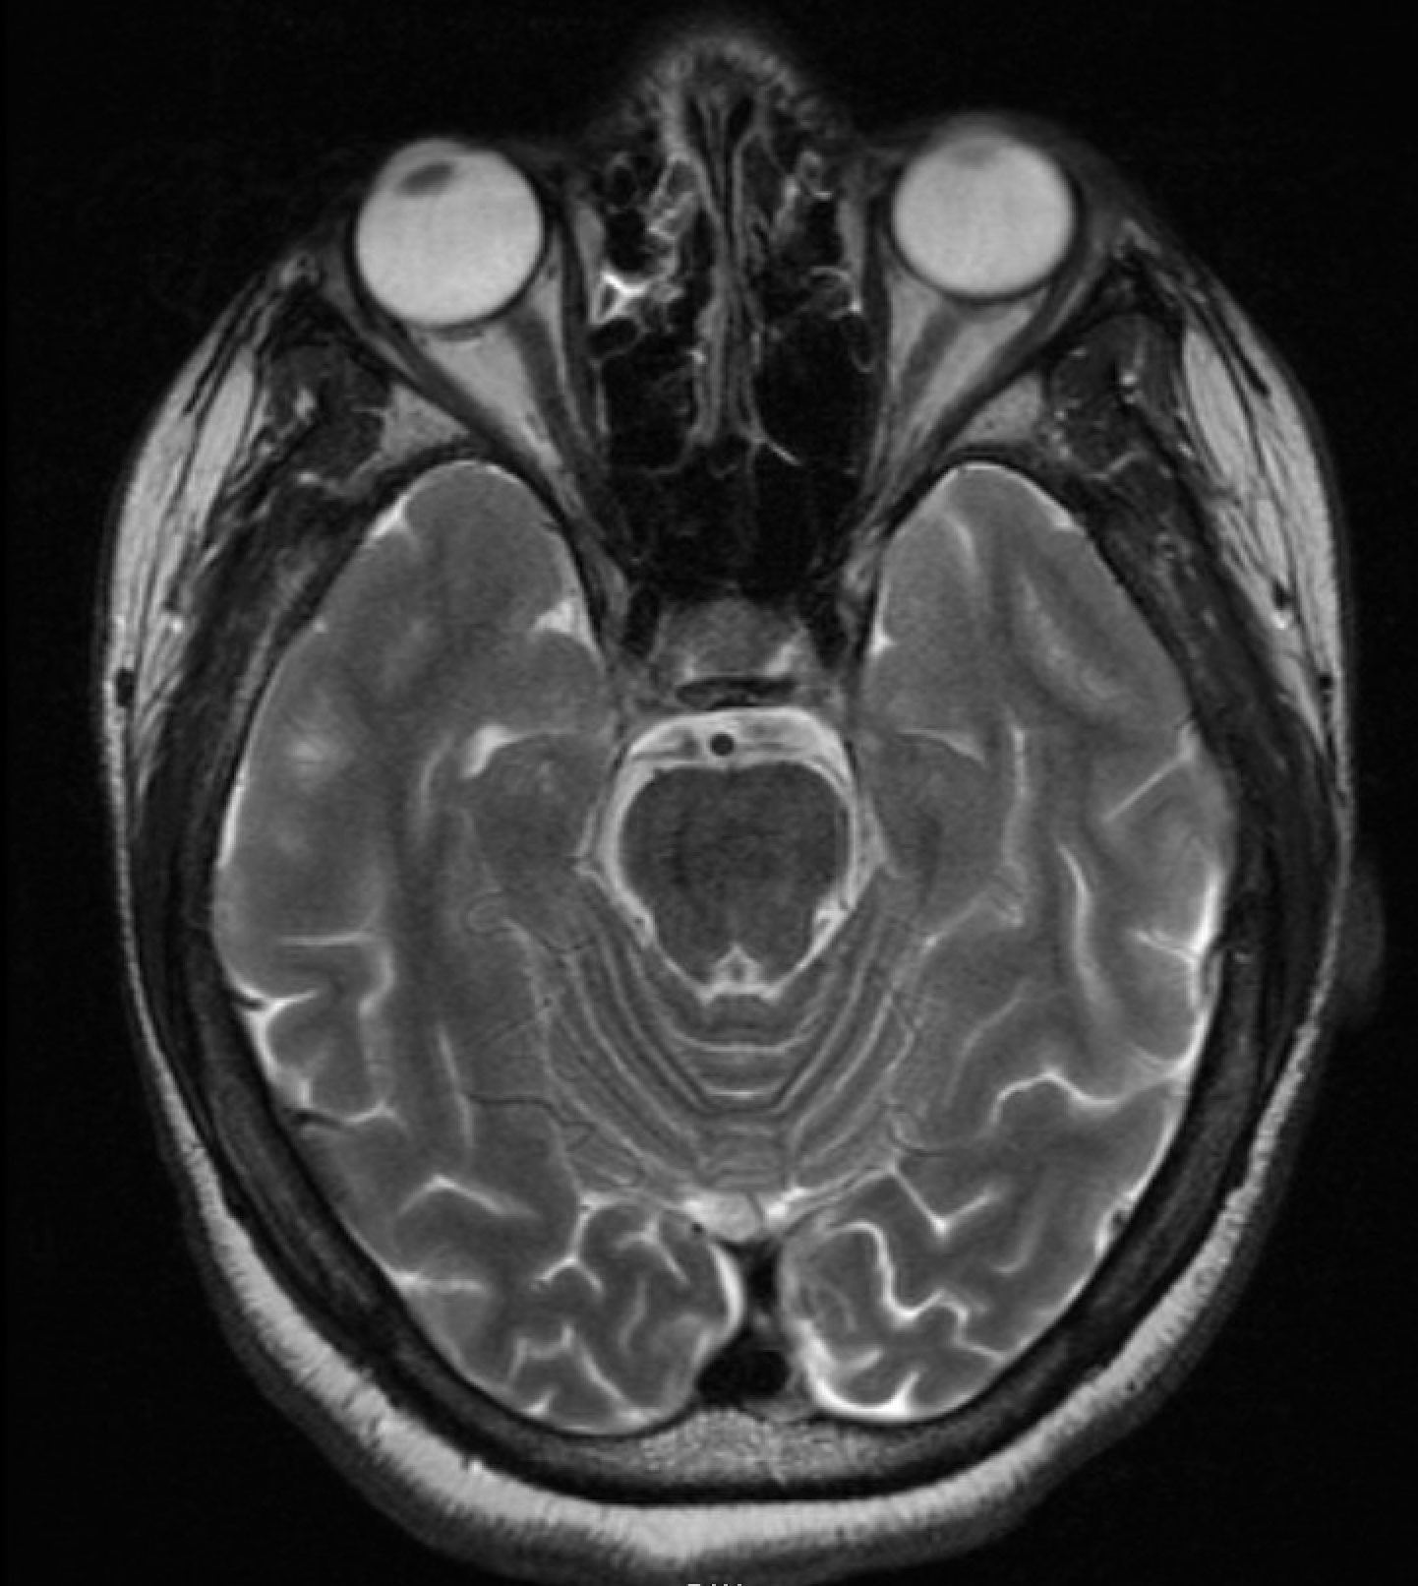
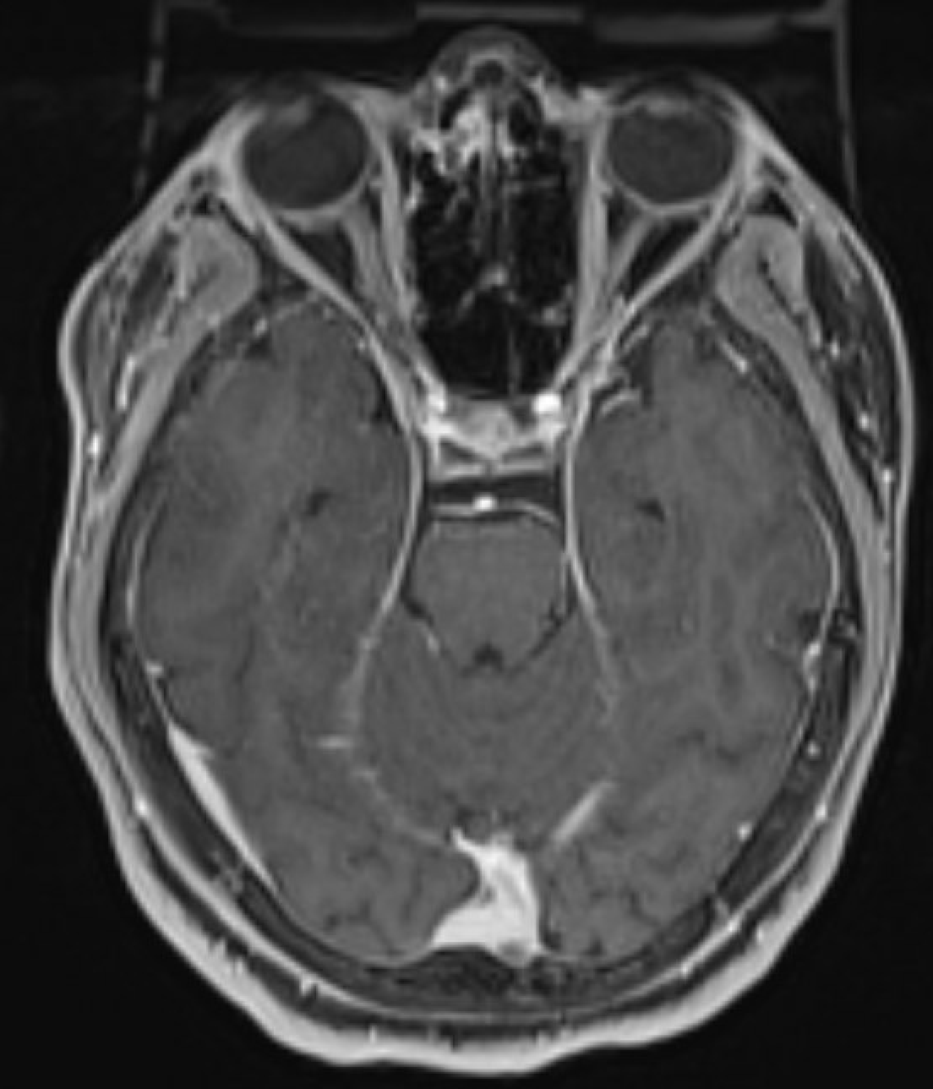
MRI Brain
Axial T2
Axial T1 Post
  Impression:
  No infarction, intracranial hemorrhage, encephalomalacia, hydrocephalus, or large malformation of cortical development
  No optic nerve abnormality, though limited due to motion degradation
Notes:
A previously obtained brain MRI was reviewed and interpreted as normal.

Slide 12
Laboratory Results
CBC/BMP – within normal limits
TSH/A1c – within normal limits
Invitae Neuronal Ceroid Lipofuscinosis gene panel (ATP13A2, CLN3, CLN5, CLN6, CLN8, CTSD, KCTD7, MFSD8, PPT1, and TPP1 genes) – heterozygous for two pathologic variants
  c.461-1 G>T (Splice acceptor)
  c.883G>T (p.Glu295*)
Notes:
Basic labs were within normal limits. Genetic testing revealed compound heterozygous, pathologic variants in the CLN3 gene: one at a splice acceptor site and the other resulting in a nonsense mutation that introduced a premature stop codon.

Slide 13
Final Diagnosis
Genetically confirmed Neuronal Ceroid Lipofuscinosis Type III (NCL3, Batten’s Disease)
Notes:
Thus the final diagnosis confirmed by genetic testing was Neuronal Ceroid Lipofuscinosis Type III (also known as NCL3 or Batten’s Disease)

Slide 14
Interval Update
Four months after initial presentation, VA 20/320 on LEA near card at six inches, 20/250 with both eyes. Manifested exotropia. Otherwise, unchanged examination.
Sleep quality worsened, prescribed clonidine 0.1mg and EEG obtained.
EEG showed frequent epileptiform activity during sleep without clinical seizures, consistent with ESES (electrical status epilepticus of sleep). Treated with a 10-day course of high dose diazepam and maintained on clobazam.
Continued physical therapy/speech therapy/school counselor.
Followed by specialist in neuro-ophthalmology, inherited retinal disorders, epilepsy, and neurology.
Notes:
Four months later, visual acuity was 20/320 on LEA at six inches and 20/250 with both eyes. She displayed a manifest exotropia but had an otherwise unchanged examination. An EEG showed frequent epileptiform activity during sleep without clinical seizures most consistent with ESES. She received symptomatic treatment and continued seeing her support providers.

Slide 15
Neuronal Ceroid Lipofuscinoses (NCL)
Inherited lysosomal storage disorders
  Most common pediatric neurodegenerative disorder, 1-4 per 100,000)^{1,11}
530 mutations in 13 disease-causing genes²
  Autosomal recessive (except CLN4, which is autosomal dominant and adult onset)³
  CLN3 most common¹
Diagnosis often delayed
  Average latency to diagnosis is 2.9 years from first presentation⁴
Notes:
Neuronal ceroid lipofuscinoses are a family of lysosomal storage disorders that collectively represent the most commonly inherited pediatric neurodegenerative disorders worldwide. NCL can result from over 530 mutations spread across 13 genes and are typically inherited in an autosomal recessive pattern. Batten disease, or NCL type 3, is the most common, though the diagnosis is often delayed. In a retrospective case series of 8 patients observed over 8 years, the time from disease onset to diagnosis ranged from 1.5 to 5 years with a mean time of 2.9 years.

Slide 16
Neuronal Ceroid Lipofuscinosis Pathophysiology
NCL genes code for proteins important for lysosomal functions including autophagy, lipid metabolism, and intracellular trafficking⁷.
Lysosomal dysfunction leads to accumulation of autofluorescent ceroid material within neuronal lysosomes causing neurotoxicity and degeneration⁷.
Possible mechanistic similarities between NCL and other neurodegenerative diseases including Alzheimer’s disease, Frontotemporal dementia, and Parkinson’s disease⁸.
Notes:
Genes mutated in NCL code for proteins that localize to the endomembrane system and regulate lysosomal functions including autophagy, lipid metabolism, ion homeostasis, and intracellular trafficking.
Disruption of this system leads to lysosomal dysfunction and the hallmark accumulation of autofluorescent ceroid lipofuscin material within neuronal lysosomes causing neurotoxicity and degeneration.

Slide 17
Treatment and Course
CLN2 enzyme replacement therapy: first and only disease-modifying therapy for NCL
  Intracerebroventricular human recombinant cerliponase alfa replaces the function of the mutated gene in CLN2 (Brineura)⁹
Supportive treatment: antiepileptics, antipsychotics/antidepressants, PT/OT/speech therapy/vision rehab, and symptomatic treatments for sleep and muscle/nerve pain
Progressive neurological deterioration is invariably fatal¹⁰
Notes:
Recently, enzyme replacement therapy has become available as a treatment for late infantile CLN type 2 and slows the decline of motor and language function. It is the first and only disease-modifying therapy for any NCL. While other symptomatic treatments can be offered to patients, progressive neurological decline is unfortunately fatal in NCL, usually by the third decade of life.

Slide 18
Key Points
Functional vision loss and functional neurological disorder can be supported by highly suggestive, positive signs. However, a thorough examination and additional investigations, perhaps including brain MRI and OCT, are important in assessing for other potential pathologies that can explain the deficits or occur in conjunction with a functional disorder. In this sense, functional vision loss can also be considered a diagnosis of exclusion.
Prior or common diagnoses are often effective clinical heuristics. However, the presence of atypical features may suggest alternative diagnoses, especially for rare conditions. Focus on these features can help prevent misdiagnosis or delayed diagnosis and help avoid anchoring bias.
Notes:
Ultimately, the diagnosis of functional disorders involves a mix of positive signs and targeted testing to investigate other plausible or concurrent diagnoses. When atypical disease features arise, one should reconsider prior or common diagnoses and consider a broader differential including rarer conditions.

Slide 19
Key Points
Patients and their families may provide important historical and symptomatic information that can aid in the diagnostic process, but care should be taken to reconcile this information with objective data.
Juvenile neuronal ceroid lipofuscinoses should be suspected in patients <10yo with progressive bilateral visual impairment, retinopathy, and neurological or neuropsychiatric regression.
Notes:
Furthermore, objective data and patient subjective and historical data must be reconciled appropriately, requiring physician judgement and experience. In this case, careful review of the clinical record revealed evidence of decline prior to her trauma.
Lastly, juvenile neuronal ceroid lipofuscinoses should be suspected in patients under ten years of age with progressive visual impairment, retinopathy, and neurological or neuropsychiatric regression.

Slide 20
References
Simonati A, Williams RE. Neuronal Ceroid Lipofuscinosis: The Multifaceted Approach to the Clinical Issues, an Overview. Front Neurol. 2022 Mar 11;13:811686. doi: 10.3389/fneur.2022.811686. PMID: 35359645; PMCID: PMC8961688.
Gardner E, Mole SE. The Genetic Basis of Phenotypic Heterogeneity in the Neuronal Ceroid Lipofuscinoses. Front Neurol. 2021 Oct 18;12:754045. doi: 10.3389/fneur.2021.754045. PMID: 34733232; PMCID: PMC8558747.
Nijssen PC, Ceuterick C, van Diggelen OP, Elleder M, Martin JJ, Teepen JL, Tyynelä J, Roos RA. Autosomal Dominant Adult Neuronal Ceroid Lipofuscinosis: A Novel Form of NCL with Granular Osmiophilic Deposits Without Palmitoyl Protein Thioesterase 1 Deficiency. Brain Pathol. 2003 Oct;13(4):574-81. doi: 10.1111/j.1750-3639.2003.tb00486.x. PMID: 14655761; PMCID: PMC8095852.
Wright GA, Georgiou M, Robson AG, Ali N, Kalhoro A, Holthaus SK, Pontikos N, Oluonye N, de Carvalho ER, Neveu MM, Weleber RG, Michaelides M. Juvenile Batten Disease (CLN3): Detailed Ocular Phenotype, Novel Observations, Delayed Diagnosis, Masquerades, and Prospects for Therapy. Ophthalmol Retina. 2020 Apr;4(4):433-445. doi: 10.1016/j.oret.2019.11.005. Epub 2019 Nov 13. PMID: 31926949; PMCID: PMC7479512.
Collins J, Holder GE, Herbert H, Adams GG. Batten disease: features to facilitate early diagnosis. Br J Ophthalmol. 2006 Sep;90(9):1119-24. doi: 10.1136/bjo.2006.091637. Epub 2006 Jun 5. PMID: 16754648; PMCID: PMC1857407.

Slide 21
References
Mantel I, Brantley MA Jr, Bellmann C, Robson AG, Holder GE, Taylor A, Anderson G, Moore AT. Juvenile Neuronal Ceroid Lipofuscinosis (Batten disease) CLN3 mutation (Chrom 16p11.2) with Different Phenotypes in a Sibling Pair and Low Intensity in vivo Autofluorescence. Klin Monbl Augenheilkd. 2004 May;221(5):427-30. doi: 10.1055/s-2004-812819. PMID: 15162299.
Huber RJ. Recent Insights into the Networking of CLN Genes and Proteins in Mammalian Cells. J Neurochem. 2023 Jun;165(5):643-659. doi: 10.1111/jnc.15822. Epub 2023 Apr 28. PMID: 37022340.
Lee JY, Marian OC, Don AS. Defective Lysosomal Lipid Catabolism as a Common Pathogenic Mechanism for Dementia. Neuromolecular Med. 2021 Mar;23(1):1-24. doi: 10.1007/s12017-021-08644-4. Epub 2021 Feb 7. PMID: 33550528.
Lewis G, Morrill AM, Conway-Allen SL, Kim B. Review of Cerliponase Alfa: Recombinant Human Enzyme Replacement Therapy for Late-Infantile Neuronal Ceroid Lipofuscinosis Type 2. J Child Neurol. 2020 Apr;35(5):348-353. doi: 10.1177/0883073819895694. Epub 2019 Dec 29. PMID: 31884868.
Bozorg S, Ramirez-Montealegre D, Chung M, Pearce DA. Juvenile Neuronal Ceroid Lipofuscinosis (JNCL) and the Eye. Surv Ophthalmol. 2009 Jul-Aug;54(4):463-71. doi: 10.1016/j.survophthal.2009.04.007. PMID: 19539834; PMCID: PMC4139962.
Johnson TB, Cain JT, White KA, Ramirez-Montealegre D, Pearce DA, Weimer JM. Therapeutic landscape for Batten disease: current treatments and future prospects. Nat Rev Neurol. 2019 Mar;15(3):161-178. doi: 10.1038/s41582-019-0138-8. PMID: 30783219; PMCID: PMC6681450.

