Slide 1

Hiding in plain sight
J. Anthony Chacko, MD
PGY-2 Ophthalmology Resident, Jones Eye Institute, University of Arkansas for Medical Sciences
Joseph G. Chacko, MD
Professor of Ophthalmology, Neurology, and Neurosurgery, Director of Neuro-ophthalmology
Jones Eye Institute, University of Arkansas for Medical Sciences

Slide 2
31-Year-Old Caucasian Male with R-sided vision loss
Referred to neuro-op clinic due to a R-sided visual field defect
PMH:
  Migraine headaches w/ aura x 1 year
  Otherwise healthy
  No ocular conditions
  No ocular surgeries

Slide 3

History
  Right-sided vision loss started 10 months ago after an intense migraine that lasted for about 24 hours
  Vision loss is stable

Slide 4
Symptoms
  Persistent right-sided blurry/black spots in vision both eyes
  Denied eye pain, double vision, flashes of light, or curtain coming down over vision
  Endorsed seeing occasional floaters in the left eye

Slide 5
Additional History
  Telestroke evaluation 10 months ago – NIHSS 1 (R-sided VF defect in both eyes)
  MRI brain with and without contrast reported as normal
Notes:
On medical chart review, the patient noted visual changes in both eyes during the telestroke evaluation, but the patient did not receive further stroke work-up at that time besides the MRI brain with and without contrast.

Slide 6
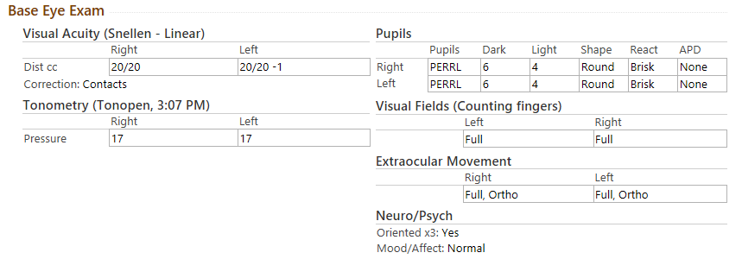
Initial Eye Examination
Color vision (Ishihara): 11/11 both eyes

Slide 7
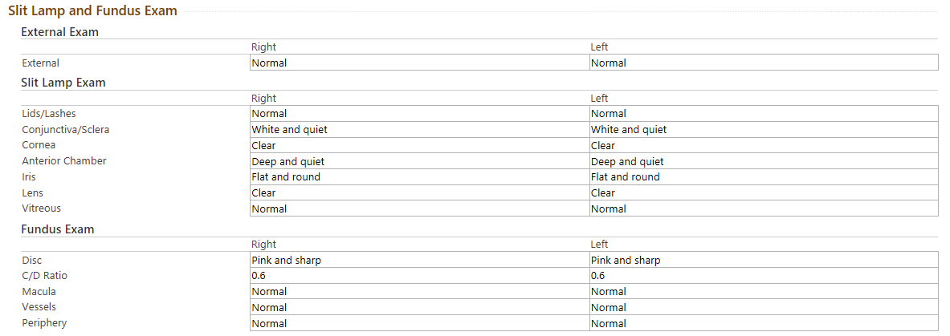
Initial Eye Examination

Slide 8
Initial Eye Examination
HVF 30-2 from outside eye clinic…

Slide 9
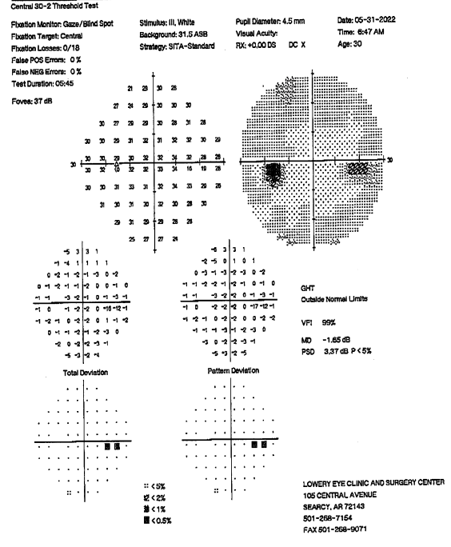
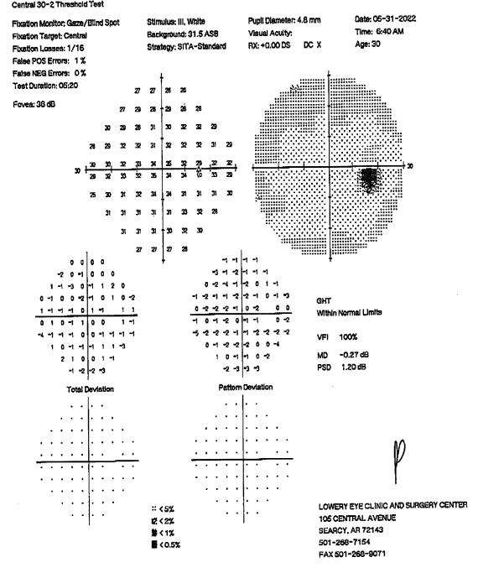
HVF 30-2
What do you see here?
Left Eye
Right Eye

Slide 10
HVF 30-2
What do you see here?
Left Eye
Right Eye

Slide 11
Time to think!
31-Year-Old Caucasian Male with history of migraines w/ aura and otherwise healthy who presents with persistent right-sided blurry/black spots in his vision both eyes
Great VA and exam WNL OU
HVF 30-2: WNL OD, small focal nasal scotoma OS
Differential Diagnosis?

Slide 12
Differential Diagnosis
Early Glaucoma
Focal chorioretinitis
Focal retinal scar
Mild optic neuropathy
Subacute cerebral infarct
Atypical Ocular Migraine
Functional Visual Field Loss
What work-up do we need?

Slide 13
Plan
Bring MRI on CD to next appointment for review
Schedule ECHO
Vascular imaging of the head and neck (carotid duplex, CTA, MRA)

Slide 14
Follow-up visit
Vision stable
Exam unchanged
ECHO had an active order, but not completed yet
Carotid Duplex was WNL:
  “Impression: Normal common, internal, and external carotid arteries bilaterally. Antegrade flow vertebral artery bilaterally.”
Repeat HVF 30-2…
Notes:
Carotid duplex exam at our institution includes evaluation of the vertebral circulation.

Slide 15
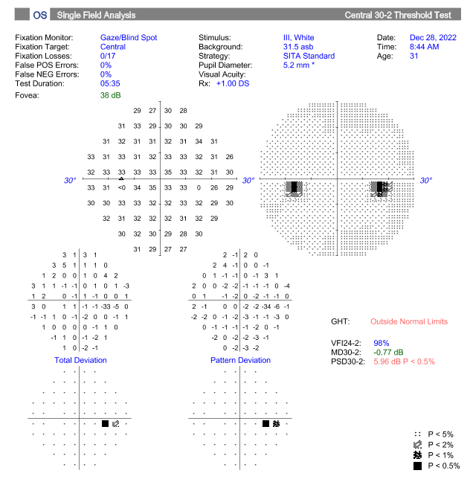
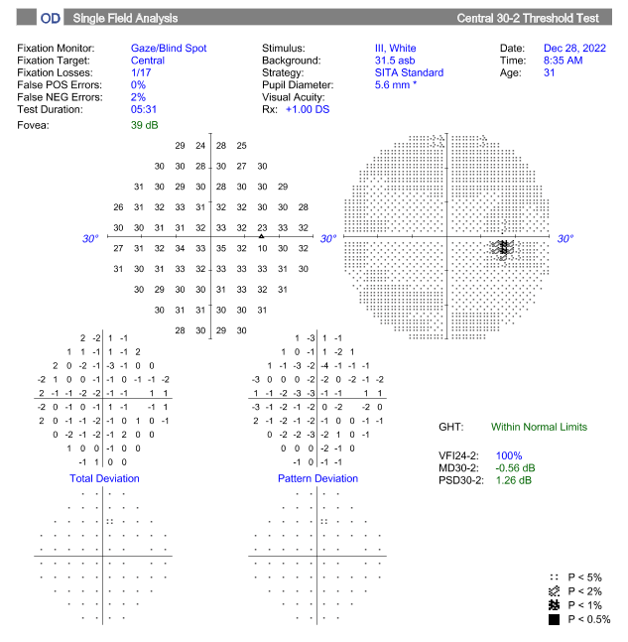
HVF 30-2
What do you see here?
Left Eye
Right Eye

Slide 16
HVF 30-2
What do you see here?
Left Eye
Right Eye

Slide 17
Follow-up visit
MRI scan uploaded from outside hospital…

Slide 18
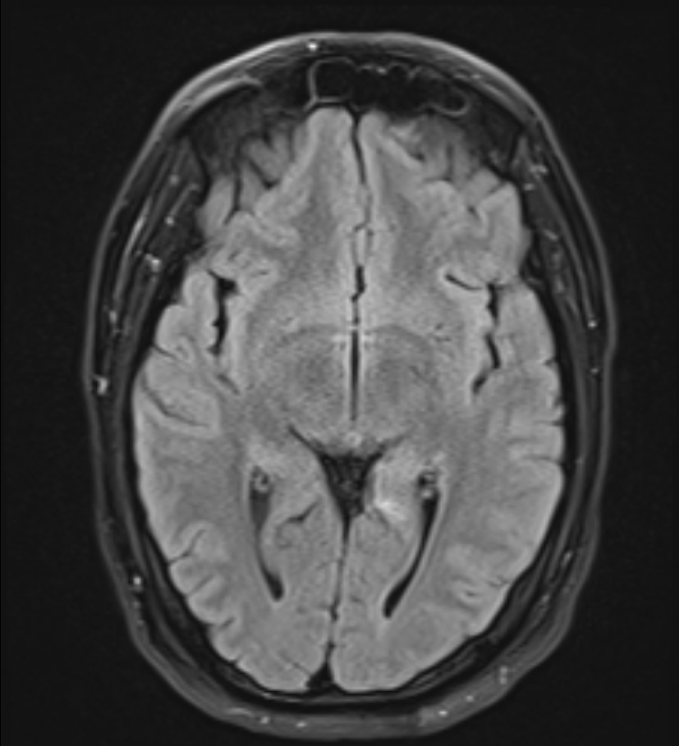
MRI from OSH
Axial T2 Flair
Do you notice any abnormalities?

Slide 19
MRI scan from OSH
Axial T2 Flair

Slide 20
Let’s review!
31-Year-Old Caucasian Male with history of migraines w/ aura and otherwise healthy who presents with persistent right-sided blurry/black spots in his vision both eyes
Great VA and exam WNL OU
HVF 30-2: WNL OD, small focal nasal scotoma OS
MRI brain: 4 mm focus of enhancement in the L anterior occipital lobe

Slide 21
Review
  What is highest on your differential diagnosis?
  What further work-up do we need?

Slide 22
Plan
  Review MRI Brain with neuro-radiology
  Schedule ECHO

Slide 23
Results
  MRI brain with a 4 mm focus of enhancement in L ant occipital lobe
  DDx:
    small subacute embolic stroke
    small focus of demyelination
    small cavernous malformation with bleed
Notes:
No GRE or SWI sequences were completed. But an EP2D tra Hemo sequence was done, which is similar to GRE.

Slide 24
And the ECHO Results…
  ECHO Report: “interatrial septum: Large (>20 bubbles), early right-to-left shunt with injection of agitated saline, suggestive of a PFO”
  Cardiology consult placed
  Vascular neurology consult placed

Slide 25
Let’s look at the HVF 30-2 again…

Slide 26
HVF 30-2 from outside eye clinic
Left Eye
Right Eye
R congruous hemianopic scotoma hiding in the physiological blind spot
Notes:
A congruous field defect to the left eye is lost in the physiological blind spot of the right eye.

Slide 27
Repeat HVF 30-2
Left Eye
Right Eye
R congruous hemianopic scotoma hiding in the physiological blind spot

Slide 28
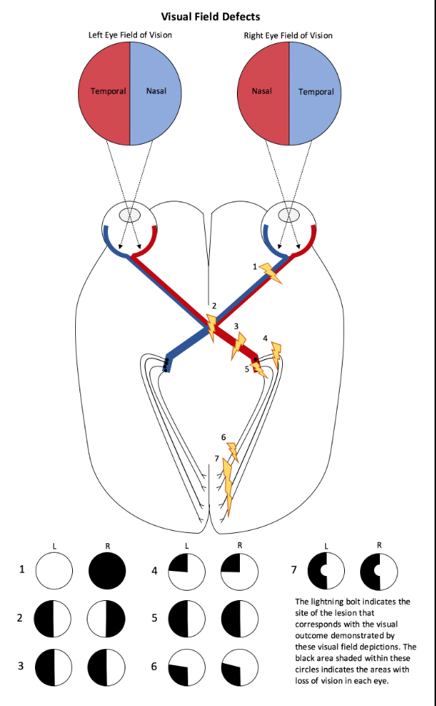
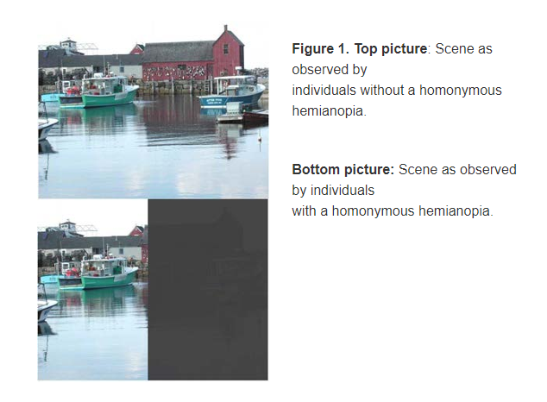
Homonymous Hemianopia (HH)
  loss of one half of the visual field in both eyes respecting the vertical meridian
  any injury to the retro-chiasmal visual pathway

Slide 29
Differential Diagnosis for HH
  Vascular – stroke, venous thrombosis, vasculitis
  Neurologic – seizures, posterior cortical atrophy, multiple sclerosis, sarcoidosis
  Infectious – abscess, encephalomyelitis, toxoplasmosis, cysticercosis
  Iatrogenic – radiation necrosis

Slide 30
Homonymous hemianopia
Stroke accounted for 69.7% of patients with homonymous hemianopia - mean age of 58
Other causes (head trauma, surgery, inflammatory conditions) - mean age of 36
Lesions of the occipital area were most common in stroke patients (54%) followed by lesions of the optic radiations (33%), and optic tract (6%)
Zhang X, Kedar S, Lynn MJ, Newman NJ, Biousse V. Homonymous hemianopias: clinical-anatomic correlations in 904 cases. Neurology. 2006 Mar 28;66(6):906-10.

Slide 31
Future Plan
Closure of Patent Foramen Ovale (PFO) with cardiology

Slide 32
Summary
Trust, but verify!
  Always review neuro-imaging
If your patient develops a homonymous hemianopia, a comprehensive stroke work-up is warranted
  MRI brain and orbits with and without contrast, ECHO, and vascular imaging of the head and neck (carotid duplex, CTA, MRA)

Slide 33
References
https://www.stroke.nih.gov/documents/NIH_Stroke_Scale_508C.pdf.
Ruddy J, Cardenas AC. Hemianopsia. [Updated 2022 Aug 8]. In: StatPearls [Internet]. Treasure Island (FL): StatPearls Publishing; 2023 Jan-. Available from: https://www.ncbi.nlm.nih.gov/books/NBK562262/.
https://www.nanosweb.org/i4a/pages/index.cfm?pageid=4166.
https://morancore.utah.edu/basic-ophthalmology-review/hemianopsia/.
Zhang X, Kedar S, Lynn MJ, Newman NJ, Biousse V. Homonymous hemianopias: clinical-anatomic correlations in 904 cases. Neurology. 2006 Mar 28;66(6):906-10.
Wolberg A, Kapoor N. Homonymous Hemianopsia. [Updated 2022 Jun 27]. In: StatPearls [Internet]. Treasure Island (FL): StatPearls Publishing; 2023 Jan-. Available from: https://www.ncbi.nlm.nih.gov/books/NBK558929/.

