Slide 1
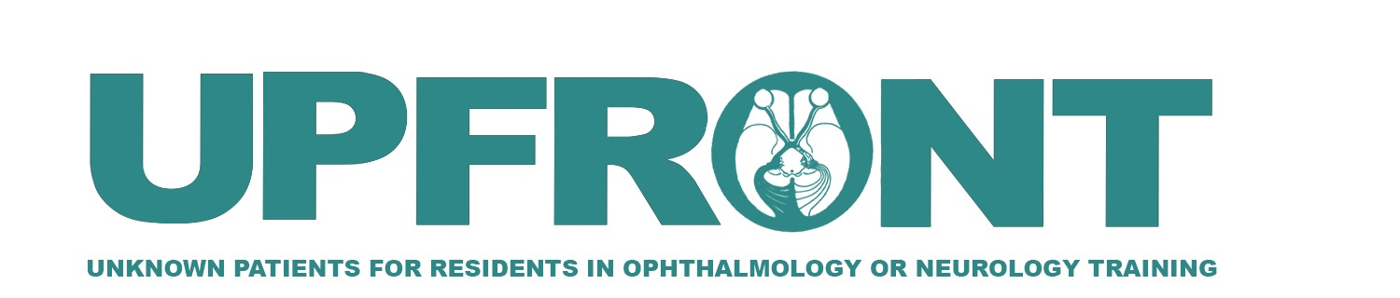

A young girl with subacute vision loss
Nhayoung Hwang¹, MD, Monica Tran², BS, Allan J. Fisher³, MD, FACMG, FACOG,
and Yin Allison Liu^{1,2}, MD, PhD
1. Department of Neurology, University of California, Davis, Sacramento, CA
2. Department of Ophthalmology, University of California, Davis, Sacramento, CA
3. Medical Director, Variantyx, Inc., Framingham, MA

Slide 2
Case description
8-year-old girl
Subacute painless blurred vision of both eyes 1 year ago
Presented to an eye doctor overseas and underwent evaluation
Mother was told that glasses would not help
Referred to an eye specialist and underwent IV and oral treatments that caused weight gain (likely steroids) without noticeable improvement

Slide 3
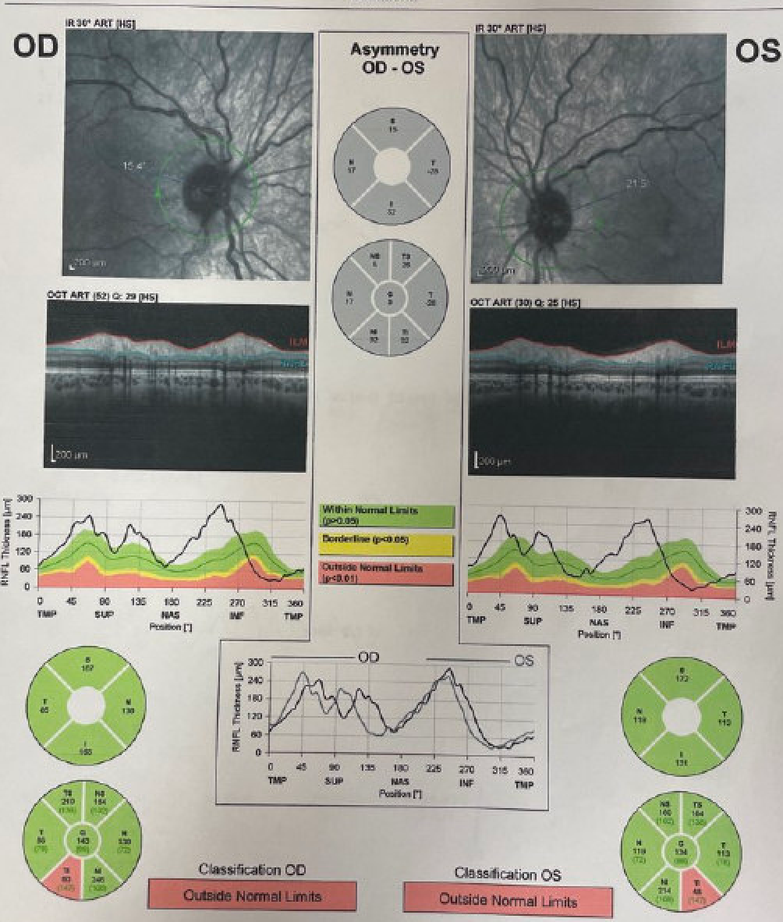
Optical coherence tomography within 1 week of symptom onset
Right eye:
RNFL average thickness: 143 um = thick
Left eye:
RNFL average thickness: 134 um = thick
(Mother hand-carried this record from Ukraine)

Slide 4
Further history
Term birth, no perinatal complications, met all developmental milestones
Had 20/20 vision before 1st grade
No past medical or surgical history, no medications or allergies
Several maternal family members wear glasses; otherwise, no known ophthalmologic family history
Lives in US with family, recently fled the war in Ukraine
Patient has been on a normal diet as per the mother’s report
Slide

Slide 5
Ophthalmologic examination
 | Right eye | Left eye
Visual acuity | CF at 3’ | 20/150
Pupils | 5mm, round, brisk, reactive, no rAPD | 5mm, round, brisk, reactive, no rAPD
IOP | Soft to palpation | Soft to palpation
Confrontation Visual Field | Full | Full
EOM | Full, orthotropic | Full, orthotropic
Ishihara color plates | 1/14 | 14/14
Slit Lamp Exam | Unremarkable anterior segment | Unremarkable anterior segment
Fundus Exam | Optic disc pallor | Optic disc pallor

Slide 6
Neurological examination
General exam: well-appearing young female, NAD
HEENT: Normocephalic, atraumatic, normal conjunctivae, bilateral ears unremarkable
Neurologic:
Awake, alert, appropriately responding to questions.
CN 3-12: Extraocular movements are intact, face is symmetric, hearing is intact on formal audiogram bilaterally.
No focal motor or sensory deficits. No truncal or appendicular ataxia noted.

Slide 7
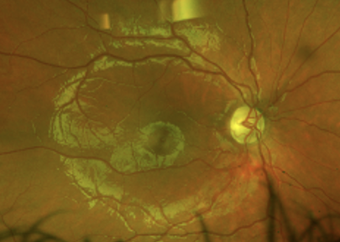
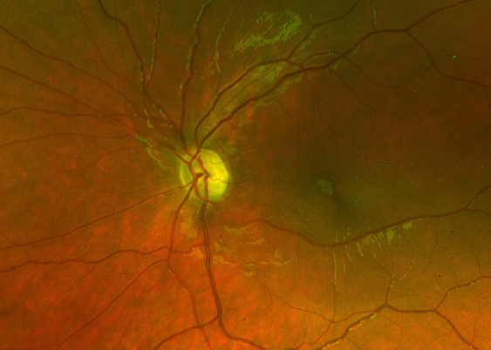
Optos scanning laser ophthalmoscopy
1 year after onset
Right eye
Left eye
What do you see?

Slide 8
Bilateral optic disc pallor
Right eye
Left eye

Slide 9
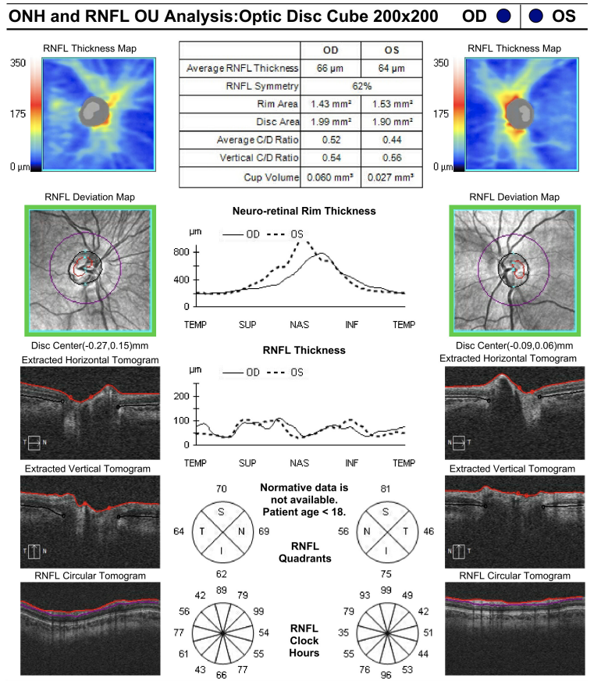
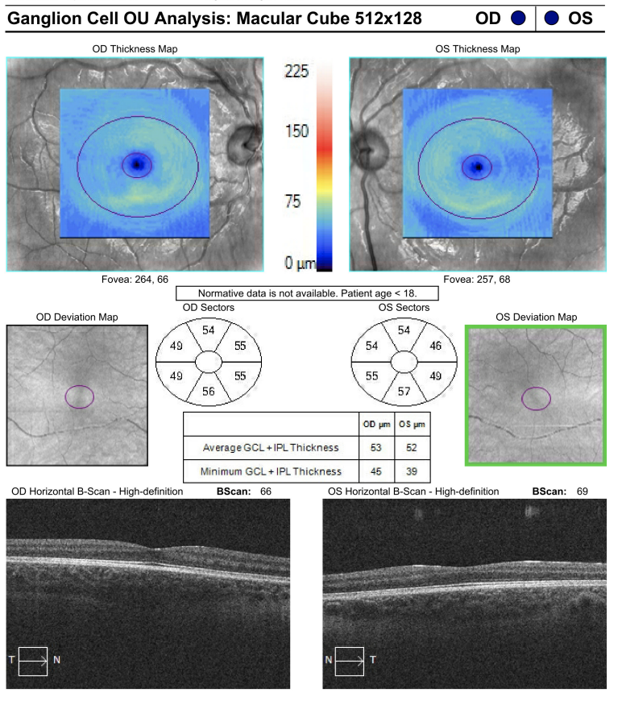
OCT 1 year after onset

Slide 10
OCT 1 year after onset
Both are now thin

Slide 11
What are the differential diagnoses?

Slide 12
Differential diagnosis of bilateral optic atrophy in childhood
Demyelinating optic neuritis
  Multiple sclerosis
  Myelin Oligodendrocyte glycoprotein associated diseases
  Neuromyelitis Optica Spectrum Disorder
Structural abnormalities of the brain/skull
  Chiari I malformation
  Craniosynostosis
Sequelae of elevated intracranial pressure
  Pseudotumor cerebri syndrome (aka idiopathic intracranial hypertension or IIH)
  Hydrocephalus
  Intracranial tumor
  Cerebral venous sinus thrombosis
Infectious/inflammatory
  Lyme disease, Bartonella henselae, syphilis, TB
Infiltrative
  Sarcoidosis
Neoplastic
  Optic nerve gliomas
Toxic/metabolic/nutritional/genetic
  Methanol, ethambutol, lead poisoning, B12 deficiency
  S/p resolution of pseudo-edema in LHON

Slide 13
What workup would you do?

Slide 14
MRI Brain and Orbits – bilateral optic nerve atrophy (blue arrow)
Axial T2 w/ fat sat
Coronal T2 w/ fat sat

Slide 15
Axial T1+gad w/ fat sat
Coronal T1+gad w/ fat sat
No abnormal enhancement
(which is not unexpected as this study was obtained 1 year after symptom onset)

Slide 16
Axial T2 FLAIR
Sagittal T1 w gad
No intraparenchymal lesions

Slide 17
Labs
CMP, CBC, T3, ACE, CRP, ESR, Vitamin B1, Vitamin B12, anticardiolipin Ab IgG, Myeloperoxidase Ab IgG, ANA, Anti-SSA Ab, Syphilis IgG/IgM Ab: All normal
Mayo laboratory CNS Demyelinating Panel (MOG and NMO, test code CDS1): negative

Slide 18
Let’s revisit the differential diagnosis
Elevated intracranial pressure, structural abnormalities, neoplastic, infiltrative → unremarkable MRI
Demyelinating optic neuritis → neg MOG, NMO antibodies, unremarkable MRI
Infectious/inflammatory → inconsistent clinical course and unremarkable labs
Toxic/metabolic/nutritional → no risk factors for toxic etiology and unremarkable labs

Slide 19
What now?
Would like to perform genetic testing:
  Optic neuropathy panel → denied
  Mitochondrial panel → denied
  Whole genome sequencing → authorized!

Slide 20
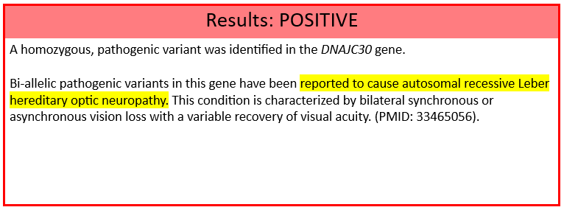
Whole Genome Sequencing – the only genetic testing that insurance company authorized
Positive for homozygous pathogenic variant in DNAJC30 gene
DNAJC30 NM_032317.3 c.152A>G p.Tyr51Cys (Homozygous)

Slide 21
We have questions!

Slide 22
AR LHON – a unicorn?
What is the difference between arLHON and mtLHON?
Isn’t LHON mitochondrial?
A girl with LHON? This is rare?
How do we treat her?
What is the visual outlook?

Slide 23
Leber hereditary optic neuropathy (LHON)
And its two distinct inheritance patterns

Slide 24
Background
LHON is commonly recognized as a mitochondrial genetic disease that causes subacute onset blindness in young adulthood
Preferentially affects males
Maternally inherited with approximately 95% of cases involving one of three mtDNA point mutations (G3460A, G11778A, and T14484C)
Yu-Wai-Man P, Turnbull DM, Chinnery PF. Leber hereditary optic neuropathy. J Med Genet. 2002;39(3):162-169. doi:10.1136/jmg.39.3.162

Slide 25
Identification of DNAJC30
Whole exome sequencing in molecularly undiagnosed LHON patients have revealed pathogenic homozygous missense DNAJC30 mutations. Other identified genes in include NDUFS2, NDUFA12, and MCAT genes.
Previously identified pedigrees indicate incomplete penetrance similar to mitochondrial LHON with significant male predominance for yet undetermined reasons
Stenton SL, Sheremet NL, Catarino CB, et al. Impaired complex I repair causes recessive Leber's hereditary optic neuropathy. J Clin Invest. 2021;131(6):e138267. doi:10.1172/JCI138267

Slide 26
Role of DNAJC30 in complex I repair mechanism
Stenton SL, Sheremet NL, Catarino CB, et al. Impaired complex I repair causes recessive Leber's hereditary optic neuropathy. J Clin Invest. 2021;131(6):e138267. doi:10.1172/JCI138267

Slide 27
What are the clinical features?
Autosomal recessive and mitochondrial LHON are phenotypically nearly identical
Prevalence of mtLHON disease is approximately 1 in 25,000 according to one study¹. On the other hand, arLHON is estimated to affect 1.09 per million individuals².
Both present with subacute concurrent or sequential loss of central vision in young adults
Degeneration of retinal ganglion cells and axons
Yu-Wai-Man P, Turnbull DM, Chinnery PF. Leber hereditary optic neuropathy. J Med Genet. 2002;39(3):162-169. doi:10.1136/jmg.39.3.162
Stenton SL, Tesarova M, Sheremet NL, et al. DNAJC30 defect: a frequent cause of recessive Leber hereditary optic neuropathy and Leigh syndrome. Brain. 2022;145(5):1624-1631. doi:10.1093/brain/awac052

Slide 28
A note about DNAJC30 mutations
Systemic neurologic symptoms such as ataxia and dysarthria can result from DNAJC30 mutations
  Consider overlap with Leigh syndrome
  Characteristic MRI findings of symmetric T2 hyperintense necrotic lesions in the basal ganglia or brainstem
Yu-Wai-Man P, Turnbull DM, Chinnery PF. Leber hereditary optic neuropathy. J Med Genet. 2002;39(3):162-169. doi:10.1136/jmg.39.3.162
Stenton SL, Tesarova M, Sheremet NL, et al. DNAJC30 defect: a frequent cause of recessive Leber hereditary optic neuropathy and Leigh syndrome. Brain. 2022;145(5):1624-1631. doi:10.1093/brain/awac052

Slide 29
What about the pseudo-edema?
LHON often misdiagnosed as optic neuritis given age at presentation and appearance of disc edema or RNFL thickening¹
Fluorescein angiography would reveal circumpapillary telangiectasis without dye leakage from the optic disc as opposed to vascular leakage in true disc edema
With disease progression, telangiectatic vessels disappear, and pseudo-edema around disc resolves²
Chang M. Leber's hereditary optic neuropathy misdiagnosed as optic neuritis and Lyme disease in a patient with multiple sclerosis. BMJ Case Rep. 2018;11(1):e227109. Published 2018 Dec 7. doi:10.1136/bcr-2018-227109
Shemesh A, Sood G, Margolin E. Leber Hereditary Optic Neuropathy (LHON) [Updated 2022 Sep 24]. In: StatPearls [Internet]. Treasure Island (FL): StatPearls Publishing; 2023 Jan-. Available from: https://www.ncbi.nlm.nih.gov/books/NBK482499/

Slide 30
Additional clinical features
Pathognomonic triad also noted in autosomal recessive LHON
Circumpapillary telangiectatic microangiopathy
No leakage on fluorescein angiography
Swelling of nerve fiber layer around disc (pseudo-edema)
Stenton SL, Sheremet NL, Catarino CB, et al. Impaired complex I repair causes recessive Leber's hereditary optic neuropathy. J Clin Invest. 2021;131(6):e138267. doi:10.1172/JCI138267

Slide 31
Important notes
Some key differences:
  Age of onset is earlier in autosomal recessive LHON (mean of 19.9 + 7.9 [SD] years vs 30.7 + 15.0 [SD] years in mitochondrial LHON)
Limitation of small sample size of identified autosomal recessive LHON cases
Kartikasalwah A, Lh N. Leigh syndrome: MRI findings in two children. Biomed Imaging Interv J. 2010;6(1):e6. doi:10.2349/biij.6.1.e6
Stenton SL, Sheremet NL, Catarino CB, et al. Impaired complex I repair causes recessive Leber's hereditary optic neuropathy. J Clin Invest. 2021;131(6):e138267. doi:10.1172/JCI138267

Slide 32
Now, how do we treat the patient?

Slide 33
Key Differences: Younger age of onset and better response to idebenone
CRR: clinically relevant recovery
Stenton SL, Tesarova M, Sheremet NL, et al. DNAJC30 defect: a frequent cause of recessive Leber hereditary optic neuropathy and Leigh syndrome. Brain. 2022;145(5):1624-1631. doi:10.1093/brain/awac052
Notes:
You will need to get permission for figures/tables from other journals, or make sure they are open access

Slide 34
Previous studies
Response to idebenone was more encouraging with recovery rates higher in autosomal recessive LHON (clinically relevant recovery noted in 80.6% vs 50.0% in mitochondrial LHON)
Suggests potential for improvement with medication for autosomal recessive LHON
Stenton SL, Sheremet NL, Catarino CB, et al. Impaired complex I repair causes recessive Leber's hereditary optic neuropathy. J Clin Invest. 2021;131(6):e138267. doi:10.1172/JCI138267

Slide 35
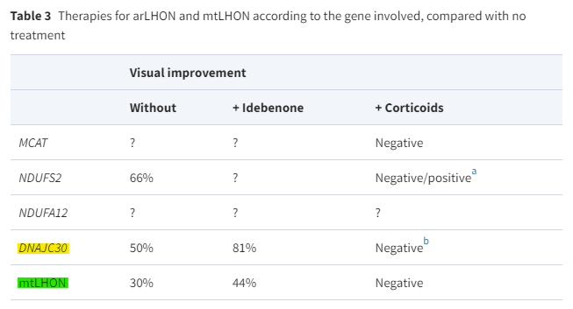
Further studies
Idebenone led to a higher ratio of visual improvement in patients carrying DNAJC30 mutation
Lenaers G, Beaulieu C, Charif M, Gerber S, Kaplan J, Rozet JM. Autosomal recessive Leber hereditary optic neuropathy, a new neuro-ophthalmo-genetic paradigm [published online ahead of print, 2023 Apr 18]. Brain. 2023;awad131. doi:10.1093/brain/awad131
Notes:
arLHON patients showed a greater ratio of visual improvement after being treated with idebenone.
(a) - NDUFS2 mutation, 2/3 siblings gained visual acuity.
(b) - 1/12 individuals improved visual acuity
(?) - no available data
In narration, will have to clarify how visual improvement was defined

Slide 36
Back to our patient
Patient was started on idebenone (a quinone analogue) 300 mg daily (adult dose is 300 mg TID, patient was 35 kg)
Scheduled for follow up in a few months
A quick note, idebenone works by transferring electrons directly to mitochondrial complex III and bypassing complex I
https://www.fishersci.com/shop/products/idebenone-16/AC466770010
Lyseng-Williamsom KA. Idebenon: A Review in Leber’s Hereditary Optic Neuropathy. Drugs. 2016; 76(7): 805-813. doi:10.1007/s40265-016-0574-3

Slide 37
In summary
LHON inheritance can be mitochondrial or autosomal recessive and should be considered in young patients who present with subacute vision loss, the appearance optic edema or optic atrophy, and negative workup for common causes of optic neuropathy
Incomplete penetrance with males more commonly affected
Treatment should be initiated with idebenone; those with autosomal recessive LHON may respond better

Slide 38
References
Chang M. Leber's hereditary optic neuropathy misdiagnosed as optic neuritis and Lyme disease in a patient with multiple sclerosis. BMJ Case Rep. 2018;11(1):e227109. Published 2018 Dec 7. doi:10.1136/bcr-2018-227109
Kartikasalwah A, Lh N. Leigh syndrome: MRI findings in two children. Biomed Imaging Interv J. 2010;6(1):e6. doi:10.2349/biij.6.1.e6
Lenaers G, Beaulieu C, Charif M, Gerber S, Kaplan J, Rozet JM. Autosomal recessive Leber hereditary optic neuropathy, a new neuro-ophthalmo-genetic paradigm [published online ahead of print, 2023 Apr 18]. Brain. 2023;awad131. doi:10.1093/brain/awad131
Lyseng-Williamsom KA. Idebenon: A Review in Leber’s Hereditary Optic Neuropathy. Drugs. 2016; 76(7): 805-813. doi:10.1007/s40265-016-0574-3
Shemesh A, Sood G, Margolin E. Leber Hereditary Optic Neuropathy (LHON) [Updated 2022 Sep 24]. In: StatPearls [Internet]. Treasure Island (FL): StatPearls Publishing; 2023 Jan-. Available from: https://www.ncbi.nlm.nih.gov/books/NBK482499/
Stenton SL, Sheremet NL, Catarino CB, et al. Impaired complex I repair causes recessive Leber's hereditary optic neuropathy. J Clin Invest. 2021;131(6):e138267. doi:10.1172/JCI138267
Stenton SL, Tesarova M, Sheremet NL, et al. DNAJC30 defect: a frequent cause of recessive Leber hereditary optic neuropathy and Leigh syndrome. Brain. 2022;145(5):1624-1631. doi:10.1093/brain/awac052
Yu-Wai-Man P, Turnbull DM, Chinnery PF. Leber hereditary optic neuropathy. J Med Genet. 2002;39(3):162-169. doi:10.1136/jmg.39.3.162

