Slide 1


Blurry vision and multiple cranial neuropathies
Eliot D. Smolyansky, MD
Subahari Raviskanthan, MBBS FRACP
Anthony Fok, MBBS FRACP
The Royal Melbourne Hospital, Australia

Slide 2
34-year-old male with headache, visual changes, facial numbness
Presents to emergency department
5-days of:
  Retro-ocular pain OS
  Blurry vision OS
  Horizontal binocular diplopia
  Left facial numbness

Slide 3
34-year-old male with headache, visual changes, facial numbness
Nil past medical or ocular history
No regular medications
Emigrated from Somalia 3 years prior

Slide 4
Examination
BCVA 20/20 OD, 20/25 OS
Ishihara plates 14/14 OD, 1/14 OS
Red desaturation OS
RAPD OS
Fundi normal OU
Visual fields intact to confrontation
-2 abduction deficit OS
Hypoesthesia left ophthalmic (V1) and maxillary (V2) divisions of CNV
Proptosis OS – Hertel’s exophthalmometry 18 mm OD, 20 mm OS
Remaining exam normal

Slide 5
Where is the lesion?

Slide 6
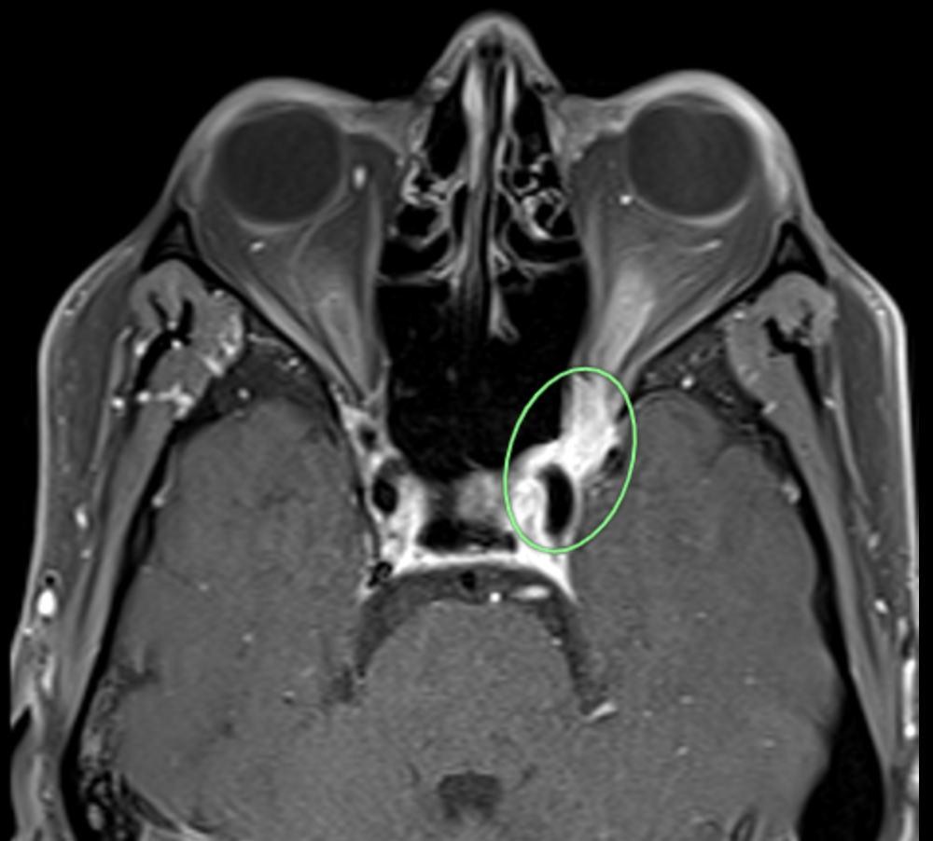
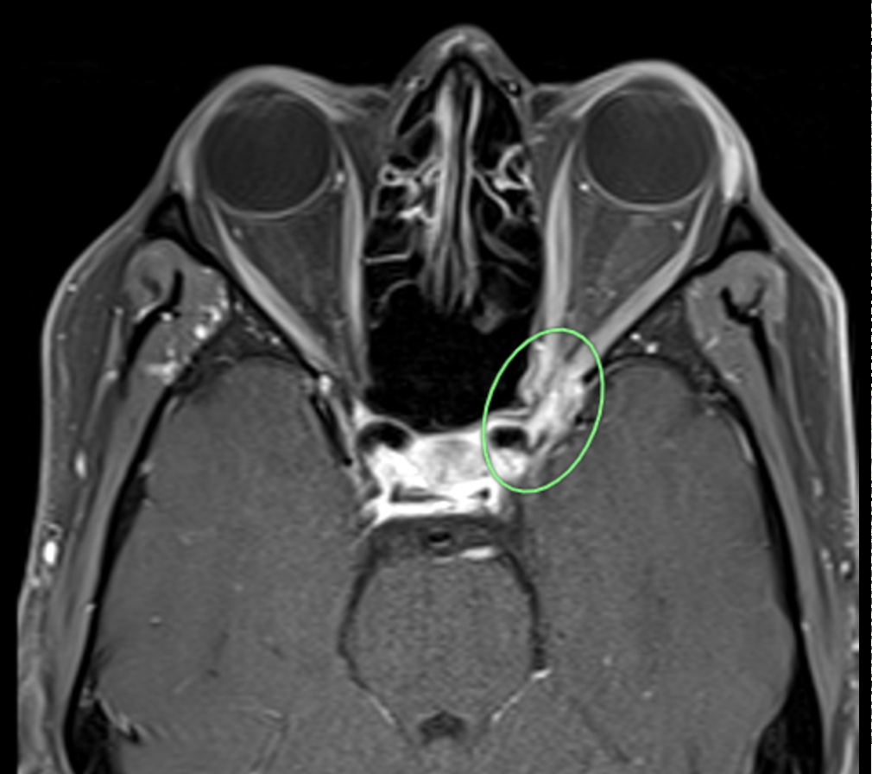
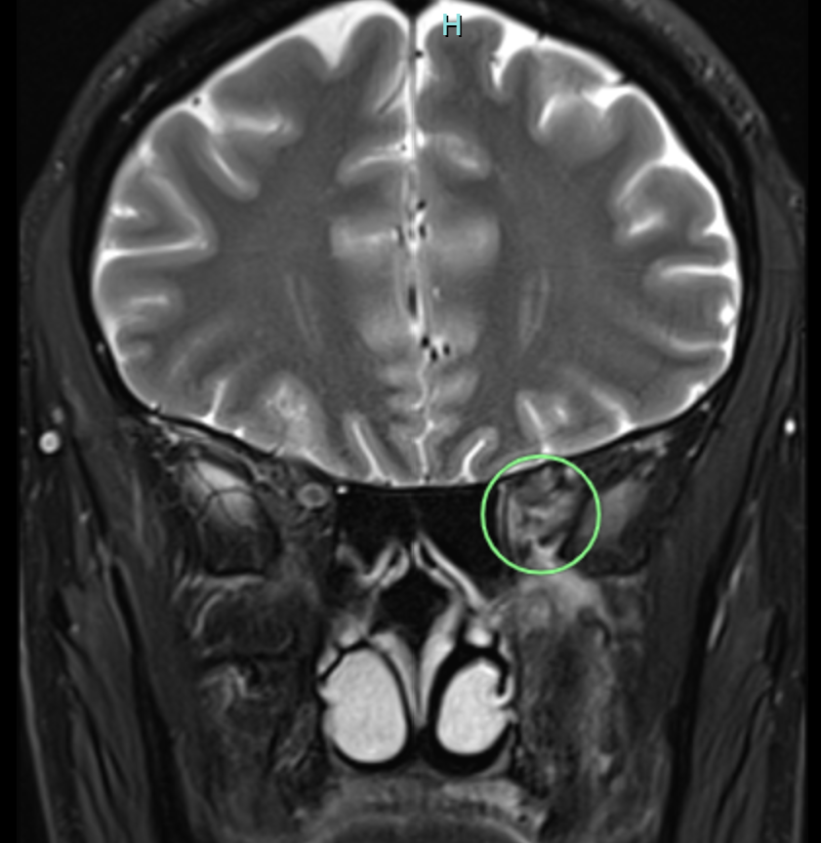
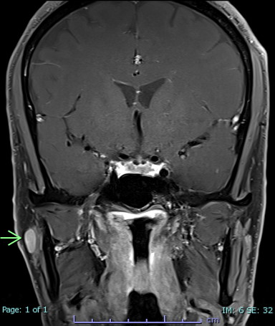
MRI Brain and Orbits
T1 axial FS C+
T2 coronal
T1 coronal FS C+
Infiltrative lesion centred on the left orbital apex and anterior cavernous
sinus. Enlarged right cervical lymph node.

Slide 7
Differential diagnosis
Infectious
  Bacterial - tuberculosis, other
  Fungal
Inflammatory
  Sarcoidosis
  Idiopathic orbital inflammatory disease (IOID)
  IgG4 disease
Neoplastic
  Lymphoma
  Meningioma
  Metastatic lesion

Slide 8
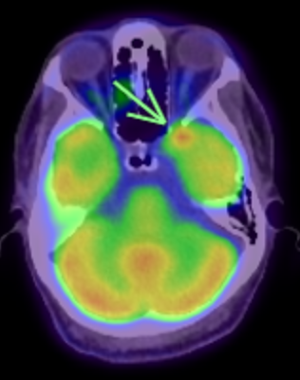
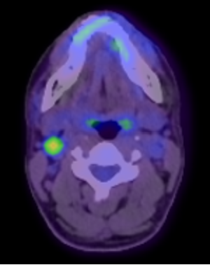
Progress and further investigations
Deterioration in left eye vision to count fingers on hospital day 3, commenced on IVMP
Inflammatory markers, HIV/syphilis serology, autoimmune panel: all negative
Serum ACE and IgG4 normal
QuantiFERON-TB Gold: positive
CT chest/abdomen/pelvis with IV contrast – normal
FDG PET: avidity at left orbital apex & right cervical lymph node; nil avidity elsewhere

Slide 9
Further investigations
CSF
  2 red cells, 0 PMNs, 2 lymphocytes
  Protein 0.34 g/L, glucose 4.7 mmol/L
  Cryptococcal Ag negative
  Gram stain & culture: negative
  AFB smear & TB PCR (Xpert Ultra): negative
  TB culture sent
Right cervical LN biopsied

Slide 10
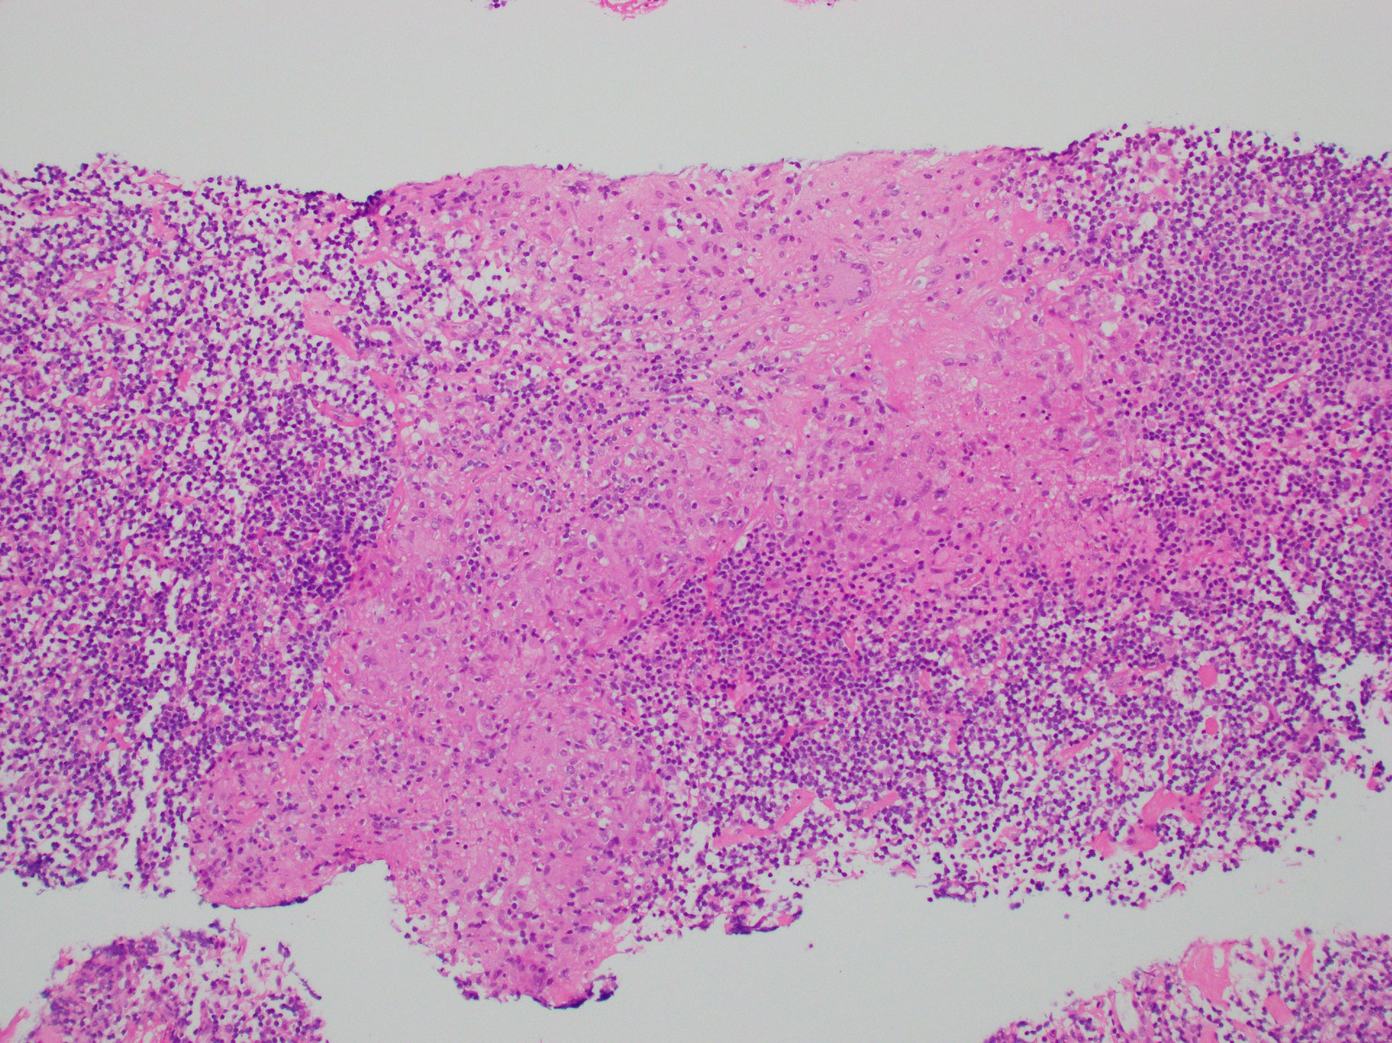
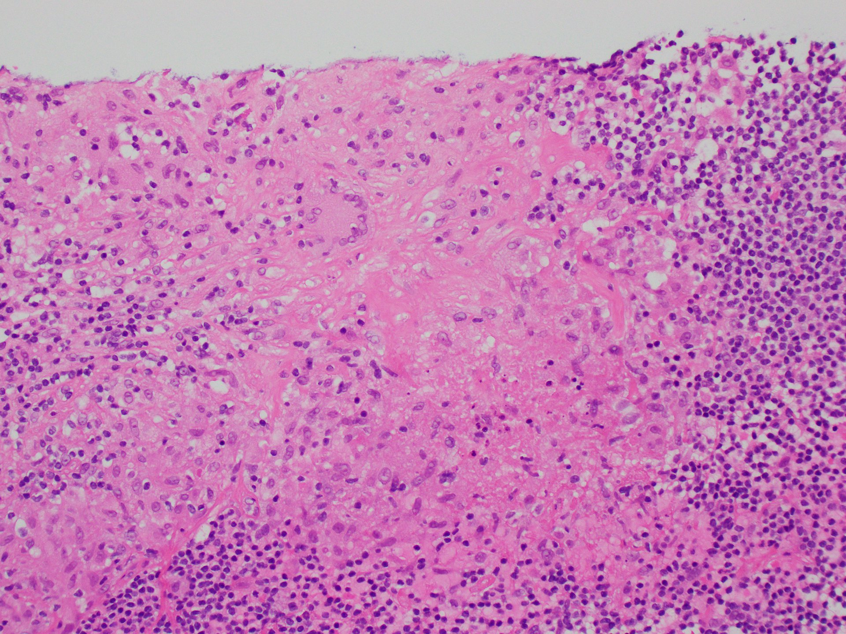
Right cervical lymph node core biopsy
Necrotizing
Granulomas
H&E x100
H&E x200

Slide 11
Further course
LN biopsy AFB smear & TB PCR (Xpert Ultra): negative
Declined LN excision
TB still felt most likely
Commenced on anti-TB therapy (rifampicin, isoniazid, pyrazinamide, levofloxacin) and weaning prednisone plan
VA 20/20 OU on discharge

Slide 12
Further course
At 8-week follow-up
Asymptomatic, normal neuro-ophthalmologic exam
CSF and LN TB cultures: negative
5mg prednisone, TB therapy rationalised (rifampicin, isoniazid)
CT Neck with IV contrast – LNs reduced to within normal limits
Repeat MRI at 5 months: near resolution of orbital apex lesion

Slide 13
Final Diagnosis
Probable TB of the left orbital apex, cavernous sinus, and right cervical lymph node
Suggested by increased risk of prior TB exposure in Somalia (approximately 40 times greater incidence of TB compared to Australia)¹, positive QuantiFERON, histopathology

Slide 14
Literature review
Orbital apex/cavernous sinus lesion is a rare manifestation of extra-pulmonary TB (EPTB)²
TB Lymphadenitis (LNTB) is the most common form of EPTB and is typically cervical, with peak age of onset of lymphadenitis 30-40 years³⁻⁴
Definitive diagnosis of LNTB requires microbiological identification^{3-4,6}
Sensitivity estimates of Xpert Ultra TB PCR (used in our case) on lymph node biopsies vary but appear to be > 65%; false negatives remain possible⁴⁻⁶
Excisional biopsy has better sensitivity than fine-needle aspirate³
Data are limited comparing core biopsy to excisional biopsy for diagnosis of LNTB
One study demonstrated equivalence between core biopsy and excisional biopsy⁷

Slide 15
Literature review
Diagnosis may be affected by the paucibacillary nature of LN disease^{4,8} and a composite of clinical, radiological, and histological features are often used to make a probable diagnosis^{4,6,8}
Sarcoidosis remains a differential⁹⁻¹⁰ and often responds well to steroids acutely, but relapses can occur with steroid taper.¹⁰ It usually involves non-necrotizing granulomas, though rarely necrotizing granulomas can also be seen¹⁰⁻¹¹
Lymph node excision for microbiological testing for TB is recommended as the diagnostic procedure of choice when other methods of detection have failed^{3, 7-8}
Lymph node excision was declined in our case

Slide 16
References
1.1 TB incidence. Accessed January 30, 2024. https://www.who.int/teams/global-tuberculosis-programme/tb-reports/global-tuberculosis-report-2023/tb-disease-burden/1-1-tb-incidence
Hughes EH, Petrushkin H, Sibtain NA, Stanford MR, Plant GT, Graham EM. Tuberculous orbital apex syndromes. Br J Ophthalmol. 2008;92(11):1511-1517. doi:10.1136/bjo.2008.138974
Fontanilla JM, Barnes A, von Reyn CF. Current Diagnosis and Management of Peripheral Tuberculous Lymphadenitis. Clin Infect Dis. 2011;53(6):555-562. doi:10.1093/cid/cir454
Gopalaswamy R, Dusthackeer VNA, Kannayan S, Subbian S. Extrapulmonary Tuberculosis—An Update on the Diagnosis, Treatment and Drug Resistance. J Respir. 2021;1(2):141-164. doi:10.3390/jor1020015
Yu X, Zhang T, Kong Y, et al. Xpert MTB/RIF Ultra outperformed the Xpert assay in tuberculosis lymphadenitis diagnosis: a prospective head-to-head cohort study. Int J Infect Dis. 2022;122:741-746. doi:10.1016/j.ijid.2022.07.039
WHO consolidated guidelines on tuberculosis: module 3: diagnosis: rapid diagnostics for tuberculosis detection, 2021 update. Accessed January 30, 2024. https://www.who.int/publications-detail-redirect/9789240029415
McAllister KA, MacGregor FB. Diagnosis of tuberculosis in the head and neck. J Laryngol Otol. 2011;125(6):603-607. doi:10.1017/S0022215110002732
Qian X, Albers AE, Nguyen DTM, et al. Head and neck tuberculosis: Literature review and meta-analysis. Tuberculosis. 2019;116:S78-S88. doi:10.1016/j.tube.2019.04.014
Henderson AD, Tian J, Carey AR. Neuro-Ophthalmic Manifestations of Sarcoidosis. J Neuroophthalmol. 2021;41(4):e591. doi:10.1097/WNO.0000000000001108
Bradshaw MJ, Pawate S, Koth LL, Cho TA, Gelfand JM. Neurosarcoidosis: Pathophysiology, Diagnosis, and Treatment. Neurol - Neuroimmunol Neuroinflammation. 2021;8(6). doi:10.1212/NXI.0000000000001084
Shen J, Lackey E, Shah S. Neurosarcoidosis: Diagnostic Challenges and Mimics A Review. Curr Allergy Asthma Rep. 2023;23(7):399-410. doi:10.1007/s11882-023-01092-z

