Slide 1


“A Rare Case of Vision Loss”
Shonar Singh, MBBS DNB, Wilmer Eye Institute, Johns Hopkins University School of Medicine, Baltimore, MD, USA
Andrew R. Carey, MD, Wilmer Eye Institute, Johns Hopkins University School of Medicine, Baltimore, MD, USA

Slide 2
62-year-old F
Right lower eyelid swelling.
Patient was initially treated with antibiotics with no improvement.
Within two weeks she developed diplopia with worsened eyelid swelling.
Diplopia was sudden onset, progressive and binocular both at far and near.
No associated changes in vision/ headache/ eye pain/ pain with eye movements/ fever/ jaw claudication/ neck stiffness.

Slide 3
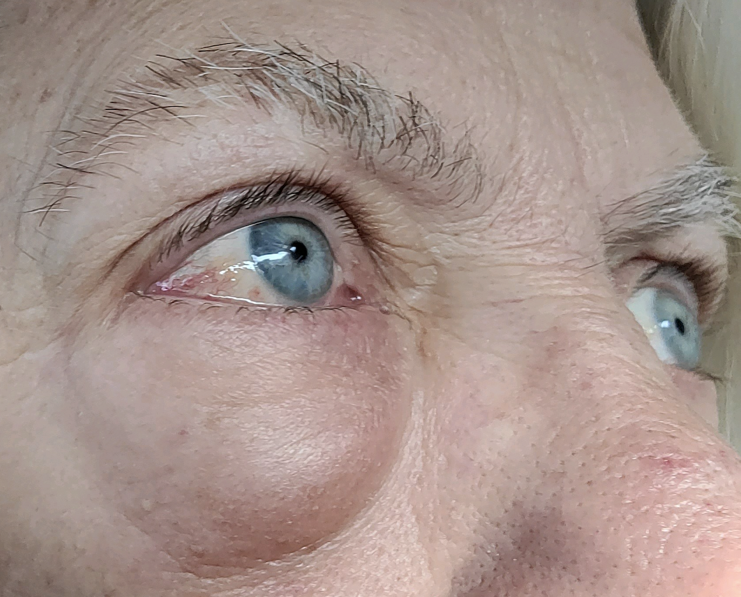
Picture showing swelling of right lower eye lid

Slide 4
What differentials should be kept in mind?
Infectious – Orbital cellulitis, peri orbital cellulitis, cavernous sinus infection, herpes zoster ophthalmicus, mucormycosis.
Inflammatory – Thyroid eye disease, Sarcoidosis, ANCA assc vasculitis, Nonspecific orbital inflammation (NSOI), IgG4 related sclerosing disease.
Vascular – cavernous carotid fistula, cavernous sinus thrombosis, orbital ischemic syndrome from ICA stenosis/ occlusion, GCA.
Neoplastic – Lymphoma, perineural invasion by squamous cell carcinoma, metastatic disease.

Slide 5
What investigations should be done at this point?
Blood tests -CBC, ESR, CMP, ACE, ANCA, TSH, T3, T4, Lyme, syphilis, QuantiFERON- Tb gold, HIV, IgG subclass antibody.
Imaging- MRI brain and orbits w/wo contrast, Chest X ray.
Biopsy - lid and orbit

Slide 6
Blood test results
Negative -CBC, ESR, CMP, ACE, ANCA, TSH, T3, T4, Lyme, syphilis, QuantiFERON- Tb gold, HIV, IgG subclass antibody

Slide 7
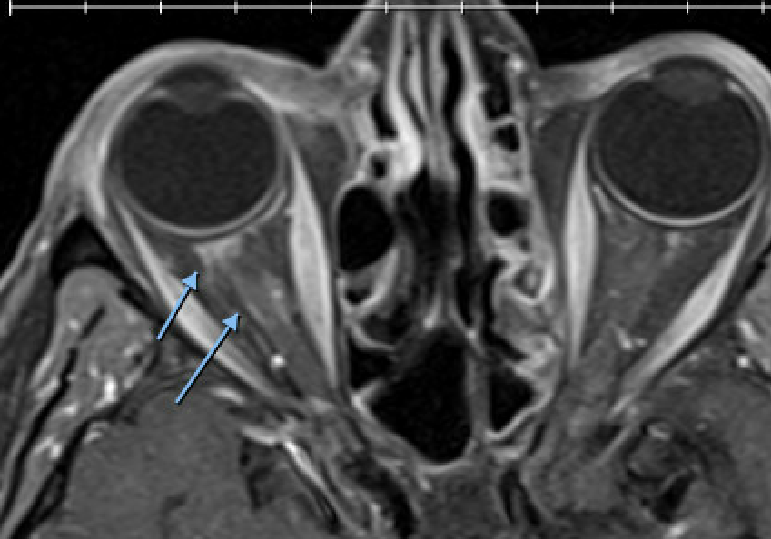
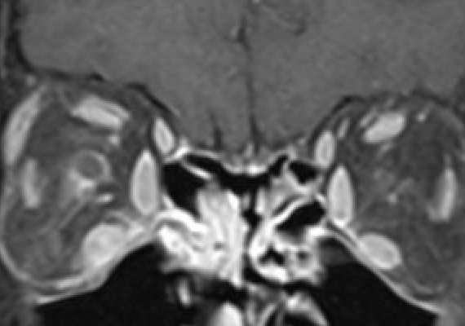
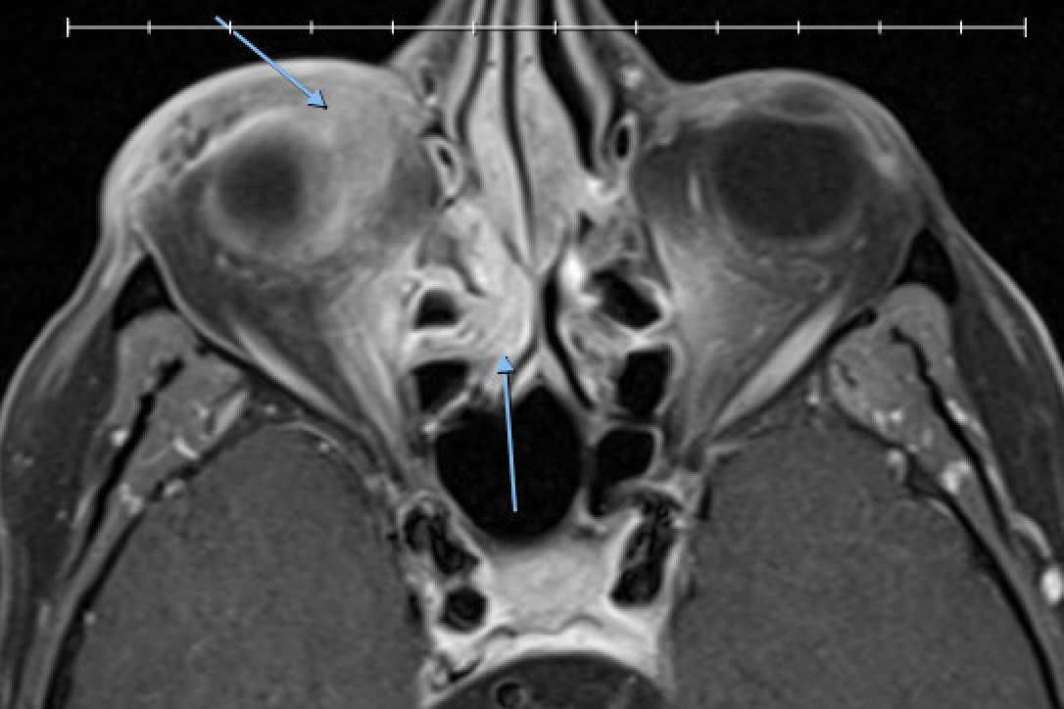
MRI orbits w/wo:
Image 2
T1 contrast fat suppressed sagittal:
Right posterior scleral and optic nerve sheath enhancement.
Image 3
T1 contrast fat suppressed sagittal:
Right anterior orbit ill-defined enhancing mass extending posteriorly involving inferior rectus.
Enhancing tissue in right ethmoidal sinus.
Image 1 T1 contrast fat suppressed coronal section:
Right Perineural enhancement, enhancement around the inferior rectus with enhancement of right ethmoidal tissue.

Slide 8
MRI orbits w/wo:
Right anterior / inferior orbit ill-defined enhancing mass extending posteriorly involving IR, posterior sclera & ? Anterior ON sheath. + R ethmoidal enhancing tissue

Slide 9
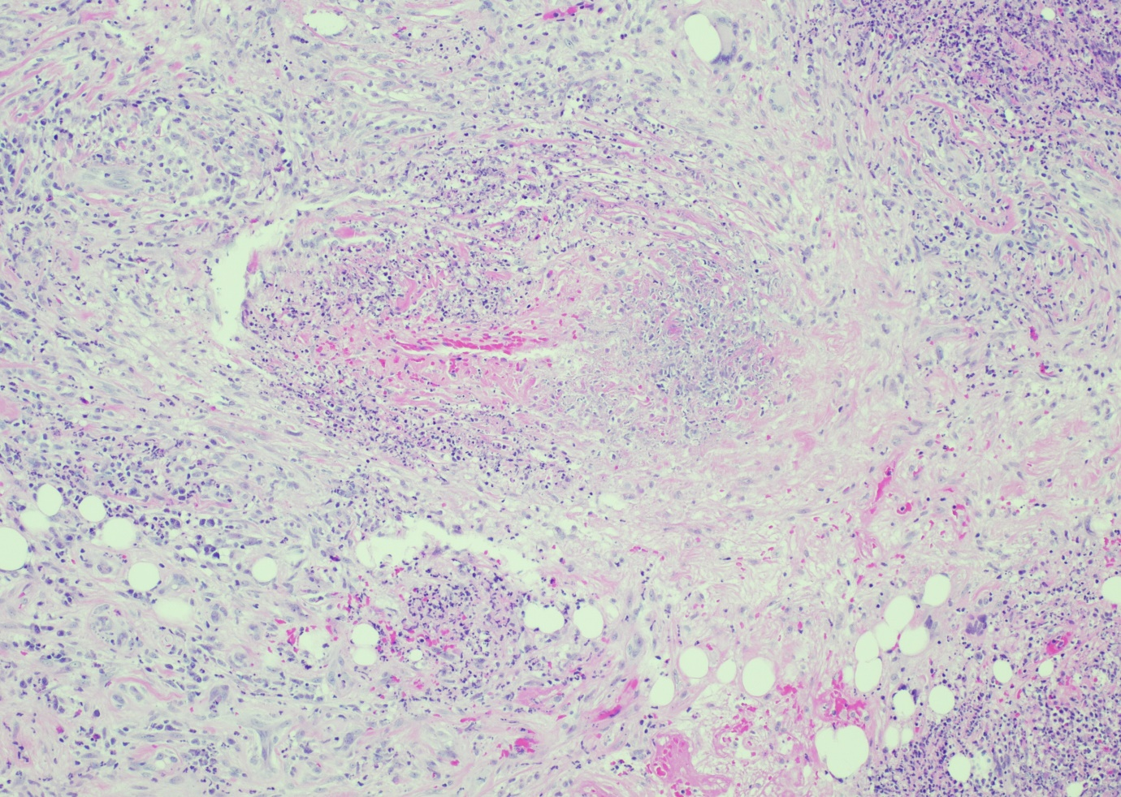
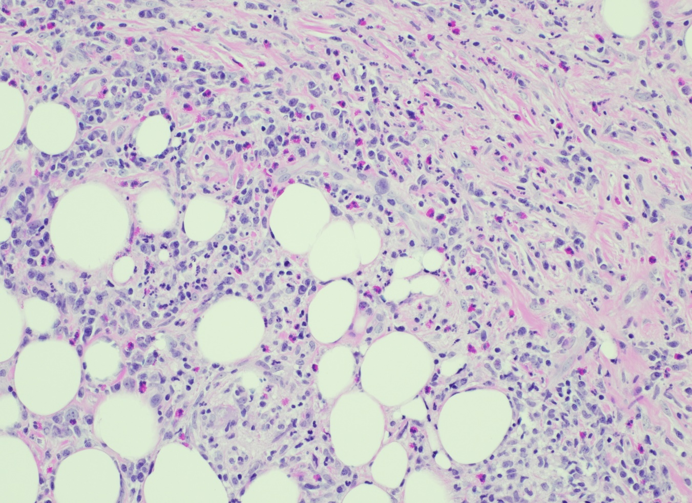
Vasculitis
Mixed Inflammation
Histopathology

Slide 10
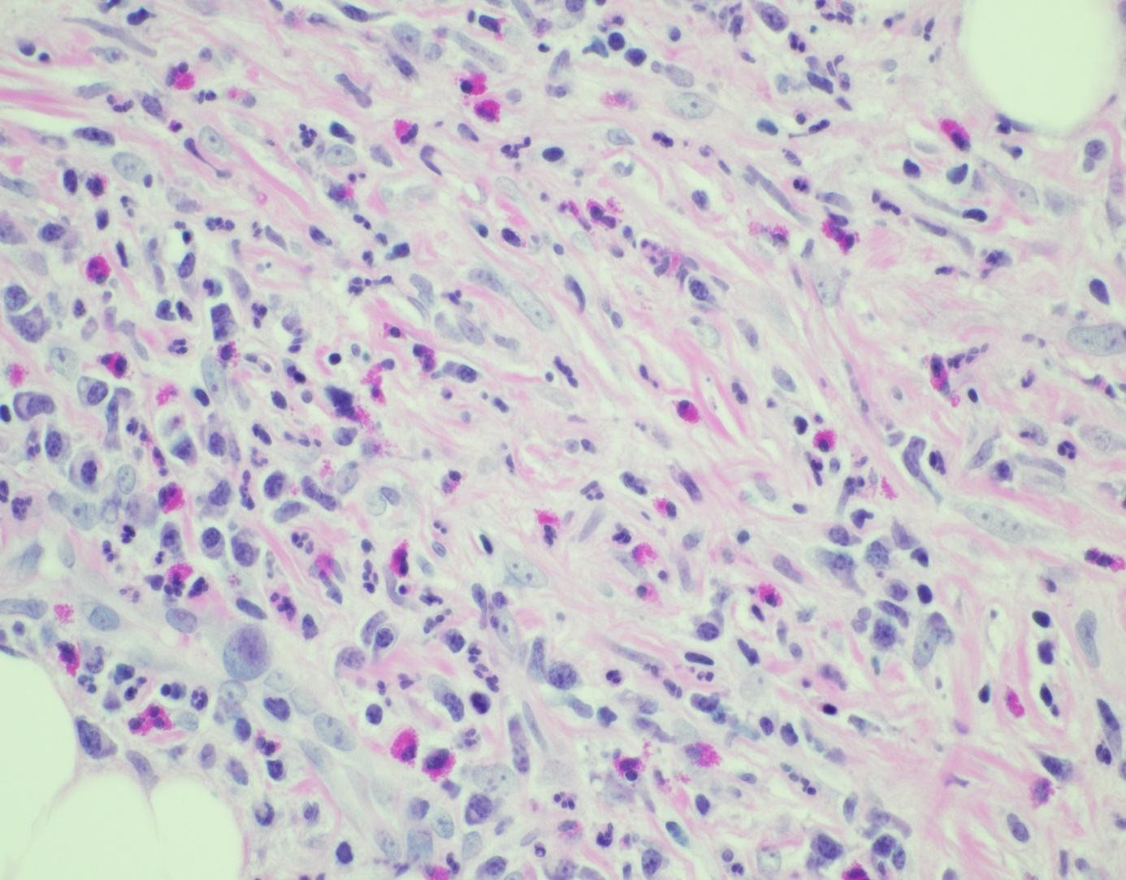
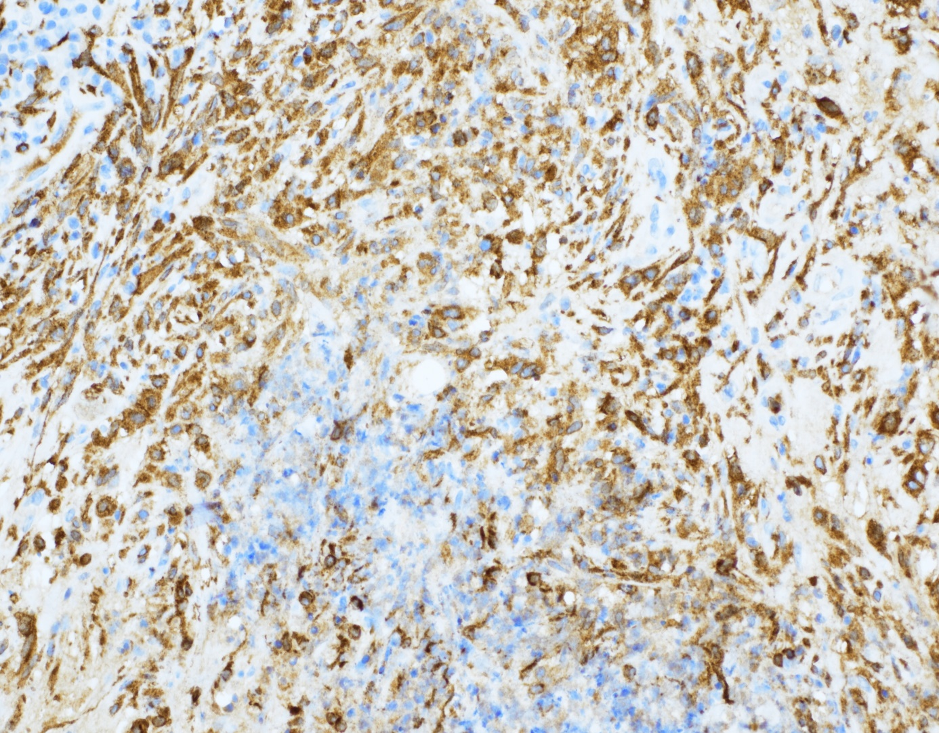
Eosinophils
Histiocytes
Histopathology

Slide 11
Biopsy
Lipogranulomatous inflammation with vasculitis and eosinophilia, compatible with Eosinophilic –Granulomatosis with polyangiitis aka Churg-Strauss syndrome.

Slide 12
On going history
Patient was started on prednisone 60mg/day with a very slow taper over a period of 9 months. During this period eyelid swelling and diplopia resolved.
Ten days after reducing the prednisone to 5 mg she noticed sudden drop in her right visual acuity.
Prednisone increased to 20mg/day, later 60mg/day and was started on methotrexate 10mg/week.
CT scan of the chest demonstrated emphysematous changes but negative for pulmonary opacities, cardiac echo was normal, lab work was negative for renal impairment

Slide 13
ROS
Social history​
Tobacco - occasional. EtOH - 5-7 per / week.
Hypertensive
Hypercholesterolemia
Snoring 2/2 nasal polyps but no apnea
Meds
OD Latan qHS
PO methotrexate 20 mg weekly / folate
PO prednisone 10 mg/day
PRN Xanax
PO ASA 81

Slide 14
Exam
 | Right Eye | Left Eye
BCVA | CF (eccentric) | 20/25
Color vision (Ishihara) | 0/13 | 13/13
Pupils | Round, symmetric, brisk RAPD 0.9 LU | Round, symmetric, brisk
IOP | 14 mm hg | 14 mm hg
CVF | Generalized constriction | Full
EOM | Full | Full

Slide 15
Exam
 | Right eye | Left eye
External exam | Trace proptosis, inferior orbit palpable firm mobile mass | Normal
Hertel’s (Base: 111mm) | 22 mm | 20mm
Lids/ lashes | Normal | Normal
Conjunctiva/ Sclera | White and quite | White and quite
Cornea | Perilimbal scar 4-6 O’ clock with mild pannus and thinning, no staining and infiltrate | Clear
Anterior Chamber | Deep and quite | Deep and quite
Iris | Normal | Normal
Lens | 1+ Nuclear Sclerosis | 1+ Nuclear Sclerosis

Slide 16
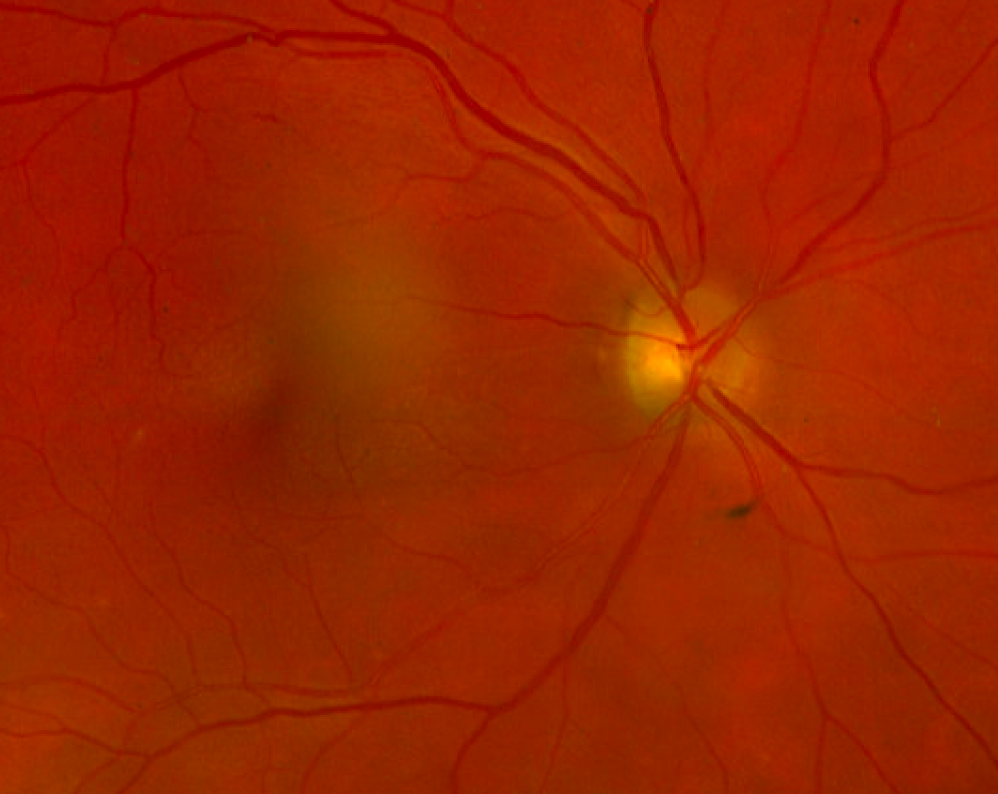
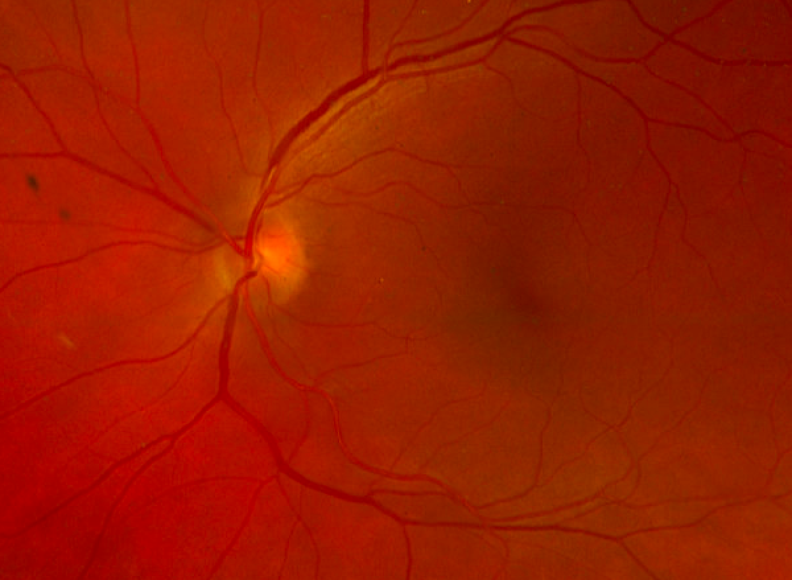
OD Trace pallor but no edema
OS Normal disc
Optic nerve photos

Slide 17
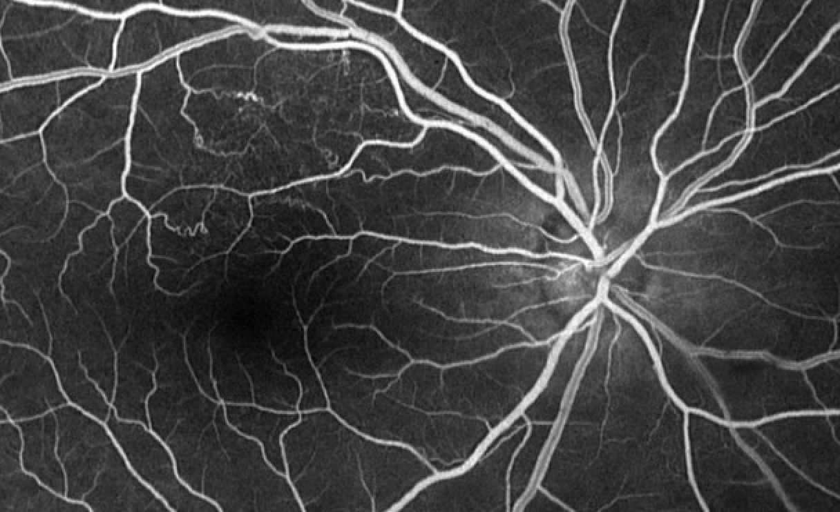
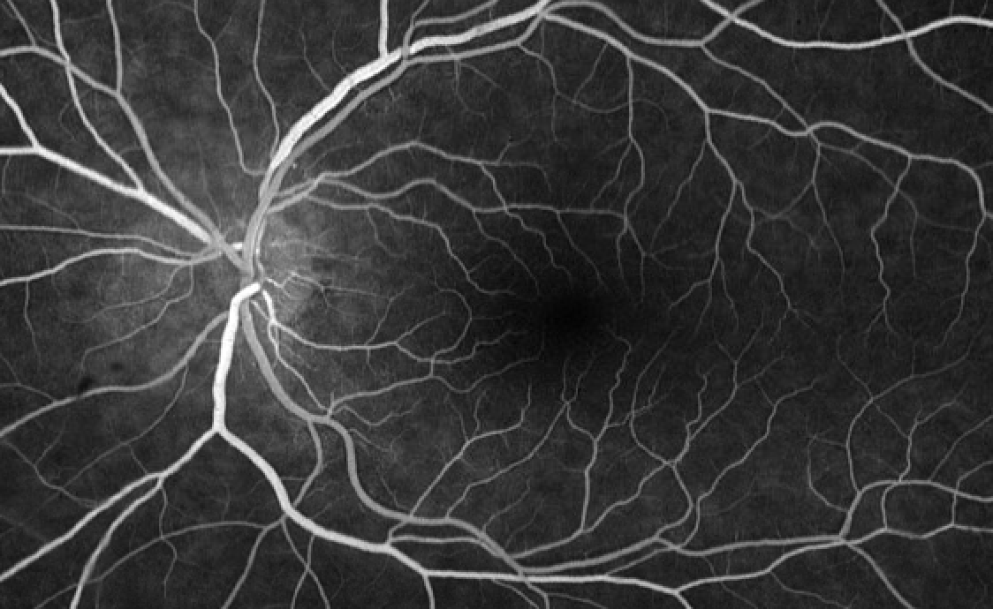
Superior macula collaterals suggestive of prior BRVO
Normal
Fluorescein Angiography

Slide 18
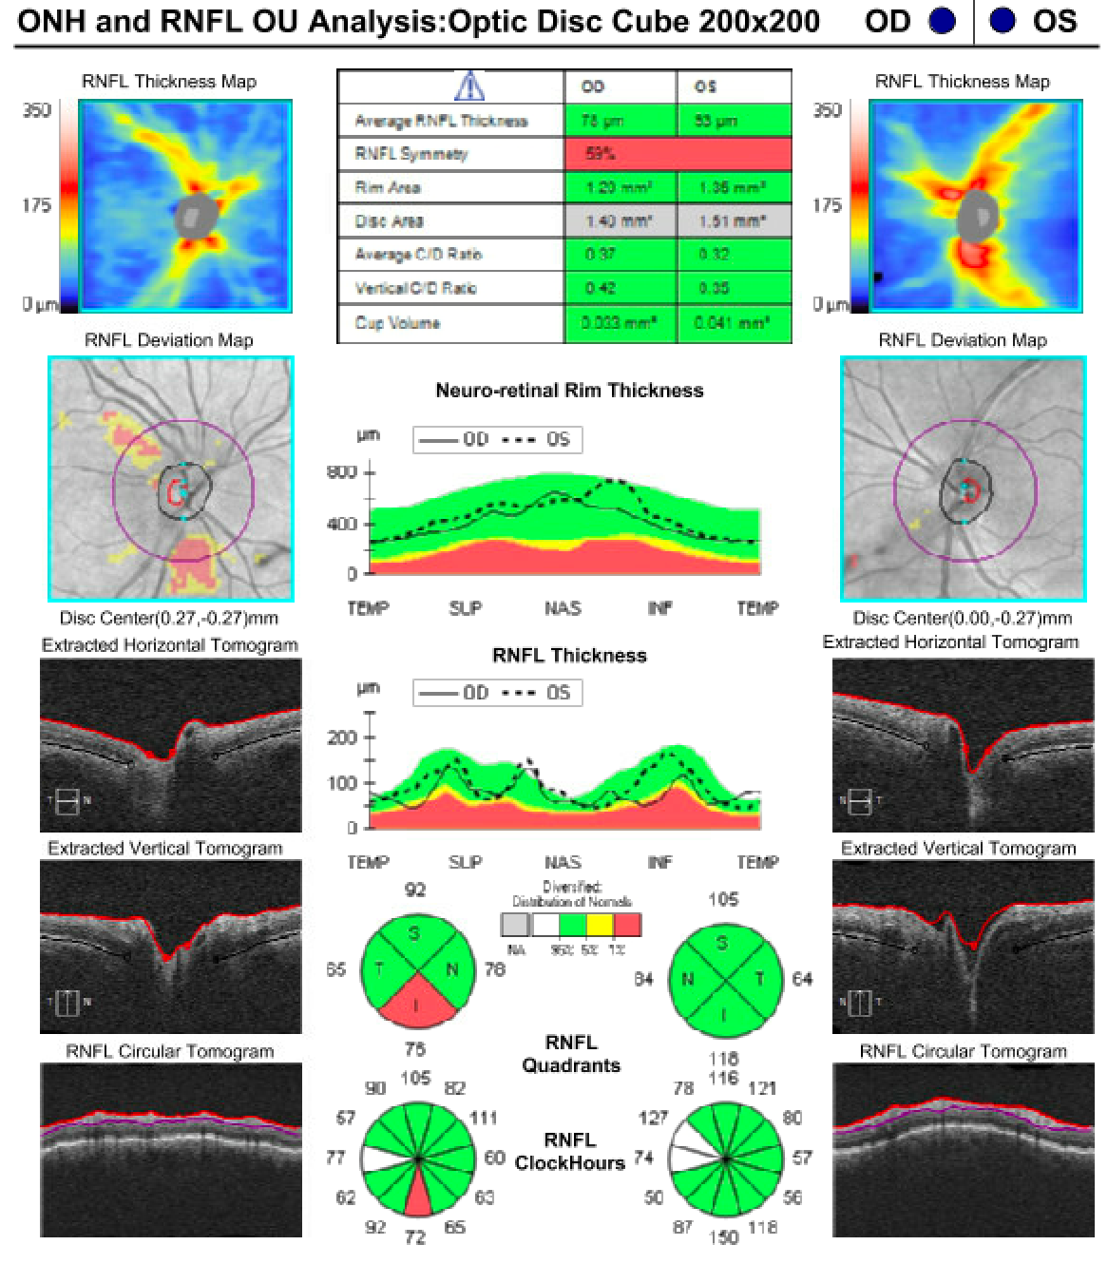
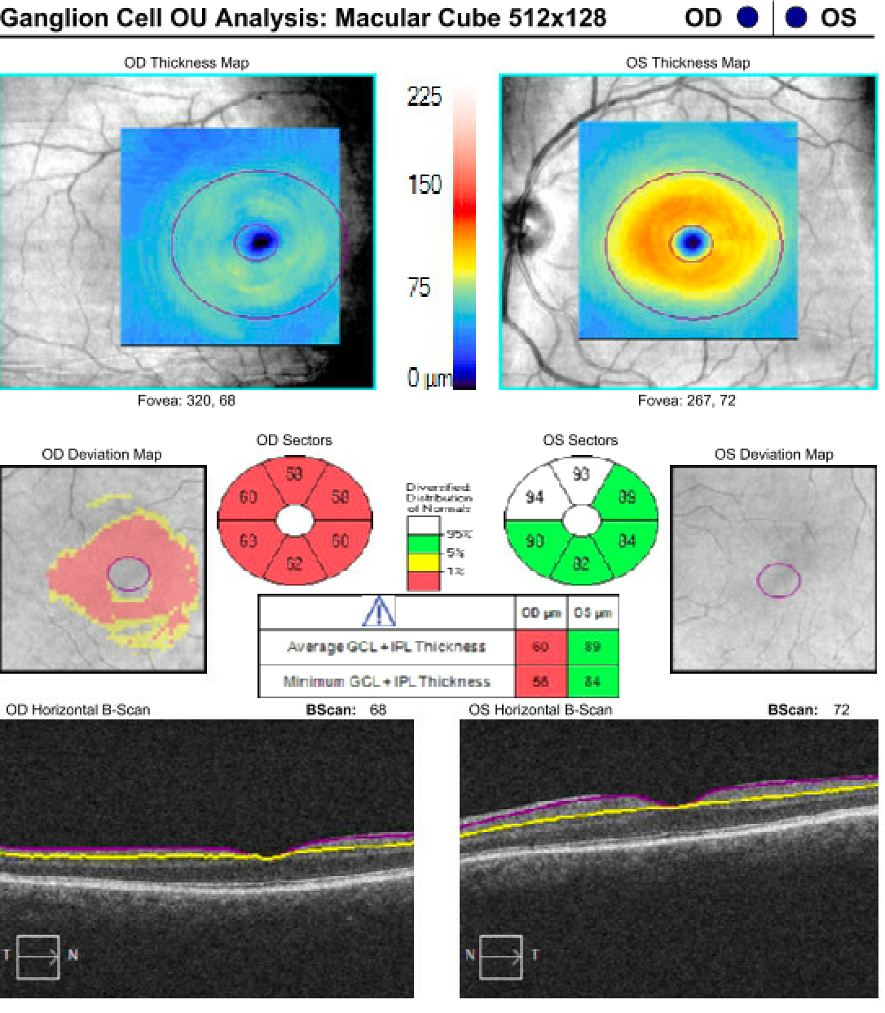
OCT RNFL
GC+IPL
Notes:
In ultimate narration, you will need to say what GC=IPL is

Slide 19
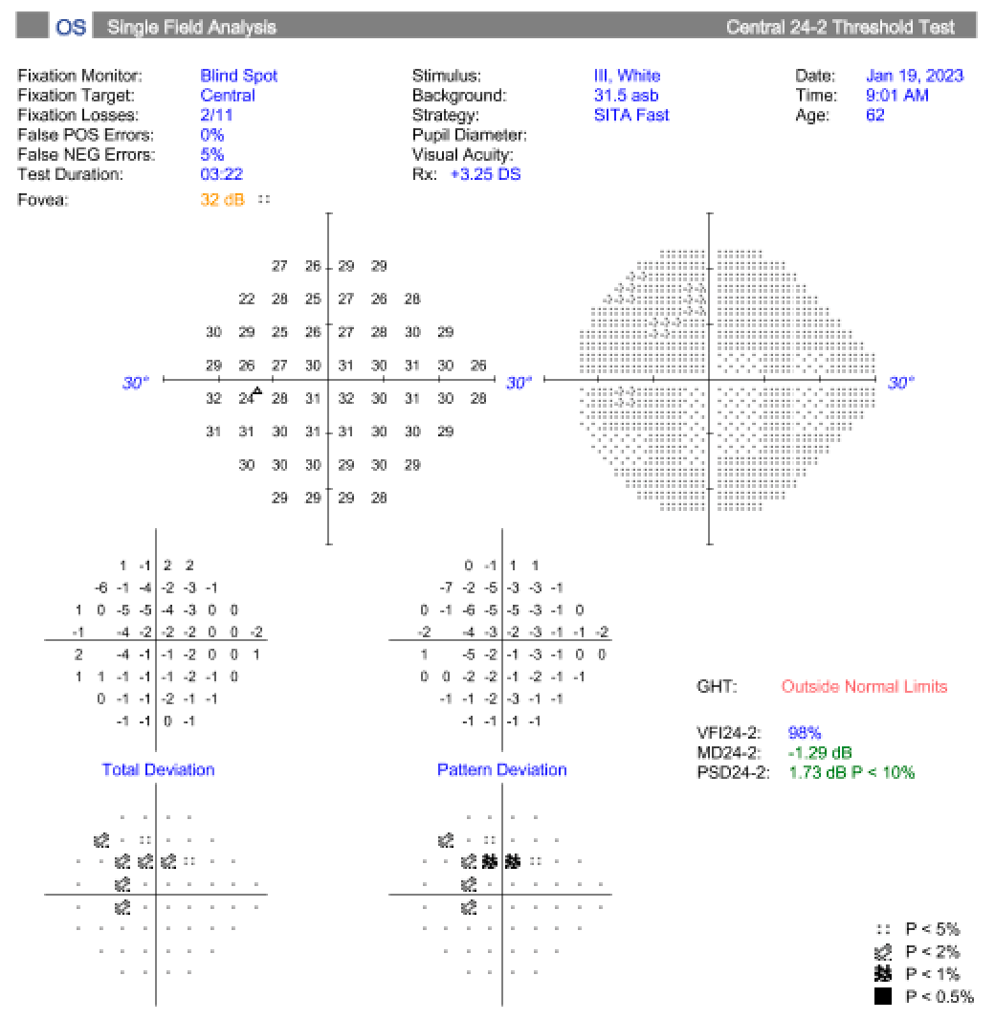
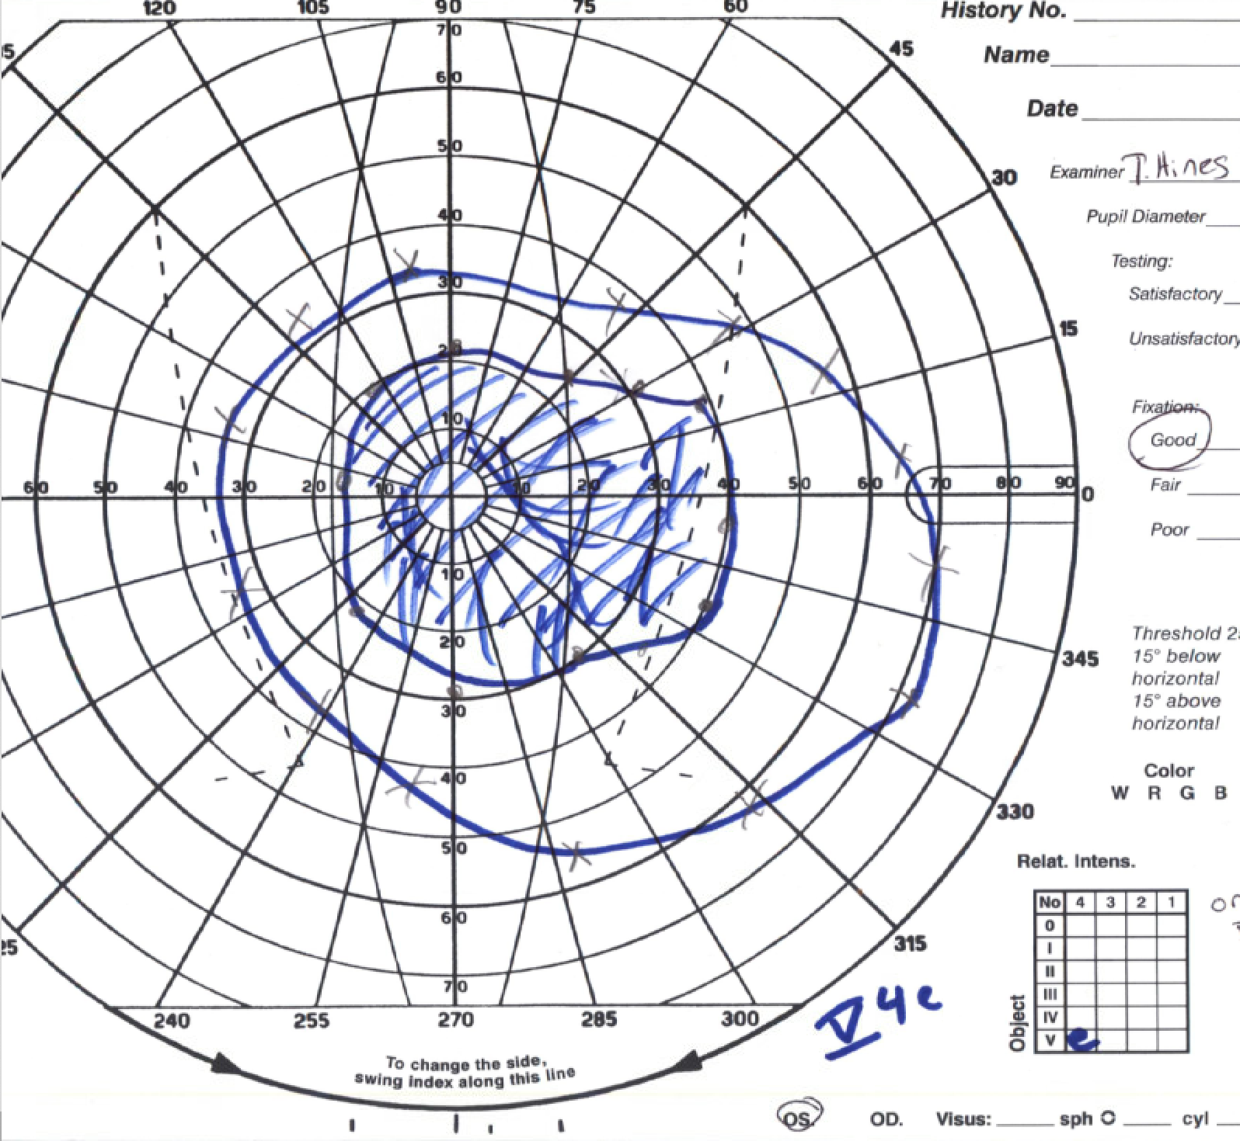
Left Eye Humphrey visual field testing
Right Eye Goldmann visual field testing
Mild paracentral clusters
Central scotoma
Visual field testing

Slide 20
What can be the cause of vision loss?
Optic neuritis
Ischemic optic neuropathy
Retinal vasculitis

Slide 21
What should be done next?
Repeat imaging.

Slide 22
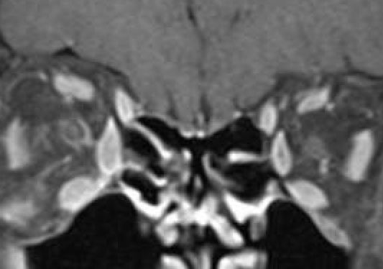
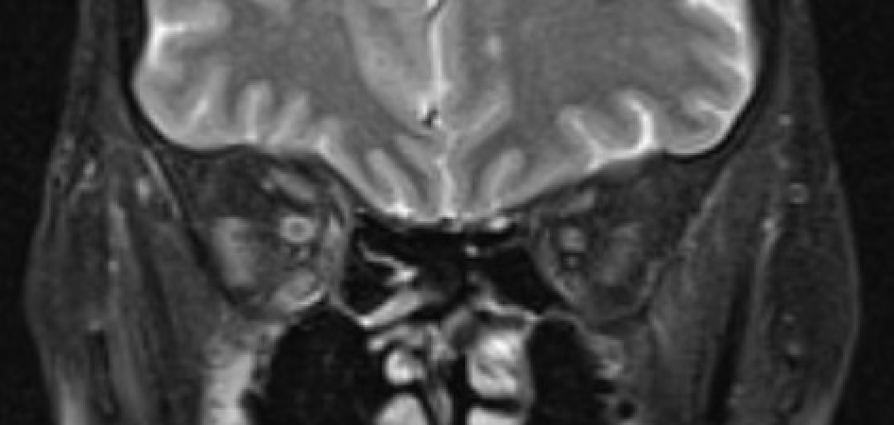
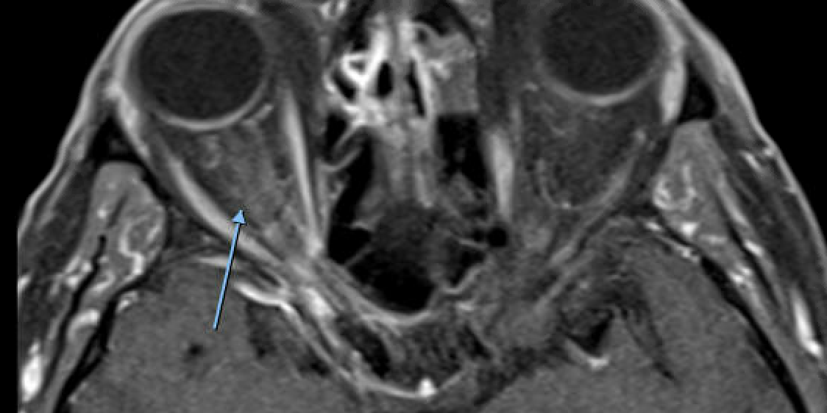
T1 contrast coronal section: Right optic nerve sheath
enhancement
T2 coronal section: Increase signal in right optic nerve sheath
T1 contrast axial section: Right optic nerve sheath
enhancement
MRI B/O wwo:
R ON Sheath enhancement

Slide 23
What is the diagnosis?
Right optic perineuritis with secondary ischemia (posterior ischemic optic neuropathy likely from involvement of perforating pial vessels) from vasculitis in the setting of eosinophilic GPA.
While optic neuritis could be considered, the MRI did not show enhancement of the optic nerve and vision did not improve with steroids.

Slide 24
What is the next plan of action?
Escalate immunosuppression.
The case was discussed with rheumatology, and it was agreed to initiate intravenous rituximab.

Slide 25
Eosinophilic granulomatosis with polyangiitis
Previously called Churg–Strauss syndrome is a multisystemic, immune mediated inflammatory disease.
Characterized by late-onset asthma, eosinophilia and systemic vasculitis of the small to medium blood vessels.
It has a prevalence and annual incidence of 22 and 0.5–3.7 per million, respectively¹.
The most commonly affected organs include the lungs, paranasal sinuses, skin, heart, and gastrointestinal tract.
Ocular involvement is unusual².
Cury et al. in 1956³ was the first to describe ophthalmic involvement.

Slide 26
EGPA classically evolves through 3 stages:
Prodromal phase: Poorly controlled asthma and systemic allergies
Eosinophilic phase: Peripheral eosinophilia and eosinophilic infiltration of multiple organs
Vasculitis phase: Life threatening vasculitis of small to medium sized vessels and extravascular granulomas.

Slide 27
What are the different ophthalmic manifestations of EGPA?
Review article by Sruti et al.² on ophthalmic manifestations of EGPA identified 46 cases.
Cases were divided into 2 groups based on their presentation² either ischemic vasculitis type or idiopathic orbital inflammation type.
Idiopathic orbital inflammation-type
Ischemic vasculitis-type
Conjunctival nodules (n = 8, 40%),
Orbital myositis (n = 5, 25%),
Orbital inflammatory syndrome (n = 4, 20%),
Dacryoadenitis (n = 2, 10%),
Cranial nerve palsy (n = 2, 10%).
Marginal keratitis (n = 1),
Scleritis / episcleritis (n = 1),
Orbital apex syndrome(n=1)
Retinal artery and vein occlusions (n = 12, 48%),
Ischemic optic neuropathy (n = 8, 32%),
Retinal vasculitis or edema (n = 2, 8%)

Slide 28
Diagnosis
The 1990 classification criteria for Churg-Strauss syndrome by the American College of Rheumatology⁴. It requires the presence of 4 or more of 6 conditions:
Asthma
Eosinophilia of greater than 10%
Neuropathy
Migratory or transient pulmonary opacities
Abnormalities of the paranasal sinuses
Extravascular eosinophils on biopsy

Slide 29
Management
Systemic glucocorticoids
Primary therapy for EGPA
Starting with doses of prednisone 0.5 to 1.5 mg/kg/day for 6 to 12 weeks or until remission is attained, followed by a gradual taper.
Steroids are found to be more effective in idiopathic inflammatory type compared to ischemic type.
2. Immunosuppressants
Cyclophosphamide is recommended to induce remission
Once obtained its switched to azathioprine to sustain remission.
Alternate immunosuppressants include methotrexate.
Of the ophthalmic EGPA 15 out of 45 (33.3%) required immunosuppressants².

Slide 30
EGPA associated montelukast therapy
Montelukast is a potent leukotriene receptor antagonist that have been introduced for the treatment of asthma.
Several cases of CSS have been reported in asthmatic patients being treated with these drugs.
Wechsler et al⁶ analyzed the cases reported in the literature and concluded that, in many patients, implementing leukotriene antagonists enabled considerable reductions of steroid doses, uncovering formerly controlled CSS.
Patients with asthma not taking oral steroids have also been documented to manifest CSS following the commencement of zafirlukast or montelukast therapy⁷.
It is uncertain how montelukast could have a direct influence in the development of this syndrome.
Despite leukotriene antagonists being generally safe for asthma patients, clinicians must be watchful for pulmonary eosinophilia and Churg-Strauss syndrome in all patients who begin treatment with these drugs and develop systemic symptoms.

Slide 31
Conclusion
We should not neglect the ophthalmic manifestations of EGPA, though rare.
Orbital involvement in GPA is seen in 15% of cases, making up 45% of ophthalmic manifestations. It is usually linked with the limited, mild form of the disease⁵.
EGPA should be on the differential for CRAO, idiopathic orbital inflammation, and other ophthalmic manifestations in the setting of steroid dependent asthma, eosinophilia and vasculitis¹.
The main goals of the treatment in GPA are remission induction, followed by maintenance of remission, by using immunosuppressant drugs. Oral corticosteroids alone failed to induce remission.
In order to avoid relapses after remission achievement, maintenance therapy is initiated, usually for 12 to 36 months⁵.

Slide 32
References
Mahr, Alfreda; Moosig, Frankb; Neumann, Thomasc; Szczeklik, Wojciechd; Taillé, Camillee; Vaglio, Augustof; Zwerina, Jocheng. Eosinophilic granulomatosis with polyangiitis (Churg–Strauss): evolutions in classification, etiopathogenesis, assessment and management. Current Opinion in Rheumatology 26(1):p 16-23, January 2014. | DOI: 10.1097/BOR.0000000000000015.
Akella, Sruti S. M.D.*; Schlachter, Dianne M. M.D.†,‡; Black, Evan H. M.D.†,‡; Barmettler, Anne M.D.*. Ophthalmic Eosinophilic Granulomatosis With Polyangiitis (Churg–Strauss Syndrome): A Systematic Review of the Literature. Ophthalmic Plastic and Reconstructive Surgery 35(1):p 7-16, January/February 2019. | DOI: 10.1097/IOP.0000000000001202
CURY D, BREAKEY AS, PAYNE BF. Allergic granulomatous angiitis associated with uveoscleritis and papilledema. AMA Arch Ophthalmol. 1956 Feb;55(2):261-6. doi: 10.1001/archopht.1956.00930030265013. PMID: 13282552.
Shunsuke Furuta, Taro Iwamoto, Hiroshi Nakajima, Update on eosinophilic granulomatosis with polyangiitis, Allergology International, Volume 68, Issue 4, 2019, Pages 430-436, ISSN 1323-8930, https://doi.org/10.1016/j.alit.2019.06.004.
Andrada-Elena M, Ioana TT, Mihaela FM, Irina-Elena C, Andrei TI, Florian B. Wegener's granulomatosis with orbital involvement: case report and literature review. Rom J Ophthalmol. 2021 Jan-Mar;65(1):93-97. doi: 10.22336/rjo.2021.19. PMID: 33817443; PMCID: PMC7995507.
Wechsler ME, Pauwels R, Drazen JM. Leukotriene modifiers and Churg-Strauss syndrome. Adverse effect or response to corticosteroid withdrawal? Drug Safety 1999;21:241–51.
Tuggey JM, Hosker HS. Churg-Strauss syndrome associated with montelukast therapy. Thorax. 2000 Sep;55(9):805-6. doi: 10.1136/thorax.55.9.805. PMID: 10950903; PMCID: PMC1745850.

