Slide 1


Idiopathic Intracranial Hypertension and
Visual Loss
Marie A. Di Nome MD
Consultant,
Ophthalmology & Neuro-Surgery
Mayo Clinic Arizona

Slide 2
21-Year-Old female goes for her annual eye exam…
Wanted to get new spectacles
Technician asked if any having blurry vision or diplopia and, surprisingly she realized “yes”

Slide 3
21-Year-Old female goes for her annual eye exam…
Optometrist told her ”optic nerves swollen”
Sent to local ED
CT contrast head reported as “negative for mass lesions or enhancing abnormalities”

Slide 4
21-Year-Old female goes for her annual eye exam…
Vision continues to be blurry
Returned to ED
Spinal tap- told opening pressure “high”
Started on acetazolamide 250mg BID
CSF content:
WBC 5
RBC 10
RBC 4
glucose 52
protein 27
-Normally, there are no RBCs in the cerebrospinal fluid,;
there should be no more than five WBCs per cubic millimeter of CSF
-If your fluid contains RBCs, this may indicate bleeding or
possibly a traumatic tap (blood leaked into the fluid sample during collection)
CSF glucose 50-80 mg/dL
CSF protein 15-40 mg/dL
.

Slide 5
21-Year-Old female referred to neuro-ophthalmology for papilledema
Blurry vision OD > OS
“graying out of vision” OU with postural changes x 3 months
Transient horizontal diplopia
Headaches x 3-4 months; daily pain; “can hear heartbeat in ears”; somewhat less on new medication
Compliant with acetazolamide x 6 weeks (started at 500 mg daily and then increased to 500 mg BID x 2 weeks)

Slide 6
21-Year-Old female referred for papilledema
No prior medical concerns
No use of tetracycline/minocycline/doxycycline, retin-A products
20 lb weight gain x one year

Slide 7
21-Year-Old female referred for papilledema
BMI 66.3
BP 127/84
 | Right Eye OD | Left Eye OS
Vision cc | 20/20-2 | 20/20
Ishihara Color Plates | 11/11 | 11/11
Pupils | Brisk, No RAPD | Brisk, RAPD
EOM | Full | Full
IOP | 14 | 18

Slide 8
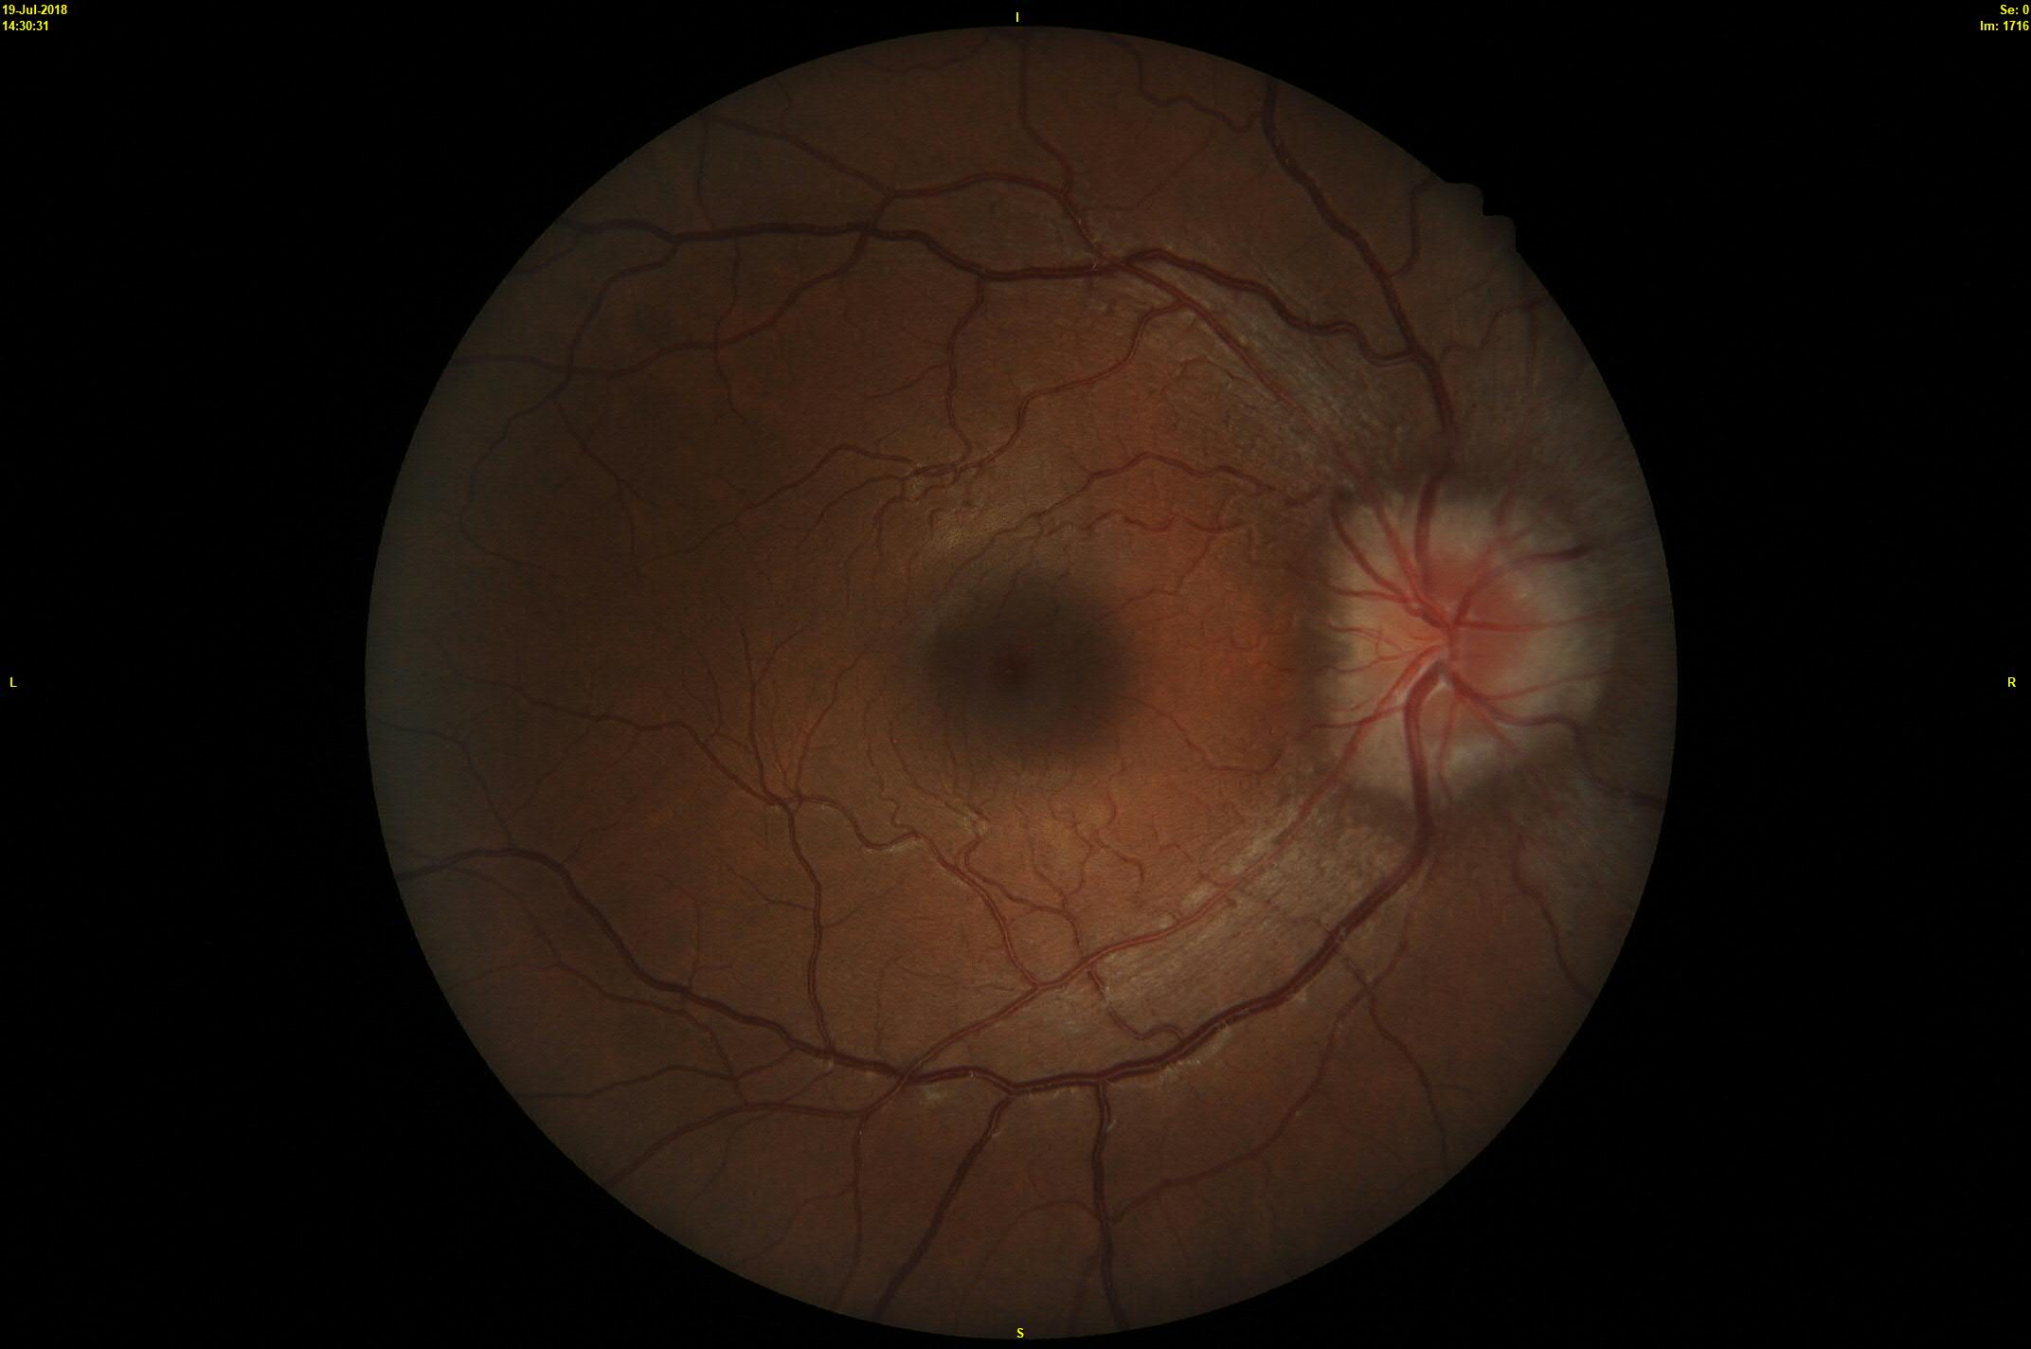
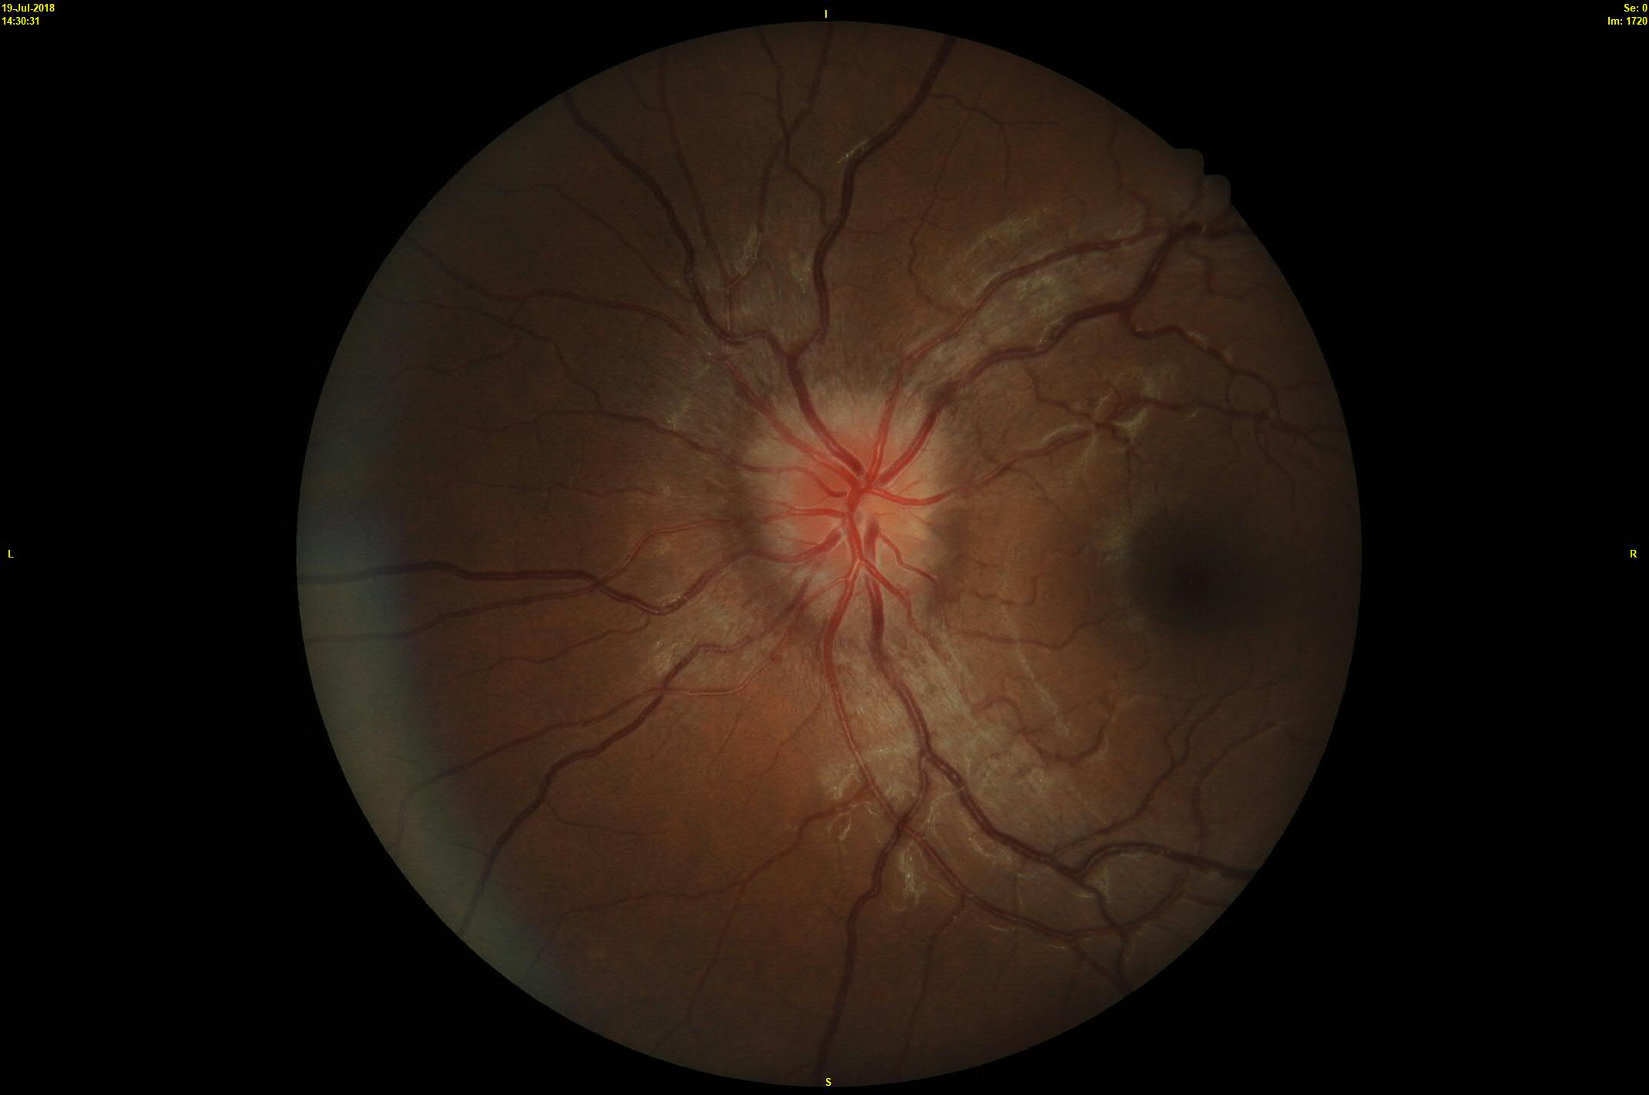
Grade 2 papilledema

Slide 9
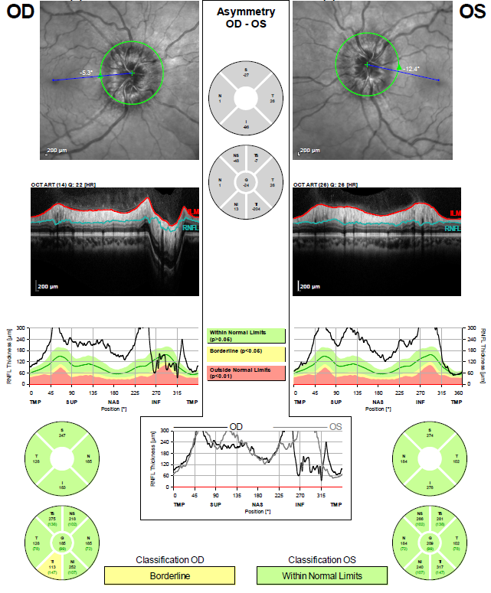
RNFL
OD 185
OS 209

Slide 10
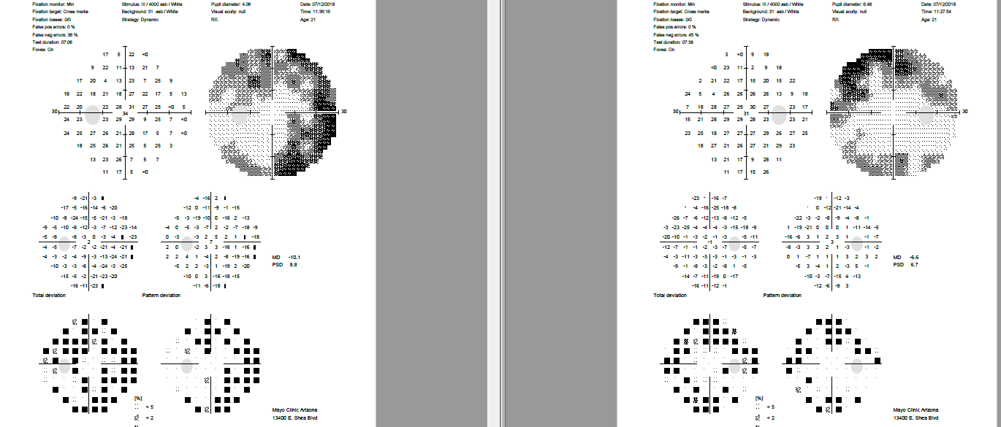
Incomplete superior and inferior arcuate defects
Nasal hemifield defect

Slide 11
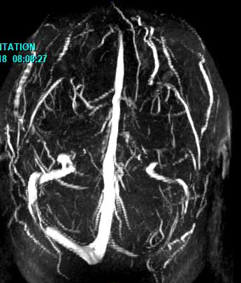
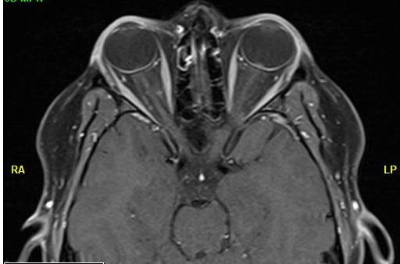
MRI brain/orbit w/wo contrast
Optic nerve sheath distention
MRV head
No venous thrombosis
--------

Slide 12
Lumbar Puncture
Opening pressure 36 cm H20
CSF analysis normal
What’s your diagnosis?
What Next?
What to consider?

Slide 13
MRV normal
MRI brain/orbit w/wo contrast
--------
Common MR features of intracranial hypertension:
-Empty sella (red arrow)
-Optic nerve sheath distention (blue arrow)
-Posterior globe flattening (yellow arrows)
-Transverse venous sinus stenosis (orange arrow)

Slide 14
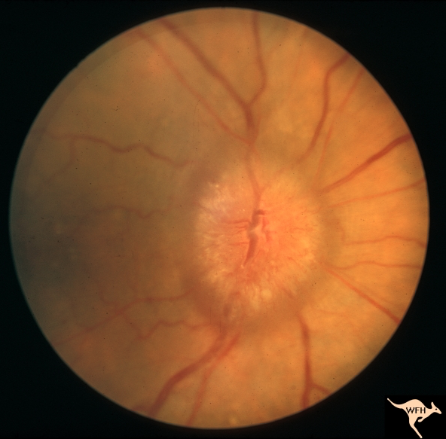
Learning Points:
Not every overweight young female with a
headache has IIH
And, not all optic nerve swelling is papilledema
Work up for suspected papilledema:
Neuroimaging
  MRI brain/CT head
  MR venogram brain
CSF analysis and opening pressure
Blood pressure
NOVEL William F. Hoyt Collection
https://collections.lib.utah.edu/ark:/87278/s6h73c8v

Slide 15
Idiopathic Intracranial Hypertension
also called Pseudotumor Cerebri (PTC)
disorder of inc ICP of unknown cause
classically taught as presenting in young, overweight women of childbearing age
headaches
bilateral optic nerve swelling
rare, males
onset with or worsen during pregnancy

Slide 16
21 year old female and papilledema
What to consider?
Patient has already been on acetazolamide x 6 weeks (500 mg daily x 4 weeks then, 500mg BID x 2 weeks)
Patient has visual (field) loss
Management options:
Medical therapy
Surgical intervention
What will you do?

Slide 17
Recommendations for surgical intervention
Discussed surgical intervention:
-Vision loss
-Worsening papilledema
-Intractable headache
Overall, goal to prevent/stabilize visual loss

Slide 18
Surgical Interventions for IIH
No consensus guidelines for:
  When
  How
  Why
SIGHT (Surgical IIHTreatment Trial) NORDIC study 2017
-terminated due to low enrollment
- medical therapy (MT) vs MT + ONSF vs MT + VPS

Slide 19
Back to our patient…
Considerations for Surgical Intervention:
ONSF (visual loss)
Venous sinus stenting (potential candidate if gradient of 8-10 mmHg or more across stenosis)
VP shunting (headaches getting better on acetazolamide)
However, patient wanted to wait…..
Now what?

Slide 20
Discussion with our patient:
Visual Function
  Visual acuity intact
  Color vision intact
  VF loss
Recommend surgical intervention: ONSF right eye vs VSS or medical therapy with close serial monitoring
Course of Action:
  Started acetazolamide 1000mg BID then, 2000mg BID
  Repeat testing 7-10 days; if no significant improvement then, surgery
  In interim, return ASAP for any visual changes
  Low sodium diet, exercise, and weight loss
  Near future, referral to bariatric program

Slide 21
Teaching Tips on IIH Medical Therapy
Weight loss, in range of 5%-10% of total body weight
Low-calorie diet, restricted sodium
Bariatric surgery (BMI > 40)
Acetazolamide
Topiramate
Furosemide
Repeated lumbar puncture
Corticosteroids
At onset, taper dose up to 2 grams a day as tolerated by patient
If needed, may increase dose to 3-4 g per day
Similar to headache using 50-200mg twice daily not to exceed 400 mg daily
Can be added to acetazolamide; start at 20mg twice daily and gradually increase
Controversial; short-term use and preoperative period
Role for short-term use in preoperative period
Idiopathic Intracranial Hypertension Treatment Trial

Slide 22
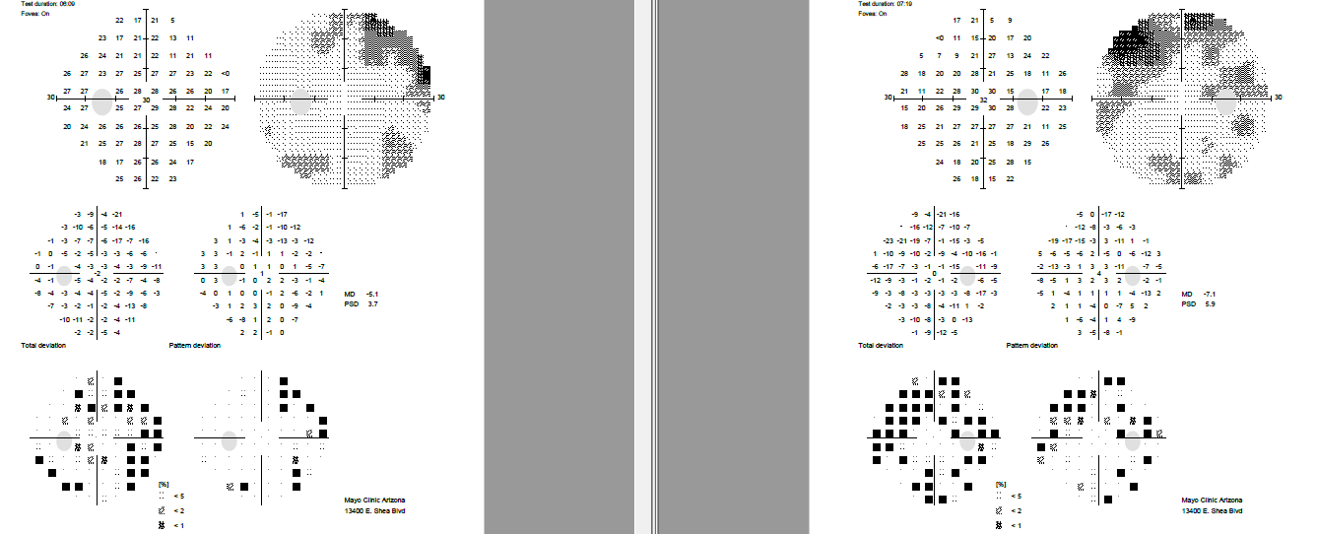
2 weeks later…
(on acetazolamide x 8 weeks)
20/20 OU
Right RAPD
Papilledema grade unchanged
Persistent Visual Field loss
(somewhat improved)
OD > OS

Slide 23
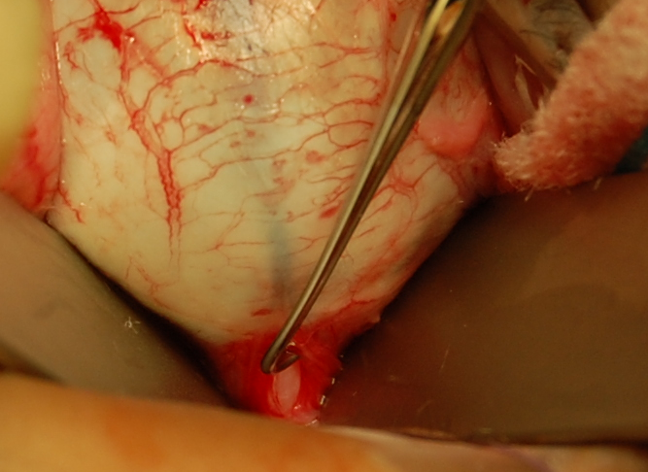
Patient had surgical intervention
ONSD (medial approach) OD
Tenotomy hook to lyse subarachnoid adhesions
Use with Permissions M.A. Di Nome

Slide 24
Why fenestrate the optic nerve?
Exact mechanism to reduce ONH edema unclear
Theorized that ONSF functions through CSF filtration
  Fenestration site:
    cyst-like fluid collection (early)
    Fibrous tissue formation (late)
Mechanical perspective
  Sudden drop subarachnoid pressure of the optic nerve
  Relief of ”compartment syndrome” on optic nerve head

Slide 25
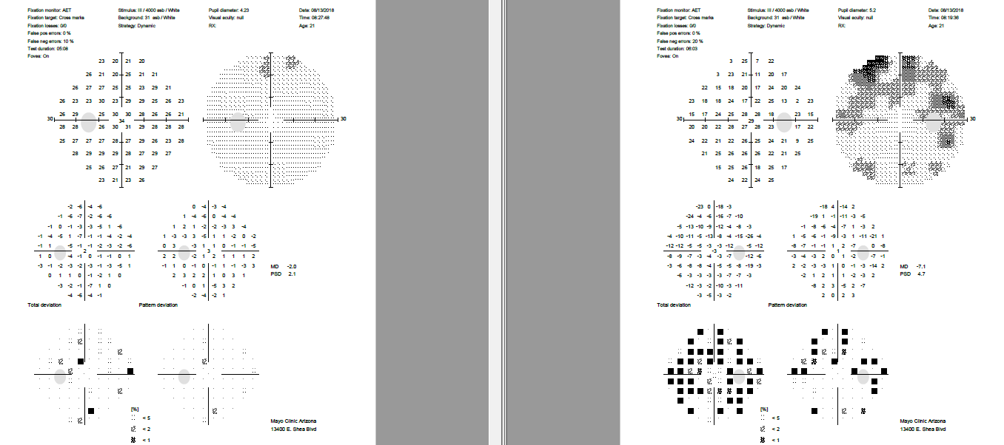
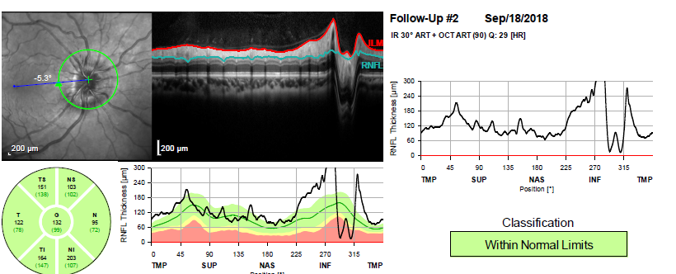
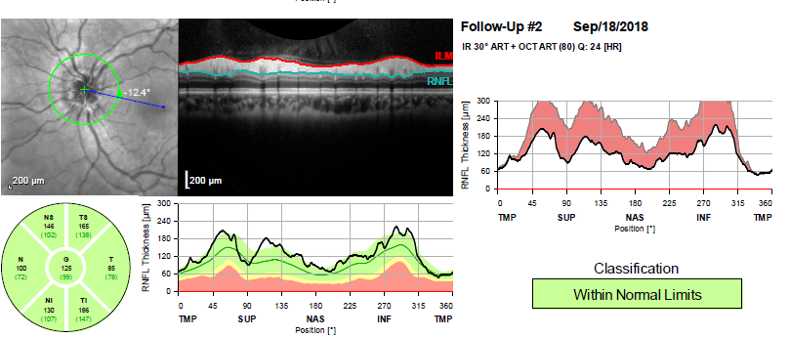
21 year old female with papilledema
HVF post op 3 weeks
OS
OD
The change report (shaded in red) indicates
reduction in RNFL correlating to resolution
of ODE (improved papilledema grade)
RNFL OD 132 OS 126

Slide 26
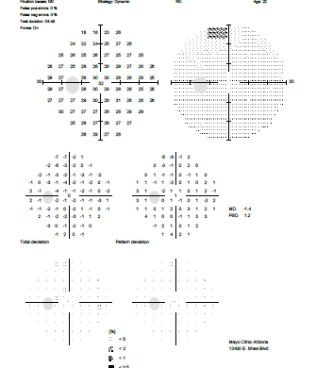
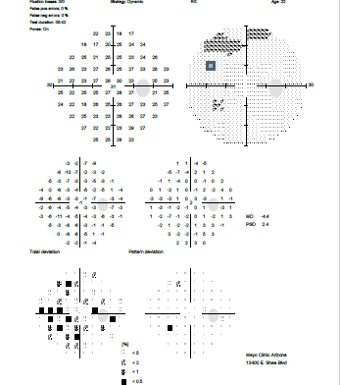
HVF post op 2 months

Slide 27
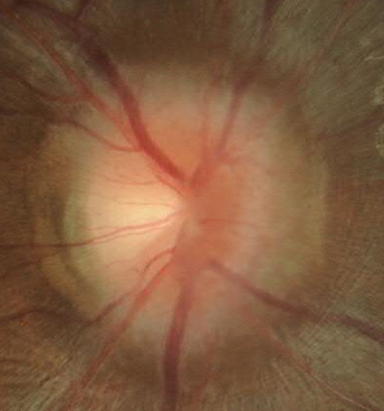
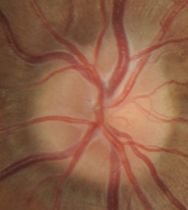
Post op 6 months
OCT RNFL OD 91 OS 113
Do you think RNFL reduction is a “good” or “bad” sign in IIH?

Slide 28
Post op 6 months
Papilledema resolved
No visual symptoms
Headache persists What is association of IIH and HA?
  Our patient remained on low dose acetazolamide

Slide 29
IIH and Headache
Some IIH patients:
  Persistent chronic HA despite IIH treatment
  Increased prevalence of migraine headache in IIH patients
  Persistent headache after normalization of intracranial pressure

Slide 30
Back to our patient… post op 9 months
BMI 68.4 (initially 66.3)
No visual symptoms
Daily headache
still on low dose acetazolamide
Gained approx 15 pounds
 | Right Eye OD | Left Eye OS
Vision | 20/20 | 20/20
Ishihara | 11/11 | 11/11
Pupils | Brisk, No RAPD | Brisk, No RAPD
EOM | Full | full

Slide 31
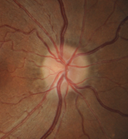
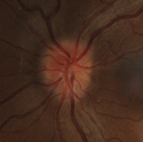
Recurrence of Papilledema
OCT RNFL OD 91 OS 124

Slide 32
Now What?
Increased acetazolamide to 500 mg BID
Discussed bariatric surgery
Tips:
-always keep in mind that IIH recurrence could be due to underlying etiology ie. r/o secondary IIH causes and repeat images as needed
-**Risk of papilledema/IIH recurrence is real with weight gain

Slide 33
Lost to follow up
Patient eventually had bariatric surgery…due to insurance issues never returned to our clinic

Slide 34
Visual Loss and IIH…it is real
Tips & Pearls
Refer for ophthalmic examination
  Dilated fundus exam
  Visual Fields
  OCT

Slide 35
When to intervene…
Tips & Pearls
  Vision-threatening disease
  Needs emergent evaluation

Slide 36
References
Abel AS, Brace JR, McKinney AM, Friedman DI, Smith SD, Westesson PL, Nascene D, Ott F, Lee MS. Effect of patient positioning on cerebrospinal fluid opening pressure. J Neuro-Ophthalmol. 2014; 34:218-222.
Alsuhaibani AH, Carter KD, Nerad JA, Lee AG. Effect of optic nerve sheath fenestration on papilledema of the operated and the contralateral nonoperated eyes in idiopathic intracranial hypertension. Ophthalmology 2011;118:412-414.
Corbett JJ, Savino PJ, Thompson HS, Kansu T, Schatz NJ, Orr LS, Hopson D. Visual loss in pseuduotumor cerebri. Arch Neurol. 1982;39:461-474.
Digre KB. Not so benign intracranial hypertension. editorial. BMJ. 2003; 326;613-614.
Digre KB, Bruce BB, McDermott MP, Galetta KM, Balcer LJ. Quality of life in idiopathic intracranial hypertension at diagnosis: IIH treatment trial results. Neurology. 2015;84:2449-2456.
Farzad S, Razmeh S, Habibzadeh N, Zavari A. Nabovvati M. Migraine headache in patients with idiopathic intracranial hypertension. Neurol Int. 2017; 9(3): 7280.
Friedman DI, Liu GT, Digre KB. Revised diagnostic criteria for the pseudotumor cerebri syndrome in adults and children. Neurology 2013: 81:1159-1165.
Friedman DI, Quiros PA, Subramanian PS, Mejico LJ, Gao S, McDermott M, Wall M. NORDIC IIHTT study group. headache in idiopathic intracranial hypertension: findings from the Idiopathic Intracranial Hypertension Treatment Trial. Headache 2017; 57:1195-1205.

Slide 37
References
Mollan SP, Grech O, Sinclair AJ. Headache attributed to idiopathic intracranial hypertension and persistent post-idiopathic intracranial hypertension headache: A narrative review. Headache. 2021: 61:808-816.
Mukherjee N, El-Dairi MA, Bhatti MT. Optic nerve sheath sheath fenestration-indications and techniques. US Ophthalmic Review. 2013;6(2) 125-131.
Nordic IIH Study Group Writing Committee. Effect of acetazolamide on visual function in patients with idiopathic intracranial hypertension and mild visual loss: The Idiopathic Intracranial Hypertension Treatment Trial. JAMA 2014; 311 (16)1641-1651.
Scherman DB, Dmytriw AA, Nguyen GT, Nguyen NT, Tchantchaleishvili N, Maingard J, Asadi H, Brooks M, Griessenauer C, Ogilvy C, Thomas AJ, Moore JM, Phan K. Shunting, optic nerve sheath fenestration and dural venous stenting for medically refractory idiopthathic intracranial hypertension: systematic review and meta-analysis. Ann Eye Sci 2018;3:26.
Subramaniam S. and Fletcher WA. Obesity and weight loss in idiopathic intracranial hypertension: A narrative review. J Neuro-Ophthalmol. 2017; 37:197-205.
Wall, M. Idiopathic Intracranial Hypertension. Focal Points, 2017; XXXV (7).
Wall M, Kupersmith MJ, Kieburtz KD, Corbett JJ, Feldon SE, Friedman DI, Katz DM, Keltner JL, Schron EB, McDermott MP. The Idiopathic Intracranial Hypertension Treatment Trial clinical profile at baseline. JAMA Neurol. 2014; 71(6):693-701.
Yazici Z, Yazici B, Tuncel E. Findings of magnetic resonance imaging after optic nerve sheath decompression in patients with idiopathic intracranial hypertension. Am J Ophthalmol 2007;144(3):429-435.

