Slide 1


Seeing Past the Disc
Amalie Chen, MD
Jeffrey Gluckstein, MD
John Gittinger, MD
Notes:
Welcome to another UPFRONT case. Today, we will be discussing a challenging case of optic disc edema. We thought this case was particularly interesting from a neurology and internal medicine standpoint and a good reminder to question your initial diagnosis when a disease does not respond as expected to therapy.

Slide 2
46 y/o woman with headache, positive visual phenomena, and hearing changes
Chief Complaint: months of new headaches, seeing lights, and pulsatile tinnitus; intermittent tingling on the tips of her fingers and toes
Headaches:
  unilateral, temporal, sharp, squeezing pain for seconds at a time
  dull, bifrontal, pressure-like pain
Notes:
This is a 46 y/o woman who presented with headache, vision and hearing changes. She reported months of new headaches that clearly differed from her baseline headaches. One type featured a sharp, squeezing pain that was unilateral and temporal, lasting for seconds at a time. The other featured dull, bifrontal pressure-like headaches. She also described intermittently seeing lights and experiencing pulsatile tinnitus. Finally, she mentioned that she may have noticed some tingling on occasion in her fingers and toes.

Slide 3
46 y/o woman with headache, positive visual phenomena, and hearing changes
Chief Complaint: months of new headaches, seeing lights, and pulsatile tinnitus; intermittent tingling on the tips of her fingers and toes
Headaches:
  unilateral, temporal, sharp, squeezing pain for seconds at a time
  dull, bifrontal, pressure-like pain
What is your approach to headache?
Primary or secondary
Concerning features
What parts of the neuro exam are going to be most important?
Notes:
When you hear a chief complaint of headache, what is your approach to determining the etiology? I think the first step is determining if if the headache is a primary headache disorder or the headache is secondary to another process, such as a mass, tumor, infection, etc. What of these symptoms jumped out to you as concerning for a secondary headache? First off, the fact that she’s having a new type of headache she hasn’t had before at the age of 46 should make you consider a secondary headache. Second, while you can get visual changes with migraine, it would be unusual for her to develop new migraines at her age. Pulsatile tinnitus is also a concerning symptom for increased intracranial pressure.
Her paresthesias seem nonspecific, but certainly shouldn’t be ignored. So what parts of the neuro exam do you not want to miss? When you first start seeing neurology cases, you should practice doing a comprehensive neurological exam, but as you become more comfortable, you should try to do a focused exam catered to the chief complaint. In this case, you definitely want to look at her optic discs to look for signs of disc edema, visual field testing, as well as check for full extraocular muscle movement. You should also evaluate for any sensory deficits and reflexes to see if she has any peripheral nerve pathology based on her complaint of paresthesias, or perhaps hyperreflexia to suggest a cervical spine pathology that could also cause headaches.

Slide 4
Past Medical History
Migraine with aura
Hepatitis C, treated
Hypothyroidism
Medications
Estradiol patch
Levothyroxine
Notes:
Before we get to the exam, let’s just round out her history. She did in fact have a history of migraine with aura, but she was clear that her new headaches were different. Otherwise, she also had a history of treated hepatitis C, and hypothyroidism.
As far as medications, she was on an estradiol patch, levothyroxine

Slide 5
Notable Exam Findings
General
BMI 36
Neuro-ophthalmologic
VA 20/20 OD, 20/20 OS
Pupils equally reactive to light
  No rAPD
Visual fields full to confrontation
Normal efferent exam
Neuro
Motor exam full
Intact sensory exam in all modalities
DTR 1+ in BUE, trace in BL knees, absent in ankles
Notes:
Here are the patient’s pertinent exam findings. She had a BMI of 36. Visual acuity was normal, with reactive and equal pupils, no relative afferent pupillary defect. Her visual fields were full to confrontation. Her efferent exam was normal, meaning her extraocular movements were full. On neuro exam, she was full strength throughout, with no sensory deficits on confrontation testing. She was diffusely hyporeflexic, with trace to absent reflexes in her distal lower extremities bilaterally.

Slide 6
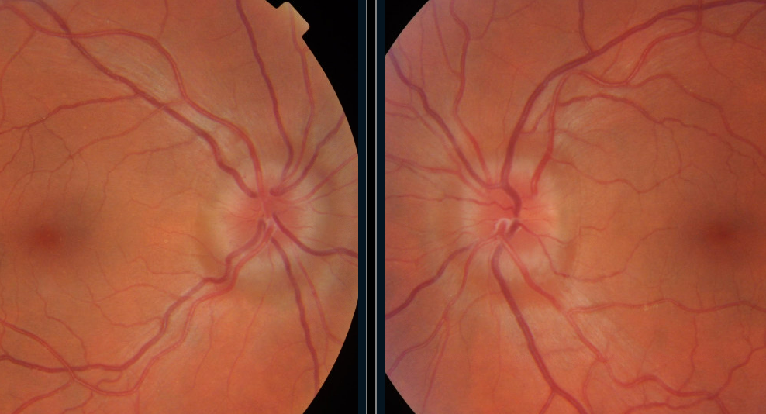
Fundus Examination: mild circumferential disc edema OU
Notes:
Here is an image of her optic discs. Does anything stand out to you?

Slide 7
Fundus Examination: mild circumferential disc edema OU
Notes:
As pointed out in the green circle, she has circumferential disc edema but as shown with the green arrow, her vessels are not obscured

Slide 8
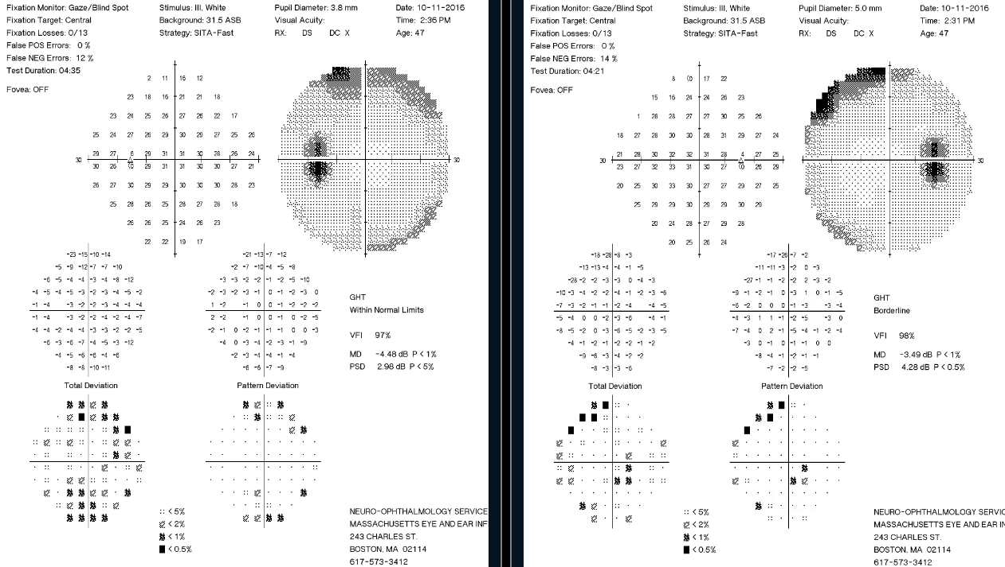
OS False pos: 0%
Fixation losses: 0/13 False neg: 13%
OD False pos: 0%
Fixation losses: 0/13 False neg: 14%
Initial Visual Field Testing
Notes:
Here are the results of her 30 degree Humphries visual field testing. She had mildly elevated false negatives: 14% in the right and 13% in the left, raising the possibility that some of the defects are artifactual. Performance was otherwise reliable.

Slide 9
OS False pos: 0%
Fixation losses: 0/13 False neg: 13%
OD False pos: 0%
Fixation losses: 0/13 False neg: 14%
Initial Visual Field Testing
Notes:
The right eye showed a superonasal arcuate-like defect and a possible enlargement of the blind spot, while the left eye showed a suggestion of superior and inferior arcuate defects. These defects are suspicious for the peripheral nerve fiber layer changes that can occur with disc edema, but would be more convincing if they were consistent over time or the patient had fewer false negatives. In both eyes, the defects were near the edge of the tested field, raising the possibility of rim artifact from the edge of the lens used for refractive correction in the visual field machine, though that usually causes a lack of detection in the portions of the field blocked by the edge of the lens rather than the reduced sensitivity seen here.

Slide 10
Differential Diagnosis for Disc Edema
Papilledema
Disc edema from optic neuropathy
Pseudopapilledema
Liu, 2019
Notes:
When considering a differential for optic disc edema, we can start by anatomically separating the causes. Elevated intracranial pressure, and thus high pressure in the optic nerve sheath leads to papilledema. Disease of the optic nerve head itself can also cause disc edema, and benign lesions in the nerve head itself result in pseudopapilledema. Let’s go into more detail for each of these categories

Slide 11
Differential Diagnosis for Disc Edema
Papilledema
  Disc edema from high intracranial pressure
  Secondary
    Venous sinus thrombosis
    Intracranial mass
    Hydrocephalus
    Cerebral edema
  Idiopathic intracranial hypertension (IIH)
    Lumbar Puncture: bland CSF, opening pressure>25 cm H₂O
    MRI: empty sella, globe flattening, tortuous optic nerves, transverse venous sinus stenosis
Liu, 2019
Notes:
Papilledema is disc edema due to a high intracranial pressure and is usually bilateral. Examples would include a clot in the venous sinuses, masses, hydrocephalus and swelling from cerebral edema. If there is no intracranial lesion causing increased ICP, you should consider idiopathic intracranial hypertension. By definition, the CSF has to be normal, and the opening pressure needs to be higher than 25 cm h2o. Classic MRI findings for IIH include an empty sella, flattening of the posterior aspect of the eyes, the optic nerves may appear tortuous and there can be stenosis of the transverse sinuses.

Slide 12
Differential Diagnosis for Disc Edema
Disc edema from optic neuropathy
  Optic neuritis
  Ischemic optic neuropathies
  Intraocular inflammation
  Diabetic papillopathy
  Leber’s hereditary optic neuropathy
  Intraorbital optic nerve compression or infiltration
Liu, 2019
Notes:
If the disc edema is not due to increased intracranial pressure, then you should consider intrinsic ocular or optic nerve pathology. In general, you should consider inflammation, ischemia, infection, infiltrative processes invading the optic nerve or the eye itself, as well as genetic causes such as Leber’s.

Slide 13
Differential Diagnosis for Disc Edema
Pseudopapilledema
  Drusen
  Congenital anomalies
  Tilted disc
Notes:
Finally, there are benign findings that can look like disc edema and these fall into the category of pseudopapilledema. Examples include drusen or calcium deposits near the optic nerve head, as well as tilting or congenital anomalies of the optic disc.

Slide 14
Differential Diagnosis for Disc Edema
Papilledema (disc edema from high intracranial pressure)
Disc edema from optic neuropathy
Pseudopapilledema
Less likely to cause headache and tinnitus
Notes:
It’s important to think about the entire clinical picture to determine the most likely diagnosis. Our patient had headaches and pulsatile tinnitus, which are symptoms of increased intracranial pressure, either idiopathic or secondary to a mass, clot, or infection. Therefore, papilledema makes sense as the most likely etiology.

Slide 15
Differential Diagnosis for Disc Edema
Papilledema (disc edema from high intracranial pressure)
Disc edema from optic neuropathy
Pseudopapilledema
Less likely to cause headache and tinnitus
What do you want to do next?
Notes:
So now what? Knowing what you know, and having a high suspicion for an intracranial process causing papilledema, what further work-up do you want?

Slide 16
Evaluation
MRI brain and MRV unremarkable
Lumbar Puncture: opening pressure 20cm H₂O, WBC 0, protein 37, glucose 61
Notes:
If you’re thinking about brain imaging and a lumbar puncture to evaluate her opening pressure and CSF results, you’d be correct:
When evaluating suspected papilledema, it's important to rule out mass lesions and CSF inflammation. Not only should you obtain an MR of the brain, but also an MR venogram to evaluate the dural venous sinuses for a clot. This patient used an estradiol patch, thereby increasing her risk of clot formation. In her case, her MRI and MRV were normal.
So the next step was to perform a lumbar puncture with opening pressure. Her CSF studies were normal, demonstrating that CSF inflammation was not the cause of high pressure or disc edema. Her opening pressure was 20 cm of water, which is in the upper range of normal, but not frankly diagnostic of idiopathic intracranial hypertension.

Slide 17
Diagnosis and Treatment
Patient was diagnosed with IIH
  Though her opening pressure was normal, this was thought to be inaccurate
  Her combination of headaches, pulsatile tinnitus, disc edema, higher BMI and arcuate field changes supported trying pressure-lowering therapy
Notes:
So what happened next? This wasn’t a slam dunk for IIH. But there was concern at that point in her work up that the LP opening pressure wasn’t accurate. Taking the whole clinical picture of a woman with a higher BMI with the complaint of vision changes, headaches, pulsatile tinnitus, and the finding of disc edema, she was given an initial diagnosis of IIH. Therefore, it was decided to try pressure lowering therapy

Slide 18
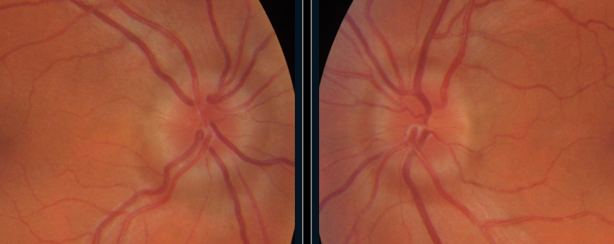
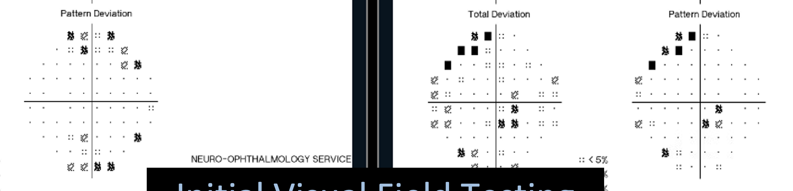
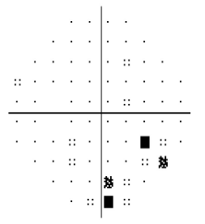
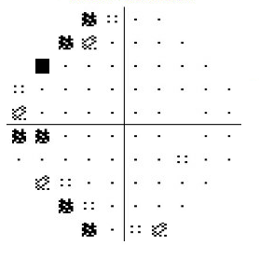
Course
Initial
Started on acetazolamide 500 mg twice daily
Reported some improvement in headaches and pulsatile tinnitus
Disc edema and visual fields were largely unchanged after 3 years
3 years later
Initial
3 years later
Notes:
So she was started on acetazolamide to bring down her presumed elevated intracranial pressure. She did endorse some improvement in her headaches and pulsatile tinnitus, suggesting that some of her symptoms were due to mildly elevated ICP. She remained on 500mg twice daily and 3 years later, her disc elevation was similar except for faintly improved temporal elevation in the left nerve. Her visual fields showed similar mild peripheral defects.

Slide 19
Yellow Flags
Features supportive of IIH
  BMI 36
  Bilateral optic disc edema
  Initial headache and pulsatile tinnitus, improved on acetazolamide
Features unsupportive of IIH:
  CSF opening pressure 20cm H₂O (higher end of normal range)
  No improvement of symptoms with acetazolamide
  No improvement of visual fields or disc edema with acetazolamide
Notes:
Now is a good time to take a step back and think about what features of this case were unusual for IIH. Yes, she had a high BMI, disc edema on exam, headaches, and pulsatile tinnitus, all features classic for IIH. She did have some improvement in her symptoms on acetazolamide. But the fact that her visual fields and disc edema hardly improved with treatment, as well as the fact that her CSF opening pressure was not elevated should lead us to be skeptical about the initial diagnosis. It’s worth pointing out that most LP opening pressure errors will result in a falsely HIGH pressure. Sources of error include performing an LP with the patient in a seated position, sedation, or valsalva.

Slide 20
Course
Over the course of the next 5 years, she developed systemic edema, lymphadenopathy, and hepatosplenomegaly. Lymph node biopsy showed Castleman disease
Notes:
So what became of the patient? Over the next several years, she began to develop other symptoms beyond her headache and vision changes. Specifically, she developed leg edema, lymphadenopathy, and organomegaly. She underwent a biopsy of her lymph node and was diagnosed with Castleman disease.

Slide 21
Course
Over the course of the next 5 years, she developed systemic edema, lymphadenopathy, and hepatosplenomegaly. Lymph node biopsy showed Castleman disease
What is Castleman disease?
Lymphoproliferative disorders
Focal or multifocal disease
Etiology: human herpesvirus (HHV)-8 (multifocal only) or idiopathic
    Pathophysiology: IL-6 overexpression
    Histopathology: ranging from hyaline vascular to plasmacytic subtypes
    Multicentric Castleman disease:
    Associated with: HIV, heme malignancies
    S&S: lymphadenopathy, B-symptoms, anemia, platelet disorders, polyclonal hypergammaglobulinemia, hepatosplenomegaly, volume overload
    (Ehsan, 2022)
    (Rajkumar, UpToDate, 2022)
Notes:
So let’s pause for a moment and talk briefly about Castleman disease. There are a lot of nuances to this disease, but we’ll touch on the basics. It’s actually a group of lymphoproliferative disorders, diagnosed by specific histological findings found on lymph node biopsy. There is focal or unicentric Castleman disease, or multicentric Castleman disease. Multifocal Castleman disease can be caused by human herpesvirus 8 or be idiopathic, like unicentric Castleman disease, ultimately leading to IL-6 overexpression. Pathology shows abnormal germinal centers either regressed or hyperplastic, abnormal follicles, and hypervascularity, depending on the subtype. Multicentric CD, like our patient had, is often associated with hematological malignancies or HIV. Signs and symptoms beyond lymphadenopathy include B symptoms such as weight loss, fevers, night sweats, along with heme abnormalities, hepatosplenomegaly, and volume overload. Our patient’s biopsy actually showed features of both hyaline and plasmacytic subtypes.

Slide 22
Course
Over the course of the next 5 years, she developed systemic edema, lymphadenopathy, and hepatosplenomegaly. Lymph node biopsy showed Castleman disease
Her neuro-ophthalmic examination remained stable
She frequently tripped, had difficulty standing from a seated position and felt imbalance in the shower
Notes:
Clinically, she also gradually developed difficulty ambulating, rising from a seated position, and staying upright in the shower. Remember, on her initial presentation she complained of tingling in her fingers and toes and she had diminished reflexes, worse distally than proximally. It sounds to me like her neuro exam changes go beyond just eye findings. I bet you’re curious what her neuro exam is like now…

Slide 23
Neurology Evaluation - Year 5
History
Months of worsening paresthesias and weakness
Exam
Normal mental status and cranial nerve exam
Mild distal and proximal bilateral lower extremity weakness
Decreased sensation in all extremities, lower>upper, distal>proximal
Diffuse hyporeflexia with areflexia in her ankles
Positive Romberg
Notes:
She was reexamined by neurology, where she described months of worsening paresthesias, along with ascending numbness and bilateral lower extremity weakness. Here’s how her neurological exam changed: she now had decreased strength in her legs, along with decreased sensation, worse in her legs than her arms, and worse distally than proximally. Her hyporeflexia was still present and now her Romberg was positive.
Sensory testing is often one of the hardest parts of the neuro exam because it is subjective. Patients often have difficulty with testing, leading to inconsistent results that are difficult to interpret. In this case, the patient’s initial sensory exam was deemed normal. But she was diffusely hyporeflexic initially, providing more objective evidence that there may have been sensory or motor pathology at first presentation. Hindsight is 20/20, but at least we have a repeat examination 5 years later.

Slide 24
Localization?
Cortex
Brainstem
Spine
Nerve Roots
Peripheral Nerve
Neuromuscular Junction
Muscle
Normal mental status and cranial nerve exam
Mild distal and proximal bilateral lower extremity weakness
Decreased sensation in all extremities, lower>upper, distal>proximal
Diffuse hyporeflexia with areflexia in her ankles
Positive Romberg
Notes:
On the right are the pertinent findings on her neuro exam. How can we use these findings to localize this lesion? Even though the patient initially presented with disc edema and our preference is to go by Occam’s Razor and find a unifying lesion, we can’t forget Hickam’s dictum: this process may have nothing to do with her disc edema. So let’s break it down: we can cross off a lesion in the cortex and brainstem because of her normal mental status, cranial nerve exam, and the ascending quality of her symptoms. We’re left with the spine and anything distal. The fact that she is hyporeflexic crosses off a spinal lesion, because we would expect to have hyperreflexia from a myelopathy. She has sensory and motor findings, so that pretty much crosses off neuromuscular junction and muscle pathology. This leaves us with either a polyneuropathy or a polyradiculopathy, involving peripheral nerves and/or nerve roots.

Slide 25
Polyneuropathy Differential Diagnosis
Diabetes, vitamin B12 and folate deficiencies, monoclonal gammopathy, HIV, hypothyroidism, chemotherapy, alcohol, hereditary (Charcot-Marie-Tooth)
Autoimmune: Acute or chronic inflammatory demyelinating polyradiculoneuropathy (AIDP, CIDP)
Castleman disease associated polyneuropathy
Polyneuropathy Organomegaly Endocrinopathy Monoclonal protein and Skin changes (POEMS) syndrome
Amyloidosis
Cryoglobulinemia
Sarcoidosis
Blue Highlight: may include disc edema
Tian, 2014
Dias-Santos, 2014
Notes:
Both her history and neuro exam point to proximal and distal peripheral nerve involvement. She described difficulty with standing from a seated position, which is a sign of proximal weakness, as well as frequent tripping, which a sign of distal weakness.
I want to point this out because polyneuropathy has a vast differential, and importantly, the work-up and treatment depend on the presentation of symptoms.
Length dependent polyneuropathies, with etiologies such as diabetes, vitamin deficiencies and long term alcohol use affect the longest nerves first, thereby presenting with what we call a stocking-glove distribution. They CAN eventually involve proximal regions, but this is a much later finding.
On the other hand, proximal and distal involvement earlier in on the process suggest a non-length dependent polyneuropathy, such as auto-immune processes such as AIDP.
Her condition developed over the course of months and at her second neurological evaluation, she already demonstrated both distal and proximal signs, but the key is the duration and her initial symptoms. Remember at her first neurological evaluation, years ago, she was complaining of tingling in her fingers and toes and she had absent reflexes in her ankles. She was already displaying signs of a length dependent polyneuropathy, and years later, we now find that it has spread to her proximal lower extremities.
Knowing this, as the neurologist, you would check for those disease processes in that first group, but you would also think about the whole clinical picture. She was recently diagnosed with a systemic process, remember? That’s right! Castleman disease, along with other systemic diseases such as amyloidosis, cryoglobulinemia, POEMS syndrome can all cause polyneuropathies.
What is of particular interest in this case are the conditions highlighted in blue, which signifies disease processes that can lead to polyneuropathy AND disc edema .

Slide 26
Nerve Conduction Study
Progressive sensorimotor length-dependent demyelinating polyneuropathy and length dependent axonal loss
Notes:
An EMG/NCS was performed, that demonstrated Progressive sensorimotor length-dependent demyelinating polyneuropathy and length dependent axonal loss, which fits a lot of our differential from the earlier slide. These findings can be seen with CIDP, Castleman’s related polyneuropathy, or POEMs. It is important to differentiate since each of these are treated differently. So more tests were performed.

Slide 27
Further Evaluation
VEGF: 294 (elevated)
Plt count: 500k
Skeletal survey: multiple sclerotic lesions
SPEP: IgA lambda gammopathy
BM biopsy: without evidence of plasma cell dyscrasia
Notes:
She had more labs checked, and she was found to have this slew of results: an elevated VEGF, thrombocytosis, and multiple sclerotic lesions on skeletal survey. She ultimately underwent a bone marrow biopsy. While this did not reveal a plasma cell dyscrasia, her SPEP demonstrated a monoclonal gammopathy. So why did anyone check these random tests?

Slide 28
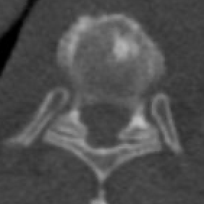
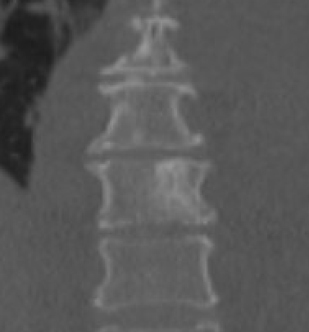
POEMS Diagnostic Criteria
2 Major and ≥ 1 Minor Criteria
Major Criteria:
  Polyneuropathy ✅
  Monoclonal plasma cell proliferative disorder ✅
Minor Criteria:
  Sclerotic bone lesions ✅
  Castleman disease ✅
  Organomegaly ✅
  Edema ✅
  Endocrinopathy
  Skin changes
  Papilledema ✅
“Papilledema” has been seen in 29-55% of patients with POEMS
Dispenzieri, 1999
Notes:
…because they were looking for POEMS syndrome. POEMS stands for polyneuropathy, organomegaly, endocrinopathy, M protein, and skin changes - though those are not the only features of the disease. It always features polyneuropathy and a monoclonal plasma cell disorder. Disc edema is seen in about 29-55% of POEMS. About 30% of patients with POEMS syndrome have CD. Our patient’s constellation of systemic symptoms and signs with disc edema met criteria for POEMS. The images on the right demonstrate some of her diffuse sclerotic bone lesions. While most literature refers to the disc edema in POEMS as papilledema, it should actually be called optic disc edema, since the edema is not always from increased intracranial pressure.

Slide 29
Treatment
General:
  Limited sclerotic lesions: Radiation therapy
  Diffuse disease:
    Hematopoietic cell transplant
    Chemotherapy: melphalan, lenalidomide, bortezomib, daratumumab, steroids
Response markers:
  Serum paraprotein levels, PET scans, CBC, VEGF
Dispenzieri, 2012
Rajkumar, UpToDate, 2022
Notes:
POEMs is treated based on how pervasive the disease process is. Limited sclerotic lesions receive RT, while diffuse disease requires treatment with chemotherapy and/or steroids, and possibly stem cell transplant. Monitoring the response to treatment involves serial checks of VEGF, SPEP, platelet count, and PET scans.

Slide 30
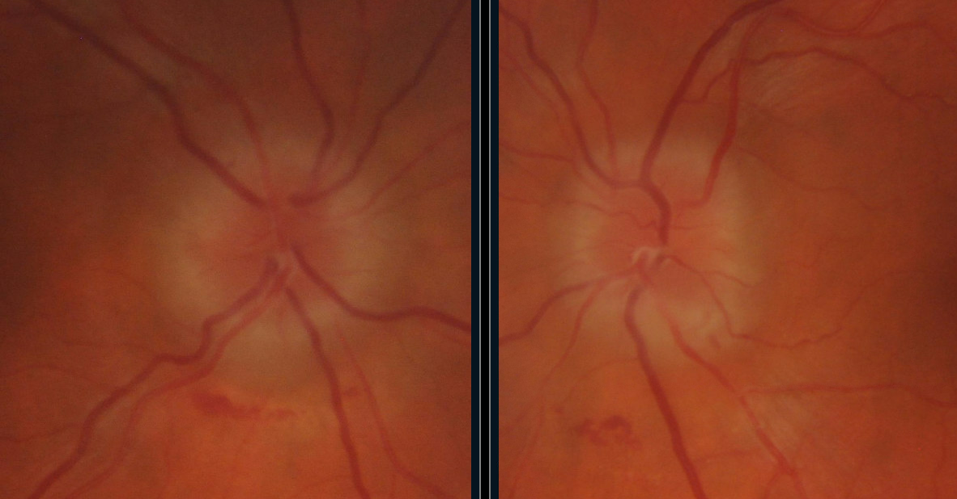
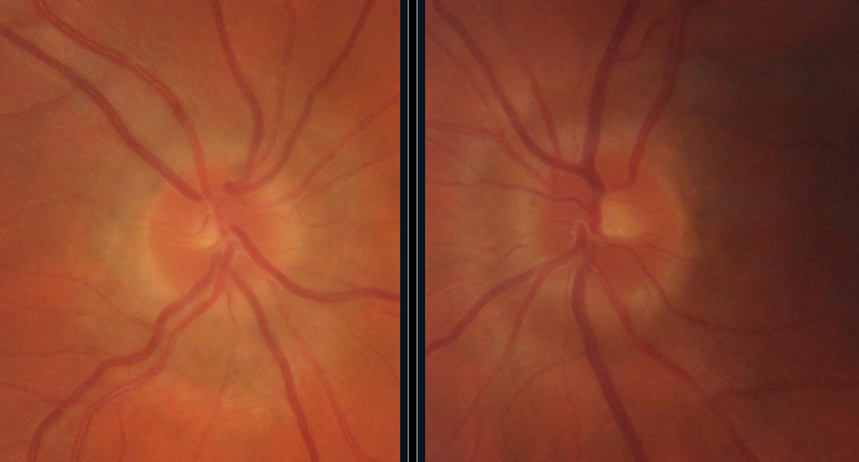
Treatment response to daratumumab, bortezomib, & dexamethasone
3 months prior to therapy:
VEGF 294 pg/mL (high)
7 months after therapy:
VEGF 28.5 pg/mL (normal)
3 months prior to therapy
7 months after therapy initiation
Notes:
Her treatment was managed by her oncologist. Treatment with chemotherapy and steroids usually leads to an improvement in disc edema. Elevations in VEGF are linked with the degree of disc edema in POEMS syndrome. In this case, the patient’s VEGF levels decreased to normal range with therapy and her disc swelling improved.

Slide 31
Learning Points
Diagnosis of disc edema can be approached anatomically, separating the disorder into papilledema, anterior optic neuropathy, and pseudopapilledema
Disc edema with a normal opening pressure, normal MRI, and lack of response to acetazolamide should lead to a broader differential than IIH
POEMS syndrome includes a constellation of symptoms that always includes polyneuropathy and a monoclonal plasma cell disorder, but often also includes disc edema
Disc edema in POEMS should improve with treatment (steroids, chemotherapy/anti-VEGF agent, radiation, stem cell transplant)
Notes:
Our goal with this case was to demonstrate that one must think about the overall clinical picture, including medical and neurological co-morbidities, to help come up with an appropriate differential. While her initial presentation seemed to fit IIH, the normal opening pressure, lack of response to treatment, and comorbidities pointed us in a different direction. We discussed the broad differential of disc edema, including POEMS, which often has disc edema as one of its clinical manifestations. In POEMS, disc edema should improve with treatment of the systemic disease process, in this case, steroids and chemotherapy. We hope this case brought to light how to approach disc edema, polyneuropathy, and systemic illnesses. Thank you for watching!

Slide 32
References
1. Dias-Santos A, Ferreira J, Cunha JP. Macular and optic disc edema and retinal vascular leakage in familial amyloid polyneuropathy with a transthyretin Val30Met mutation: a case report. J Med Case Rep. 2014;8:327. doi:10.1186/1752-1947-8-327
2. Dispenzieri A. How I treat POEMS syndrome. Blood. 2012;119(24):5650-5658. doi:10.1182/blood-2012-03-378992
3. Dispenzieri A, Kyle RA, Lacy MQ, et al. POEMS syndrome: definitions and long-term outcome: Presented in abstract form at the 41st annual meeting of the American Society of Hematology, New Orleans, LA, December 3-7, 1999. Blood. 2003;101(7):2496-2506. doi:10.1182/blood-2002-07-2299
4. Ehsan N, Zahra F. Castleman Disease. In: StatPearls. StatPearls Publishing; 2022. http://www.ncbi.nlm.nih.gov/books/NBK576394/
5. Liu GT, Volpe NJ, Galetta SL. Optic Disc Swelling: Papilledema and Other Causes. In: Liu, Volpe, and Galetta’s Neuro-Ophthalmology. 3rd ed. Elsevier; 2019:197-200.
6. Rajkumar SV. POEMS syndrome. UpToDate. https://www.uptodate.com/contents/poems-syndrome?search=castleman%20disease&topicRef=117312&source=see_link#H29
7. Tian G, Jing Y, Jiang H, Wang J, Zhang X. Papilledema as the Initial Presentation of Castleman Disease. Journal of Neuro-Ophthalmology. 2014;34(2):169-172. doi:10.1097/WNO.0000000000000096

