Slide 1


Movie-Like Palinopsia
Heather M. McDonald, Western University
Lulu L.C.D. Bursztyn, Western University
J. Alexander Fraser, Western University

Slide 2
62-Year-Old Male with Palinopsia
Presents to the neuro-ophthalmology clinic
CC: Intermittent visual disturbances in his left visual field for the past 13 months

Slide 3
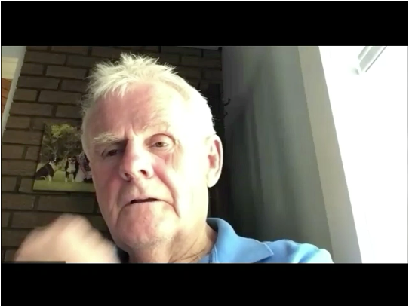
HPI
December 2011: 10-15 minute visual disturbance consisting of “wavy coloured” lines in both eyes
4 months later: left-sided visual disturbance
  Alternating obstruction of left visual field (could not see fingers on left hand) and duplication of an image (multiple images of his thumb)
  Went to bed → pain and visual disturbance resolved upon awakening
PATIENT DESCRIPTION OF VISUAL DISTURBANCE

Slide 4

HPI
December 2011: 10-15 minute visual disturbance consisting of “wavy coloured” lines in both eyes
4 months later: left-sided visual disturbance
  Alternating obstruction of left visual field (could not see fingers on left hand) and duplication of an image (multiple images of his thumb)
  Went to bed → pain and visual disturbance resolved upon awakening
PATIENT DESCRIPTION OF VISUAL DISTURBANCE

Slide 5

HPI
2 days later: awoke from sleep and noticed “corrugated plate” in his left visual field x 10 minutes
PATIENT DESCRIPTION OF VISUAL DISTURBANCE

Slide 6

HPI
2 days later: awoke from sleep and noticed “corrugated plate” in his left visual field x 10 minutes
PATIENT DESCRIPTION OF VISUAL DISTURBANCE

Slide 7
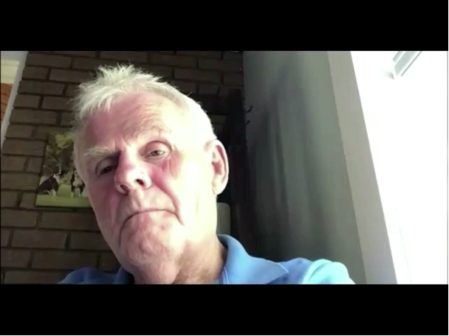
HPI
Later that day: he drove his truck across the border from Canada into USA
  Interacted with customs officer then continued his drive
  A persistent vivid image, or movie, of the customs officer played in his left superior visual field x 10 minutes
    He could still see the officer moving his mouth and talking, though he could not hear him
  He also saw cars and trucks moving on the road in his left visual field that were not there
PATIENT DESCRIPTION OF VISUAL DISTURBANCE

Slide 8
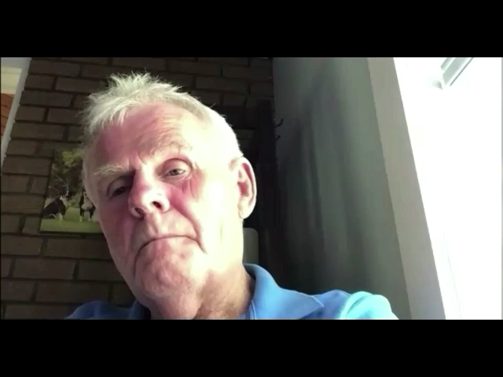
HPI
Later that day: he drove his truck across the border from Canada into USA
  Interacted with customs officer then continued his drive
  A persistent vivid image, or movie, of the customs officer played in his left superior visual field x 10 minutes
    He could still see the officer moving his mouth and talking, though he could not hear him
  He also saw cars and trucks moving on the road in his left visual field that were not there
PATIENT DESCRIPTION OF VISUAL DISTURBANCE

Slide 9
Other History
Past medical history:
  Dyslipidemia
  No known history of migraines, seizures, strokes, or other neurological problems.
Past ocular history:
  None
Medications:
  ASA 81 mg, statin
Social history:
  No smoking history, no recreational drug use (such as LSD, MDMA/ecstasy, or mushrooms), occasional alcohol, works as a truck driver

Slide 10
HPI
After crossing the border back into Canada, presented to the ED where a CT Head was performed
  Initially reported as normal
Seen by a local ophthalmologist who could not identify a cause for his symptoms
Examined by an internist who identified decreased coordination in his left hand
A follow-up MR Head was performed…

Slide 11
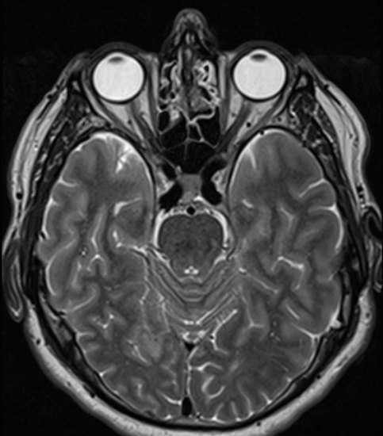
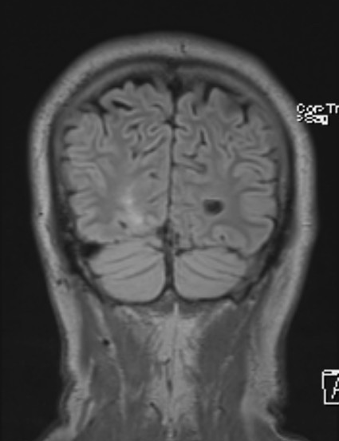
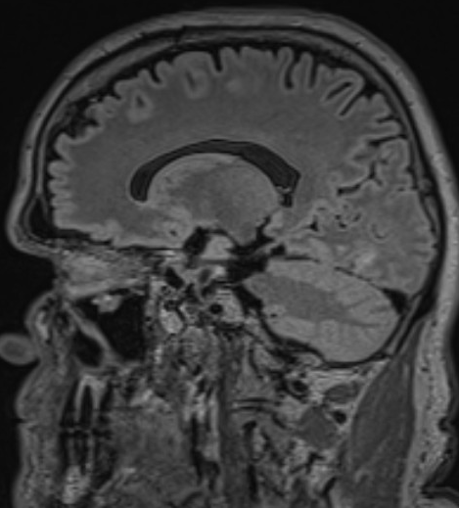
MR Head – Right anterior occipital lobe infarct
A
B
C
A) Axial T2 image, B) Coronal FLAIR image, C) Sagittal FLAIR image.

Slide 12
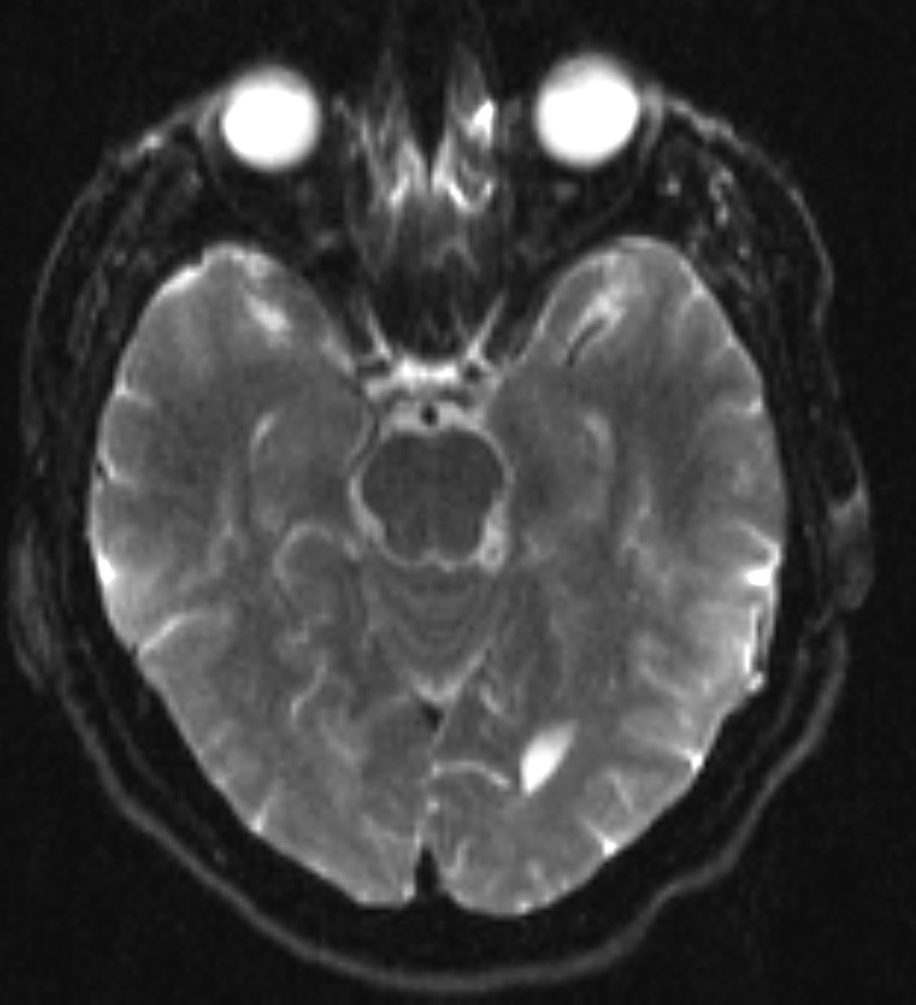
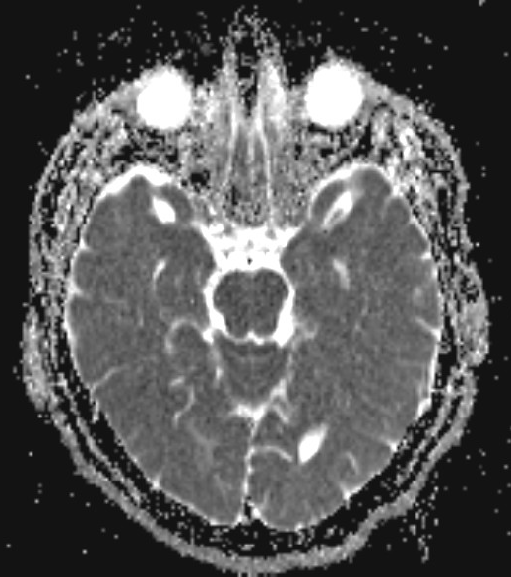
MR Head
A
B
No diffusion restriction at location of infarct, indicating chronicity.
A) Axial diffusion-weighted image, B) Axial ADC (apparent diffusion coefficient) image.

Slide 13
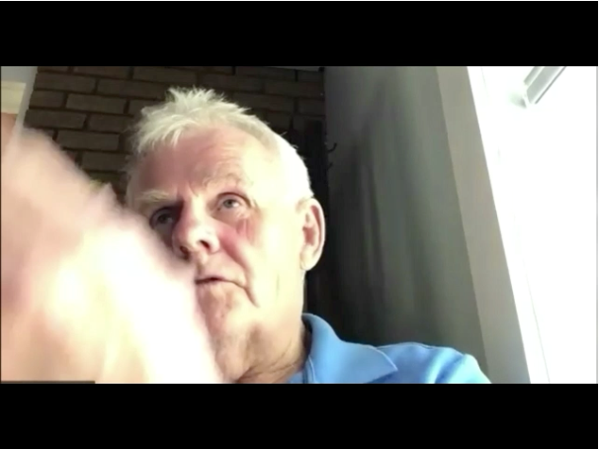
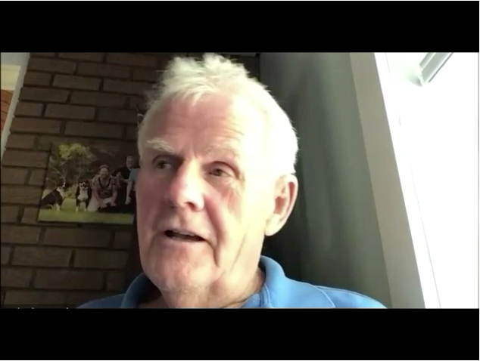
Ongoing Symptoms
Later in the day he noted “waterfall” and “rainbow colours” in his left visual field x1-2 min on and off every hour
He looked in the mirror while brushing his hair, and then continued to see himself brushing his hair after stopping
PATIENT DESCRIPTION OF VISUAL DISTURBANCE

Slide 14
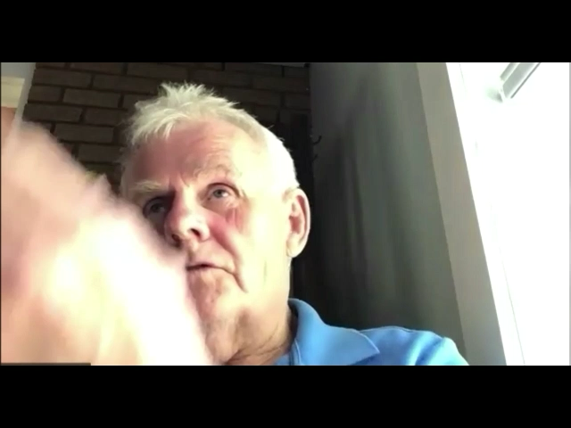
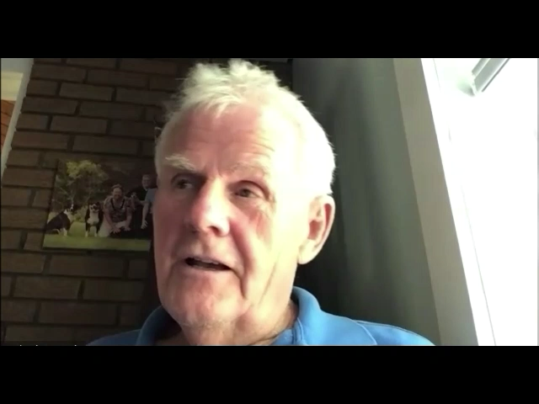
Ongoing Symptoms
Later in the day he noted “waterfall” and “rainbow colours” in his left visual field x1-2 min on and off every hour
He looked in the mirror while brushing his hair, and then continued to see himself brushing his hair after stopping
PATIENT DESCRIPTION OF VISUAL DISTURBANCE

Slide 15
Investigations
Scalp EEG: Normal
Referred to neuro-ophthalmology 13 months following start of symptoms

Slide 16
Neuro-Ophthalmology History
Patient reports recurrent events over past 13 months
  Always occur in the left homonymous visual field
  Usually reduplication of images from central vision
  Always binocular
  Episodes last 10-15 minutes
No other associated neurological symptoms; no associated headache, nausea, photophobia, or phonophobia
Has stopped working as a truck driver
Example of symptoms: watching TV and a copy of the TV appeared in his left visual field and persisted regardless where he looked for 10 minutes

Slide 17
Neuro-Ophthalmic Examination
Best-corrected Visual Acuity | 20/20 both eyes | Slit Lamp Exam | Unremarkable
Colour Vision | 10/10 both eyes | Dilated Fundus Exam | Healthy pink discs with sharp margins in each eye Macula, vessels and retina WNLs
Pupils | PERL, no RAPD | Cranial Nerves | Remainder intact
Pressure | 15 mmHg both eyes | Motor | Bulk, tone, power, reflexes normal throughout No pronator drift
Orbits | No proptosis or ptosis | Sensation | Normal
EOMs | Full, orthophoric in all directions of gaze | Coordination | Normal
Confrontational VF | Full in both eyes | Stance and gait | Normal

Slide 18
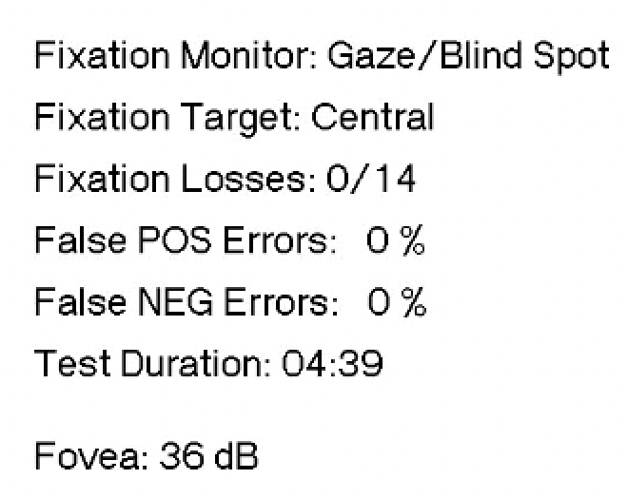
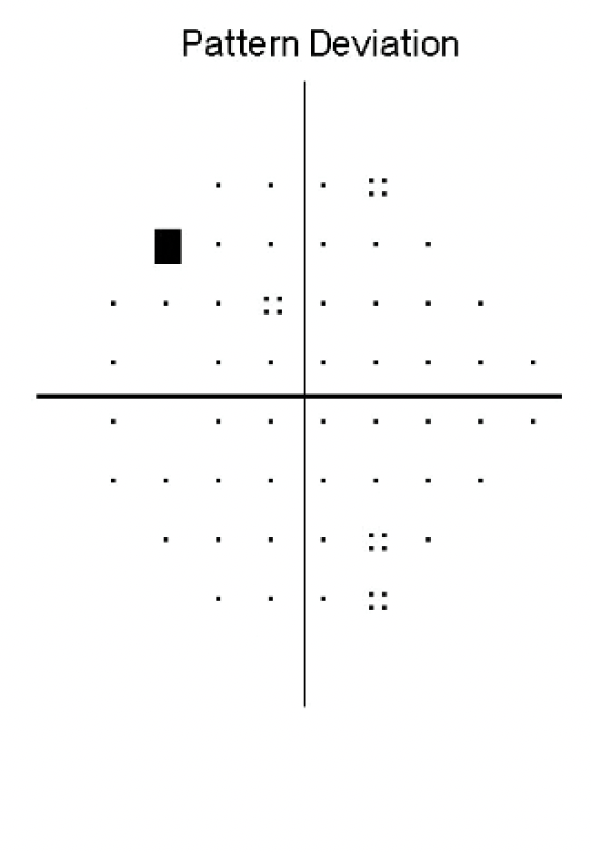
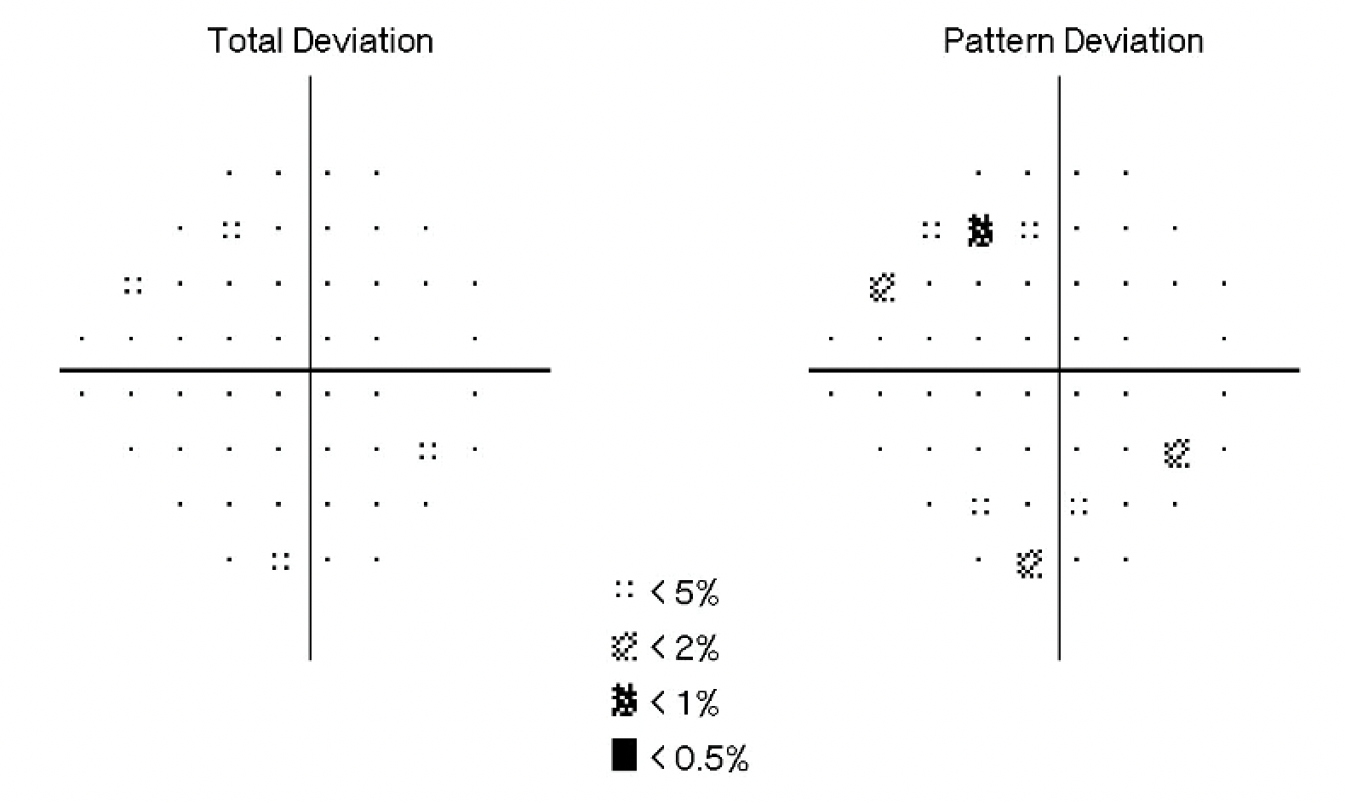
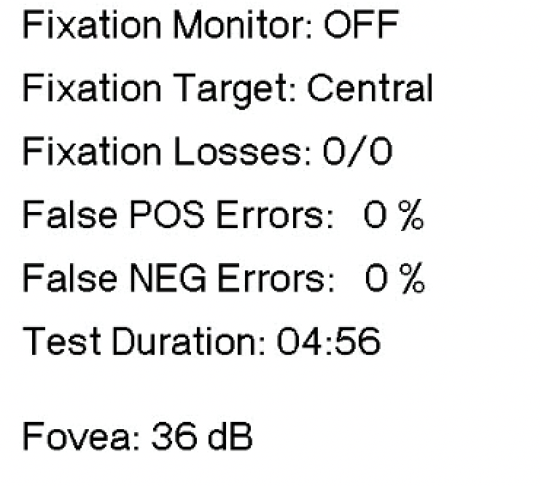
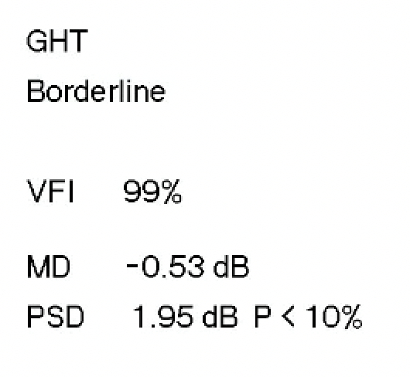
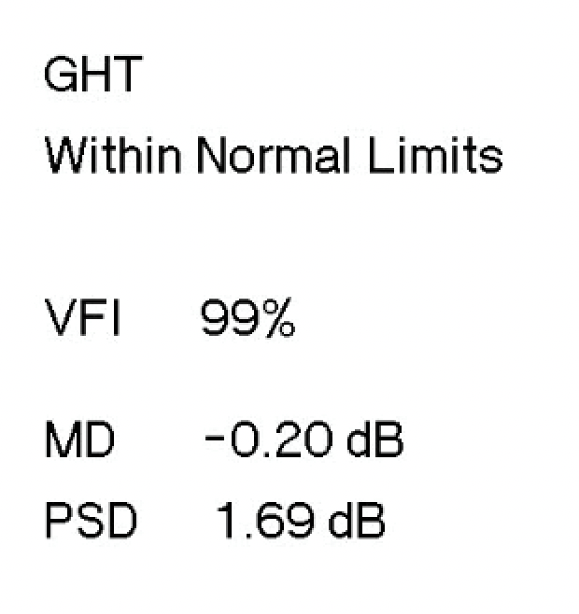
Humphrey Visual Field 24-2
Left Eye
Right Eye

Slide 19
Work-Up
Although not required in this patient, other testing may include¹:
  ERG
  VEP
  LP
  Functional neuroimaging
  Toxicology testing

Slide 20
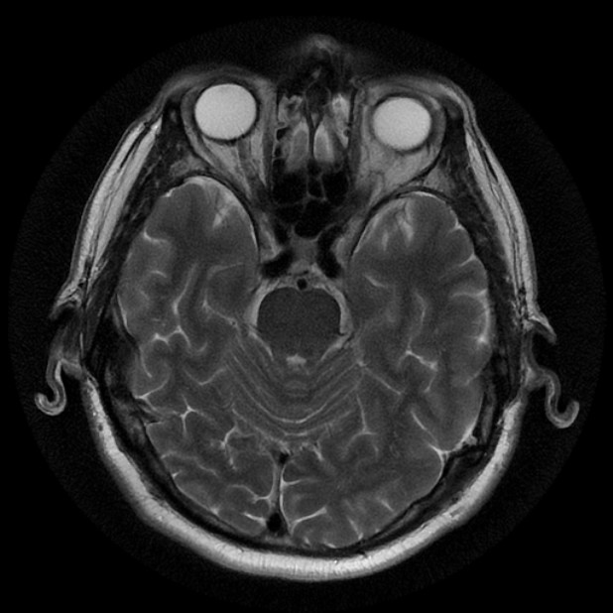
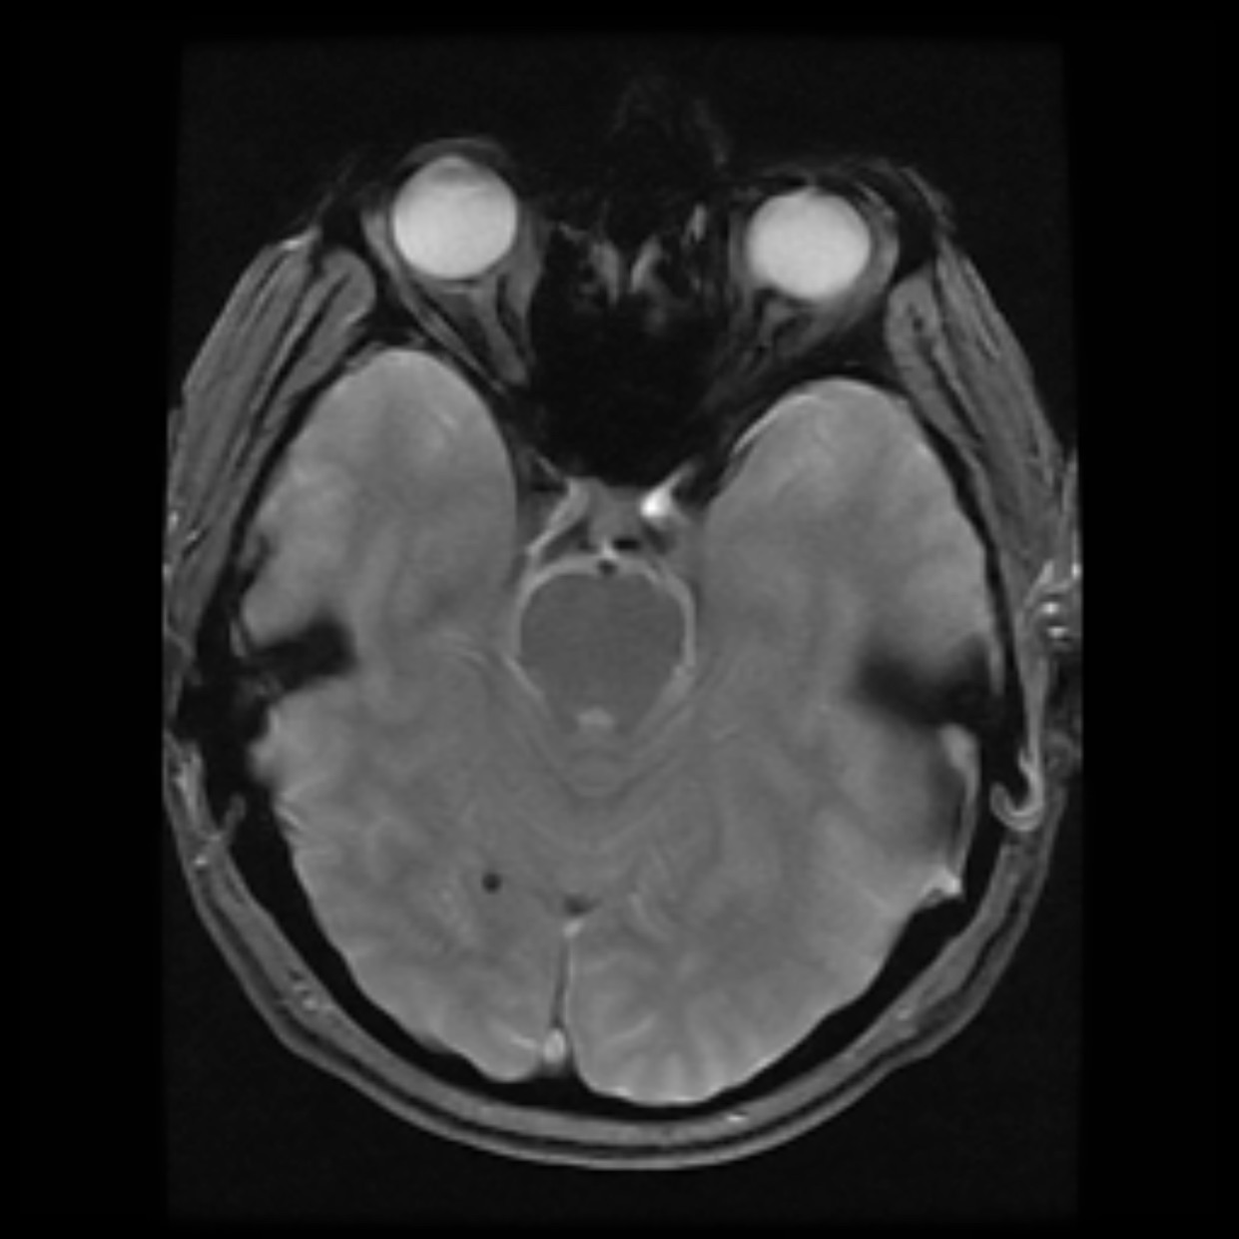
Repeat MR Head
A) Axial T2 image demonstrating encephalomalacia, B) Axial multiplanar gradient recalled acquisition (MPGR) image demonstrating microbleed.

Slide 21
Diagnosis
Episodes of kinetic hallucinatory palinopsia and cerebral diplopia occurring in the left visual field
Etiology: right inferior occipital cortical stroke
Probable focal seizures
  Scalp EEG negative, but lesion quite deep to scalp leads, and EEG obtained interictally
Anterior location in occipital cortex means any visual field defect would not be situated within the central 24 degrees tested by HVF. Likely too subtle to be detected on CVF, which were normal.

Slide 22
What is palinopsia?
Greek
  palin = again
  opsia = seeing
Cortical persistence or recurrence of a visual image after the stimulus is removed²
  Variable latency and durability
  Most commonly static, but can be kinetic
  The afterimage can have some qualitative or quantitative differences from the original image

Slide 23
What is palinopsia?
Two categories¹:
  Illusory: unformed, indistinct, low-resolution images affected by ambient light and motion
    Dysfunction in visual perception of a real image
    Secondary to migraines, drugs, or head trauma
    Similar to a visual illusion
  Hallucinatory: long-lasting, high-resolution images secondary to dysfunction in visual memory
    Often caused by posterior cortical lesions or seizures
    Similar to a complex visual hallucination
      Creation of a visual image without an external stimulus

Slide 24
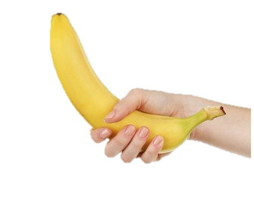
What is palinopsia?
  Illusory palinopsia:
  Prolonged indistinct afterimage¹
    Indistinct or unformed perseverated image or light (longer than physiological afterimages)
  Light streaking¹
    Streak follows behind a moving light source
  Visual trailing¹
    Object in motion with image copies trailing behind
Example of Visual Trailing

Slide 25
What is palinopsia?
Static = formed image perseveration¹
Realistic: same colour/resolution as original image
Usually lasts at least 15 seconds, can last up to days
Can occur at original location within VF or elsewhere
May materialize immediately after stimulus, or be delayed
May occur in a VF defect or area of normal vision
Kinetic = scene perseveration¹
Previously seen, often short/stereotyped action
Repetitively replays for minutes
Usually occurs within minutes of the original stimulus
Same colour and clarity as stimulus
May occur in a VF defect or area of normal vision
Hallucinatory:

Slide 26
What is palinopsia?
  Other types of hallucinatory palinopsia:
  Categorical incorporation¹
    Patient incorporates the image into comparable situations
    Ex. Seeing someone’s glasses on every other person
  Illusory visual spread/patterned visual spread¹
    Seeing a pattern repeated on other objects, but not contextual
    Ex. Seeing striped lines from paper now covering the wall

Slide 27
Differential Diagnosis
Cerebral polyopia or diplopia³
  ≥2 duplicated images, occurring monocularly bilaterally
Akinetopsia¹
  Inability to perceive motion ± visual trailing
Visual allesthesia¹
  Duplication of an image in the opposite visual field (left/right)
Visual aura
Entoptic phenomena⁴
  Autovisualization of physiologic processes in the eye that are normally subthreshold – e.g., seeing one’s own retinal vessels
Physiological afterimage
  An optical illusion secondary to overexposure of rods and cones¹
Psychiatric conditions (true hallucinations)

Slide 28
Treatment
Treat underlying cause (or discontinue offending agent)
In this case:
  Trial of Keppra 250 mg PO BID
    Patient did not tolerate well
  Switched to Gabapentin 300 mg PO TID
    Tolerated well and increased to 600 mg PO TID with good effect
  Could also consider: carbamazepine, phenytoin
Motor vehicle licensing authority notified and patient advised not to drive

Slide 29
What is the etiology of palinopsia?
Post-geniculate (occipital, temporal or parietal) cortical lesions or irritation
  Stroke leading to deafferentation¹
    Increase in presynaptic neurotransmitter vesicle size and number, and post-synaptic receptor sensitivity⁶
    Similar to Charles-Bonnet syndrome and phantom limb syndrome
  Seizures⁵
  Diffuse cortical pathology (ex. MS, Alzheimer dx)¹
  Tumours, hemorrhages, arteriovenous malformations, aneurysms

Slide 30
What is the etiology of palinopsia?
Demyelination
Drug-induced
  Illicit: LSD, psylocibin, MDMA, cannabis
  Prescription: trazodone, topiramate, risperidone, clomiphene²
  Disruption of serotonergic or GABAnergic transmission, leading to cortical hyperexcitability^{8,9}
Migraine¹⁰
  Alteration in neuronal excitability
Head trauma¹
  Diffuse cortical irritation
Can be idiopathic!

Slide 31
Take Home Message
Palinopsia can present in multiple different forms, including kinetic “movie-like” visual hallucinations
Palinopsia is not a diagnosis itself, but rather a symptom of an underlying pathology
Although it can be idiopathic or caused by benign etiologies, workup for infarction, seizures, tumours, etc. must always be performed if a clear cause is not present

Slide 32
References
Gersztenkorn D, Lee AG. Palinopsia revamped: a systematic review of the literature. Surv Ophthalmol. 2015;60(1):1-35.
Lahiri D. Palinopsia. Cortex. 2020;133:399.
Zakaria A, Lalani I, Belorgey L, Jay Foreman P. Focal occipital seizures with cerebral polyopia. Epileptic Disord. 2006;8(4):295-7.
Friedman B. Observations of Entoptic Phenomena. Arch Ophthalmol. 1942;28(2):285–312.
Muller T, Buttner T, Kuhn W, et al. Palinopsia as sensory epileptic phenomenon. Acta Neurol Scand. 1995;91:433e6
Burke W. The neural basis of Charles Bonnet hallucinations: a hypothesis. J Neurol Neurosurg Psychiatry. 2002;73:535e41
Hayashi R, Shimizu S, Watanabe R, et al. Palinopsia and perilesional hyperperfusion following subcortical hemorrhage. Acta Neurol Scand. 2002;105:228e31
le Grand SM, Supornsilpchai W, Saengjaroentham C, et al. Serotonin depletion leads to cortical hyperexcitability and trigeminal nociceptive facilitation via the nitric oxide pathway. Headache. 2011;51:1152e60
Shen RY, Andrade R. 5-Hydroxytryptamine2 receptor facilitates GABAergic neurotransmission in rat hippocampus. J Pharmacol Exp Ther. 1998;285: 805e12
Belcastro V, Cupini LM, Corbelli I, et al. Palinopsia in patients with migraine: a case-control study. Cephalalgia. 2011;31:999e1004

