Slide 1

Subacute Vision Loss in a Patient with HIV
George Park, DO
Neuro-Ophthalmology Fellow
NYU Langone Health
Doria M. Gold, MD
Neurology
NYU Langone Health
Yasha Modi, MD
Ophthalmology
NYU Langone Health
Janet C. Rucker, MD
Neurology
NYU Langone Health

Slide 2
56 year old man with progressive vision loss over 2 weeks
Past Medical History:
  HIV (well controlled with undetectable viral load)
  Insulin Dependent Type 2 Diabetes
  Hypertension, Hyperlipidemia, Hypertrophic Cardiomyopathy
Began with intermittent blurry vision that became constant over a few days
Involved both eyes, unclear if one more than the other
Began to bump into objects, worse at night
Denied headaches, nausea, vomiting, eye pain, chest pain, shortness of breath, bowel or bladder changes

Slide 3
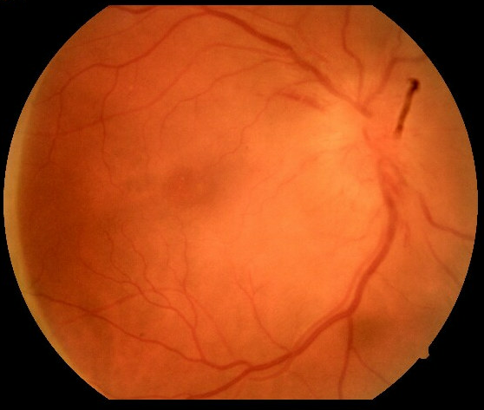
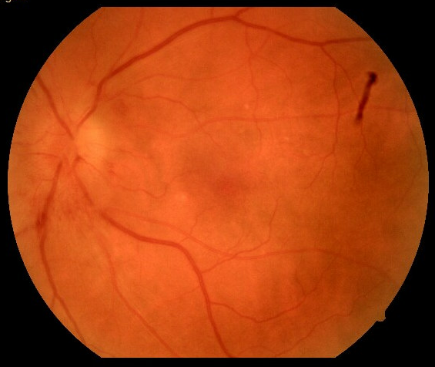
Presented to an optometrist…
Visual Acuities 20/400 right eye, 20/40 left eye
Bilateral optic disc edema right >left
*blue arrow - artifact

Slide 4
Patient was sent to the emergency room for expedited workup

Slide 5
Differential for bilateral optic disc edema
Papilledema (by definition secondary to raised intracranial pressure)
  Intracranial Hemorrhage
  Brain Tumor
  Cerebral Venous Thrombosis
  Meningitis
  Idiopathic Intracranial Hypertension
Infectious
  Syphilis
  Bartonella
  Tuberculosis
Infiltrative
  Neurosarcoidosis
  Lymphoma, leukemia
Hypertensive Retinopathy
Ischemic
  Giant Cell Arteritis
Inflammatory
  Bilateral Papillitis

Slide 6
Initial Workup Performed
Basic Metabolic Profile normal
COVID negative
WBC: 9.9 with a neutrophilic predominance (73%)
Hemoglobin/Hematocrit: 13.1/39.3
HgbA1c: 8.3
ESR: 113
CRP: 17.2 (normal range 0-5)
Urinalysis negative

Slide 7
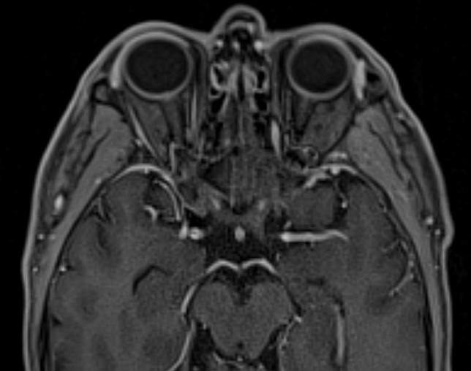
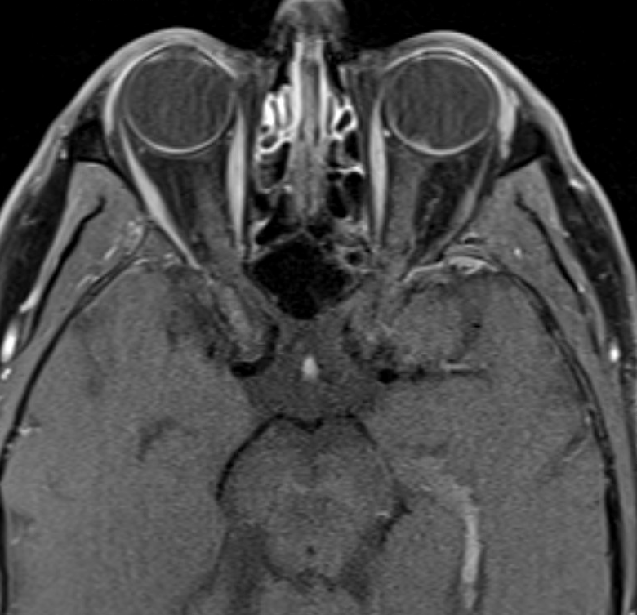
MRI Brain and Orbits w/ and w/o contrast
What do you see?

Slide 8
Exam – Inpatient Ophthalmology Consult
 | Right | Left
Best corrected acuity | 20/400 | 20/25
Color Vision Ishihara | Unable to see the control plate | 6/7 plates correct
Pupils | Pharmacologically Dilated | Pharmacologically Dilated
Intraocular Pressure | 16 | 17
Extraocular Movement | Full | Full
Visual Field to confrontation | Central defect | Grossly full

Slide 9
Exam – Slit Lamp
 | Right | Left
Lids/Lashes | Normal | Normal
Conjunctiva/Sclera | White/Quiet | White/Quiet
Cornea | Clear | Clear
Anterior Chamber | 1+ cells, non-pigmented, 2+ flare | Trace cells and flare
Iris | Normal | Normal
Lens | NS Cataract - insignificant | NS Cataract - insignificant
Vitreous | Vitreous cells | Vitreous cells
Optic Nerve | 4+ optic disc edema, hemorrhage | 4+ optic disc edema, hemorrhage
Macula | Flat | Flat
Retina | Loss of foveal reflex and hazy view due to vitritis | Flat 360, no breaks, tears, or heme

Slide 10
Bilateral disc edema with panuveitis – Differential now?
Infectious
  Syphilis
  Tuberculosis
  Bartonella
Inflammatory
  Neurosarcoidosis

Slide 11
What would you do next…?
Lumbar puncture
Serum and CSF infectious workup

Slide 12
Quantiferon gold negative
Lyme Western Blot IgM negative, IgG positive
MOG negative
ACE: 36
Lysozyme: 0.83
HIV non-detectable
Treponema pallidum particle agglutination (TP-PA): Reactive
RPR reactive 1:256

Slide 13
CSF:
Opening Pressure of 19 cm H2O
8 nucleated cells in tube 1
1 nucleated cell in tube 4 with lymphocytic predominance (96%)
Glucose: 90
Protein: 59
CSF culture negative
Meningitis-Encephalitis panel negative*
VDRL non-reactive
AFB culture negative
Cryptococcal antigen <2
IgG elevated to 10.6 (normal range 0-6)
Cytology negative
*includes CMV, HSV1, HSV2, VZV, HHV6

Slide 14
Diagnosis
Neurosyphilis
Started on IV Penicillin
After one dose…developed diffuse blanching morbilliform rash
Dermatology thought likely secondary Jarish-Herxheimer reaction vs drug eruption from penicillin
Was pretreated with Benadryl and monitored closely inpatient for duration of 14 day IV penicillin treatment

Slide 15
Follow-up Exam 1 month later - Basic
 | Right | Left
Best corrected acuity | 20/300 | 20/50
Near acuity | 20/400 | 20/50
Color Vision Ishihara | 1/12 correct | 12/12 correct
Pupils | Minimally reactive | Sluggishly reactive
 | No Afferent Pupillary Defect | No Afferent Pupillary Defect
Intraocular Pressure | 16 | 16
Extraocular Movement | Full | Full

Slide 16
Follow-up Exam 1 month later – Slit Lamp
 | Right | Left
Lids/Lashes | Normal | Normal
Conjunctiva/Sclera | White/Quiet | White/Quiet
Cornea | Clear | Clear
Anterior Chamber | Quiet | Quiet
Iris | Round and reactive | Round and reactive
Lens | NS Cataract - insignificant | NS Cataract - insignificant
Vitreous | 1+ cell | 1+ cell
Disc | Pale nerve | Slightly pale nerve
Macula | Retinal pigment epithelium changes nasally | Retinal pigment epithelium changes
Vessels | Normal | Normal
Periphery | Choroidal nevus inferior to Optic Nerve Head | Retinal pigment epithelium changes

Slide 17
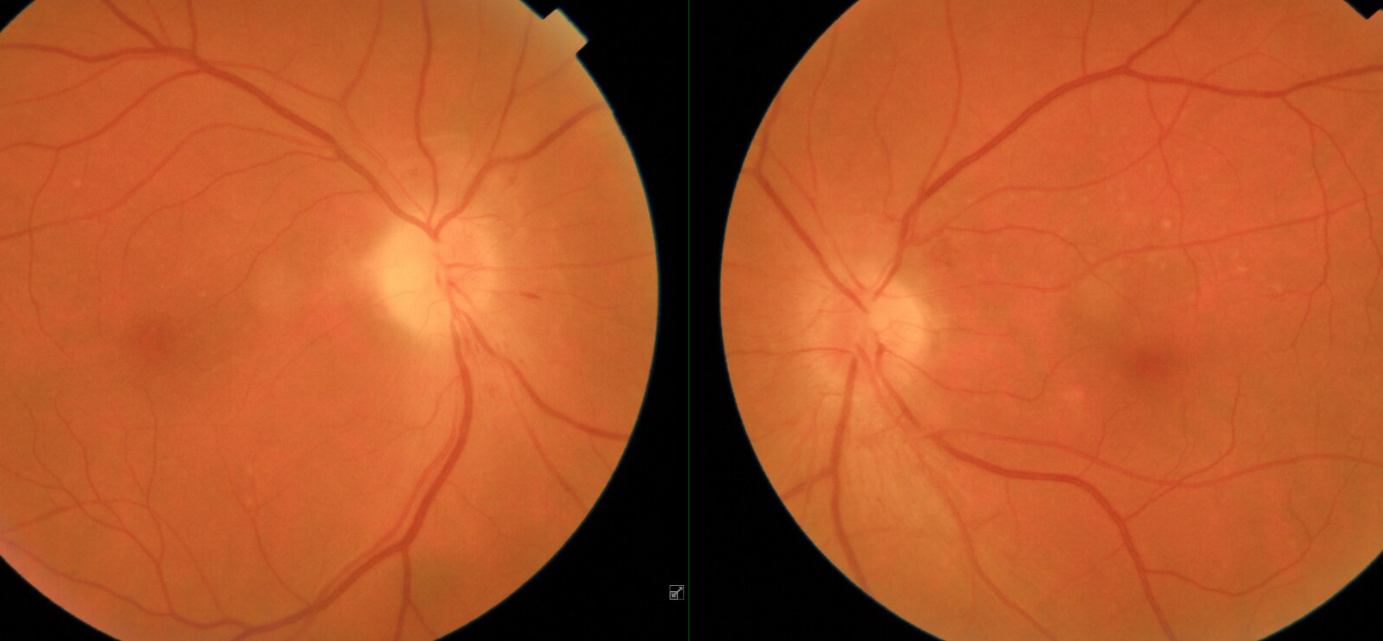
Fundus photos showing pales nerves bilaterally with improving disc edema and focal retinal pigment epithelial changes
(appear as creamy dots in retina)

Slide 18
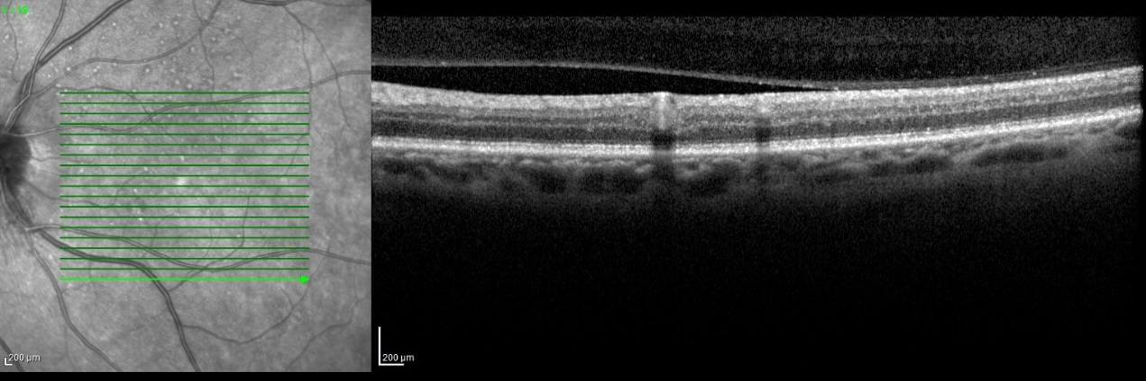
OCT Retinal Scan showing resolution of intraretinal and subretinal fluid suggesting improving disc edema
Retinal pigment epithelial changes visualized
(white dots in retina on left photo)

Slide 19
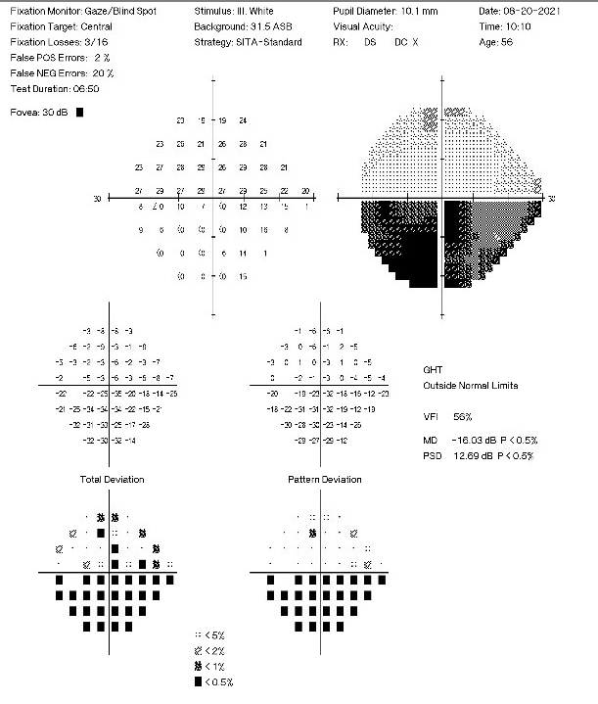
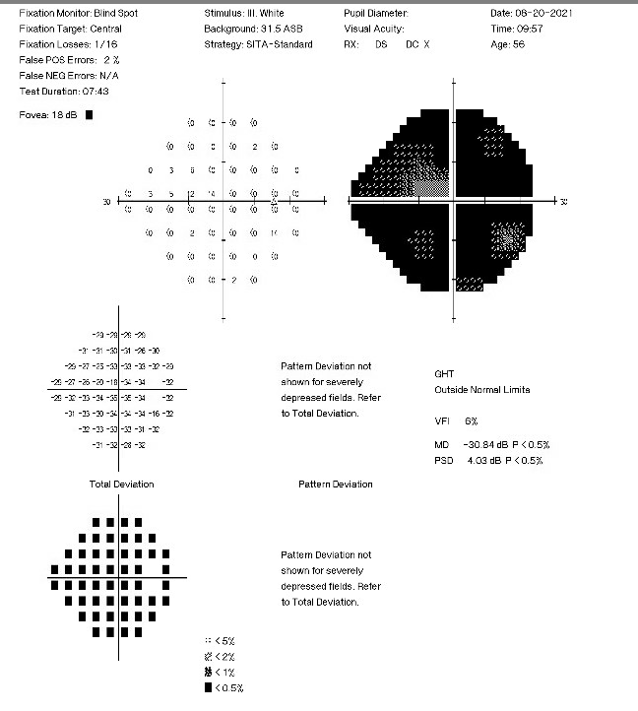
Visual Fields

Slide 20
Final Diagnosis
Syphilis

Slide 21
Syphilis
Spirochetal infection: Treponema pallidum
Reported primary and secondary cases increasing from 8724 in 2005 to 35,063 in 2018
Similar modes of transmission as HIV
Stages of infection –
  Early (primary and secondary syphilis, weeks to months after initial infection)
  Late (tertiary syphilis, months to years after initial infection)

Slide 22
Neurosyphilis
Begins with invasion of the CSF
Likely occurs shortly after acquisition of T. pallidum infection
Can be identified in CSF in one-quarter of untreated patients with early syphilis
Spontaneous resolution may occur without an inflammatory response or after a transient meningitis
Classified into early and late stages

Slide 23
Early Neurosyphilis
Asymptomatic neurosyphilis
  No symptoms or signs of CNS disease
  Can occur with primary or secondary syphilis
  Generally occurs weeks to months after initial infection, rarely more than two years
  Diagnosis: CSF
    HIV patients
      Lymphocytic pleocytosis typically <100cells/microL
      Elevated protein typically <100mg/dL
      Reactive CSF-VDRL (recommended to treat regardless of reactivity)
    Non-HIV patients: CSF lymphocyte count >5cells/microL, protein >45mg/dL
      Reactive CSF-VDRL

Slide 24
Early Neurosyphilis
Symptomatic meningitis
  Generally occurs within first year after infection, but can occur years later
  Headache, confusion, nausea, vomiting, stiff neck
  Can have cranial neuropathies most commonly optic, facial, or auditory
  Can cause hydrocephalus
  Focal meningeal inflammation may lead to diffuse leptomeningitis or syphilitic gummas (focal areas of inflammation that present as mass lesions contiguous with the leptomeninges)
  Uncommonly can affect spinal cord leading to back pain, sensory loss, incontinence, leg weakness
  CSF findings generally more severe than with asymptomatic meningitis
    CSF lymphocyte counts generally between 200-400 cells/microL
    CSF protein 100-200 mg/dL
    CSF VDRL almost always reactive

Slide 25
Early Neurosyphilis
Ocular Syphilis – can involve almost any eye structure
  Posterior uveitis and panuveitis are most common and present with diminished visual acuity
  Less commonly: optic neuropathy, interstitial keratitis, anterior uveitis, retinal vasculitis
  Often but not always accompanied by syphilitic meningitis
  Frequently mistaken for inflammatory or infiltrative causes and initially treated with corticosteroids that can worsen the course

Slide 26
Uveal Tract
Uveitis is the most common ophthalmologic presentation of syphilis
Can occur as soon as 6 weeks following primary infection up to years after during the late latent stage
Manifestations Vary
  Granulomatous vs non-granulomatous
  Anterior Segment, Posterior Segment, or both
  Unilateral or bilateral
Much rarer with the advent of PCN

Slide 27
Optic Nerve
Can affect any portion of the optic nerve
No clinical feature to distinguish syphilitic optic neuritis vs non-syphilitic causes
Combination of disc swelling, hemorrhages, dilated veins and subretinal infiltrates are highly suggestive of syphilis

Slide 28
Acute Syphilitic Posterior Placoid Chorioretinitis (ASPPC)
Classic and nearly pathognomonic manifestation of ocular syphilis
Presents during secondary stage of syphilis
Lesions located on the surface of retina or near macula
Placoid, yellowish with faded center and stippling of adjacent retina
Thought to be secondary to inflammation vs direct invasion of choriocapillaris by T. pallidum

Slide 29
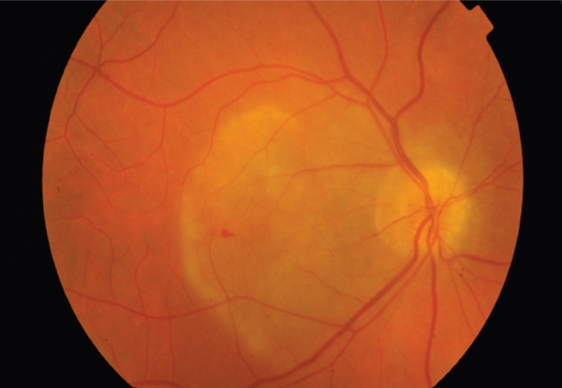
Example of posterior placoid chorioretinitis

Slide 30
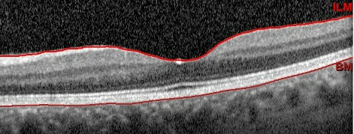
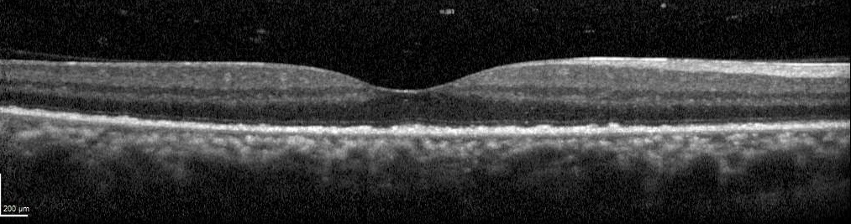
Normal OCT with presence of ellipsoid zone (at tip of arrow)
Macular OCT from patient with fundus photo in prior slide, showing
Loss of ellipsoid zone (at tip of arrow)

Slide 31
Diagnosis of posterior placoid chorioretinopathy
Importance of ophthalmology (especially retina) consultation!
Spectral-domain optical coherence tomography can be extremely useful
Findings include ellipsoid zone loss and RPE nodular thickening
Shows hyper-reflective nodular retinal pigment epithelial thickening and disruption of the outer segment

Slide 32
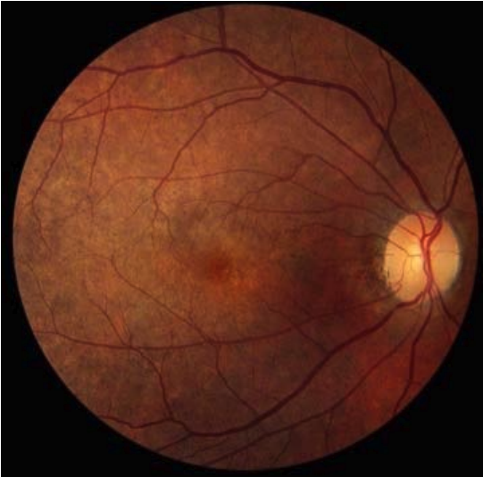
”Salt and Pepper” Retinopathy
Granular, pigmentary mottling in the macula and periphery with punctate hypopigmentation and hyperpigmentation
Often seen in congenital syphilis
© 2022 American Academy of Ophthalmology
Notes:
https://www.aao.org/Assets/8e67f82a-7b93-4bb6-bc29-eced3ae459ba/637153837288730000/u16u-pdf?inline=1

Slide 33
Diagnosis
VDRL-CSF is highly specific for neurosyphilis
  However not sensitive so a negative result does not exclude
  In one study, the sensitivity of CSF VDRL was as low as 27% with near 100% specificity
  In this patient, CSF- VDRL was negative
  Limited utility in screening
CSF FTA-ABS is less specific however highly sensitive
  Neurosyphilis is highly unlikely with a negative CSF FTA-Abs test
Ultimately diagnosis and treatment should be based on clinical judgement in combination with CSF and serum studies

Slide 34
Treatment
Penicillin is the drug of choice
Long acting benzathine penicillin via IM can be given for most stages
With Ocular, Otic or CNS involvement, IV therapy should be given
Ocular syphilis should be considered Neurosyphilis for treatment purposes
~35% of cases of ocular syphilis have concomitant neurosyphilis, however negative CSF VDRL has low sensitivity so recommend treatment regardless

Slide 35
In cases of Penicillin Allergy
In patients with a mild penicillin allergy, ceftriaxone can be used for a 10-14 day course with careful monitoring and observation for cross-reactivity
High dose oral doxycycline has also been used for a duration of 21-28 days
  one study performed showed similar efficacy compared to penicillin-based treatments
  Not formally recommended by the CDC
Penicillin desensitization can temporarily induce short term tolerance
  should be performed in a closely monitored setting with the assistance of an allergist

Slide 36
Jarisch-Herxheimer Reaction
Acute febrile reaction occurs within 24 hours after any therapy for syphilis
Thought to be secondary to systemic reaction to inflammatory lipoproteins from dying T. pallidum
Fever, headaches, pharyngitis, fatigue, myalgias
HIV coinfection is not associated with increased or more severe reaction
Generally self limited and resolves within 12-24 hours
Can use NSAIDs or other antipyretics for symptomatic relief
The use of glucocorticoids is generally not recommended
  A few studies performed have shown reduction in fever, and shortened duration of symptoms however pretreatment is not routinely recommended

Slide 37
Neurosyphilis monitoring
CSF examinations should be repeated every 6 months until the cell count is normal
Resolution of CSF pleocytosis is the most sensitive indicator of effective treatment
If CSF pleocytosis persists, then CSF protein or VDRL may be followed
Retreatment recommended if no resolution in two years
With ocular syphilis and normal CSF examination at time of diagnosis, follow up CSF studies are not needed

Slide 38
Take Home Points
Differential for bilateral optic disc edema can be very broad
Neurosyphilis can have a wide array of both neurologic and ocular findings
Proper ophthalmologic exam to determine presence of uveitis and/or retinal pathology is vital
CSF VDRL is highly specific but insensitive and can therefore have false negatives
Ocular manifestations of syphilis should be treated with IV penicillin for 14 days which is the treatment of choice for neurosyphilis

Slide 39
References
Amaratunge, B.C., J.E. Camuglia, and A.J. Hall, Syphilitic uveitis: a review of clinical manifestations and treatment outcomes of syphilitic uveitis in human immunodeficiency virus-positive and negative patients. Clin Experiment Ophthalmol, 2010. 38(1): p. 68-74.
Chen J, Lee L. Posterior placoid chorioretinitis: An unusual ocular manifestation of syphilis. Clin Ophthalmol. 2008 Sep;2(3):669-73. doi: 10.2147/opth.s2743. PMID: 19668773; PMCID: PMC2694006.
Davis LE, Schmitt JW. Clinical significance of cerebrospinal fluid tests for neurosyphilis. Ann Neurol. 1989 Jan;25(1):50-5. doi: 10.1002/ana.410250108. PMID: 2643918.
Hendriks KD, van Etten RW, van Wijngaarden P. Koorts en hypotensie na behandeling van syfilis [Fever and hypotension after treatment of syphilis; the Jarisch-Herxheimer reaction]. Ned Tijdschr Geneeskd. 2017;161:D649. Dutch. PMID: 28181892.
Liu, Grant T, Nicholas J. Volpe, Steven Galetta, and Grant T. Liu. Liu, Volpe, and Galetta's Neuro-Ophthalmology: Diagnosis and Management. , 2019.
Mehta D, Chan K. Syphilis presenting as acute syphilitic posterior placoid chorioretinitis. BMJ Case Rep. 2021 Jul 28;14(7):e243923. doi: 10.1136/bcr-2021-243923. PMID: 34321269; PMCID: PMC8319970.
Pound MW, May DB. Proposed mechanisms and preventative options of Jarisch-Herxheimer reactions. J Clin Pharm Ther. 2005 Jun;30(3):291-5. doi: 10.1111/j.1365-2710.2005.00631.x. PMID: 15896248.
Syphilis Presenting as Acute Syphilitic Posterior Placoid Chorioretinitis. https://casereports.bmj.com/content/bmjcr/14/7/e243923.full.pdf.

