Slide 1


Nystagmus and Dysphagia
Christian Leal, MD
PGY 4, Dean McGee Eye Institute
Andrew Melson, MD
Neuro-Ophthalmologist and Residency Program Director, Dean McGee Eye Institute

Slide 2
Case Presentation
CC: “I’ve been having a hard time walking the last month”
86yo previously healthy Caucasian M who presented with worsening gait imbalance and bladder/bowel incontinence x2 months and new dysphagia x 2 days.
Underwent CT Head by PCP given concern for normal pressure hydrocephalus that was unremarkable for acute pathology. Lumbar puncture done to drain CSF, which was unremarkable with opening pressure of 20mmHg. Progressive decline in ADLs over the last two months.
Vision stable per patient. No ocular pain.
Ophthalmology consulted for “unusual eye movements” by neurology

Slide 3
Additional History
PMHx:
Hyperlipidemia
POHx:
CEIOL OU 1990s
PSHx:
None
Meds:
None
Allergies:
NKDA
Family Hx:
No ocular disease
Social Hx:
No tobacco or ETOH use
Lives in assisted living facility
Previously animal science professor
ROS:
No N/V, numbness/tingling, headaches, fevers
+Ataxia, bladder/bowel incontinence, dysphagia

Slide 4
Exam
Full to CF
CVF
20/30
Full to CF
VAph
20/30
NSC
Motility: Will be shown
5→3mm, no RAPD
Pupils
5→3mm, no RAPD
15
Alignment: orthotropic
T
13
iCare

Slide 5
Anterior Segment | OD | OS
Lids/Lashes | Ocular Rosacea, Blepharitis | Ocular Rosacea, Blepharitis
Conjunctiva | Normal | Normal
Sclera | W/Q | W/Q
Cornea | Clear | Clear
Anterior Chamber | D/Q | D/Q
Iris | Normal | Normal
Lens | Pseudophakia | Pseudophakia

Slide 6
Posterior Segment | OD | OS
Vitreous | PVD | PVD
Optic Nerve | 0.4 CDR, no pallor or edema | 0.4 CDR, no pallor or edema
Macula | Scattered drusen | Scattered drusen
Vessels | Mild attenuation | Mild attenuation
Periphery | Flat | Flat

Slide 7
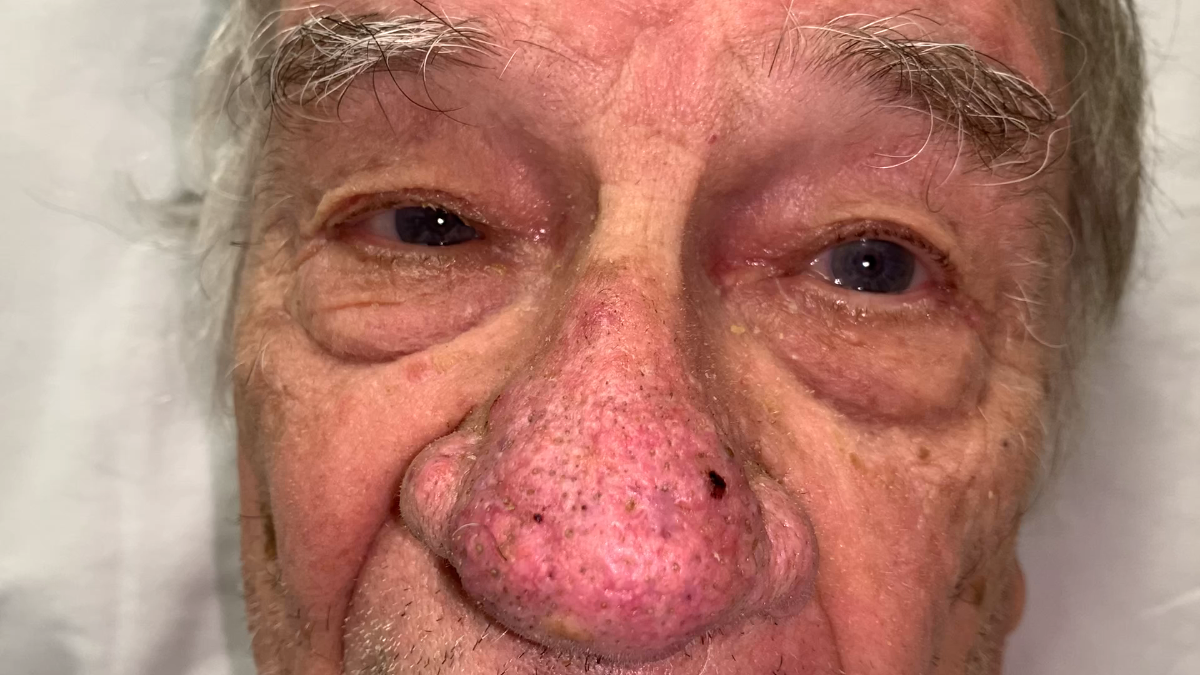
Motility
Downbeat nystagmus most pronounced in right and left gazes and absent in primary gaze

Slide 8
Differential Diagnosis
Previously healthy 86yo male with progressive gait instability, GI/GU incontinence x2 months and downbeat nystagmus
Stroke
Demyelination
B1/B12/Mg deficiency
Toxicity (lithium, anticonvulsants, EtOH)
Brainstem Tumor
Arnold-Chiari I Malformation
Spinocerebellar Degeneration
Paraneoplastic cerebellar degeneration
Anti-GAD
Idiopathic
Additional workup?

Slide 9
Differential Diagnosis
Previously healthy 86yo male with progressive gait instability, GI/GU incontinence x2 months and downbeat nystagmus
Stroke
Demyelination
B1/B12/Mg deficiency
Toxicity (lithium, anticonvulsants, EtOH)
Brainstem Tumor
Arnold-Chiari I Malformation
Spinocerebellar Degeneration
Paraneoplastic cerebellar degeneration
Anti-GAD
Idiopathic
Additional workup?
MRI brain with and without contrast
Nutritional levels
Medication list review

Slide 10
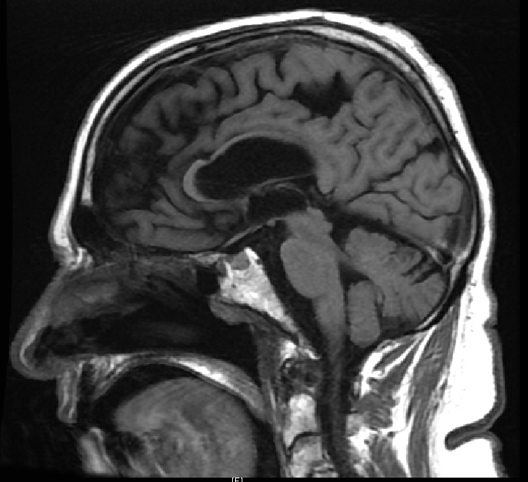
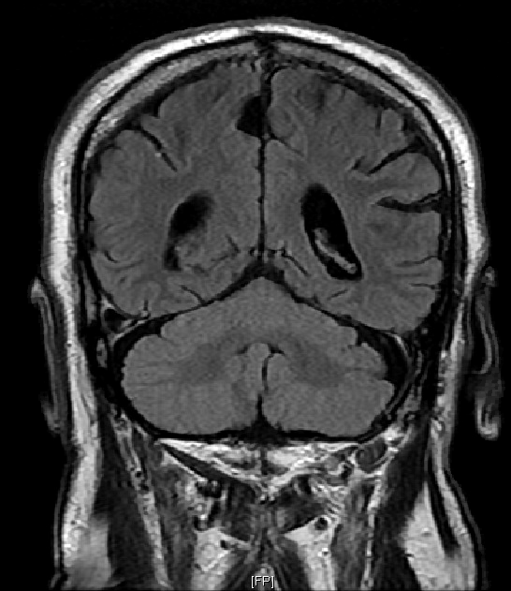
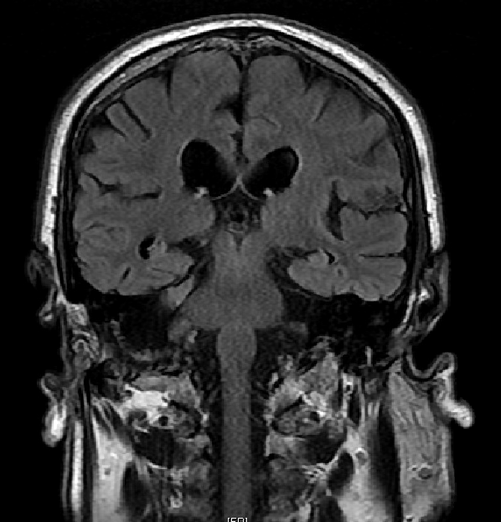
T1
T2 FLAIR

Slide 11
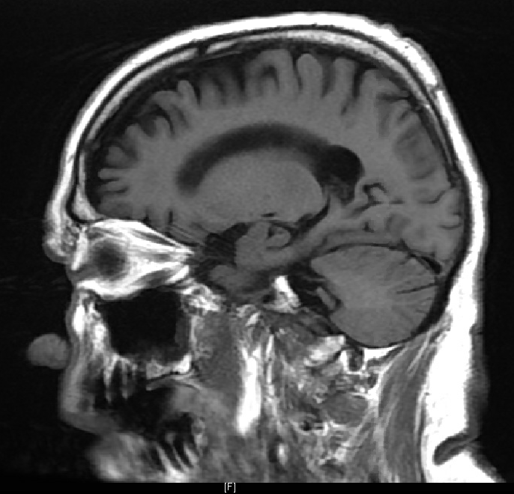
MRI BRAIN WITH AND WITHOUT CONTRAST
IMPRESSION:
1. Generalized volume loss and ventriculomegaly.
2. Minimal chronic small vessel ischemic changes which is not excessive for age.
3. Suspected arachnoid cyst along the mesial surface of the right frontoparietal region.
4. No pathologic contrast-enhancement.

Slide 12
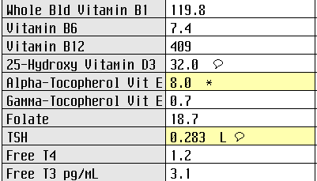

Nutritional deficiency workup overall unremarkable

Slide 13
Differential Diagnosis
Previously healthy 86yo male with progressive gait instability, GI/GU incontinence x2 months and downbeat nystagmus
Paraneoplastic cerebellar degeneration
Anti-GAD
Idiopathic
Stroke
Demyelination
B1/B12/Mg deficiency
Toxicity (lithium, anticonvulsants, EtOH)
Brainstem Tumor
Arnold-Chiari/Spinocerebellar Degeneration
Trauma
Further workup?
Paraneoplastic work up:
  CT chest, abdomen, pelvis
  Paraneoplastic antibody panel

Slide 14
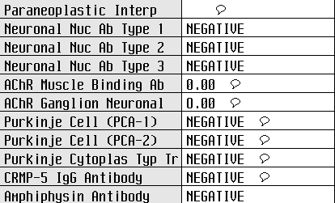

Paraneoplastic panel notable for Ca channel P/Q antibodies

Slide 15
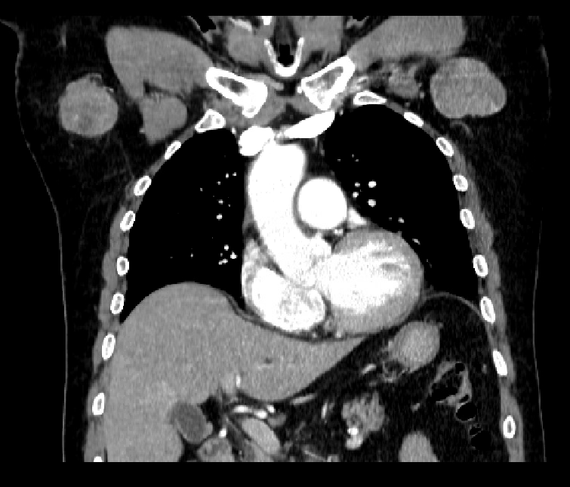
Chest CT with Contrast

Slide 16
There is a right axillary mass present measuring 6.5 x 4.0 cm.
There is a left axillary mass present measuring 5.3 x 2.8 cm.
Next steps?

Slide 17
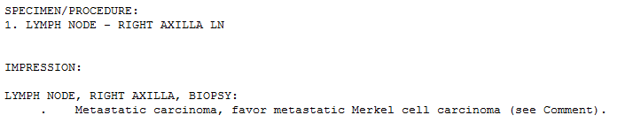

Slide 18
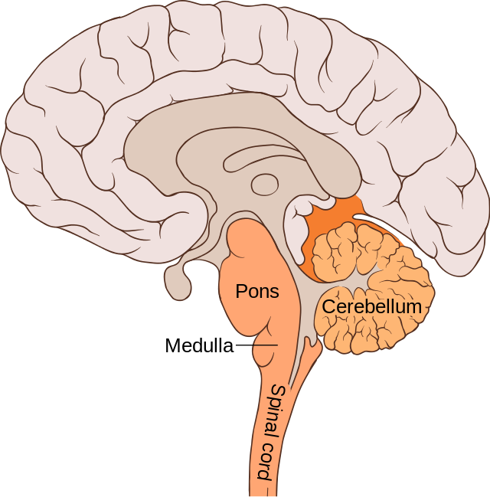
Downbeat Nystagmus Basics
Pathologic upward drift of eyes corrected with downward saccade
Typically vertical oscillopsia if acquired
Cervicomedullary junction most likely location of a structural lesion
Antibodies associated with DBN ➔ voltage gated calcium channels + glutamic acid decarboxylase
Lynch P, Jaffe C. Brain Bulbar Region.; 2007. Accessed June 10, 2022. https://commons.wikimedia.org/wiki/File:Brain_bulbar_region.svg
Al Othman BA, ed. Nystagmus [Internet]. EyeWiki; [updated 2022 Jan 29]. Available from: eyewiki.org/nystagmus.

Slide 19
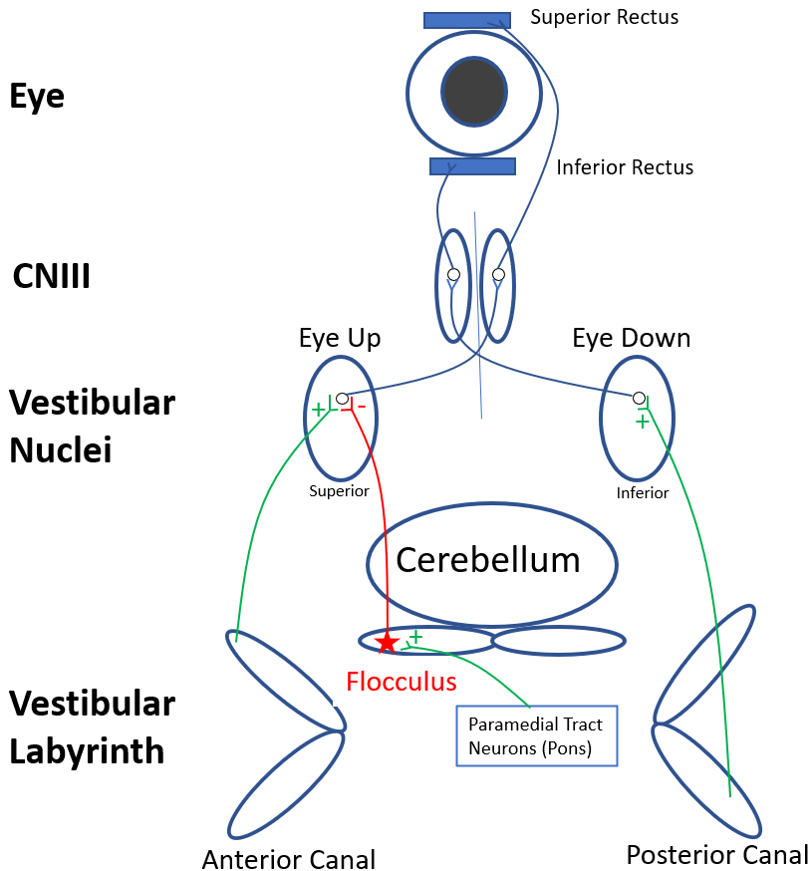
Pathophysiology of DBN
Anterior vestibular canal ➔ evoke upward eye movements
Posterior vestibular canal ➔ evoke downward eye movements
Cerebellar flocculus inhibits the superior vestibular nuclei ➔ keeps eyes steady in downgaze
Miller NR, Newman NJ, editors. Walsh & Hoyt’s Clinical Neuro-Ophthalmology. 6th ed. Lippincott Williams & Wilkins; 2005.
Marti S, Straumann D, Glasauer S. The origin of downbeat nystagmus: an asymmetry in the distribution of on-directions of vertical gaze-velocity Purkinje cells. Ann N Y Acad Sci. 2005 Apr; 1039:548-53.

Slide 20
Pathophysiology of DBN
If the flocculus is impaired ➔ superior vestibular nucleus signaling increases
Signaling to superior rectus increases ➔ slow upward drift of eyes followed by corrective downbeat saccade
Paramedial tract neurons (PMT) in the lower pons project to and stimulate the flocculus. If damaged, the superior vestibular nucleus is uninhibited and DBN results
Miller NR, Newman NJ, editors. Walsh & Hoyt’s Clinical Neuro-Ophthalmology. 6th ed. Lippincott Williams & Wilkins; 2005.
Marti S, Straumann D, Glasauer S. The origin of downbeat nystagmus: an asymmetry in the distribution of on-directions of vertical gaze-velocity Purkinje cells. Ann N Y Acad Sci. 2005 Apr;1039:548-53.

Slide 21
DBN Example
https://collections.lib.utah.edu/ark:/87278/s6x69p7s
In contrast to our patient, the patient in the example above has DBN in lateral as well as primary gaze
If DBN is not apparent in primary gaze, hyperventilation and head shaking will increase DBN in primary gaze
Trobe J. Downbeat Nystagmus. Health Sciences Library, University of Utah. Published online September 2021. Accessed June 10, 2022. https://collections.lib.utah.edu/ark:/87278/s6x69p7s
‌

Slide 22
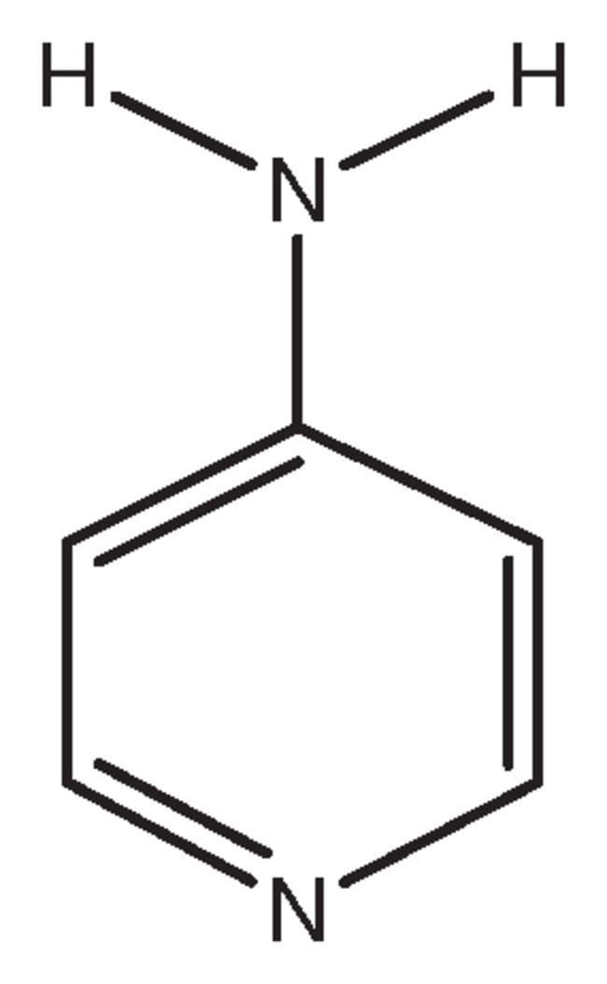
Treatment of DBN
Clonazepam, baclofen, gabapentin, memantine, 4-aminopyridine (4-AP)
Often with mixed success
Significant side effects, abuse potential, and insurance coverage issues (4-AP)
Strupp M, Schüler O, Krafczyk S, et al. Treatment of downbeat nystagmus with 3,4-diaminopyridine: a placebo-controlled study. Neurology. 2003 Jul 22;61(2):165-70.
Averbuch-Heller L, Tusa RJ, Fuhry L, et al. A double-blind controlled study of gabapentin and baclofen as treatment for acquired nystagmus. Ann Neurol. 1997 Jun;41(6):818-25.

Slide 23
4-aminopyridine
Potassium channel blocker
Promotes increased excitability of Purkinje cells in flocculus
First line therapy for DBN
Side effects: perioral/digital paresthesias, GI symptoms, rarely seizures at high doses
Miller NR, Newman NJ, editors. Walsh & Hoyt’s Clinical Neuro-Ophthalmology. 6th ed. Lippincott Williams & Wilkins; 2005.
Kalla R, Spiegel R, Claassen J, et al. Comparison of 10-mg doses of 4-aminopyridine and 3,4-diaminopyridine for the treatment of downbeat nystagmus. J Neuroophthalmol. 2011 Dec;31(4):320-5.

Slide 24
Paraneoplastic syndromes (PNS)
Physiologic response from ectopic hormone secretion or autoimmune response to cancer-associated antigens
Host generates antibodies to tumor antigens that cross react with normal human antigens
8% of cancers are associated with PNS
Most commonly from small cell lung cancer
Darnell RB, Posner JB. Paraneoplastic syndromes involving the nervous system. N Engl J Med. 2003 Oct 16;349(16):1543-54.

Slide 25
Ophthalmic Manifestations of PNS
Antibody | Ophthalmic Findings | Associated cancers | Associated disorders
Alpha-enolase | Decreased acuity Central cone dysfunction Optic nerve pallor | Skin Cervical Ovarian Breast | Cancer Associated Retinopathy
Anti-AChR/striational | Diplopia Ptosis | Thymoma | Myasthenia Gravis
Anti-CRMP5 | Optic disc edema Optic atrophy | Small Cell Lung Cancer Thymoma | Paraneoplastic Optic Neuropathy
Anti-GAD | Ptosis Ophthalmoplegia | Breast Small Cell Lung Cancer | Stiff Person Syndrome Cerebellar ataxia Autoimmune Related Retinopathy and Optic Neuropathy
Anti-Hu | Tonic pupil Ophthalmoplegia | Small Cell Lung Cancer | Encephalomyelitis Lambert Eaton Myasthenic Syndrome
Anti-Ma2 | Vertical gaze paresis Ophthalmoplegia | Testicular | Encephalitis
Anti-NMDA | Mild visual dysfunction Decreased acuity | Ovarian teratoma Small Cell Lung Cancer Testicular | HSV Encephalitis Optic Neuritis
Anti-PCA-2 | Optic disc edema Large vitreous cells | Small Cell Lung Cancer | Optic Neuritis
Anti-recoverin | Progressive vision loss OU | Small Cell Lung Cancer | Cancer Associated Retinopathy
Anti-Ri | Eye movement disorders Ptosis | Breast Small Cell Lung Cancer | Opsoclonus-Myoclonus Syndrome Ataxia
Anti-Yo | Ptosis Oscillopsia Nystagmus | Ovarian Breast | Opsoclonus-Myoclonus Syndrome Paraneoplastic Cerebellar Degeneration
VGCCA | Mild dry eye Ocular motor abnormalities | Small Cell Lung Cancer Non-SCLC | Lambert Eaton Myasthenic Syndrome Cerebellar degeneration
Lee M. Ophthalmologic Manifestations of Paraneoplastic Syndromes - EyeWiki. eyewiki.aao.org. Published October 20, 2021. Accessed August 2, 2022. https://eyewiki.aao.org/Ophthalmologic_Manifestations_of_Paraneoplastic_Syndromes

Slide 26
DBN and Associated Antibodies
Anti-GAD
  Most common
Anti-Hu, Anti-Yo, anti-VGCC
Anti-Kelch11
Anti-CRMP5
  Associated with vitritis, retinitis, optic nerve edema without nerve enhancement
Cohen DA, Bhatti MT, et al. Collapsin Response-Mediator Protein 5-Associated Retinitis, Vitritis, and Optic Disc Edema. Ophthalmology. 2020 Feb;127(2):221-229.
Kattah JC, Eggers SD, Bach SE, et al. Paraneoplastic Progressive Downbeat Nystagmus, Ataxia and Sensorineural Hearing Loss due to the ANTI-Kelch-11 Protein Antibody. J Neuroophthalmol. 2021 Jun 1;41(2):261-265.
Wray SH, Dalmau J, et al. Paraneoplastic disorders of eye movements. Ann N Y Acad Sci. 2011 Sep;1233(1):279-84.
Notes:
Vestibulocerebellar presentation is mostly indistinguishable with these antibiodies
Cancer occurrence/type is variable

Slide 27
Paraneoplastic Cerebellar Degeneration (PCD)
Due to diffuse loss of Purkinje cells
Nausea/vomiting, gait instability, oscillopsia, ataxia, dysarthria, dysphagia over weeks/months
70% without cancer diagnosis at onset of symptoms
Rule out other causes with MRI and CSF analysis
  CSF studies with an inflammatory appearance may justify early steroids/PLEX prior to paraneoplastic antibody profile results and cancer work up completion
Vernino S. Paraneoplastic cerebellar degeneration. Handb Clin Neurol. 2012;103:215-23.

Slide 28
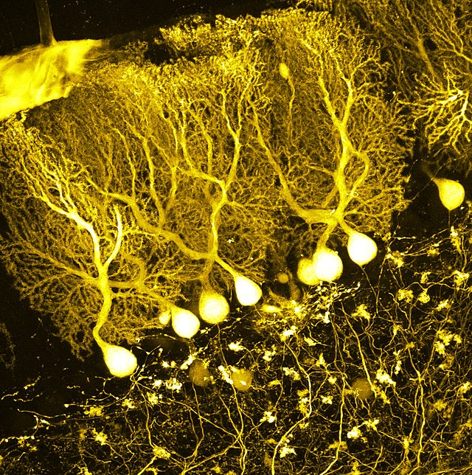
Voltage Gated Calcium Channel Antibodies
P/Q type VGCC are highly expressed in cerebellar Purkinje cells
P/Q type VGCC antibodies found in 40% of patients with paraneoplastic cerebellar degeneration
The exact pathogenesis of VGCC antibodies in PCD still not entirely clear
Cerebellar Purkinje Cells.; 2017. Accessed June 10, 2022. https://commons.wikimedia.org/wiki/File:All_that_glitters_in_the_brain.jpg
Bekircan-Kurt CE, Derle Çiftçi E, Kurne AT, et al. Voltage gated calcium channel antibody-related neurological diseases. World J Clin Cases. 2015 Mar 16;3(3):293-300.
Notes:
https://commons.wikimedia.org/wiki/File:All_that_glitters_in_the_brain.jpg

Slide 29
PCD Management
Treatment of malignancy necessary for neuro stabilization
Steroids, IVIG, PLEX can be helpful
80% become and remain non-ambulatory
Vernino S. Paraneoplastic cerebellar degeneration. Handb Clin Neurol. 2012;103:215-23.

Slide 30
Paraneoplastic Cerebellar Degeneration & Merkel Cell Carcinoma
Case series of 8 PNS cases secondary to Merkel Cell carcinoma
  Cerebellar Degeneration = 1 case
  Lambert-Eaton = 2 cases
  Hyponatremia = 5 cases
Review of existing literature prior to this study: 2/13 with cerebellar degeneration
Queen D, Gu Y, Lopez A, et al. Paraneoplastic cerebellar ataxia in Merkel cell carcinoma of unknown primary. JAAD Case Rep. 2019 Apr 20;5(5):398-400.
Iyer JG, Parvathaneni K, Bhatia S, et al. Paraneoplastic syndromes (PNS) associated with Merkel cell carcinoma (MCC): A case series of 8 patients highlighting different clinical manifestations. J Am Acad Dermatol. 2016 Sep;75(3):541-547.

Slide 31
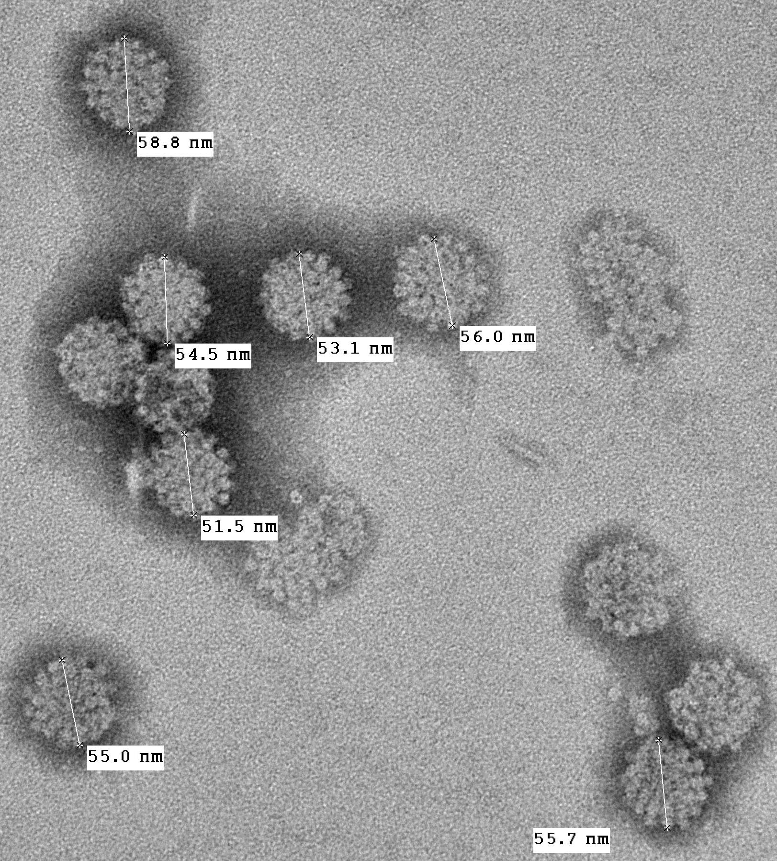
Paraneoplastic Cerebellar Degeneration 2/2 Merkel Cell Carcinoma
Rare and aggressive cutaneous neuroendocrine tumor (2800 cases in 2020)
Merkel cells = tactile mechanoreceptors in epidermis
Merkel cell polyomavirus causally linked
High mortality rates
Electron Microphotograph of Merkel Cell Polyomavirus Virus-like Particles.; 2009. Accessed June 10, 2022. https://commons.wikimedia.org/wiki/File:MCV_VLP_EM_PTA_staining.jpg
Dellambra E, Carbone ML, Ricci F, et al. Merkel cell carcinoma. Biomedicines. 2021 Jun 23;9(7):718.

Slide 32
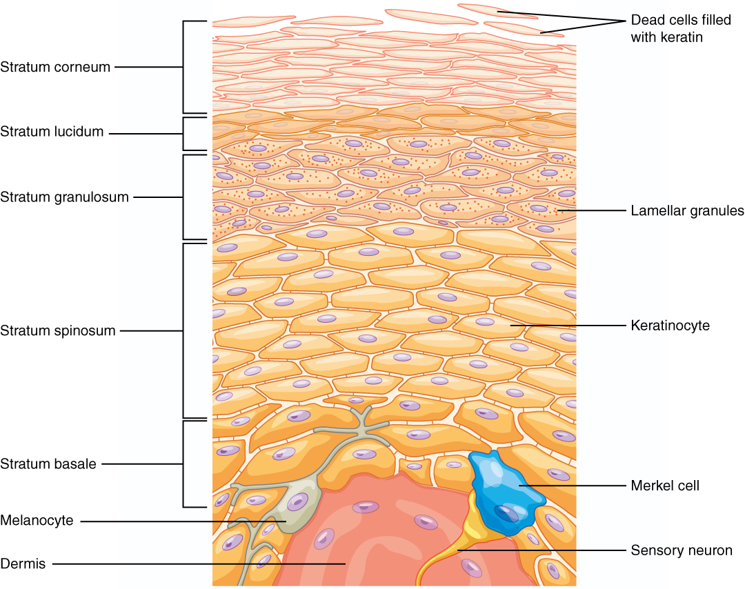
Betts G, Desaix P, Johnson E. Layers of Epidermis.; 2013. Accessed June 10, 22AD. https://commons.wikimedia.org/wiki/File:502_Layers_of_epidermis.jpg
Betts G, Desaix P, Johnson E. Layers of Epidermis.; 2013. Accessed June 10, 22AD. https://commons.wikimedia.org/wiki/File:502_Layers_of_epidermis.jpg

Slide 33
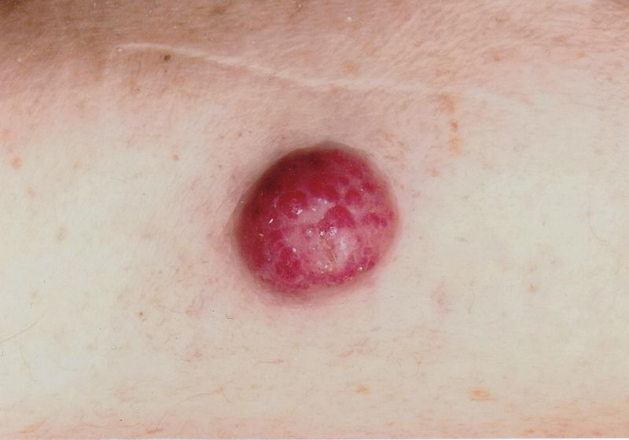
Clinical Features
Risk factors: male, older age, light skin, immunosuppression
Rapidly growing, firm, painless, flesh-colored or bluish-red nodule
40% present on head/neck
MCC is histologically similar to small cell lung cancer
Carcinome à Cellules de Merkel de La Face Antérieure de l’Avant-Bras. Accessed June 10, 2022. https://commons.wikimedia.org/wiki/File:Carcinome_%C3%A0_cellules_de_Merkel.jpg
Dellambra E, et al. Merkel Cell Carcinoma. Biomedicines. 2021 Jun 23;9(7):718.

Slide 34
Treatment of Merkel Cell Carcinoma
Localized:
  Excision +/- RT
Metastatic:
  PD-L1 inhibitors: Avelumab
  PD-1 inhibitors: Pembrolizumab, nivolumab
D'Angelo SP, Russell J, Lebbé C, et al. Efficacy and safety of first-line Avelumab treatment in patients With stage IV metastatic Merkel cell carcinoma: A preplanned interim analysis of a clinical trial. JAMA Oncol. 2018 Sep 1;4(9):e180077.

Slide 35
Patient Update
Improvement in DBN after initiation of IV solumedrol during admission
Started pembrolizumab and chemotherapy with some palliation of symptoms

Slide 36
Learning Points
Structural lesions causing DBN most often localize to the cervicomedullary junction
Paraneoplastic syndromes most often arise from small cell lung cancer
Paraneoplastic cerebellar degeneration occurs due to autoimmune destruction of Purkinje cells
Clonazepam, baclofen, gabapentin, memantine, 4-aminopyridine are modestly effective for DBN
Merkel cell carcinoma is a rare but deadly neuroendocrine malignancy

Slide 37
Image Attributions
Image:Brain human sagittal section.svg by Patrick J. Lynch; Image:Brain bulbar region.PNG by DO11.10; present image by Fvasconcellos., CC BY 2.5 <https://creativecommons.org/licenses/by/2.5>, via Wikimedia Commons
BrainsRusDC, CC BY 4.0 <https://creativecommons.org/licenses/by/4.0>, via Wikimedia Commons
Locusceruleus, CC BY-SA 3.0 <https://creativecommons.org/licenses/by-sa/3.0>, via Wikimedia Commons
John Paoli (GU), CC BY-SA 4.0 <https://creativecommons.org/licenses/by-sa/4.0>, via Wikimedia Commons
OpenStax College : J. Gordon Betts, Peter Desaix, Eddie Johnson., CC BY 3.0 <https://creativecommons.org/licenses/by/3.0>, via Wikimedia Commons
Doc103, CC BY-SA 3.0 <https://creativecommons.org/licenses/by-sa/3.0>, via Wikimedia Commons

