Slide 1


Periorbital pain and difficulty reading
Sojung Kara Park, DO
Neurology Resident
Hauenstein Neurosciences, Trinity Health Grand Rapids, Michigan
Aileen A. Antonio, MD
Neuro-Ophthalmology
Hauenstein Neurosciences, Trinity Health Grand Rapids, Michigan

Slide 2
30-year-old female
Past medical history: migraine without aura
2 months of periorbital pain and difficulty reading

Slide 3
Summary of clinical course
July 2022: right periorbital pain
  Severity 3/10
  Constant, not worse with eye movements
  Different from her migraines
Paracentral C-shaped area of vision loss, right eye
What else would you ask the patient?
Notes:
Patient usually loves to read but reported it was challenging for her to read.

Slide 4
Ophthalmology evaluation
Late July 2022
Distance visual acuity 20/40 OD, 20/20 OS
Right optic disc edema. Normal left optic disc and nerve.
No RAPD
Full EOM, without pain
Concerned for optic neuritis related to multiple sclerosis
Do you agree with the working diagnosis?

Slide 5
Referred to neuro-ophthalmology clinic
September 2022
Visual acuity: OD 20/40, OS 20/20
Color (Hardy-Rand-Rittler): OD 9/10, OS 10/10
Amsler
  Normal OU
Pupils
  OD: 6mm in dark, 4mm in light, briskly reactive, 0- 0.3 APD
  OS: 6mm in dark, 4mm in light, briskly reactive, no APD

Slide 6
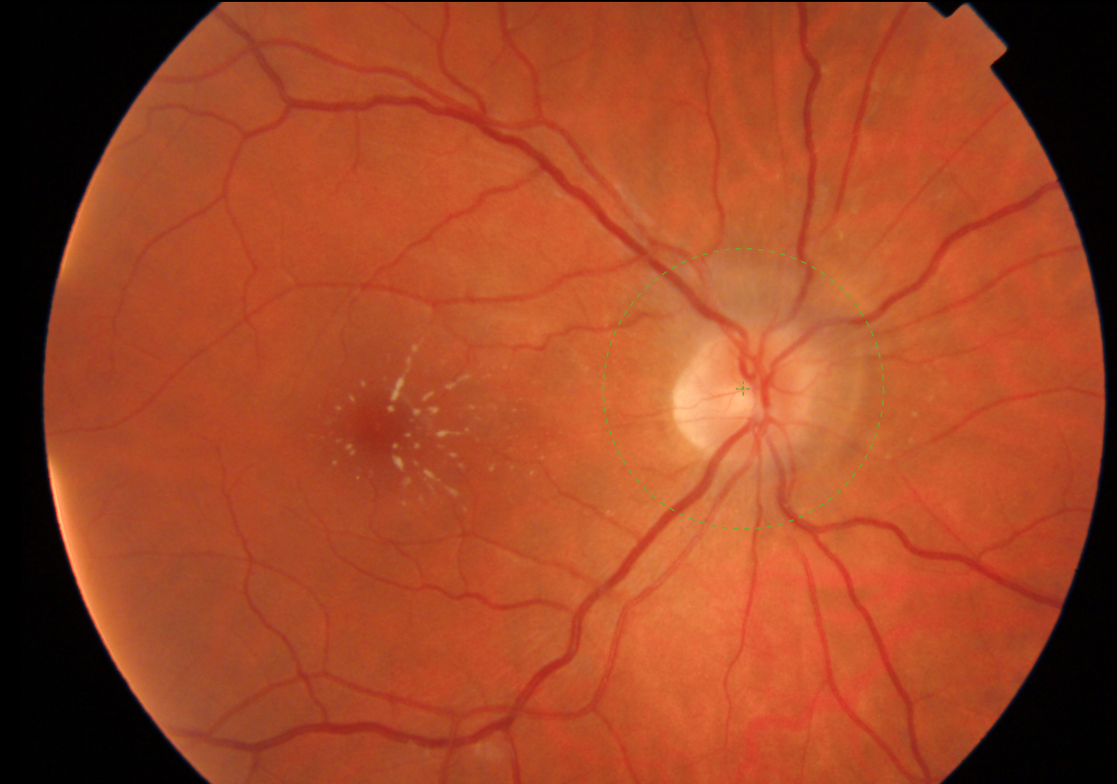
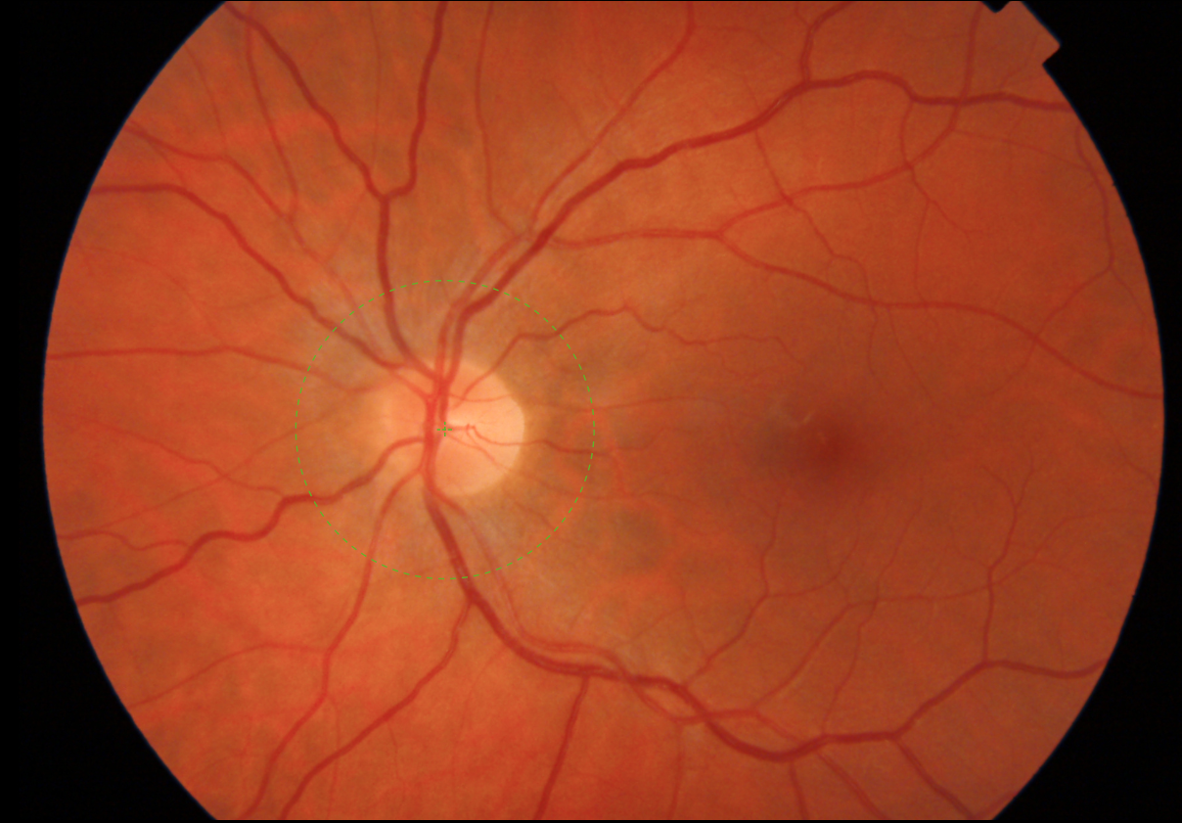
Fundoscopic exam
OD
OS
What do you see?

Slide 7
Fundoscopic exam
Disc edema
Macular star
OD
OS
Notes:
OS is normal
OD Macular star (parafoveal abnormality in a stellate or star-shaped pattern, which represents retinal exudates)
OD Optic disc edema with blurred margins, disc elevation

Slide 8
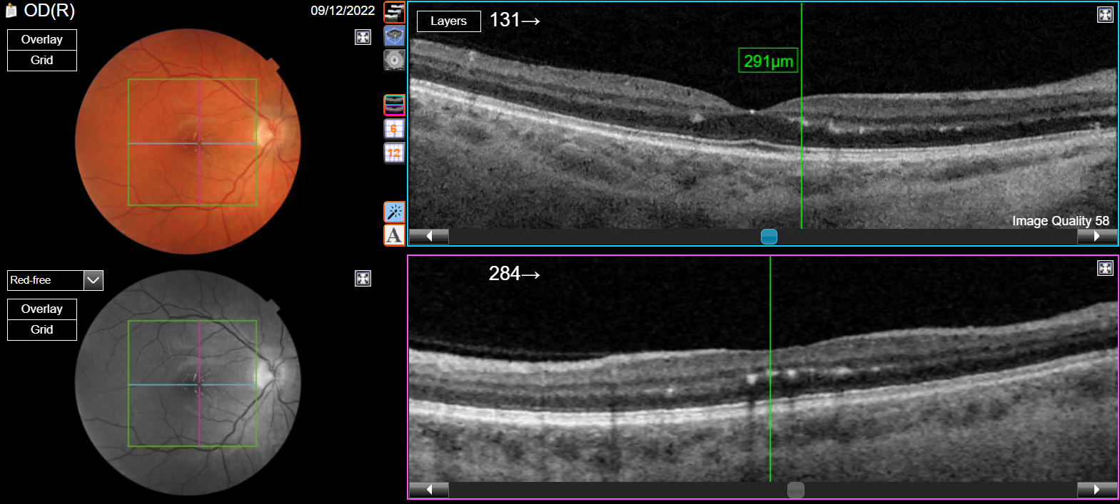
Optical coherence tomography (OCT) - OD
A
B
What do you see?

Slide 9
Optical coherence tomography (OCT) - OD
A
A
*
*
B
B
Legends
White asterisk (*): Abnormal collection of subretinal fluid in the foveal/parafoveal area
Yellow arrowheads ( ): Diffuse lipid exudates throughout the outer plexiform layer and Henle’s fiber layer
Notes:
OCT horizontal (A) and vertical (B) scans passing through the macula in the right eye, where we identified the macular star
Abnormal collection of subretinal fluid in the foveal/parafoveal area (white asterisk)
Exudates diffusely throughout the outer plexiform layer and Henle’s fiber layer (yellow arrowheads)

Slide 10
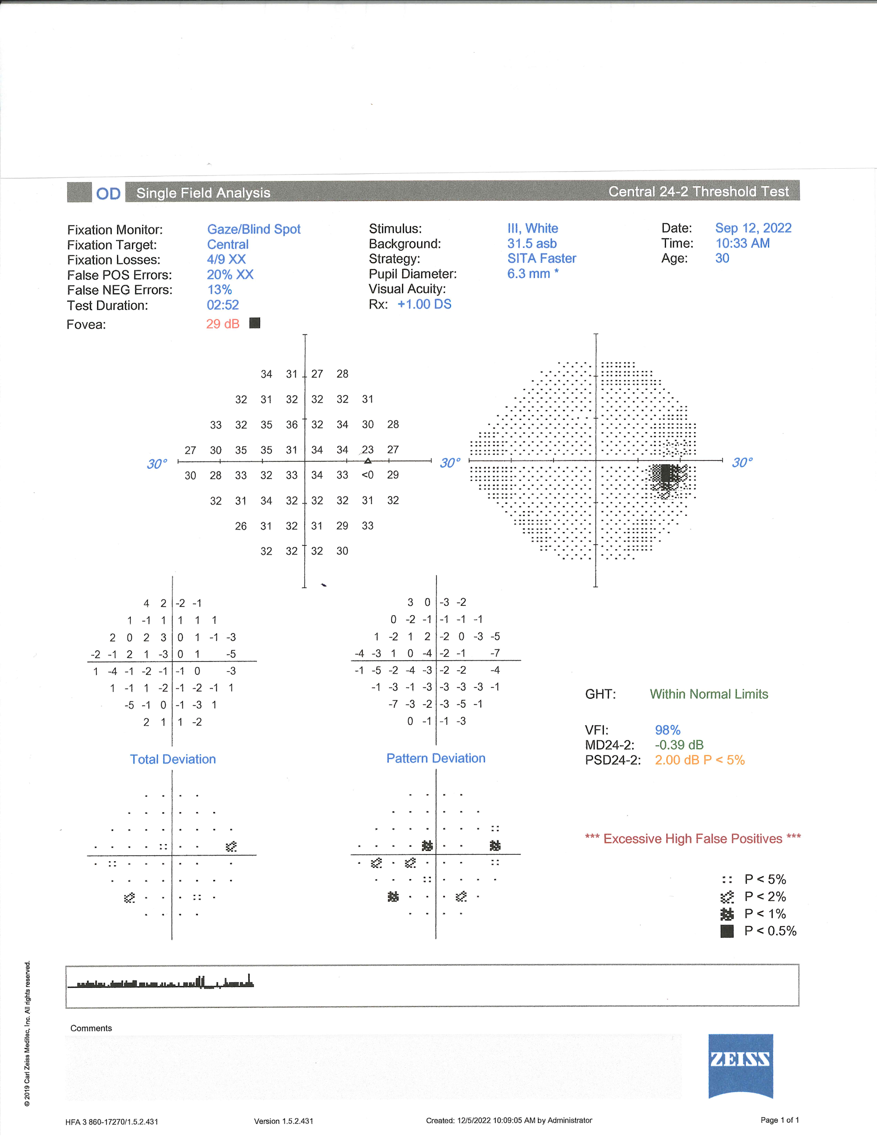
Humphrey visual field - OD

Slide 11
Humphrey visual field - OD
Subtle changes in the central & paracentral areas
What are your differential diagnoses?

Slide 12
Differential diagnoses for neuroretinitis
INFECTIOUS
Cat scratch disease (Bartonella henselae)
Lyme disease
Syphilis
Toxoplasmosis
Tuberculosis
Hepatitis
Measles, mumps, rubella
West Nile, Zika virus
Histoplasmosis, coccidioidomycosis
INFLAMMATORY
Systemic lupus erythematosus
Sarcoidosis
Polyarteritis nodosa
Takayasu arteritis
Behcet disease
OTHER
Diabetic papillitis
IDIOPATHIC
(50%, can be recurrent)
What else would you ask the patient?
Notes:
Idiopathic neuroretinitis (Aka. Leber’s idiopathic stellate neuroretinitis)
Diagnosis of exclusion. Must rule out other possible etiologies of neuroretinitis.
Can be recurrent, in which case prognosis is worse.

Slide 13
Upon further questioning…
2 weeks prior to the onset of visual symptoms, experienced 4 days of fever, chills, diaphoresis, malaise, nausea
COVID-19 was negative
What additional history would you ask?
Notes:
Our patient did not have any lymphadenopathy. (Checked cervical, supraclavicular or submandibular nodes.)

Slide 14
She has 3 cats!
One of the cats stays outdoors, has flank sores, and recently experienced a “flea problem”
Patient was bitten by this cat a few months prior to the development of visual symptoms
Would you order any imaging?

Slide 15
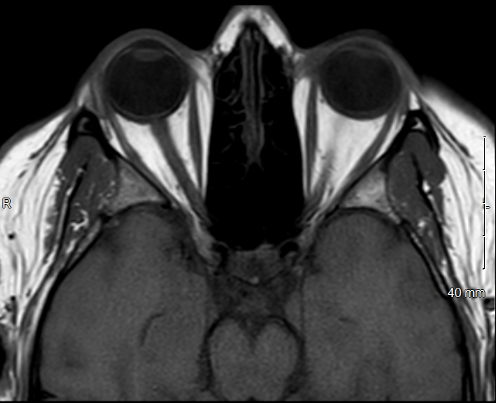
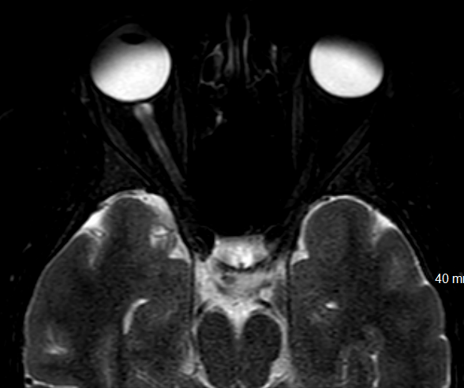
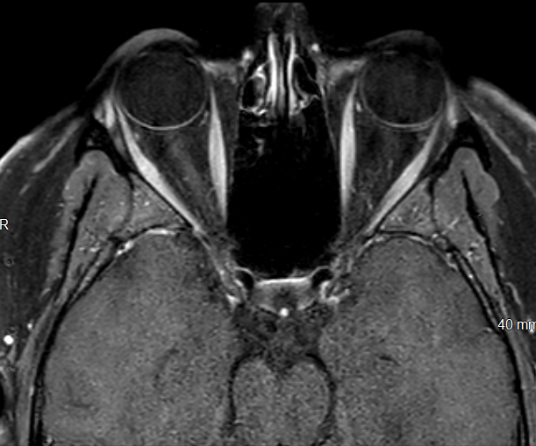
MRI Orbits with and without contrast
A
B
C
A. T1 pre-gadolinium image shows isointensity in the right optic nerve head (arrow).
B. T2 image shows hyperintensity around the right optic nerve head and slight dilation of the optic nerve sheath as it inserts into the globe (arrow).
C. T1 post-gadolinium shows subtle enhancement of the right optic nerve head (arrowhead) and of the right optic nerve (arrow).
Notes:
Important to obtain imaging
Subtly pronounced right optic nerve head with mild T2 hyperintensity, T1 isointensity
Subtle enhancement of the right optic nerve head
Enhancement of the right optic nerve and slight dilation of the optic nerve sheath as it inserts into the globe
Enhancement of the intraorbital fat on the right

Slide 16
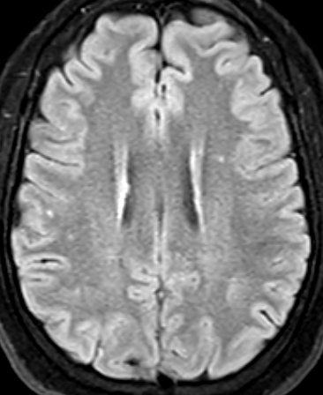
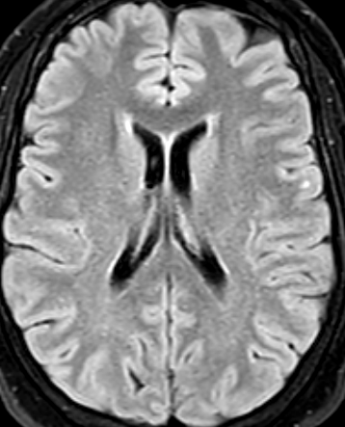
MRI Brain with and without contrast
What laboratory studies would you order?
T2 FLAIR axial images demonstrate hyperintense white matter lesions in juxtacortical and subcortical supratentorial areas (arrows). These are non-specific and potentially related to patient’s history of migraines.

Slide 17
Labs
 | Result | Reference range
Bartonella henselae IgG | > 1:1024 | < 1:64 negative
Bartonella henselae IgM | 1:16 | < 1:16 negative
Bartonella quintana IgG | 1:64 | < 1:64 negative
Bartonella quintana IgM | < 1:16 | < 1:16 negative
CRP | 1.9 mg/dL | < 0.5 mg/dL
ESR | 16 mm/hr | 0-20 mm/hr
Serum ACE | 37 U/L | 8-52 U/L
B. burgdorferi IgG and IgM | Negative | Negative
Treponema antibody | Non-reactive | Non-reactive
Interferon gamma | Negative | Negative
What is the diagnosis?
Notes:
Bartonella labs from 9/12/2022

Slide 18
Bartonella henselae
About 40% of cats carry B. henselae at some point in their lives
Most cats with the infection show no signs of illness
Cats get flea bites or get flea droppings into wounds
Human inoculation via cat bite or scratch
Dogs can also be infected by B. henselae
Notes:
Cats can also get infected by fighting with other infected cats..
OR, cat bite or scratch causing a break in the human skin
While cats are the major reservoir, dogs can also be infected by B. henselae and transmit to humans
Cat Scratch Disease | Healthy Pets, Healthy People | CDC

Slide 19
Bartonella neuroretinitis
Affects 1-2% of patients with Bartonella henselae
Characterized by optic disc edema with partial or complete macular star
Usually unilateral, but may be bilateral in both immunocompetent and immunocompromised patients
How would you treat the patient?

Slide 20
Treatment for Bartonella neuroretinitis
PO doxycycline + rifampin combination regimen for 4-6 weeks
Adjunctive glucocorticoids (oral prednisone) tapered over 6 weeks
Alternative antimicrobial regimen: rifampin PLUS either azithromycin or trimethoprim-sulfamethoxazole
Notes:
PO doxycycline 100 mg every 12 hours x 6 weeks (Doxycycline: inhibits bacterial protein synthesis by allosterically binding to the 30 S prokaryotic ribosomal unit during protein synthesis)
Rifampin 300 mg every 12 hours x 6 weeks (Inhibits bacterial DNA-dependent RNA polymerase, thereby blocking bacterial RNA synthesis)
Steroids: adjuvant use of oral corticosteroids further improve visual outcomes (Data regarding steroids is somewhat limited- no randomized control trial. However, in a retrospective, multicenter study of 86 patients with ocular manifestations of cat scratch disease, they found that visual improvement was significantly better in patients who received corticosteroids plus antimocrobials vs. those who only received antimicrobials (88% vs 50%). In this study, most of these patients were treated with oral doxycycline + rifampin. Steroids were usually started at 40-80mg/day and gradually tapered down over 6 weeks. (Habot-Wilner et al)
****Ksiaa et al:
“There is no consensus on the management modalities of CSD or its ocular manifestations. CSD is usually characterized by a self-limited course in immunocompetent patients. There is no recommendation to treat mild to moderate systemic CSD. However, severe ocular or systemic complications of CSD and immunocompromised patients should be treated.”

Slide 21
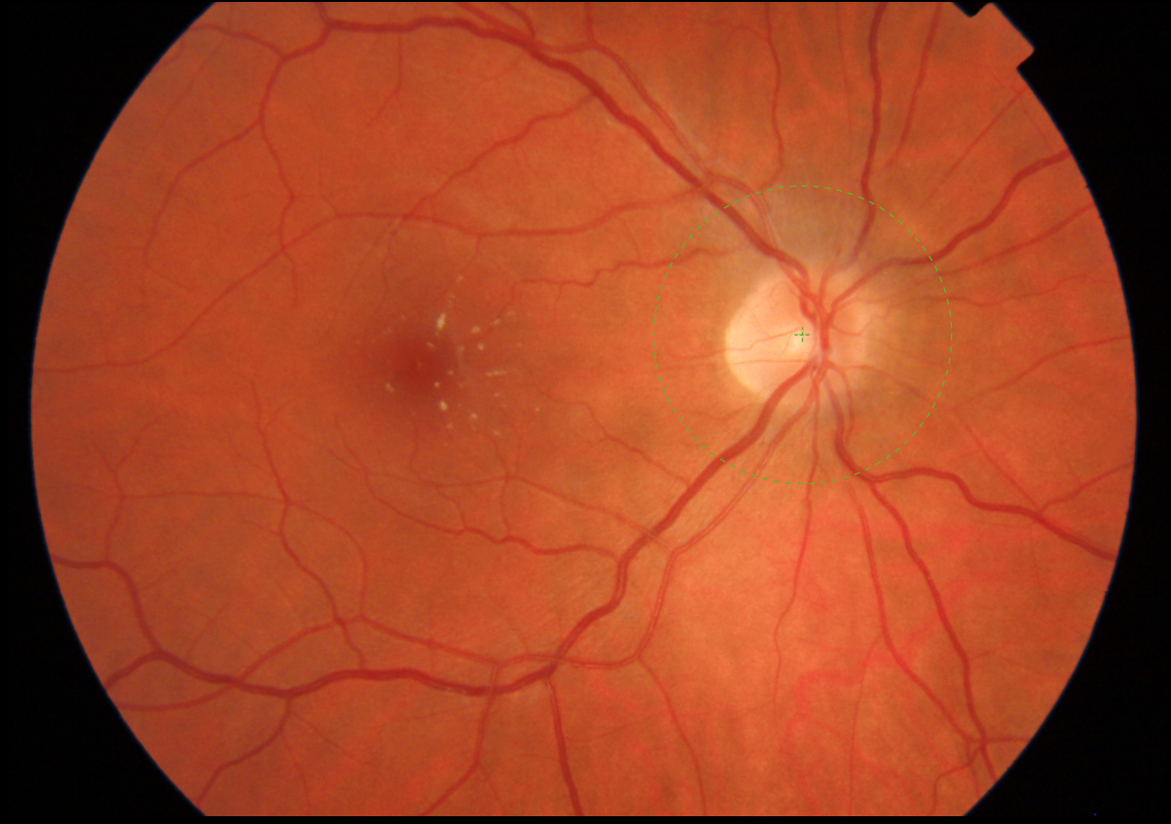
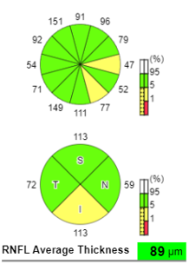
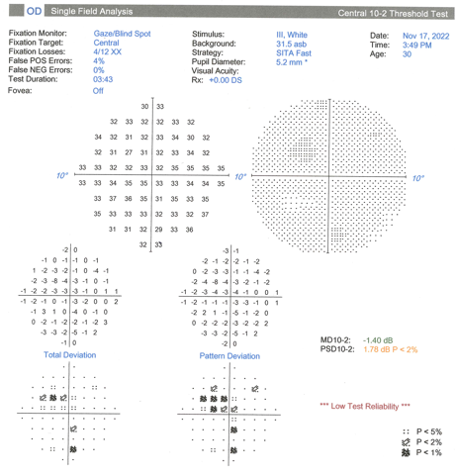
Neuro-ophthalmology follow up after treatment
November 2022
Visual acuity: 20/20 OD, 20/20 OS
Improved macular star
Improved disc edema
What are some other symptoms and signs of cat scratch disease?
Notes:
Macular star improved. Disc edema and blurring of the margins improved compared to initial exam. Central /paracentral scotoma remain but appears slightly improved.
The patient’s symptoms improved after treatment. Periorbital pain resolved.
Visual acuity improved (OD VA improved from 20/40 to 20/20)

Slide 22
Neurologic manifestations of cat scratch disease (CSD)
Encephalopathy
Transverse myelitis
Radiculitis
Cerebellar ataxia

Slide 23
Systemic manifestations of cat scratch disease (CSD)
Primary inoculation lesion (pustule or nodule)
Lymphadenopathy
Fever
Hepatomegaly or splenomegaly
Myalgia, arthralgia
Bacteremia
Endocarditis

Slide 24
Why was this case neuroretinitis and not optic neuritis?
Both neuroretinitis and optic neuritis
Unilateral vision loss
Neuroretinitis
Macular star
Fever, lymphadenopathy (LAD)
Elevated inflammatory markers (ESR, CRP)
Optic neuritis
No macular star
Not likely to have systemic symptoms (fever, LAD)
Would expect normal ESR, CRP

Slide 25
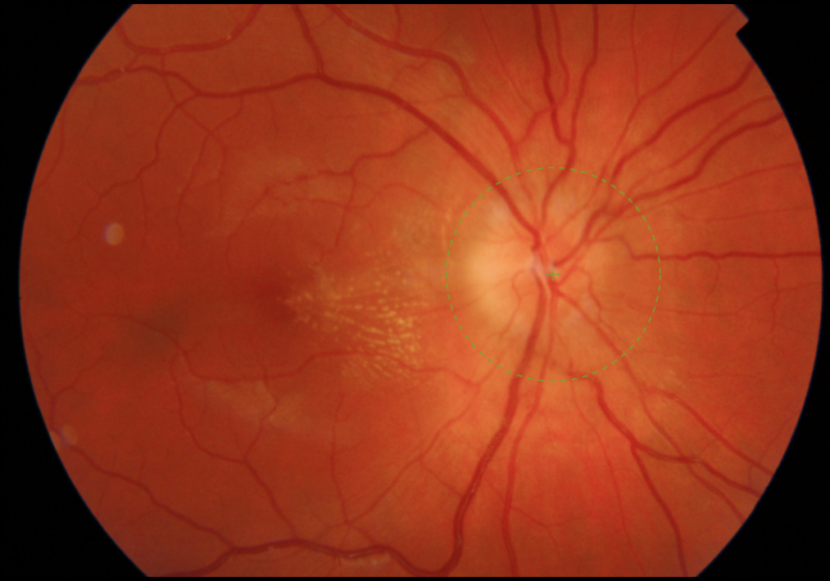
Macular star in Bartonella neuroretinitis
Fluid extends from peripapillary area into the macula
  As the fluid resorbs, lipid exudates form a stellate shape in the macula
May be absent at initial presentation
Usually develops about 1-2 weeks after onset of optic disc edema
Decreases in 4 weeks, but may be present for up to 1 year
Notes:
Macular star decreases in ~4 weeks but may be present for up to 1 year (S. Ray, E. Gragoudas Neuroretinitis Int Ophthalmol Clin, 41 (1) (2001), pp. 83-102)
In script: explain the photo. There’s an abnormal area around the fovea in a star pattern which represents the retinal exudates
Picture from AA’s pt (I just got the list of neuroret pts from IT, but I don’t have my work laptop. I’ll only have access to the photos on Tuesday to see if there’s a full macular star – AA)
If a complete star is desired, can use picture from this article: Macular Star in Neuroretinitis | Ophthalmology | JAMA Neurology | JAMA Network

Slide 26
Bartonella neuroretinitis prognosis
Usually self-limited course in immunocompetent patients
Optic disc edema decreases in ~2 weeks, completely resolves in 8-12 weeks
Final visual acuity ≥ 20/40 in most patients
Some patients acquire a mild post-infectious optic neuropathy
Notes:
Prolonged use of doxycycline, or a macrolide, may be helpful for prevention of cat scratch disease recurrences in HIV-positive patients
Final visual acuity of at least 20/40 in 97% of cases in Bartonella neuroretinitis and idiopathic neuroretinitis
However, in idiopathic recurrent neuroretinitis, prognosis is worse (final visual acuity of 20/40 in only 36% of pts)
Stats from this article: Update on Bartonella neuroretinitis - PMC (nih.gov)

Slide 27
Bartonella neuroretinitis
- Key learning points
Acute monocular vision loss
Unilateral optic disc edema
Macular star
Systemic symptoms/signs
Prevention: avoiding close contacts with cats or cat fleas, increased awareness of risk of cat scratches
Good prognosis
Visual recovery improves with treatment

Slide 28
References
Bhatti MT, Asif R, Bhatti LB. Macular star in neuroretinitis. Arch Neurol. 2001;58(6):1008-1009. doi:10.1001/archneur.58.6.1008
Carithers HA. Cat-scratch disease. An overview based on a study of 1,200 patients. Am J Dis Child. 1985;139(11):1124-1133. doi:10.1001/archpedi.1985.02140130062031
"Cat Scratch Disease." Centers for Disease Control and Prevention, 17 Jan. 2020, https://www.cdc.gov/healthypets/diseases/cat-scratch.html#:~:text=Cat%20scratch%20disease%20(CSD)%20is,the%20surface%20of%20the%20skin.
Gan JJ, Mandell AM, Otis JA, Holmuhamedova M, Perloff MD. Suspecting optic neuritis, diagnosing Bartonella cat scratch disease. Arch Neurol. 2011;68(1):122-126. doi:10.1001/archneurol.2010.345
Habot-Wilner Z, Trivizki O, Goldstein M, et al. Cat-scratch disease: ocular manifestations and treatment outcome. Acta Ophthalmol. 2018;96(4):e524-e532. doi:10.1111/aos.13684
Ksiaa I, Abroug N, Mahmoud A, et al. Update on Bartonella neuroretinitis. J Curr Ophthalmol. 2019;31(3):254-261. Published 2019 May 6. doi:10.1016/j.joco.2019.03.005

Slide 29
References
Marra CM. Neurologic complications of Bartonella henselae infection. Curr Opin Neurol. 1995;8(3):164-169. doi:10.1097/00019052-199506000-00002
Narayan SK, Kaliaperumal S, Srinivasan R. Neuroretinitis, a great mimicker. Ann Indian Acad Neurol. 2008;11(2):109-113. doi:10.4103/0972-2327.41879
Patel R, Patel BC, Chauhan S. Neuroretinitis. In: StatPearls. Treasure Island (FL): StatPearls Publishing; October 12, 2022.
Purvin V, Sundaram S, Kawasaki A. Neuroretinitis: review of the literature and new observations. J Neuroophthalmol. 2011;31(1):58-68. doi:10.1097/WNO.0b013e31820cf78a
Raihan AR, Zunaina E, Wan-Hazabbah WH, Adil H, Lakana-Kumar T. Neuroretinitis in ocular bartonellosis: a case series. Clin Ophthalmol. 2014;8:1459-1466. Published 2014 Aug 5. doi:10.2147/OPTH.S63667
Ray S, Gragoudas E. Neuroretinitis. Int Ophthalmol Clin. 2001;41(1):83-102. doi:10.1097/00004397-200101000-00009

