Slide 1


Acute diplopia after vitrectomy: a revealing MRI
Francois Kirouac, MD
Fannie Nadeau, MD
Ananda Kalevar, MD
Dept. of Ophthalmology
Francois Evoy
Dept. of Neurology
University of Sherbrooke, Qc, Canada

Slide 2
49 yo female with acute binocular diplopia
Presents to the emergency department, referred to the on call ophthalmologist
Past medical history : nothing relevant
No current or recent oral medication
Underwent uneventful pars plana vitrectomy (PPV) for epi-retinal membrane (ERM) 4 days ago , in the left eye

Slide 3
49 yo female with acute diplopia
The double vision is
  Binocular
  Horizontal
  Constant
  Worse at distance or when she looks to the left
  Persists in all gaze positions
No known history of strabismus
No pain, no headaches

Slide 4
Examination shows:
VA 20/20 OD, 20/25 OS
No RAPD (by reverse), left pupil pharmacologically dilated
No ptosis, normal levator function, no proptosis
Limited abduction (-2) OS and cover-test:
 | ET 16 PD
ET 10 PD | ET 16 PD | ET 20 PD
 | ET 16 PD
E’T 10PD
SLE: Vitreal air-bubble at about 40% total volume
What is the differential diagnosis of diplopia in this case?

Slide 5
What’s the differential ?
The nerve : left abducens nerve
Microvascular 6th nerve palsy
Demyelinating process
Elevated intracranial pressure
Inflammation : sarcoidosis
Infection: abcess, meningitis
Tumoral : lymphoma, pituitary apoplexy
Myasthenia gravis
The muscle : left lateral rectus
Traumatic
Idiopathic orbital inflammation (orbital pseudotumor)
Thyroid eye disease

Slide 6
What’s the differential ?
The nerve : paralytic
Microvascular 6th nerve palsy
Demyelinating process
Myasthenia gravis
Elevated intracranial pressure
Inflammation : sarcoidosis
Infection: abcess, meningitis
Tumoral : lymphoma, pituitary apoplexy
The muscle : typically restrictive
Idiopathic orbital inflammation (orbital pseudotumor)
Thyroid eye disease
Traumatic
How can you differentiate a paralytic versus a restrictive cause?

Slide 7
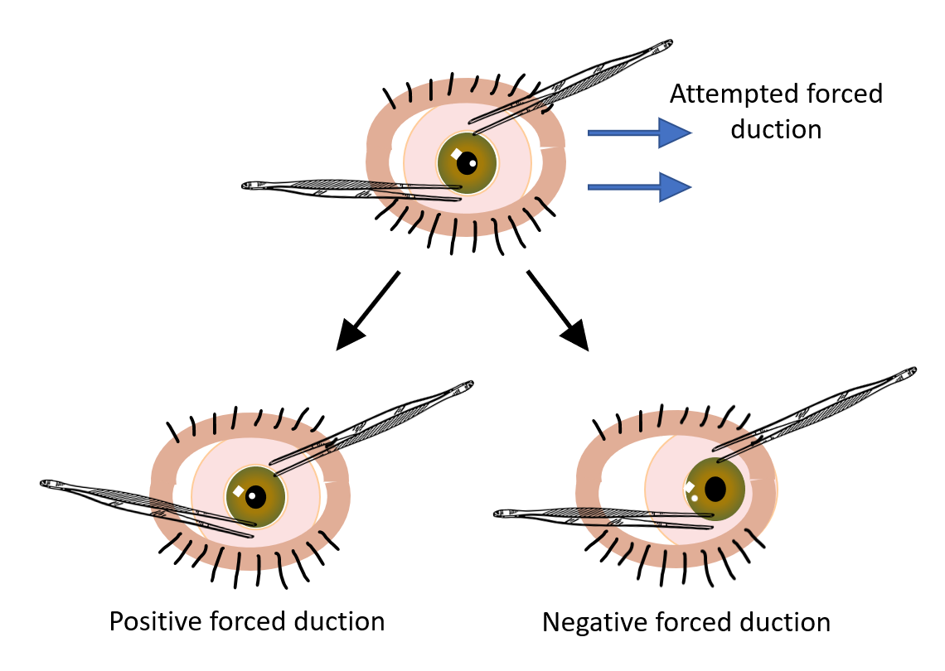
Restrictive vs paralytic
 | Paralytic | Restrictive
Forced duction | Normal | Positive
Saccadic velocity | Reduced | Normal (up to the restriction point)
Pain on eye movement | No to variable | Often
Duction vs version Range of motion | Duction > Version | Duction = version

Slide 8
Work-up needed in sixth nerve palsy?
Basic : CBC, TSH, Erythrocyte sedimentation rate, C-Reactive protein, acetylcholine receptor antibody
Basic risk factors : Diabetes screening, Blood pressure, lipid panel
As needed : Syphilis testing, Lyme, ANA, ACE
Brain imaging
When can we omit brain imaging in an acute 6th nerve palsy ?

Slide 9
Work-up needed ?
Basic : CBC, TSH, Erythrocyte sedimentation rate, C-Reactive protein, acetycholine receptor antibody
Basic risk factor : Diabetes screening, Blood pressure, lipid panel
As needed : Syphilis testing, Lyme, ANA, ACE
Brain imaging if…
When can we omit brain imaging in an acute 6th nerve palsy ?
-acute, isolated and non-traumatic
-older > than 50 yo with vasculopathic risk factor
-no past medical history of malignancy
-resolution or marked improvement after 3 months

Slide 10
Work-up needed ?
Basic : CBC, Erythrocyte sedimentation rate, C-Reactive protein
Basic risk factor : Diabetes screening, Blood pressure, lipids
As needed : Syphilis testing, Lyme, ANA, ACE
Brain imaging if…
When can we omit brain imaging in an acute 6th nerve palsy ?
In view of recent literature, in 2023 ; MRI should be performed in most cases of sixth nerve palsy

Slide 11
Let’s get back to the case …
MRI with dedicated sequences for cranial nerves was done
(FIESTA: Fast Imaging Employing Steady-state)
i.e. high resolution T2

Slide 12
Ax-FIESTA
Ax - T2 FSE
What are the relevant findings on the MRI?
Ax T1 FS C+
Coronal T1 C+

Slide 13
Ax-FIESTA
Ax - T2 FSE
T2 hyperintense
Relative to the other muscles
Tendon sparing
Thickening, T2 Hyper-intensity and homogeneous contrast uptake of the left lateral rectus
Ax T1 FS C+
Coronal T1 C+
*Note the air bubble
Thickening
*
Homogenous contrast uptake

Slide 14
Left lateral rectus myopathy
Orbital inflammatory syndrome/myositis
Thyroid eye disease
Muscle injury

Slide 15
Left lateral rectus myopathy
Orbital inflammatory syndrome/myositis
Thyroid eye disease
Muscle injury

Slide 16
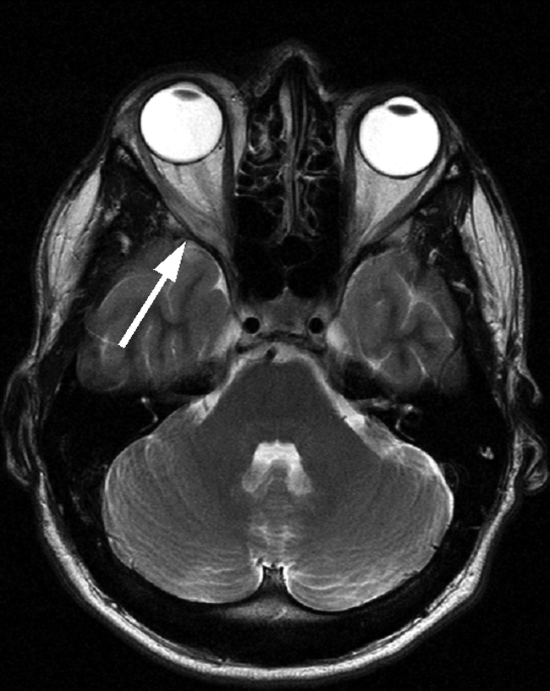
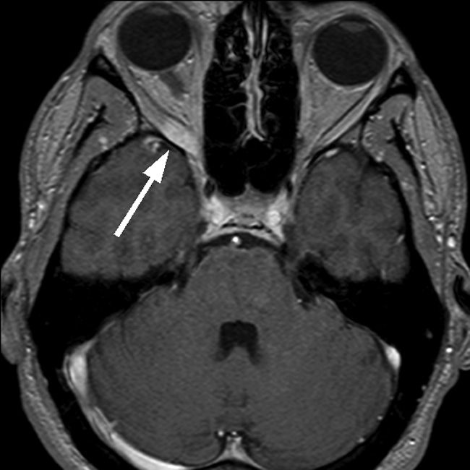
Fischer, M & Kempkes, U & Haage, Patrick & Isenmann, Stefan. (2009). Recurrent Orbital Myositis Mimicking Sixth Nerve Palsy: Diagnosis with MR Imaging. AJNR. American journal of neuroradiology. 31. 275-6. 10.3174/ajnr.A1751.
Reproduced here with permission

Slide 17
Orbital inflammatory syndrome/myositis
Unilateral or sequential bilateral subacute painful ophthalmoplegia with diplopia
Other local symptoms and signs : conjunctival redness, chemosis, ptosis, and proptosis
MRI : Thickening of the muscle and its tendon
Improves drastically and rapidly with corticosteroids

Slide 18
Left lateral rectus myopathy
Orbital inflammatory syndrome/myositis
Thyroid eye disease
Muscle injury
Isolated lateral rectus involvement : extremely rare !

Slide 19
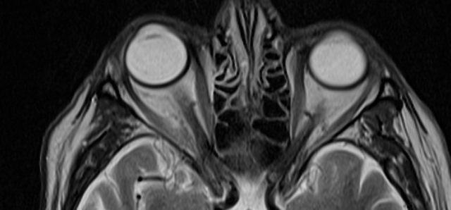
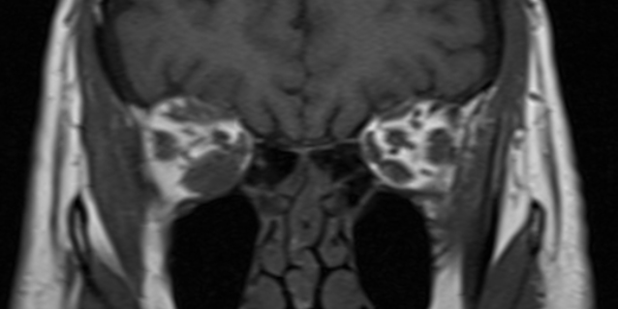
T2
T1
Case courtesy of Henry Knipe, Radiopaedia.org, rID: 97505

Slide 20
Thyroid Eye Disease (TED)
Unilateral or bilateral subacute ophthalmoplegia, may be painful
  Dry eye syndrome
Other local symptoms and signs : conjunctival/palpebral redness and edema, eyelid retraction and proptosis
Frequency of involvement: inferior rectus > medial rectus > superior rectus > lateral rectus
CT-scan or MRI : enlargement of the muscle belly with sparing of the tendon

Slide 21
Let’s get back to the case…
CBC, TSH, CRP wnl
Initial diagnosis of inflammatory myopathy
Oral prednisone was offered but the patient declined

Slide 22
Let’s get back to the case…
PO # day 9 : The diplopia resolved on it’s own without treatment
PO # day 16 : She was seen by the neuro-ophthalmology service with a then normal orthoptic examination
  -The PPV was done under local anesthesia with a peri-bulbar block with lidocaine 2%.
  -The patient recalled that she felt her eye move during the block.
  An iatrogenic lateral rectus injury during the block was then diagnosed:
  -Natural history and painless presentation were inconsistent with previous diagnosis of inflammatory myopathy

Slide 23
Diplopia post retrobulbar anesthesia
How frequent is persistent diplopia following retrobulbar anesthesia ?
What are the typical mechanisms ?

Slide 24
Diplopia post retrobulbar anesthesia
How frequent is persistent diplopia following retrobulbar anesthesia ? 0.75-2%
What are the typical mechanisms ?
  Decompensated latent strabismus
  Direct inferior rectus injury by the needle (hemorrhage)
  Intra-muscular infiltration of anesthetic with secondary toxicity
  Long-lasting paralytic effect of intra-muscular sodium channels blocking agents

Slide 25
Diplopia post retrobulbar anesthesia
What treatment can we offer ?
  Nothing evidence-based but most cases reported in the literature utilized a trial of oral corticosteroids
Can there be long-term sequelae ?
  Yes, there are reports of progressive muscle fibrosis following inadvertent anesthetic injection. Most patients in the literature needed strabismus surgery
  In our case the patient is still orthotropic more than 1 year after the event
Trick question: Why did the diplopia manifested on the 4th day post-op?
Because the air bubble blurred her vision! Only when the bubble resorbed above the level of the macula could she experience diplopia.

Slide 26
KEYPOINTS
Lateral rectus injury following peribulbar block is a rare mimicker of a 6th nerve palsy
  No treatment needed
  Be aware that it can cause long-term muscle fibrosis and persistent diplopia
Good history and quick MRI will help distinguish it from more daunting conditions such as stroke, MS or neoplasia

Slide 27
REFERENCES
1. Yannuzzi NA, Sridhar J, Flynn HW, et al. Current Trends in Vitreoretinal Anesthesia. Ophthalmol Retin. 2019;3(9):804-805. doi:10.1016/j.oret.2019.05.020
2. Gómez-Arnau JI, Yangüela J, González A, et al. Anaesthsia-related diplopia after cataract surgery. Br J Anaesth. 2003;90(2):189-193. doi:10.1093/bja/aeg029
3. Guyton DL. Strabismus complications from local anesthetics. Semin Ophthalmol. 2008;23(5):298-301. doi:10.1080/08820530802505914
4. Hamilton RC. Retrobulbar block revisited and revised. J Cataract Refract Surg. 1996;22(9):1147-1150. doi:10.1016/s0886-3350(96)80062-9
5. Zink W, Graf BM. Local anesthetic myotoxicity. Reg Anesth Pain Med. 2004;29(4):333-340. doi:10.1016/j.rapm.2004.02.008
6. Taylor G, Devys JM, Heran F, Plaud B. Early exploration of diplopia with magnetic resonance imaging after peribulbar anaesthesia. Br J Anaesth. 2004;92(6):899-901. doi:10.1093/bja/aeh153
7. Kim C-H, Kim US. Large exotropia after retrobulbar anesthesia. Indian J Ophthalmol. 2016;64(1):91-92. doi:10.4103/0301-4738.178148
8. Fischer, M & Kempkes, U & Haage, Patrick & Isenmann, Stefan. (2009). Recurrent Orbital Myositis Mimicking Sixth Nerve Palsy: Diagnosis with MR Imaging. AJNR. American journal of neuroradiology. 31. 275-6. 10.3174/ajnr.A1751.
9. Schoser BH , Ocular myositis: diagnostic assessment, differential diagnoses, and therapy of a rare muscle disease – five new cases and review, Clin Ophthalmol. 2007 Mar; 1(1): 37–42.

