Slide 1


Eye swelling and Decreased Vision in a Patient with Autism
Jia Xu, MD
Boston Medical Center / Boston University School of Medicine
Yanjia Jason Zhang, MD
Efren Gonzalez, MD
Thomas H. Dohlman, MD
Eric D. Gaier MD, PhD
Boston Children’s Hospital / Harvard Medical School

Slide 2
8-year-old girl with autism spectrum disorder presents with eye swelling and decreased vision
Eye rubbing, blinking and eyelid swelling for 2-3 months prior to presentation. She prefers to keep her eyes closed and seems in discomfort. These symptoms are worse in the mornings. Suspecting allergies, her parents trialed oral cetirizine, but don’t feel this has helped.
New eye misalignment “wandering” for 1-2 months prior to presentation.
Her parents suspect she is also having difficulty seeing.
No dry mouth or GI symptoms.

Slide 3
Initial examination
 | Right Eye | Left Eye
Visual acuity | ~Fix and Follow OU (not interested in Teller Cards); pinching examiner
Sensorimotor exam | Attempted but unable to assess stereoacuity/motor fusion XT 15-20 PD at near (Krimsky), alternating fixation, versions full
CVF (distraction) | Looks to target in all quadrants with both eyes viewing
Pupils | Unable to assess for rAPD due to limited patient cooperation
Cycloplegic refraction | Apparent with-motion with bright reflex OU. Attempted but unable to obtain a refraction due to limited patient cooperation
Anterior Exam | Mild, symmetric periorbital edema, dry bulbar conjunctiva, no visible tear film
It was suspected that the findings represent a primary anterior segment disorder – dry eyes.
Recommendations: Stop cetirizine, start erythromycin ointment at bedtime. Cyclosporine topical bid. Cornea referral.

Slide 4
8-year-old girl with autism spectrum disorder presents with eye swelling and decreased vision
Follow-up visit; interval history:
  Stopped cetirizine. Using ophthalmic erythromycin ung and cyclosporine gtts.
  Unable to see cornea until 1 week prior. Cornea exam was similarly limited.
  Examination under anesthesia scheduled (pending).
  Eye rubbing and eye swelling initially slightly better, but then worsened.
  She could no longer walk well, needing to feel the area around her feet. She is holding her tablet close to her eyes

Slide 5
Follow-up examination
 | Right Eye | Left Eye
Visual acuity | ~Unable to fix or follow OU (not interested in Teller Cards)
Sensorimotor exam | Attempted but unable to assess stereoacuity/motor fusion XT 15-20 PD at near (Krimsky), unable to assess fixation, versions full
CVF (distraction) | Unable to assess
Pupils | Complete rAPD OD (no response to light, confirmed by reverse)
Anterior Exam | Mild, symmetric periorbital edema - stable, improved tear film, but persistent dry appearance of the bulbar conjunctiva
Given the new finding of an rAPD on the right, the patient was referred to the emergency department for neuroimaging.
In what ways can the examiner assess visual function in uncooperative patients?

Slide 6
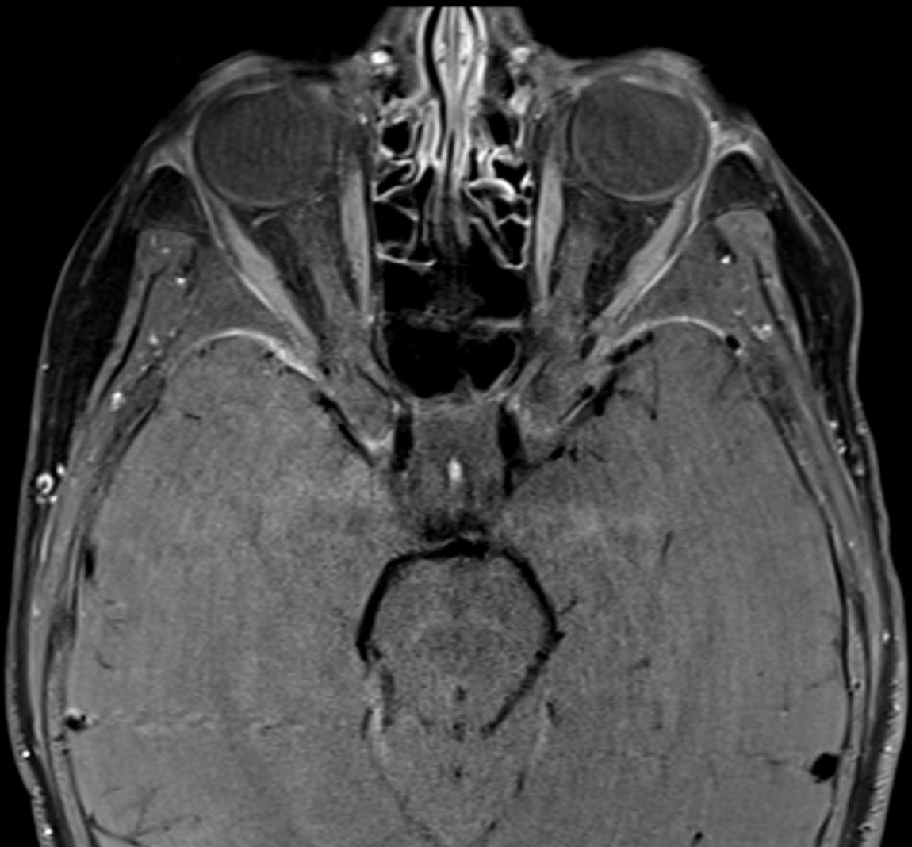
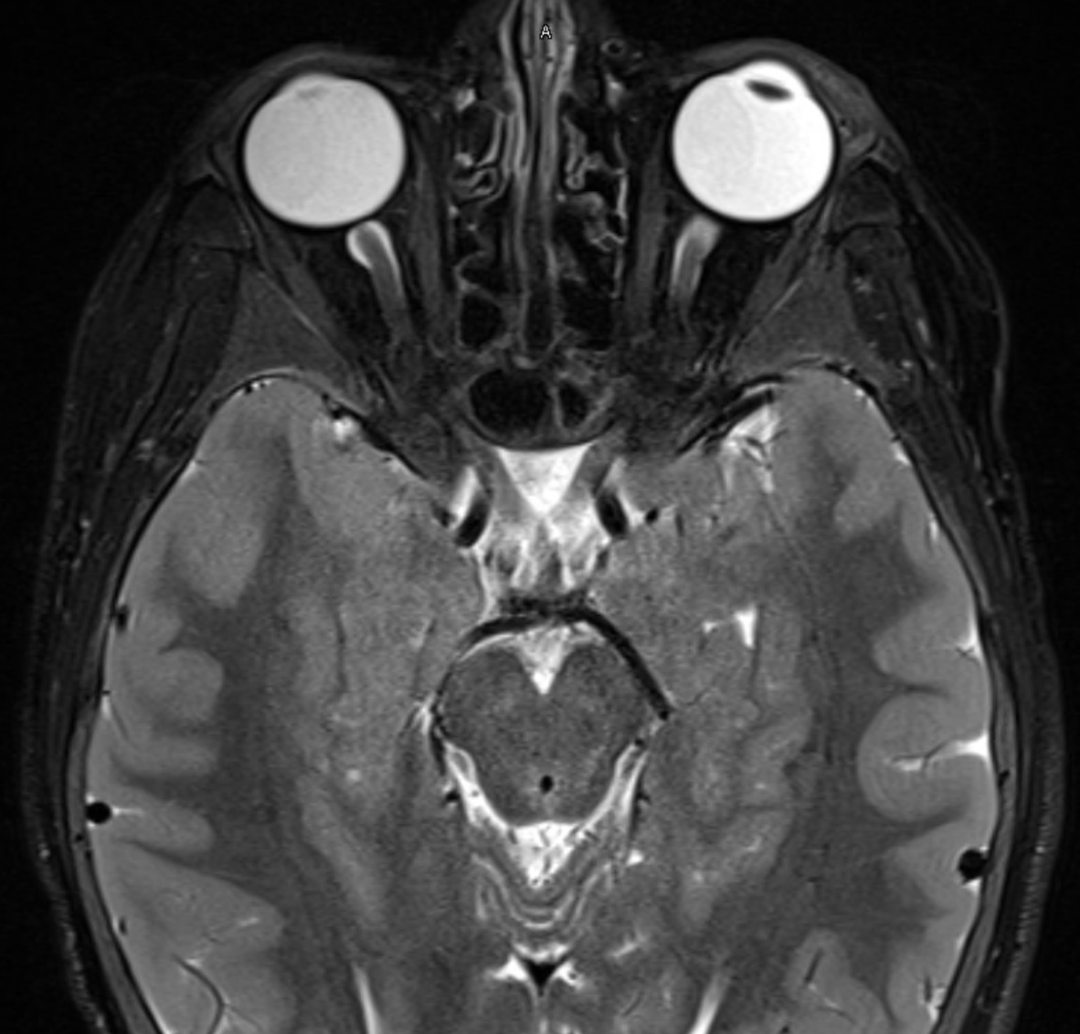
MRI brain and orbits with gadolinium
T1+G (FS)
T2 (FS)
Impression:
No signs of optic neuritis or orbital masses. Tiny foci of periventricular gray matter heterotopia. Diffuse thickening of calvarium and retained fatty signal, may represent increased hematopoiesis (such as anemia).

Slide 7
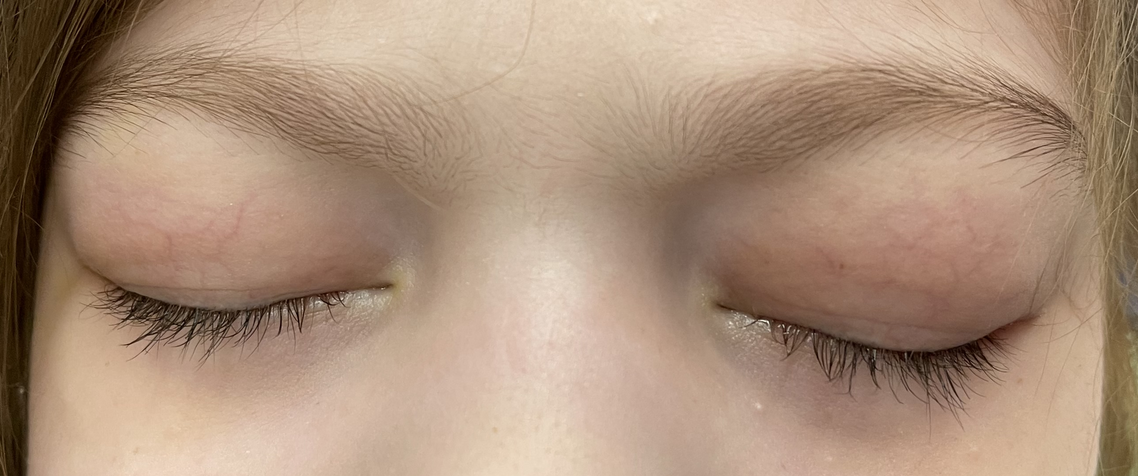
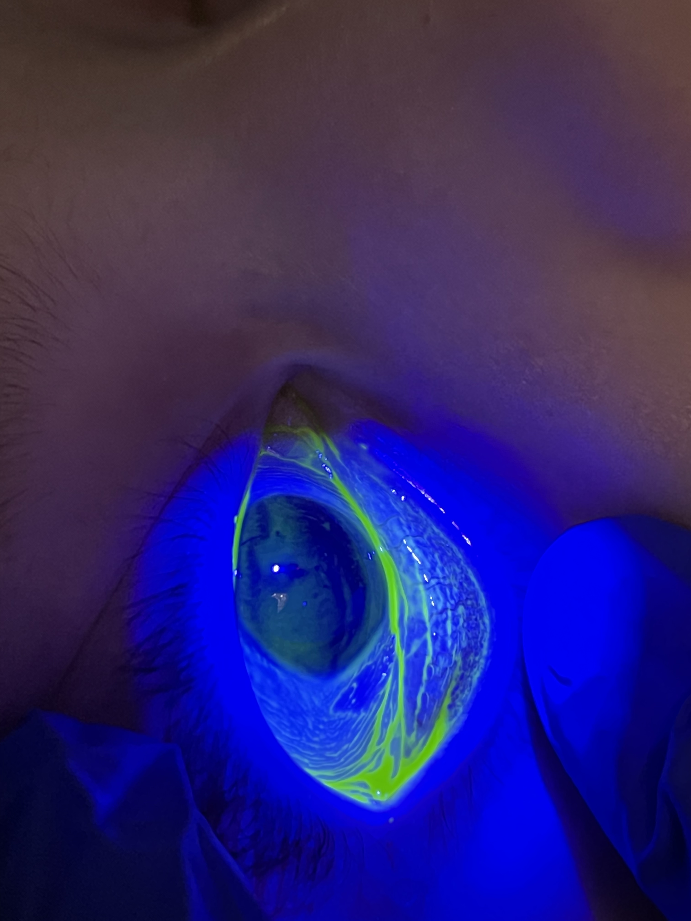
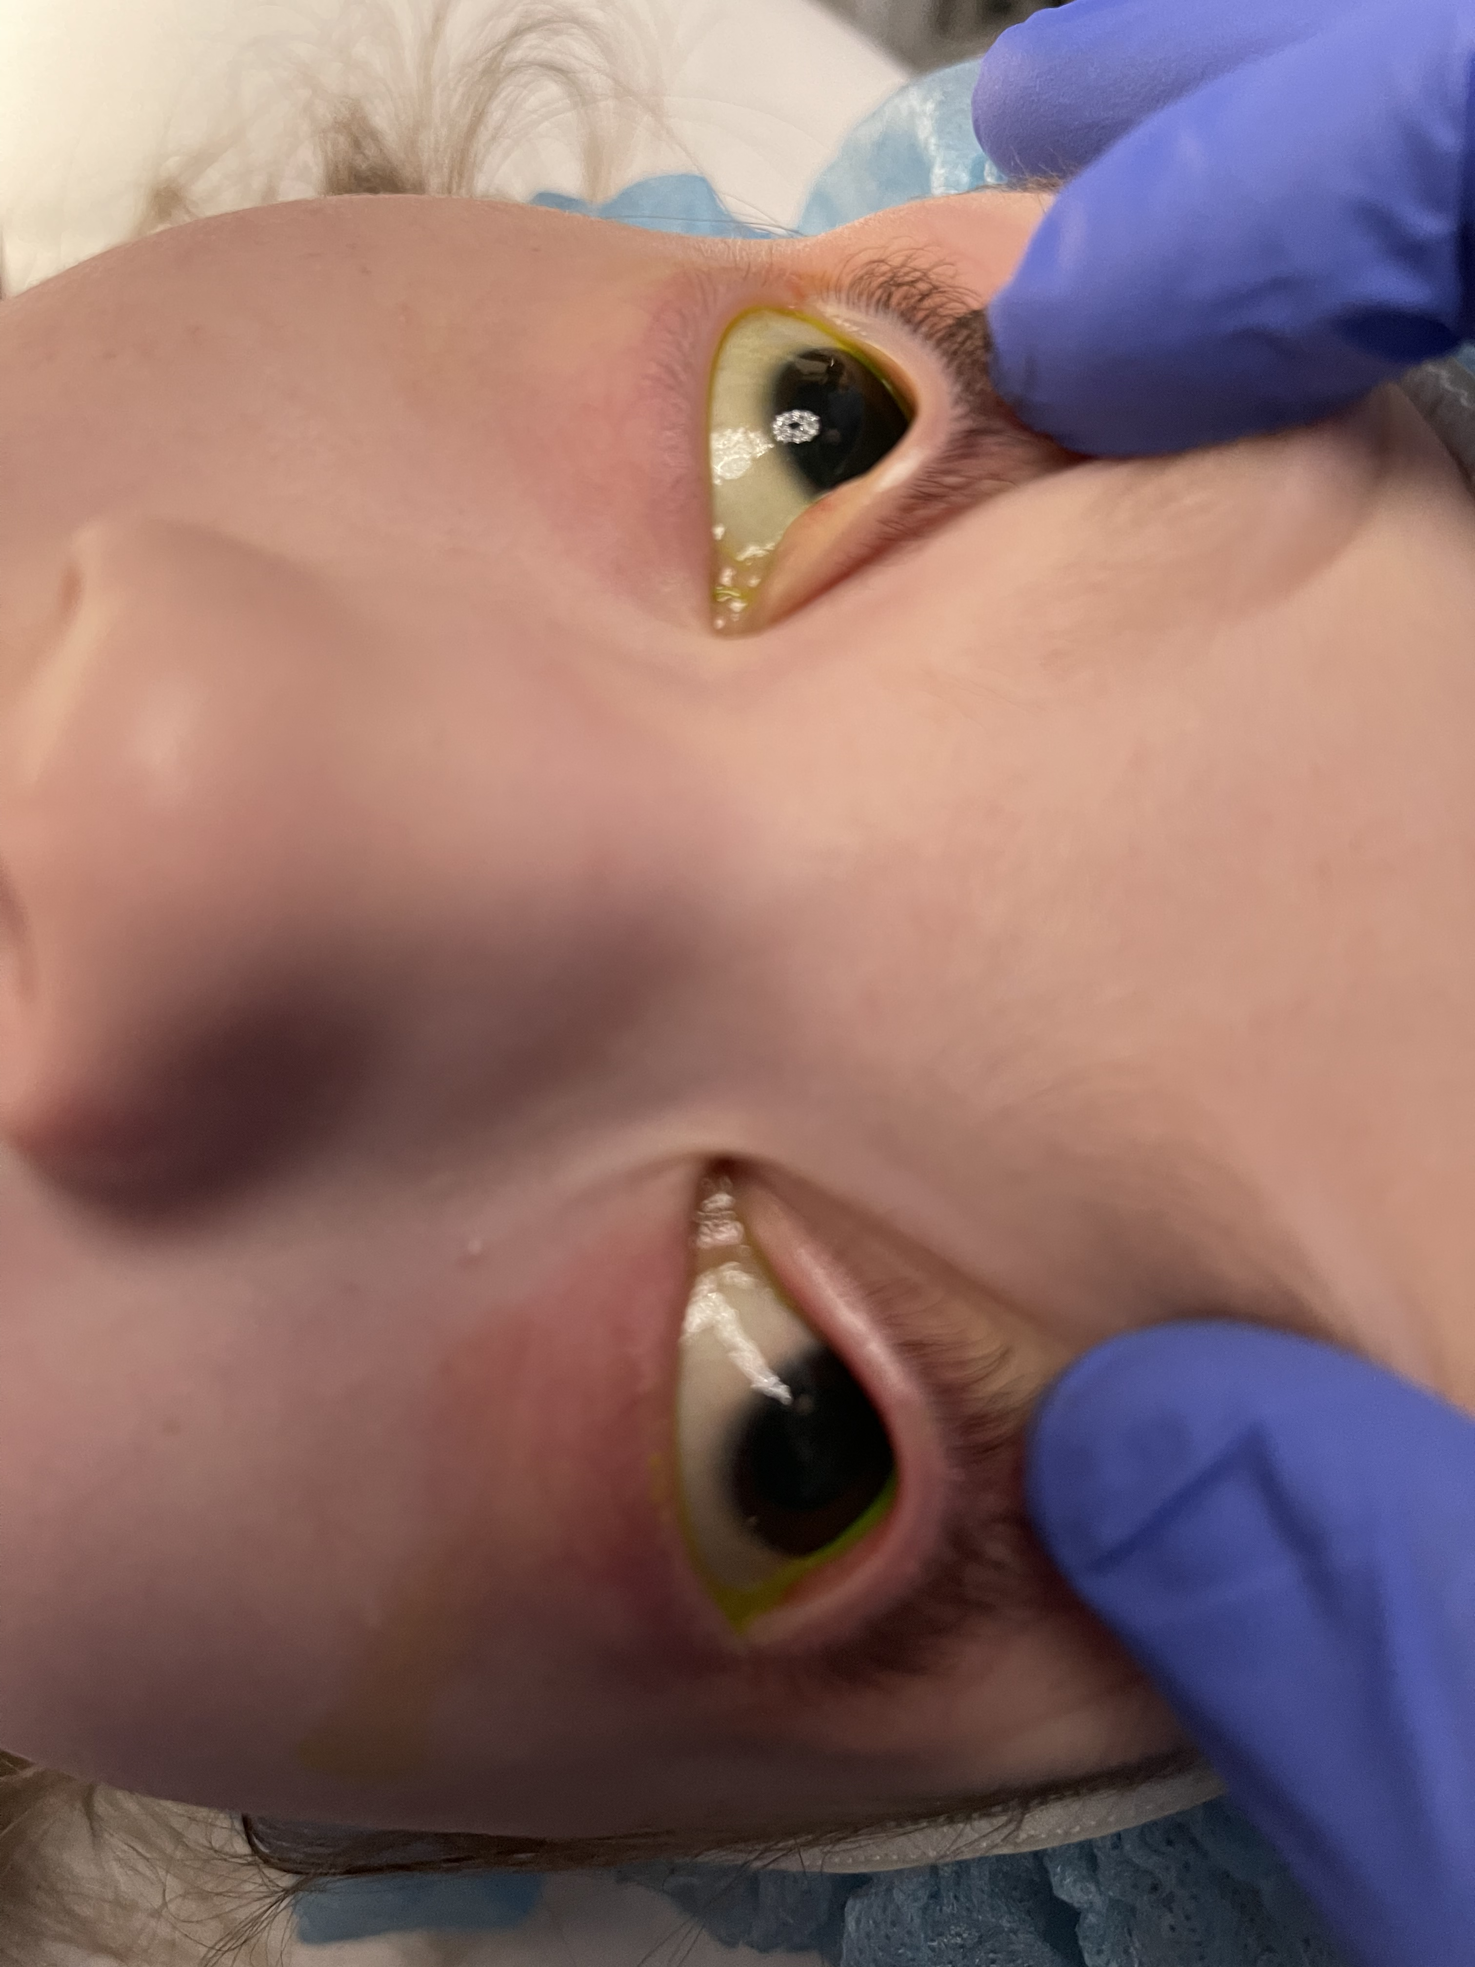
Examination under anesthesia
Findings in each eye: conjunctival wrinkling and inferotemporal patch of rough, keratinized conjunctiva with negative fluorescein staining (right)

Slide 8
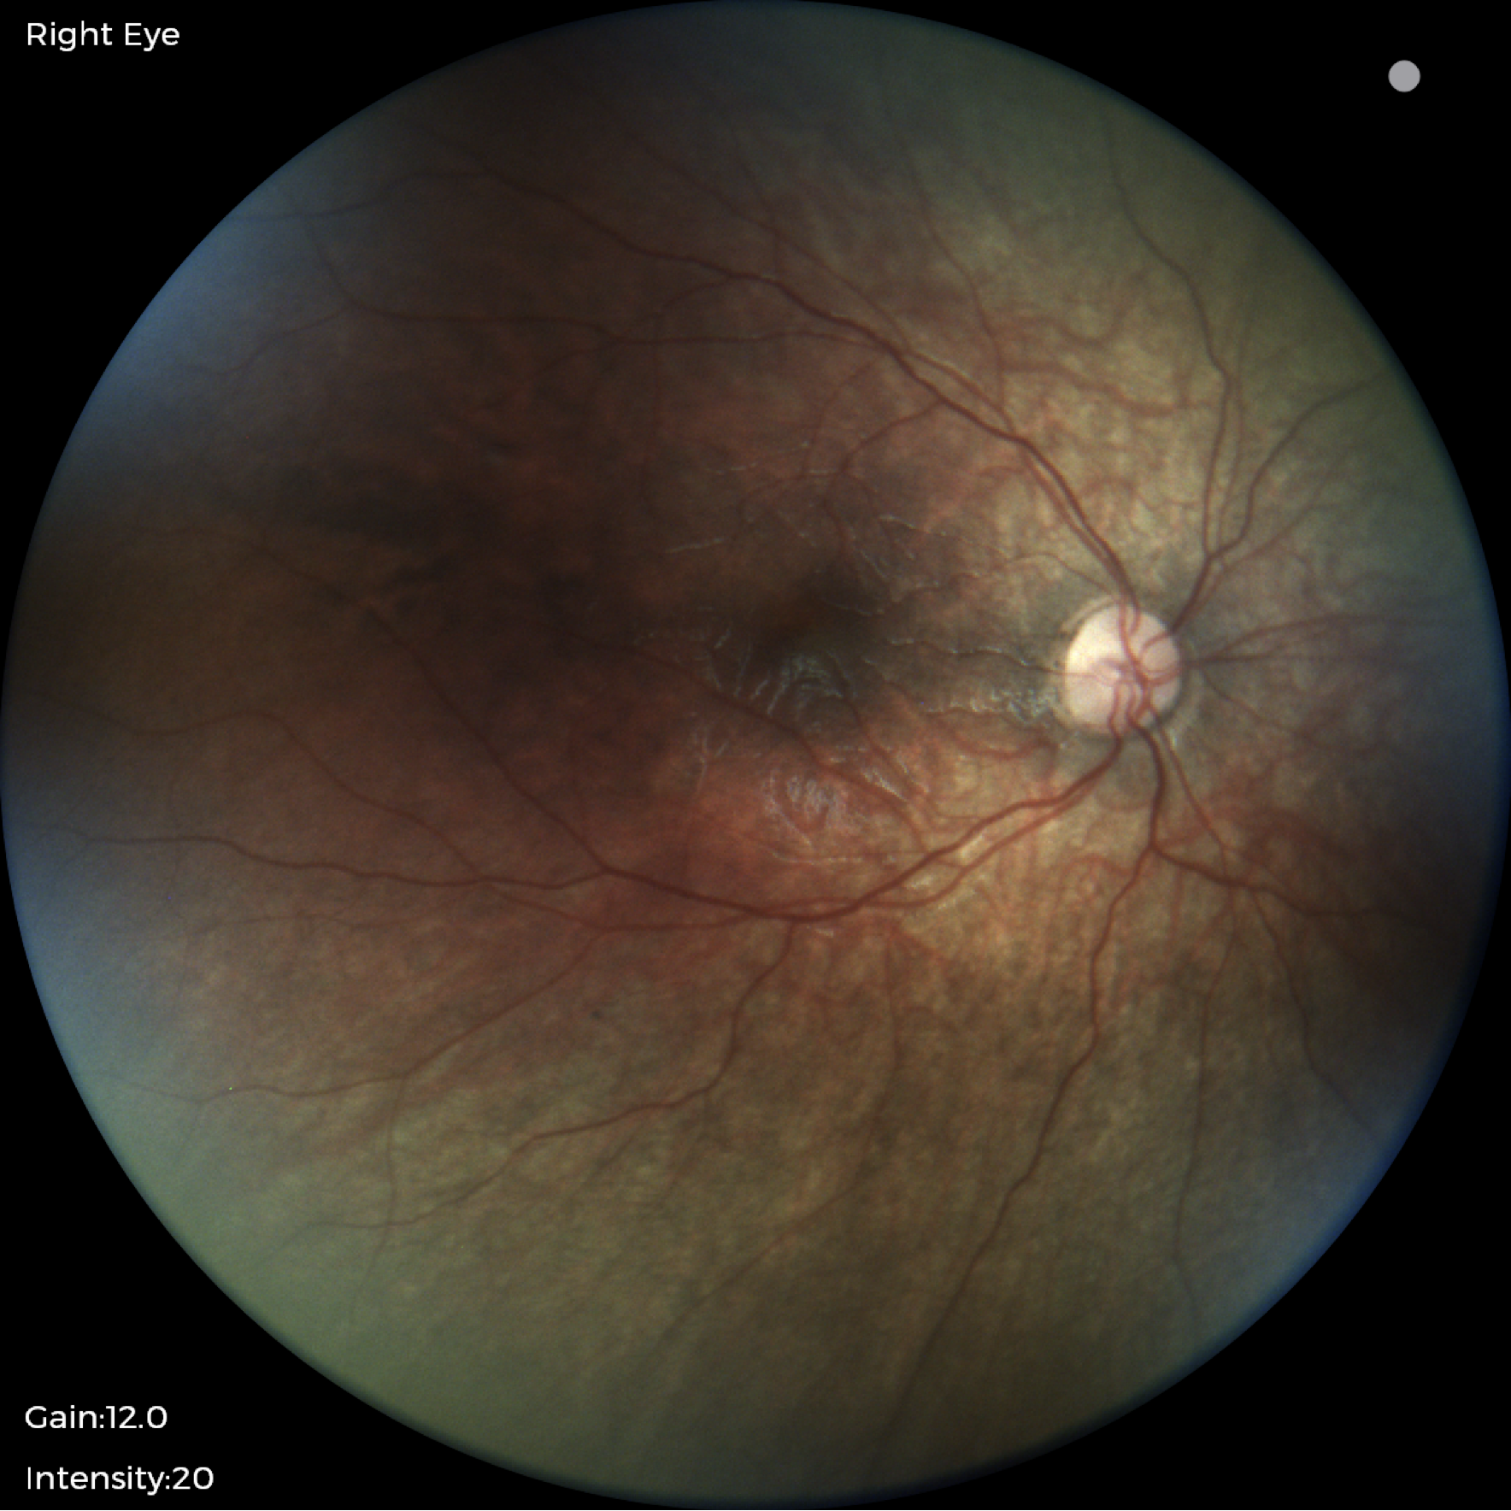
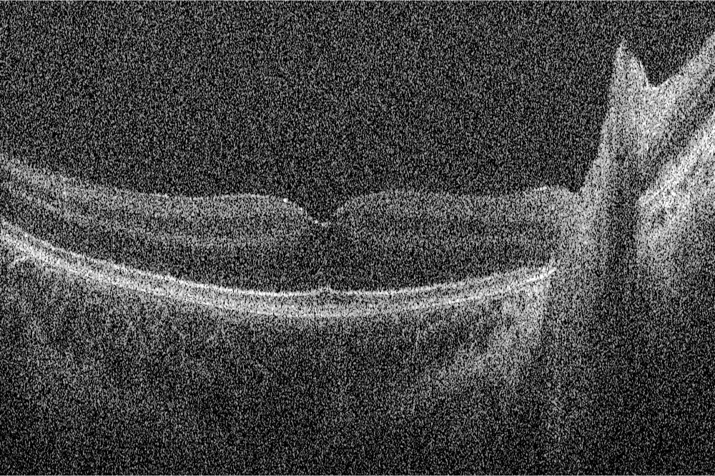
Examination under anesthesia
Fundus exam: temporal disc pallor, attenuated vasculature and salt and pepper retinopathy
OCT: intact macular architecture
What additional testing would help narrow the differential?

Slide 9
Examination under anesthesia
Assessment:
  Nutritional deficiency was suspected as a unifying diagnosis
Intraoperative plan:
  Obtain nutritional labs
Immediately following the EUA:
  Further history from parents: very picky eating for 1+ years; diet exclusively consists of chicken nuggets, cheerios, French fries.
  Malabsorption-focused history, including any prior bariatric surgery, and review of systems were negative

Slide 10
Laboratory evaluation
  CBC:
  WBC 7.4
  Plt 356
  Hgb 11.3
  Hct 33.0 (L)
  MCV 82.9
  RCDW 14.2 (H)
  Negative/normal:
  ANA
  ESR/CRP
  anti-Ro, anti-LA,
  NMO Ab, MOG Ab
Nutritional labs:
Vitamin A <10 mcg/dL [20-80]
Vitamin B12 <150 pg/mL [190-778]
MMA 1.4 mcmol [0.0-0.8]
Vitamin B1 85 nmol/L [70-180]
Vitamin B6 53.9 nmol/L [20.0-150.0]
Folate 9.3 ng/mL [4.2-20.0]
Vitamin C <5 umol/L [23-114]
Vitamin D 10.8 ng/mL [30.0-80.0]
Vitamin E 7.8 mg/L [5.0-23.0]
Copper 101 mcg/dL [86-150]
Zinc 70 mcg/dL [60-120]
Iron 55 mcg/dL [50-120]
TIBC 461 mcg/dL [250-420]
Transferrin 12 % [15-50]
What types of anemia does the patient have as evidenced by the differential blood count and how is this explained by the nutritional labs?

Slide 11
Final Diagnosis
Xerosis, Bitot’s spots, and bilateral optic neuropathy secondary to severe deficiencies of vitamins A and B12

Slide 12
Clinical Course
Nutrition and GI consults
  Direct admission for IV/IM supplementation
  Vit A 100kU IM x3, Vit B12 1000mcg IM x1
  Continued outpatient:
    10-day course of 15kU Vit A IM qD
    4-week course of 1000mcg Vit B12 IM qWeekly
The patient continues to follow with Nutrition/GI:
  Improving diet, incorporating new food including fruits/vegetables
  Normalization of Vit A and B12 levels, arguing against contribution by a malabsorptive mechanism.

Slide 13
Clinical Course
Neuro-ophthalmic follow up 2 months later:
  Resolved eye swelling and blinking
  Improved gait
  Now able to differentiate colors
  Now using her vision more, but holding objects closely to her face
  Developed a left eye fixation preference
  Able to reach for the stripes on Teller card (20/2700; 0.22 cy/deg)
  XT unchanged
  +rAPD, but now the right pupil is reactive to light
  Fundus exam stable
Assessment:
Functional visual improvement with nutrition repletion of VitA and B12 (among others)

Slide 14
Vitamin A Deficiency
Most common symptoms of Vit A deficiency are
  Nyctalopia (night blindness)
  Conjunctival wrinkling
  Bitot spot
  Conjunctival and corneal xerosis (dryness)
  Photophobia
  Posterior segment changes (granular pigmentary changes and multiple punctate dots) and optic atrophy are uncommon
Cases of autistic children with restrictive diets have been reported.
Cheah J, Muhammed J, Tharmathurai S, et al. Optic Neuropathy in an Autistic Child With Vitamin A Deficiency: A Case Report and Literature Review. Cureus. 2022; 14(2): e22074.
Venkataswamy G: Ocular manifestations of vitamin A deficiency. Br J Ophthalmol. 1967, 51:854-9.

Slide 15
Vitamin B12 Deficiency
Due to demyelination of the papillomacular bundle
  Higher risk in patients who lack animal-based products (meat and dairy), individuals with pernicious anemia, or status post surgery involving the ileum
Presents with hematologic abnormalities (macrocytic anemia) and neurologic abnormalities (subacute degeneration, peripheral neuropathies, neuropsychiatric syndromes)
Ophthalmic symptoms include subacute painless, bilateral vision loss with decreased color vision and ceco-central scotomas
Pineles SL, Avery RA, Liu GT. Vitamin B12 optic neuropathy in autism. Pediatrics. 2010; 126(4):e967-e970.
Ata F, Bint I Bilal A, Javed S, et al. Optic neuropathy as a presenting feature of vitamin B-12 deficiency: A systematic review of literature and a case report. Ann Med Surg (Lond). 2020;60:316-322. doi:10.1016/j.amsu.2020.11.010

Slide 16
Summary
In patients with neurodevelopmental disorders, it is important to obtain a complete exam, including a timely exam under anesthesia if necessary, to reach a timely definitive diagnosis.
Workup of dry eye and optic neuropathy in developed regions should include nutritional causes, especially in the setting of autism spectrum disorder.
Multidisciplinary care is needed to treat severe nutritional deficiency with systemic, functional manifestations. Parenteral nutritional repletion is necessary.

