Slide 1


“Blurred Disc Margins”
John O.T. Britton^{1,2}, Patrick Yu-Wai-Man^{1,2,3}, Benson S. Chen^{1,2}
¹University of Cambridge, United Kingdom
²Cambridge University Hospitals NHS Foundation Trust, United Kingdom
³Moorfields Eye Hospital NHS Foundation Trust, United Kingdom

Slide 2
Presentation
15-year-old female was referred to the neuro-ophthalmology clinic by an outside eye care provider.
The patient was referred for “bilateral blurred disc margins” and an associated headache.

Slide 3
Past Medical History
Multiple intracranial aneurysms
  Right supraclinoid, left ICA, bilateral PCA
Raised BMI
Autistic spectrum disorder
Mixed anxiety/depression
Hypermobility
Genetic testing ongoing at present

Slide 4
Genetic testing
Prior analysis did not detect pathogenic variants of genes associated with connective tissue disorders (including Ehlers-Danlos syndrome) and familial thoracic aortic aneurysms.
Genetic testing for trio whole-genome sequencing is currently in process – including congenital malformation panel, primary immunodeficiency panel and thoracic aneurysm and dissection panel.

Slide 5
Seen by Outside Eye Care Provider
Non-specific headache associated with left-sided puffy eyelid.
Eyelid documented as showing moderate swelling of the soft periorbital tissue, mainly affecting the lower eyelid – no known precipitants.
The patient reported this was associated with ipsilateral blurred vision, flashes and floaters.
No migrainous features.
Assessed to have excellent visual acuity and color vision bilaterally.
Full eye movements; no squint; normal pupillary reflexes.

Slide 6
Seen by Outside Eye Care Provider
Fundus exam showed “mild blurred disc margin with sparing of the temporal margin” bilaterally.
OCT showed “increased RNFL thickness”.
Referred to neuro-ophthalmology clinic due to the above.
Lumbar puncture requested by outside provider.
Neuro-imaging not requested.

Slide 7
What are the Differential Diagnoses of Bilateral Blurred Disc Margins in a Young Person?
Papilledema
Bilateral optic neuritis (especially MOGAD)
Anomalous optic discs
Optic disc drusen
Methanol toxicity
Syphilis
Lyme disease
More unusual:
  LHON with a short inter-eye interval
  Bilateral anterior ischemic optic neuropathy

Slide 8
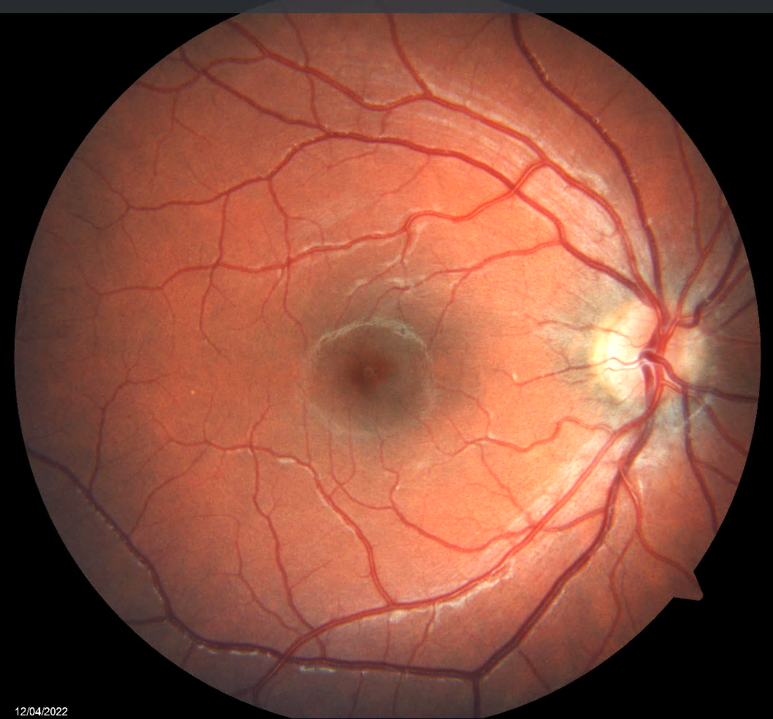
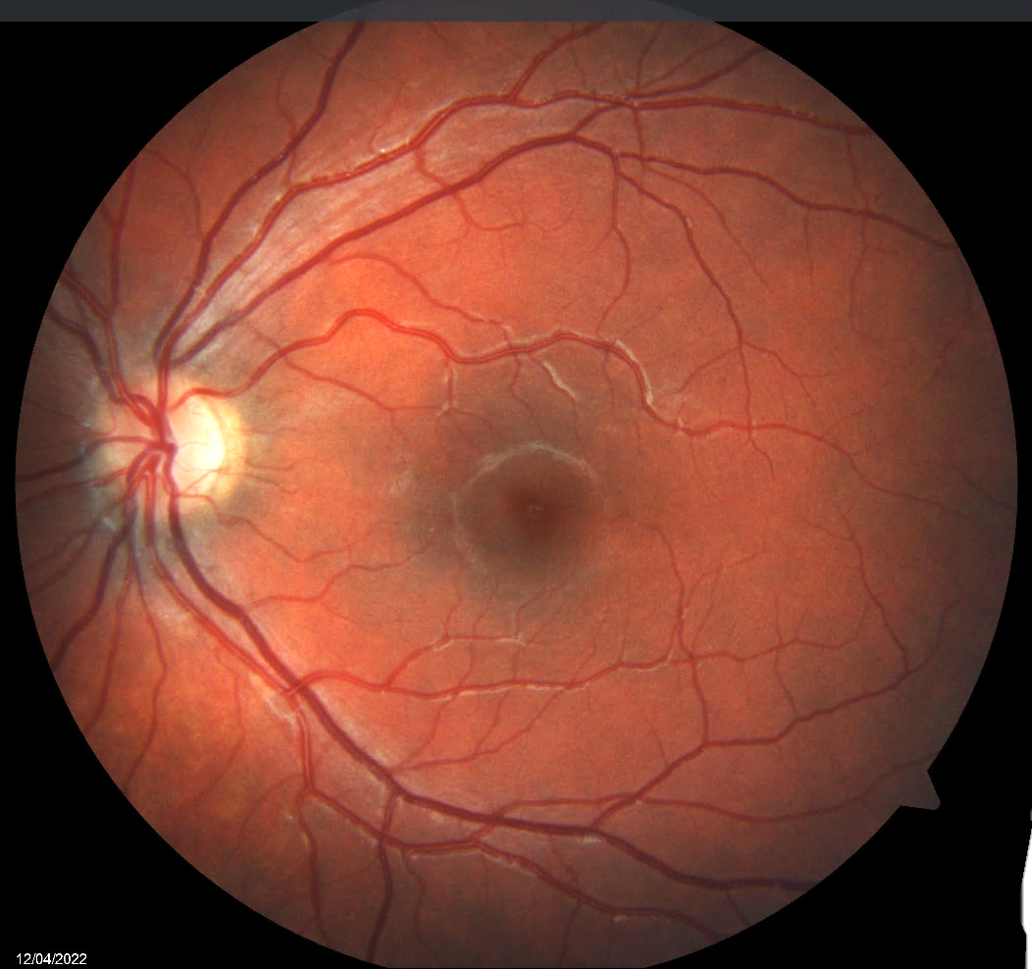

Slide 9
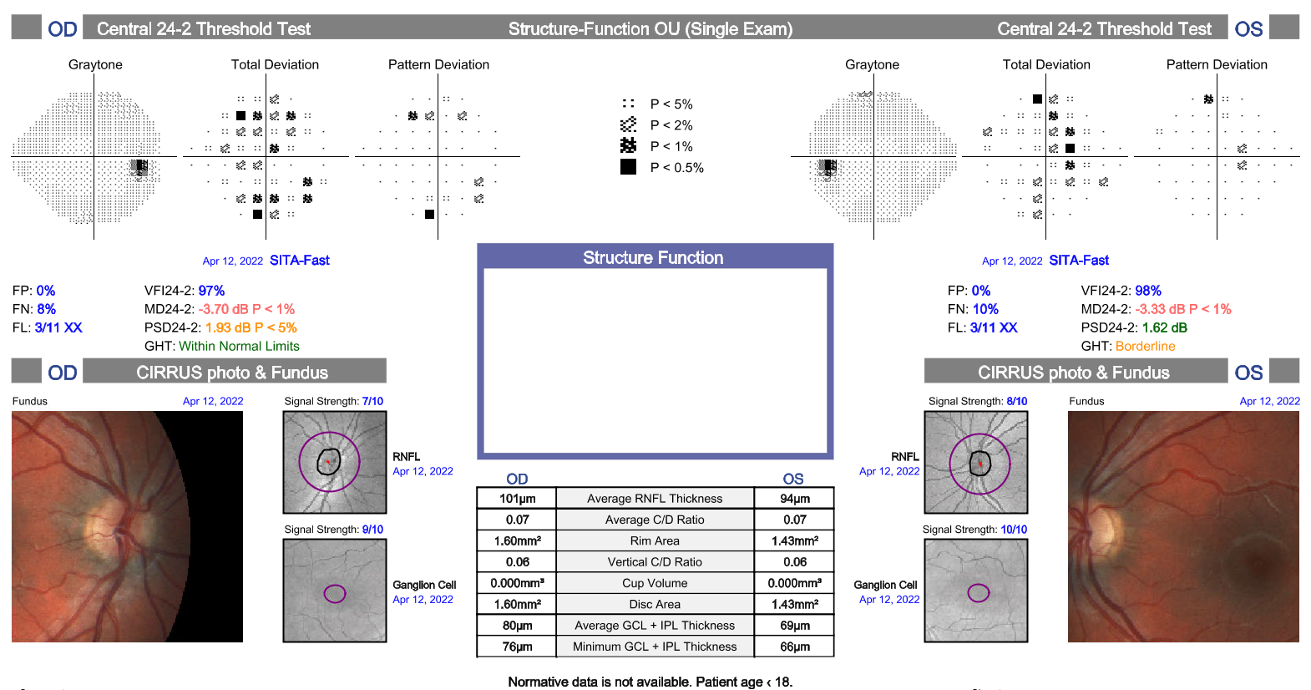
Average pRNFL:
OD – 101 microns
OS – 94 microns
Average macular GC-IPL:
OD – 80 microns
OS – 69 microns
Visual Fields OD:
Fair reliability
Points of depression located in superior and inferior rim
Visual Fields OS:
Fair reliability
Points of depression centrally

Slide 10
Patient was Subsequently Reviewed in Neuro-Ophthalmology Clinic: 4 weeks later
Headache and puffy eyelid had self-resolved without intervention or treatment.
Reported no ongoing vision problems.
Base Eye Exam
BCVA: Right 20/15; Left 20/15
Colour Vision (Ishihara Plates): 15/15 bilaterally, no red desaturation
Pupils: normal pupil examination, including no APDs
Eye movements: full, no associated pain or double vision
Anterior segment: normal bilaterally
IOP not checked – patient unwilling

Slide 11
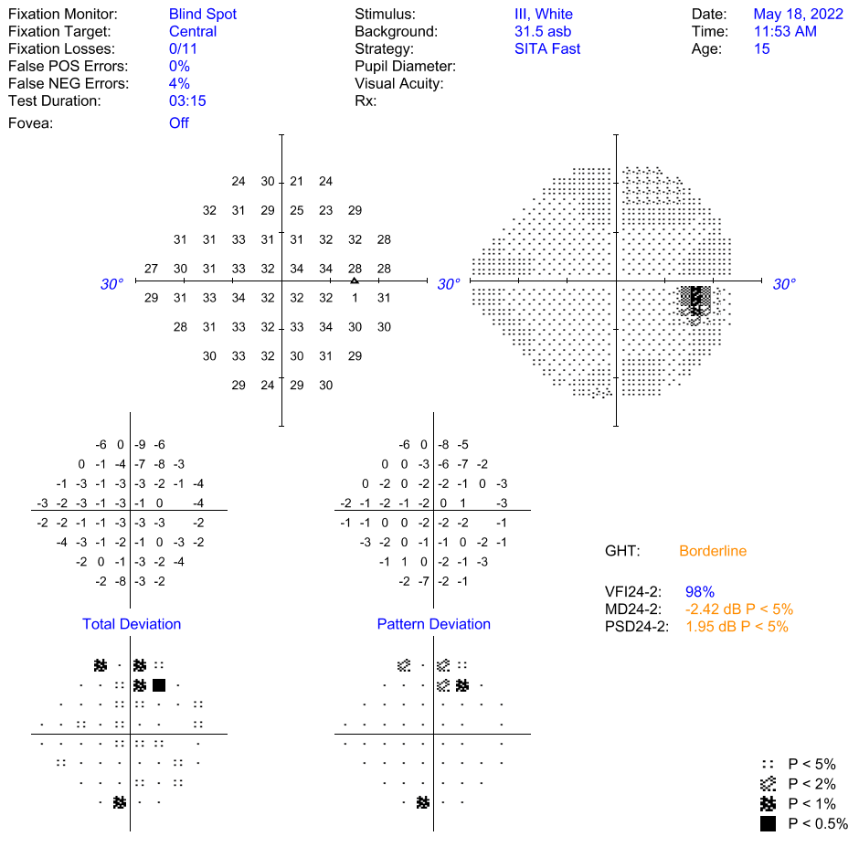
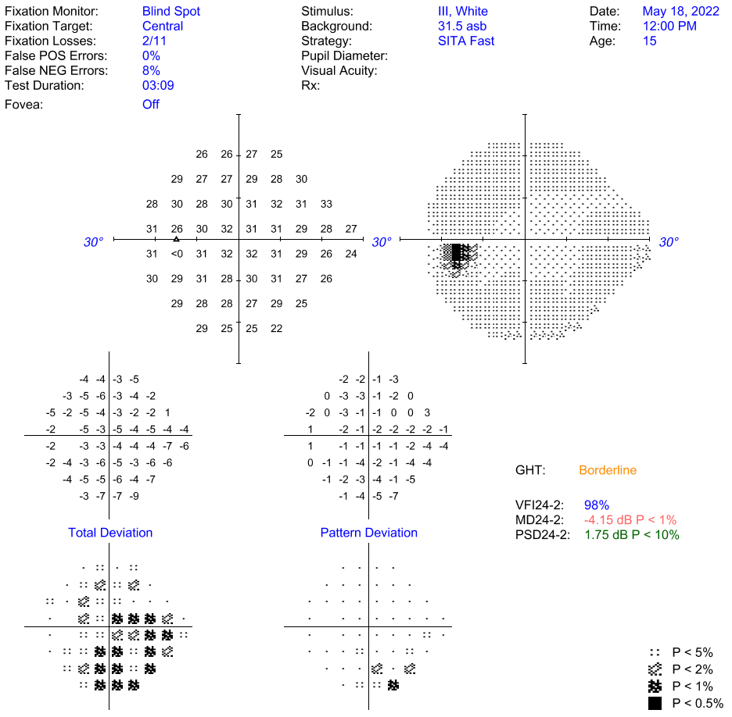
Visual Fields OS:
Good reliability
Scotomatous defect worse inferonasally

Slide 12
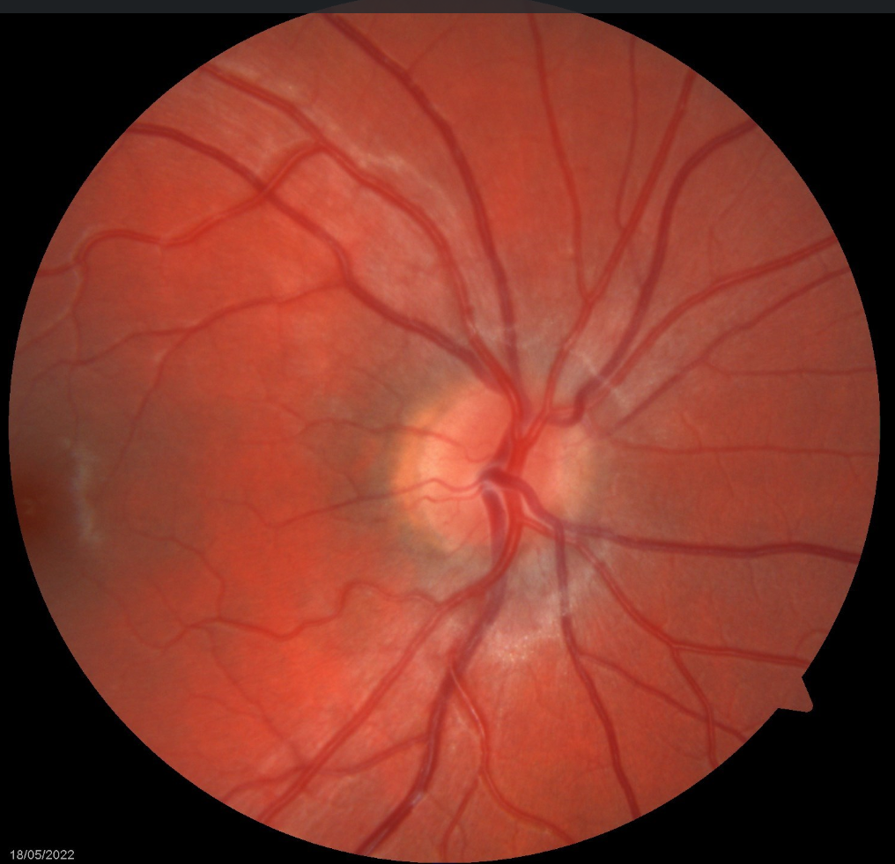
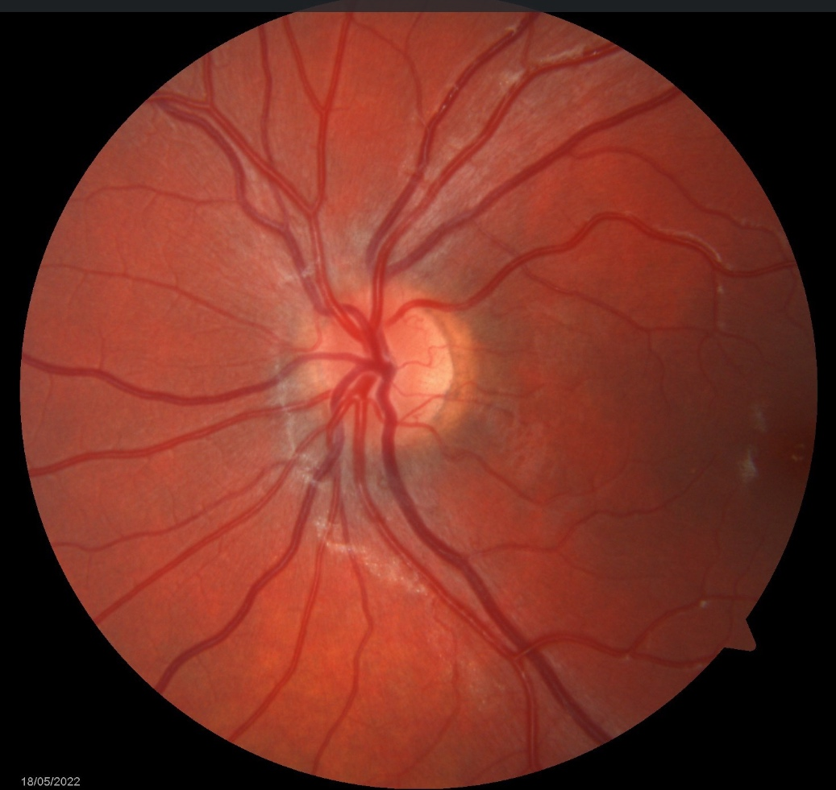

Slide 13
Does the patient have swollen optic nerves?
What is the abnormality on ophthalmic imaging?

Slide 14
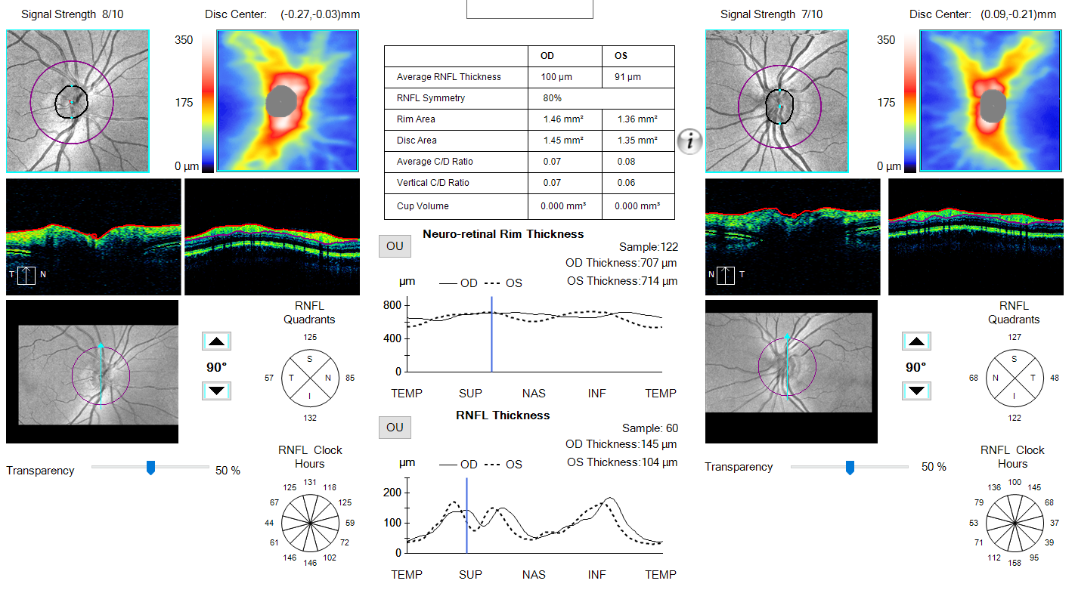
OCT analysis of the RNFL shows thinning of the left temporal and inferior quadrants

Slide 15
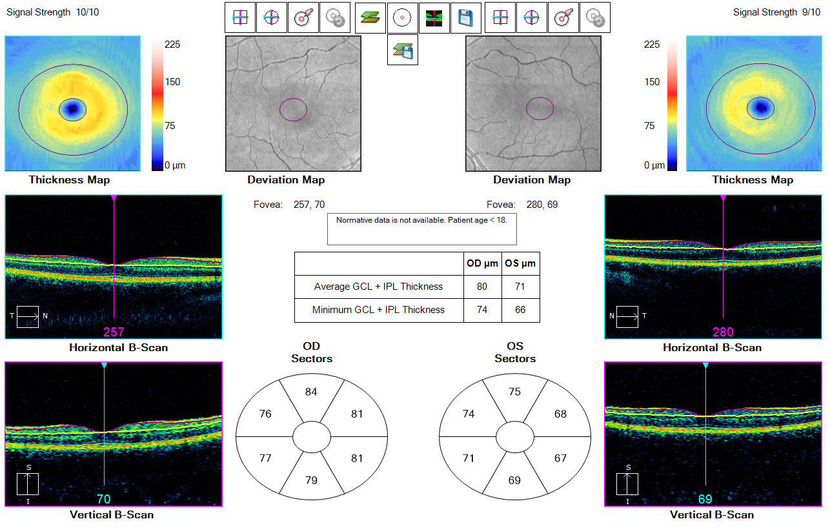
OCT acquired GC-IPL thickness measurements corroborate with RNFL imaging – apparent thinning on the left side

Slide 16
Beware Automated OCT Analysis
OCT reports grade thickness measurements based on normative data for the adult population.
OCT reports do not consider normative data for pediatric patients.
Kneejerk reaction: white = thickened!
However, there is an apparent asymmetry of RNFL and GC-IPL with thinning of left sided RNFL + GC-IPL.
This asymmetry is more than would be expected for physiological inter-eye difference.
Findings suggest a left optic neuropathy.

Slide 17
What is the Cause of Left Optic Neuropathy in this Patient?
Past Medical History:
  Multiple intracranial aneurysms
    Right supraclinoid, left ICA, bilateral PCA
  Raised BMI
  Autistic spectrum disorder
  Mixed anxiety/depression
  Hypermobility
  Genetic testing ongoing at present

Slide 18
Further Background
Left ICA blow-out aneurysm extending into left orbit:
  September 2019:
  - Presented with headaches after falling from a horse
  - MRA found ICA aneurysm associated with mild compressive left optic neuropathy
  - Stented and coiled
  May 2020:
  - Giant cortico-ophthalmic aneurysm treated with stent and partial coiling but unsuccessful
  - Second stage treatment – placement of second braided stent
  June 2021:
  - Insertion of flow diverter, successful with no further compression of the left optic nerve

Slide 19
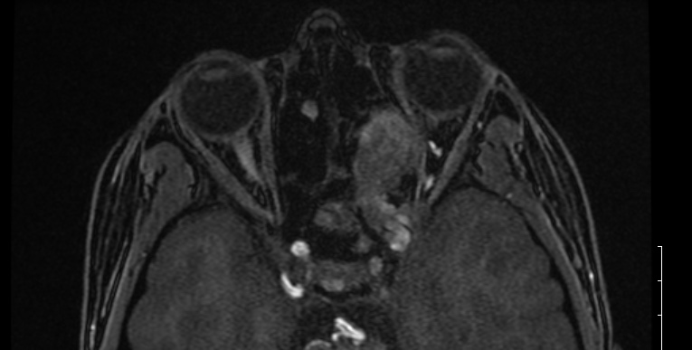
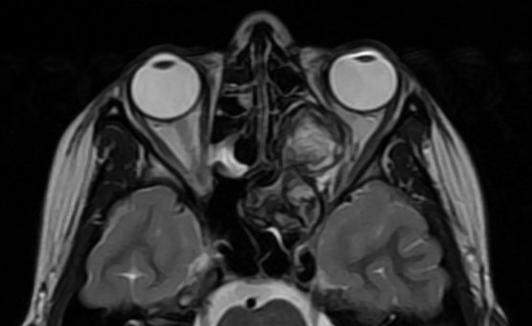

Slide 20
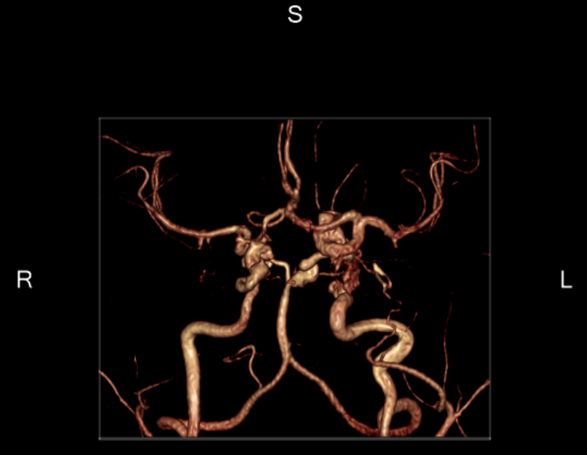

Slide 21
Ultimate diagnosis
Unilateral compressive optic neuropathy.
  Aneurysmal etiology
Manifesting with asymmetrical OCT measurements.
  Mild RNFL and GC-IPL loss in the left eye.
Left visual field mildly impaired but otherwise excellent visual acuity and color vision.
No evidence of ongoing compression on MRI.

Slide 22
Summary of patient journey
September 2019:
Left ICA aneurysm diagnosed
Stented
June 2021:
Successful placement of flow-diverting stent
May 2020:
Second stent inserted
April 2022:
Seen by outside eye care provider
May 2022:
Seen by neuro-ophthalmology

Slide 23
Compressive Optic Neuropathies
Compromised optic nerve due to a lesion, either within the orbit or along the nerve’s intracranial course¹.
Presentation depends on the type and location of the lesion:
  Visual field defect
  Optic disc pallor and edema
  Eye movements not usually accompanied by pain
  Proptosis and diplopia
  Associated headache
In chronic cases, OCT will show optic atrophy affecting both the RNFL and GC-IPL complex².

Slide 24
Compressive Optic Neuropathies
Wide variety of causes include:
  Infectious eg aspergilloma
  Neoplastic eg meningioma, hemangioma, pituitary tumor
  Vascular eg aneurysm
  Traumatic eg orbital hemorrhage
Diagnosis is based on presentation and imaging.

Slide 25
Aneurysmal Compressive Optic Neuropathies
Intracranial aneurysms most commonly occur at arterial branching points, with the majority located in the anterior circulation³.
Visual field defects and an accompanying compressive optic neuropathy may be the first sign of an aneurysm⁴.
Vision loss progresses slowly, and patients may be unaware of symptoms until the late stages of disease.
The goal of surgical management is to reduce the risk of rupture, and reduce the mass effect of the aneurysm.

Slide 26
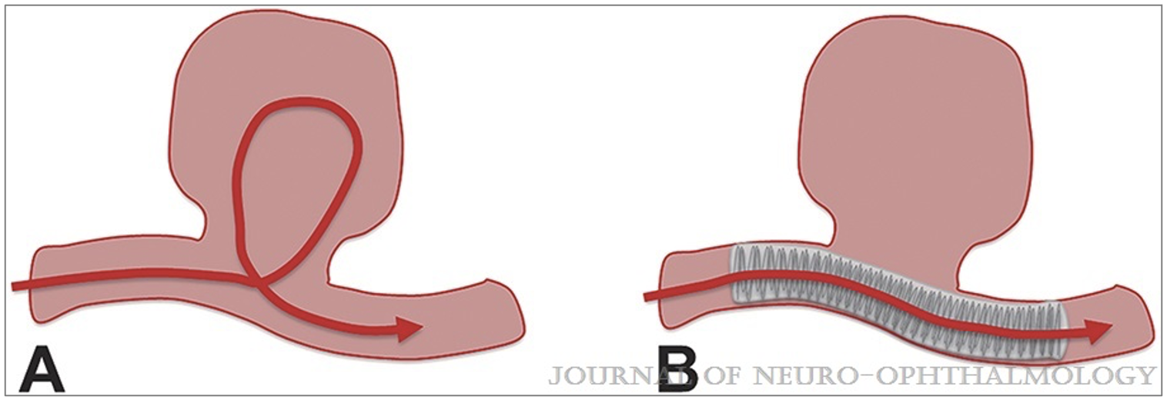
Established Surgical Management
Clipping
  Applying a small clip across the neck of an aneurysm during an open craniotomy.
Endovascular coiling
  The aneurysm is filled with coils, which encourage formation of a clot and lead to occlusion of the aneurysm.
Flow diverter
  Endoluminal implants redirect the flow past the aneurysm and into the normal distal artery.
Micieli, Jonathan A. MD; Newman, Nancy J. MD; Barrow, Daniel L. MD; Biousse, Valérie MD Intracranial Aneurysms of Neuro-Ophthalmologic Relevance, Journal of Neuro-Ophthalmology: December 2017 - Volume 37 - Issue 4 - p 421-439 doi: 10.1097/WNO.0000000000000515

Slide 27
In Summary
A 15-year-old female referred to neuro-ophthalmology with “bilateral blurred disc margins”.
Background of a compressive ICA aneurysm, which had shown interval size reduction with neurosurgical intervention.
The patient demonstrated clinical and radiological signs of a unilateral compressive optic neuropathy.

Slide 28
Take-Home Messages
Beware OCT software, which does not utilize normative data for pediatric patients.
Remember to consider macular GC-IPL measurements in addition to RNFL to show optic neuropathy.
History taking and review of previous imaging is vital – in this case confirming that the patient has a compressive left optic neuropathy, with improvement following insertion of a flow diverter.
Fortunately for the patient, the above considerations meant a lumbar puncture was not indicated to work-up for IIH.

Slide 29
References
Rodriguez-Beato FY, De Jesus O. Compressive Optic Neuropathy. 2021 Aug 30. In: StatPearls [Internet]. Treasure Island (FL): StatPearls Publishing; 2022 Jan. PMID: 32809418
Biousse, V. and Newman, N., 2019. Neuro-ophthalmology illustrated. 3rd ed. Thieme Medical Publishers, pp.217-228.
Schievink WI. Intracranial aneurysms. N Engl J Med. 1997 Jan 2;336(1):28-40. doi: 10.1056/NEJM199701023360106. Erratum in: N Engl J Med 1997 Apr 24;336(17):1267. PMID: 8970938.
Micieli JA, Newman NJ, Barrow DL, Biousse V. Intracranial Aneurysms of Neuro-Ophthalmologic Relevance. J Neuroophthalmol. 2017 Dec;37(4):421-439. doi: 10.1097/WNO.0000000000000515. PMID: 28665866.

