Slide 1

Headache, Confusion, and Hearing Loss
Abigail Jebaraj MD, Sam Wilkinson MD, Jacob Nydegger, and Meagan Seay DO
John A. Moran Eye Center, University of Utah Department of Ophthalmology, Salt Lake City, UT

Slide 2
43-year-old woman presents with headache, confusion, and hearing loss
Six weeks of nausea, vomiting, headaches, and episodic confusion
Two weeks of hearing loss with whooshing tinnitus in the left ear
Audiometry performed prior to presentation with decreased hearing in left compared to right, but limited testing due to mental status

Slide 3
Prior History
Past medical history: depression and migraine with vertigo and visual aura that has been well-managed with rizatriptan for years
Past surgical history: remote spine and hip surgeries
Social and family histories: non-contributory

Slide 4
Neurologic Exam
Afebrile and hemodynamically stable
Oriented to person and place only
Cranial nerve function was intact other than decreased hearing left > right
Neurologic examination revealed hyperreflexia of the left upper and lower extremities, normal strength, normal sensation, normal coordination testing
What workup do you want to obtain?

Slide 5
Laboratory Workup
Elevated C-Reactive Protein (CRP) of 4.7 mg/dL and erythrocyte sedimentation rate (ESR) of 32 mm/hr
CBC without leukocytosis, CMP overall within normal range
Negative VZV antibody, Hepatitis C, Cryoglobulin, ANCA, anti-dsDNA, HIV, Smith antibody, SSA, SSB, Scl-70, Jo-1, VDRL, Quantiferon TB Gold Plus, and Hepatitis B

Slide 6
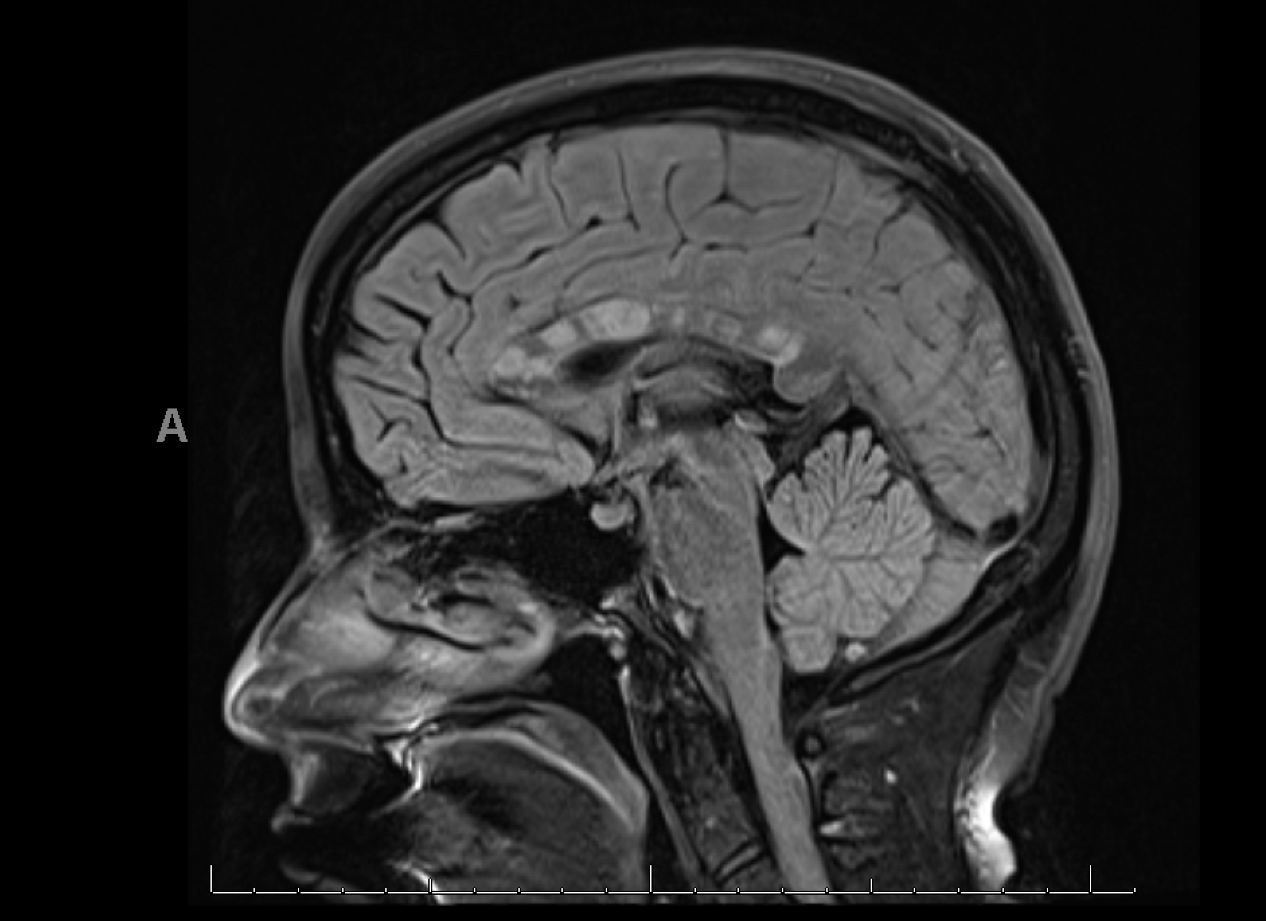
What abnormality do you see on this MRI Brain T2 FLAIR?

Slide 7
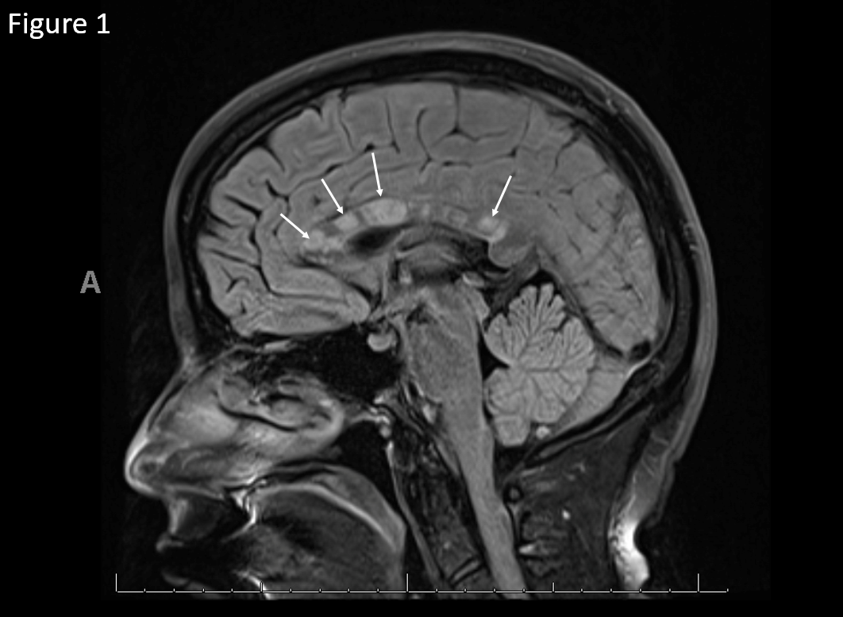
Sagittal T2 FLAIR with hyperintense lesions in the corpus callosum

Slide 8
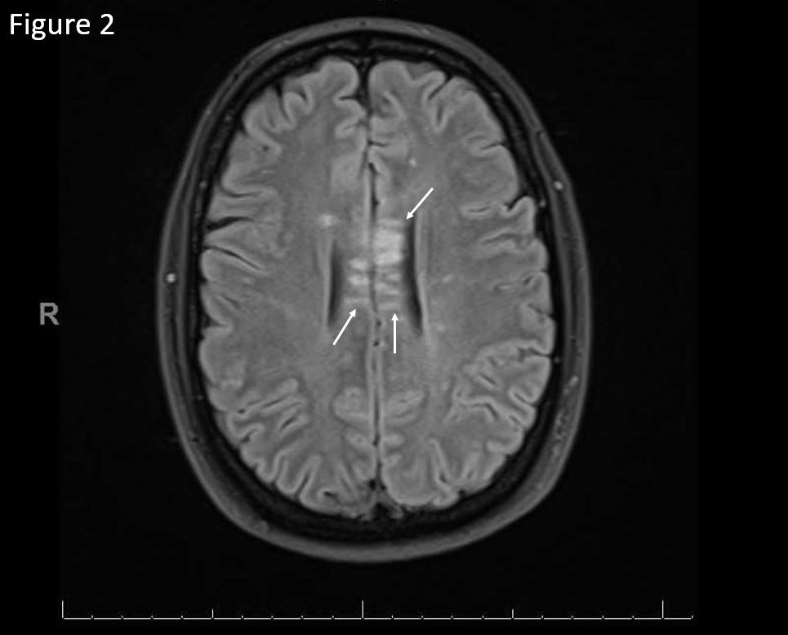
Axial T2 FLAIR with hyperintense lesions in the corpus callosum

Slide 9
Lumbar Puncture
Normal opening pressure
Cerebrospinal fluid (CSF): elevated white blood cells (26 /uL) and elevated protein (295 mg/dL), no oligoclonal bands

Slide 10
Ophthalmology Consultation
Visual acuity: 20/25 right eye and 20/25 left eye
Visual fields full to confrontation bilaterally
Color vision: normal bilaterally by Ishihara color plate testing
No afferent pupillary defect bilaterally
Full extraocular movements bilaterally
Intraocular pressures normal bilaterally
No anterior or posterior inflammatory cell
Dilated fundus examination was unremarkable, however, a peripheral view was difficult due to patient confusion and inability to participate in examination
Is there any further testing you would like to get?

Slide 11
Fluorescein Angiogram
Fluorescein angiography (FA) is used diagnostically to evaluate retinal blood flow and retinal tissue health
Fluorescein dye is injected into a peripheral vein and then timed photos are taken from the time of injection to when the fluorescein has completed flowing through retinal vasculature
It is useful to detect nonperfusion, vessel inflammation, and other retinal abnormalities such as macular degeneration or diabetic retinopathy

Slide 12
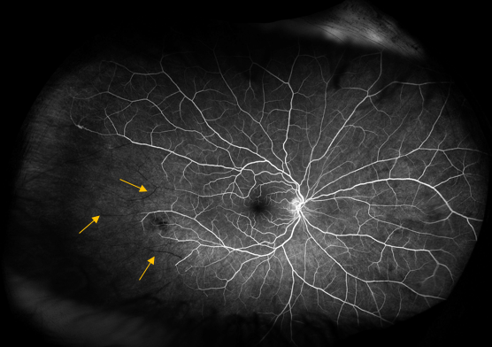
Right Eye: Multiple branch retinal artery occlusions (yellow arrows) at non-branching points characterized by arteriolar vascular filling defects and mild periphlebitis temporally
00:59:542

Slide 13
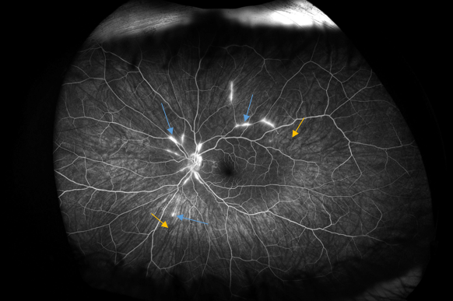
Left Eye: Multiple branch retinal artery occlusions characterized by arteriolar vascular filling defects (yellow arrows) and vessel staining (blue arrows) consistent with segmental arteriolitis of the main arcades
03:24:072

Slide 14
Differential Diagnosis for MRI Findings ¹
Susac Syndrome
Multiple Sclerosis (MS)
Neuromyelitis optica (NMO)
Cerebral Autosomal Dominant Arteriopathy with Sub-cortical Infarcts and Leukoencephalopathy (CADASIL)
Acute disseminated encephalomyelitis (ADEM)
Progressive multifocal leukoencephalopathy (PML)
Marchiafava-Bignami disease
Malignancy
Trauma
Additional consideration: Cogan syndrome

Slide 15
Multiple Sclerosis (MS)²
MS is classically characterized by CNS lesions disseminated in space and time and oligoclonal band positivity in the CSF
Our patient had white matter lesions centrally in the corpus callosum, which is characteristic of Susac Syndrome
She had no white matter lesions elsewhere
She had no oligoclonal bands in the CSF
Retinovascular signs were not consistent with MS

Slide 16
Neuromyelitis optica (NMO)³
NMO is classically associated with optic neuritis and transverse myelitis, testing is often positive for AQP4-IgG
Our patient did not have optic neuritis or spinal cord lesions
NMO is not associated with retinovascular findings as seen in our patient
AQP4-IgG testing deferred due to low clinical suspicion in our patient

Slide 17
Cerebral Autosomal Dominant Arteriopathy with Sub-cortical Infarcts and Leukoencephalopathy (CADASIL)⁴
Characteristics of CADASIL: recurrent TIA/strokes, cognitive decline, migraine with aura, seizures, and mood disturbances
Though not required, our patient had no family history of neurologic disorders or NOTCH3 mutation, which is autosomal dominant
CADASIL tends to cause anterior temporal lobe white matter lesions, which is not seen in this case
Although she had a recent history of cognitive disturbance and migraine with aura, her MRI did not demonstrate strokes
Her retinovascular changes and hearing loss were not consistent with CADASIL

Slide 18
Acute disseminated encephalomyelitis (ADEM)⁵
This CNS immune-mediated demyelination disorder can affect children after vaccination or viral infection, but occurs in adults as well
Can be seen with myelin oligodendrocyte glycoprotein (MOG) associated demyelinating disease
Often presents as acute encephalopathy with multifocal neurologic signs
The hearing loss and retinovascular findings in our patient are not typical of ADEM

Slide 19
Progressive multifocal leukoencephalopathy (PML)⁶
Our patient was not immunocompromised, making this CNS infection with the JC virus (which can be active in immunocompromised individuals) unlikely

Slide 20
Marchiafava-Bignami disease ⁷
Disease characterized by demyelination and necrosis of the corpus callosum
Seen classically in alcohol use disorder with malnutrition
Often with psychiatric disturbances, difficulty ambulating, encephalopathy, and dysarthria
Our patient did not have risk factors for this disease
The hearing loss and retinovascular findings in our patient are not typical of Marchiafava-Bignami disease

Slide 21
Glioma or Lymphoma
Different types, locations and aggressiveness (grade)
Can be diagnosed via imaging and/or biopsy
Our patient’s MRI findings were determined not to be neoplastic given the full clinic picture
Trauma
White matter changes in setting of trauma
Our patient had no history to cause white matter lesions to this extent

Slide 22
Cogan Syndrome ⁸
Rare autoimmune vasculitis with ocular and vestibulo-auditory involvement
Typical:
  interstitial keratitis (not syphilitic) and associated iritis, conjunctivitis or subconjunctival hemorrhage
  Audiovestibular symptoms similar to Meniere’s disease and even deafness
  Association of the above two less than 2 years
Atypical: other type ocular involvement (including retinal artery occlusions), other audiovestibular symptoms, or symptoms more than 2 years apart
Not typically associated with encephalopathy, although it can be
Not associated with the white matter findings in our case

Slide 23
Final Diagnosis?
Susac Syndrome

Slide 24
Clinical Course
While inpatient, she was treated with IV methylprednisolone then intravenous immunoglobulin (IVIG)
Cognitive improvement: Montreal Cognitive Assessment (MoCA) testing improved from 11/30 to 23/30
She was discharged home with outpatient treatment plan of IVIG infusion every 2 weeks, mycophenolate mofetil, and oral prednisone (to be tapered over time)
At the one month follow up, she reported improved mental status but persisting decreased hearing in her left ear
Follow-up FA: Improved with multiple stable BRAOs bilaterally, mild periphlebitis in the right eye, and resolved arteriolitis of the main arcades in the left eye

Slide 25
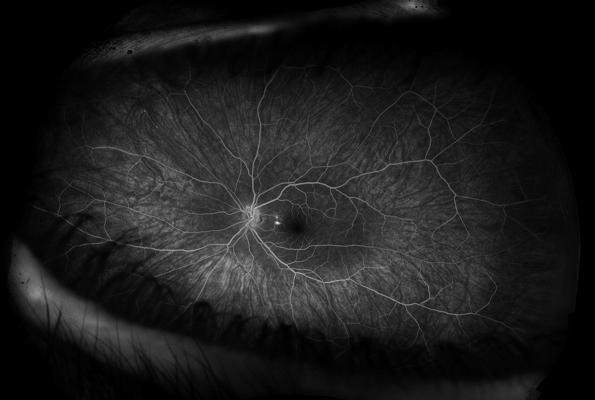
Left Eye: Resolved arteriolitis of the main arcades
03:24:072
Follow-up
Initial
03:26:928

Slide 26
What is Susac Syndrome?
Rare autoimmune disease affecting small blood vessels in the brain, inner ear, and retina
Classic Triad: Encephalopathy, Vision Changes, Sensorineural Hearing Loss
  Vision changes: blurry vision, peripheral vision losses, scotomas
More common in females having a 3:1 female to male ratio. Relapses of the condition have been noted around the same time as pregnancies in women, which may contribute to the increased female to male ratio⁹
Majority of diagnosed individuals fall between the ages of 20 and 40¹⁰

Slide 27
Susac Syndrome
Other: memory loss, cognitive deficits, seizures, psychiatric disturbances, cranial nerve dysfunction, sensory loss, motor loss, aphasia, and headaches
Headaches are the most common and often present before the other symptoms by up to 6 months
Patients can have multiple, recurrent branch retinal artery occlusions (BRAOs) without signs of intraocular inflammation¹¹
Hearing loss can be bilateral or unilateral, and typically affects low- and mid-frequencies on audiometry¹²
While many of these symptoms can be reversed, hearing loss in Susac syndrome is largely irreversible-sometimes requiring cochlear implants.¹³ Notably, not all symptoms may present themselves in every case⁹

Slide 28
Imaging
Magnetic resonance imaging (MRI) is the preferred method for neuroimaging of suspected cases of Susac syndrome
Characteristic punched-out lesions in the corpus callosum¹⁴
Fluorescein angiography (FA) is used to visualize and confirm ophthalmic examination findings of BRAO
Optical Coherence Tomography Angiography (OCTA) is a possible noninvasive diagnostic alternative that evaluates perfusion of the superficial and deep retinal vascular plexuses¹⁵

Slide 29
Management ¹⁶
Therapy depends upon the type and severity of associated symptoms
Some cases respond well to treatment while others recur after two years and, on rare occasion, develop a chronic course
Firstline: glucocorticoids (typically high dose methylprednisolone)
Cyclophosphamide, plasmapheresis, and IVIG are considerations for severe or persistent cases
Anticoagulation and aspirin are therapeutic adjuncts as well
Other immunosuppressive treatments, such as azathioprine and tacrolimus, can be used after the acute phase of the disease
More aggressive treatment is required for severe cases involving the central nervous system

Slide 30
Prognosis
The majority of patients respond well to treatment
54% of cases resolve within two years, while 42% of cases recur beyond two years, and 4% become chronic⁹
In rare cases, Susac syndrome can be fatal¹⁷
Common chronic symptoms include hearing loss, gait disturbance, and cognitive deficits
Given the rarity of the condition, prognosis is thought to depend upon severity of disease at presentation. Immediate treatment is indicated if there is suspicion of Susac syndrome to prevent morbidity and mortality¹⁴

Slide 31
Summary
This is a case of a 43-year-old female with Susac syndrome who presented with progressively worsening encephalopathy and hearing loss who was found to have bilateral, multiple branch retinal artery occlusions on fluorescein angiography and characteristic MRI T2/FLAIR hyperintense corpus callosum lesions.

Slide 32
References
Sarbu N, Shih RY, Jones RV, Horkayne-Szakaly I, Oleaga L, Smirniotopoulos JG. White Matter Diseases with Radiologic-Pathologic Correlation. Radiographics. 2016;36(5):1426-1447. doi:10.1148/rg.2016160031
Thompson AJ, Banwell BL, Barkhof F, et al. Diagnosis of multiple sclerosis: 2017 revisions of the McDonald criteria. Lancet Neurol. 2018;17(2):162-173. doi:10.1016/S1474-4422(17)30470-2
Wingerchuk DM, Banwell B, Bennett JL, et al. International consensus diagnostic criteria for neuromyelitis optica spectrum disorders. Neurology. 2015;85(2):177-189. doi:10.1212/WNL.0000000000001729
Di Donato I, Bianchi S, De Stefano N, et al. Cerebral Autosomal Dominant Arteriopathy with Subcortical Infarcts and Leukoencephalopathy (CADASIL) as a model of small vessel disease: update on clinical, diagnostic, and management aspects. BMC Med. 2017;15(1):41. Published 2017 Feb 24. doi:10.1186/s12916-017-0778-8
Tenembaum S, Chitnis T, Ness J, Hahn JS; International Pediatric MS Study Group. Acute disseminated encephalomyelitis. Neurology. 2007;68(16 Suppl 2):S23-S36. doi:10.1212/01.wnl.0000259404.51352.7f
Berger JR, Aksamit AJ, Clifford DB, et al. PML diagnostic criteria: consensus statement from the AAN Neuroinfectious Disease Section. Neurology. 2013;80(15):1430-1438. doi:10.1212/WNL.0b013e31828c2fa1
Hillbom M, Saloheimo P, Fujioka S, Wszolek ZK, Juvela S, Leone MA. Diagnosis and management of Marchiafava-Bignami disease: a review of CT/MRI confirmed cases. J Neurol Neurosurg Psychiatry. 2014;85(2):168-173. doi:10.1136/jnnp-2013-305979
Iliescu DA, Timaru CM, Batras M, De Simone A, Stefan C. COGAN'S SYNDROME. Rom J Ophthalmol. 2015;59(1):6-13.

Slide 33
References
Dörr J, Krautwald S, Wildemann B, et al. Characteristics of Susac syndrome: A review of all reported cases. Nat Rev Neurol. 2013;9(6):307-316. doi:10.1038/nrneurol.2013.82
Susac syndrome | Genetic and Rare Diseases Information Center (GARD) – an NCATS Program. Accessed June 15, 2021. https://rarediseases.info.nih.gov/diseases/7713/disease#ref_13094
Sauma J, Rivera D, Wu A, et al. Susac’s syndrome: an update. Br J Ophthalmol. 2020;104(9):1190-1195. doi:10.1136/BJOPHTHALMOL-2019-315597
Vishnevskia-Dai V, Chapman J, Sheinfeld R, et al. Susac syndrome: clinical characteristics, clinical classification, and long-term prognosis. Medicine (Baltimore). 2016;95(43). doi:10.1097/MD.0000000000005223
Roeser MM, Driscoll CLW, Shallop JK, Gifford RH, Kasperbauer JL, Gluth MB. Susac syndrome – A report of cochlear implantation and review of otologic manifestations in twenty-three patients. Otol Neurotol. 2009;30(1):34-40. doi:10.1097/MAO.0B013E31818B6AC2
B G-G, M P, E C. Susac syndrome–clinical insight and strategies of therapy. Eur Rev Med Pharmacol Sci. 2015;19(9):1729-1735. Accessed July 7, 2021. https://pubmed.ncbi.nlm.nih.gov/26004617/
Mastropasqua R, Toto L, Senatore A, et al. Optical coherence tomography angiography findings in Susac's syndrome: a case report. Int Ophthalmol. 2018;38(4):1803-1808. doi:10.1007/s10792-017-0653-9
Vodopivec I, Prasad S. Treatment of Susac Syndrome. Curr Treat Options Neurol. 2016. doi:10.1007/s11940-015-0386-x
Agamanolis DP, Klonk C, Bigley K, Rennebohm RM. Neuropathological Findings in Susac Syndrome: An Autopsy Report. J Neuropathol Exp Neurol. 2019;78(6):515-519. doi:10.1093/JNEN/NLZ031

