Slide 1


Abduction Deficit
Mehdi Tavakoli MD, Natalie N DeBolske MD, Robert C Foster MD
University of Alabama at Birmingham Heersink School of Medicine, Department of Ophthalmology and Visual Sciences

Slide 2
Presentation
A 49-year-old female presented to the neuro-ophthalmology clinic with double vision.
Diplopia started about 4 months before the presentation and slowly progressed without diurnal variation.
Diplopia was
  Horizontal,
  Binocular (disappeared with the closure of either eye), and
  Only present when she looked left.

Slide 3
Presentation
She denied any illness or injury preceding the onset of diplopia but stated that her symptoms began 4 weeks after Botox injections to the forehead for migraines
She has not injected Botox since, but her diplopia has persisted

Slide 4
Could her diplopia be a complication of the Botox injections?
Temporary extraocular muscle paresis as a complication of periocular Botox injection is a well-described phenomenon
Higher doses may be more likely to affect the extraocular muscles
Onset would be expected within the first week, with the resolution of symptoms within a few months of injection, therefore her late onset and persistent diplopia cannot be explained by Botox injection.

Slide 5
Further History…
She denied associated pain, redness, visual acuity changes
PMHx: migraines +; no history of DM, HTN, or thyroid disease
PSHx: cholecystectomy
Medications: Xanax PRN
Family history: HTN in both parents, breast cancer in mother
Social history: non-smoker

Slide 6
Examination
 | OD | OS
Visual Acuity | 20/20 | 20/20
RAPD | Negative | Negative
Pupil Reaction | Brisk | Brisk
Exophthalmometry (mm) | 17 | 15
Lid Fissure Height (mm) | 10 | 10
Anterior Segment | Unremarkable | Unremarkable
Posterior Segment | Unremarkable | Unremarkable

Slide 7
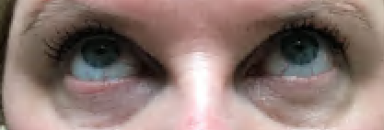
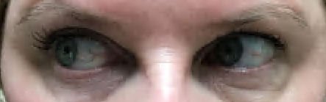
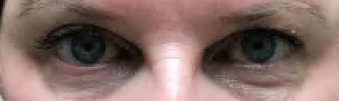
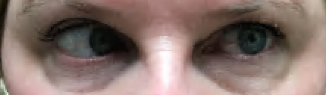
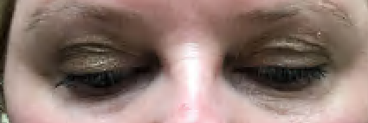
Ocular ductions are spared except for 50% restricted abduction in the left eye.
This caused esotropia of 14 prism diopter in left gaze. She is orthotropic at the primary position and other cardinal gazes.

Slide 8
Etiologies of Acquired Unilateral Abduction Deficit
Unilateral Abduction Deficit
Brainstem
Gaze Palsy
6th Cranial Nerve
Intracranial Lesions
Neuromuscular junction
Muscles
Orbit
Increased intracranial Pressure
Isolated
(Vasculopathic, traumatic, etc.)
Myasthenia Gravis
Thyroid Eye Disease
Fracture
Myositis
Tumors
Inflammations

Slide 9
Decreased Abduction
What office maneuver can we perform to narrow our differential diagnosis?

Slide 10
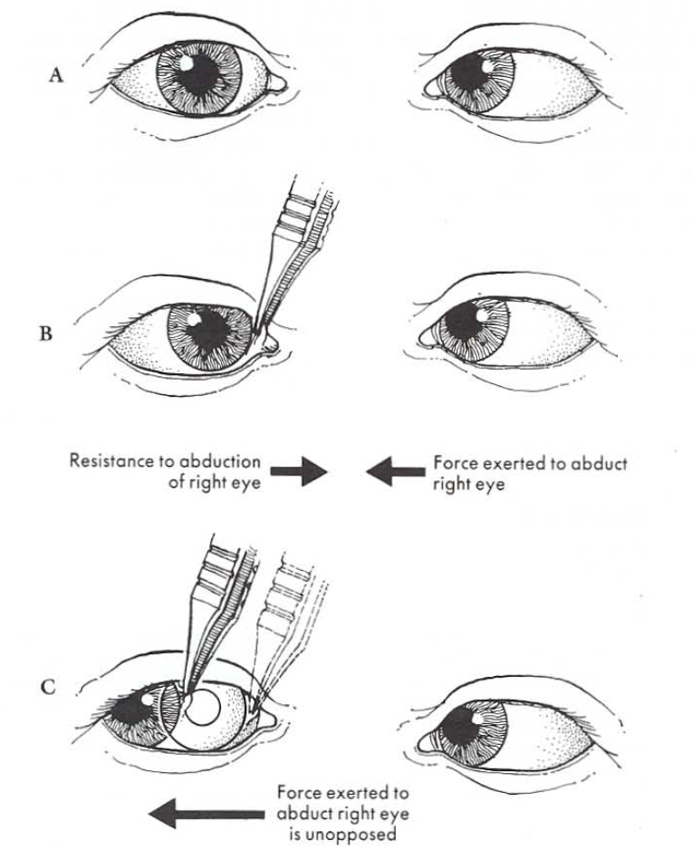
Forced Duction Test (FDT)
Forced Duction Test (FDT) is helpful to distinguish restrictive from paralytic strabismus.
After the eye surface is anesthetized with a Proparacaine drop, the conjunctiva is grasped with forceps to pull the eye into the desired direction (abduction in this case). If resistance against the movement is noted, that is consistent with a restrictive process.
Photo obtained from Helveston E. Surgical management of strabismus. Fifth Edition. 2006; Page 96. Online accessible via https://flaumresident.com/wp-content/uploads/2021/02/Surgical-Management-of-Strabismus-A-Practical-and-Updated-Approach.pdf

Slide 11
Forced Duction Test (FDT)
The FDT was performed in this patient and showed resistance to abduction in the left eye.
This suggests a restrictive process in the medial aspect of the orbit (including the medial rectus muscle).

Slide 12
Summary of Findings ---> Localization
So far, our patient showed limited abduction and positive FDT that suggests a restrictive process.
This localizes the problem to orbit (including extraocular muscles).
What orbital findings did we have in this patient?
2 mm enophthalmos was evident in exophthalmometry (see slide 6)

Slide 13
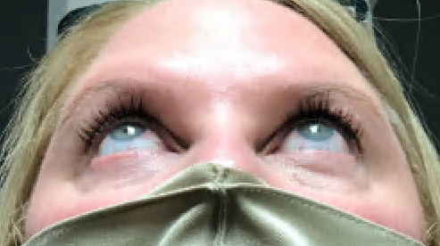
Exophthalmometry
This test was performed with Hertel Exophthalmometer that measures the distance between the corneal apex and the lateral canthus
  Results: OD 17 mm Vs. OS 15 mm
Looking from below or above can also help recognize the subtle difference in proptosis between two eyes
Inter-eye difference >2 mm is considered significant
Is this a right eye proptosis or left eye enophthalmos?
  Since the ocular restriction is evident in the left, this result is consistent with enophthalmos of the left eye.

Slide 14
The common causes of Enophthalmos
Enophthalmos
Blowout
Fracture
Silent Sinus Syndrome
Orbital Fat Atrophy
Maxillary Sinus Mucocele
Metastatic Carcinoma
Breast
Prostate
Orbital Varix
Posterior displacement of globe when varix empties

Slide 15
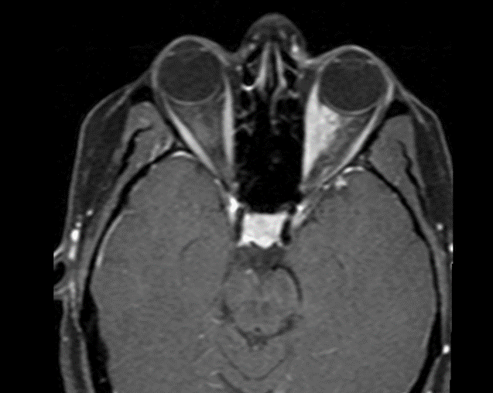
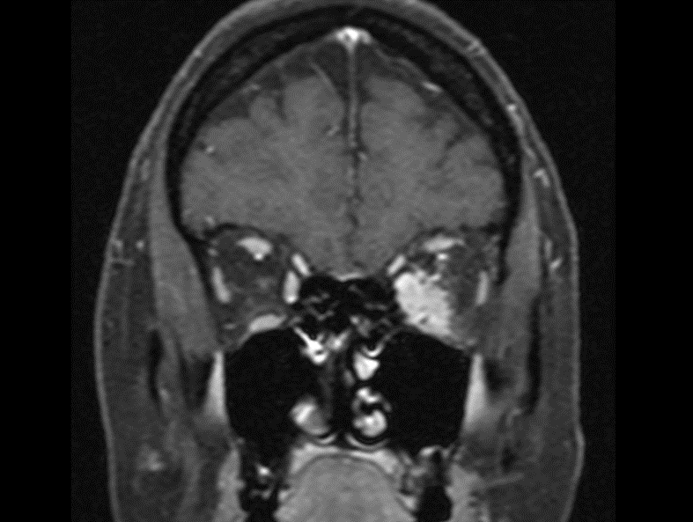
Next step: MRI of the orbits with/without contrast
Orbital MRI, Post-gadolinium T-1 fat suppressed scans (left: axial and right: coronal view). Abnormal soft tissue density with enhancement in the inferior and medial rectus muscles. This also extended to and partially encased the optic nerves.

Slide 16
Differential Diagnoses of Orbital Infiltrative lesions
Orbital Inflammations
  While the orbital inflammations including nonspecific orbital inflammation (NSOI) can have similar radiologic findings, they typically present with pain and proptosis, which were absent in our patient.
  Patient’s work ups including blood cell count, metabolic panel, thyroid function tests and antibodies, Quantiferon gold test, and IgG4 all in the normal range.
Orbital Tumors
  Lymphomas: Also, usually cause proptosis
  Metastatic tumors: Breast cancer is known to cause enophthalmos in some cases (also prostate cancer in men)

Slide 17
Final Diagnosis and Management
This patient was overdue for a mammogram.
Her mammogram was performed in the following day with abnormal results. The subsequent biopsy revealed breast adenocarcinoma.
PET scan demonstrated a “hot spot” consistent with distant metastasis only in the left orbit (scans are not available to the authors).
She was subsequently started on chemotherapy. She did not return to the follow up visits.

Slide 18
The most common origins of orbital metastatic tumors in adults
Breast | 28.5-58.8%
Lung | 8-12%
Prostate | 3-10%
Cutaneous melanoma | 5.3-15%
Carcinoid tumors | 4-5%

Slide 19
Clinical signs/symptoms of orbital metastasis
Diplopia
Proptosis
Decreased vision
Pain
Ptosis
Chemosis
Eyelid edema

Slide 20
Neoplastic Involvement of Ocular Muscles
Neoplastic involvement of the ocular muscles is rare, compared to inflammatory etiologies such as thyroid eye disease and orbital myositis.
Both paretic and restrictive patterns of strabismus have been reported with neoplastic infiltration of the ocular muscles. Positive forced duction in our patient suggested a restrictive process.

Slide 21
Neoplastic Involvement of Ocular Muscles
The radiographic patterns for neoplastic infiltration of the ocular muscles are variable including tendon sparing, diffuse, fusiform enlargement, etc.
When the clinical suspicion of malignancy is high, a metastatic workup is warranted. This includes mammogram, CT scan of the chest, and GI and prostate evaluations. Once a primary tumor is found, its biopsy usually has a higher diagnostic yield than biopsy of the extraocular muscle.
Biopsy of the involved extraocular muscle may be warranted when the diagnosis is still not clear and malignancy is suspected.

Slide 22
Orbital Metastasis from Breast Carcinoma
Most prevalent primary tumor for orbital metastasis in women, 29-60% of all orbital metastases
Bilateral involvement: in 20% of patients
Enophthalmos: in 10% of patients
  Scirrhous infiltration, fibrosis and desmoplastic response cause tissue retraction and enophthalmos
It is unclear why breast carcinoma has a predilection for the orbit given the lack of lymphatics in the orbit

Slide 23
Orbital Metastasis from Breast Carcinoma
H&E staining of an orbital breast carcinoma metastasis demonstrating strands of neoplastic cells, ductile differentiation, and fibrotic stroma
Breast carcinoma metastatic to the orbit. EyeWiki. (2021, October 17). Retrieved November 1, 2021, from https://eyewiki.aao.org/Breast_Carcinoma_Metastatic_to_the_Orbit#cite_note-wickremasinghe11-11.

Slide 24
Orbital Metastasis from Breast Carcinoma
A systemic workup in conjunction with oncology is indicated
Treatment with chemotherapy or hormone therapy
External beam radiation may be considered to preserve vision, limit exposure, or improve comfort
5- year survival rate for metastatic breast carcinoma is 22%
Mean survival time after diagnosis of orbital metastases is 22 months

Slide 25
Orbital Metastasis from Breast Carcinoma
Orbital metastasis from breast cancer has many different presentations. In the following slides two representative patients are demonstrated:

Slide 26
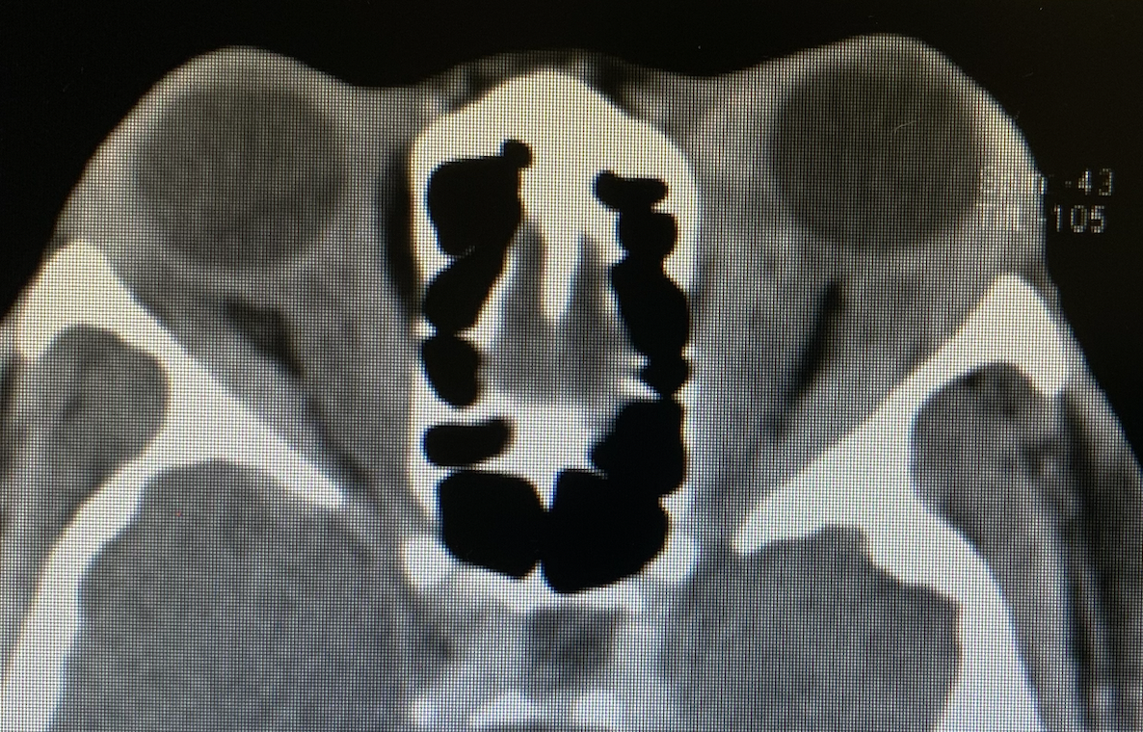
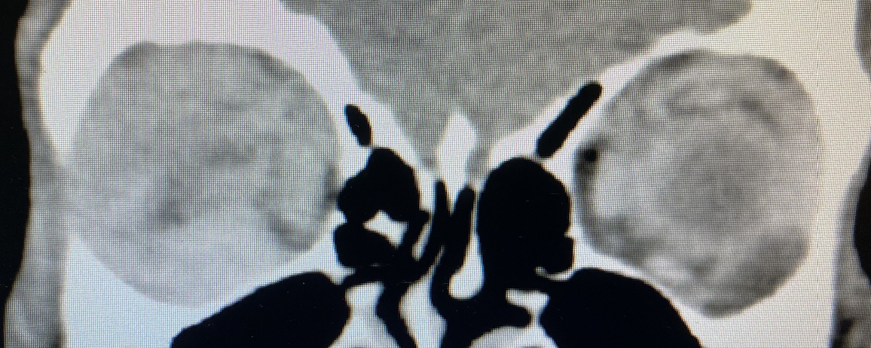
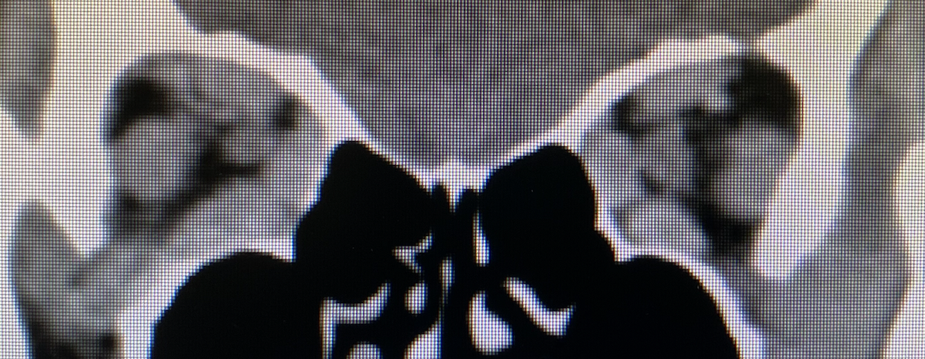
Orbital CT scan of another patient with biopsy-proven orbital metastasis from breast adenocarcinoma. In this case, the orbital fat and extraocular muscles were infiltrated with cancerous cells causing proptosis and restriction of ocular movements. The clinical and radiographic features were also suggesting thyroid eye disease, however, the rapid progression, lack of thyroid dysfunction, and pre-existing breast cancer, in this case, prompted the diagnosis of orbital metastasis. Top: Axial view; Bottom left: Coronal view at the globe equator level; Bottom right: Coronal view, posterior orbit level. (From Tavakoli M. personal archive)

Slide 27
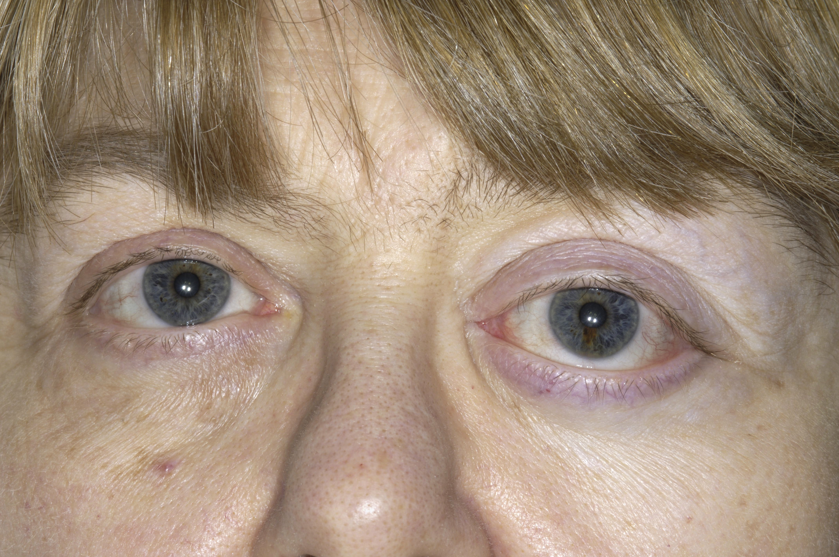
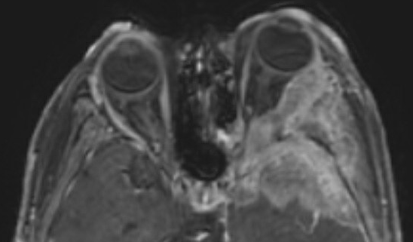
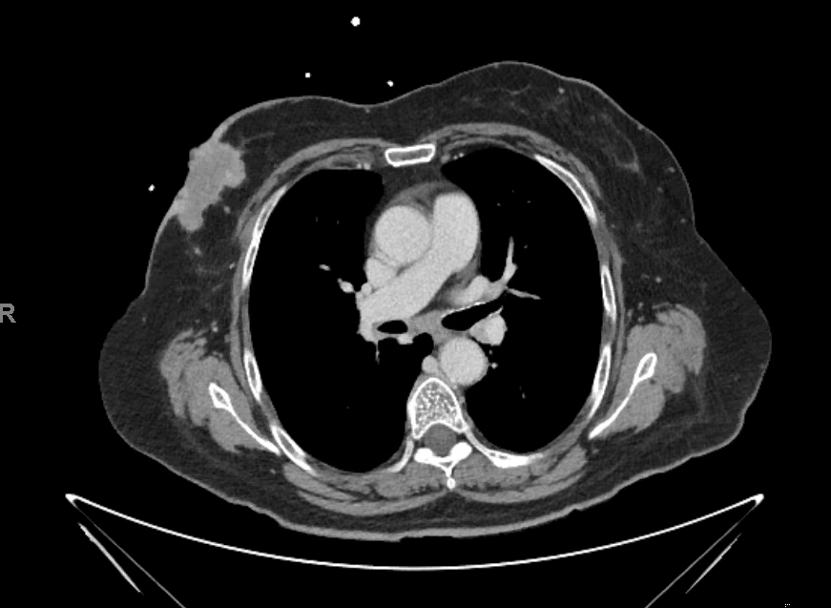
✤
✤
✚
▷
♤
This 64-year-old female patient presented to our clinic with multiple left cranial nerve palsies (nerves 2,3,4,5,6) and proptosis of the left eye (Top). Orbital MRI, the post-contrast T1 scan, demonstrates an infiltrative mass in the lateral aspect of the left orbit (✤), greater wing of the sphenoid bone (✚), cavernous sinus (▷), and anterior portion of the temporal lobe (♤) (Bottom, left). The work-up included a CT scan of the chest, revealing a mass in her right breast (✤) (Bottom, right).

Slide 28
Take Home Points
Considering orbital etiologies in the differential diagnoses of abduction deficit in addition to the neurologic, neuromuscular, and muscular causes.
The clinical utility of forced duction test in narrowing a differential diagnosis.
Subtle asymmetry in exophthalmometry measurements may hint at orbital mass lesions.
Findings of enophthalmos and orbital restriction in the absence of trauma are highly concerning for a malignant process.

Slide 29
References
Aristodemou P, Watt, L, Baldwin C, Hugkulstone C. Diplopia Associated With the Cosmetic Use of Botulinum Toxin A for Facial Rejuvenation, Ophthalmic Plastic & Reconstructive Surgery: 2006:22: 134-136 doi: 10.1097/01.iop.0000203304.22031.b5
Foroozan, R., & Vaphiades, M. S. (2018). Kline's neuro-ophthalmology review manual. Thorofare, NJ: SLACK Incorporated.
Hamedani M, Pournaras JA, Goldblum D. Diagnosis and management of enophthalmos. Surv Ophthalmol. 2007;52 (5): 457-73. doi:10.1016/j.survophthal.2007.06.009
Shields JA, Shields CL, Brotman HK, et al. Cancer metastatic to the orbit: the 2000 Robert M. Curts Lecture. Ophthal Plast Reconst Surg. 2000;17:346-354.
Ahmad SM, Esmaeli B. Metastatic tumors of the orbit and ocular adnexa.Curr Opin Ophthalmol. 2007;18:405-413.
Almeida AC, Fung A, Guedes ME, Costa JM. Bilateral metastatic melanoma to the extraocular-muscles simulating thyroid eye disease. BMJ Case Rep. 2012 Oct 30;2012:bcr2012007068. doi: 10.1136/bcr-2012-007068. PMID: 23112262; PMCID: PMC4543875.
Greaves GH, Livingston K, Liu GT, Shindler KS, Volpe NJ, Pistilli M, Mehta S, Tamhankar MA. Orbital ultrasonography in the diagnosis of neoplastic extraocular muscle enlargement. Orbit. 2017 Oct;36(5):317-321. doi: 10.1080/01676830.2017.1337173. Epub 2017 Jul 13.
Eade EL, Hardy TG, McKelvie PA, McNab AA. Review of extraocular muscle biopsies and utility of biopsy in extraocular muscle enlargement. Br J Ophthalmol. 2018 Nov;102(11):1586-1590. doi: 10.1136/bjophthalmol-2017-311147. Epub 2018 Jan 19.
Wickremasinghe S, Dansingani K, Tranos P, et al. Ocular presentations of breast cancer. Acta Ophthalmol Scand. 2007;85:133-142.

