Slide 1


Vision Loss in a Cancer Patient
Denis Huang¹, MD, Neesurg S. Mehta¹, MD, Kit W. Tam², MD, Kareem Moussa¹, MD, Yin Allison Liu^{1,3}, MD, PhD
1. Department of Ophthalmology & Vision Science, University of California, Davis | 2. Department of Hematology & Oncology, University of California, Davis | 3. Departments of Neurology, and Neurological Surgery, University of California, Davis
Notes:
This is a case of new onset vision loss in a cancer patient seen at the University of California, Davis who was the under the care of the department of ophthalmology and vision science, neurology and neurological surgery and hematology and oncology.

Slide 2
55-year-old Asian male with vision loss
Chief Complaint:
New onset central vision loss in the right eye and bilateral peripheral vision loss

Slide 3
Initial Clinical Course
History of known metastatic pancreatic adenocarcinoma s/p surgical decompression on palliative chemotherapy
3 months following surgical debulking and starting palliative chemotherapy, patient reported new bilateral vision changes to his oncologist
Subsequent MRI brain showed a large pituitary macroadenoma causing compression of the optic chiasm
Pre-operative Humphrey visual fields were performed, which showed dense bitemporal hemianopia consistent with compressive optic neuropathy
Due to the COVID19 pandemic, patient was unable to have full neuro-ophthalmologic evaluation prior to resection with neurosurgery
Patient subsequently seen in neuro-ophthalmology clinic 6 months after surgery. At this time, he had just switched chemotherapy to paclitaxel-gemcitabine.

Slide 4
Initial Neuro-ophthalmic Exam
(6 months after pituitary adenoma resection)
  BCVA:
  Cranial nerves III-VI intact
  Bilateral optic atrophy with diffuse ganglion cell layer thinning on OCT
  Partial bitemporal hemianopia on visual field testing
OD | OS
Count Fingers @ 2 ft; 2+ rAPD | 20/80; no rAPD

Slide 5
Humphrey Visual Fields
Left eye
Right eye
  What are his visual field deficits consistent with?

Slide 6
Answer:
Left eye
Right eye
  What are his visual field deficits consistent with?
    Compressive optic neuropathy secondary to the pituitary mass

Slide 7
Macular Cube
  Why does the patient have diffuse bilateral ganglion cell complex (GCC) thinning?

Slide 8
Answer:
  Why does the patient have diffuse bilateral GCC thinning?
    Retrograde degeneration caused by compressive optic neuropathy from the pituitary mass

Slide 9
6 month follow up
  Patient has now been on paclitaxel-gemcitabine chemotherapy for 6 months and is 12 months s/p pituitary macroadenoma resection
  At this visit, he reports no vision changes
  However, macular changes are noted on OCT

Slide 10
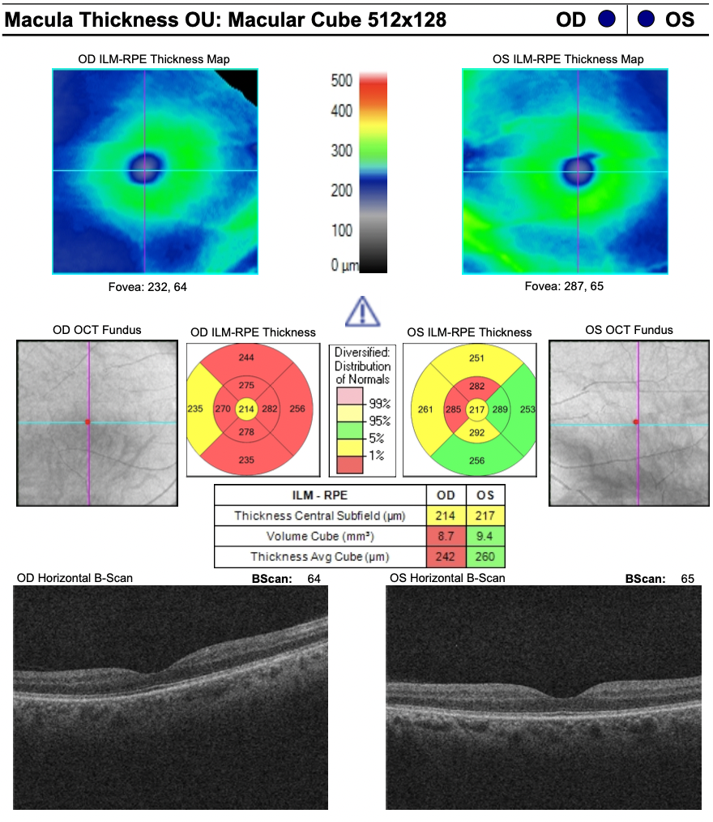
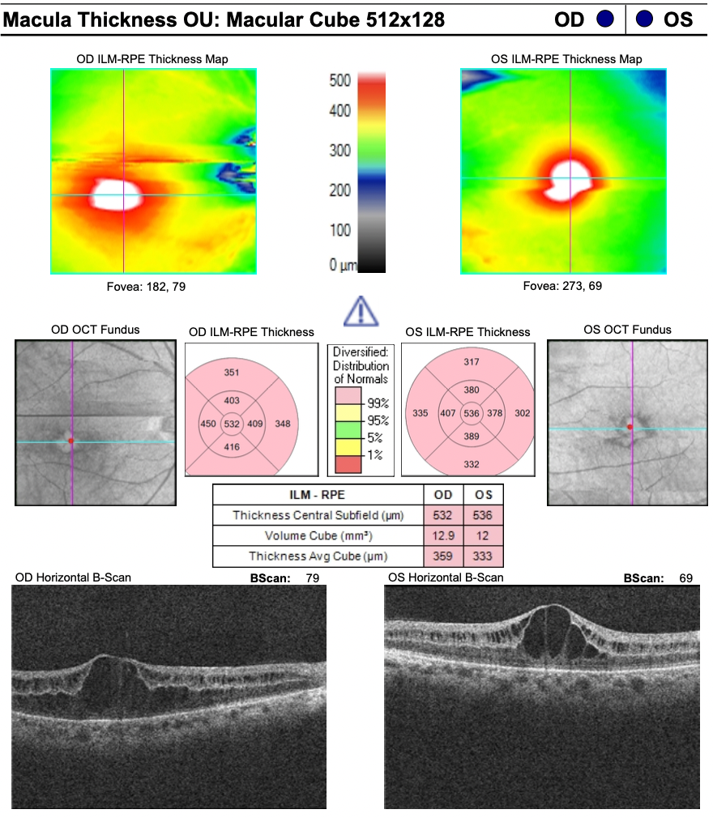
Macular Cube at 6 months follow up
03/2021
09/2021
  What are the new macular findings called (white arrows)?

Slide 11
Answer:
03/2021
09/2021
  What are the new macular findings called (white arrows)?
  Cystoid macular edema

Slide 12
More imaging studies
A
B
A and B. Fluorescein angiography was significant for faint petaloid leakage (white arrows) at the macula in both eyes
C and D. Optical coherence tomography (OCT) of the macula confirms cystoid macular edema (CME) in both eyes.
C
D
OD
OS

Slide 13
Most likely etiology of CME
  Petaloid leakage at the macula on FA is highly suggestive of drug-induced CME
  Presumed that paclitaxel, which was recently started, was the culprit

Slide 14
What is the most appropriate next step for this patient?
  Stop his paclitaxel chemotherapy
  Start steroid and NSAID eye drops
  Administer an intravitreal steroid injection
  Observe

Slide 15
Answer: B
  After consultation with our Retina Service, we elected to start the patient on prednisolone acetate 1% and ketorolac drops.
  Given the life-prolonging nature of his chemotherapy regimen, we did not stop paclitaxel treatment pending further discussion with his oncologist.

Slide 16
Follow-up
Patient succumbed to cancer afterwards. No follow up eye exam was performed.

Slide 17
Paclitaxel-related maculopathy
Previous reports of paclitaxel-related maculopathy were bilateral, associated with decreased vision and, notably, several describe angiographic-negative CME^{1–3} primarily in breast and ovarian cancer patients.
In complex oncologic patients, vision may be affected by multiple etiologies. While stopping chemotherapy may lead to resolution of drug-induced CME,⁴ the decision is not to be taken lightly and requires a careful multi-disciplinary approach.
When life-prolonging treatment causes ocular side effects, the goal is to attempt to treat the ocular side effects while keeping the life-prolonging treatment. If the patient’s CME was refractory to topical steroids and NSAIDs, other options including intravitreal steroids or anti-VEGF injections could be considered.

Slide 18
Take Home Points
Medication-related ophthalmologic side effects can initially present with subtle exam findings without visual symptoms
Many cancer therapeutics have ocular side effects. Always keep them in mind!
Multi-modal imaging is useful in the workup of a patient with a complex medical history and multiple potential etiologies affecting their vision
Topical steroids and topical NSAIDs are a good first line treatment for medication-related CME

Slide 19
References
1. Bassi E, Loizzi V, Furino C, et al. Cystoid macular edema secondary to paclitaxel therapy for ovarian cancer: A case report. Mol Clin Oncol. 2017;7(2):285.
2. Yokoe T, Fukada I, Kobayashi K, et al. Cystoid Macular Edema during Treatment with Paclitaxel and Bevacizumab in a Patient with Metastatic Breast Cancer: A Case Report and Literature Review. Case Rep Oncol. 2017;10(2):605.
3. Burgos-Blasco B, Hernandez-Ruiz S, Lopez-Guajardo L, Donate-Lopez J. Dexamethasone intravitreal implant in cystoid macular edema secondary to paclitaxel therapy. Am J Ophthalmol Case Reports. 2020;18:100653.
4. Joshi MM, Garretson BR. Paclitaxel Maculopathy. Arch Ophthalmol. 2007;125(5):709-710.

