Slide 1

Ophthalmoplegia in Patient with Papilledema
UPFRONT CASE
Larry Frohman, MD
Departments of Ophthalmology & Neurosciences
Rutgers-New Jersey Medical School
Executive Vice President, NANOS
Eric S. Hwang, MD
PGY-3 Ophthalmology Resident
Rutgers- New Jersey Medical School

Slide 2
17-Year-Old Female with Diplopia and Blurry Vision
Referred by outside neuro-ophthalmologist for bilateral disc swelling
In the few weeks prior to our initial encounter, patient presented to ED for diplopia, nonspecific back pains, and right arm/hand weakness
  Evaluated by neurology and subsequently discharged for outpatient follow up and imaging

Slide 3
17-Year-Old Female with Diplopia and Blurry Vision
Following the ED visit, patient pursued a consultation with an outside neuro-ophthalmologist who noted bilateral disc edema
Subsequently referred to University Hospital for further care

Slide 4
17-Year-Old Female with Diplopia and Blurry Vision
The following symptoms were present at our initial neuro-ophthalmic examination:
  Pulsatile tinnitus while lying down
  Subjective decreased vision
  Diplopia
  Nonspecific flank pain
  Right arm weakness and discomfort

Slide 5
17-Year-Old Female with Diplopia and Blurry Vision
What else do you want to know about her history?

Slide 6
17-Year-Old Female with Diplopia and Blurry Vision
What else do you want to know about her history?
  Denied history of headache
  Denied transient visual obscurations
  Denied difficulty swallowing, breathing
  Denied recent illness

Slide 7
17-Year-Old Female with Diplopia and Blurry Vision
Past Medical History:
  Hypothyroidism
  Asthma
Medications:
  Fluticasone
  Albuterol
  Allegra
  Medrol Dosepak (Given by ED for nonspecific back pains, thought to be of musculoskeletal etiology)
  Naproxen

Slide 8

Exam
OD: 20/60, OS: 20/150, no improvement with pinhole
Pupils: sluggishly reactive to light in both eyes with 2+ RAPD left eye
Extraocular movements:

Slide 9
Exam
Which cranial nerves appear to be involved?

Slide 10
Exam
Which cranial nerves appear to be involved?
CN 3 and 6 OU
Besides cranial neuropathies, what other etiologies should you consider?

Slide 11
Exam
Which cranial nerves appear to be involved?
Neuromuscular Disease
Inflammatory Disease
Meningitis/Infectious Processes
CN 3 and 6 OU
Besides cranial neuropathies, what other etiologies should you consider?

Slide 12
Exam
Slit lamp exam:
  1mm left upper eyelid ptosis with good excursions of the eyelid
  Otherwise normal anterior exam

Slide 13
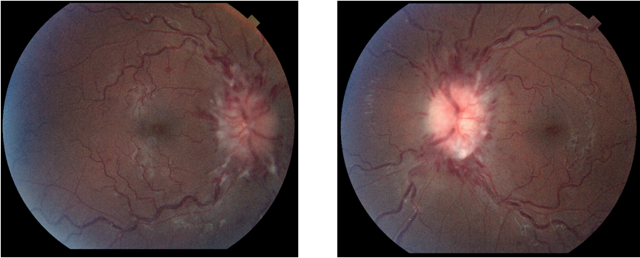
Fundus Exam
Right eye
Left eye
What do you see here? Anything unusual?

Slide 14
Ready to diagnose?
Or maybe a little more imaging…

Slide 15
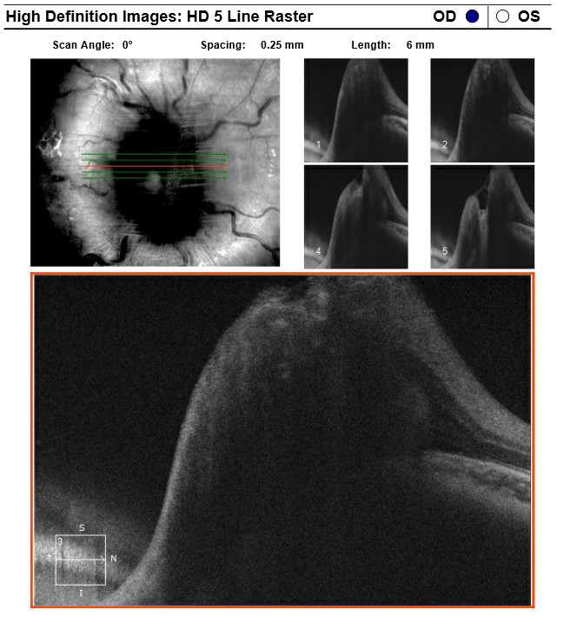
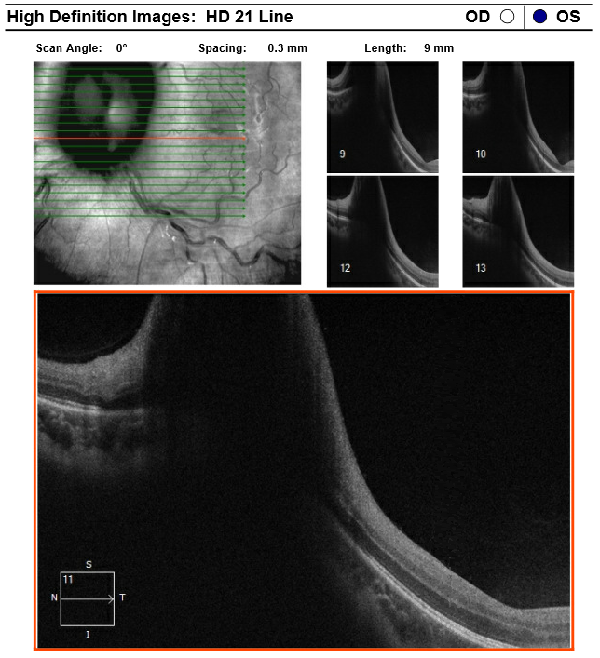
OCT Nerve
What do you see here?

Slide 16
Visual Field…?
Patient declined to complete the visual field exam

Slide 17
17-Year-Old Female with Diplopia and Blurry Vision
With the history and exam obtained so far, what would you include in your differential diagnosis?
Intracranial mass
Miller-Fisher variant Guillain-Barre syndrome
Cavernous sinus pathology
Dural venous sinus stenosis/thrombosis
Idiopathic intracranial hypertension
Meningitis

Slide 18
Intracranial mass?
  Outside MRI Normal, although study was limited by dental braces

Slide 19
Miller-Fisher variant GBS?
  Neurologic examination did not exhibit ataxia nor areflexia

Slide 20
Cavernous sinus pathology?
  Recent MRI did not demonstrate cavernous sinus or intracranial abnormalities

Slide 21
Dural venous sinus thrombosis/stenosis?
  Unusual to have CN 3 involvement, but would require MRV or CTV to absolutely rule out
    No external stigmata of venous engorgement

Slide 22
Meningitis?
  No headache
  Normal CBC – no leukocytosis
  No fever
  No neck stiffness
  No signs of altered mental status

Slide 23
Idiopathic intracranial hypertension?
  No/minimal headache
  No transient visual obscurations
  Only sixth nerve palsies are acceptable without further investigation in IIH
    Her ophthalmoplegia would be quite unusual
    Certainly possible but must rule out other etiologies

Slide 24
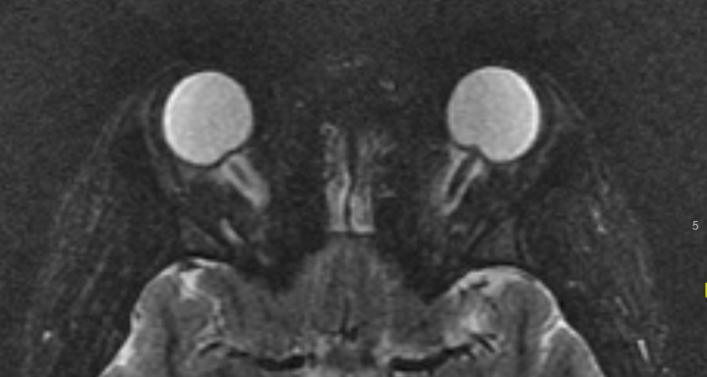
MRI Orbit/Brain
What findings do you see in this image?

Slide 25
MRI Orbit/Brain

Slide 26
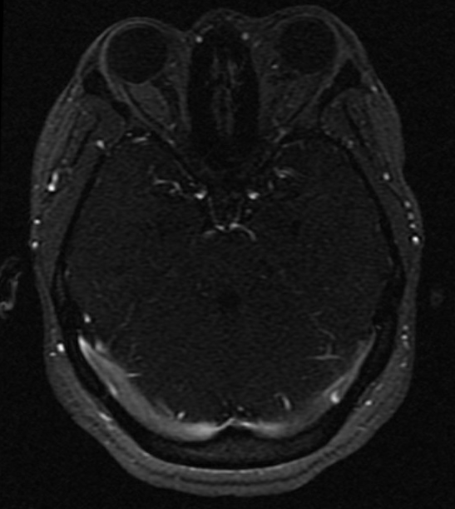
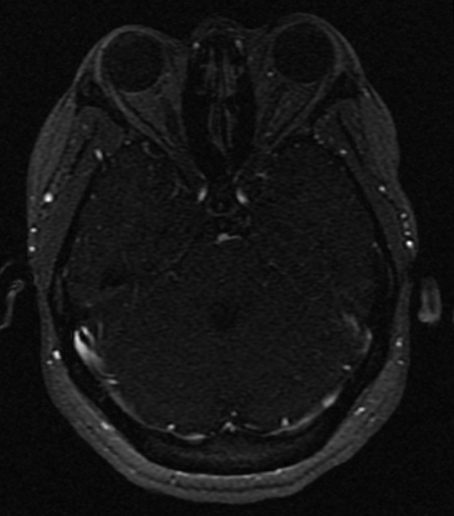
MRV Brain
What findings do you see in these images?

Slide 27
MRI/MRV Impressions
IMPRESSION:
Suggested stenoses at the distal transverse sinuses bilaterally. No evidence of dural venous sinus thrombosis.
Protrusion of the optic nerves to the posterior globes, and relatively diminutive pituitary gland for the patient's age and gender, findings which are compatible with increased intracranial pressure.

Slide 28
So what further workup would you like?
We were concerned about Miller Fisher/Guillain Barre without full triad but with papilledema
  Lumbar puncture with:
    Large volume cytology
  Serum Gq1b antibodies

Slide 29
Lumbar puncture
Opening pressure: >55 with closing pressure 26
CSF cell counts, protein, lactate, glucose: normal
Which diagnoses are less likely with a normal protein and cell counts?

Slide 30
Gq1b antibodies
Serum Gq1b antibodies were negative
Ruled out Miller-Fisher variant Guillain-Barre syndrome

Slide 31
Hospital Course
7/24:
Pending MRV
Possible cerebral angiogram
7/21:
Initial visit Baseline OCT
7/26:
MRV Head completed
7/23:
LP negative except high ICP
Started on
Diamox 500mg BID Solumedrol 40mg IV TID
7/25:
Left eye Va decrease to 20/400.
OR for ONSF Left eye
7/29:
Cerebral angiogram completed
***Patient declined HVF at initial visit. First HVF obtained after optic nerve sheath fenestration of the left eye

Slide 32
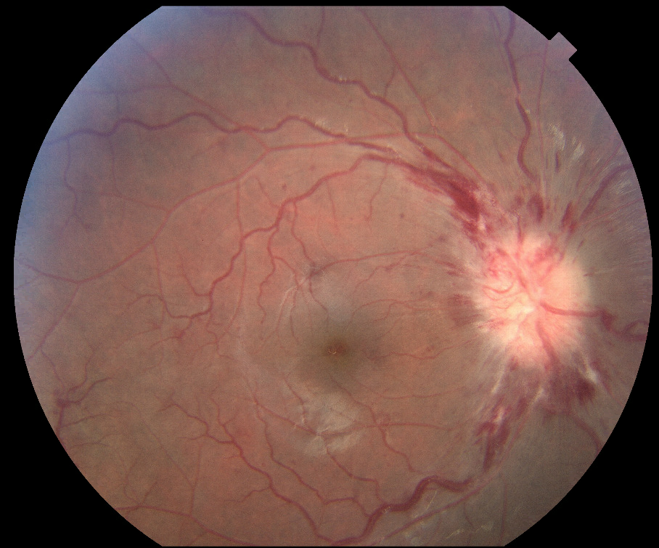
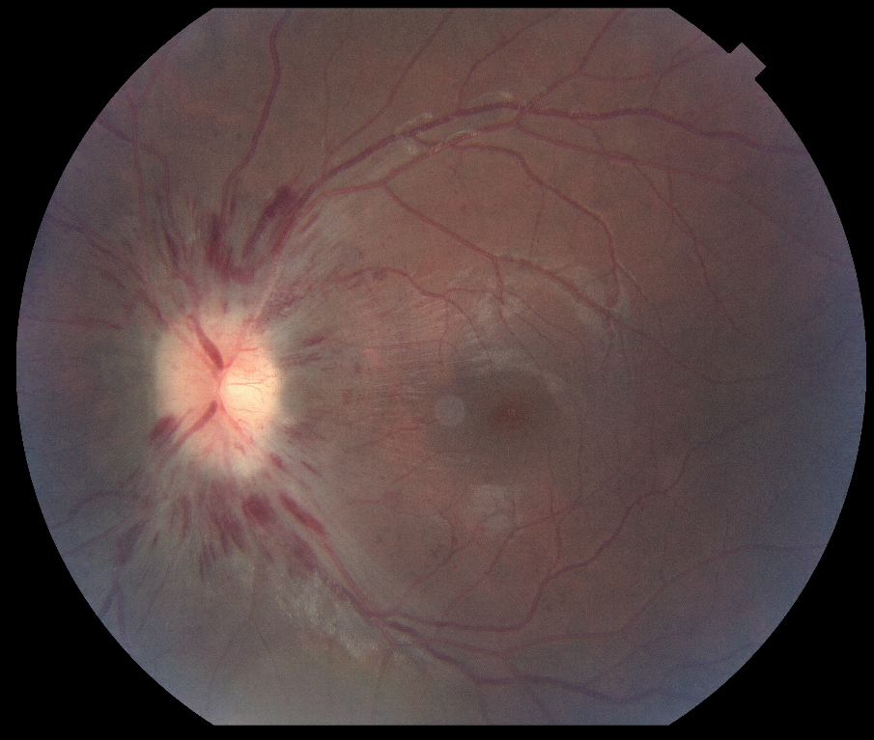
Post-operative Fundus Photos
S/p optic nerve sheath fenestration of the left eye POD#4
Right eye
Left eye

Slide 33
Pre vs Post-operative Left eye
7/21 Pre-op
7/25 Post-op
Do you notice a change compared to the pre-op photos?

Slide 34
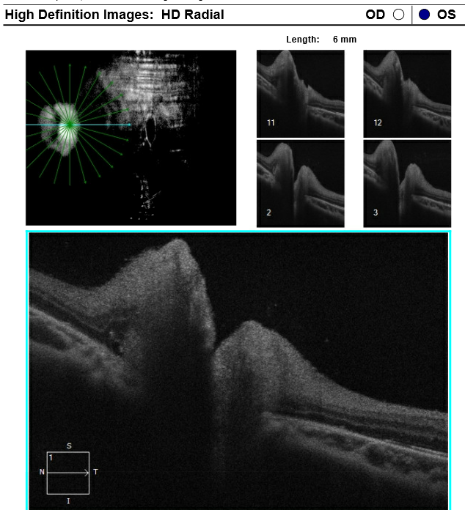
Pre vs Post-operative OCT Nerve, OS
7/21 Pre-op
7/30 Post-op
Do you notice a change in the left eye compared to the pre-op OCT?

Slide 35
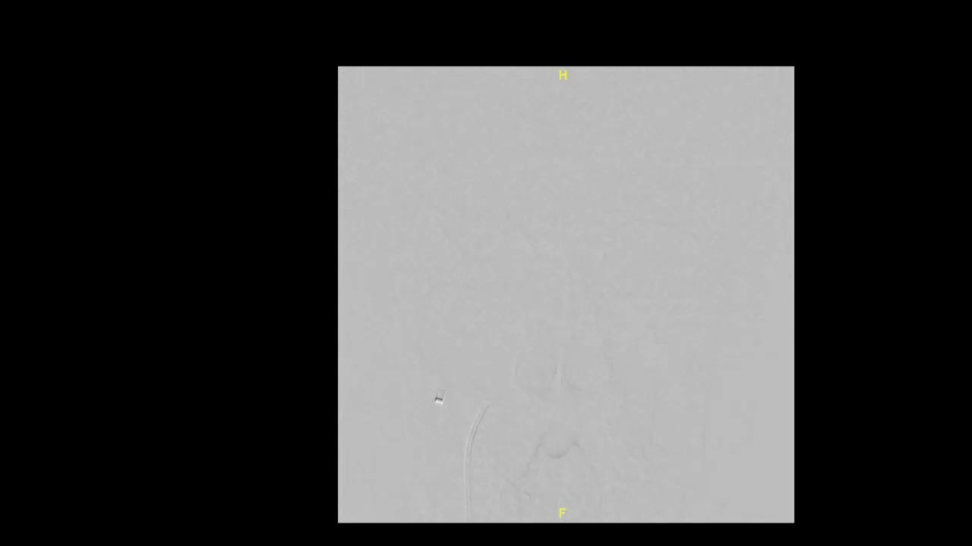
Cerebral angiogram with manometry
  L sigmoid sinus: 24 mmHg
  L transverse/sigmoid sinus junction: 72mmHg
  R sigmoid sinus: 28 mmHg
  R transverse/sigmoid sinus junction: 70mmHg
  Normal values: 2-6 mmHg
What do these findings imply, and what would you do next?

Slide 36
Hospital Course
  After few days of anticoagulation, a stent was placed from R mid transverse sinus to R sigmoid sinus, with confirmed reduction in pressure gradient

Slide 37
Post-stent Day #2
  Va OD: 20/40, OS: 20/100
  EOMs much improved, nearly full in all gazes
  No TVOs, pulsatile tinnitus, headaches
  Fundus improving with appearance of cups

Slide 38
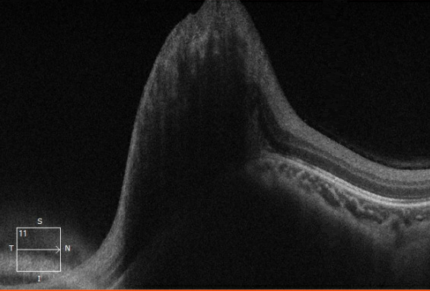
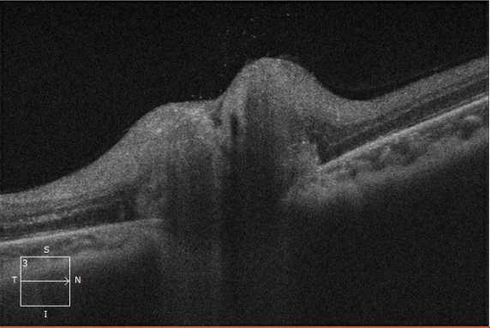
Pre vs Post stenting OD
7/27 Pre-op
7/30 Post-op

Slide 39
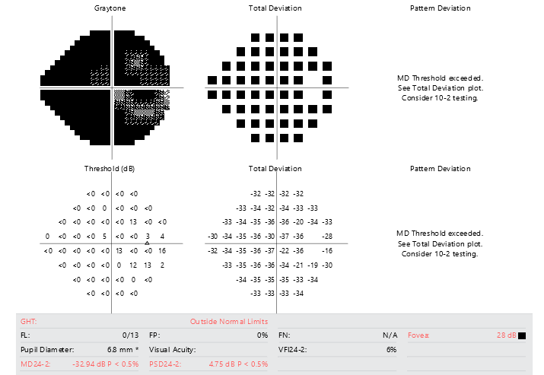
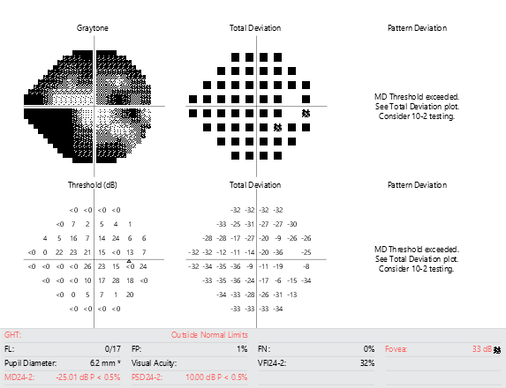
HVF 24-2 Spot III
Pre vs Post stenting OD
7/28 Pre-op
7/30 Post-op

Slide 40
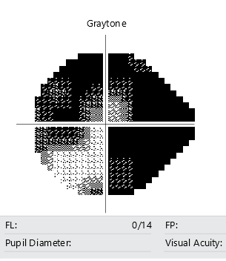
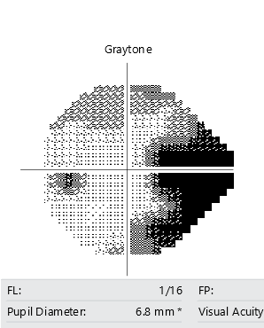
HVF 24-2 Spot V
Pre vs Post stenting OS
7/28 Pre-op
7/30 Post-op
Notes:
Same here

Slide 41
Final Diagnosis
Intracranial hypertension with ophthalmoplegia due to dural venous sinus stenosis

Slide 42
Ophthalmoplegia in ICP
Ophthalmoplegia in the setting of elevated intracranial pressures without mass or inflammation has been previously documented
  6th cranial nerve palsy has been most commonly implicated in the setting of increased ICP
    In pediatric population with IIH, Reid et al. reported approximately 12% develop 6th nerve palsy
    In adults, Wall and George reported approximately 12% of patients with IIH developing 6th nerve palsy
    Vertical gaze paresis and other cranial nerve palsies are uncommon

Slide 43
Ophthalmoplegia in ICP
Bruce et al. reported 2 cases of idiopathic intracranial hypertension (IIH)
  1st patient with bilateral 6th nerve palsies and partial 3rd palsy
    Marked limitation of abduction, adduction and mild limitation of elevation
  2nd patient with alternating skew deviation and nystagmus
BOTH patients dramatically improved after CSF shunting procedure

Slide 44
Ophthalmoplegia in ICP
Frohman and Kupersmith also reported 2 patients with skew deviations with IIIH
  Previously skew deviation was thought to be a localizing sign of posterior fossa abnormalities
  Showed variety of falsely localizing signs in setting of increased ICP
  Patients’ ophthalmoplegia improved with LP

Slide 45
Ophthalmoplegia in ICP
Exact mechanism is unknown
  Series by Friedman also describes patients with ophthalmoplegia in setting of high ICP >30 cm/H20
    10/13 patients with pressures >55 cm/H20
    3 patients with complete ophthalmoplegia
    3 patients with global ophthalmoparesis
    6 patients with INO
    3 patients with vertical gaze palsies
    5 patients with abduction deficits
  Improvement with diversion of CSF suggests a direct relationship to intracranial pressure
  Postulated that increased intracranial pressure causes distortion or displacement of brainstem structures

Slide 46
Summary
Although only a sixth nerve palsy is accepted as consistent with IIH without need for further investigation, ICP can rarely present with a variety of ocular motility findings
A broad differential diagnosis is necessary to properly evaluate and treat the underlying cause
In many cases, treating the elevated ICP can drastically improve symptoms, including vision and ophthalmoplegia

Slide 47
References
Beau B. Bruce, Nancy J. Newman, Valérie Biousse. Ophthalmoparesis in Idiopathic Intracranial Hypertension. American Journal of Ophthalmology, Volume 142, Issue 5, 2006, Pages 878-880
Frohman LP, Kupersmith MJ. Reversible vertical ocular deviations associated with raised intracranial pressure. Journal of Clinic Neuro-ophthalmology. 5(3):158-63, 1985 Sept.
Friedman DI, Forman S, Levi et al. Unusual ocular motility disturbances with increased intracranial pressure. Neurology, 50 (1998). Pp. 1893-1896.
Reid JE, Reem RE, Aylward SC, Rogers DL. Sixth Nerve Palsy in Paediatric Intracranial Hypertension. Neuroophthalmology. 2016;40(1):23-27. Published 2016 Jan 30. doi:10.3109/01658107.2015.1117498
Wall M, George D. Idiopathic intracranial hypertension. A prospective study of 50 patients. Brain. 1991 Feb;114 ( Pt 1A):155-80. PMID: 1998880.

