Slide 1

Unexplained Bilateral Optic Atrophy for Decades
Chaow Charoenkijkajorn MBBS, Houston Methodist Hospital
Junsang Cho, University of Missouri
Andrew G. Lee MD, Houston Methodist Hospital

Slide 2
69-year-old woman with chronic vision loss OU
Presents to Neuro-Ophthalmology clinic
CC: recent worsening of blurry vision
Worsening of vision bilaterally over 25-30 years then stable until this visit

Slide 3
69-Year-Old woman with chronic vision loss
40-year history of blurry vision and vision loss
Started wearing bifocals since 1st grade
Initially evaluated by Neurology
No evidence of MS or other autoimmune conditions then and now
Evaluated for vascular migraines in the 1970s
  Migraines started to improve without medication
POH: Prior Laser Peripheral Iridotomy (LPI) for narrow angles OU

Slide 4
Neuro-ophthalmic Examination
Neurologic exam: normal
Ophthalmologic exam
Visual Acuity: 20/250 OD, 20/200 OS
Pupil: sluggishly reactive but no RAPD OU
External Examination: normal
Slit Lamp Examination: mild nuclear cataract and superior patent peripheral iridotomy OU
Fundus Examination: Pale discs OU
Color plates: 0/14, 1/14

Slide 5
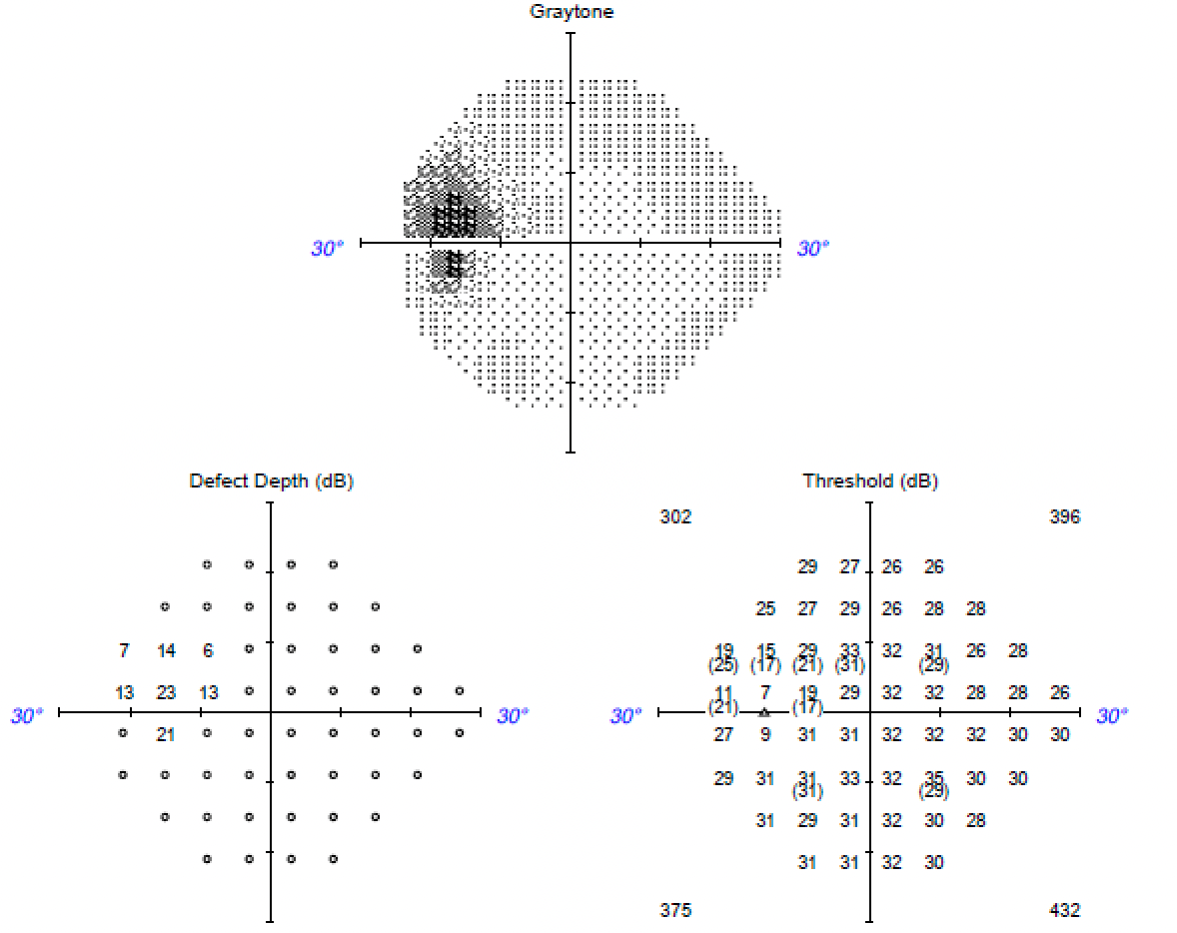
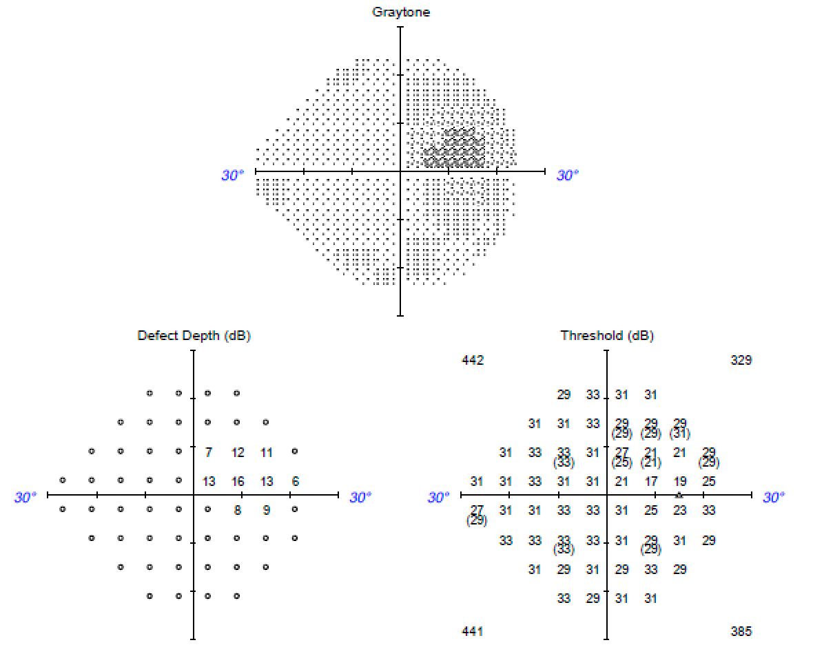
Visual Fields
OS
OD

Slide 6
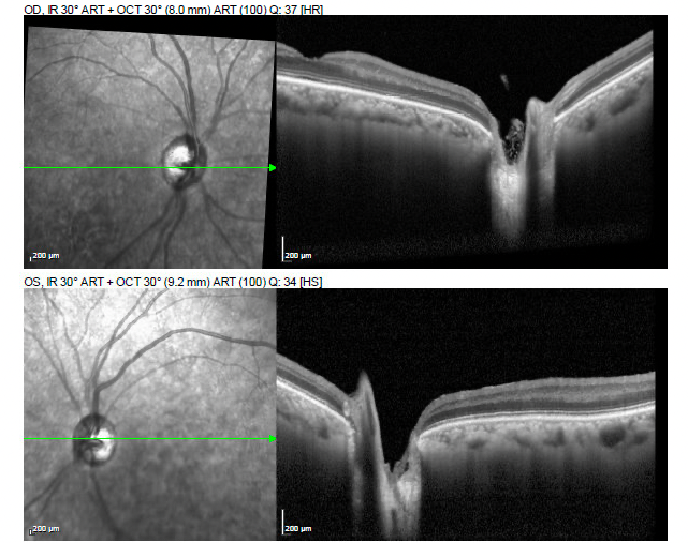
Spectral-domain optical coherence tomography (SD-OCT) B-scan
OD
OS

Slide 7
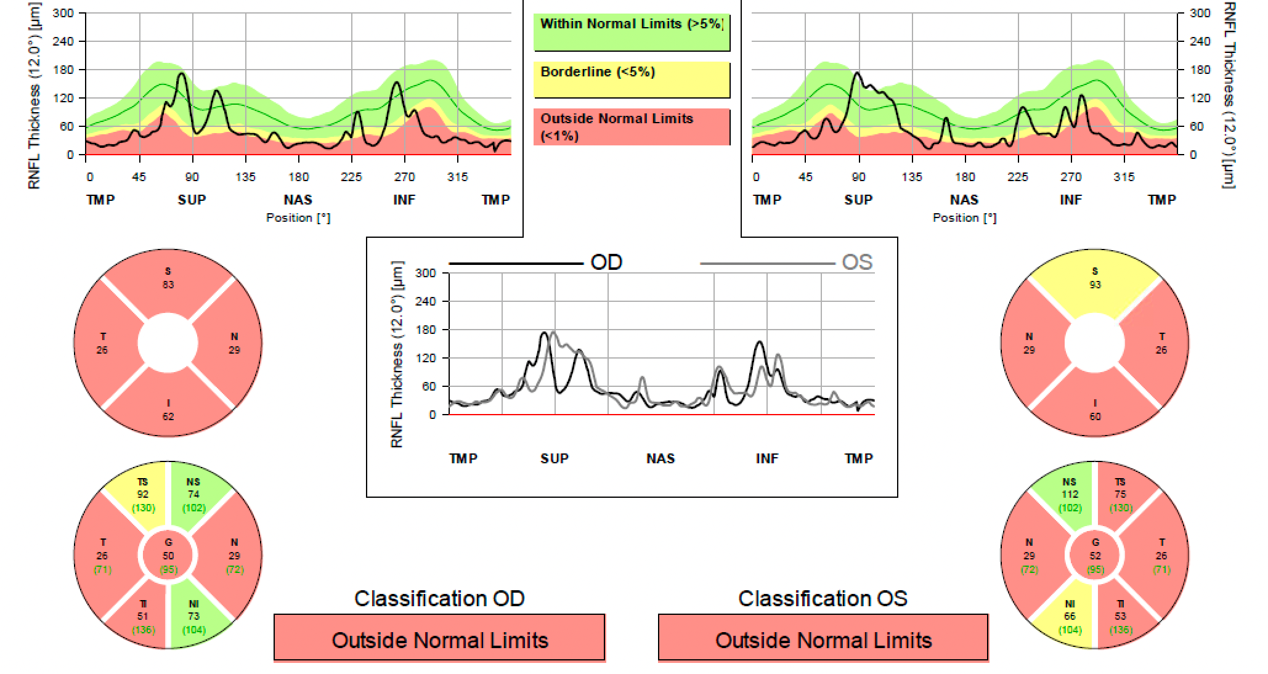
SD-OCT peripapillary retinal nerve fiber layer (pRNFL)

Slide 8
Differential for Optic Atrophy
Primary
  Leber Hereditary Optic Neuropathy (LHON)
  Autosomal Dominant Optic Atrophy (ADOA)
  Toxic (lead, tobacco)
  Compressive (neoplastic)
Secondary
  Chronic papilledema
  Papillitis
  Neuro-retinitis
  Anterior ischemic optic neuropathy

Slide 9
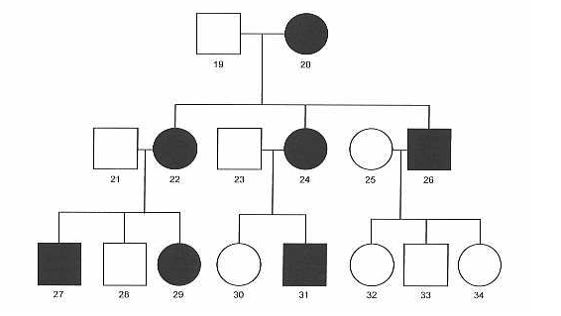
No family history of eye conditions
What inheritance pattern is exhibited in the figure to the right?

Slide 10
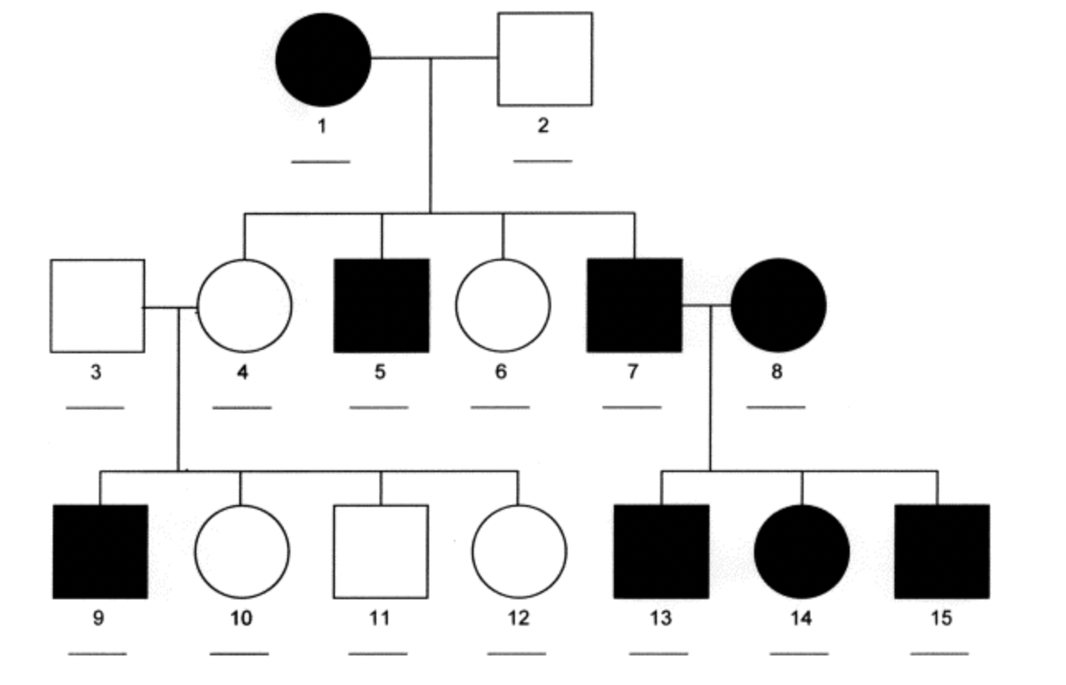
What inheritance pattern is presented to the right?

Slide 11
Outside evaluation
Past medical history of:
  gastric bypass surgery in 2012
  Tested in the past for:
    Leber hereditary optic neuropathy (11778, 3460, 14484)
  Normal MRI
  Labs (FTA, ACE, ESR, CRP, CBC, CXR)
    Neuromyelitis optica (NMO)
    Myelin oligodendrocyte glycoprotein (MOG) antibody disorder

Slide 12
Repeat testing
Vitamin levels (B1, B6, B12, folate, homocysteine)
Pernicious anemia (intrinsic factor levels)
Mitochondrial panel
  Larger panel including common mutations that cause Leber (11778, 3460, 14484)
Nuclear optic atrophy panel including OPA1
MRI brain with and without contrast
NMO/MOG antibodies

Slide 13
A diagnostic laboratory returned
Everything was negative, except for…
OPA1 mutation positive!!!!

Slide 14
Autosomal Dominant Optic Atrophy - Introduction
Most common hereditary optic neuropathy
  OPA1 gene makes 59% of ADOA cases
  Other genes include OPA 2, 4, 5, 6, 7, 8
Onset typically 1st or 2nd decade
Gradual progression → hard to track duration
Many patients preserve visual acuity (better than 20/200)
Color vision deficits present
ADOA plus → hearing loss, peripheral neuropathy, myopathy, ataxia, CPEO

Slide 15
ADOA - Pathogenesis
OPA1 gene located on chromosome 3q28-q29
OPA1 encodes for a mitochondrial GTPase
  Membrane stabilization
  Membrane biogenesis
Abnormal oxidative phosphorylation → ROS species → retinal ganglion apoptosis
Papillomacular bundle retinal ganglion atrophy

Slide 16
ADOA - Diagnosis
Clinical
  Family history - variable
  Gradual b/l vision loss
  Optic disc atrophy
  Color vision deficiencies
  Visual field abnormalities
    Papillomacular, arcuate, temporal wedge, bitemporal, hemianopsia defects
Confirm with genetic testing

Slide 17
Why did our patient have no family history?
Incomplete penetrance
Variable expressivity
Heteroplasmy (gene product)

Slide 18
Treatment
No scientifically proven treatments available
Potential future therapies under study
  Idebenone
    Coenzyme q10 – bypasses damaged mitochondrial product
  Gene therapy (CRISPR-Cas9)
    Clustered Regularly Interspaced Short Palindromic Repeats

Slide 19
Relevant Studies
Meta-analysis 85% of patients reporting symptoms < 20 years
Variable onset → one study 6 out 8 pts presented in 4th-5th decade
  Oldest reported age at diagnosis is a 62-year-old female
Variable expressivity → 27% of patients in study had no sx
Older patients have worse visual acuity
Significant RNFL and ganglion cell layer thinning

Slide 20
Take Home Message
This patient had a visually debilitating condition for over 40 years but is currently stable.
Clinicians should be aware that autosomal dominant inheritance pattern does not present similarly in all patients
ADOA secondary to OPA1 mutation should be considered in chronic, unexplained, painless bilateral optic atrophy regardless of duration of symptoms

Slide 21
References
Sun S, Erchova I, Sengpiel F, Votruba M. Opa1 Deficiency Leads to Diminished Mitochondrial Bioenergetics With Compensatory Increased Mitochondrial Motility. Investigative Opthalmology & Visual Science. 2020;61(6). doi:10.1167/iovs.61.6.42
Cohn AC, Toomes C, Potter C, et al. Autosomal Dominant Optic Atrophy: Penetrance and Expressivity in Patients With OPA1 Mutations. American Journal of Ophthalmology. 2007;143(4). doi:10.1016/j.ajo.2006.12.038
Yu-Wai-Man P, Shankar SP, Biousse V, et al. Genetic Screening for OPA1 and OPA3 Mutations in Patients with Suspected Inherited Optic Neuropathies. Ophthalmology. 2011;118(3). doi:10.1016/j.ophtha.2010.07.029
Romagnoli M, la Morgia C, Carbonelli M, et al. Idebenone increases chance of stabilization/recovery of visual acuity in OPA1 ‐dominant optic atrophy. Annals of Clinical and Translational Neurology. 2020;7(4). doi:10.1002/acn3.51026
Caglayan S, Hashim A, Cieslar-Pobuda A, et al. Optic Atrophy 1 Controls Human Neuronal Development by Preventing Aberrant Nuclear DNA Methylation. iScience. 2020;23(6). doi:10.1016/j.isci.2020.101154
https://eyewiki.aao.org/Autosomal_Dominant_Optic_Atrophy
Puomila, A., Huoponen, K., Mäntyjärvi, M., Hämäläinen, P., Paananen, R., Sankila, E. M., Savontaus, M. L., Somer, M., & Nikoskelainen, E. (2005). Dominant optic atrophy: correlation between clinical and molecular genetic studies. Acta ophthalmologica Scandinavica, 83(3), 337–346. https://doi.org/10.1111/j.1600-0420.2005.00448.x
Rönnbäck C, Milea D, Larsen M. Imaging of the macula indicates early completion of structural deficit in autosomal-dominant optic atrophy. Ophthalmology 2013;120:2672–7. https://doi.org/10.1016/j.ophtha.2013.08.008.
Milea D, Sander B, Wegener M, Jensen H, Kjer B, Jørgensen TM, et al. Axonal loss occurs early in dominant optic atrophy. Acta Ophthalmologica 2010;88:342–6. https://doi.org/10.1111/j.1755-3768.2008.01469.x.

