Slide 1
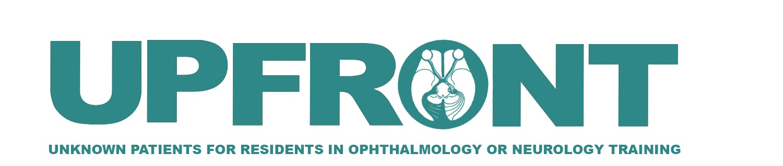

Acute, Bilateral Visual Loss in a Pediatric Patient
Elizabeth H. Roll, MD
Rutgers New Jersey Medical School
Larry P. Frohman, MD
Rutgers New Jersey Medical School
Roger E. Turbin, MD
Rutgers New Jersey Medical School

Slide 2
11-Year-Old Male with Acute, Bilateral Visual Loss x 3 days
3 days ago, developed TVOs + decreased vision in his left eye
The following day, he developed similar visual changes in his right eye
1 day ago, vision severely worsened in both eyes
  Left eye went completely “black”

Slide 3
11-Year-Old Male with Acute, Bilateral Visual Loss x 3 days
PMHx: obstructive sleep apnea (untreated), obesity (BMI: 43.6 kg/m²)
PSHx: no significant PSHx
FHx: no significant FHx
Medications: none

Slide 4
11-Year-Old Male with Acute, Bilateral Visual Loss x 3 days
Review of Systems
(+) Pain with EOMs
(-) Headache
(-) Pulsatile tinnitus
(-) Nausea
(-) Vomiting
(-) History of trauma
(-) Diplopia

Slide 5
11-Year-Old Male with Acute, Bilateral Visual Loss x 3 days
Vision: HM OD, NLP OS
Pupils:
  OD: 6→4, round, sluggish, no rAPD
  OS: 6→6, round, amaurotic, + rAPD
Dilated Fundus Exam
  Marked elevation of discs with peripapillary hemorrhages OU

Slide 6
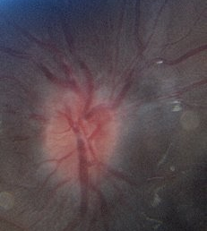
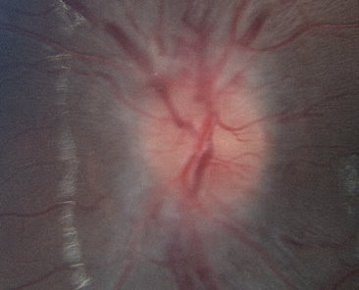
Fundus Photos on Day 7
Right Eye
Left Eye
What is your differential diagnosis?

Slide 7
Differential Diagnosis
Papilledema
  Pseudotumor cerebri
  Brain tumor (primary or metastasis)
  Cerebral venous sinus thrombosis/stenosis
Pseudopapilledema
  Optic Disc Drusen
Optic Neuritis
  Myelin Oligodendrocyte glycoprotein antibody optic neuritis (MOG optic neuritis)
  Neuromyelitis optica (AQP4 IgG optic neuritis)
  Multiple sclerosis
  Lyme disease
What would be your next step?

Slide 8
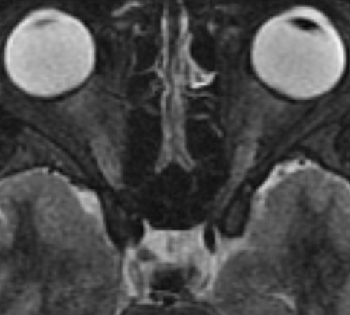
MRI: T2 without contrast
Flattening of the globe

Slide 9
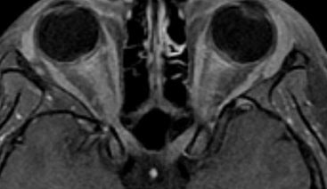
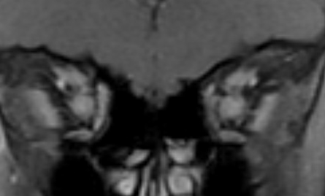
MRI: T1 with Fat Suppression
Enhancement of the optic nerves
Sparing the optic chiasm
What would be your next step in this patient’s management?
What lab work would you order?

Slide 10
Assessment and Plan
Bilateral enlargement of optic nerves from globe to chiasm, sparing the chiasm, with marked disc edema, strongly suggests myelin oligodendrocyte glycoprotein (MOG) optic neuritis
Obtain Lumbar Puncture
Obtain NMO, anti-MOG, HSV PCR, ANA, anti-cardiolipin Ab, lupus anticoagulant, ACE, RPR/VDRL, FTA, Lyme, ESR, CRP, bartonella, PT/PTT, quantiferon gold
Start the patient on IV solumedrol 250mg q6hr x5 days
Start the patient on IVIG 2g/kg x3 days
Co-manage with pediatric neurology
Why would we start IVIG?

Slide 11
Why start IVIG?
In the setting of severe visual loss, IVIG has been found to decrease relapse rates in cases of pediatric optic neuritis with MOG-antibody positivity
(Tajfirouz, et al. Reference #10)

Slide 12
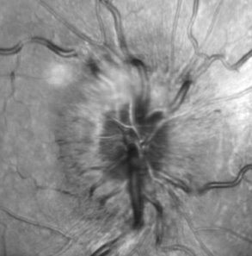
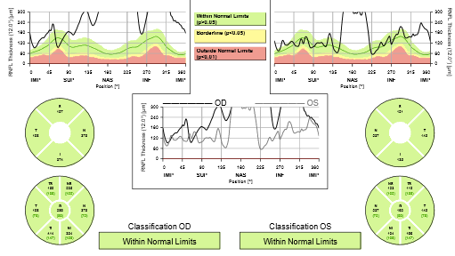
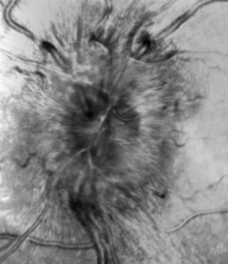
Day 3: Optical Coherence Tomography (OCT)
Right Eye
Left Eye

Slide 13
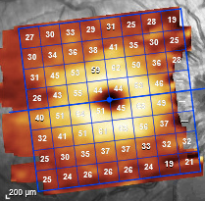
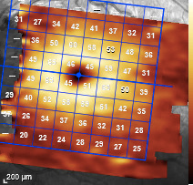
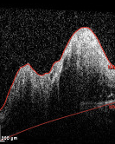
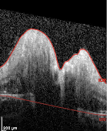
Day 3: Optical Coherence Tomography (OCT)
Right Eye
Left Eye
Preservation of the ganglion cell layer (GCL)
No upward deflection of Bruch’s membrane
Why is this relevant?
Upward deflection of Bruch’s membrane into the vitreous cavity suggests papilledema due to increased intracranial pressure

Slide 14
Lumbar Puncture Results
Color: clear
Glucose: 68
Protein: 41
RBC: 3
WBC: 1
Opening Pressure: 23 cm H₂O

Slide 15
Relevant Lab Results
VDRL/RPR, FTA non-reactive
CRP 4, ESR 15
PT/PTT 13, 31.8
Lyme, bartonella, NMO, HSV1/2, quantiferon gold negative
Anticardiolipin Ab, ACE within normal limits
MOG antibody positive (titer 1:100)

Slide 16
Day 8: Assessment/Plan
Vision somewhat improved, although still with significant visual loss
  Distance: CF at 3ft OU
  Near: 20/100- OD, 20/400 OS
S/p IV solumedrol x 5 days, currently on PO prednisone 1mg/kg/day
S/p IVIG 2g/kg x3 days
Due to this patient's severe visual loss, an additional therapeutic intervention was performed.
What would you consider adding to this patient’s treatment regimen?

Slide 17
Day 8: Assessment/Plan
Consider plasma exchange (PLEX), +/- repeat IVIG given severe bilateral vision loss
  What are some potential side effects of PLEX in children?
    Hypotension, infection, transfusion reaction, headache, nausea, vomiting urticaria, hypocalcemia
Attempt a baseline visual field test
What effect do you think PLEX could have on the therapy already received?
PLEX could wash out the IVIG already received, potentially diminishing its therapeutic effect.

Slide 18
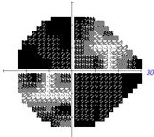
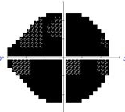
Day 8: Humphrey Visual Field
s/p IV steroids + IVIG
24-2, Size V Left Eye
VA: CF at 3ft
24-2, Size III Right Eye
VA: CF at 3ft

Slide 19
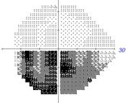
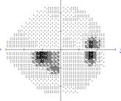
Day 15: Humphrey Visual Field
s/p IV steroids + IVIG + 1st session of PLEX
24-2, Size V Left Eye
VA: 20/150, PH 20/100+
24-2, Size V Right Eye
VA 20/150, PH 20/50-2

Slide 20
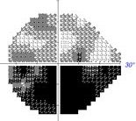
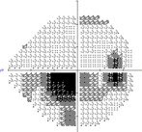
Day 19: Humphrey Visual Field
s/p IV steroids + IVIG + 5 sessions of PLEX + IVIG
24-2, Size III Left Eye
VA: 20/50, PH 20/25-2
24-2, Size III Right Eye
VA: 20/100, PH 20/50-2

Slide 21
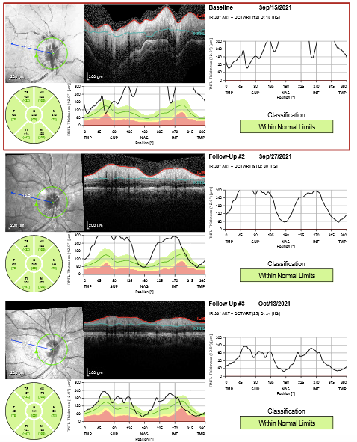
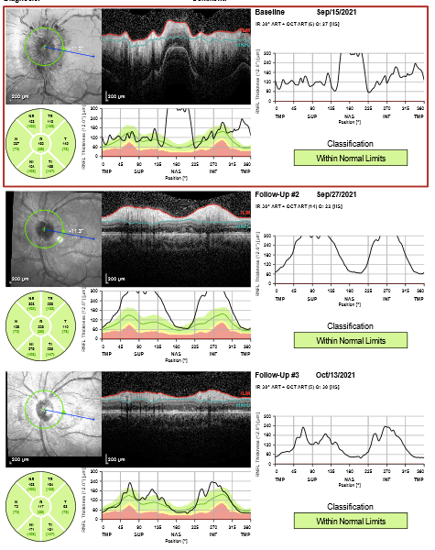
Right Eye
Left Eye
Baseline
1 month

Slide 22
1 Month Later: OCT Nerve
Right Eye
Left Eye
Ganglion cell layer (GCL) loss in both eyes

Slide 23
1 Month Later: OCT Nerve
Right Eye
Left Eye
Pre-treatment
Post- treatment
Nearly full resolution of edema in both eyes

Slide 24
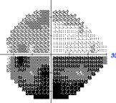
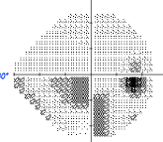
1 month later: Humphrey Visual Field
24-2, Size III Left Eye
VA: 20/50-2
24-2, Size III Right Eye
VA: 20/30, PH 20/25-2

Slide 25
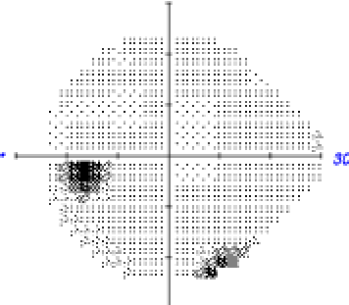
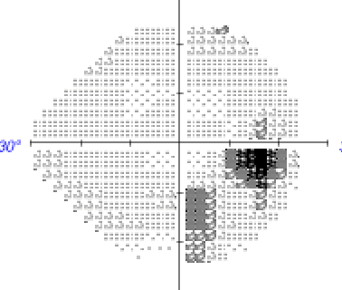
6 months later: Humphrey Visual Field
24-2, Size III Left Eye
VA: 20/25-2
24-2, Size III Right Eye
VA: 20/25-2

Slide 26
Myelin Oligodendrocyte Glycoprotein (MOG) Optic Neuritis: Background, Epidemiology, and Characteristics
Myelin oligodendrocyte protein: transmembrane protein expressed on the surface of oligodendrocytes and on the external surface of myelin
Epidemiology
  Mean age of 32.6 in adults, 8.7 in children
  Affects males and females equally
  Children: more commonly present with acute disseminated encephalomyelitis (ADEM)
  Adults: more commonly present with acute optic neuritis or transverse myelitis
Presenting signs
  Pain with EOMs (86%), severe and rapid vision loss at onset, rAPD, decreased color vision, bilateral optic nerve involvement (37%), moderate-severe disc edema with peripapillary hemorrhages (86%)

Slide 27
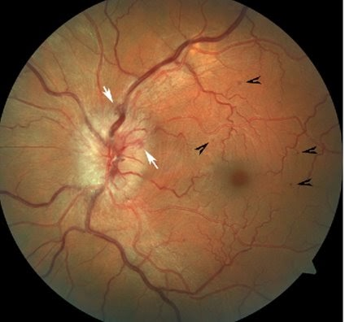
Peripapillary and Paramacular Hemorrhages in MOG
Image reprinted with permission from Biotti D, Bonneville F, Tournaire E, Ayrignac X, Carra Dalliere C, Mahieu L...et al. Optic neuritis in patients with anti-MOG antibodies spectrum disorder: MRI and clinical features from a large multicentric cohort in France. Journal of Neurology 2017; 264: 2173-2175.

Slide 28
MOG Optic Neuritis: Radiographic and Diagnostic Findings
MRI findings
Optic nerve enhancement >½ of the intraorbital optic nerve length (60%)
Anterior and orbital portions of the nerve, typically sparing the optic chiasm
Enhancement of the optic nerve sheath and surrounding orbital fat (50%)
Demyelinating lesions in the brain are less common
  If they do occur, more often located in the brainstem and adjacent to the 4th ventricle
Lumbar Puncture
May see pleocytosis with >5 WBCs, protein> 50, but with no oligoclonal bands

Slide 29
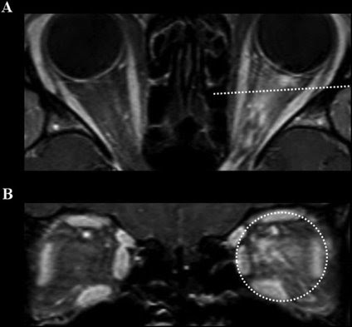
Orbital Inflammation in MOG Optic Neuritis
Enhancement of the optic nerve, optic nerve sheath, and orbital fat
Image reprinted with permission from: Kim SM, Kim SJ, Lee HJ, Kuroda H, Palace J, Fujihara K. Differential diagnosis of neuromyelitis optica spectrum disorders. Therapeutic advances in neurological disorders 2017; 10(7): 1-25

Slide 30
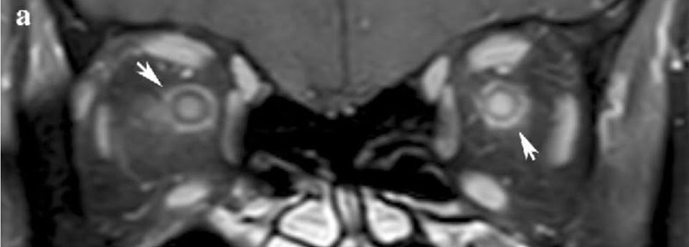
Enhancement of the Optic Nerve Sheath in MOG Optic Neuritis
Image reprinted with permission from Biotti D, Bonneville F, Tournaire E, Ayrignac X, Carra Dalliere C, Mahieu L...et al. Optic neuritis in patients with anti-MOG antibodies spectrum disorder: MRI and clinical features from a large multicentric cohort in France. Journal of Neurology 2017; 264: 2173-2175.

Slide 31
MOG Optic Neuritis: Treatment and Prognosis
Treatment
  Acute episode: solumedrol alone, or a combination of solumedrol + PLEX, solumedrol + IVIG, or solumedrol + IVIG + PLEX
  Chronic treatment: azathioprine, mycophenolate, or rituximab
Prognosis
  MOG Ab remained persistently positive in 98% of patients after treatment
  Annual relapse rate was 0.8 attacks/year with 50% of patients developing recurrent ON
    Median interval between attacks was 4 months
  12% of patients had a single episode of optic neuritis without a relapse or other neurologic symptoms
  Recurrence may be common, but vision typically improves dramatically after an acute episode

Slide 32
MOG Optic Neuritis: Treatment and Prognosis
70 patients
  Inclusion criteria: MOG-IgG seropositivity, ≥1 CNS demyelinating attack, immunotherapy for ≥6 months
Medication | Proportion with post-treatment relapse | Percent with post-treatment relapse | Annualized relapse rate
Mycophenolate mofetil | 14/19 | 74% | 0.67
Rituximab | 23/37 | 62% | 0.59
Azathioprine | 13/22 | 59% | 0.20
IVIG | 2/10 | 20% | 0.00
MS disease modifying agents | 9/9 | 100% | 1.50

Slide 33
MOG+ Pediatric Optic Neuritis
Pediatric Optic Neuritis Prospective Outcomes Study (Pineles, et al.)
  29% of cases of pediatric optic neuritis were MOG+ (n=8)
  MOG+ ON patients were at low risk for severe and permanent visual loss
    No participant relapsed over the 2 year period
    All patients with a known diagnosis of MOG+ demyelinating disorder obtained age-normal VA (ie BCVA 20/30 or better) at 2 year follow up
MOG-IgG Among Participants in the Pediatric Optic Neuritis Prospective Outcomes Study (Chen et al.)
  MOG IgG positive pediatric patients were more likely to present with bilateral optic neuritis and severe visual loss. However, these patients tended to have a substantial recovery of visual acuity after 6 months of treatment.
  A majority of MOG-IgG positive patients were male (86%)

Slide 34
Conclusion: 11-Year-Old Male with Acute, Bilateral Visual Loss x 3 days
MOG optic neuritis should be considered in the differential for a patient with optic neuritis (unilateral or bilateral), especially if the presenting symptoms include pain with EOMs, optic disc swelling with peripapillary hemorrhages, and nerve enhancement which spares the optic chiasm on MRI
Treatment consists of a combination of steroids +/- PLEX or IVIG, or PLEX followed by IVIG, in cases of severe visual loss

Slide 35
References
Biotti D, Bonneville F, Tournaire E, Ayrignac X, Carra Dalliere C, Mahieu L...et al. Optic neuritis in patients with anti-MOG antibodies spectrum disorder: MRI and clinical features from a large multicentric cohort in France. Journal of Neurology 2017; 264: 2173-2175.
Chen JJ, Flanagan EP, Jitprapaikulsan J, Lopez-Chiriboga ASS, Fryer JP, Leavitt JA...et al. Myelin oligodendrocyte glycoprotein antibody-positive optic neuritis: clinical characteristics, radiologic clues, and outcome. American Journal of Ophthalmology 2018; 195: 8-15.
Chen JJ, Flanagan EP, Bhatti TM, Jitprapaikulsan J, Dubey D, Lopez Chiriboga AS…et al. Steroid-sparing maintenance immunotherapy for MOG-IgG associated disorder. Journal of Neurology 2020; 95: e111-e120.
Chen JJ, Pineles SL, Repka MX, Pittock SJ, Henderson RJ, Liu GT. MOG-IgG among participants in the pediatric optic neuritis prospective outcomes study. JAMA Ophthalmology 2021; 139 (5): 583-585.
Garg A, Margolin E, Micieli JA. Myelin oligodendrocyte glycoprotein antibody-associated optic neurtitis in Canada. The Canadian Journal of Neurological Sciences 2020; 48: 321-326.
Jitprapaikulsan J, Chen JJ, Flanagan EP, Tobin WO, Fryer JP, Weinshenker BG...et al. Aquaporin-4 and myelin oligodendrocyte glycoprotein autoantibody status predict outcome of recurrent optic neuritis. Ophthalmology 2018; 125 (10): 1628-1637.
Kim SM, Kim SJ, Lee HJ, Kuroda H, Palace J, Fujihara K. Differential diagnosis of neuromyelitis optica spectrum disorders. Therapeutic Advances in Neurological Disorders 2017; 1-25.
Kezuka T, Ishikawa H. Diagnosis and treatment of anti-myelin oligodendrocyte glycoprotein antibody positive optic neuritis. Japanese Journal of Ophthalmology 2018; 62: 101-108.
Pineles SL, Henderson RJ, Repka MX, Heidary G, Liu GT, Waldman AT, Borchert MS...et al. The pediatric optic neuritis prospective outcomes study- two year results. Ophthalmology 2022; Status: in press.
Ramanathan S, Mohammad S, Tantsis E, Nguyen TK, Meheb V, Fung VSC...et al. Clinical course, therapeutic responses and outcomes in relapsing MOG antibody associated demyelination. BMJ Journal of Neurology, Neurosurgery, and Psychiatry 2018; 89: 127-137.
Ramanathan S, Prelog K, Barnes EH, Tantsis EM, Reddel SW, Henderson APD...et al. Radiological differentiation of optic neuritis with myelin oligodendrocyte glycoprotein antibodies, aquaporin-4 antibodies, and multiple sclerosis. Multiple Sclerosis Journal 2015; 22(4): 470-482.
Tajfirouz DA, Bhatti MT, Chen JJ. Clinical characteristics and treatment of MOG-IgG associated optic neuritis. Current Neurology and Neuroscience Reports 2019; 19:100.
Vicini R, Brügger D, Abegg M, Salmen A, Grabe HM. Differences in morphology and visual function of myelin oligodendrocyte glycoprotein antibody and multiple sclerosis associated optic neuritis. Journal of Neurology 2021; 268: 276-284.

