Slide 1


Recurrent branch retinal artery occlusions
Francisco Sanchez, MD, M. Tariq Bhatti, MD, John J Chen, MD, PhD
Neuro-ophthalmology Department
Mayo Clinic, Rochester, MN
Neuro-ophthalmology UPFRONT cases series
May, 2021

Slide 2
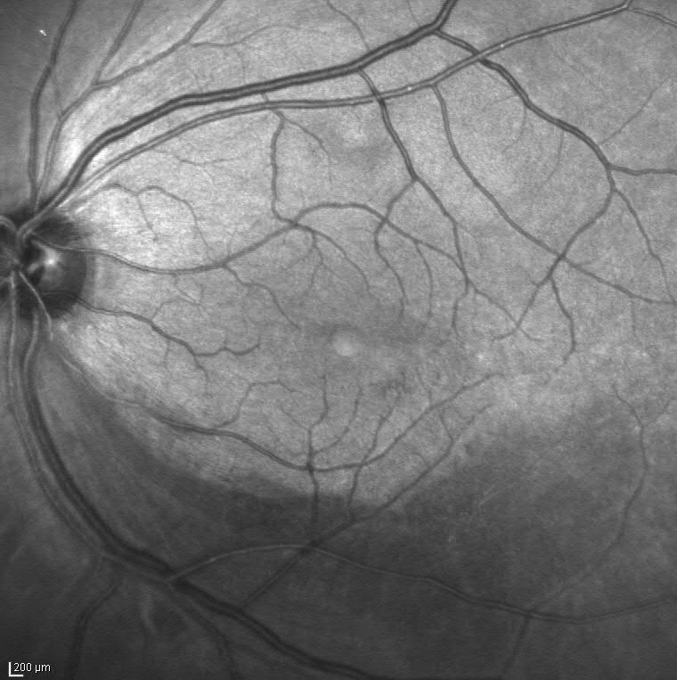
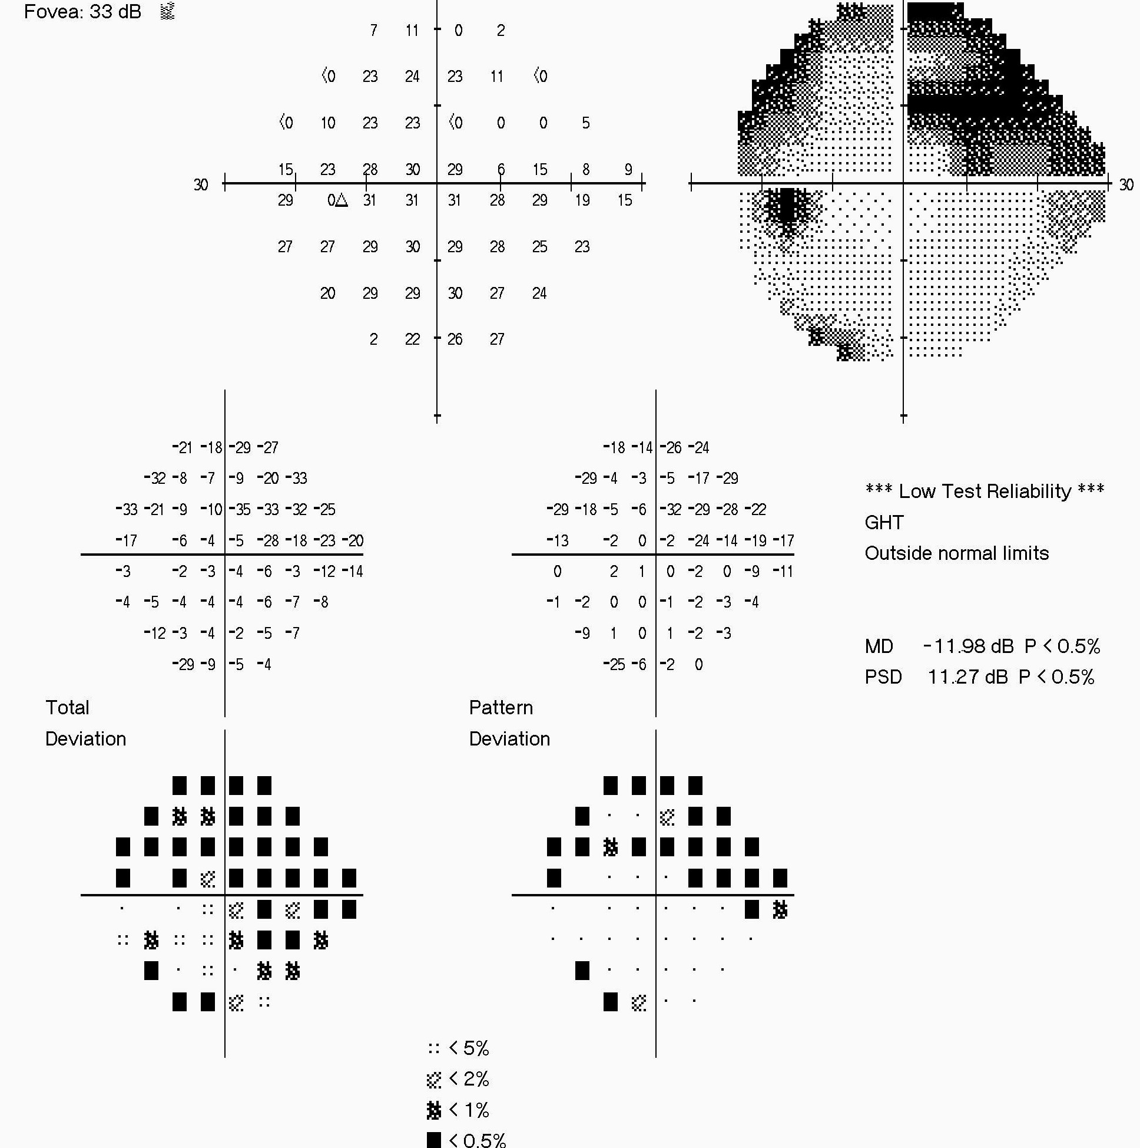
History
27 yo male presents with left eye vision loss and was found to have a superior arcuate scotoma from a branch retinal artery occlusion (BRAO) by an outside provider.

Slide 3
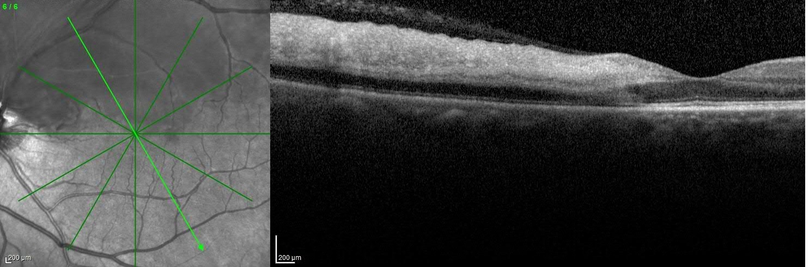
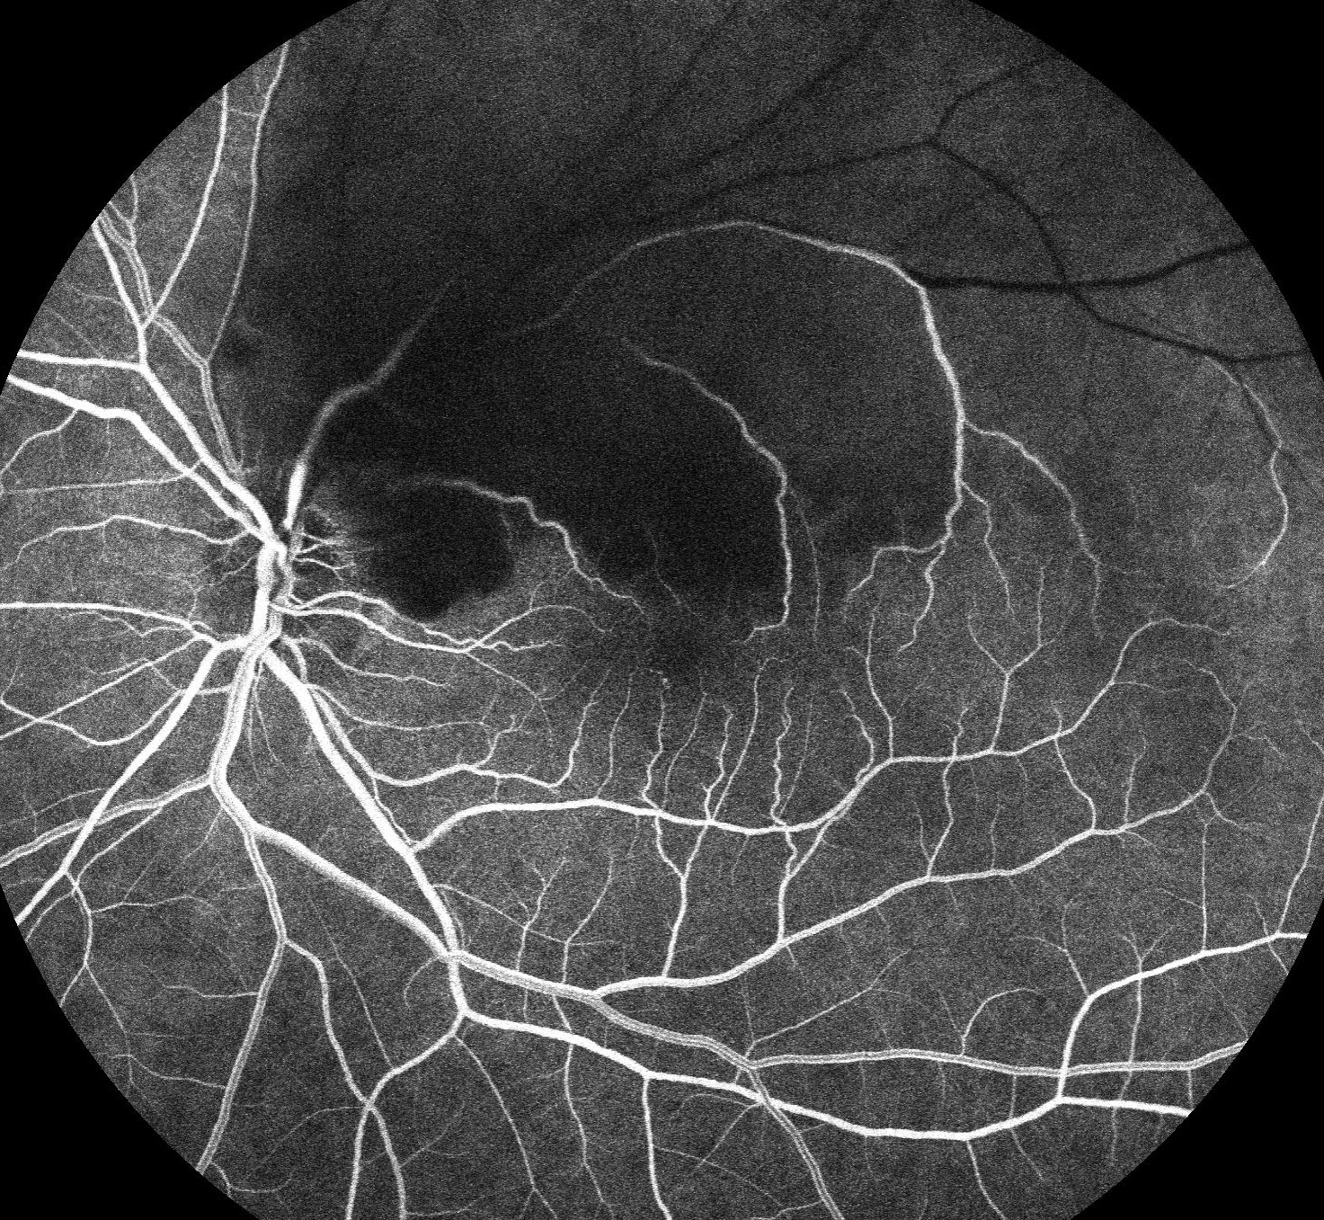
What is the workup of a BRAO?
BRAO is a stroke equivalent
  If acute, this requires urgent evaluation for a thromboembolic cause
Embolic workup
  Carotid imaging (ultrasound, CT angiogram or MR angiogram)
  Echocardiogram (preferred transesophageal but transthoracic if not availability or contraindicated)
  48-hour Holter monitoring
  +/- MRI/MRA Brain with and without contrast
Ophthalmologic Diagnostic Procedures
  FA: Perfusion of the retinal arteries may be visualized using fluorescein angiography
  SD-OCT (Spectral domain optic coherence tomography): In acute phase, the scan through the affected area in BRAO shows thickening and increased inner retinal reflectivity and in late phase inner retinal thinning ensues
*
*
Images taken from another patient with embolic BRAO and do not represent this case’s patient
Notes:
Do you want to show an example of a FA with poor perfusion and an OCT in BRAO? (not from this case)

Slide 4
History
The patient was sent to the local emergency department and had a thromboembolic workup, which was negative, including unremarkable carotid ultrasound, transthoracic echocardiogram, and EKG.

Slide 5
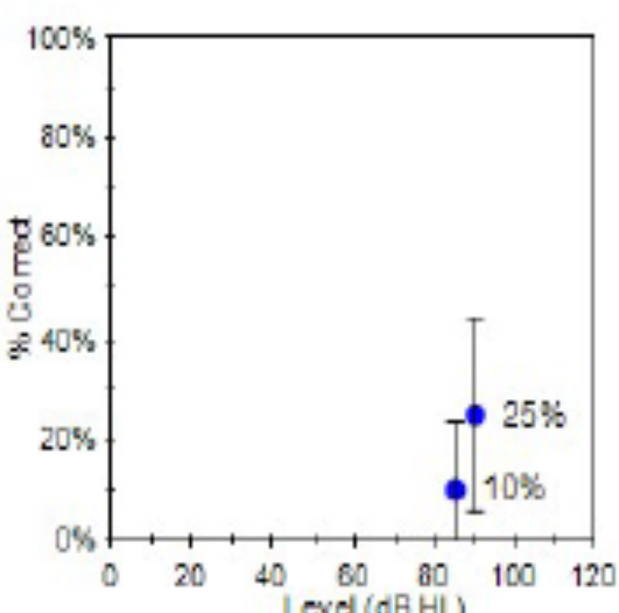
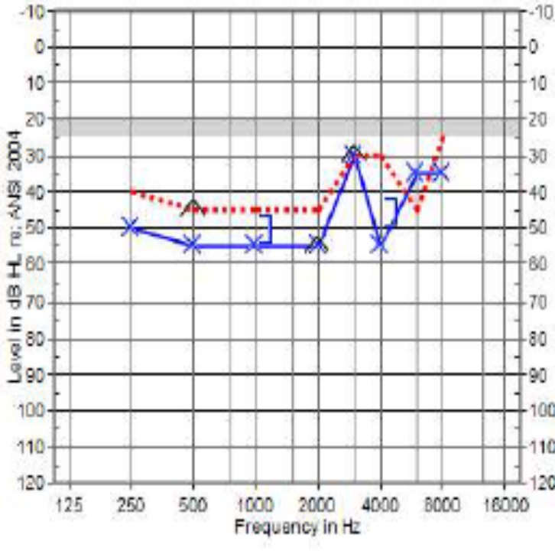
History
Two months later, he reported acute left ear hearing loss and found to have moderate sensorineural hearing loss on audiogram.
Word Recognition
Frequency in Hertz
Notes:
Do you want to have a slide asking about differential dx here, omitting final answer, but including entities such as Cogan’s?

Slide 6
Differential Diagnosis of Combined Vision and Hearing Loss
Category of Disease | Possible Diagnosis
Infectious | Syphilis and Lyme
Autoimmune/Inflammatory | Cogan syndrome, Susac syndrome, Vogt-Koyanagi-Harada syndrome, giant cell arteritis, and acute posterior multifocal placoid pigment epitheliopathy
Metabolic | Refsum disease and Fabry disease
Hereditary | Usher syndrome, Wolfram syndrome
Mitochondrial | MELAS syndrome, neuropathy ataxia and retinitis pigmentosa syndrome, dominant optic atrophy-plus
Kung NH, Bucelli RC, Van Stavern RB, Goebel JA, Van Stavern GP. A Young Man With Progressive Vision and Hearing Loss. JAMA Neurol. 2016;73(7):880–883. doi:10.1001/jamaneurol.2016.1336

Slide 7
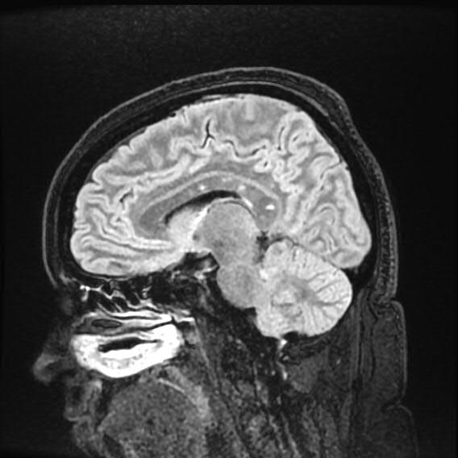
History
Two weeks later, he went to the emergency department because of headaches and balance problems
MRI Brain disclosed small T2 hyperintense lesions in the corpus callosum

Slide 8
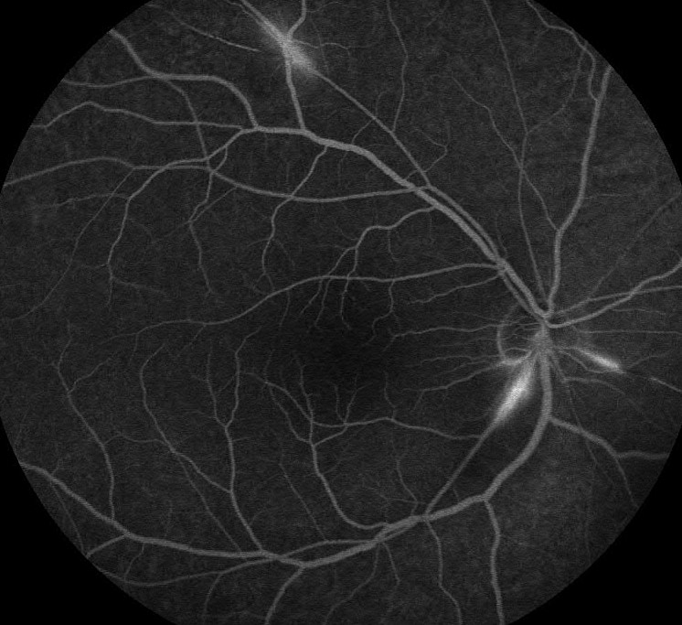
History
He then developed a new onset scotoma in his right eye. Fluorescein angiography disclosed staining of a few arterioles and areas of nonperfusion in both eyes consistent with a retinal vasculitis.

Slide 9
What is your Diagnosis?
What will your treatment be?

Slide 10
Susac Syndrome
Susac syndrome is an autoimmune disease of the small arterioles of the brain, retina, and inner ear
First described by Dr. John Susac in 1979
Mean age is 32, women more affected than men
Characterized by the triad of:
  Encephalopathy
  Sensorineural Hearing Impairment
  Branch Retinal Artery Occlusion
Only 13% of patients present with the full triad and can take up to 2 years to develop
  Definite diagnosis requires all 3 features. 2 of the 3 provides a probable diagnosis.

Slide 11
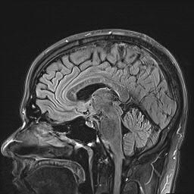
Susac’s Syndrome
MRI classically shows snowball lesions (shown with arrows on image) in the corpus collosum.
Audiogram typically shows low to medium frequency hearing loss.
Fluorescein angiogram is helpful for detecting BRAO’s and arterial wall hyperfluorescence/staining.
  The presence of arterial wall hyperfluoresence remote from a BRAO is suggestive of a retinal vasculitis and can support the diagnosis of Susac syndrome
Notes:
Do you want to show an example of a snowball lesion (I am sure we could get this from a member of NANOS if you do not have)

Slide 12
Susac Syndrome Treatment
Acute treatment with intravenous methylprednisolone during exacerbations and/or IVIG or plasma exchange
Maintenance immunotherapy
  Treatment options: IVIG, rituximab, cyclophosphamide, mycophenolate mofetil and azathioprine

Slide 13
Comparison of Susac syndrome and Cogan’s syndrome
Susac Syndrome
Cogan Syndrome
Ophthalmological Manifestations
  Branch retinal artery occlusions
Neurological Manifestations
  Gait disturbances
  Dysarthria
  Cognitive Disfunction
Hearing loss
  Mid to low frequencies
Microangiopathy
Vasculitis
Ophthalmological Manifestations
  Interstitial Keratitis
  Episcleritis
  Scleritis
  Retinal vasculitis
Vestibuloauditory dysfunction related to autoimmunity to the inner ear and cochlea.
Can be associated with systemic vasculitis (medium and large vessel arteritis)
  Aortitis
  Inflammatory bowel disease
  Pericarditis

Slide 14
Take home messages
BRAO is a stroke equivalent
Susac syndrome can be a rare cause of BRAO
Classic triad of Susac syndrome:
  Encephalopathy
  Sensorineural Hearing Impairment
  Branch Retinal Artery Occlusion
Fluorescein angiogram is very sensitive in detecting retinal vasculitis seen in Susac syndrome
Notes:
Since Cogan’s can present with BRAO and hearing loss, might be good to have a slide that differentiates two

Slide 15
References
Murthy RK, Grover S, Chalam KV. Sequential spectral domain OCT documentation of retinal changes after branch retinal artery occlusion. Clinical ophthalmology (Auckland, N.Z.). 2010;4:327-329.
Coady PA, Cunningham ET, Jr., Vora RA, et al. Spectral domain optical coherence tomography findings in eyes with acute ischaemic retinal whitening. The British journal of ophthalmology. May 2015;99(5):586-592.
Antonio Greco, Armando De Virgilio, Andrea Gallo, Massimo Fusconi, Rosaria Turchetta, Mario Tombolini, Maria Ida Rizzo, Marco de Vincentiis, Susac's syndrome — Pathogenesis, clinical variants and treatment approaches, Autoimmunity Reviews, Volume 13, Issue 8, 2014, Pages 814-821.
Egan, Robert A. MD Diagnostic Criteria and Treatment Algorithm for Susac Syndrome, Journal of Neuro-Ophthalmology: March 2019 - Volume 39 - Issue 1 - p 60-67.
Wilf-Yarkoni, A., Elkayam, O., Aizenstein, O. et al. Increased incidence of Susac syndrome: a case series study. BMC Neurol 20, 332 (2020).
Mario García-Carrasco, Claudia Mendoza-Pinto, Ricard Cervera, Diagnosis and classification of Susac syndrome, Autoimmunity Reviews, Volume 13, Issues 4–5, 2014, Pages 347-350.
Dörr, J., et al., Characteristics of Susac syndrome: a review of all reported cases. Nature reviews. Neurology, 2013. 9(6): p. 307-316.

