Slide 1


“Fuzzy Side”
Mehdi Tavakoli MD¹, Danielle R. Isen DO¹, Aparna Singhal, MD², James R. Hackney, M.D³
1- University of Alabama at Birmingham School of Medicine, Department of Ophthalmology and Visual Sciences
2- University of Alabama at Birmingham School of Medicine, Department of Radiology, Neuroradiology section
3- University of Alabama at Birmingham School of Medicine, Department of Pathology

Slide 2
Presentation:
The patient is a 15-year-old girl who was referred to the neuro-ophthalmology clinic
The chief complaint: “I see fuzzy when I look to the right side”
When she closes either eye, the blurring resolves
This has been present for the past 12 months and recently more noticeable
Past medical history is insignificant

Slide 3
What visual abnormalities can happen with side gaze?
  Gaze-evoked Amaurosis: Transient blurred vision in eccentric gazes
Etiology: abnormalities causing compression of the optic nerve and compromised perfusion of the optic nerve and/or retina in the eccentric gaze
Specific causes:
  1- Orbital tumors
  2- Thyroid eye disease
  3- Idiopathic intracranial hypertension
  4- Orbital fractures

Slide 4
What visual abnormalities can happen with side gaze?
Gaze-evoked Nystagmus: nystagmus caused by inability to maintain the eye fixation in the eccentric gaze
Etiology: disorders and drugs that affect the neural integrators which hold the eyes in the eccentric position (nucleus prepositus hypoglossi for horizontal gaze and interstitial nucleus of Cajal for vertical gaze)
Specific causes:
  1- Alcohol
  2- Neurologic medications (e.g., anticonvulsants and sedatives)
  3- Cerebellar lesions (e.g., multiple sclerosis and stroke)

Slide 5
What visual abnormalities can happen with side gaze?
Incomitant diplopia/deviation
Etiology: Any side-gaze misalignment can cause binocular diplopia or blurred vision with eccentric gaze. The misalignment can be too subtle to cause symptoms in the primary position.
Specific causes:
  1- Paralytic strabismus: 6th nerve palsy, 3rd nerve palsy
  2- EOM restriction: Thyroid eye disease
  3- Dysinnervation strabismus: Duane retraction syndrome (rare)

Slide 6
Binocular diplopia/blurred vision
What does “binocular diplopia” mean?
  It means that the problem only occurs with both eyes open
  Remember: our patient had no blurred vision when she closed either eye
  This is in contrast with monocular diplopia which is associated with a wide range of ocular surface/media and non-neurologic conditions
But why the patient does have “blurred vision” NOT double vision?
  A subtle misalignment does not cause a frank diplopia but instead induces fuzzy margins and outlines due to the minimally displaced second image

Slide 7
…Back to the patient
Examination
 | OD | OS
Visual Acuity | 20/20 | 20/20
RAPD | Negative | Negative
Pupil Reaction | Brisk | Sluggish
External | Normal | Normal
Anterior segment | Unremarkable | Unremarkable
Posterior segment | Unremarkable | Unremarkable

Slide 8
Pupil study:
 | Right Eye | Left Eye
Dim Light | 6 mm | 6.5 mm
Bright Light | 2.5 mm | 4.5 mm
Difference in pupil size: Anisocoria

Slide 9
What are the differential diagnoses of anisocoria with abnormal constriction to light?
Damage to iris: usually the damage is noted in the slit- lamp exam
Adie's tonic pupil: affected pupil responds to dilute pilocarpine 0.1%
Pharmacologic dilation: no pupil response to pilocarpine 0.1% and 1%
3rd nerve palsy: usually associates with other features of the palsy

Slide 10
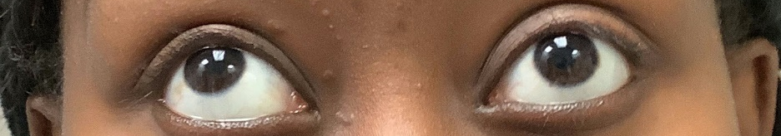
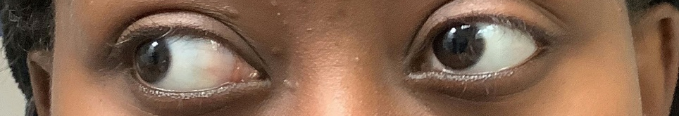
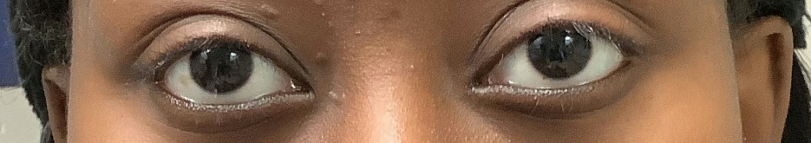
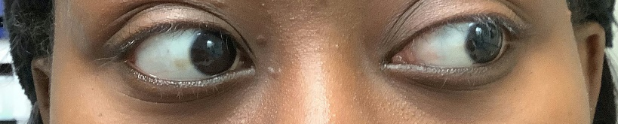
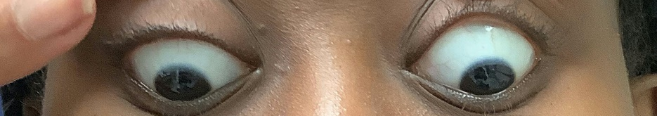
2 PD X/ 3 PD LHypo/Left supraduction -1
8 PD XT/2 PD LHypo/Left adduction -1
2 PD X/1 PD LHypo
1 PD LHypo
2 PD X/ 2 PD LH/Left Infraduction -0.50
X: exophoria
XT: exotropia
LHypo: Left Hypophoria
LH: Left Hyperphoria

Slide 11
In summary:
A 15 y/o girl with a 1-year history of blurred vision at right gaze
Anisocoria and sluggish reaction of the left pupil to light
Small angle of exophoria at primary gaze with increased angle of exodeviation at right gaze
Mild deficits in adduction, supraduction and infraduction of the left eye

Slide 12
Clinical Diagnosis
The clinical findings are consistent with partial left third nerve palsy

Slide 13
Etiology of pediatric 3rd nerve palsy
Congenital
Traumatic (the most common)
Tumors
Inflammation/infections
Aneurysms
Migraine
Iatrogenic
Cyclic oculomotor palsy

Slide 14
Next step:
Given the high risk of tumor/aneurysm in acquired third nerve palsy, the patient was admitted to the hospital and underwent urgent MRI and CT angiography.

Slide 15
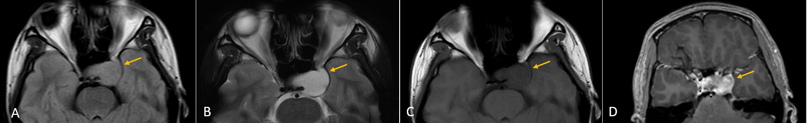
MRI of the brain and orbits (with and without gadolinium)
*Artifact is present due to a dental brace
Axial FLAIR (A), T2-weighted (B) and T1-weighted (C) images demonstrate a left sellar, parasellar and paracavernous expansile mass with mild FLAIR hyperintensity, T2 hyperintensity, and T1 hypointensity. Axial post-contrast T1-weighted image (D) demonstrates heterogeneous enhancement of the lesion.

Slide 16
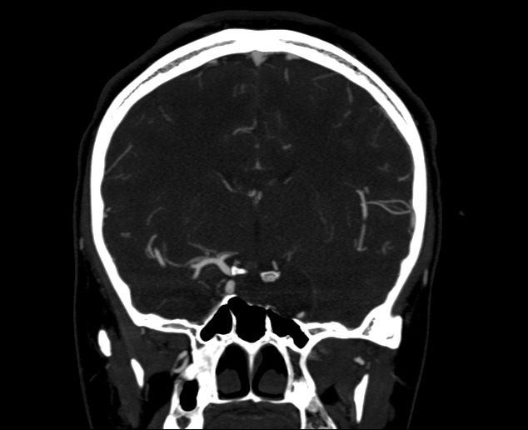
CT-Angiography
*
Coronal CT Angiography image demonstrates a relatively hypodense lesion (white block arrow) with bony scalloping inferiorly (white arrowhead). Note the inferior displacement and narrowing of the left internal carotid artery by the mass (white narrow arrow) and compare to the right internal carotid artery (asterisk).

Slide 17
Pediatric intra-cavernous sinus lesions
Meningioma
Germ-cell tumor
Hemangioma
Lymphoma
Dermoid tumor
Craniopharyngioma
Chordoma/chondrosarcoma

Slide 18
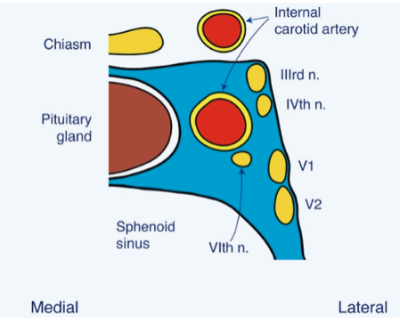
Cavernous sinus and ocular cranial nerves
From Liu, Volpe, and Galetta’s Neuro-ophthalmology; third edition, Chapter 15

Slide 19
Next step…
Patient underwent neurosurgery.

Slide 20
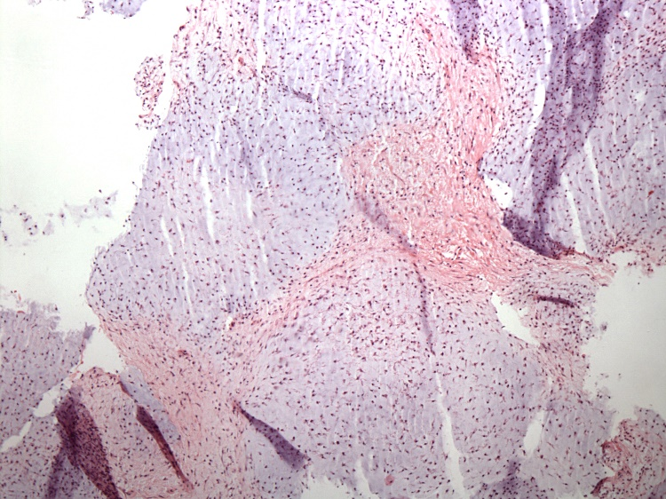
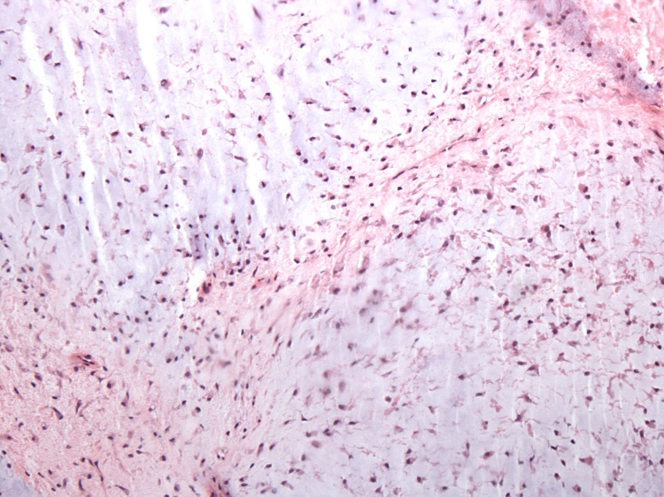
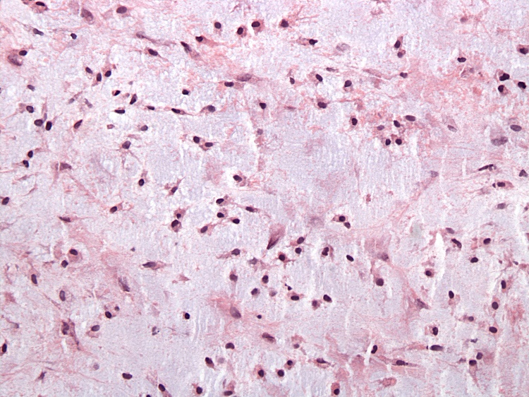
Histopathology
Allen H&E 40x – Cartilaginous nodules comprised of mildly atypical neoplastic cells
Allen H&E 100x – Neoplastic cells within a blue-gray cartilaginous matrix
Allen H&E 200x – Neoplastic cells have hyperchromatic nuclei and eosinophilic cytoplasm

Slide 21
Histopathology
Microscopic examination demonstrates low grade chondrosarcoma (WHO grade II), characterized by bland, round cells with round to oval nuclei, dispersed chromatin, and abundant pink cytoplasm
These cells are scattered symmetrically within a gray-blue chondroid matrix
Mitotic figures are extremely rare
The histologic differential diagnosis includes chordoma, but permanent sections confirmed the lack of the classic linear arrangement of tumor cells or "physaliferous" cells typically seen in chordomas

Slide 22
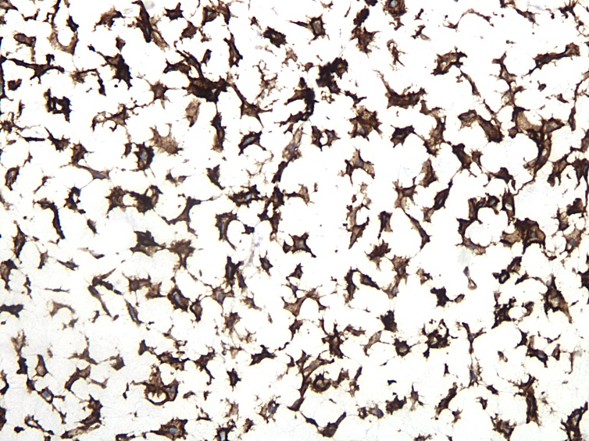
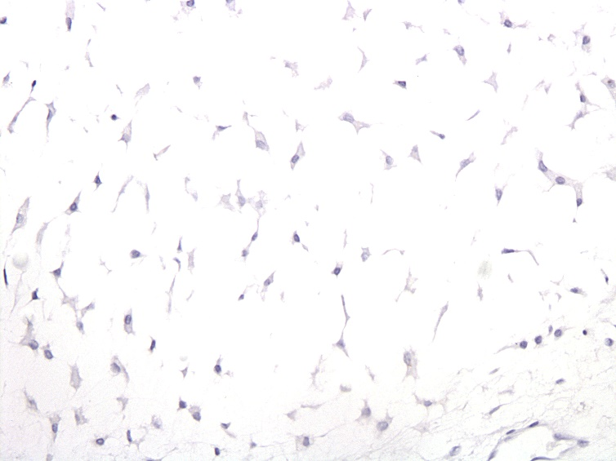
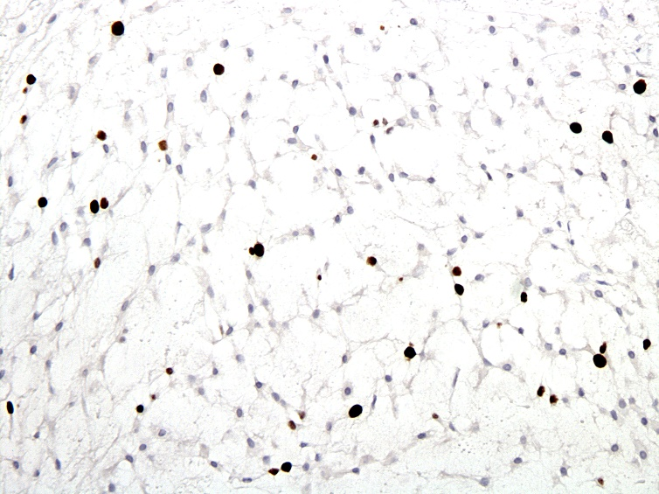
Immunohistochemistry
“Allen D2-40 200x” – Neoplastic cells are positive for D2-40 (podoplanin)
“Allen Keratin 200x” – Neoplastic cells are negative for pancytokeratin
“Allen Ki67 200x” – Ki-67 proliferation rate is low

Slide 23
Immunohistochemistry
Tumor cells are strongly positive for cartilaginous marker D2-40 (a cartilaginous neoplasm marker) and negative for chordoma marker pancytokeratin. The Ki-67 proliferation index is low at about 5%.

Slide 24
Final Diagnosis
The constellation of histologic findings is consistent with a low-grade chondrosarcoma

Slide 25
Intracranial chondrosarcoma:
Epidemiology and Presentation
A rare tumor: 1 in 1000 intracranial tumors
The most common age: 40-70; Rare in pediatric group
The most common origin: post-clival synchondrosis
Tends to involve the base of skull
Slow growing tumors
Present with headaches, diplopia, hearing reduction and/or tinnitus, facial sensory disturbances, and gait abnormalities
Most cases are sporadic though some cases are associated with Maffucci syndrome and Ollier disease

Slide 26
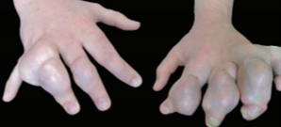
Maffucci Syndrome
Ollier Disease
Multiple enchondromas
  Often Bilateral
Tumors can be soft tissue hemangiomas
Multiple enchondromas
  Often Unilateral
Tumors spare the soft tissues
Both conditions are very rare
Congenital
Present in childhood
50% of patients with either condition develop malignancy such as chondrosarcoma, glioma, or ovarian juvenile granulosa cell tumor
Bilateral deformities of several digits caused by cartilaginous tumors and soft tissue hemangiomas in an individual with Maffucci syndrome¹
¹Amary FM, Damato S, Halai D, Eskandarpour M, et al. Ollier disease and Maffucci syndrome are caused by somatic mosaic mutations of IDH1 and IDH2. Nature Genetics. 2011 Nov;43:1262-5.

Slide 27
Intracranial chondrosarcoma: Imaging
CT scan: a well-defined isodense or hyperdense mass and occasional erosion of the local bones
MRI: low signal intensity in T1-weighted scans, high signal intensity in T2-weighted, and enhancement with gadolinium
Radiologic differential diagnoses: chordoma, nasopharyngeal carcinoma, and metastasis

Slide 28
Intracranial chondrosarcoma:
Treatment and Prognosis
Mainstay of treatment is surgery
Adjuvant radiotherapy will enhance the treatment, especially in patients with partially resected tumors
Prognosis: depends on anatomic extension of the tumor and the histologic grading
Total/near total resection there is a 5-year survival of 85-100%

Slide 29
Take Home Messages
It is always important to carefully listen to the patients. You can often get helpful diagnostic clues from their history.
Partial third nerve palsy may only present with diplopia (or blurring) at side gaze. It may also have very mild findings in the exam.
The common etiologies for pediatric third nerve palsy include congenital, trauma, and tumors.
Skull base chondrosarcoma is a rare pathology in pediatric group that may cause cavernous sinus involvement and consequent cranial nerve palsies.

Slide 30
References
Manor RS, Yassur Y, Hoyt WF. Reading-evoked visual dimming. American journal of ophthalmology. 1996 Feb 1;121(2):212-4.
Eggers SDZ. Approach to the Examination and Classification of Nystagmus. J Neurol Phys Ther. 2019 Apr;43 Suppl 2:S20-S26.
Schumacher-Feero LA, Yoo KW, Solari FM, Biglan AW. Third cranial nerve palsy in children. Am J Ophthalmol. 1999 Aug;128(2):216-21
Liu, Volpe, and Galetta’s Neuro-ophthalmology; third edition, Chapter 15
Tsai EC, Santoreneos S, Rutka JT. Tumors of the skull base in children: review of tumor types and management strategies. Neurosurg Focus. 2002 May 15;12(5):e1. doi: 10.3171/foc.2002.12.5.2. PMID: 16119897.
Awad M, Gogos AJ, Kaye AH. Skull base chondrosarcoma. J Clin Neurosci. 2016 Feb;24:1-5. doi: 10.1016/j.jocn.2015.10.029. Epub 2015 Dec 24. PMID: 26724847.
Amary FM, Damato S, Halai D, Eskandarpour M, et al. Ollier disease and Maffucci syndrome are caused by somatic mosaic mutations of IDH1 and IDH2. Nature Genetics. 2011 Nov;43:1262-5.

