Slide 1


Intractable Headache and Vomiting in a Pediatric Patient
Khelly Shah, MD
Rutgers New Jersey Medical School
Larry Frohman, MD
Rutgers New Jersey Medical School

Slide 2
6-Year-Old Girl with Severe Headache and Vomiting
Presents to emergency department with one day of severe headache, unrelieved by Tylenol or Rizatriptan, and vomiting, unrelieved by Zofran

Slide 3
6-Year-Old Girl with Severe Headache and Vomiting
PMH: right-sided frontotemporal arachnoid cyst status-post removal and cystic-peritoneal shunt placement in Ecuador at age of 1
Did well until similar episodic and recurrent headaches over previous year, progressively worsening
Located in right frontotemporal region and feels like “someone is nailing into my head”

Slide 4
6-Year-Old Girl with Severe Headache and Vomiting
ROS
(+) Photophobia
(+) Phonophobia
(+) Lethargy
(-) Fevers
(-) Blurry vision
(-) Transient visual
obscurations
(-) Diplopia
(-) Tinnitus
What are your differential diagnoses?

Slide 5
Differential Diagnoses
Arachnoid cyst recurrence (with active fluid secretion)
Shunt infection or malfunction
CNS infection
Brain malformation (Chiari type I, Dandy Walker)
Brain tumor
Venous sinus thrombosis or stenosis
Idiopathic intracranial hypertension
New-onset Migraine
What tests would you order?

Slide 6
Evaluation by Neurosurgery
  ‘No focal neurologic deficits on physical exam’
  Labs:
    ESR (7)
    CRP (1)
    Procalcitonin (Negative)
  Shunt tap: CSF unremarkable
  X-ray Shunt Series: no kinks or breaks in the visualized courses of the shunt catheter to suggest shunt malfunction

Slide 7
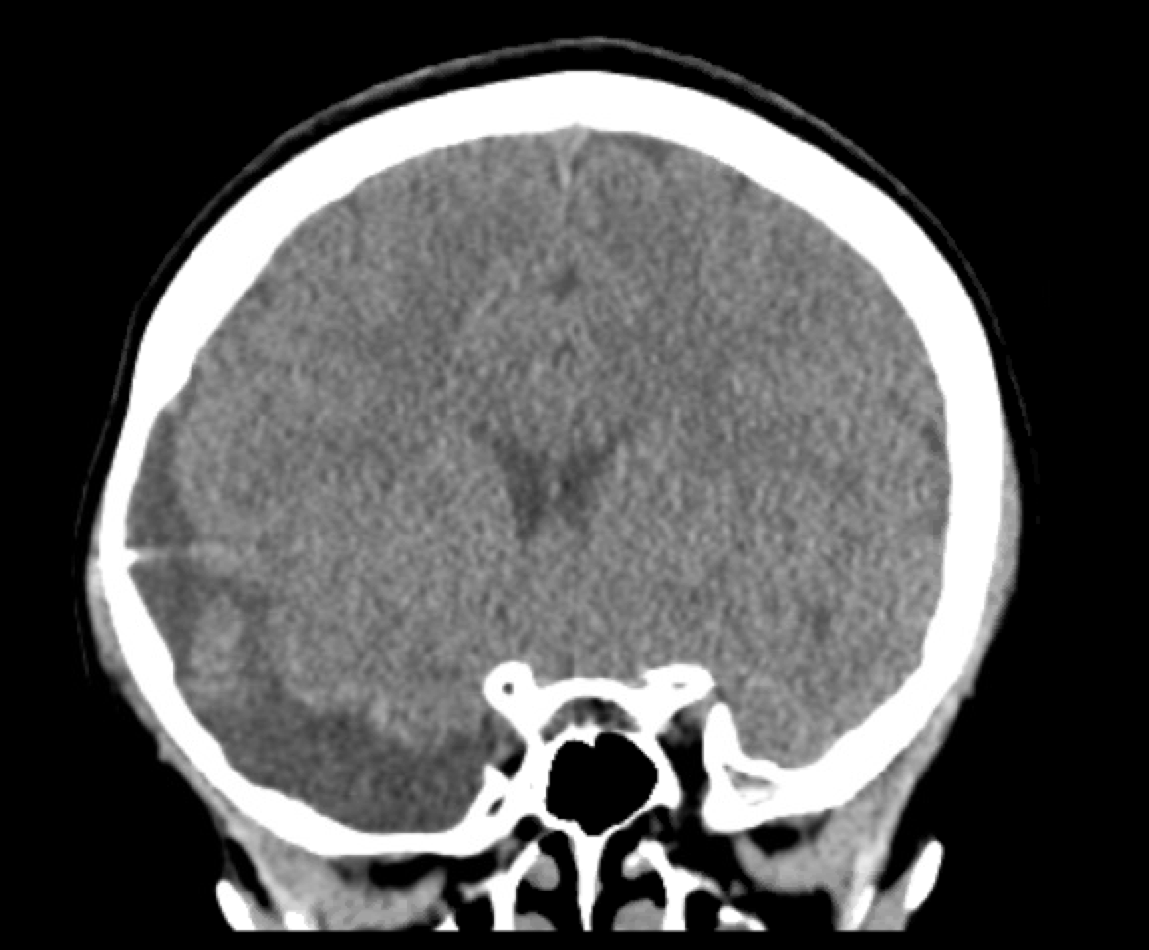
Imaging: CT
Previously placed shunt catheter
Recurrent Cyst

Slide 8
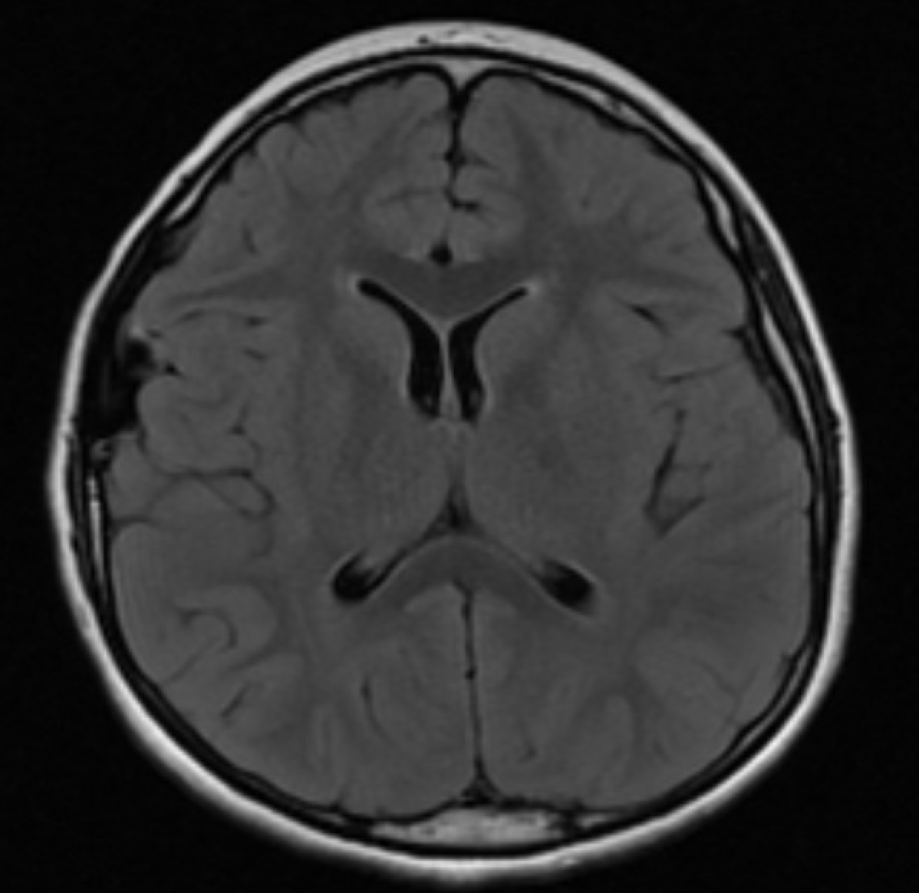
Imaging: MRI
Do the ventricles appear normal? Can the patient have increased intracranial pressure?

Slide 9
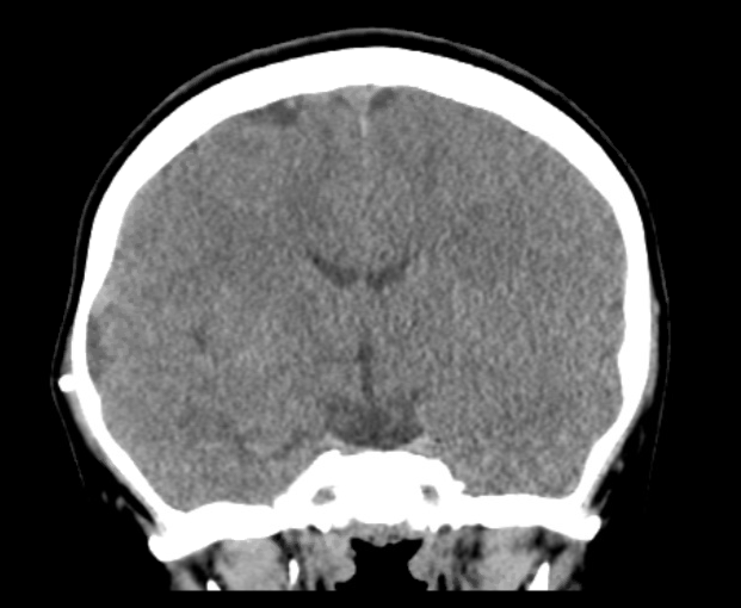
Imaging: CT

Slide 10
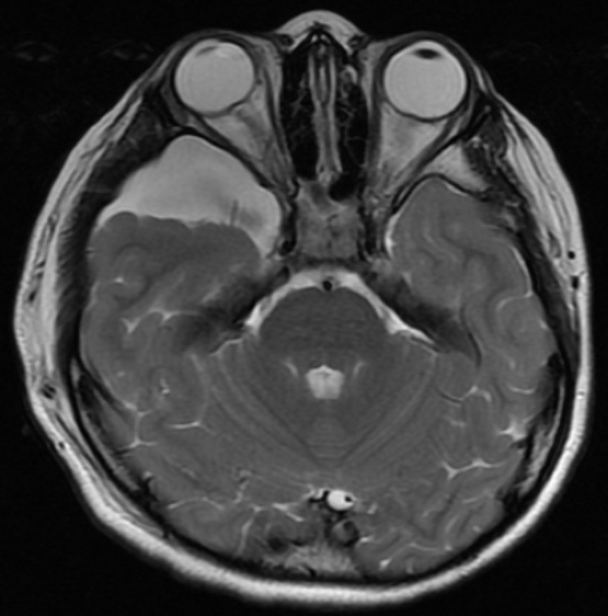
Imaging: MRI
Arachnoid cyst in the right middle cranial fossa

Slide 11
Hospital Course
Plan:
  Given unremarkable shunt tap and series and normal ventricles on imaging, neurosurgery deemed that no intervention was required; signed off
  Peds Neurology managed headache with IV magnesium sulfate, amitriptyline, gabapentin, topical lidocaine, but no significant relief
Prior to discharge, ophthalmology was consulted

Slide 12
Ophthalmologic Exam
Visual acuity: 20/25, 20/20
Pupils: PERRL, no rAPD
EOMs: full
Confrontational visual field: full
Color plates: normal
Slit lamp exam normal
Dilated fundus exam: 360 optic nerve edema both eyes with high watermark in left eye
How can the patient have papilledema if there is no evidence of hydrocephalus on imaging?
A sign that defines the prior extent of retinal elevation after acute edema resolves; may take months or years to disappear

Slide 13
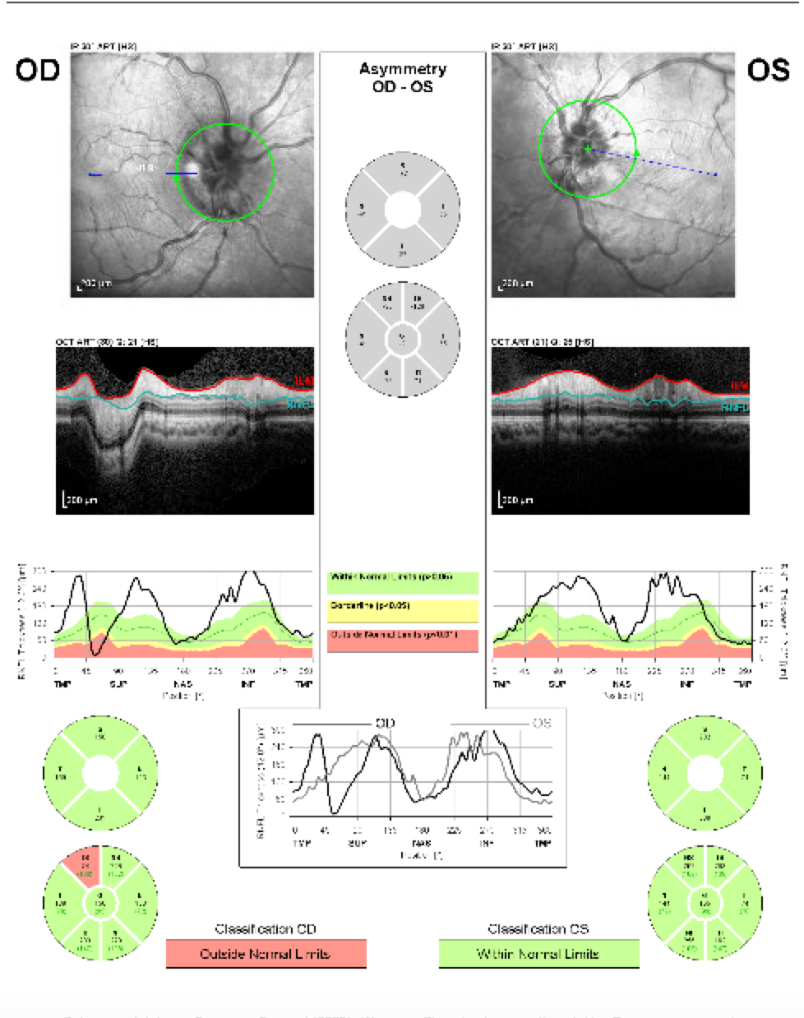
Optical Coherence Tomography (OCT)
RIGHT EYE
LEFT EYE
Thickening of nerve fiber layer in both eyes

Slide 14
6-Year-Old Girl with Severe Headache and Vomiting
Which prior test should be re-interpreted at this point?

Slide 15
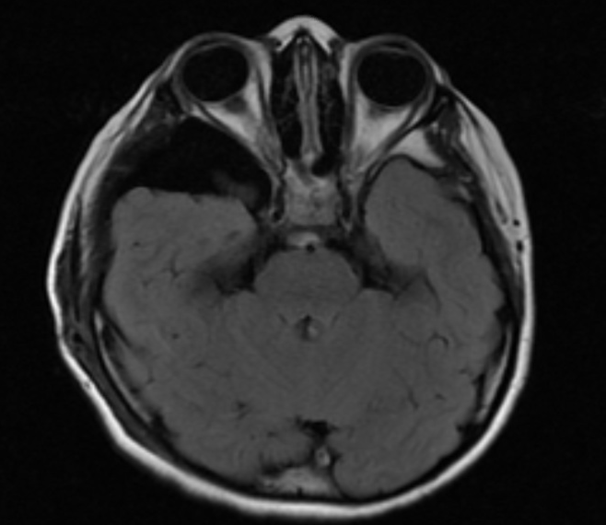
Imaging: MRI
Flattening of posterior globe and widening of optic nerve sheath
Lack of ventricular dilatation does not rule out increased intracranial pressure in this case!

Slide 16
Imaging: MRI
Slide previously shown also demonstrated flattening of posterior globe bilaterally

Slide 17
Slit Ventricle Syndrome
  Rare symptomatic condition whereby brain compliance is reduced due to period of simultaneous brain growth and excessive drainage (e.g. shunt placement in childhood)
  Associated with intermittent intracranial hypertension, presenting with neuro-imaging findings of small or normal ventricles
  Lack of ventricular dilation related to reduction in brain compliance
  Patients present with symptoms of increased intracranial pressure (e.g. headache, vomiting, impaired consciousness, visual disturbance, etc.); often cyclical with periods of exacerbation and remission

Slide 18
Slit Ventricle Syndrome
  Recognition of syndrome critical for favorable patient outcomes because consequences of intermittent intracranial hypertension could be progressive
  Overall incidence: 5-34% of patients with long-standing ventricular shunting for hydrocephalus

Slide 19
Possible Etiologies
  Pathogenesis remains unclear but several ideas proposed
  Intermittent proximal obstruction of ventricular catheter
  Intracranial hypertension in patients with a working shunt
  Shunt-related migraine

Slide 20
Treatment
  Optimal therapeutic strategy remains controversial
  Primary goal is to control symptoms through normalization of CSF dynamics
    Shunt revision, replacement with different type (e.g. lumboperitoneal, ventriculoperitoneal, cystoperitoneal), or removal if possible
    Placement of adjustable shunt valve with anti-siphon device
    Subtemporal decompression
    Endoscopic third ventriculostomy

Slide 21
Back to the case: Clinical Course
Patient transferred to different hospital with pediatric neurosurgical services
Surgical exploration: shunt found to be occluded with pseudo-meningocele around the valve (proper reading of ICP not able to be done initially)
Underwent exchange of cystic-peritoneal shunt for ventriculoperitoneal shunt
Went to OR again for catheter repositioning, after which ICP was 9.5 cm H₂O

Slide 22
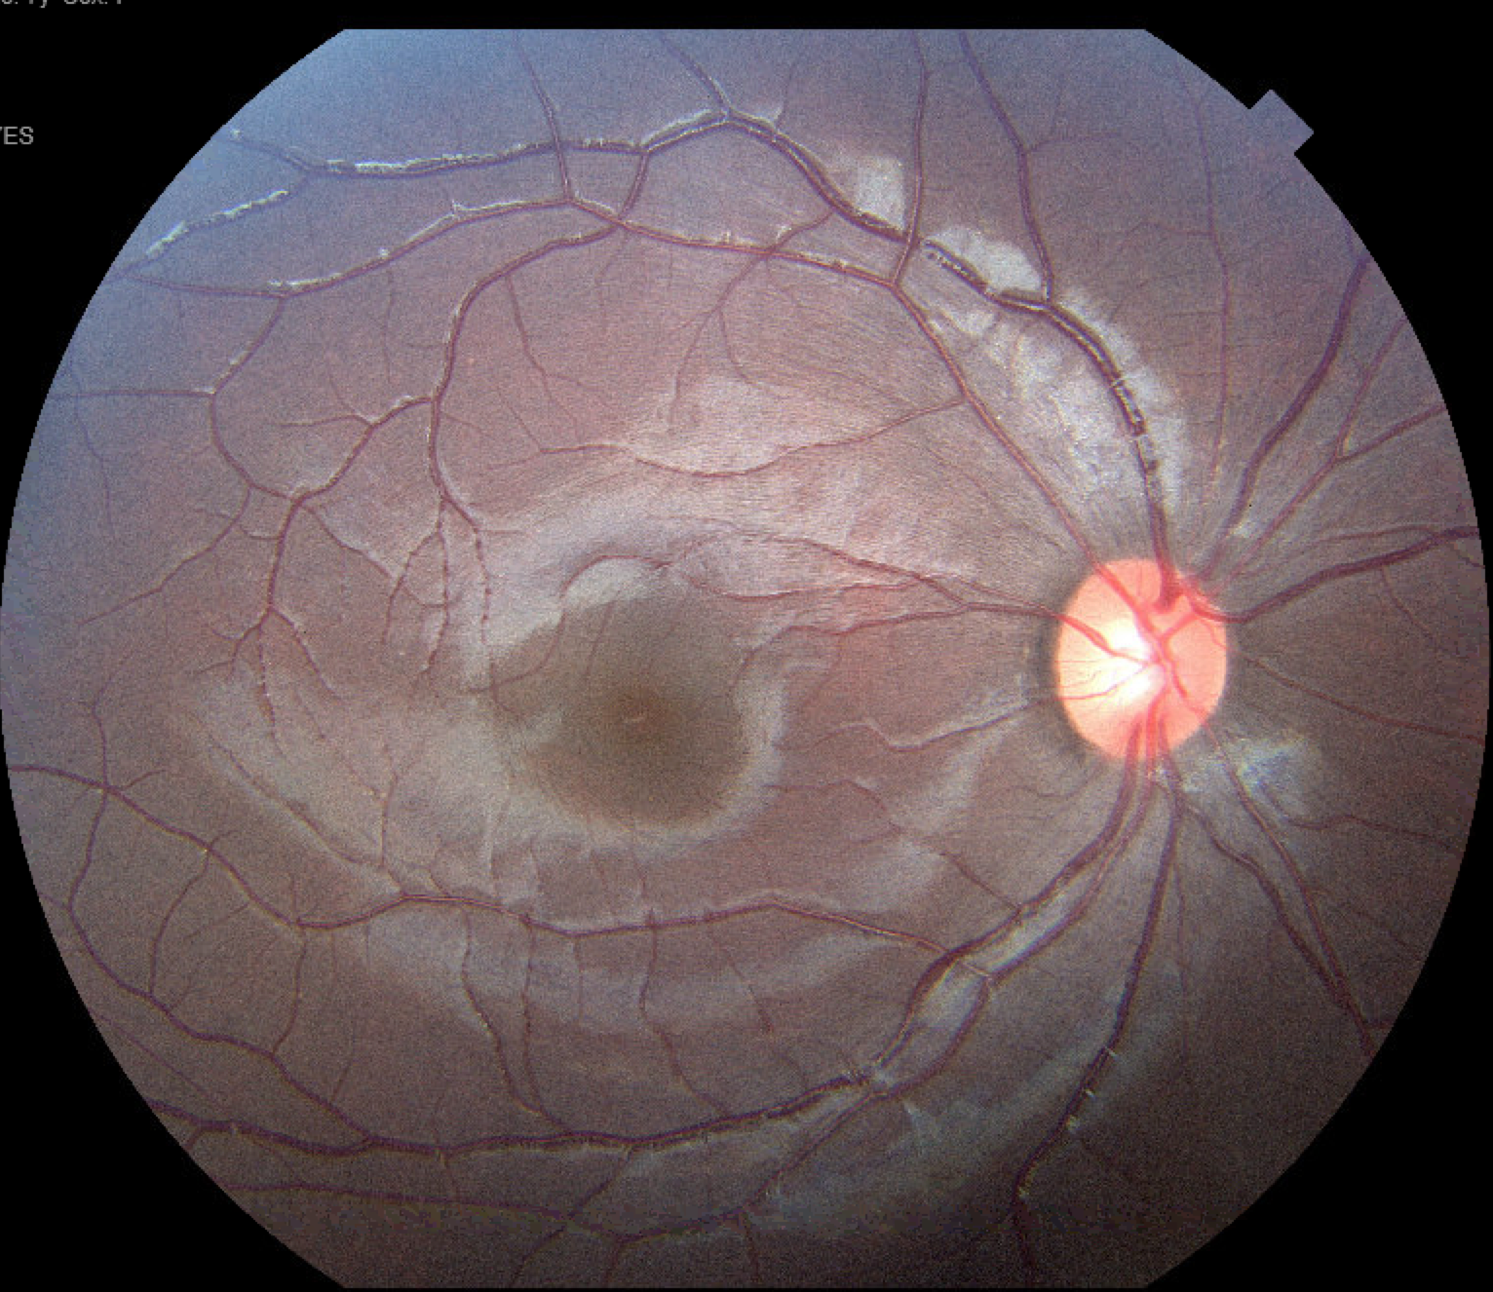
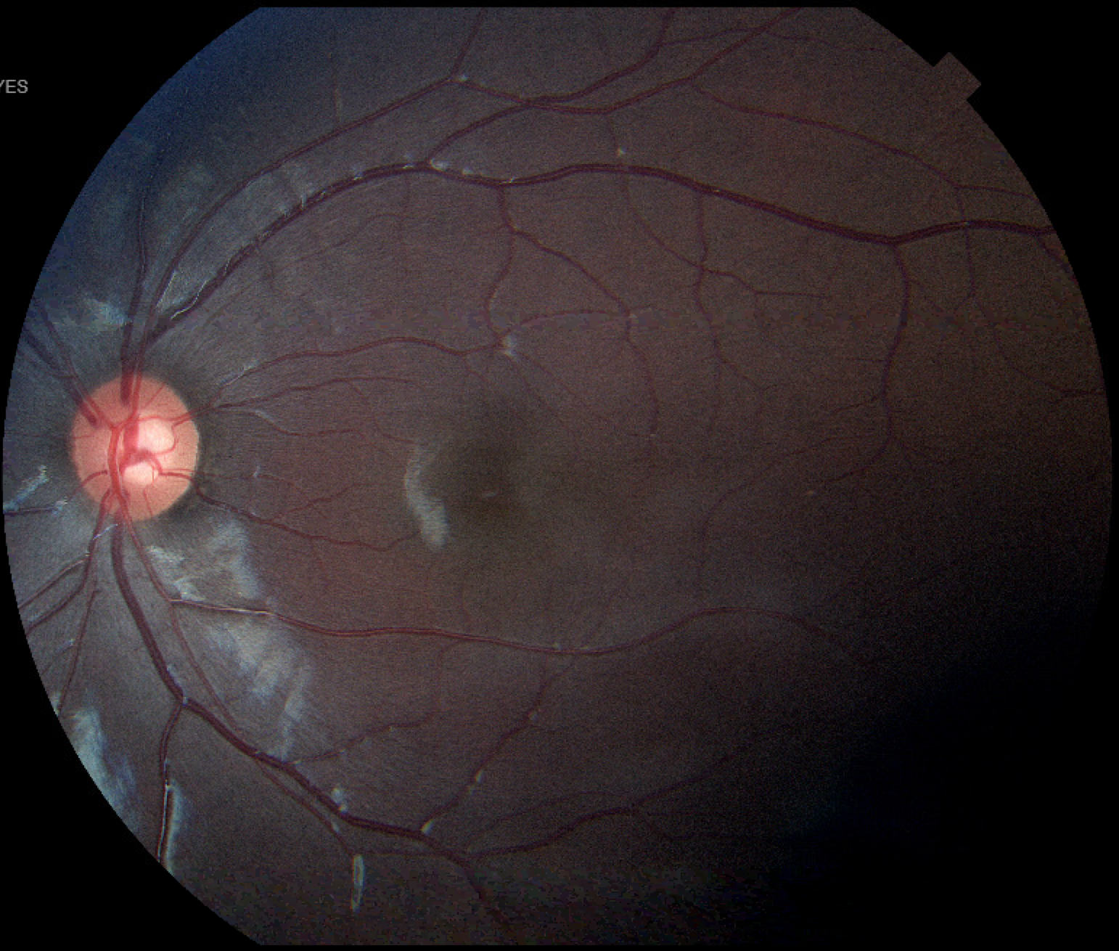
Post-Operative Funduscopic Exam
Papilledema Resolved!

Slide 23
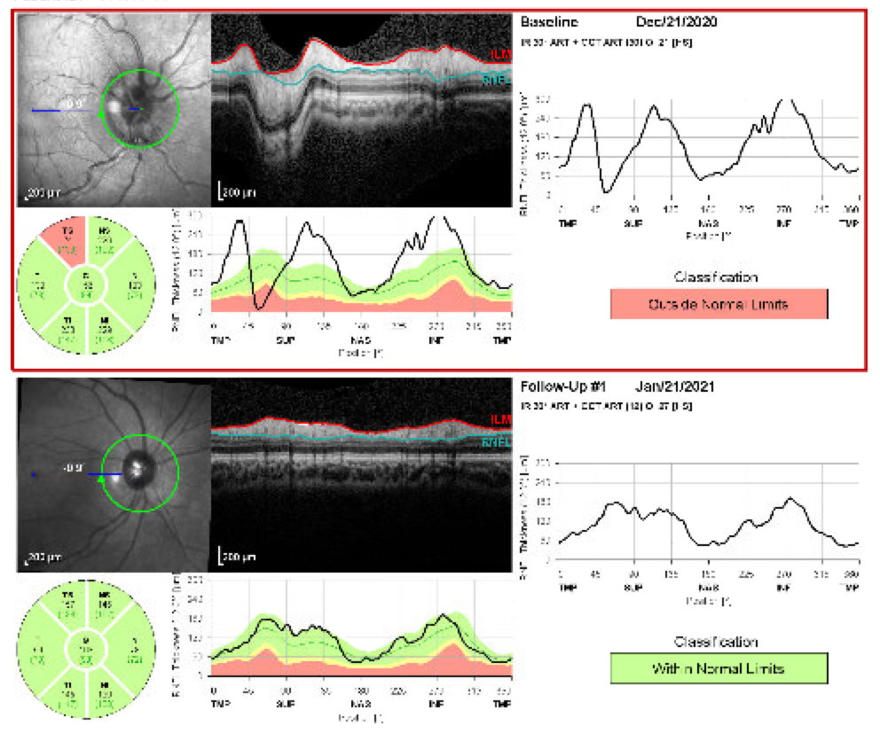
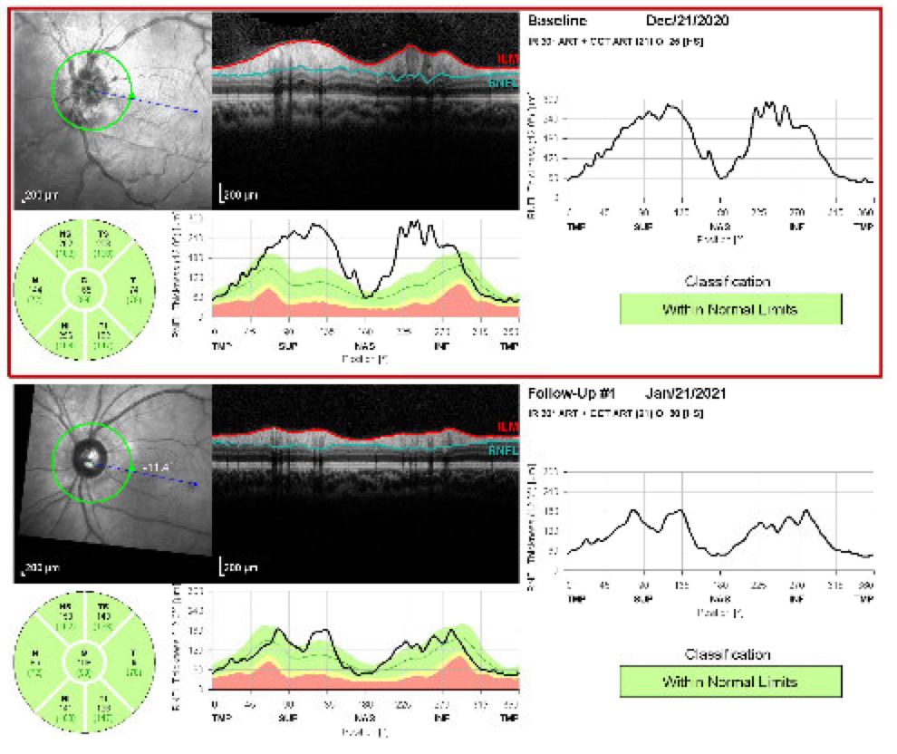
Post-Operative OCT
Normalization of nerve fiber layer in both eyes

Slide 24
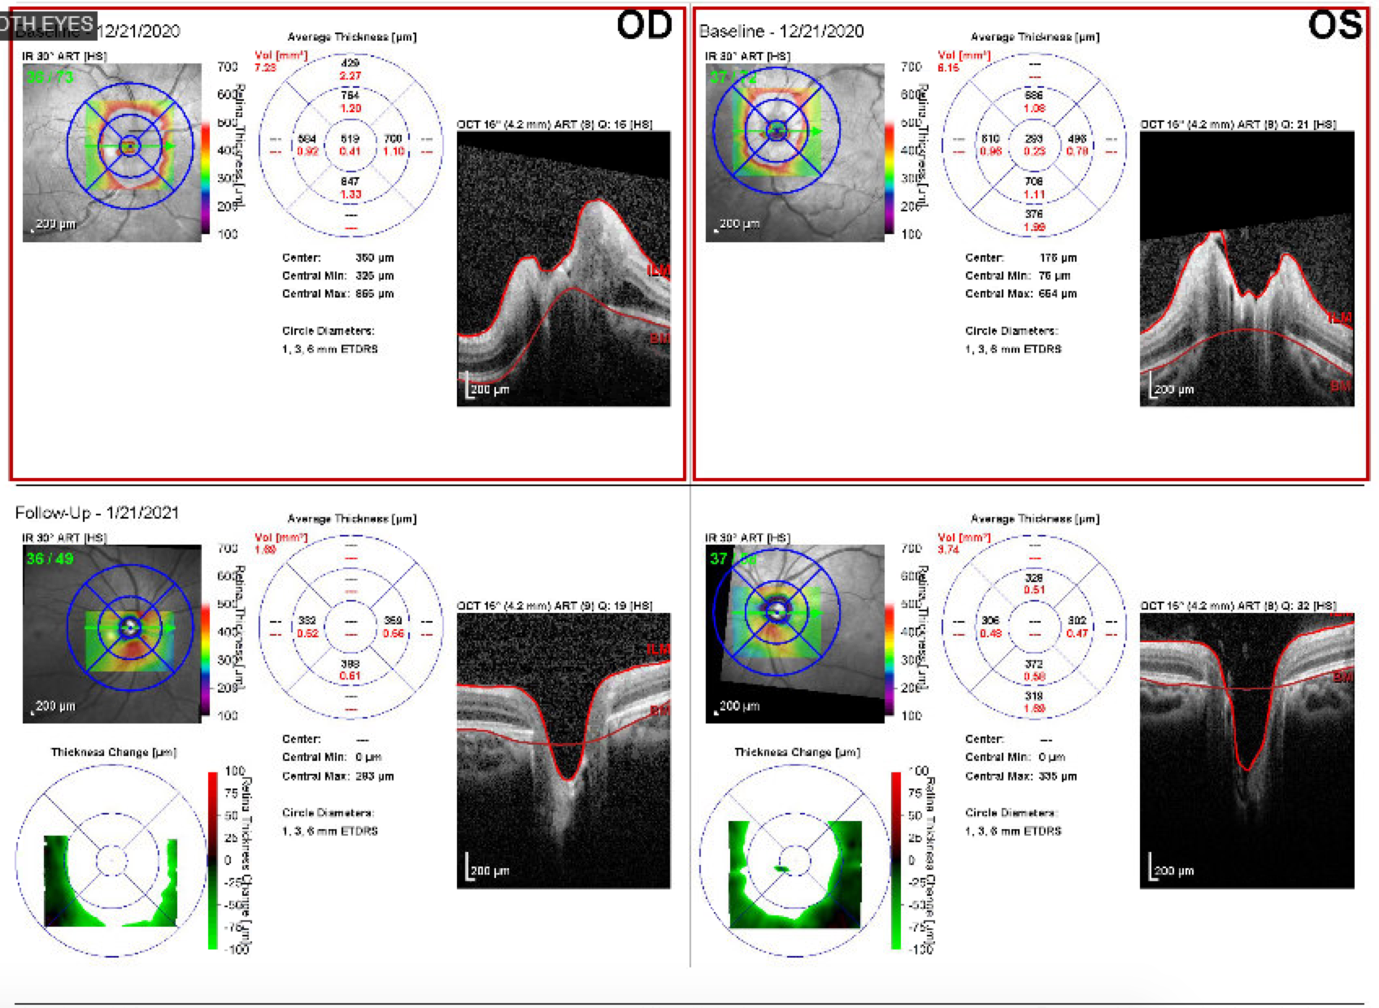
Post-Operative OCT
PRE-OP
Prior upward deflection of Bruch’s membrane
(purple arrows) now normal
POST- OP

Slide 25
Summary: In a patient who underwent shunting in childhood, ventricles may not dilate in response to increased intracranial pressure.
Although papilledema is not a sensitive sign of shunt dysfunction in children, it remains a pivotal finding that may suggest shunt dysfunction despite lack of ventricular enlargement.

Slide 26
References
Agarwal N, Vernier E, Ravenscroft S, Schwartz L, Oleske J, Ming X. Slit ventricle syndrome: a case report of intermittent intracranial hypertension. J Child Neurol. 2013 Jun;28(6):784-6. doi: 10.1177/0883073812449906. Epub 2012 Jul 17. PMID: 22805245.
Fang T, Xu J, Wang S, Ma Z, Xing J. Analysis of therapeutic choices for slit ventricle syndrome after cyst-peritoneal shunting for temporal arachnoid cysts in children. J Neurosurg Pediatr. 2010 Nov;6(5):474-80. doi: 10.3171/2010.8.PEDS10222. Erratum in: J Neurosurg Pediatr. 2011 Feb;7(2):220. PMID: 21039172.
Hamilton K, Koueik J, Maganti R, Iskandar B. Slit Ventricle Syndrome Leads to 10-Year History of Repetitive Transient Central Herniation Masquerading as Seizures: Hydrocephalus Case Report. World Neurosurg. 2019 Jun;126:134-138. doi: 10.1016/j.wneu.2019.02.106. Epub 2019 Mar 1. PMID: 30831286.
Kaliaperumal C, O'Connor B, Marks C. Development of intracranial hypertension after surgical management of intracranial arachnoid cyst: report of three cases and review of the literature. World Neurosurg. 2013 Jul-Aug;80(1-2):222.e1-4. doi: 10.1016/j.wneu.2012.11.002. Epub 2012 Nov 7. PMID: 23142586.
Kim WJ, Kim MM. Slit Ventricle Syndrome in Pediatric Patient Presenting with Only Visual Symptoms. Korean J Ophthalmol. 2017 Feb;31(1):92-93. doi: 10.3341/kjo.2017.31.1.92. Epub 2017 Feb 2. PMID: 28243031; PMCID: PMC5327183.
Marupudi NI, Harris C, Pavri T, Mell B, Singh R, Ham SD, Sood S. The role of lumboperitoneal shunts in managing chronic hydrocephalus with slit ventricles. J Neurosurg Pediatr. 2018 Dec 1;22(6):632-637. doi: 10.3171/2018.6.PEDS17642. PMID: 30239284.
Mencser Z, Kopniczky Z, Kis D, Barzo P. Slit Ventricle as a Neurosurgical Emergency: Case Report and Review of Literature. World Neurosurg. 2019 Oct;130:493-498. doi: 10.1016/j.wneu.2019.07.006. Epub 2019 Jul 9. PMID: 31295607.
Raucci U, Della Vecchia N, Ossella C, et al. Management of Childhood Headache in the Emergency Department. Review of the Literature. Front Neurol. 2019;10:886. Published 2019 Aug 23. doi:10.3389/fneur.2019.00886
Rekate HL. Shunt-related headaches: the slit ventricle syndromes. Childs Nerv Syst. 2008 Apr;24(4):423-30. doi: 10.1007/s00381-008-0579-7. Epub 2008 Feb 8. PMID: 18259760.

