Slide 1
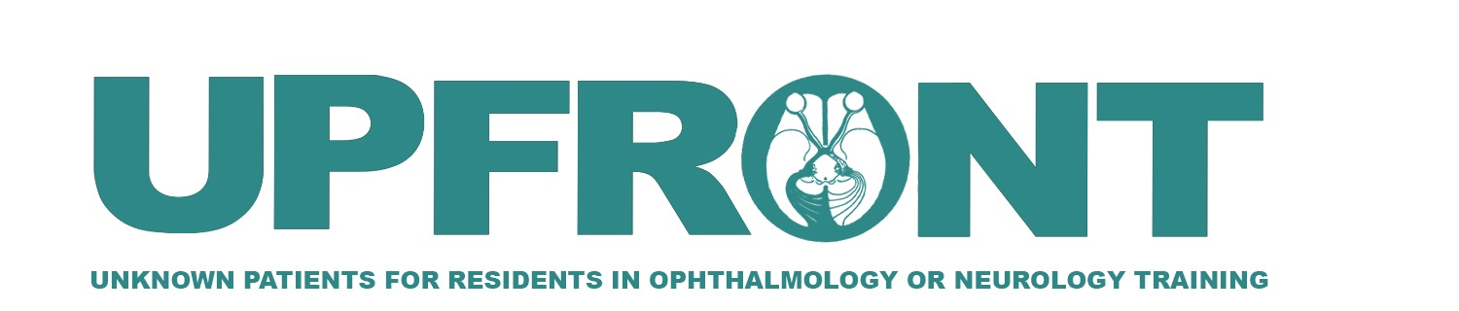

Bilateral vision loss in a young patient
Jorge Cardenas-Belaunzarán, MD, MSc
Professor of Neuro-Ophthalmology, Asociación para Evitar la Ceguera en México, I.A.P.
Octavio Turcio Aceves, MD
Resident Physician in Ophthalmology Asociación para Evitar la Ceguera en México, I.A.P.
Vianney Cortés González, MD, MSc
Professor of Ophthalmic Genetics, Asociación para Evitar la Ceguera en México, I.A.P.

Slide 2
18-Year-Old Male with Vision Loss in Both Eyes
Subacute, painless vision loss in right eye (OD), first noted 3 months prior to presentation
Subacute, painless vision loss in left eye (OS), first noted 1 month prior to presentation
Patient unsure if it kept progressing

Slide 3
18-Year-Old Male with Vision Loss in Both Eyes
PMH: (-)
Denies tobacco, alcohol or drug abuse
Denies ocular or head injury
Denies family history
ROS:
  Diplopia (-)
  Oscillopsia (-)
  Vertigo (-)
  Headache (-)
  Fevers (-)
  Weight Loss (-)
  Sensory or motor abnormalities (-)

Slide 4
Relevant Neuro-ophthalmic Examination
Best-corrected visual acuity: Counting fingers at 2 feet OD, 20/150 OS
Pupillary reactivity: isochoric in light and dark, reacted briskly to light, no relative afferent defect
Color vision - Ishihara plates: does not see control OD, + control 0/8 test plates OS
Optic Discs: to describe in next slide

Slide 5
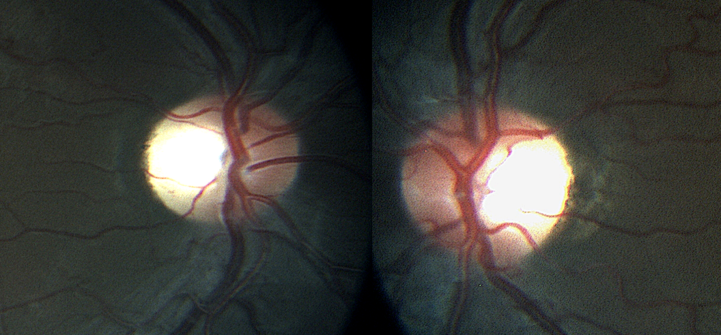
Ophthalmoscopy
What abnormality do you see?
What ophthalmic testing would you order now?

Slide 6
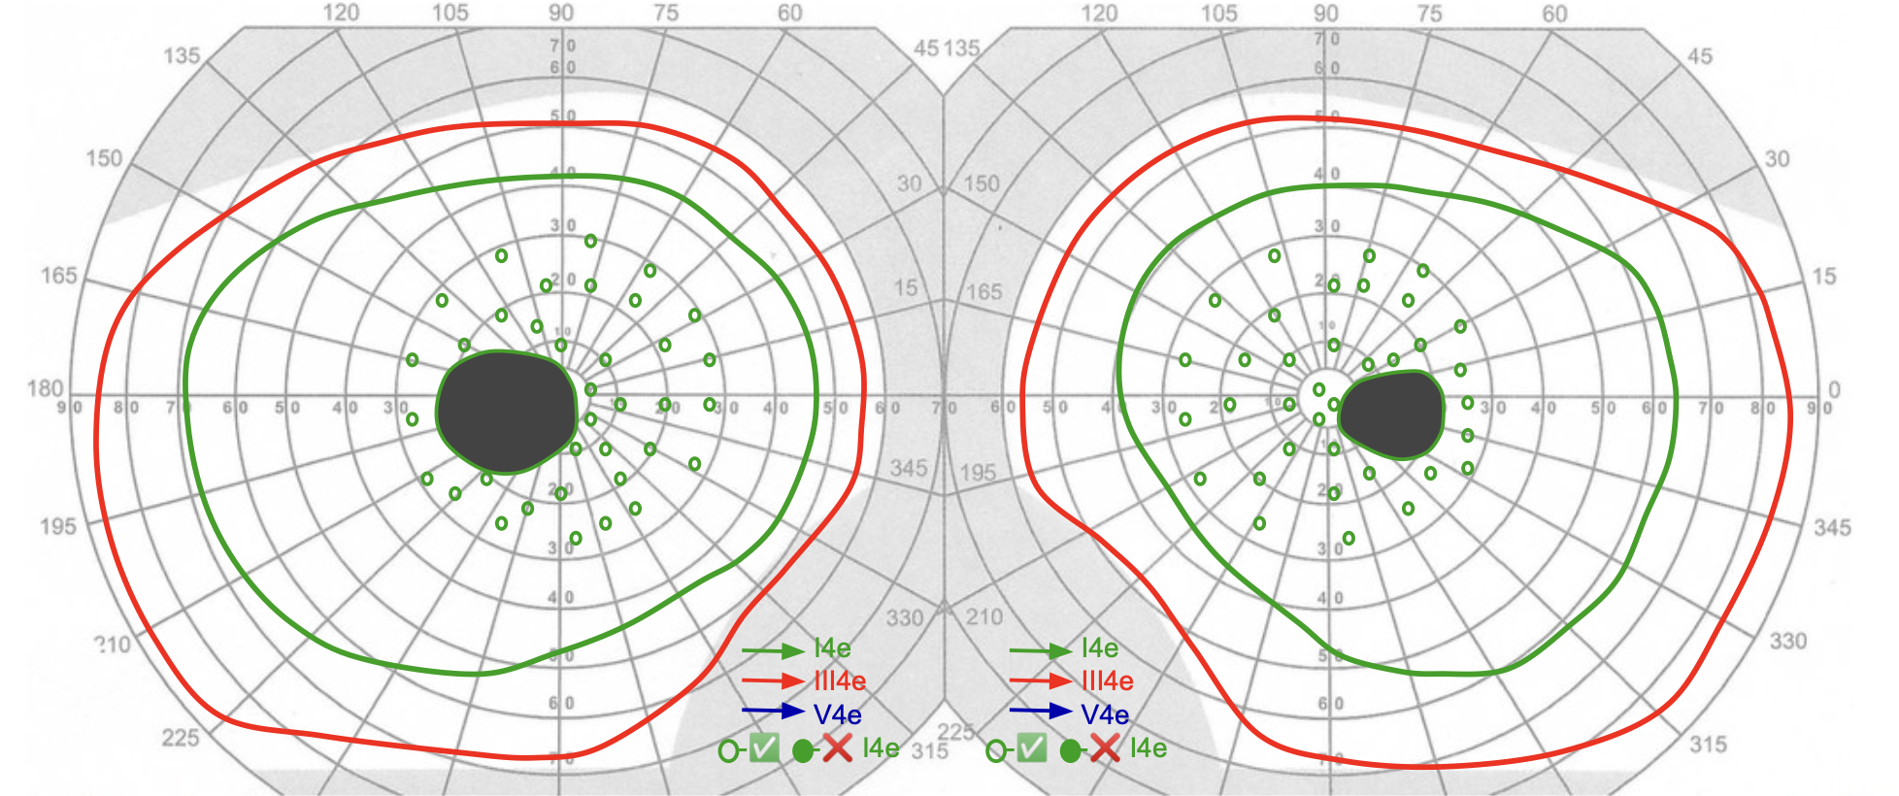
Goldmann Visual Field Analysis
What visual field abnormality do you see?

Slide 7
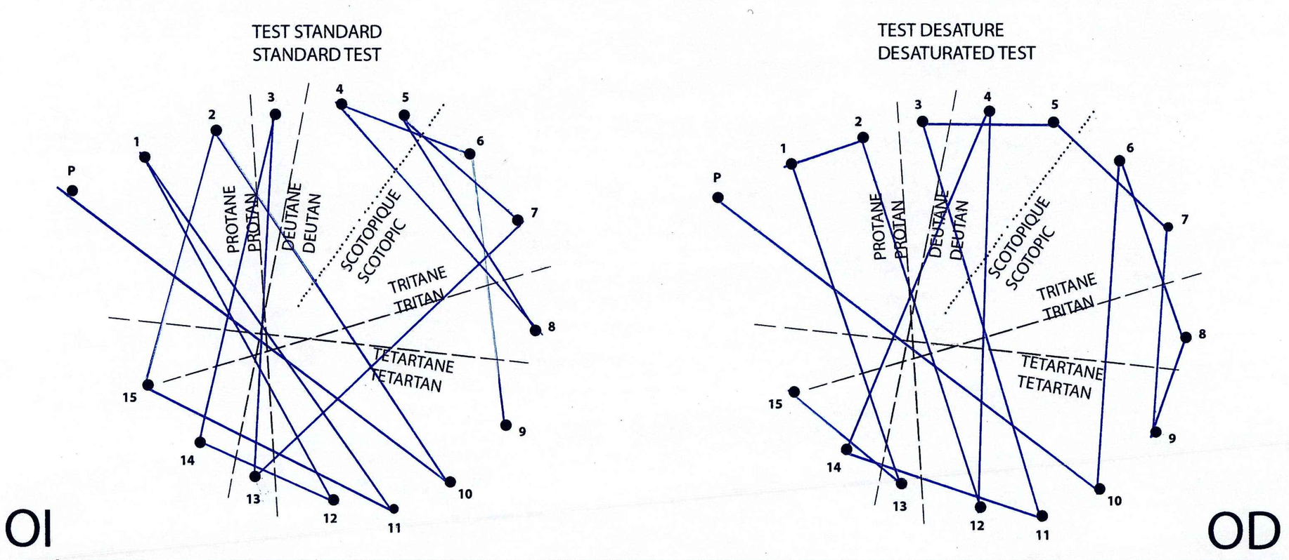
Farnsworth-Munsell D15 color vision test
What color vision abnormality do you see?

Slide 8
Farnsworth-Munsell D15 color vision test
Acquired dyschromatopsia.
Not following single type of color defect axis

Slide 9
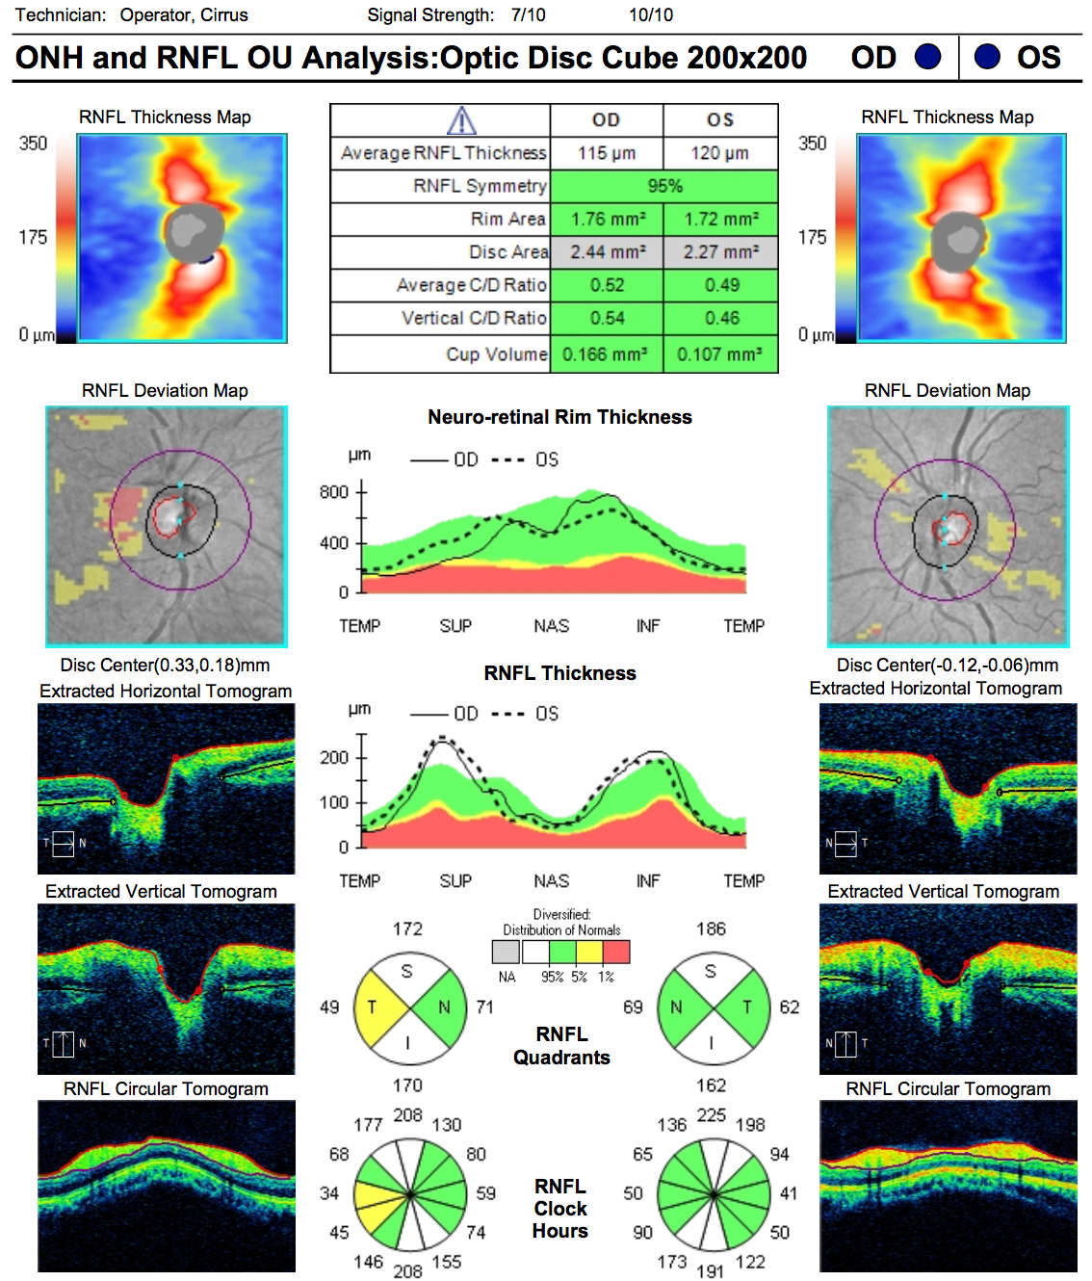
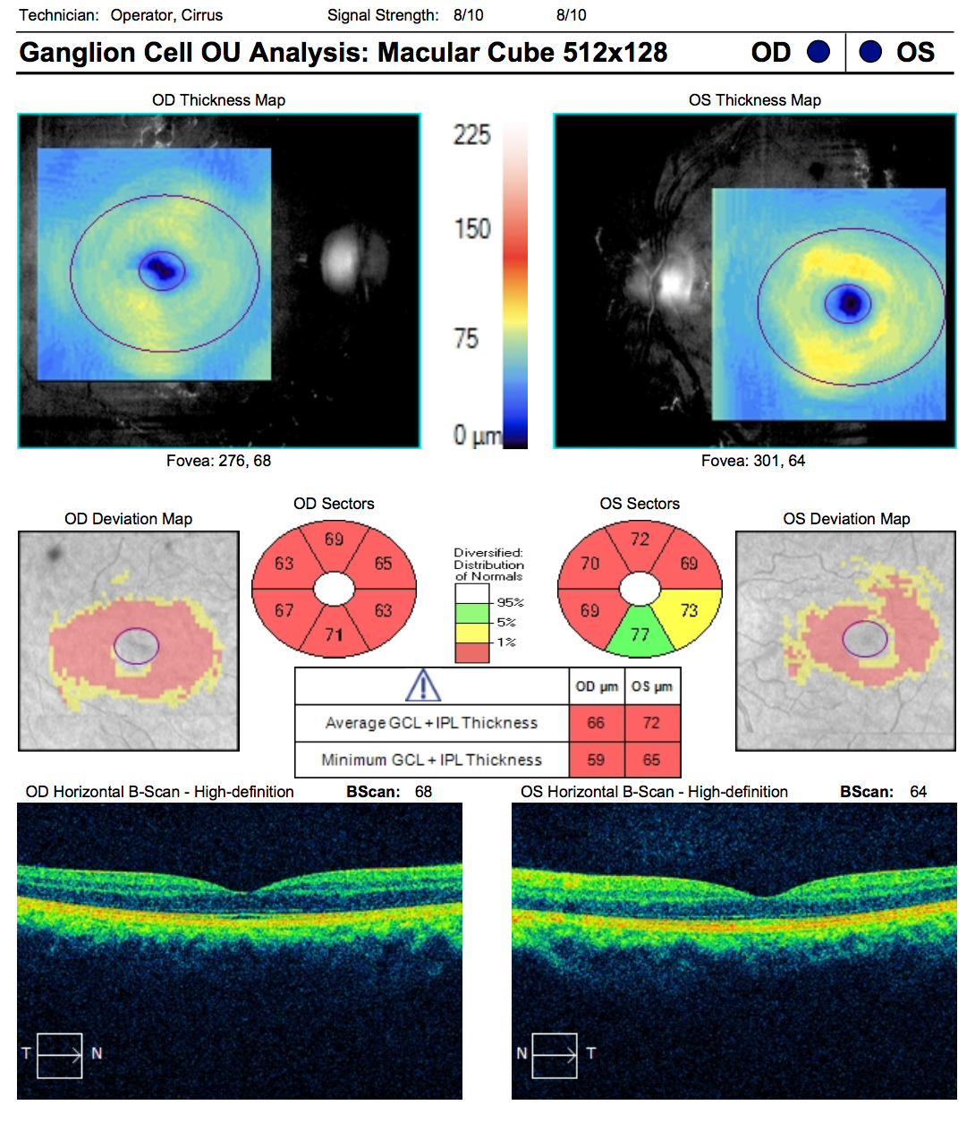
Optical Coherence Tomography

Slide 10
Neuro-Ophthalmic Differential Diagnosis
Retrobulbar painless, subacute, bilateral vision loss
Inflammatory etiology (demyelinating, autoimmune, infectious)
Compressive / infiltrative etiology
Toxic / nutritional optic neuropathy
Hereditary optic nerve disorders
Retinopathy

Slide 11
Neuro-Ophthalmic Differential Diagnosis
Painless, subacute, bilateral, central vision loss
Demyelinating Optic Neuritis
  Typically younger females, unilateral, painful.
  Optic disc: normal optic disc in 2/3 (retrobulbar)
  Associated in most cases with multiple sclerosis
  Other etiologies:
  Neuromyelitis Optica Spectrum Disorders, may be bilateral, some associated with transverse myelitis or area postrema syndrome, affects chiasm
  Anti-MOG (myelin oligodendrocyte glycoprotein), may be bilateral, often prominent disc edema
Autoimmune / infectious optic neuropathy
  History of systemic autoimmune disease, sexually transmitted infections, recent travel
  Positive systemic review of symptoms
  Frequently associated with intraocular inflammation

Slide 12
Neuro-Ophthalmic Differential Diagnosis
Painless, subacute, bilateral, central vision loss
Compressive / infiltrative optic neuropathy
  Field defect according to location of compression
  Indolent progressive vision loss
  History of known malignancy
  Neuroimaging will show mass lesion with optic nerve/chiasm displacement or enlargement
Toxic / nutritional optic neuropathy
  Symmetric, painless, progressive vision loss
  Systemic medication use
  History of recreational drug abuse
  History of occupational exposure
  Gastrointestinal malabsorption risk factors: surgery, dietary habits

Slide 13
Neuro-Ophthalmic Differential Diagnosis
Painless, subacute, bilateral, central vision loss
Leber's Hereditary Optic Neuropathy (LHON)
  Defect in mitochondrial NADH-ubiquinone oxi-reductase chains
  Increased reactive oxygen species
  Typically young males
  Painless subacute sequential involvement
  Maculo-papillary bundle most susceptible to injury
  Optic disc: normal or pseudo-edema early, temporal pallor later. May show peripapillary telangiectatic vessels
Autosomal Dominant Optic Atrophy
  Most common inherited optic neuropathy
  OPA1 gene (chromosome 3): a dynamin-related GTPase, which is essential for mitochondrial inner membrane fusion and maintenance of mitochondrial cristae network
  Indolent progression over years
  Optic disc: temporal or diffuse pallor.

Slide 14
Neuro-Ophthalmic Differential Diagnosis
Painless, subacute, bilateral, central vision loss
Retinopathy
  Hereditary cone dystrophy / paraneoplastic autoimmune retinopathy
  May have positive family history or history of malignancy
  Slow progression over months – years
  May describe more prominent night or day symptoms
  Few findings initially: arteriolar narrowing, optic disc pallor
  Full-field or multifocal electroretinogram will be abnormal

Slide 15
Neuro-Ophthalmic Differential Diagnosis
Retrobulbar painless, subacute, bilateral vision loss
Compressive / infiltrative etiology
Inflammatory etiology (demyelinating, autoimmune, infectious)
Toxic / nutritional optic neuropathy
Hereditary optic nerve disorders
Retinopathy
Can you eliminate any differential diagnosis at this point?
What additional tests would you order?

Slide 16
Laboratory Tests Results
CBC – within normal limits
PPD – within normal limits
FTA-Ab – non-reactive
VDRL – non-reactive
ESG – 8 mm/h
RCP: Negative
Glucose: 103 mg/dl
Cholesterol: 158 mg/dl
Triglycerides: 78 mg/dl
16

Slide 17
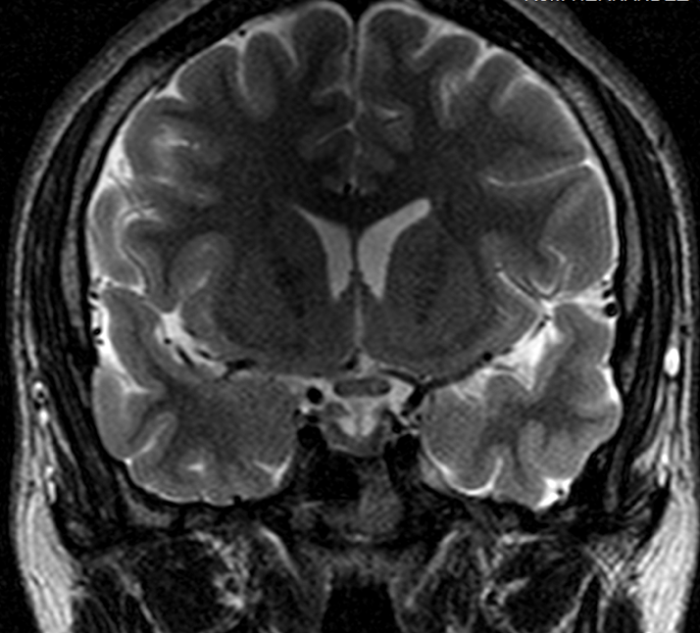
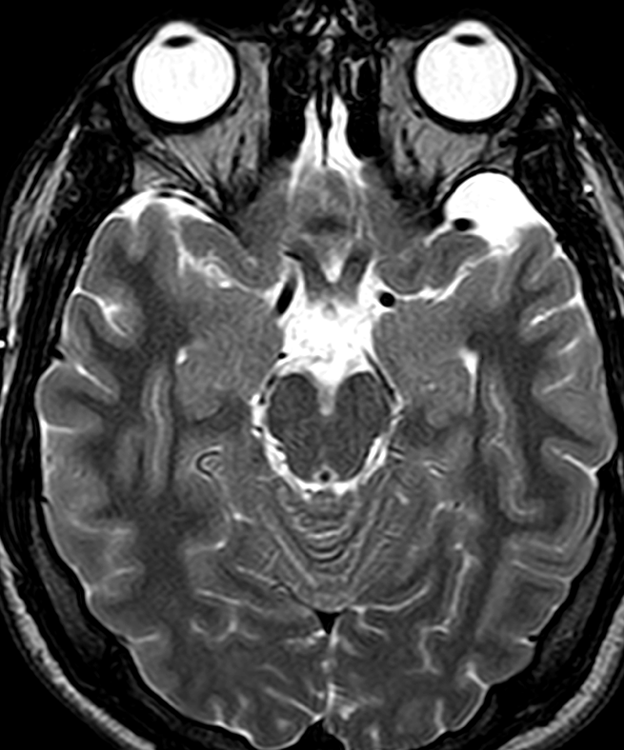
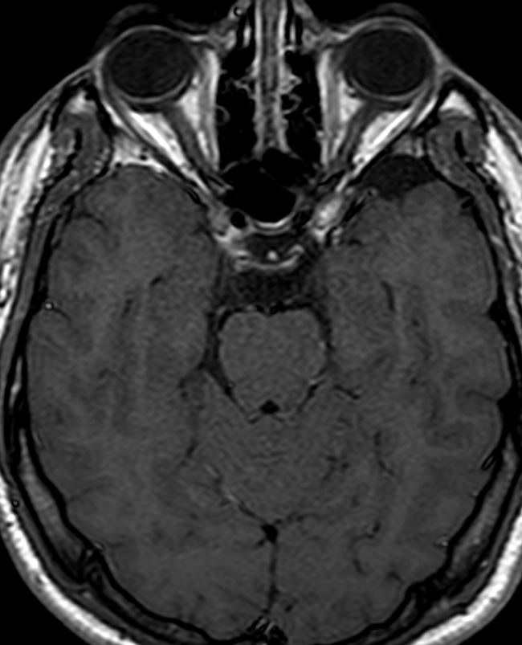
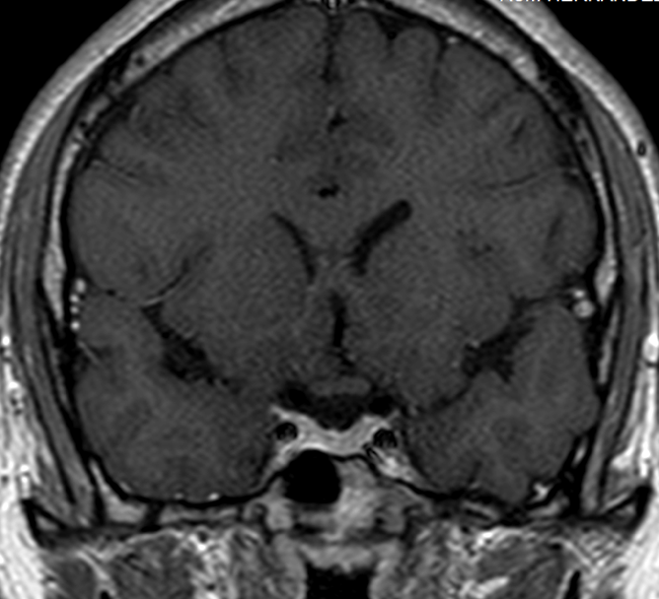
T2 Coronal and Axial MRI
What abnormalities should you look for on MRI?
T1 + gad Axial and Coronal MRI
Notes:
Very hard to see- did this show on any other sequences? Enhance?
JCB, I added T1 + gad as an animation

Slide 18
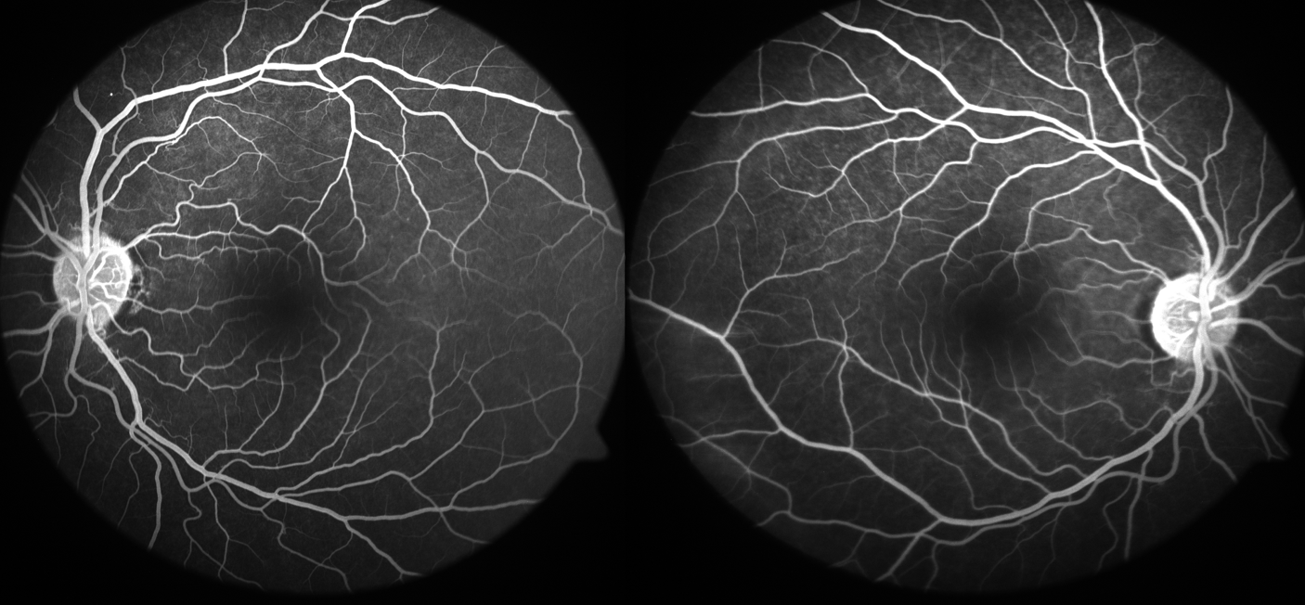
Fluoresceine angiography
Are you expecting any abnormality in this study?

Slide 19
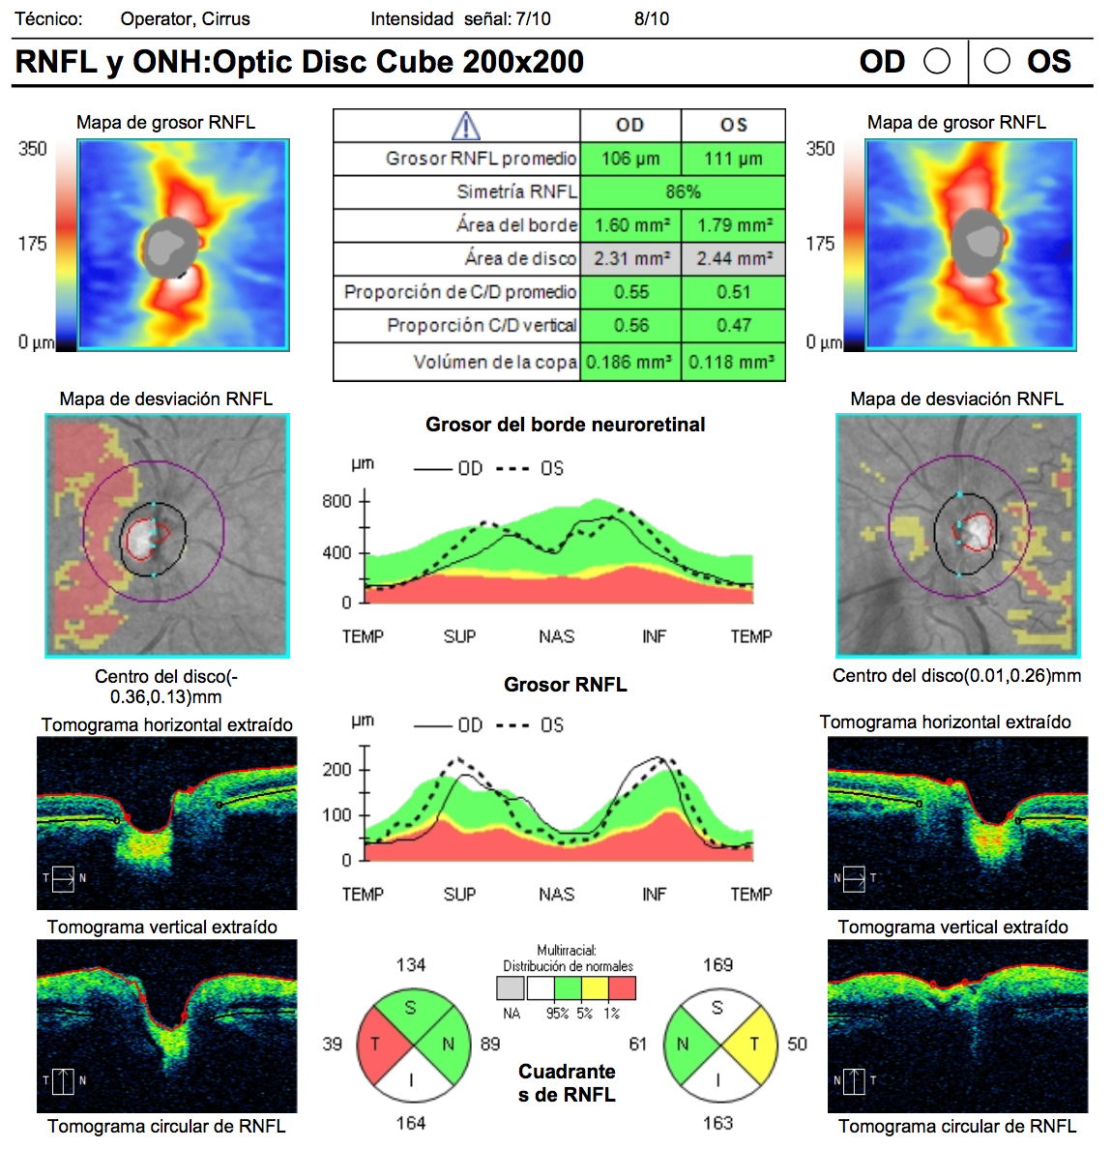
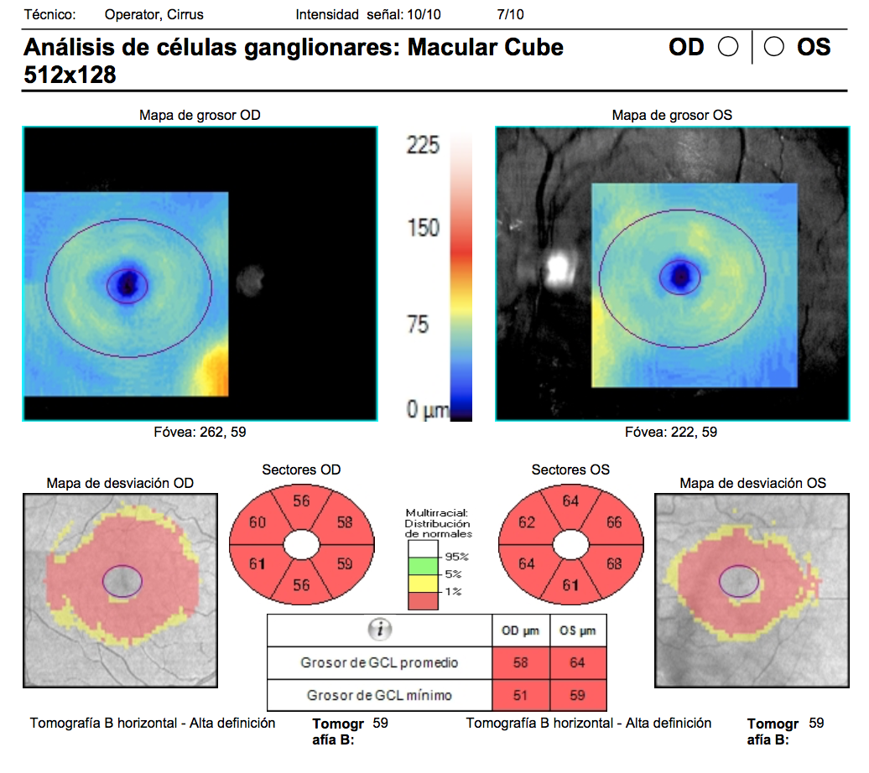
Optical Coherence Tomography
3 months later
Any changes compared with previous study?

Slide 20
Optical Coherence Tomography
Initial
3 months later
Retinal nerve fiber layer and GCL/IPL thickness thinning

Slide 21
Evaluation
OCT of the optic nerve: progressive ganglion cell layer atrophy
Farnsworth: acquired color vision abnormalities
MRI: no compressive lesion, no enhancement
Fluorescein angiography: telangiectatic microangiopathy
Plan: genetic evaluation for Leber’s Hereditary Optic Neuropathy

Slide 22

Genetic testing
Molecular study on leukocyte DNA
NC_012920.1(MTND6):m.14484T>C
Idebenone 900 mg every 24 hrs

Slide 23
Leber’s Hereditary Optic Neuropathy (LHON)
First described by Theodore Leber in 1871
Most common primary mitochondrial DNA (mtDNA) disorder
Predominates in young men (15-35 years)
Subacute, progressive, painless central vision loss

Slide 24

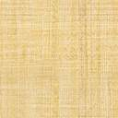
Pathogenic Mutations
70%
m.11778 G>A
Increased reactive oxygen species, decreasing ATP production
14%
m.14484 T>C
13%
m.3460 G>A

Slide 25
Natural History
Spontaneous improvement can occur up to 72 months after onset of visual loss
Different rates of partial visual improvement according to mutation
m.11778 G>A: 4 – 33 %
m.14484 T>C: 52 %
m.3460 G>A: 4 – 20 %

Slide 26
Treatment
Idebenone: synthetic short-chain analog of ubiquinone, which is responsible for transporting electrons from complexes I and II, directly to complex III
The efficacy of idebenone was assessed in a randomized, double-blinded, placebo-controlled study (RHODOS). Best evidence for 11778G>A mutation
It is the only specific therapy approved to treat visual impairment in adolescents and adults with LHON
Gene therapy clinical trials are underway

Slide 27
Summary
Useful imaging studies include
  OCT of optic nerve
  Visual fields
  Fluorescein angiography
  Magnetic resonance imaging
Genetic testing is the gold standard test

Slide 28
References
Blanc C, Heran F, Habas C, Bejot Y, Sahel J, Vignal-Clermont C. MRI of the Optic Nerves and Chiasm in Patients With Leber Hereditary Optic Neuropathy. J Neuroophthalmol. 2018 Dec;38(4):434-437. PMID: 29300239.
Carelli, V., Carbonelli, M., De Coo, I. F., Kawasaki, A., Klopstock, T., Lagrèze, W. A., La Morgia, C., Newman, N. J., Orssaud, C., Pott, J. W. R., Sadun, A. A., Van Everdingen, J., Vignal-Clermont, C., Votruba, M., Yu-Wai-Man, P., & Barboni, P.. International consensus statement on the clinical and therapeutic management of Leber’s hereditary optic neuropathy. Journal of Neuro-Ophthalmology. 2017 Dec;37(4), 371–381. https://doi.org/10.1097/WNO.0000000000000570. PMID: 28991104.
Chun B, Rizzo J. Dominant Optic Atrophy and Leber’s Hereditary Optic Neuropathy: Update on Clinical Features and Current Therapeutic Approaches. Semin Pediatr Neurol. 2017 May;24(2):129-34. doi: 10.1016/j.spen.2017.06.001. Epub 2017 Jun 30. PMID: 28941528.
Kerr N, Chew S, Danesh-Meyer H. Non-arteritic anterior ischaemic optic neuropathy: A review and update. J Clin Neurosci. 2009 Aug;16(8):994-1000. doi:10.1016/j.jocn.2009.04.002. PMID: 19596112
Lyseng-Williamson K. Idebenone: A Review in Leber’s Hereditary Optic Neuropathy. Drugs. 2016 May;76(7):805-13. doi: 10.1007/s40265-016-0574-3. PMID: 27071925.
Klopstock, T., Yu-Wai-Man, P., Dimitriadis, K., Rouleau, J., Heck, S., Bailie, M., Atawan, A., Chattopadhyay, S., Schubert, M., Garip, A., Kernt, M., Petraki, D., Rummey, C., Leinonen, M., Metz, G., Griffiths, P. G., Meier, T., & Chinnery, P. F. (2011). A randomized placebo-controlled trial of idebenone in Leber’s hereditary optic neuropathy. Brain. 2011 July;134(9):2677–2686. doi.org/10.1093/brain/awr170. PMID: 21788663.
Pilz Y, Bass S, Sherman J. A Review of Mitochondrial Optic Neuropathies: From Inherited to Acquired Forms. J Optom. 2017 Oct-Dec;10(4):205-214. doi:10.1016/j.optom.2016.09.003. Epub 2016 Dec 28. PMID: 28040497
Zuccarelli M, Vella-Szijj J, Serracino-Inglott A, Borg J. Treatment of Leber’s hereditary optic neuropathy: An overview of recent developments. Eur J Ophthalmol. 2020 Nov;30(6):1220-1227. doi: 10.1177/1120672120936592. Epub 2020 Jun 19. PMID: 32552047.

