Slide 1


Post-operative Vision Loss
Amir Ali BSA, University of Texas Medical Branch
Subahari Raviskanthan MBBS, Houston Methodist Hospital
Ardalan Sharifi MD, University of Texas Medical Branch
Andrew G. Lee MD, Houston Methodist Hospital

Slide 2
74-Year-Old Man with vision loss
CC: Sudden onset postoperative painless loss of right eye vision

Slide 3
Past Medical History
Primary open-angle glaucoma
Hypertension
Type 2 diabetes mellitus
Hyperlipidemia
Peripheral artery disease
52.5 pack year smoking history, quit 25 years ago

Slide 4
Medications
Latanoprost
Metformin
Simvastatin
Aspirin
Clopidogrel

Slide 5
74-Year-Old Man with acute painless vision loss
Complicated left superficial femoral endarterectomy:
Prolonged duration, hybrid open and endovascular procedure
Transfusions required (intraop and postop)
Re-anaesthetized and Reinduction
Intensive care unit
Upon extubation, complained of severe vision loss OD

Slide 6
What are the causes of postoperative acute painless vision loss?
Ophthalmic:
  Central retinal artery or vein occlusion (CRAO/CRVO)
  Ischemic optic neuropathy (ION)
Neurologic:
  Stroke (homonymous hemianopsia)
  Posterior reversible encephalopathy syndrome
  Pituitary apoplexy
  Intracranial hemorrhage
Systemic:
  Hyperglycemia
Notes:
Corneal abrasion would not likely be painless
Would add hyperglycemia

Slide 7
Neuro-ophthalmic Examination
Ophthalmologic:
Visual Acuity: count fingers OD, 20/30 OS
Ishihara color plates 0/14 OD and 14/14 OS
Pupils isocoric and reactive, relative afferent pupillary defect OD
Slit Lamp Examination: normal OU
Intraocular Pressure: 21 mm Hg OU
No scalp tenderness or temporal artery nodularity
Neurologic exam: normal
Notes:
Perhaps this slide should precede the evaluation slide?

Slide 8
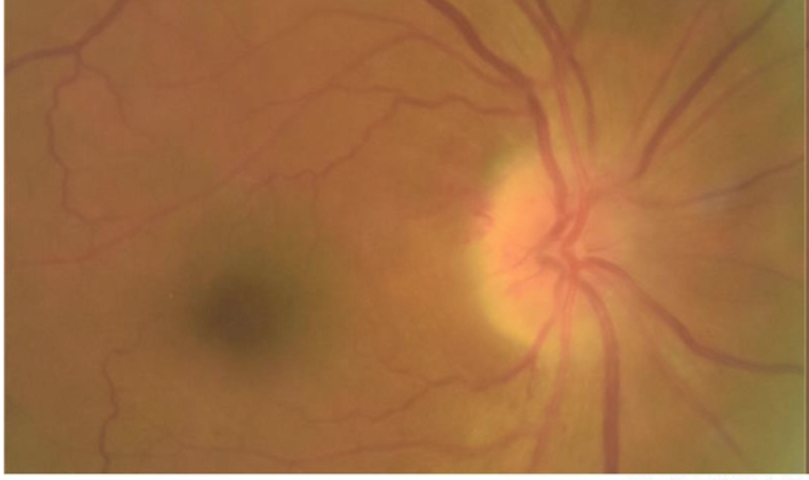
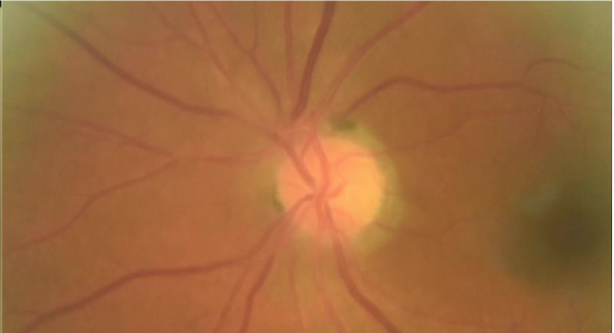
Fundus Examination: Disc edema OD
Notes:
I do not understand your narration here. He does have small cup: discs and does seem to have a disc at risk. I do not see this as a cup of 0.8- I see this as a cup of no more than 0.2 sloping out temporally with a peripapillary conus
Perhaps this should go ahead of the evaluation slide, too

Slide 9
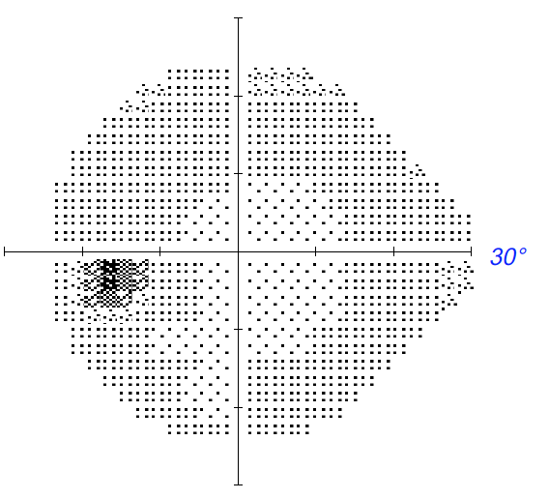
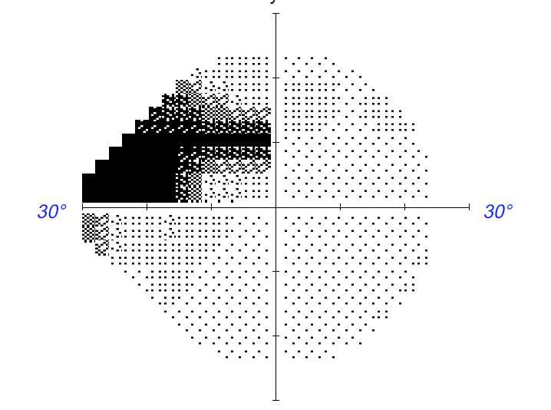
Humphrey Visual Field 24-2: Superior nasal step OD

Slide 10
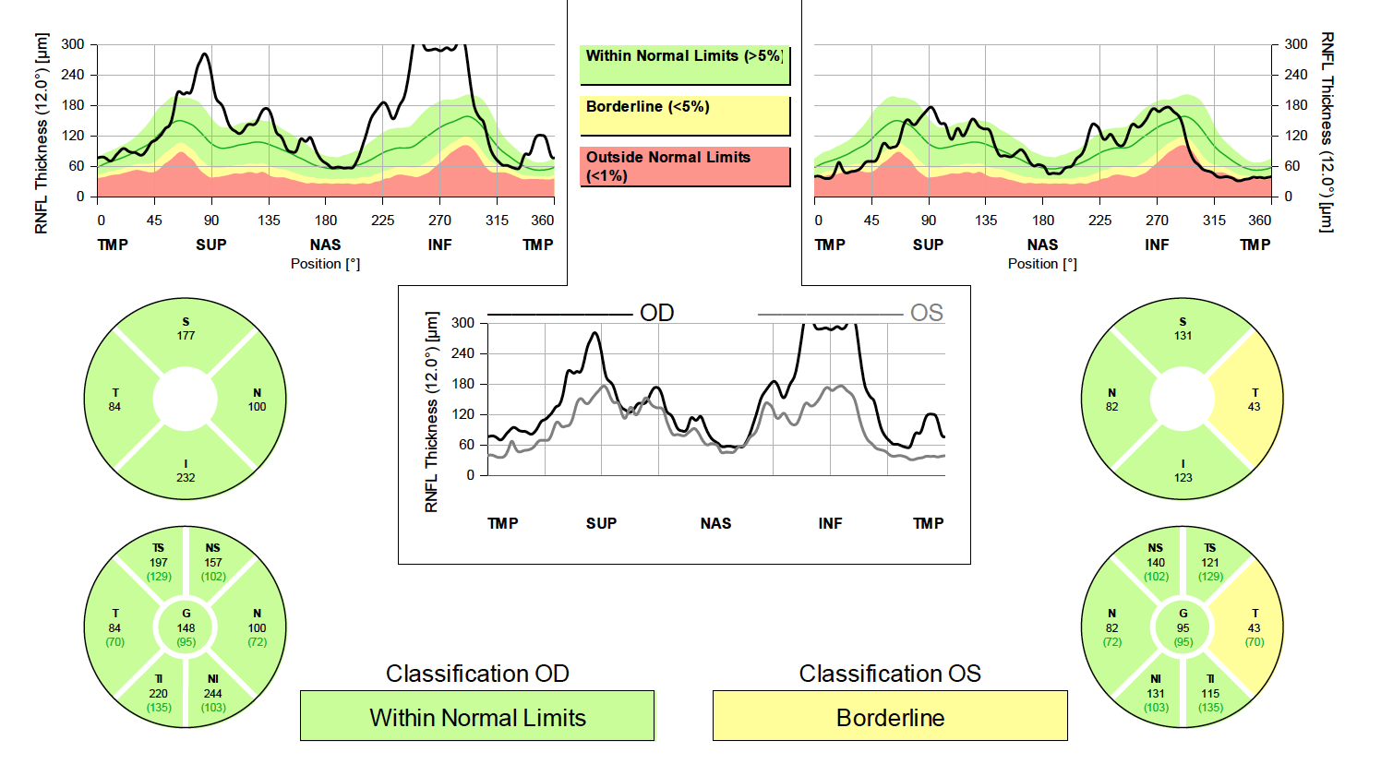
Optical Coherence Tomography: Increased RNFL OD (disc edema)

Slide 11
Most likely diagnosis?
Ophthalmic:
  Central retinal artery or vein occlusion (CRAO/CRVO)
  Ischemic optic neuropathy (ION)
Neurologic:
  Stroke (homonymous hemianopsia)
  Posterior reversible encephalopathy syndrome
  Pituitary apoplexy
  Intracranial hemorrhage
Systemic:
  Hyperglycemia

Slide 12
Evaluation
Blood pressure: 147/67 mmHg (normal: <120 mmHg)
Hgb: 10.5 (normal: 13.5-17.5 g/dL)
ESR (not adjusted for anemia): 45 (age adjusted normal: 1-37 mm/hr)
CRP: 53 (normal: 0.0-1.0 mg/dL)
HbA1c: 9.1% (4-5.6%)
MRI Brain and Orbits with contrast: Normal
Notes:
Normal sed rate is in a male (age/2), so here it would be 37
Also, there is an adjustment for anemia in interpreting ESR- I think you can just make it ESR (unadjusted fro anemia):45…

Slide 13
Unilateral Acute Painless Vision Loss
VF defect, RAPD, optic disc edema → optic neuropathy
Likely ischemic given sudden onset
Anterior given optic disc edema present
Anterior Ischemic Optic Neuropathy
Arteritic
Non-Arteritic

Slide 14
Pathophysiology of Arteritic vs. Non-Arteritic Anterior ION
Anterior ION: Ischemia of laminar, prelaminar, immediate or short posterior ciliary arteries originating from ophthalmic artery supplying the optic nerve head
Arteritic
Non-Arteritic
Optic nerve head infarction from inflammation, granuloma formation, and thrombosis from vasculitic disease
Giant Cell Arteritis
Vasospasm/autoregulatory
Hypotension/hypertension
Hypoxia
Hyperlipidemia
Hyperglycemia (DM)
Anemia (blood loss)
Increased IOP

Slide 15
Literature Review of post operative NAION after non-ocular surgeries
Commonly spine (Ho et al., 2005) or cardiac surgery
Hip Arthroplasty (Manzotti et al., 2019 and Yazgan et al., 2014)
Burn or trauma surgery (Qurioga et al., 2019)
Carotid Endarterectomy (Konstantinuik et al., 2015)
Robotic-Assisted Gynecologic Surgery (Ozcan et al., 2019)
Coronary artery bypass graft (Gowthaman et al., 2018)

Slide 16
Risk factors for NAION
Operation related risk factors
Standard non-surgical risk factors
Intra/postoperative hypotension secondary to blood loss
Prolonged surgical time
Septic shock
Prone surgical position
Embolic phenomenon
Hypothermia (CABG)
Intraocular pressure fluctuations
Extreme Trendelenburg positioning
Hypertension
Hyperlipidemia
T2DM
Smoking
Alcohol consumption
Small cup: disc ratio

Slide 17
Treatment
No effective treatment for NAION
Control of vasculopathic risk factors associated with vascular insufficiency
  HTN
  Diabetes Mellitus II
  Hyperlipidemia
  Smoking
Use of antiplatelets / anticoagulation is controversial
Steroids unproven
Transfusion for anemia unproven

Slide 18
Take Home Message
Post operative vision loss can occur after non ophthalmic operations (including superficial femoral endarterectomy)
Multifactorial: risk factors include prolonged surgical time, anemia, hypotension, vasopressors, type of surgery (spine/cardiac).
“Ischemic optic neuropathy” is not an etiologic diagnosis
ION: Further classified into anterior (AION), posterior (PION), and arteritic (A-AION), non-arteritic (NAION)
No proven effective therapy for post-operative NAION or PION

Slide 19
References
Beran DI, Murphy-Lavoie H. Acute, painless vision loss. J La State Med Soc. 2009 Jul-Aug;161(4):214-6, 218-23.
Stephenson M. Diagnosing and Managing Ischemic Optic Neuropathy. Review of Ophthalmology. 2010. https://www.reviewofophthalmology.com/article/diagnosing-and-managing-ischemic-optic-neuropathy
Gowthaman AS, Prasanth HR, Sanjana E. Postoperative vision loss following non ocular surgery- A case report. IP International Journal of Ocular Oncology and Oculoplasty. 2018 4(1), 64–66. DOI: 10.18231/2455-8478.2018.0018.
Manzotti A, Schianchi A, Pace L, Salvadori G, Biazzo A, Cerveri P. Non artheritic bilateral anterior ischaemic optic neuropathy (NAION) as devastating complication following Total Hip Arthroplasty: a case report: Bilateral visual loss following total Hip Arthoplasty [JB]. Acta Bio Medica Atenei Parmensis. 2019 90(4), 583–586. DOI: 10.23750/abm.v90i4.7704.
Yazgan S, Ayar O, Akdemir MO, Uğurbas SH. Simultaneous Bilateral Non-Arteritic Anterior Ischaemic Optic Neuropathy and Unilateral Central Retinal Artery Occlusion after Hip Prosthesis Surgery. Neuro-Ophthalmology. 2014 38(5), 257–259. https://doi.org/10.3109/01658107.2014.917685.
Quiroga L, Asif M, Lagziel T, Caffrey J. Waking Up Blind in the ICU: A Case Report of Ischemic Optic Neuropathy in a Burn Patient. Cureus. 2019. https://doi.org/10.7759/cureus.5437.

Slide 20
References
Konstantiniuk P, Cohnert T. Acute Monocular Blindness after Carotid Endarterectomy due to Non-arteritic Anterior Ischemic Optic Neuropathy. European Journal of Vascular and Endovascular Surgery. 2015 50(4), 419. https://doi.org/10.1016/j.ejvs.2015.07.010.
Ozcan AA, Ulas B. Ischemic optic neuropathy in robotic-assisted gynaecologic surgery: A case report. Journal of Obstetrics and Gynaecology Research. 2018 45(3), 748–750. https://doi.org/10.1111/jog.13877.
Ho VT, Newman NJ, Song S, Ksiazek S, Roth S. Ischemic optic neuropathy following spine surgery. J Neurosurg Anesthesiol. 2005 Jan;17(1):38-44.
Gupta M, Puri P, Rennie IG. Anterior ischemic optic neuropathy after emergency caesarean section under epidural anesthesia. Acta Anaesthesiologica Scandinavica. 2002 46(6), 751–752. https://doi.org/10.1034/j.1399-6576.2002.460621.x
Gowthaman AS, Prasanth HR, Sanjana E. Postoperative vision loss following non ocular surgery- A case report. IP International Journal of Ocular Oncology and Oculoplasty. 2020 4(1), 64–66. https://doi.org/10.18231/2455-8478.2018.0018.

