Slide 1

Subacute Bilateral Vision Loss
Vladislav Bekerman, MD MBA
Resident Physician in Ophthalmology
Rutgers-New Jersey Medical School
Roger Turbin, MD
Professor of Ophthalmology
Rutgers-New Jersey Medical School
Larry Frohman, MD
Executive Vice President, NANOS
Professor of Ophthalmology and Neurology
Rutgers-New Jersey Medical School

Slide 2
54-Year-Old Woman with Bilateral Vision Loss
Noted 2 week course of visual decline 4 months prior to presentation
Visual loss perceived as largely “straight ahead” in both eyes
Denies trauma, ocular pain, diplopia, flashes, floaters, or headache
Any considerations in the history that could help identify potential causes of vision loss?
2

Slide 3
Historical Considerations for Bilateral Progressive Visual Loss
DM, Chronic kidney disease, thyroid disease – metabolic, ischemic, or compressive
Peculiar diet habits, GI surgeries – nutritional deficiencies
Cancer – infiltrative disease
Systemic medication side effect
Workplace – toxin exposure
Alcohol or tobacco abuse
Family Hx – hereditary optic nerve disorders
ROS – sensory or gait abnormalities indicating peripheral neuropathy
3

Slide 4
54-Year-Old Woman with Bilateral Vision Loss
Past Medical History
PMH (+) for tuberculosis (pulmonary)
Denies smoking, alcohol, or drug abuse
No abnormal diet or nutritional habits
4

Slide 5
54-Year-Old Woman with Bilateral Vision Loss
Has been taking for tuberculosis: Started 1 year prior to presentation
  Ethambutol 1,200mg daily
  Rifampin 600mg daily
  Levaquin 500mg daily
Ethambutol discontinued once visual loss occurred 4 months prior
5

Slide 6
Relevant Neuro-Ophthalmic Examination
Best-corrected visual acuity: 20/400 right eye & counting fingers at 2 feet left eye
Pupillary reactivity: 4mm in dark & 2mm in light, no relative afferent pupillary defect
Ishihara color plates: + Control, 0/7 test plates right; - Control, 0/7 test plates
Optic Nerve exam: Pink, sharp, flat
What ophthalmic testing would you order now?
6

Slide 7
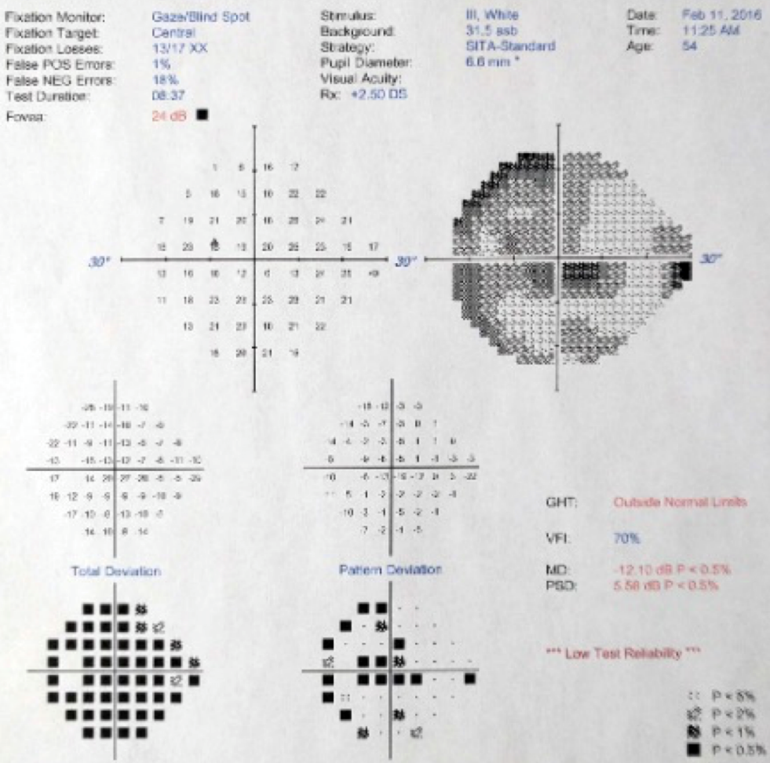
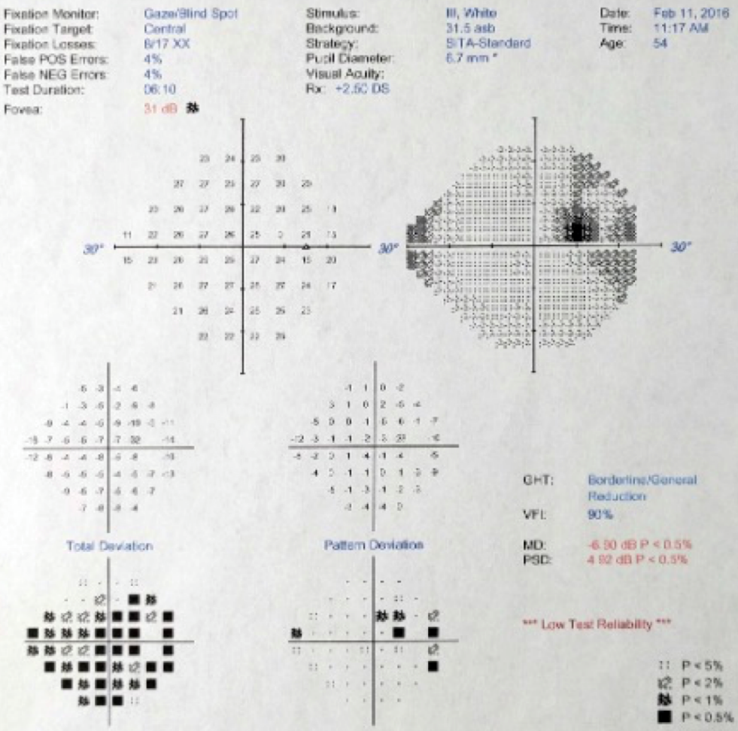
24-2 Automated Visual Field Analysis
What visual field abnormality do you see?
LEFT
RIGHT
7

Slide 8
24-2 Humphrey Visual Field Analysis
Visual field defects most prominent in the center of visual field.
Are there other tests we can order to assess scotoma further?
LEFT
RIGHT
8

Slide 9
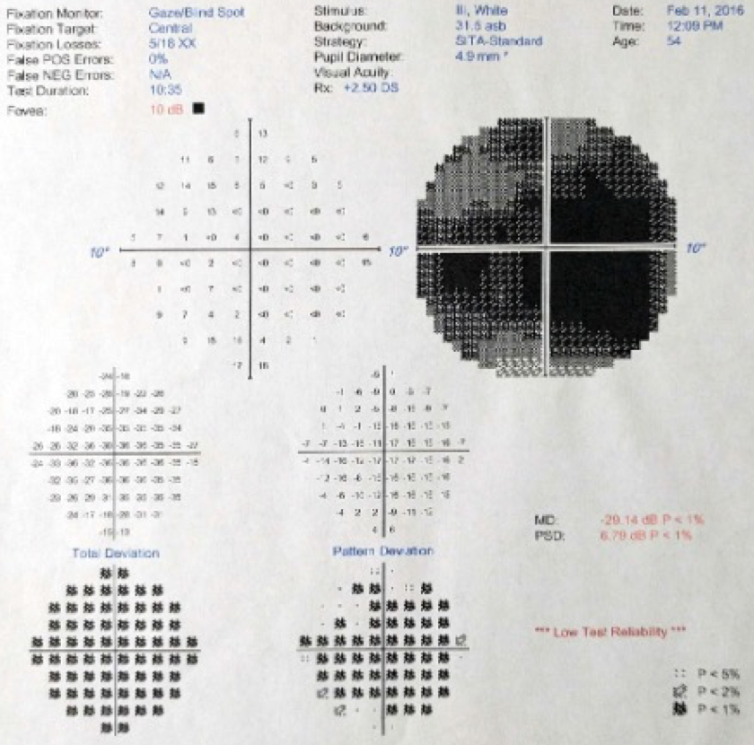
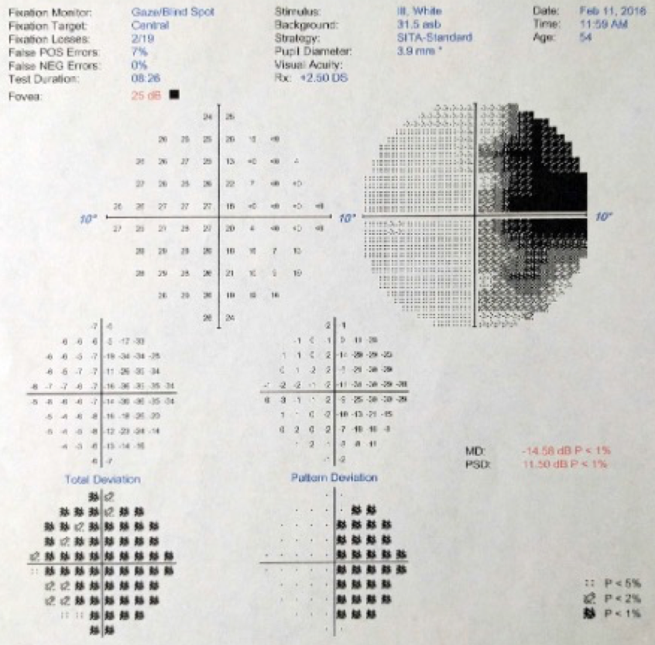
10-2 Visual Field Analysis
Visual field analysis of central 10 degrees.
Dense central scotoma left eye, cecocentral (between fixation and blind spot) on right.
LEFT
RIGHT
9

Slide 10
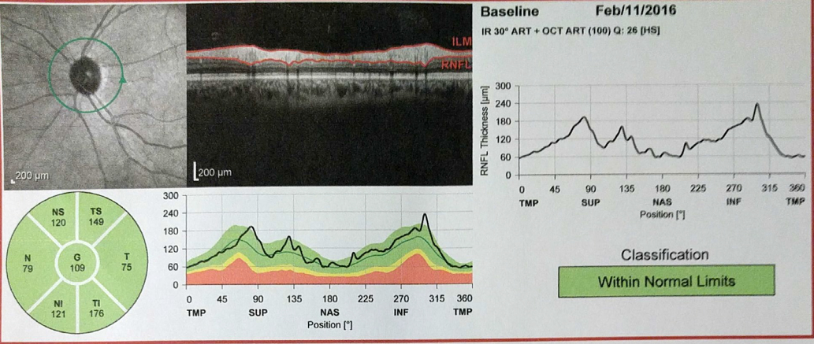
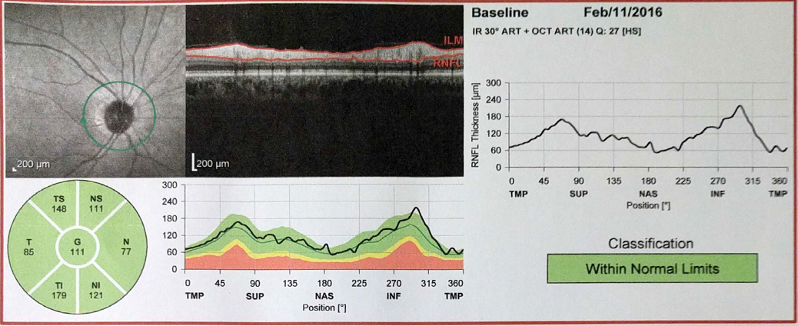
Optical Coherence Tomography
Normal nerve fiber layer of optic nerve OU
RIGHT EYE
LEFT EYE
10

Slide 11

Scotoma Localization Considerations
Retinal:
Degenerative
  Age-related Macular Degeneration
  Angioid Streaks | Solar retinopathy | Macular Dystrophies
Vascular
  Diabetic Macular Edema | Sickle Cell Retinopathy
Infectious
  Ocular Histoplasmosis | Toxoplasmosis | Toxocariasis
Inflammatory
  Acute Macular Neuroretinopathy
  Acute Idiopathic Maculopathy
  Acute Posterior Multifocal Placoid Pigmentary Epitheliopathy
Toxic
  Hydroxychloroquine | Tamoxifen

Slide 12
Scotoma Localization Considerations
Optic Nerve:
Glaucoma
  Normal Tension Glaucoma
Papilledema with maculopathy
Inflammatory
  Optic Neuritis
Vascular (ie. Ischemic)
  Anterior/Posterior | Arteritic/nonarteritic
Compressive/Infiltrative
  Neoplastic | Thyroid Orbitopathy
Toxic/Nutritional
  Alcohol | Vitamin deficiency
  Heavy Metals
  Medications (eg. Ethambutol, Amiodarone, PDE inhibitors)
Genetic/Leber’s

Slide 13
Scotoma Localization Considerations
Chiasmal:
Compressive
  Pituitary adenoma
  Parasellar meningioma
  Craniopharyngioma
  Parasellar internal carotid aneurysm
  Pituitary apoplexy
Inflammatory
  Sarcoidosis
  Multiple sclerosis
Infectious
  Tuberculosis
  Lyme disease

Slide 14
Scotoma Localization Considerations
Post-Chiasmal (typically homonymous hemianopsia):
Neurologic
  Seizure disorders
  Migraine auras
Vascular
  Strokes (ischemic/hemorrhagic)
  Systemic hypoperfusion
Compressive
  Neoplastic
Inflammatory
Iatrogenic
  Lobectomy

Slide 15
Potential Neuro-Ophthalmic Differential
Painless, bilateral, central vision loss
Toxic or Nutritional Optic Neuropathy
  Medications – Ethambutol, Amiodarone
  Alcohol consumption
  Heavy metals – Lead, mercury
  Nutritional deficiency – Vitamin B12, folate
Leber's Hereditary Optic Neuropathy
  Defect in mitochondrial NADH-ubiquinone oxireductase chains
  Typically young males, tobacco is risk factor
  Reports of environmentally triggered Type II variant (rather than purely genetic Type I)
  On exam: hyperemia, ”pseudoedema,” peripapillary telangiectatic vessels
Compressive/infiltrative Process
  Pituitary lesions >> meningioma, glioma
  On testing: Typically bitemporal visual field loss
  Neuroimaging will show mass lesions compressing chiasm.

Slide 16
Potential Differential Diagnosis Continued
Painless, bilateral, and central vision loss
Autosomal Dominant Optic Atrophy (DOA)
  OPA1 gene – responsible for mitochondrial membrane stabilization
  Typically younger presentation with family history
  On exam: temporal or diffuse pallor
Thyroid Associated Orbitopathy
  Proptosis, lid retraction, restricted EOMs
  Optic nerve stretching or compression by EOMs
  Progressive, bilateral – optic disc normal or edema, atrophy (chronic)
Demyelinating Optic Neuritis
  Typically younger females, unilateral, painful (92%), normal disc in 2/3 (retrobulbar)
  Neuromyelitis Optica Spectrum Disorders, often bilateral
  Anti-MOG (myelin oligodendrocyte glycoprotein)
Optic Perineuritis
  Older (36% > 50), pain until treated
  Optic nerve sheath enhancement
  Less commonly involves central vision

Slide 17
Potential Differential Diagnosis Continued
Painless, bilateral, and central vision loss
Autoimmune-Related Retinopathy and Optic Neuropathy (ARRONS)
  Development of autoantibody that cross-reacts with photoreceptors, optic nerve
  Exam – may be normal early, arteriolar narrowing early, ERG with reduced amp if retinal
Cone Dystrophy
  Any age, gradual progressive acuity and color perception decline
  Exam – normal initially or blunted foveal light reflex with granular macular pigmentation -> bulls eye depigmentation, early may have arteriolar narrowing
Paraneoplastic Retinopathy or Optic Neuropathy
  Cancer Associated Retinopathy
  Melanoma Associated retinopathy
  Heightened clinical suspicion needed in most cases as exam can prove to be normal early in course.
    Look for narrowed arterioles
  Testing:
    Serum for paraneoplastic-associated antibodies
    Multifocal ERG
What would you do next?

Slide 18
Laboratory Results
CBC – within normal limits
FTA-Ab – non-reactive
RPR – non-reactive
Zinc – 86 (56-134 ug/dL)
Copper – 83 (72-166 ug/dL)
B12 (cobalamin) – 918 (211-946 pg/mL)
B9 (Folic Acid) - >20 (>3 ng/mL)
B1 (Thiamine) – 133.4 (66.4-200 nmol/L)
Mitochondrial Sequencing - Normal mitochondrial DNA
Can you eliminate anything from our differential at this point?
18

Slide 19
Is anything ruled out yet?
Hereditary
  Leber's hereditary optic neuropathy – Mitochondrial DNA did not reveal known or novel mutations
Nutritional
  No deficiencies in vitamin B1, B9, B12
Inflammatory
  Neuritis or perineuritis – clinical picture, i.e. lack of pain, time course with slow progression, not in favor

Slide 20
Localizations considered less likely
Clinical context of known toxin exposure and time course of symptoms after exposure made consideration for the following less likely:
Optic nerve
  Thyroid Associated Orbitopathy
Chiasmal
  Junctional chiasmal compressive lesions (eg. Pituitary mass)
  Definitive rule out would require MRI brain

Slide 21
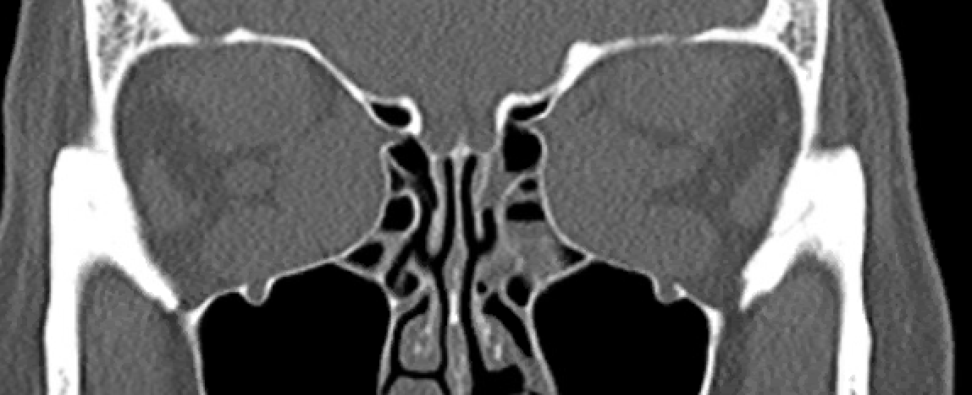
Localization Considerations Explored
Thyroid Associated Orbitopathy
Example from another patient of optic nerve compression from EOM enlargement
Optic nerve

Slide 22
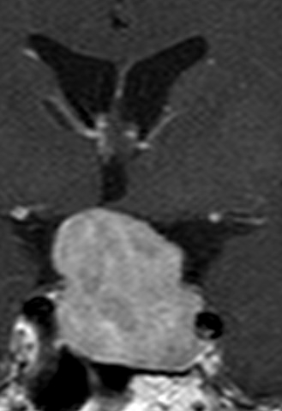
Localization Considerations Explored
Pituitary Adenoma
Chiasmal compression by pituitary mass
CHIASM

Slide 23
Ethambutol Optic Neuropathy (EON)
Time course and clinical picture felt to be consistent with ethambutol optic neuropathy

Slide 24
Ethambutol Optic Neuropathy (EON)
Ethambutol – First line defense against Mycobacterium Tuberculosis (TB) and Mycobacterum Avium Complex (MAC)
  Bacteriostatic antimicrobial medication
  Chelating agent, disrupts metal containing arabinosyl transferase – mycobacterial cell wall synthesis
EON prevalence in patients treated for tuberculosis: 1-2%¹
  9.2 million TB cases per year, 55% receive ethambutol
  (9,200,000x0.55x0.01=50,600)
  Most common toxic optic neuropathy
  Risk highly dose dependent
24

Slide 25
Ethambutol Optic Neuropathy (EON)¹
Pathophysiology
  Impacts mitochondrial function
    Interferes with iron-containing complex I and copper-containing complex IV
Mitochondrial dysfunction has central role in many optic nerve diseases – inherited or acquired
  Besides the exam, pearls in the history brings you to source of affected state
25

Slide 26
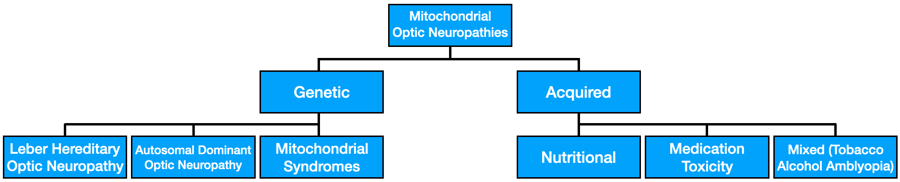
Mitochondrial Optic Neuropathies¹
26

Slide 27
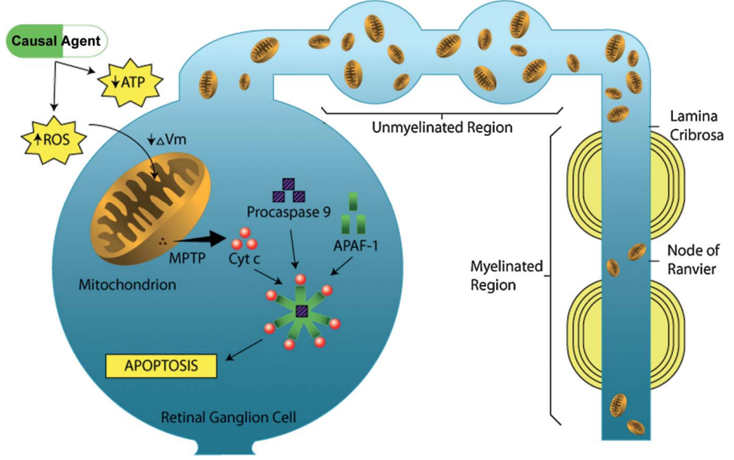
Mitochondrial Optic Neuropathies¹
Maculo-papillary bundle
  Most susceptible to injury
  Smallest caliber axons (more restriction in mitochondrial transport)
  Unmyelinated (high energy demand)
  Low volume (energy source) to surface area (energy demand) ratio
27

Slide 28
Ethambutol Optic Neuropathy (EON)¹⁻⁵
Symptom onset: 4-12 months after initiation
  Sooner in renal dysfunction (decreased excretion) [normal in our patient]
  Risk factors: age, race/ethnicity, dose, treatment duration, low zinc levels
Signs: in common with other mitochondrial optic neuropathies
  Sluggish pupils
    Relative afferent pupillary defect only if asymmetric
  Central or cecocentral scotomas
    Can resemble bitemporal hemianopia mimicking pituitary/chiasmal compression
      Preferential involvement of maculo-papillary bundle
  Dyschromatopsia
  Optic Disc Appearance
    Acutely-normal to hyperemia/edema
    Late- atrophy
28

Slide 29
Ethambutol Optic Neuropathy (EON)^{1,6-8}
Incidence by dosage reported in literature
  50% of patients receiving 60-100 mg/kg/day, 5-6% at 25 mg/kg/day, and 1% at <15 mg/kg/day had vision loss
  18% of patients receiving doses > 35 mg/kg/day, whereas only 3.3% of low dose therapy, < 30 mg/kg/day had vision loss
  6% of patients receiving doses of 25 mg/kg/day and only 1% of patients on doses of 15 mg/kg/day had vision loss
29

Slide 30
Ethambutol Optic Neuropathy (EON)^{1,9}
Management
  No consensus on standard of treatment
  After discontinuation – vision recovers slowly over several months (up to 2 years)
  Numerous case reports of non-reversible vision loss after ethambutol use - 50% improved
  Window of reversibility as mitochondrial impairment does not lead to immediate axonal death
  Consider zinc/copper supplementation
    No consensus on dosages
    AREDS 2 multivitamin formulation is a convenient source for this
      Clinical pearl: AREDS formulation contains beta carotene which may increase risk for lung cancer.
Why Zinc and Copper?
30

Slide 31
Ethambutol Optic Neuropathy (EON)^{1,9,10}
Rationale for multivitamin treatment
  Ethambutol is considered a zinc and copper chelator
  This disrupts mitochondrial oxidative phosphorylation by interfering with the iron-containing complex I and copper containing complex IV.
  Leads to reactive oxygen species and a cascade of events resulting in tissue injury and cellular apoptosis.
  Increasing plasma levels has potential protective effect against optic neuropathy.
31

Slide 32
Back to Case:
9 Month Follow Up with Neuro-Ophthalmology¹¹
Visual acuity: 20/25 in both eyes
Color plates: Identifies control plates and 7/7 test plates in both eyes
Fundus examination: Temporal pallor in both eyes
32

Slide 33
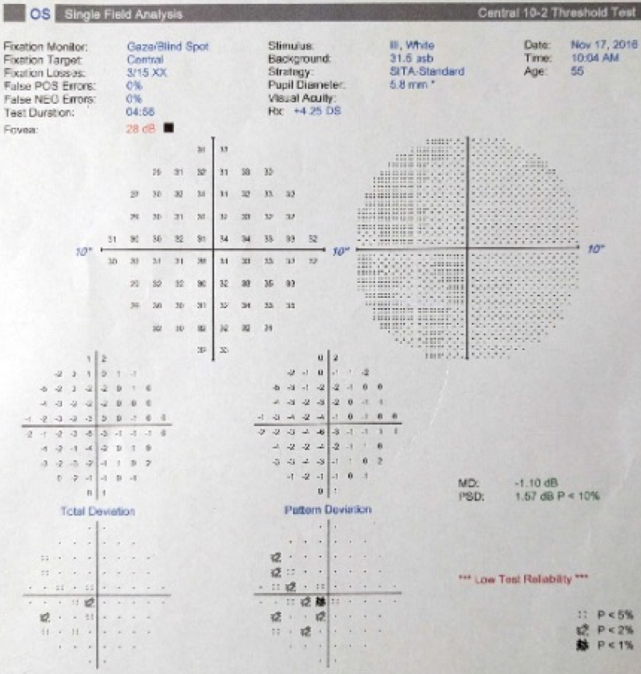
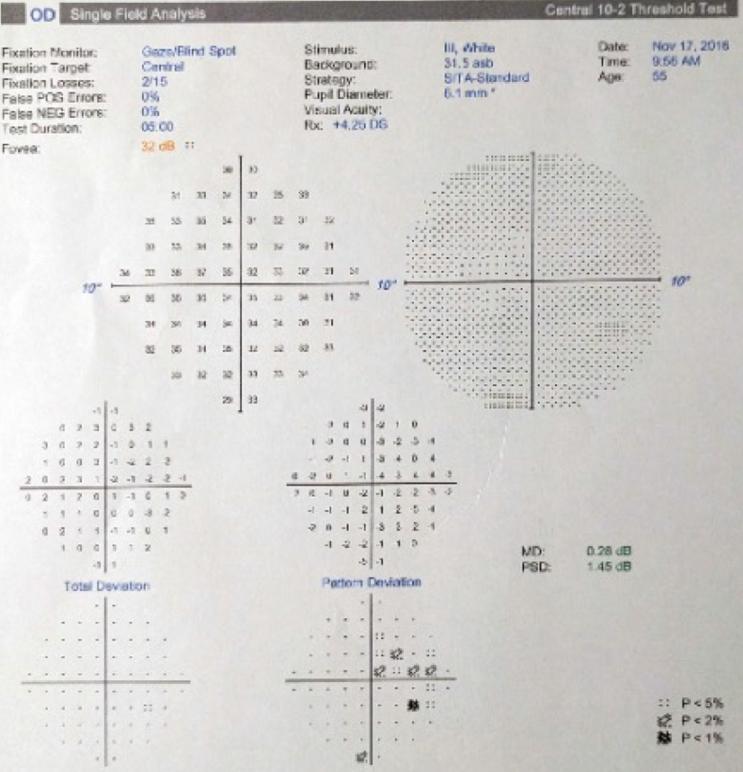
10-2 Humphrey Visual Field Analysis
Favorable functional result.
Resolution of ceco-central scotomas.
LEFT
RIGHT
33

Slide 34
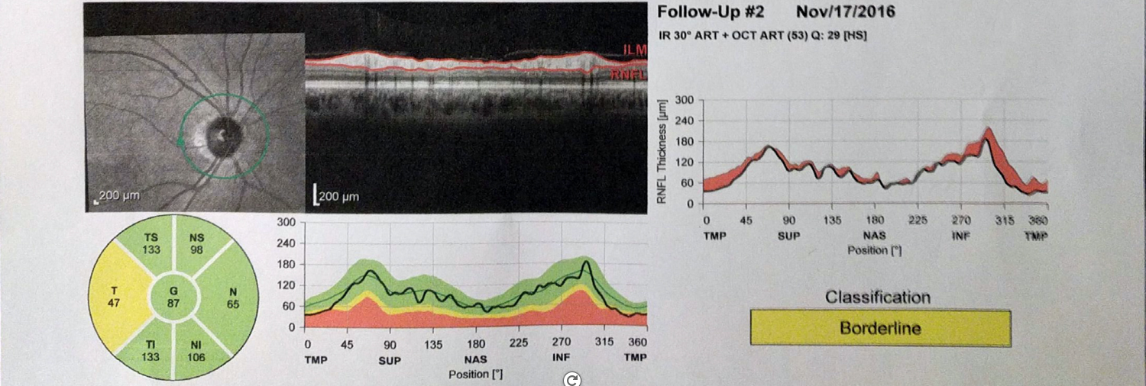
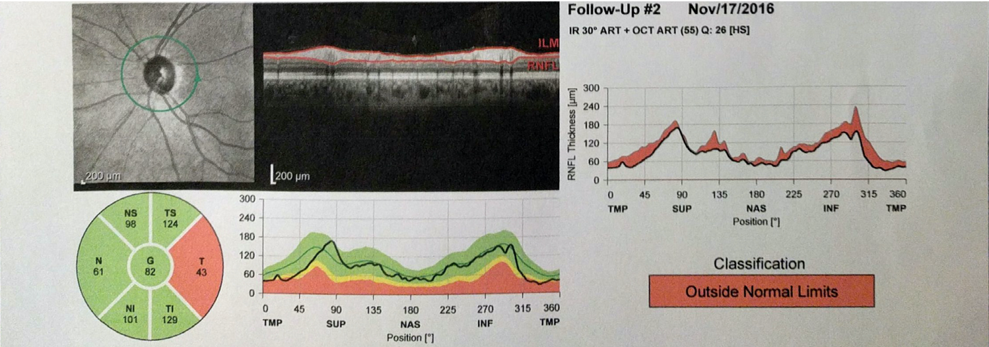
Optical Coherence Tomography
Evidence of temporal optic nerve atrophy L>R. (arrows)
Consistent with loss of fibers in maculo-papillary bundle.
RIGHT EYE
LEFT EYE
34

Slide 35
References:
Wang MY, Sadun AA. Drug-related mitochondrial optic neuropathies. J Neuroophthalmol. 2013 Jun;33(2):172-8.
Leibold JE. The ocular toxicity of ethambutol and its relation to dose. Ann N Y Acad Sci. 1966 Apr 20;135(2):904-9.
Grzybowski A, Zülsdorff M, Wilhelm H, Tonagel F. Toxic optic neuropathies: an updated review. Acta Ophthalmol. 2015 Aug;93(5):402-10.
Chen SC, Lin MC, Sheu SJ. Incidence and prognostic factor of ethambutol-related optic neuropathy: 10-year experience in southern Taiwan. Kaohsiung J Med Sci. 2015 Jul;31(7):358-62.
De Palma P, Franco F, Bragliani G, Michetti L, Marescotti A, Pirazzoli G, Fiorenza M. The incidence of optic neuropathy in 84 patients treated with ethambutol. Metab Pediatr Syst Ophthalmol (1985). 1989;12(1-3):80-2.
Citron KM, Thomas GO. Ocular toxicity from ethambutol. Thorax. 1986 Oct;41(10):737-9.
Leibold JE. The ocular toxicity of ethambutol and its relation to dose. Ann N Y Acad Sci. 1966 Apr 20;135(2):904-9.
Yang HK, Park MJ, Lee JH, Lee CT, Park JS, Hwang JM. Incidence of toxic optic neuropathy with low-dose ethambutol. Int J Tuberc Lung Dis. 2016 Feb;20(2):261-4.
Sadun AA, Wang MY. Ethambutol optic neuropathy: how we can prevent 100,000 new cases of blindness each year. J Neuroophthalmol. 2008 Dec;28(4):265-8.
De Palma P, Franco F, Bragliani G, Michetti L, Marescotti A, Pirazzoli G, Fiorenza M. The incidence of optic neuropathy in 84 patients treated with ethambutol. Metab Pediatr Syst Ophthalmol (1985). 1989;12(1-3):80-2.
Woung LC, Jou JR, Liaw SL. Visual function in recovered ethambutol optic neuropathy. J Ocul Pharmacol Ther. 1995 Fall;11(3):411-9.
35

