Slide 1

An older patient with difficulty reading
Victoria S. Pelak, MD
February 2021
Professor of Neurology and Ophthalmology
University of Colorado School of Medicine

Slide 2
History of Present Illness
54-year-old man with 3-4 years of difficulty reading
  Trouble seeing up close – hard for him to describe
  Vision not blurry
  Difficulty with spreadsheets that impacted his work as military data analyst and he had to stop working
  Increased font size on computer, use of a magnifier, and task light helped
    In low lighting, words and objects that are close together ”blend”
    Hard to discern space between words or columns on spreadsheet

Slide 3
Overview of course
Two years ago, after 2nd pair of new glasses and continued reading difficulty → referred to cataract surgeon and had successful cataract extraction with intraocular lens placement, both eyes: no help
Three months prior to neuro-ophthalmology presented, he stopped driving because of difficulty with his vision
Informed his family practice doctor about his difficulties and his doctor ordered a Brain MRI, which was reported as normal

Slide 4
Past History
Ocular
  Wears progressive lenses
  PCIOL OU: 2 years prior
Medical
  Obstructive sleep apnea, obesity, hypertension
Social
  Former smoker (2 pack years)
Family
  Colon cancer: father and two male siblings
  Congenital color blindness: father
Meds
  Lisinopril 10 mg / day
  Compliance with CPAP

Slide 5
Exam - Basic
 | Right | Left
Best corrected acuity difficulty managing use of pinholes | 20/25 J2 | 20/25+1 J2
Color vision Ishihara 14 | Control +4 | Control +4
Pupils | 5 light /3 dark; brisk; no APD | 5 light /3 dark; brisk no APD
Intraocular Pressure | 14 | 14
Extraocular Movement | Full ductions | Full ductions
 | +saccadic horizontal pursuits and no convergence insufficiency
Visual Field to confrontation | Variable and kept looking at examiner’s fingers | Variable and kept looking at examiner’s fingers

Slide 6
Exam – Slit Lamp
*posterior chamber intraocular lens
 | Right | Left
Lids/Lashes | Normal | Normal
Conjunctiva/Sclera | White/Quiet | White/Quiet
Cornea | Clear | Clear
Anterior Chamber | Deep/Quiet | Deep/Quiet
Iris | Normal | Normal
Lens | *PCIOL; no posterior capsule opacity | *PCIOL; no posterior capsule opacity
Vitreous | Syneresis | Syneresis
Optic Nerve | Normal; 0.3 C/D | Normal; 0.3 C/D
Macula | Normal | Normal
Vessels | Normal | Normal
Periphery | Normal | Normal

Slide 7
Neurologic Examination
Mental Status completed during first clinic visit:
Alert and oriented to person, place and time with normal attention, recent and remote memory.
Language: occasional word finding difficulty but normal grammar and able to write.
Mood and affect normal, although somewhat dissociated mood for discussion of situation (e.g., jovial at times).
Remainder of neurologic examination: normal

Slide 8
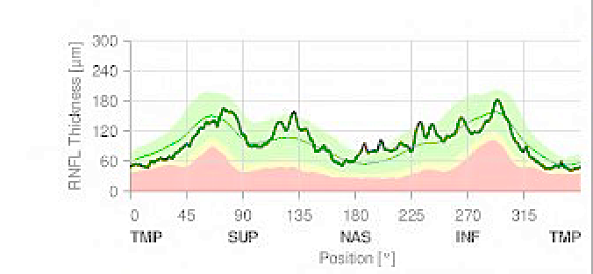
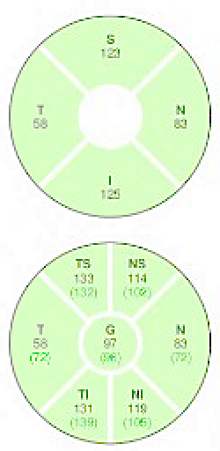
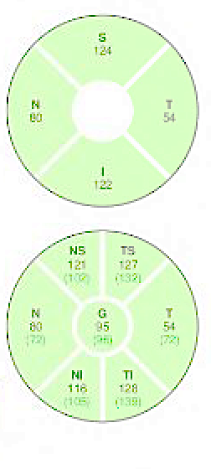
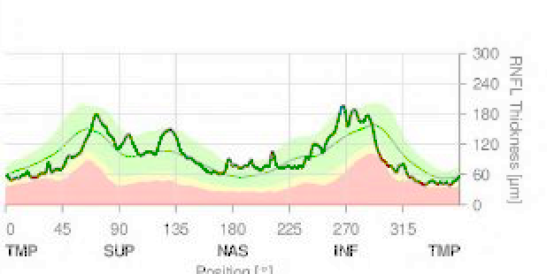
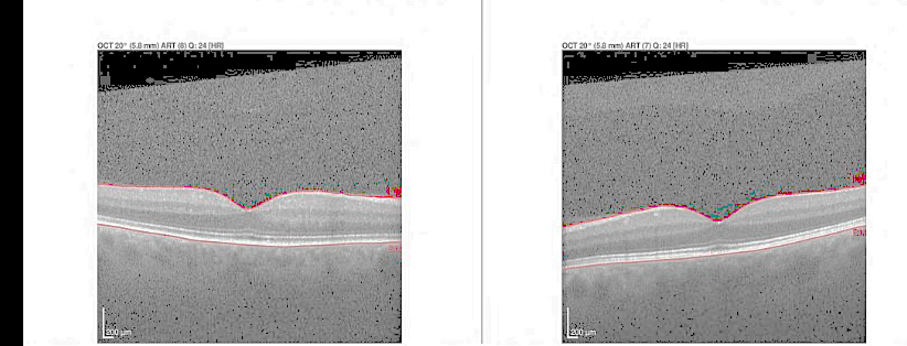
Further Evaluation
Retinal Optical Coherence Tomography: Normal
  Macula and Retinal Nerve Fiber Layer thickness
Farnsworth-Munsell Dichotomous D-15 Test (test of color hue): Normal
Notes:
Further evaluation

Slide 9
Differential Diagnosis: guides next step
Summary: 54-year-old with difficulty reading causing an inability to work with a normal eye examination and 20/25 vision. He had normal ocular alignment and no evidence of convergence insufficiency.
Potential causes (with notations)
  Brain-related alexia (but normal MRI by report)
  Occult retinopathy (but acuity relatively preserved)
  Malingering (but excellent acuity and effort and no other indicators)
  Conversion disorder or stress (but no sign of such)

Slide 10




What is the next best step?
Fluorescein angiogram
Humphrey Visual Field
Repeat MRI Brain scan
Psychiatry Consultation

Slide 11
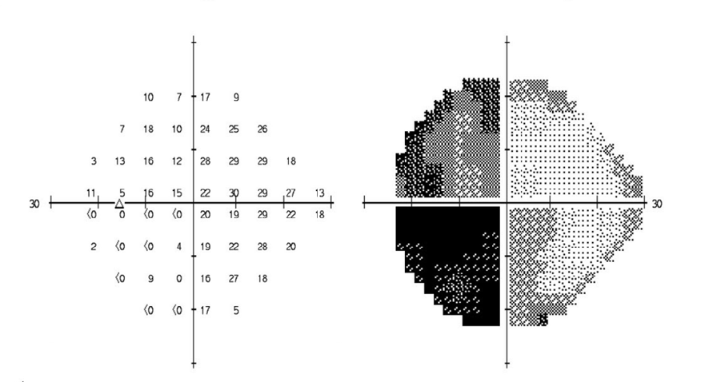
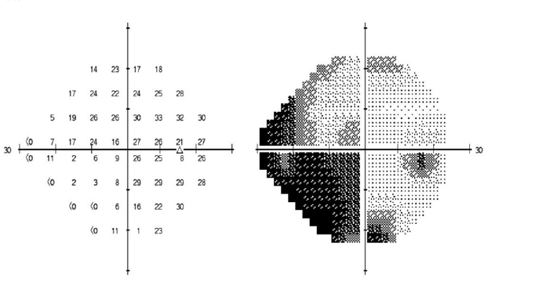
Answer B: We chose Humphrey 24-2 Visual Field
Interpretation: Left homonymous hemianopia
Left Eye Right Eye
Assessment for central visual field loss (i.e., central 24 degrees or 10 degrees) is important for patients reporting reading difficulties with normal visual acuity

Slide 12
What to do next?
Visual Evoked Response
Electroretinogram (ERG)
Refer patient to Psychiatry
Review the MRI brain scan

Slide 13
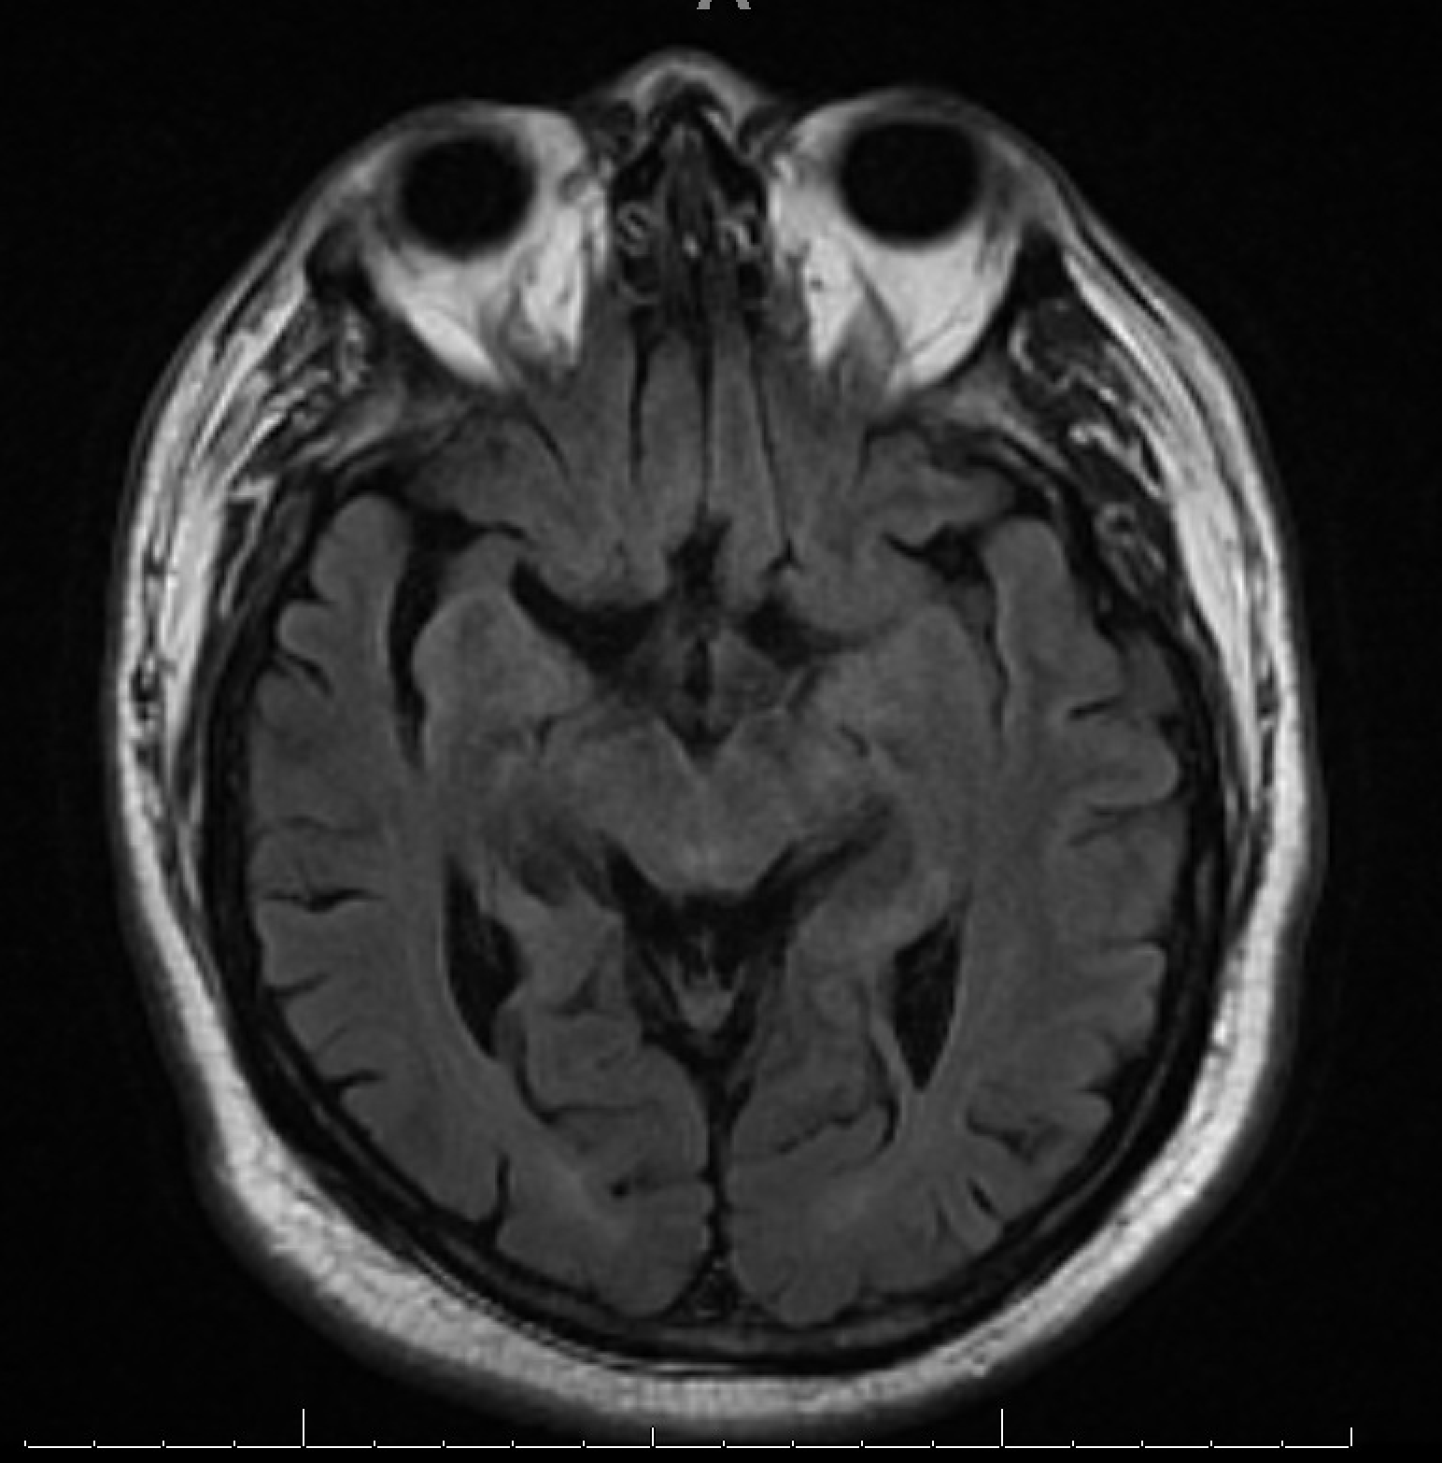
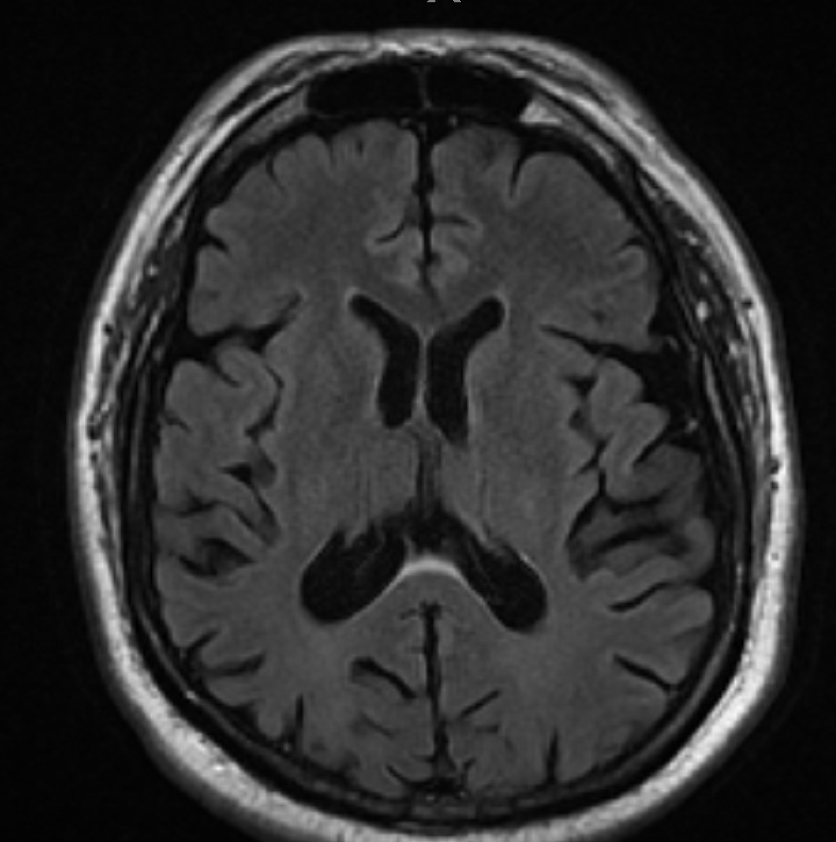
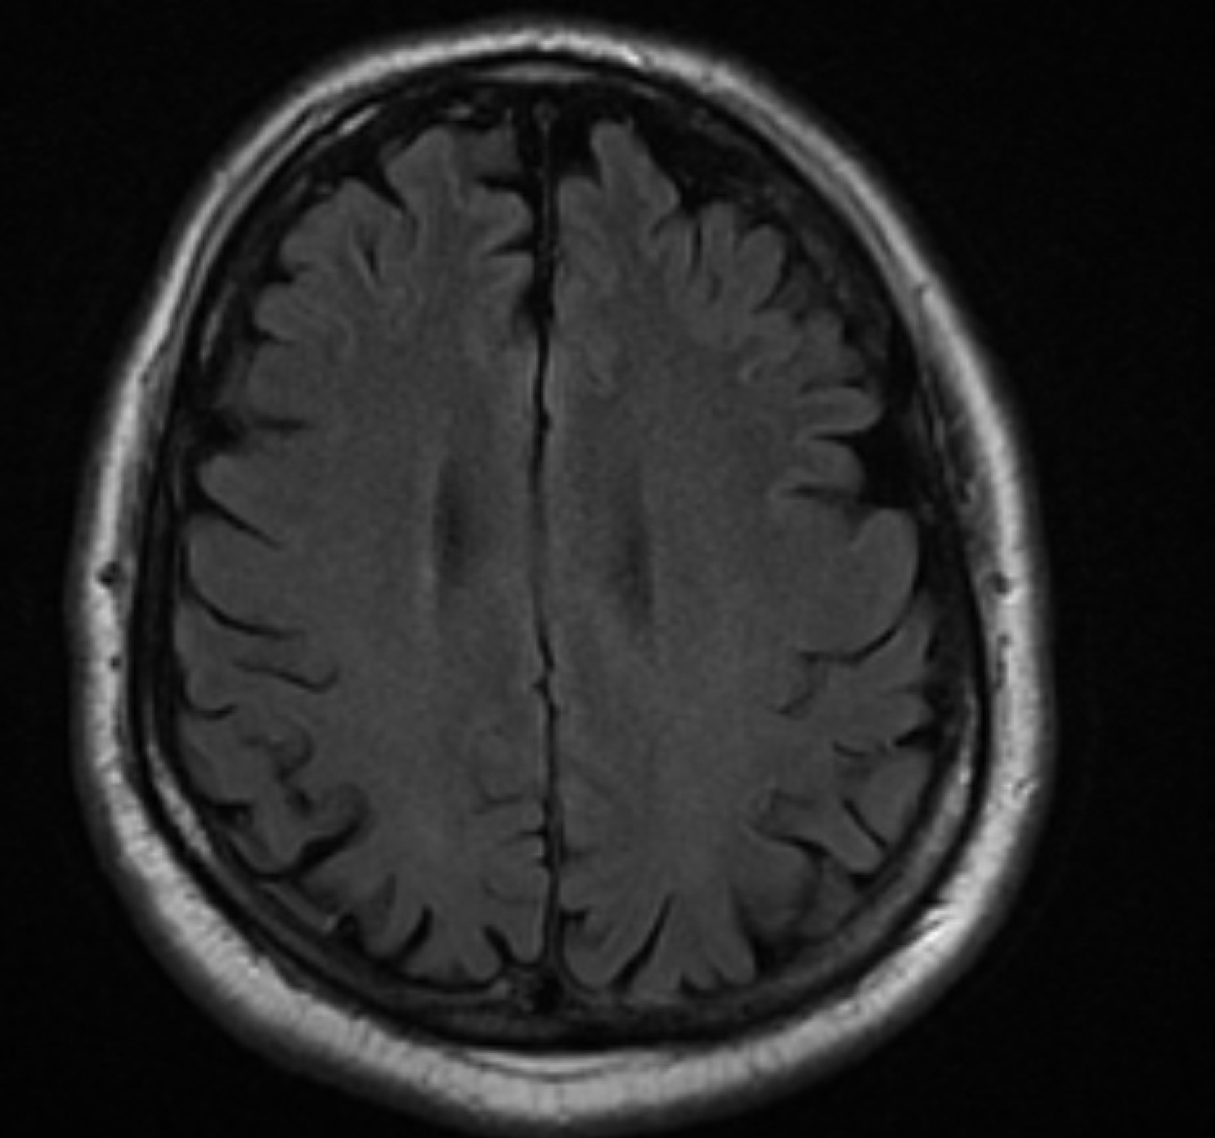
Answer D: We chose to review the MRI
For age 54, he has more significant occipital, temporal, and parietal atrophy than expected

Slide 14
Localization and differential diagnostic reasoning
Why is this likely to be a true central nervous system problem?
  Posterior cortical visual regions include occipital, posterior temporal, and the posterior parietal regions. With degeneration of these posterior regions, dysfunction occurs and results in visual crowding, homonymous hemianopia, reading problems, impaired recognition and identification of faces and objects, and depth and spatial perceptual dysfunction, while maintaining normal visual acuity. [This patient’s symptoms and signs are noted in bold.]
What makes this less likely to be a functional disorder?
  It is not common for patients to report a vision issue due to a functional disorder and have normal visual acuity (i.e., this patient had 20/25 vision both eyes).
  Presentation after the age 50 years is not typical for a functional disorder and there was no indication for malingering (i.e., no evident secondary gain).

Slide 15
Next step: Formal neuropsychological testing
Options for referral for neuropsychological (i.e., cognitive) testing:
Refer to a neurologist: call in advance to let them know your concerns and they can see patient and order testing.
Refer to a neuropsychologist for cognitive testing and then to a neurologist after testing is complete: call to let them know your concerns.
No matter the approach, communicating your concerns is critical to ensure proper assessment of visual cortical functions and acceptance of the approach by the patient.

Slide 16
Neuropsychological test results and diagnosis
Neuropsychological testing: revealed findings of relative sparing of memory, executive, and language functions compared to impairment in higher order visual processing.
Additional lab evaluation: all normal or negative - TSH, comprehensive metabolic panel, vitamin B12/folate, HIV1/2, treponemal antibodies, complete blood count.
Final diagnosis: Posterior Cortical Atrophy syndrome.

Slide 17
Posterior Cortical Atrophy (PCA) Syndrome
PCA syndrome is a progressive, neurodegenerative condition most commonly due to Alzheimer’s disease (AD) with specific criteria¹.
Visual dysfunction, particularly reading impairment, is the most common initial presentation of PCA syndrome to the neuro-ophthalmologist².
Think of PCA when visual complaints and functional impairment outweigh the findings on eye exam in a person >45 years (PCA most often presents in the sixth decade).
Think of PCA in the presence of homonymous visual field defects and “normal” brain imaging.

Slide 18
Summary of the Clinical Criteria for PCA Syndrome¹
Gradual progression with prominent early disturbances in visual or other posterior cognitive functions
Three of the following core features should be present early in the course: space perception deficit, object perception deficit, constructional dyspraxia, environmental agnosia, oculomotor apraxia, dressing apraxia, optic ataxia, alexia, left/right disorientation, acalculia, limb apraxia, apperceptive prosopagnosia, agraphia, homonymous visual field defect, finger agnosia
Relative sparing of memory, speech and language, and executive functions, and sparing of changes in behavior and personality
Supporting the diagnosis: posterior brain atrophy or hypometabolism or hypoperfusion on MRI, FDG-PET, or SPECT
No other explanation for the posterior cortical dysfunction

Slide 19
AD and the PCA syndrome continued
AD is the most common form of age-related dementia and affects over 6 million people in the US alone. Early onset AD (age <65 years) occurs in 5% of patients. Prominent visual symptoms with relative sparing of memory loss can be the initial presentation of AD at any age^{1,3}. For PCA presentations, reading complaints are the most common presentation to Neuro-ophthalmology².
  With PCA there is a disproportionate degree of posterior cortical atrophy involving the occipital, temporal, and parietal lobes, and are often not mentioned in the radiology interpretation.
  People with PCA are often younger than those with typical AD (i.e., <65 years).
  Autopsy findings in PCA can also reveal Lewy Bodies (i.e., Lewy Body dementia) or prion disease or corticobasal degeneration.

Slide 20
Homonymous visual field loss and a report of a normal brain imaging
If homonymous visual field patterns occur in the setting of a reportedly normal brain scan, or a brain scan described as having cortical atrophy only, neurodegenerative disease should be suspected and further evaluation for such should be sought. Homonymous visual field defects are common in the presentation of PCA syndrome to the neuro-ophthalmologist^{2,4}.
Fluorodeoxyglucose-positron emission tomography (FDG-PET) of the brain can be used to identify hypometabolism in posterior cortical regions when a concern for the diagnosis of PCA syndrome arises⁵. See next slide.
Ultimately, neurologic evaluation and formal neuropsychological testing is necessary to identify the syndrome and to determine the appropriate diagnosis and/or diagnostic work up that is necessary.

Slide 21
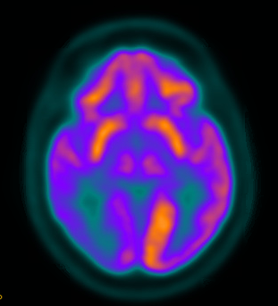
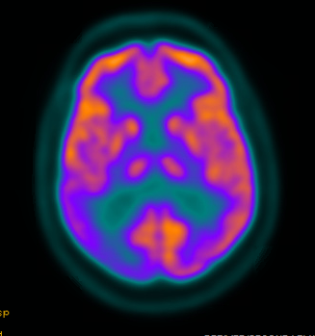
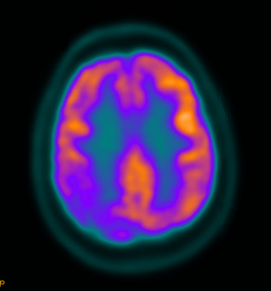
Fluorodeoxyglucose-positron emission tomography (FDG-PET) in a patient with PCA Syndrome
Arrows pointing to the right occipital and right parietal areas of hypometabolism noted by the “less orange” color. Images left to right move from rostral to caudal as labeled. These regions corresponded to this patient’s left homonymous hemianopia.
occipital
occipitoparietal
parietal

Slide 22
Dissociation between visual complaints and examination findings in an older patient
…should raise the suspicion for a neurodegenerative disorder.
Impairment of activities of daily living (reading, working, driving) without explanation is a common presenting feature of PCA.
Subtle problems on examination, such as the inability to read the Ishihara color plates (linked to simultanagnosia) or difficulty with the use of a pinhole device (linked to apraxia), such as this patient had, are clues to underlying posterior cortical dysfunction.

Slide 23
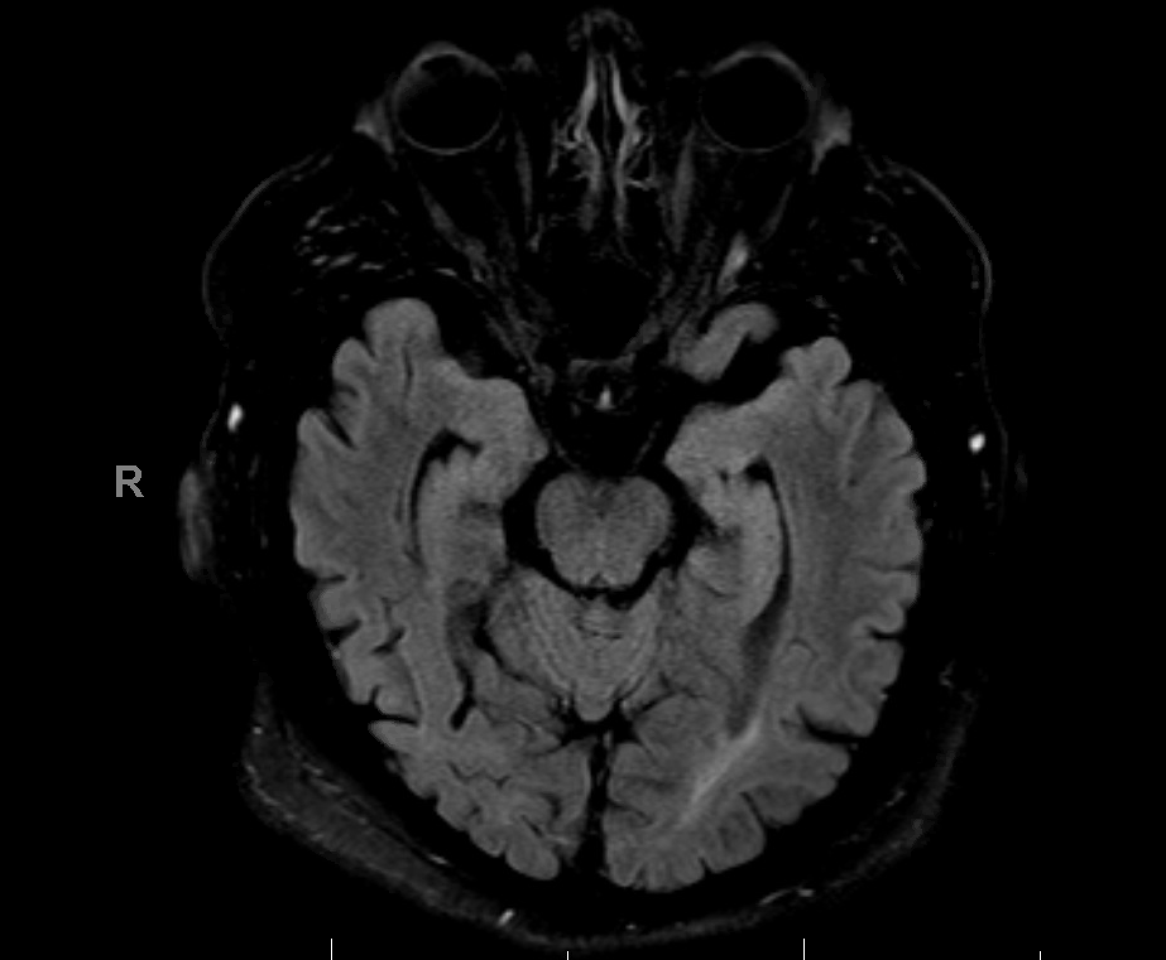
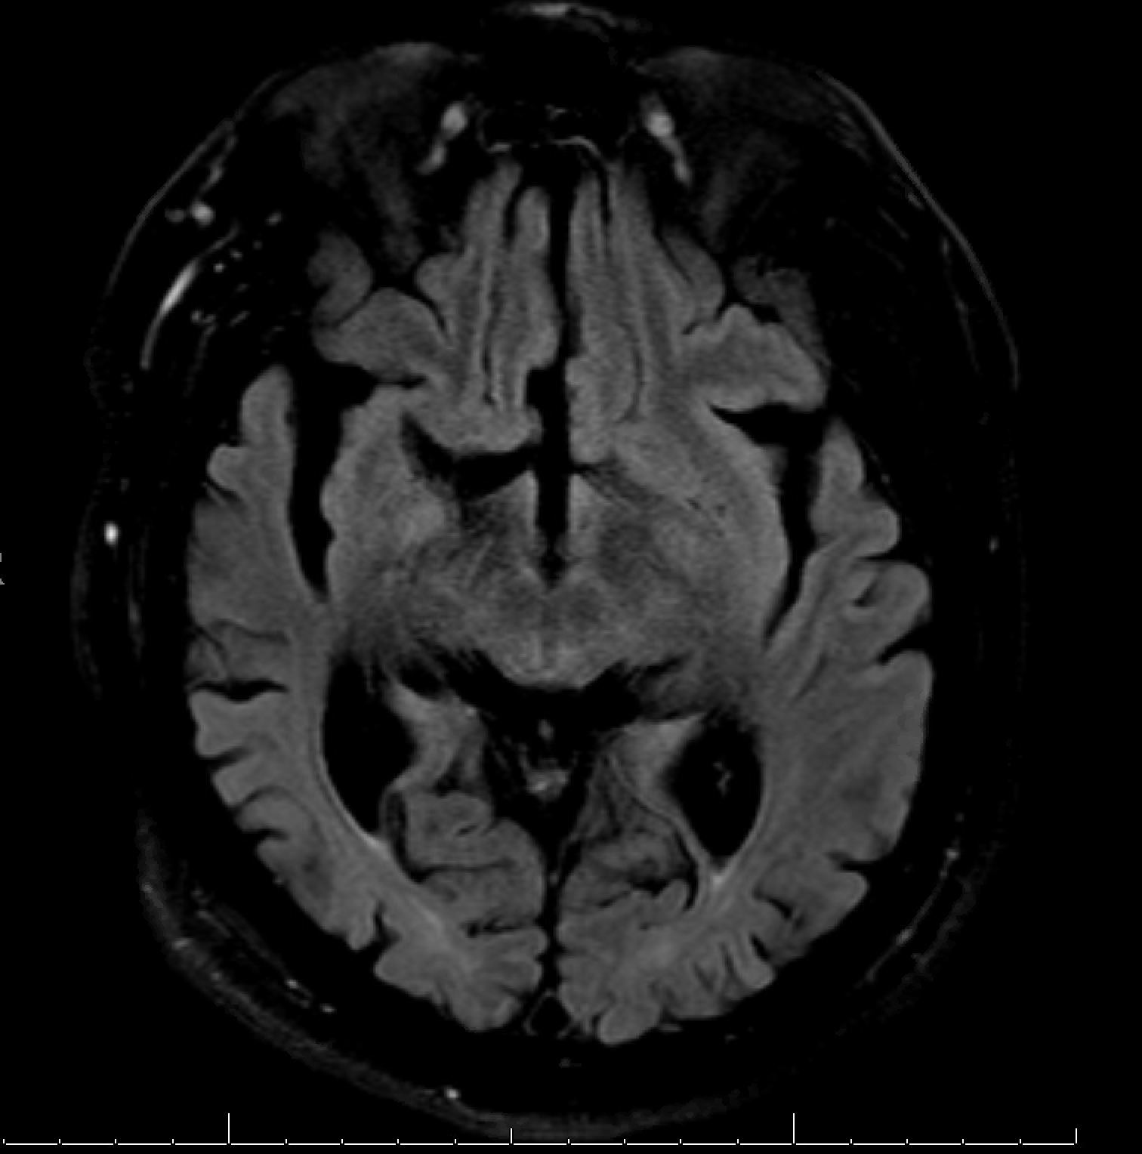
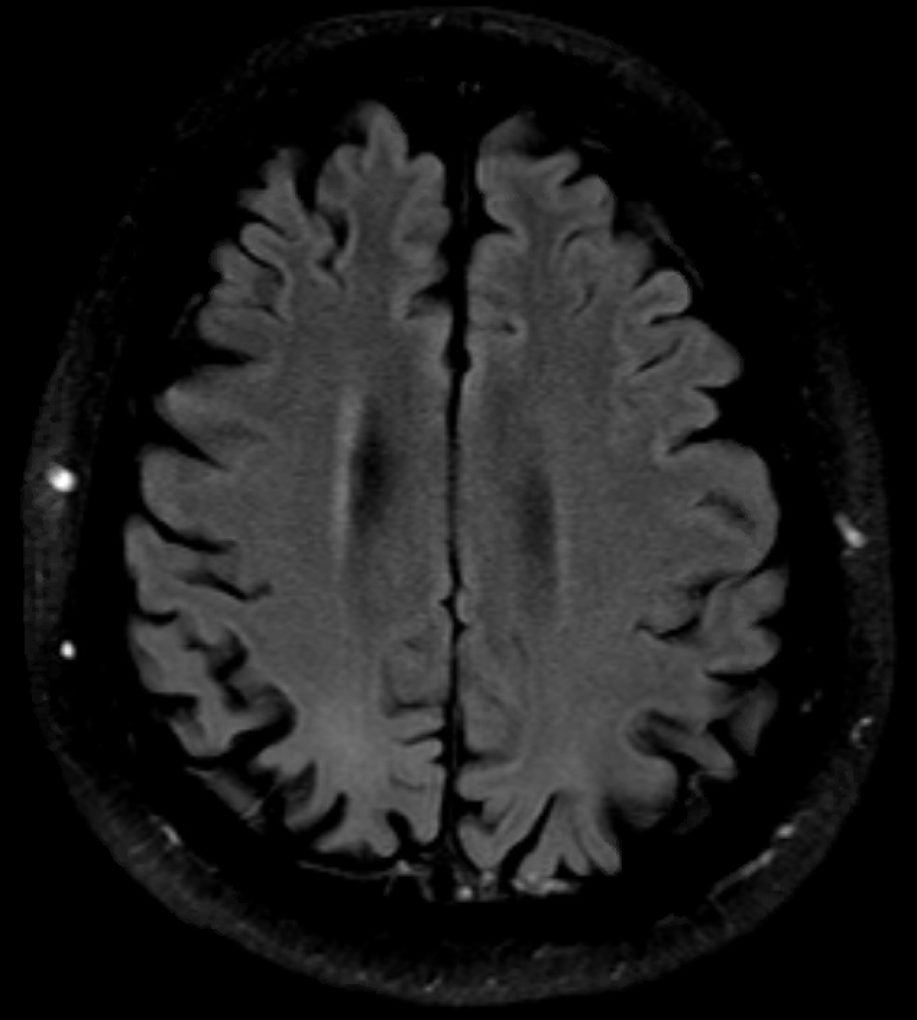
After 3 years, the posterior atrophy became severe
And after 5 years, the patient could no longer live at home with his wife and is currently in a memory care facility with dementia with behavioral issues.

Slide 24
References
Crutch SJ, Schott JM, Rabinovici GD, et al. Consensus classification of posterior cortical atrophy. Alzheimer's & Dementia 2017; 1-15.
Olds JJ, Hills WL, Warner J, Falardeau J, Alasantro LH, Moster ML, Egan RA, Cornblath WT, Lee AG, Frishberg BM, Turbin RE, Katz DM, Charley JA, Pelak VS. Posterior Cortical Atrophy: Characteristics From a Clinical Data Registry. Front Neurol 2020; 11:358.
Tzekov R, Mullan M. Vision function abnormalities in Alzheimer disease. Surv Ophthalmol 2014; 59(4):414-33.
Pelak VS, Smyth SF, Boyer PJ, et al. Computerized visual field defects in posterior cortical atrophy. Neurology 2011; 77(24):2119-22.
Pelak VS, Filley, CM. Clinical and imaging clues to posterior cortical atrophy. Neurol Clin Pract 2015; 5(3):270–271.

