Slide 1

Papilledema in a Patient Being Treated for Multiple Sclerosis
Larry Frohman, MD
Roger Turbin, MD
Peter Wawrzusin, MD
Gaurav Srivastava, MD
Dept. of Ophthalmology
Rutgers-New Jersey Medical School
Nicole Sakla, DO
Dept. of Radiology
Newark-Beth Israel Medical Center

Slide 2
27 yo Female Presents Elsewhere 8 Years Before Initial Neuro-ophthalmology Consult
Ataxia
Vomiting
Dysphagia
Slurred speech
Left sided weakness
Left upper extremity tremors
Left lower extremity cramping
Binocular horizontal diplopia
  No diurnal variation

Slide 3
Initial Workup Elsewhere
MRI brain:
  Non-enhancing hypodensity in the pontomedullary region
MRI of the cervical, thoracic and lumbar spine:
  Discogenic disease, no demyelinating lesions
Spinal Tap:
  0 RBC, 25 WBC [96% Lymphocytes, 4% monocytes]
  Protein (37) and glucose (63)
  Normal cytology
  No oligoclonal bands
Serum:
  Elevated amylase and lipase
  Positive H. pylori IgM
  ANA negative

Slide 4
Initial Course
  Symptoms resolve with 5 days of intravenous corticosteroids followed by a brief outpatient prednisone taper
  Neurology notes:
    Visual acuity 20/25 in each eye
    PERRL
    EOMI without nystagmus
    Normal fundi exam
    Cranial nerve, motor, sensory, reflex, and cerebellar exams were now normal
  4 months into course, repeat MRI of the brain and spine remain unchanged

Slide 5
Further Course
6 months later (10 months after initial presentation) develops bilateral leg numbness
  Brain (MRI): Stable non-enhancing medullary lesion
  Spine (MRI): New enhancing spinal cord lesion (C7-T2) suspicious for demyelinating process
Diagnosed as having Multiple Sclerosis
  Started on Interferon beta-1b

Slide 6
Over Next Two Years
Numbness progresses to involve chest and shoulders
Develops abnormal tandem walk and Romberg
Next year (5 years into her course)
  Binocular diplopia without diurnal variation
  Brisk bilateral lower extremity reflexes
  Bilateral abnormal heel to shin testing
Repeat MRI obtained

Slide 7
MRI Finding Of Note
Bilateral optic nerve papilla bulging into globes
What is that a sign of?
Elevated Intracranial Pressure
Also felt EOM size might be generous

Slide 8
Develops Headache
Ophthalmology Consulted
  Confirms papilledema
  Acetazolamide 250 mg bid started

Slide 9
Is This Idiopathic Intracranial Hypertension (aka IIH or Pseudotumor Cerebri)?
No - Remember that at onset she had 25 white cells in her CSF
And remember that she has multiple other neurologic findings and structural lesions on MRI

Slide 10
If It Were IIH, Is This The Right Dose Of Acetazolamide?
No- the Idiopathic Intracranial Hypertension Treatment Trial suggested the dose of acetazolamide to treat this disorder is ultimately building up to 2-4 grams daily in divided doses

Slide 11
Further Course
Intolerant of acetazolamide, stopped
Switched from interferon-beta to Teriflunomide for her MS

Slide 12
Is There Anything Problematic About This Being MS?
MS does not cause papilledema- would have to be two simultaneous diseases
Or, search for a unifying process

Slide 13
Two Spinal Taps Done In Fall 2017, 8 Years After Presentation
Highest of two had opening pressure = 25 , but
CSF protein = 1087 (top normal 15-45)
Referred to our neuro-ophthalmology service

Slide 14
Initial Neuro-Ophthalmology Consultation
C/o 3 months intermittent diplopia
  No diurnal pattern, horizontal and binocular
Bilateral orbital pain
Headaches
Pulsatile tinnitus
Increasing frequency of bilateral transient visual obscurations

Slide 15
Initial Neurologic Exam
Decreased vibration sense, all extremities
Diffuse hyporeflexia without clonus
Ataxic, could not perform tandem walk
Did not have
  Nystagmus
  Finger to nose dysmetria nor heel to shin dysmetria

Slide 16
Initial Visual Assessment
20/25 OU
Pupils brisk, RRL, no relative afferent pupillary defect
Exophthalmometry 23 OD, 24 OS (no obvious proptosis)
  No resistance to retropulsion of globes
EOM full
Orthophoric (eyes straight) in all cardinal gazes

Slide 17
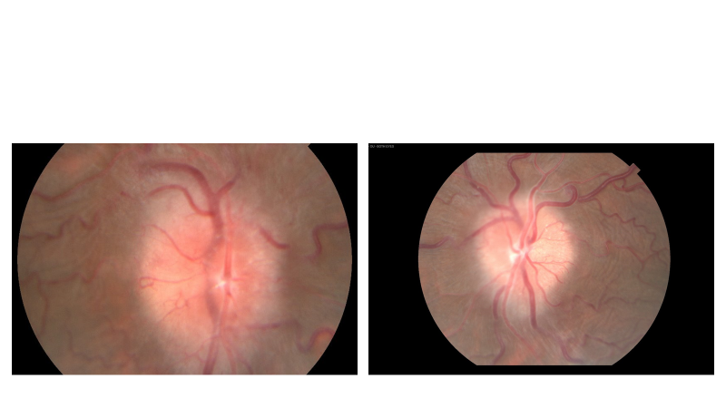
Fundus- Frisen Grade 3 Papilledema OU
RIGHT EYE LEFT EYE

Slide 18
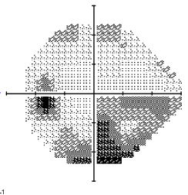
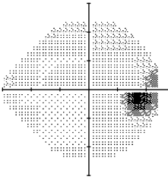
Visual Fields
Perhaps enlarged blind spots each eye, inferior arcuate/partial altitudinalscotoma left eye
LEFT EYE
RIGHT EYE

Slide 19
Further Studies
MR Venogram wnl
Spinal Tap:
  Opening pressure = 30 cm H20
  5 WBC (78% Lymphs, 22% Monocytes)
  Protein > 600

Slide 20
Lab Results
West Nile Virus positive
  Infection with WNV subsequently ruled out by Infectious Disease consult
Lyme negative
CSF ACE slightly elevated (3.9, normal to 2.5)

Slide 21
More Imaging
Lumbar spinal MRI
  Multiple bilateral enhancing nerve root masses within neural foramina suggestive of Chronic Inflammatory Demyelinating Polyneuropathy (CIDP) (corroborating the sensorimotor exam and overall clinical picture) or neurofibromatosis 2
Brain MRI
  Enhancing lesions of both facial nerves, and enhancement in the right internal auditory canal

Slide 22
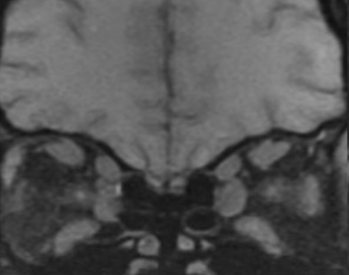
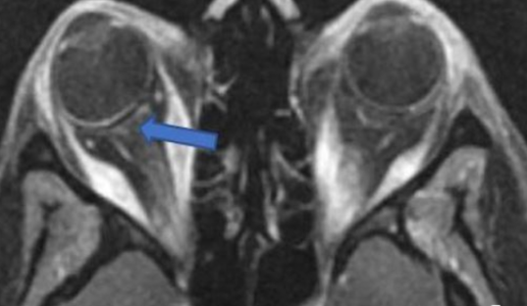
MRI Internal Auditory Canals
Bilateral tendon-sparing enlargement of extraocular muscle bellies
Posterior globe flattening consistent with increased intracranial pressure

Slide 23
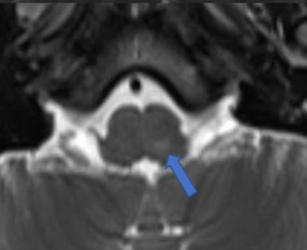
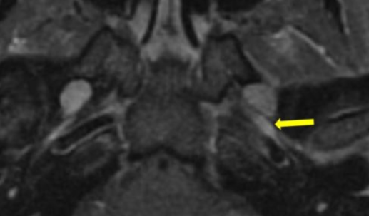
MRI Internal Auditory Canals
Axial MRI of the internal auditory canal (T2 FLAIR) 4 days post presentation shows enhancing lesion in medulla (arrow)
Axial MRI of internal auditory canal (T1 with contrast and fat suppression) shows enhancement of the mandibular division of the trigeminal nerve, left more than right (arrow)

Slide 24
Because Of Enlarged Muscles With Tendon Sparing Thyroid Studies Performed
Euthyroid
Normal
  Thyroid stimulating immunoglobulin
  Thyroid peroxidase
  Thyroglobulin antibody

Slide 25
Further Serologic Assessment- All Normal
ACE
NMO IGG
Myelin oligodendrocyte glycoprotein (MOG)
Campylobacter
Anticardiolipin antibody
Rheumatoid factor
VDRL & FTA-ABS
QuantiFERON-gold
SPEP

Slide 26
Electrophysiology
Nerve conduction studies showed prolonged distal latency in both median nerves, as well as a reduced conduction velocity and compound muscle action potential in the left median nerve. The right ulnar nerve showed similar findings. Sensory responses were absent in the bilateral upper extremities.
Electromyography showed signs of chronic denervation and/or reinnervation of the left gastrocnemius.
Electrophysiological testing was consistent with CIDP.

Slide 27
So, Is This all CIDP?
Are we Done?
Hold on just a minute- would CIDP do all this and does it cause papilledema?
Any process that causes enough elevation of CSF protein or CSF cells can cause elevated intracranial pressure and therefore papilledema
But what about the eye muscles?

Slide 28
Remember That Positive CSF ACE-Could This Be Neurosarcoidosis???
CXR Normal, ACE normal in serum
Are we done???
Gallium Scan to look for systemic sarcoid
  Gallium scan showed intense bilateral lacrimal gland uptake

Slide 29
SEE UPFRONT CASE 1
Apply Sutton’s Law
“Go where the money is”
Lacrimal and salivary gland biopsies performed
Non-granulomatous chronic non-specific inflammatory changes, not specific for sarcoid

Slide 30
Does This Absolutely Rule Out Sarcoidosis?
No, in one series, biopsying the lacrimal glands of a patient whose gallium scan showed high levels of uptake in the lacrimal gland yielded pathology consistent with sarcoid in only 50% of cases ultimately shown to have sarcoidosis.
Furthermore in this patient the biopsies were performed 2 weeks after steroid initiation, which could have masked prior presence of granulomas.
Nothing else suggestive of sarcoid was ever found.

Slide 31
Treatment
60 mg prednisone a day
1000 mg acetazolamide twice daily (now tolerated)

Slide 32
Further Course
ANA positive
Anti-histone antibodies positive
Rheumatology Consult Diagnosis:
  Systemic Lupus Erythematosus

Slide 33
Further Rx
Intravenous Gammaglobulin (IVIG) begun
Mycophenolate begun
Prednisone tapered to 5 mg daily

Slide 34
Clinical Course
Patient followed-up sporadically
Visual Fields left eye deteriorated despite increase to 3 grams acetazolamide daily
Optic atrophy noted left eye
What is your therapeutic next step?

Slide 35
Optic Nerve Sheath Fenestrations Performed
Mycophenolate and IVIG stopped
Rituximab begun

Slide 36
Final Neuro-Ophthalmic Visit
2 Years After Initial Neuro-ophthalmic Exam And 10 Years After Initial Symptoms
20/30 right eye, 20/25 left
No diplopia, ophthalmoplegia, proptosis, nor symptoms of elevated intracranial pressure
Automated perimetry revealed a superior altitudinal defect in the right eye and a central island in the left eye
Optic nerves demonstrated bilateral atrophy without signs suggestive of elevated intracranial pressure

Slide 37
Final Diagnosis?
Chronic Inflammatory Demyelinating Polyneuropathy with Intracranial Hypertension and Extraocular Muscle Enlargement as Features of Occult Systemic Lupus Erythematosus

Slide 38
Summary: CIDP
Exhibits a variable presentation
Many reported associated systemic conditions
  Autoimmune
  Genetic
  Infectious
  Metabolic
Makes defining a spectrum of CIDP itself difficult
In this case, seems to have been a manifestation of occult systemic lupus erythematosus

Slide 39
Key Points
Because of its association with other illnesses, the diagnosis of CIDP is often delayed
Conversely, a diagnosis of CIDP should not preclude the investigation into whether other systemic illness is also present
CIDP rarely causes elevated intracranial pressure
Posterior fossa lesions have been reported in CIDP
There are very rare cases of enlarged eye muscles in CIDP, but only in cases where, unlike this case, there was evidence of concomitant thyroid disease

Slide 40
What This Was Not…
This was not Multiple Sclerosis:
  Absence of oligoclonal bands
  Elevation of CSF white cells and protein beyond what is seen in MS
  MS does not cause elevated intracranial pressure/papilledema
This was not idiopathic intracranial hypertension:
  Spinal fluid findings of pleocytosis and markedly elevated proteins are not permitted in a diagnosis of IIH
  Structural lesions present not consistent with IIH

Slide 41
REFERENCES
Wall M, Kupersmith MJ, Kieburtz KD, et al. The idiopathic intracranial hypertension treatment trial: clinical profile at baseline. JAMA Neurol. 2014;71(6):693-701. doi:10.1001/jamaneurol.2014.133
Tannen BL, Kolomeyer AM, Turbin RE, Frohman L, Langer PD, Oh C, Ghesani NV, Zuckier LS, Chu DS. Lacrimal gland uptake of 67Ga-gallium citrate correlates with biopsy results in patients with suspected sarcoidosis. Ocul Immunol Inflamm 2014 Feb;22(1):15-22. doi: 10.3109/09273948.2013.791700.
Vina ER, Fang AJ, Wallace DJ, et al. Chronic Inflammatory demyelinating polyneuropathy in patients with systemic lupus erythematosus: Prognosis and outcome. Semin Arthritis Rheum. 2005;35:175–84. doi: 10.1016/j.semarthrit.2005.08.008. PMID: 16325658.
Busby M, Donaghy M. Chronic dysimmune neuropathys. J Neurol. 2003;250(6):714-724. doi:10.1007/s00415-003-1068-2. Doi: 10.1007/s00415-003-1068-2.
Rajabally YA, Nicolas G, Piéret F, et al. Validity of diagnostic criteria for chronic inflammatory demyelinating polyneuropathy: a multicentre European study. J Neurol Neurosurg Psychiatry. 2009; 80:1364. doi: 10.1136/jnnp.2009.179358.
Kissel JT. The treatment of chronic inflammatory demyelinating polyradiculoneuropathy. Semin Neurol. 2003;23(2):169–80. doi:10.1055/s-2003-41130.
Rammohan KW. Cerebrospinal fluid in multiple sclerosis. Ann Indian Acad Neurol. 2009;12(4):246-253. doi:10.4103/0972-2327.58282.
Thomas PK, Walker WH, Rudge P et al. Chronic demyelinating neuropathy associated with multifocal central nervous system demyelination. Brain. 1987;110:53–76. doi: 10.1093/brain/110.1.53.

Slide 42
REFERENCES
Altinkaya A, Topcular B, Sakalli NK, Kuscu DY, Kirbas D. Chronic inflammatory demyelinating polyradiculoneuropathy associated intracranial hypertension. Neurol Sci. 2012;34(6):1027-1029. doi: 10.1007/s10072-012-1179-6.
Morrison KE, Davies PT. Chronic inflammatory demyelinatingpolyneuropathy presenting with headache and papilledema. Headache. 1999;39(4):299-300. doi: 10.1046/j.1526-4610.1999.3904299.x.
Dave S, Longmuir, R Shah, VA. Intracranial hypertension in systemic lupus erythematosus. Semin Ophthalmol. 2008;23:127–133. Doi: 10.1080/08820530801888188.
Palejwala NV, Walia HS, Yeh S. Ocular Manifestations of Systemic Lupus Erythematosus: A Review of the Literature. Autoimmune Dis. 2012;2012:1-9. doi:10.1155/2012/290898.
Abraham H, Kuzhively J, Rizvi SW. Chronic Inflammatory Demyelinating Polyneuropathy (CIDP): An Uncommon Manifestation of Systemic Lupus Erythematosus (SLE). Am J Case Rep. 2017;18:980–983. doi:10.12659/ajcr.903541.
Bridel C, Courvoisier DS, Vuilleumier N, Lalive PH. Cerebrospinal fluid angiotensin-converting enzyme for diagnosis of neurosarcoidosis. J Neuroimmunol. 2015;285:1-3. doi:10.1016/j.jneuroim.2015.05.020.

