Slide 1

Double Vision and Headache
UPFRONT CASE
Larry Frohman, MD
Executive Vice President, NANOS
Rutgers-New Jersey Medical School
Christopher Seery, MD
PGY-3 Ophthalmology Resident
Rutgers- New Jersey Medical School
Notes:
This UPFRONT Case is a patient with diplopia and headache

Slide 2
68-Year-Old Asian Woman with Diplopia and Headache
Presents with headache in the cranial vault and forehead, and right cheek pain for about 1 year
  Previously diagnosed as sinus headaches
About 1 month prior to our evaluation, she reports blurred vision of her right eye and binocular diplopia
No unsteadiness or other neurologic sx
She underwent extensive workup prior to our evaluation
Notes:
This 68 yo Asian woman told us that she had been suffering form cranial vault and forehead headaches, as well as right cheek pain, fro about a year. These had been diagnosed with sinus headaches.
About one month before she saw she developed binocular diplopia, and wondered if her right eye was blurry. She denied any neurologic symptoms, and had no sense of unsteadiness. She had undergone an extensive evaluation for the diplopia

Slide 3
68-Year-Old Asian Woman with Diplopia and Headache
  Past Medical History
    Breast cancer at age 49
    s/p Tamoxifen x 4 years
    No chemotherapy or radiation therapy
    Believes nodes were free
Notes:
Her past medical history included breast carcinoma, treated with resection and Tamoxifen, she said her nodes were free.

Slide 4
68-Year-Old Asian Woman with Diplopia and Headache
Other than her past workup, what else do you want to know about her symptoms?
  The double vision is:
    Binocular (goes away when she covers either eye)
    Vertical
    Worse at distance
    Worse when she looks to the right
Notes:
So, other than her past workup, what more do you want to know about her visual symptoms?
The diplopia was binocular, she thought it had a vertical component, it was worse at distance, and it was worse in right gaze.

Slide 5
68-Year-Old Asian Woman with Diplopia and Headache
Any other specific questions about her history?
  No ptosis, although her eyelids feel heavy late in the day
  No difficulty swallowing, breathing, or weakness of her extremities
Notes:
Are there any more questions about her history that you should ask?
Well, you should. Thinking about myasthenia, ask about ptosis, diurnal variation, meaning the symptoms getting worse late in the day, and about systemic signs of myasthenia

Slide 6
More History
  When asked about antecedent illness, she said she had a cough and URI around the onset of the diplopia
Notes:
We also like to know if there was any antecedent vaccination or illness that might be related to the symptoms. There were no vaccinations, but she said that around the time of the onset of the double vision, she had a URI.

Slide 7
Prior Workup
MRI Brain normal
ESR, CRP, CXR normal
ANA 1:160
Bilateral temporal artery biopsies
  3 cm specimens
  Bilaterally negative
  Elastin stains negative
Notes:
The prior workup included a negative brain MRI, sed rate, CRP, and CXR. She had a low positive ANA of 1:160. Outside doctors, not having an explanation for the diplopia in this 68 year old who had headaches for 11 months before the onset of diplopia, decided to get bilateral temporal artery biopsies. They had adequate 3 cm sections, did elastin stains, and these were negative.

Slide 8
Treatment Tried
Patient had been started on 60mg prednisone for temporal arteritis prior to our evaluation
Do you concur?
Notes:
Despite the negative biopsies, these doctors who saw her before neuro-ophthalmology was involved decided to start her on 60 mg of prednisone for biopsy-negative temporal arteritis.
Do you agree with this treatment plan?

Slide 9
Diplopia in Temporal Arteritis
(Giant Cell Arteritis, GCA) ¹
Compared to age matched patients with diplopia related to other causes, patients with GCA were more likely to:
  Complain of visual symptoms (58% vs 25%, P = 0.008)
  Have a greater number of systemic GCA symptoms (3.5, GCA vs 0.6, controls, P < 0.001)
    Headache (94% [17/18] vs 39% [23/67]; P < 0.001)
    Jaw claudication (80% [12/15] vs 0% [0/36]; P < 0.001)
    Scalp tenderness (44% [7/16] vs 7% [3/43]; P < 0.001)
Notes:
When temporal or giant cell arteritis have double vision, they have a usually have systemic symptoms of GCA such as jaw claudication. Aside from the headache, she did not

Slide 10
Diplopia in Temporal Arteritis
(Giant Cell Arteritis) ¹
Compared to age matched patients with diplopia related to other causes, patients with GCA were more likely to exhibit:
  Ocular ischemic lesions (26% vs 1%, P < 0.001)
  Elevated inflammatory markers
    ESR 91% [10/11] vs 12% [3/25], P < 0.001
    CRP 89% [8/9] vs 11% [2/19], P < 0.001
Notes:
Patients with diplopia from giant ell arteritis almost always have either an elevated sed rate, CRP, or both- she did not

Slide 11
Why Was This Case Not Likely
Temporal Arteritis?
No complaints of fevers, myalgia, weight loss, temporal/ scalp tenderness, jaw claudication
Normal inflammatory markers
Negative biopsies
So then where do we go from here?
How about some exam!
Notes:
Given that she had no systemic symptoms except for headache, which is quite nonspecific, and had normal inflammatory markers in her blood, and bilaterally negative adequate biopsy specimens that were properly stained, we did not think that temporal arteritis was a tenable diagnosis.
So what do you want to do next?
Well, what we wanted to do was examine her some more.

Slide 12
Exam (seen early in day)
20/20 both eyes with correction
Normal color plates
PERRL, no RAPD
Palpebral fissure height 8.5mm/ 9mm
Notes:
The comment about seeing her early in the day is that you should be mindful that an ocular myasthenic might look normal early in the day. If we are really considering myasthenia, sometimes we bring back patients late in the day to see f they exhibit diurnal variability in their exam.
She had no afferent visual dysfunction, meaning that acuity, color plates, fields, and pupils were all normal. She had one half a mm of ptosis in the right eye.

Slide 13

Exam (seen early in day)
Good orbicularis tone
No fatigue after 2 minutes of sustained upgaze
No Cogan’s Lid Twitch
  You can see an example of this sign of ocular myasthenia via the NANOS NOVEL Collection at https://collections.lib.utah.edu/details?id=1209829&q=sort_type_t%3A%2AMovingImage%2A+AND+myasthenia&fd=type_t%2Ctitle_t%2Cdescription_t%2Csubject_t%2Ccollection_t&rows=50&sort=sort_title_t+asc&facet_setname_s=ehsl_novel_%2A
What would positivity of these tests suggest?
Myasthenia
Notes:
She exhibited good orbicularis tone, no fatigue on sustained upgaze, and no Cogan’s lid twitch sign. You can click on the URL to see what a positive case of Cogan’s lid twitch sign of myasthenia looks like.
So she did not have the classic ocular myasthenia signs.

Slide 14
Extraocular Movements
Bilateral pseudointernuclear ophthalmoplegia
No nystagmus
No elevation either eye
Full depression
You can see an example of pseudointernuclear ophthalmoplegia and its response to tensilon in a myasthenic man in the classic video available via the NOVEL collection at https://collections.lib.utah.edu/details?id=188639&q=sort_type_t%3A%2AMovingImage%2A+AND+pseudo+internuclear&fd=type_t%2Ctitle_t%2Cdescription_t%2Csubject_t%2Ccollection_t&rows=50&sort=sort_title_t+asc&facet_setname_s=ehsl_novel_%2A
Anyone recall what this means?
Notes:
Narration- a true internuclear ophthalmoplegia is from a lesion in the medial longitudinal fasciculus. What you see is that one eye cannot adduct, or does so very slowly, while the other eye has nystagmus in abduction. Pseudointernuclear ophthalmoplegia has a number of causes including ocular myasthenia, and shows the same eye movement disorder but without the abducting nystagmus. You can see an example at the URL listed

Slide 15
Extraocular Movements
0
0
100%
50%
50%
100%
Should we do any additional tests on EOMs?
100%
100%
OD
OS
Notes:
Here are her ranges of motion. There is no elevation in either eye, and about 50% adduction in either eye. Are there other things we can do ion the exam room to assess these eye movements?

Slide 16
Forced Ductions
Manipulation of an anesthetized eye by the examiner looking for restriction
No restriction horizontally
Maybe minimal restriction upward in both eyes
  Thought to be related to chronicity rather than a primary restriction
Notes:
We did a test called forced ductions. Since she cannot move her eye up, we needed to address whether this was from a nerve problem , or a mechanical restriction, such as in a swollen inferior rectus tethering the eye down.
We did not think there was a significant restriction to our passively rotating her eye. This can be done with either an appropriate forceps or a cotton applicator.

Slide 17
Alternate Prism Cover Measurements
XT=14
RT GAZE
XT=14
XT=14
XT10, RH2
LT GAZE
XT=16
Notes:
These are the measurements on the alternate cover test in prism diopters. Right gaze is on the eft pf the screen, left gaze on the right, as if you are looking at the patient.
These measurements are almost equal, or comitant in all directions. Despite that she reported that she believed it was a vertical diplopia, her alternate cover test revealed this to be a horizontal misalignment everywhere but on left gaze, where there was a small vertical component.

Slide 18
Ready to diagnose?
Or maybe a little more exam…
Notes:
Do you have your diagnosis? Or is there more you would like to do first?

Slide 19
More Exam
No increased EOM with oculocephalics
  (Not a supranuclear gaze dysfunction)
No proptosis
Cranial nerves normal
IOP 16, 10
Additional IOP tests?
No change of IOP in upgaze
Notes:
There are still a few examination techniques that help address the differential diagnosis here. First, we said she could not volitionally move her eyes up, and had partial issues with adduction. But could this be a supranuclear gaze dysfunction, meaning that the final common pathway (nerve and muscle) were intact, but that their ability to receive the input telling the eyes to move was interrupted. There are several ways to investigate this. An easy one is to use oculocephalics, which is a reflex eye movement with a different pathway to the eye muscles. We rolled her head up and down, and the eyes did not rotate in the vertical plane, telling us that this was not supranuclear, meaning that the final common pathway of nerve and muscle seemed to be the problem. You can also use Bell’s phenomenon- that eyes roll up when they are closed, to test this.
Also thinking about thyroid disease, we made sure there was no proptosis, and we checked to see if her eye pressures were higher in up gaze. In thyroid induced eye movement disorders, when looking up with swollen muscles and a crowded orbit, the IOP often elevates significantly. In our patient, it did not.

Slide 20
More Exam
Normal gait
Normal motor strength, sensation, reflexes
A little trouble with tandem walk- but not unusual for diplopic patients
  Can have patient repeat with 1 eye closed if needed
Notes:
She had a normal neurologic exam otherwise, including her reflexes. Patients with diplopia often have trouble with tests like finger to nose and tandem walk, not from other disease, but from diplopia interfering with the test. You can often get better results simply by having the patient close an eye and repeating the test.

Slide 21
Fundus Examination
Optic cups:
  0.6 OD
  0.7 OS
Discs normal otherwise
OD Hypopigmented scarring like old choroiditis, posterior vitreous detachment (floater)
OS Normal retina, posterior vitreous detachment (floater)
Periphery normal
Notes:
Aside from generous cups and some old choroidal scarring and a floater in the left eye, the fundi were normal.

Slide 22
Differential Diagnosis
Ocular Myasthenia
Pontine Ischemic Disease
Thyroid Orbitopathy
Kearns Sayre/CPEO spectrum
Progressive Supranuclear Palsy
MS
Notes:
So what is your differential?- there are 6 fly ins here

Slide 23
Ocular Myasthenia?
  No diurnal variation
  No fatigue
  No Cogan’s
  Good orbicularis tone
  FUGGEDDABOUTIT !
Notes:
So could this be ocular myasthenia?
With none of the classic features, click again for the answer

Slide 24
Pontine Ischemic Disease?
  No evidence on MRI
Notes:
There was no sign of pontine ischemic disease on neuroimaging

Slide 25
Thyroid orbitopathy?
  No proptosis
  No significant restriction on forced ductions
  No elevation of IOP in upgaze
  MRI did not show enlarged muscles
Notes:
We went through much of the testing for thyroid orbitopathy. Not only was the forced duction not suggestive, and that the pressure did not rise with up gaze, the MRI scan did not show any enlargement of the ocular muscles.

Slide 26
CPEO/ Kearns-Sayre?
  Sudden onset not consistent
  Diplopia is atypical
  Normal downgaze would be atypical
Notes:
Could this be the Chronic Progressive External Ophthalmoplegia/Kearn Sayres Spectrum? Well, this disorder is of insidious onset, is typically symmetric so that diplopia is not much of a feature as the eyes are often still aligned, and normal down gaze, as well as abduction, would be unusual

Slide 27
Progressive Supranuclear Palsy (PSP)?
  Not progressive
  Not supranuclear
  Diplopia early in course would be atypical
Notes:
How about progressive supranuclear palsy? Well, this case was of sudden onset, and unlike our patient, where rolling the head showed it was not a supranucllear issue, in PSP, it is, so oculocephalics would have been preserved.

Slide 28
Multiple Sclerosis?
  No suggestive history or other findings
  MRI without characteristic lesions
Notes:
There were no MRI lesions to suggest this was MS

Slide 29
Any More Ideas?
Does anyone recall the MFS Triad?
  Miller Fisher Variant of
  Guillain Barre Syndrome?
  Ataxia, Areflexia, Ophthalmoplegia
  Acute Ophthalmoplegia?
  Bickerstaff’s Brainstem Encephalopathy?
GQ1b Antibody Related Spectrum
Notes:
Do you have any other ideas? Clicking will reveal some thoughts- first one is Miller Fisher syndrome- click again do you remember the triad- it is ataxia, areflexia, and ophthalmoplegia. So she did not have the first two of these. Click again- what about the acute ophthalmolplegia cousin of MFS?> click again- or Bickerstaff’;s Brainstem Encephalopathy? What do these all have in common- click again-
They are all parts of a Gq1b antibody spectrum.

Slide 30
A Little More Info
  Gq1b Antibody Syndrome ³⁻⁴
Miller Fisher syndrome
+ areflexia
Acute ophthalmoparesis without ataxia
+ cerebellar ataxia
+ limb weakness
with
overlapping Guillain- Barre
+
consciousness disturbance or pyramidal signs
Bickerstaff’s brainstem encephalitis
Notes:
This diagram, provided by Dr. Vivek Patel, indicates a number of disease entities that are traditionally associated with elevated GQ1b titers and some with ophthalmoplegia. One should think of these as a continuum of overlapping disease entities, as many cases that are not a “pure” form have been reported. Our patient if she had Gq1b, would probably be closest to the Acute Ophthalmoparesis without ataxia form.

Slide 31
A Little More Info
  What is Gq1b ganglioside?
    A cell surface component found densest in the paranodal region of CN III, IV, and VI ²⁻³
    Contains polysaccharides that are identical to those on certain bacteria ²⁻³
  What is Gq1b ab significance?
    Can be found in some similar diseases and is correlated with the presence of ophthalmoplegia ²⁻³
    Is frequently associated with an antecedent URI like illness ⁴
Notes:
Click two times, just read

Slide 32
68-Year-Old Asian Woman with Diplopia and Headache
So what further workup would you like?
Notes:
So what should we do?

Slide 33
Diagnostic Testing
  Re-examine patient later in the day
    No change in exam or symptoms
  Ach receptor antibody x 3
    Negative
  Anti-striatal muscle antibody
    Negative
  Thyroid function tests
    Within normal limits
Notes:
Fly 1We did see her in a later in the day followup-
fly 2she did not exhibit diurnal variability.
Flye We did draw acetylcholine receptor antibodies.
Fly 4Although the lack of these antibodies does not rule out myasthenia, she was negative.
Fly 5 We also drew antistriatal muscle antibodies
Fly 6- these were also absent
Fy 7 and we did thyroid testing
Fly 8- this bllodwork was also normal

Slide 34
Results
  EKG with rhythm strip
    Why?
  Anything else?
  Gq1b
    This may take a while…
Notes:
We also did an EKG
Fly in What else- well we have to draw a Gq1b. This test may take a while to come back- what can we do to help her in the interim?

Slide 35
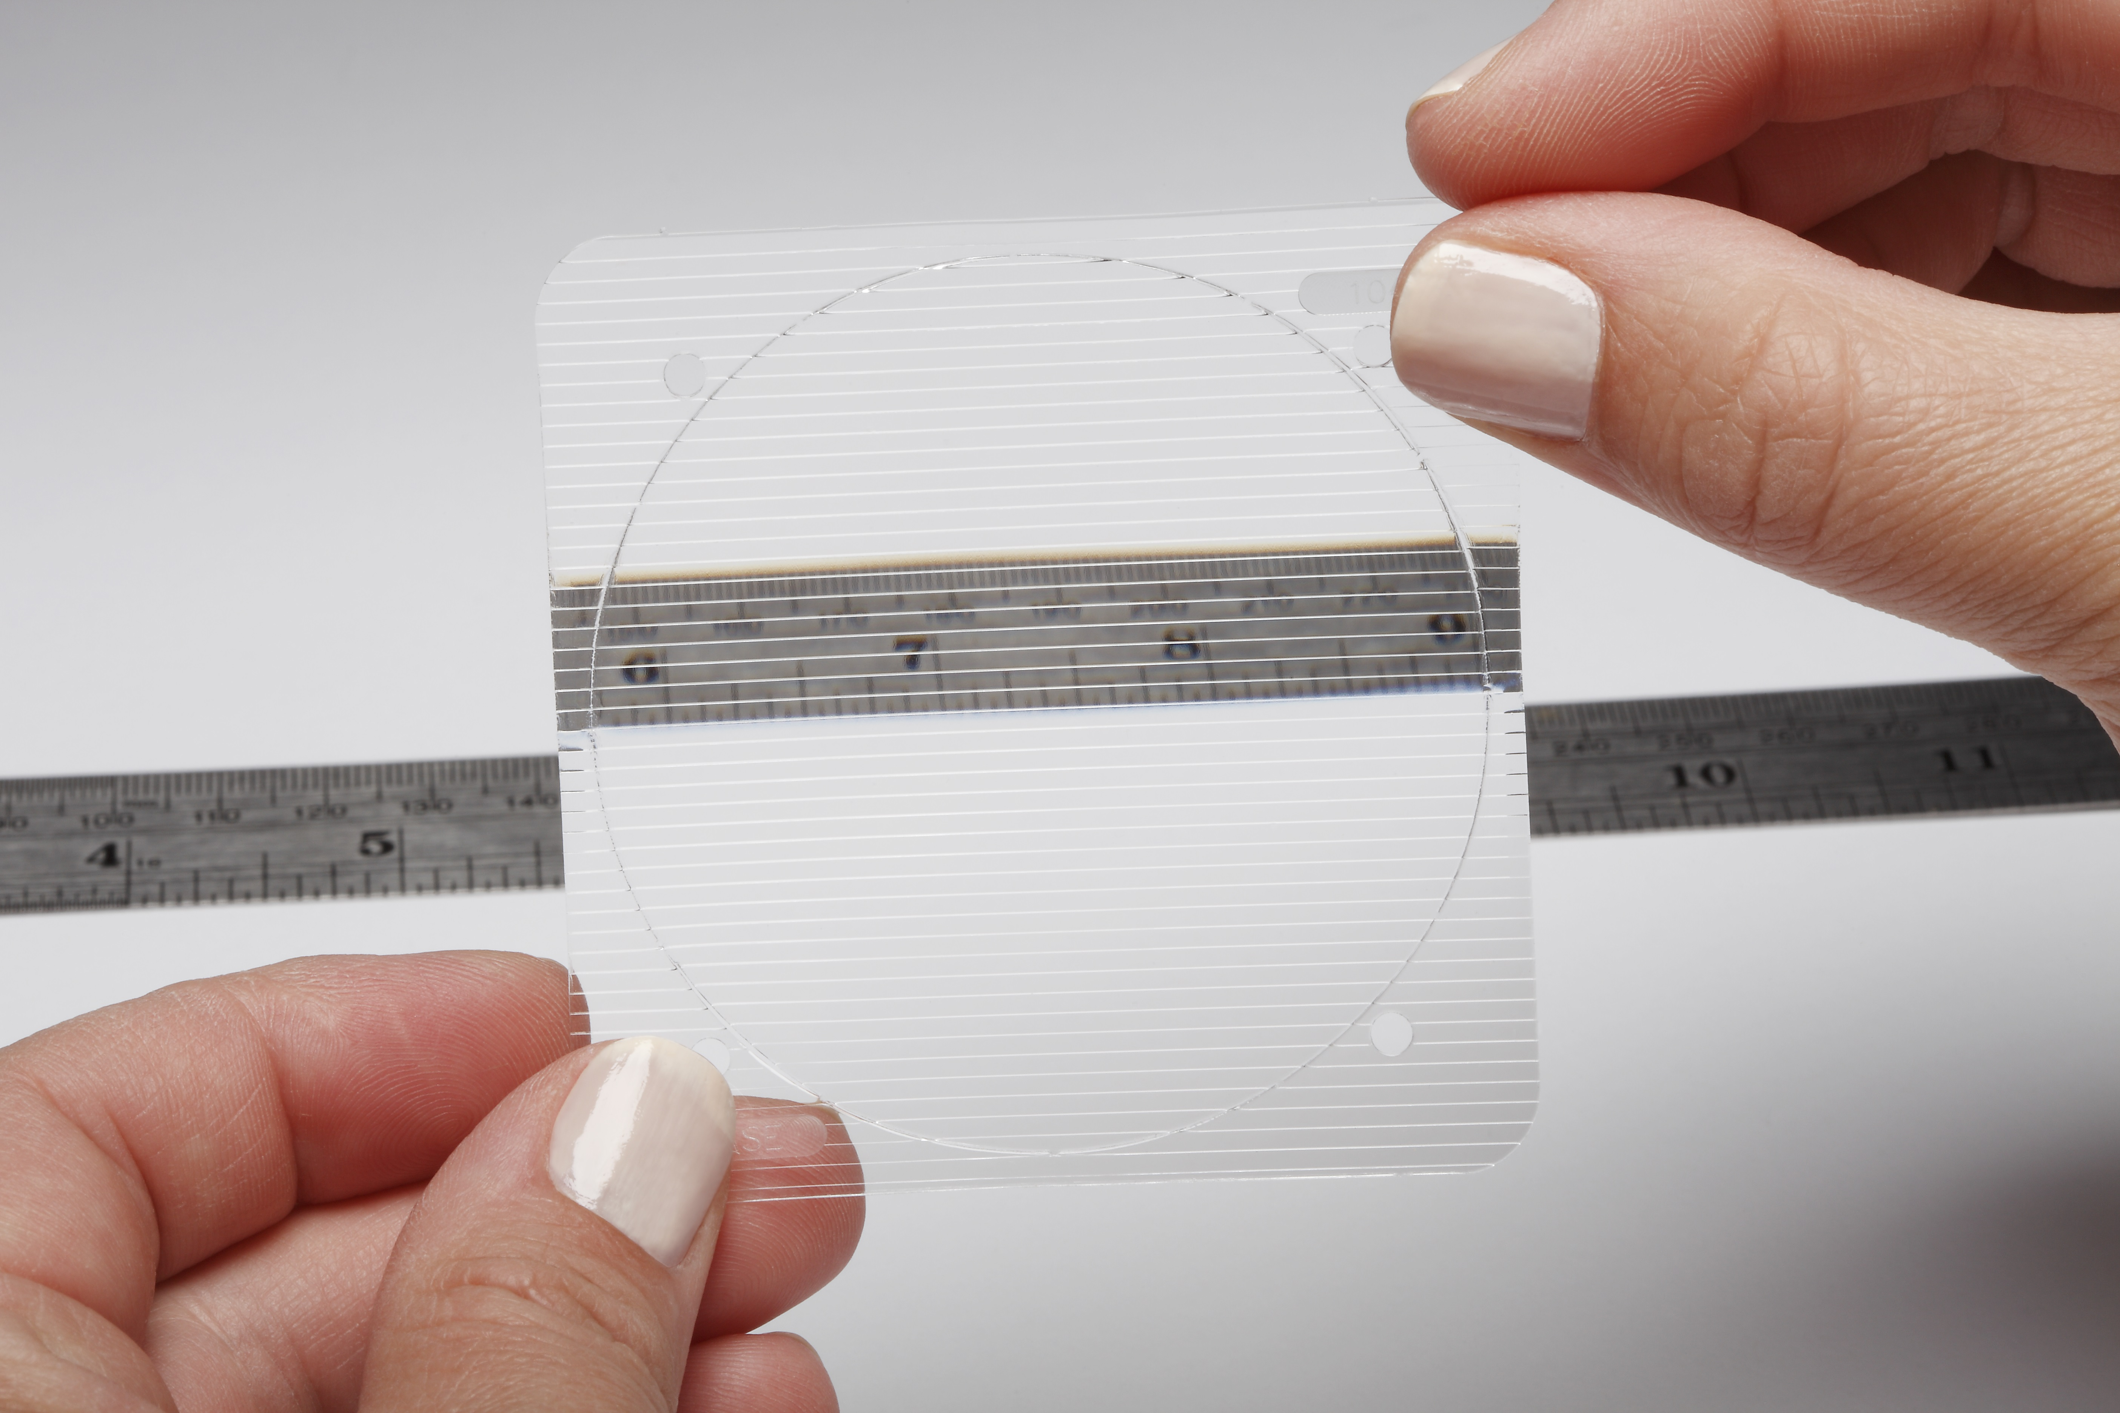
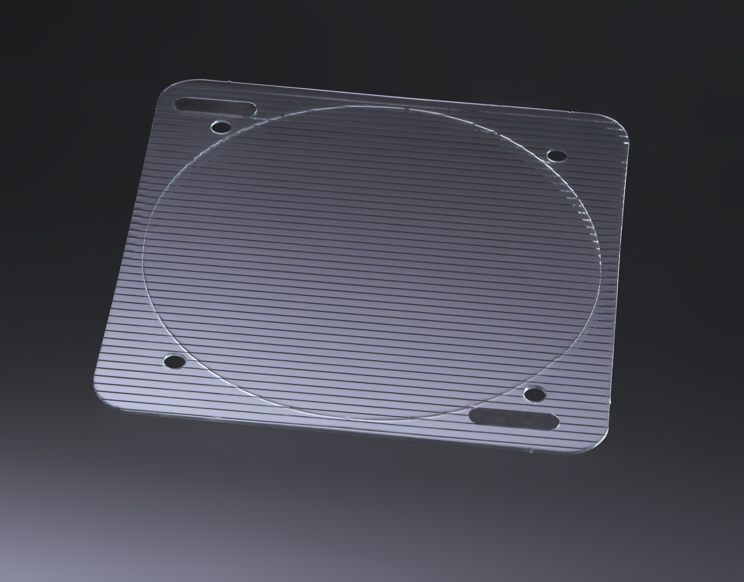
Clinical Course
  Patient fit with fresnel prism
    Temporary prisms that adhere to eyeglasses to attempt to correct diplopia without surgery
Notes:
This is not treatment of a disorder- it is to make the patient more comfortable and functional regardless of underlying cause of diplopia. These bend light to the misaligned eye to attempt to eliminate diplopia.

Slide 36
Clinical Course
  1 month later…
  Gq1b positive 1:800 (normal is up to 1:100), repeat test remains positive
Notes:
About a month after it was drawn, the Gq1b test came back significantly positive. It was repeated and was again positive.

Slide 37
So do we have our diagnosis?
Are we done?
Never developed ataxia or areflexia
Acute Ophthalmoplegia Without Ataxia
Any thoughts on a few more tests?
She had an acute illness at onset…
Notes:
So, are we done?
Fly in
Is this close cousin of Miller Fisher syndrome, Gq1b positive Acute Ophthalmoplegia without ataxia, this patient’s final diagnosis?
Remember that she had an acute illness at onset…

Slide 38
Anti-GM1b IgG antibody is associated with acute motor axonal neuropathy and Campylobacter jejuni infection
Journal of the Neurological Sciences, Volume 210, Issues 1–2, 15 June 2003, Pages 41-45
Kazue Ogawara, Satoshi Kuwabara, Michiaki Koga, Masahiro Mori, Nobuhiro Yuki, Takamichi Hattori
An antibody to VacA of Helicobacter pylori in the CSF of patients with Miller-Fisher syndrome. Neurology. 63(11):2184-6, 2004 Dec 14. Chiba S; Sugiyama T; Yonekura K; Tanaka S; Matsumoto H; Fujii N; Yokota S; Hirayama T
Association between Helicobacter pylori infection and Guillain-Barré Syndrome: a meta-analysis. Eur J Clin Invest. 2020;5:e13218. Dardiotis E, Sokratous M, Tsouris Z, Siokas V, Mentis AA, Aloizou AM, Michalopoulou A, Bogdanos DP, Xiromerisiou G, Deretzi G, Kountouras J, Hadjigeorgiou GM.
Miller Fisher Syndrome With Papilledema and Antecedent Helicobacter pylori Infection Wawrzusin, Peter MD; Chung, Stella MD; Sakla, Nicole DO; Turbin, Roger MD; Frohman, Larry MD Journal of Neuro-Ophthalmology: September 11, 2020
Notes:
Gq1b ganglioside has been associated with a few infectious correlations as seen in these papers, notably, campylobacter and heliobacter

Slide 39
Labs
Campylobacter
  Negative
H Pylori
  IgM negative
  IgG 1.74 (ref <0.91)
  IgA 14.1 (ref <1.8)
Notes:
Her campylobacter titer was negative.
Although he IgM for H pylori was negative, both IgG and IgA were elevated. We are now several months after the development of her diplopia

Slide 40
Treated for H Pylori
  Biaxin, Oxacillin, Prevacid
  After 2 weeks of the treatment upgaze improved to 50% bilaterally and all other EOMs normalized!
Notes:
She was treated with Biaxin, oxacillin, and prevacid for h pylori, and after 2 weeks of this treatment, her upgaze was now 50% in each eye and her horizontal movements were normal.

Slide 41
Treatments for GQ1b Antibody Syndromes
Acute ophthalmoplegia related to Gq1b positive patients (with or without ataxia/ areflexia) is commonly self limited ²⁻³ but has responded well to IVIG ⁶⁻⁸
A recurrent form has been reported, and has also been treated with IVIG
Chronic Gq1b Disease
  Persistently elevated levels of Gq1b titers have been reported with more chronic ophthalmoplegia as compared to the more traditional limited duration of illness ⁵
Notes:
The ophthalmoplegia of the Gq1b antibody syndromes is often self-limited, but IVIG has been reported to be an effective treatment by several authors. There is a recurrent form of this ophthalmoplegia which may also be treated with IVIG.
A chronic form of the disease also exists.

Slide 42
Follow Up
Patient returned again 5 months after treatment
  Vision remained normal without diplopia
  Upgaze improved to 67% (may be normal for her age)
  Down, left, right gazes full
  4 Prism Diopter Exotropia
  Neurologic exam remained normal
Notes:
5 months after treatment, she had no diplopia, had full eye movements except she had about 2/3 of elevation in each eye symmetrically, which is probably normal for age. She had a 4 prism diopter exotropia, and the rest of her neurologic exam was normal.

Slide 43
Final Diagnosis
GQ1b + Acute Ophthalmoplegia
Without Ataxia
Possibly Secondary to H. pylori
Notes:
The timing of improvement related to treatment of this patient’s H pylori begs the question if this may have been a causative agent in this case despite the presence of the classic antecedent URI

Slide 44
Summary
There is a very broad differential of ophthalmoplegia which often requires an equally broad workup
  Thyroid Eye Disease, Multiple Sclerosis, Myasthenia,
  Chronic Progressive External Ophthalmoplegia/ Kearns Sayre,
  Temporal Arteritis, Progressive Supranuclear Palsy, Pontine
  Disease, Various Mass Lesions (orbital and cerebral)
  GQ1b Antibody Syndromes (Miller Fisher, Guillain-Barre, Acute Ophthalmoplegia, Bickerstaff’s Brainstem Encephalitis)
    Presence of GQ1b in high concentrations on CN III, IV, and VI
Always seek the cause of a problem, not just the diagnosis, to determine best treatment
Notes:
Diplopia, when not caused by a single cranial neuropathy, has a long differential as you see here. You need to remember that the Gqib syndromes can cause an ophthalmoplegia that does not follow cranial nerve distributions and should include them in your differential. And just because you can name the diagnosis does not mean you know the etiology of the patient’s problem- sometimes you have to continue to dig deeper.

Slide 45
References
Ross AG, Jivraj I, et al. Retrospective, Multicenter Comparison of the Clinical Presentation of Patients Presenting With Diplopia From Giant Cell Arteritis vs Other Causes. J Neuroophthalmol. 2019 Mar;39(1):8-13. doi: 10.1097/WNO.0000000000000656. PMID: 29697441. 10.3109/09273948.2013.791700
Snyder LA. Rismondo V. Miller NR. The Fisher variant of Guillain-Barre Syndrome Journal of Neuro-Ophthalmology. 29(4):312-24, 2009.
Saul, R.F. Neuro-ophthalmology and the anti-GQ1b antibody syndromes. Curr Neurol Neurosci Rep 9, 379–383 (2009).
Odaka M, Yuki N, Hirata K. Anti-GQ1b IgG antibody syndrome: clinical and immunological range. J Neurol Neurosurg Psychiatry. 2001 Jan;70(1):50-5.
Reddel SW, Barnett MH, Yan WX, Halmagyi GM, Pollard JD. Chronic ophthalmoplegia with anti-GQ1b antibody. Neurology Feb 2000, 54 (4) 1000-1002.
Rigamonti A. Lauria G. Longoni M. Stanzani L. Agostoni E. Acute isolated ophthalmoplega with anti-Gq1b antibodies. Neurological Sciences. 32(4):681-2, 2011 Aug.
Sunhee Kim, Muhammad Rizwan Husain, Lawrence Zeidman. Isolated external ophthalmoplegia associated with IgG anti-GQ1b antibody. Neurology. Apr 2018, 90
Lee SH, Lim GH, Kim JS, Oh SY, Kim JK, Cha JK, Yun CH, Kang JK, Lee H, Song HK, Chung KC (2008) Acute ophthalmoplegia (without ataxia) associated with anti-GQ1b antibody. Neurology 71(6):426–429
Kazue Ogawara, Satoshi Kuwabara, Michiaki Koga, Masahiro Mori, Nobuhiro Yuki, Takamichi Hattori. Anti-GM1b IgG antibody is associated with acute motor axonal neuropathy and Campylobacter jejuni infection. Journal of the Neurological Sciences, Volume 210, Issues 1–2, 15 June 2003, p 41-45
Chiba S; Sugiyama T; Yonekura K; Tanaka S; Matsumoto H; Fujii N; Yokota S; Hirayama T. An antibody to VacA of Helicobacter pylori in the CSF of patients with Miller-Fisher syndrome. Neurology. 63(11):2184-6, 2004 Dec 14.
Dardiotis E, Sokratous M, Tsouris Z, Siokas V, Mentis AA, Aloizou AM, Michalopoulou A, Bogdanos DP, Xiromerisiou G, Deretzi G, Kountouras J, Hadjigeorgiou GM. Association between Helicobacter pylori infection and Guillain-Barré Syndrome: a meta-analysis. Eur J Clin Invest. 2020;5:e13218.
Wawrzusin, Peter MD; Chung, Stella MD; Sakla, Nicole DO; Turbin, Roger MD; Frohman, Larry MD Miller Fisher Syndrome With Papilledema and Antecedent Helicobacter pylori Infection. Journal of Neuro-Ophthalmology: September 11, 2020

