Slide 1

Vertical Nystagmus
Sugi Panneerselvam, Baylor College of Medicine
Subahari Raviskanthan MBBS, Houston Methodist Hospital
Andrew G. Lee MD, Houston Methodist Hospital

Slide 2
82-Year-Old Man with Nystagmus
Presents to Ophthalmology clinic
CC: Few months of oscillopsia and intermittent diplopia

Slide 3
82-Year-Old Man with Nystagmus
1 year ago: horizontal jerk nystagmus and vertical nystagmus:
Downbeat (fast component of nystagmus down, slow phase up)
Not present in primary gaze
Worse on gaze to the left and to the right
Oscillopsia (perception of the environment moving/oscillating when it is not) and intermittent oblique diplopia x few months

Slide 4
Downbeat Nystagmus
https://collections.lib.utah.edu/ark:/87278/s65181nc
Notes:
Downbeat nystagmus from the University of Utah’s Neuro-ophthalmology Virtual Education Library.

Slide 5
What are the causes of acquired nystagmus?
CNS Lesions
  Stroke
  Multiple sclerosis
  Trauma
  Tumors
  Inflammatory
  Infectious
Pharmacologic
  Anti-epileptic drugs
Intoxication
  Alcohol
  Phencyclidine (PCP)
  Toluene abuse
Paraneoplastic
Notes:
https://www.ncbi.nlm.nih.gov/pmc/articles/PMC5363284/

Slide 6
82-Year-Old Man with Nystagmus
Past medical history of:
Severe sensorimotor peripheral neuropathy on IVIg treatment
Well-controlled Type 2 Diabetes Mellitus for 30 years
Chronic bitemporal headaches without migraine features controlled on nortriptyline
4 alcoholic drinks/day

Slide 7
Neuro-ophthalmic Examination
Neurologic exam: wide based gait, decreased sensation in toes bilaterally
Ophthalmologic:
Visual Acuity: 20/25 OD, 20/30 OS
External Examination: downbeat nystagmus
Slit Lamp Examination: mild dry eye OU
Visual Fields: normal OU
Fundus Examination: normal OU

Slide 8
Localizing the Nystagmus Lesion
Periodic Alternating
Upbeating
Downbeating
Upbeating
Cervical-Medullary Junction
Vermis or Brainstem
Cerebellum
Notes:
https://www.ophthalmologytimes.com/view/new-onset-nystagmus-adult-consider-ms

Slide 9
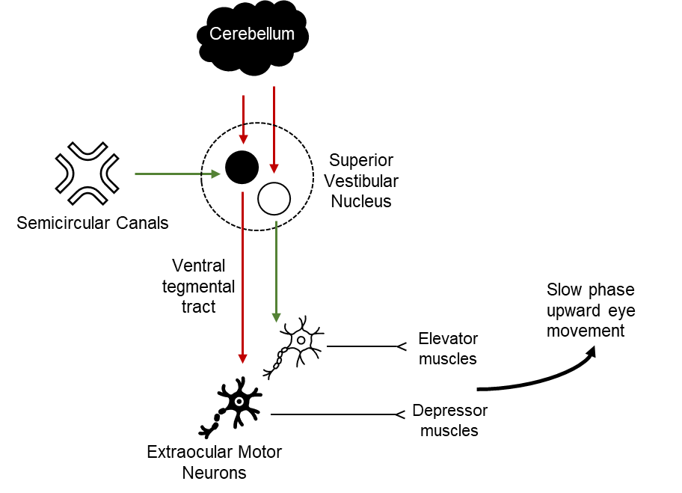
Pathophysiology of Downbeat Nystagmus
Tonic downward force is exerted by gravity on the anterior semicircular canals → upward drift of the eyes via the superior vestibular nucleus
Unwanted upward drift usually counteracted by central cerebellar connections
Midline cerebellar lesions → loss of inhibition → tonic activation of elevator muscles → slow upward drift and compensatory downward saccade

Slide 10
Evaluation
MRI: non-diagnostic
LP: opening pressure 18cm H2O, CSF content normal
TSH / T4: normal
Metanephrines, renin, aldosterone: within normal limits
HbA1c: 5.8
Homocysteine / folate Vit D / B6 / B12 / B1: within normal limits

Slide 11
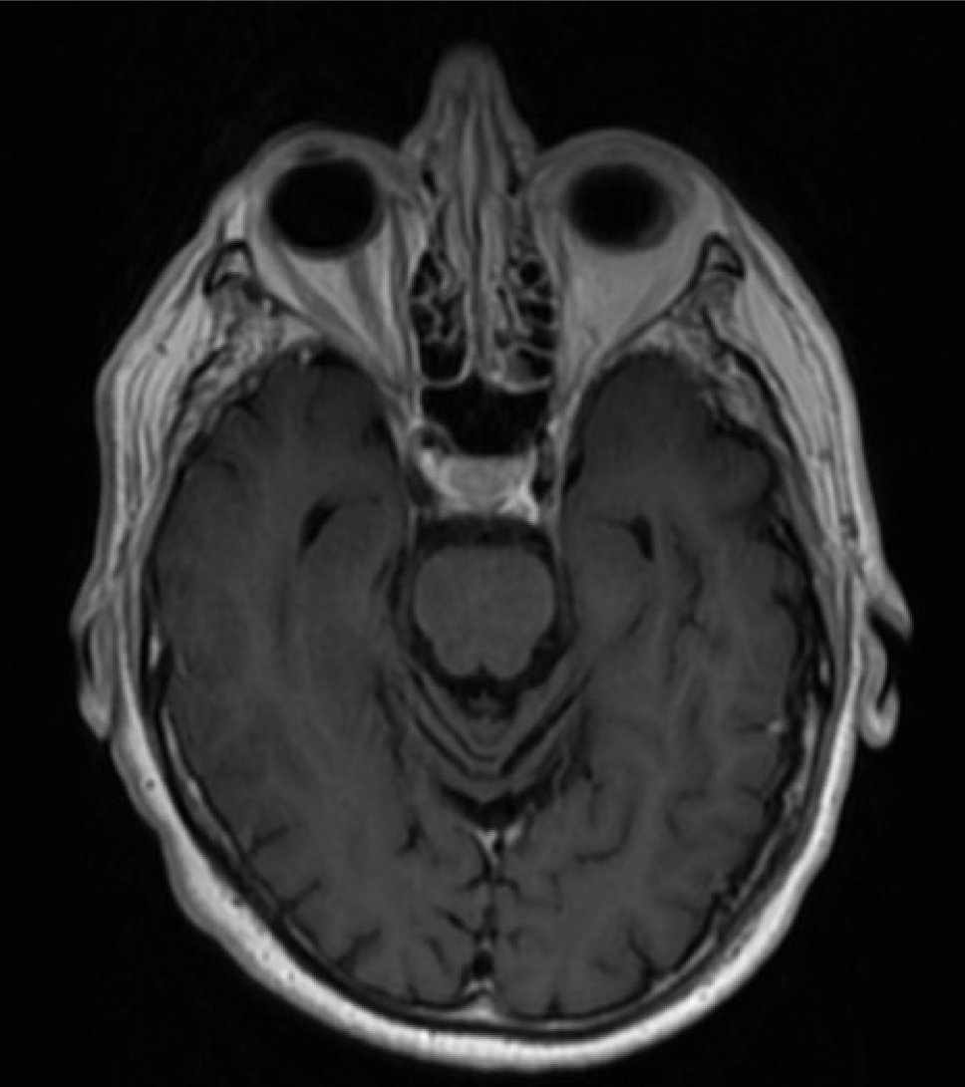
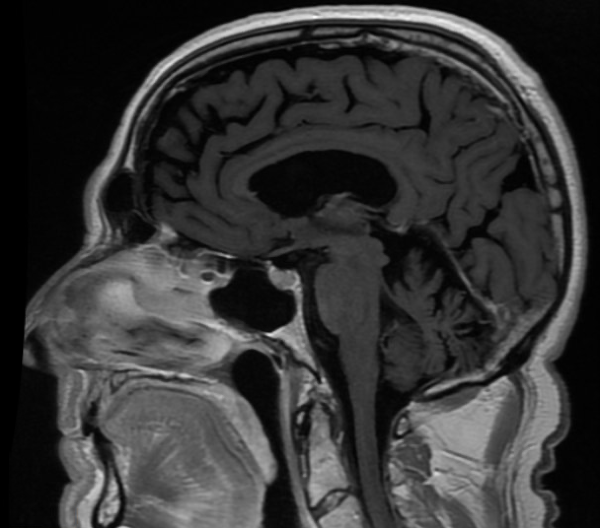
T2 Axial FLAIR MRI
Stable generalized brain parenchymal atrophy
Decreased cerebellar volume
Nonspecific T2 hyperintensities representing microvascular chronic ischemic disease.

Slide 12
What is the differential diagnosis for downbeat nystagmus?
Cervical medullary junction lesions
  Tumor
  Demyelinating (MS)
  Vasculopathies
  Trauma
Posterior midline/cerebellar diseases
  Spinocerebellar ataxia
  Multisystem atrophy
Medications
  Anti-epileptic drugs
  Lithium
Deficiencies
  Vitamin B12 deficiency
  Magnesium deficiency
Metabolic
  Wernicke’s encephalopathy
Congenital structural malformations (ie. Chiari malformation)
Autoimmune conditions
  Anti-glutamic acid decarboxylase antibodies
Notes:
Wagner JN, Glaser M, Brandt T, StruppM. Downbeat nystagmus: aetiology and comorbidity in 117 patients. J Neurol Neurosurg Psychiatry. 2008;79:672-677

Slide 13
Peripheral neuropathy, downbeat nystagmus, and wide based gait
Thyroperoxidase (TPO) antibody: 43.8 IU/mL (high) (ref: < 35 IU/mL)
Anti-glutamic acid decarboxylase (GAD) antibody: 42.6 IU/mL (high) (ref: < 10 IU/mL)

Slide 14
Anti-GAD Antibody Syndrome
Autoimmune antibodies against glutamic acid decarboxylase, the enzyme involved in the normally inhibitory neurotransmitter, GABA
Associated with Type 1 Diabetes Mellitus
Imaging shows cerebellar atrophy in 75% of chronic cases
Symptoms include downbeat nystagmus, ataxia, dysarthria, diplopia, and episodic vertigo
Recent reports show association with peripheral sensorimotor neuropathies, like chronic inflammatory demyelinating neuropathy (CIDP)
Usually associated with central downbeat nystagmus
  The spectrum of diseases associated with anti-GAD is widening, so the distinctions of central vs. peripheral nystagmus may be misleading
Notes:
https://www.ncbi.nlm.nih.gov/pmc/articles/PMC5107286/
https://www.nature.com/articles/s41582-020-0359-x?utm_source=feedburner&utm_medium=feed&utm_campaign=Feed%3A+nrneurol%2Frss%2Fcurrent+%28Nature+Reviews+Neurology+-+Issue%29
https://www.jacionline.org/article/S0091-6749(13)01974-X/fulltext#secsectitle0015

Slide 15
Treatment
IVIg treatment every 4 weeks
Consider plasma exchange or immunosuppressive therapy
Base down prism glasses for intermittent diplopia
At last review continuing on 4-weekly IVIg with stable nystagmus. Attempts to wean / stretch IVIg led to worsening mobility and oscillopsia

Slide 16
Take Home Message
Single unifying diagnosis of anti-GAD antibodies is the most likely cause of peripheral neuropathy, wide-based gait, and downbeat nystagmus
Notes:
https://www.nature.com/articles/s41582-020-0359-x

Slide 17
References
GAD antibodies can signal downbeat nystagmus. British Journal of Ophthalmology. 2003;87(11):1339-1339. doi:10.1136/bjo.87.11.1339
Graus F, Saiz A, Dalmau J. GAD antibodies in neurological disorders — insights and challenges. Nature Reviews Neurology. 2020;16(7):353-365. doi:10.1038/s41582-020-0359-x
Kesserwani H. Glutamic Acid Decarboxylase (GAD-65) Autoimmunity Associated With Profound Daytime Hypersomnia, Nighttime Insomnia, Mild Autonomic Neuropathy and Axonal Sensori-Motor Polyneuropathy: A Case Report on a New Phenotype. Cureus. 2020. doi:10.7759/cureus.11112
Kreiner R, Rubinstein A. Neuropathy In Patients With Underlying Immunodeficiency Syndrome. Journal of Allergy and Clinical Immunology. 2014;133(2). doi:10.1016/j.jaci.2013.12.070
Manto, M., Mitoma, H. & Hampe, C.S. Anti-GAD Antibodies and the Cerebellum: Where Do We Stand?. Cerebellum 18, 153–156 (2019). https://doi.org/10.1007/s12311-018-0986-6
Wagner JN, Glaser M, Brandt T, Strupp M. Downbeat nystagmus: aetiology and comorbidity in 117 patients. Journal of Neurology, Neurosurgery & Psychiatry. 2007;79(6):672-677. doi:10.1136/jnnp.2007.126284
With new-onset nystagmus in adult, consider MS. Ophthalmology Times. https://www.ophthalmologytimes.com/view/new-onset-nystagmus-adult-consider-ms. Accessed December 11, 2020.

