Slide 1


A 28-year-old woman with bilateral visual loss and swollen discs
Kambiz Ameli Zamani, MD, Department of Ophthalmology, University of Texas Southwestern Medical Center
Sanjana Molleti, BA, Department of Ophthalmology and Visual Neurosciences, University of Minnesota
Collin McClelland, MD, Department of Ophthalmology and Visual Neurosciences, University of Minnesota
Michael S Lee, MD, Department of Ophthalmology and Visual Neurosciences, University of Minnesota

Slide 2
28-year-old Female With Blurry Vision
Sudden onset blurred vision OD > OS x 3 days
Soreness with eye movement OU
No headaches

Slide 3
28-year-old Female With Blurry Vision
PMHx: Diagnosed with metastatic stage IVB immature teratoma 2 months prior. Underwent surgical resection and currently undergoing chemotherapy
Medications: Bleomycin, Etoposide, Cisplatin, Apixaban, Duloxetine, Filgrastim-aafi, Gabapentin, Levonorgestrel-releasing intrauterine device, Olanzapine
Ocular Hx: Amblyopia OD (baseline vision unknown)

Slide 4
28-year-old Female With Blurry Vision
VA: 3/200 OD, 20/25 OS
Ishihara: 0/11 OD, 1/11 OS
Pupils: sluggish response to light OD with APD, brisk response to light OS
Anterior chamber without cells OU
Optic disc edema OD >> OS

Slide 5
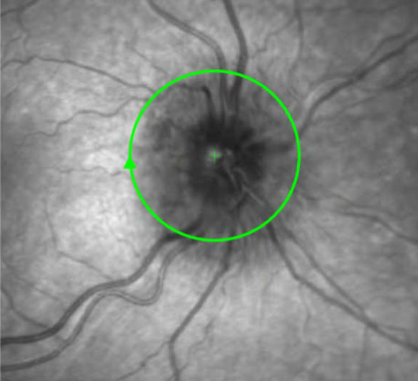
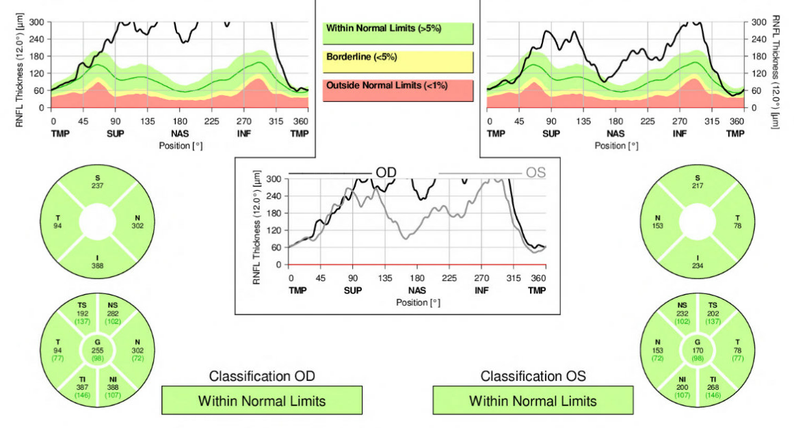
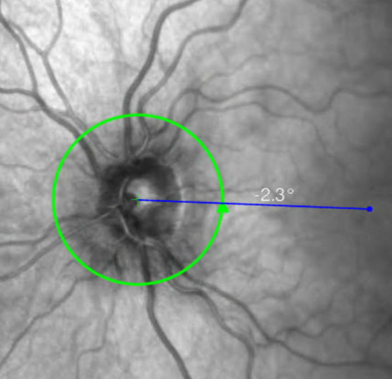
OCT with Bilateral Optic Disc Edema
Right Eye
Left Eye
RNFL Thickness: OD 255µm, OS 170µm
Within normal limits label is false negative!
Heidelburg software will detect thinning in interpretation but not thickening
Normal RNFL thickness ranges from 80 – 100 µm

Slide 6
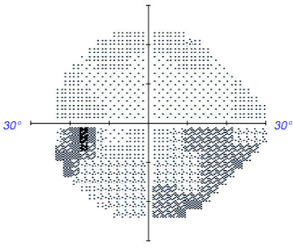
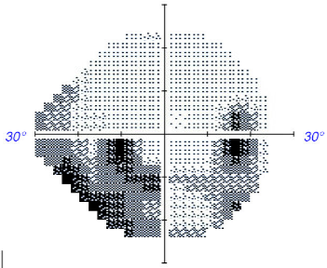
Visual fields
Left eye – size III stim
Right eye – size V stim
Enlarged blind spots, more in the right eye
Inferior altitudinal scotoma right eye
Inferior partial arcuate defect left eye
What is your differential diagnosis?

Slide 7
Differential Diagnosis:
Infiltrative optic neuropathy
Toxic optic neuropathy
Optic neuritis
Anterior ischemic optic neuropathy
Compressive optic neuropathy
Fulminant increased intracranial pressure
What would be your next step?

Slide 8
Diagnostic Approach to Acute Bilateral Optic Neuropathy with Optic Disc Edema
Neuroimaging
  MRI Brain + Orbits with contrast
    Evaluate for optic nerve or sheath enhancement
    Evaluate for metastatic disease
    Evaluate for demyelinating brain lesions to MRI brain
  MRI cervical and thoracic spine
    Evaluate for demyelinating lesions (long and short segments) and metastatic disease

Slide 9
Diagnostic Approach to Acute Bilateral Optic Neuropathy with Optic Disc Edema
Lumbar puncture
  Assess opening pressure
  CSF constituents: total protein, cell count, glucose
  Cytology and flow cytometry
  Infectious disease workup
Serum lab testing
  MOG IgG, AQP4 IgG, Lyme, Treponema, ACE, ANA, ANCA
Paraneoplastic Antibody Panel (Serum and CSF)

Slide 10
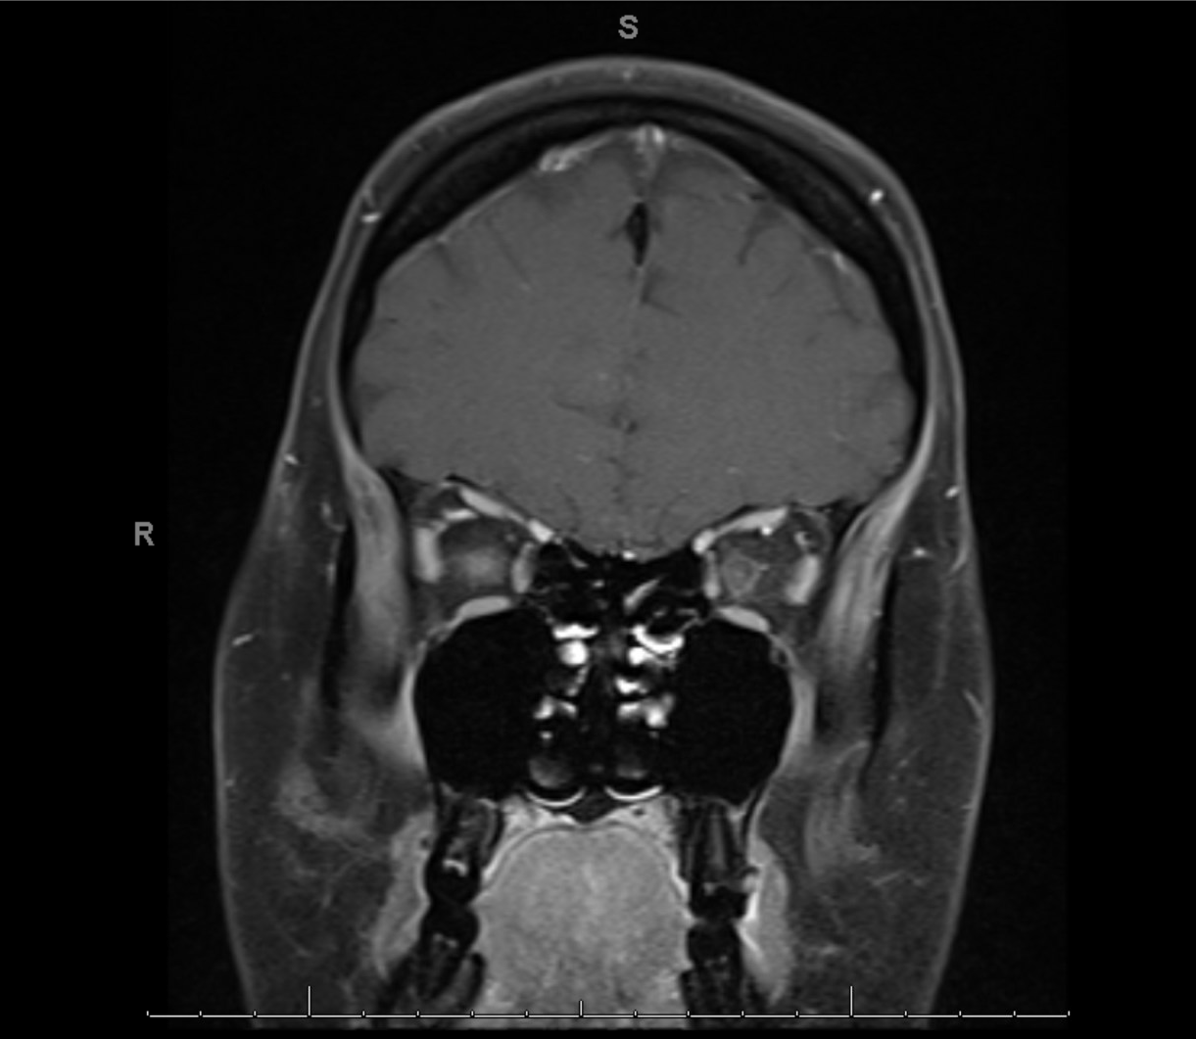
Emergent MRI - T1 Coronal with fat suppression
Abnormal thickening and enhancement of the right greater than left optic nerves

Slide 11
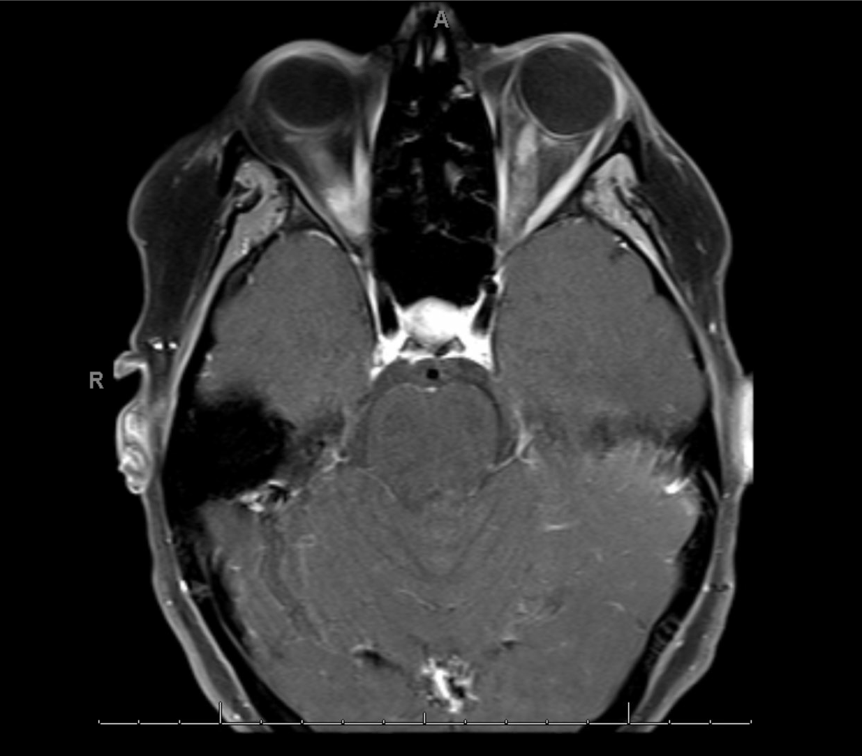
Emergent MRI - T1 Axial with fat suppression
Abnormal thickening and enhancement of the right greater than left optic nerves

Slide 12
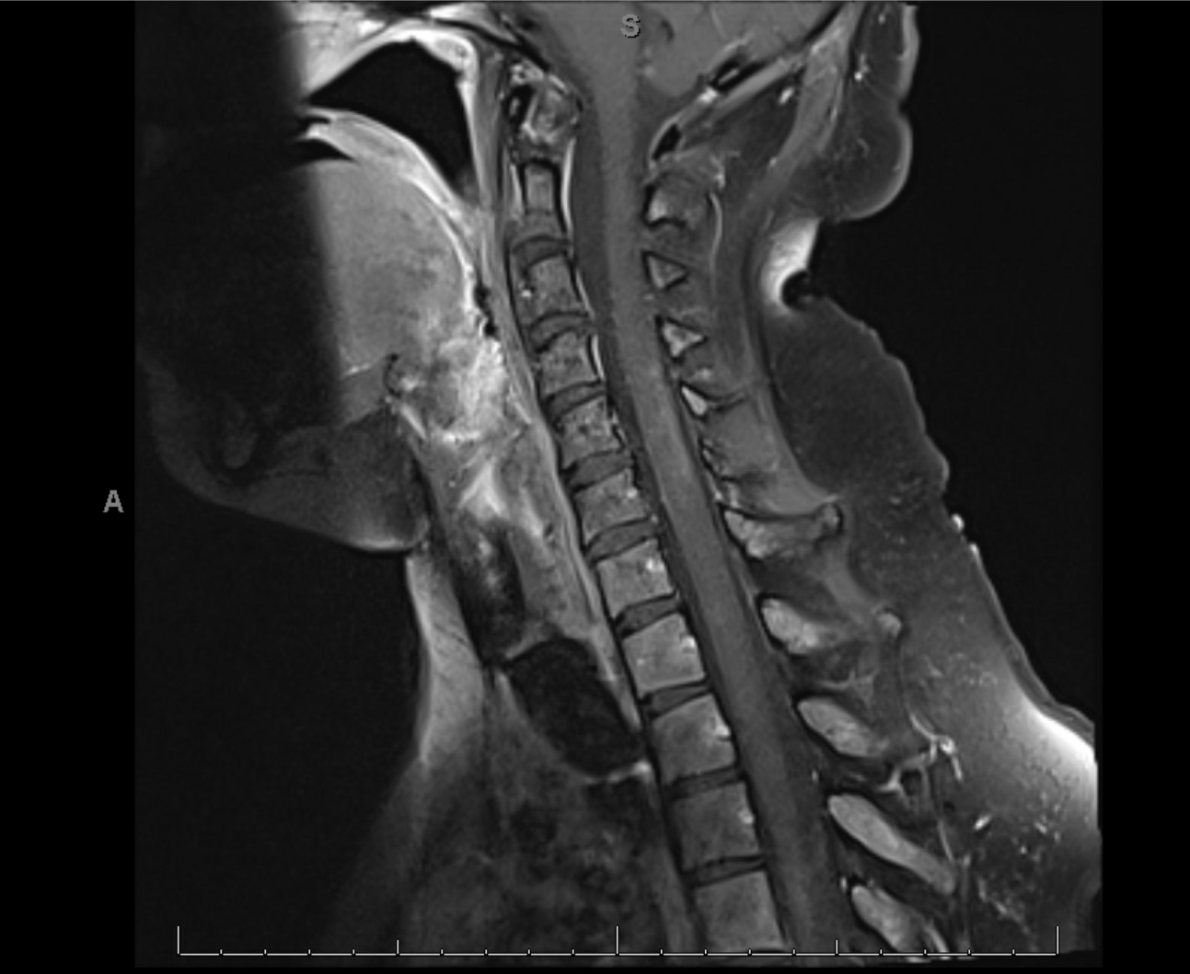
Emergent MRI - T1 Sagittal of lower brain stem and spinal cord
Diffuse patchy nodular enhancement along the cervical cord
Official Radiology Interpretation
Impression:
Findings concerning for metastatic involvement.

Slide 13
Diagnosed with Optic Nerve Infiltration and Leptomeningeal Disease
Malignant seeding of the leptomeninges occurs when neoplastic cells enter the subarachnoid compartment and disseminate across the neuraxis
Neuro-ophthalmic signs may be the sole initial manifestation of leptomeningeal disease, and are essential for a prompt diagnosis and improved clinical outcomes
Neoplastic leptomeningeal disease (NLD)¹
  Primary NLD (rare)
  Secondary NLD (more common), with a 5-20% prevalence in patients with solid tumors² commonly breast cancer, lung cancer, and melanoma³

Slide 14
Neoplastic Leptomeningeal Disease
Increased ICP is common manifestation³
Most commonly affects CN II, III, VI, and VII, leading to visual impairment, diplopia, and/or facial weakness^{4,5}
Treatment is urgent radiotherapy, although prognosis is poor, median time to mortality is 3 weeks if untreated¹
Leptomeningeal enhancement can also be caused by infectious (tuberculosis) and autoimmune/inflammatory (sarcoidosis and immunoglobulin G4 related disease)⁵

Slide 15
Interval History
Lumbar puncture was deferred per neurology, oncology, and radiation oncology due to history and characteristic neuroimaging findings
Received whole-brain radiation
Her vision improved subjectively
One week later, developed severe spasms of bilateral legs, arms, abdomen and neck
Endorsed 15-20 episodes per hour and was admitted
What workup would you like in the hospital?

Slide 16
Second Admission
Lumbar puncture
  Opening pressure: 22 cm H20
  Culture: no growth
  Gram stain: no organisms
  Meningitis/Encephalitis panel: negative
  Protein: Elevated (54.6)
  Cytology: No morphologic evidence of malignancy
  Flow Cytometry: Rare to absent B cells
CNS Demyelinating disease serum panel
  AQP4 antibody positive (1:100)
CSF cytology exhibits an initial sensitivity as low as 45% on the first attempt, for solid tumors. This diagnostic yield increases to approximately 80% with a second lumbar puncture and typically plateaus by the third attempt. Consequently, clinical guidelines advocate for serial sampling, often requiring 3 or more².
Diagnosis: Paraneoplastic AQP4 + NMOSD. Presumed leptomeningeal disease was likely an incorrect diagnosis.

Slide 17
What is NMOSD?
Prevalence of NMOSD is 0.52 - 4.4 per 100,000 population⁶
It is a CNS inflammatory disorder, distinct from multiple sclerosis (MS)
  Optic neuritis (bilateral, extension into the chiasm and more than half of the length of the optic nerve)
  Longitudinally extensive transverse myelitis (LETM)
  Area postrema syndrome, which presents as unexplained, intractable hiccups, nausea, or vomiting
Historically mistaken for MS, it is now recognized as a distinct disease caused by specific antibodies that target the aquaporin-4 (AQP4) water channels on the astrocytes
The discovery of the AQP4-IgG antibody provided a reliable biomarker, but the accuracy of the diagnosis depends heavily on the specific testing method used⁹
Painful tonic spasms are a common symptom of transverse myelitis that can be seen in NMO¹⁰

Slide 18
Diagnosis of NMOSD
Cell-based Assay, is the preferred "gold standard" method compared to ELISAs, with a sensitivity of cell-based assay testing reported between 76.7%⁹ to 80% and specificity of >99%^{11, 12}
Diagnostic Criteria for Seropositive NMOSD:⁹
  Presence of at least 1 core clinical characteristic: optic neuritis, acute myelitis, area postrema syndrome, acute brainstem syndrome, symptomatic narcolepsy, symptomatic cerebral syndrome
  Positive serum AQP4-IgG (cell-based assay recommended)
  Exclusion of alternative diagnosis
You can still have a diagnosis of seronegative NMOSD, if you have 2 core clinical characteristics and one must be optic neuritis, LETM, or area postrema syndrome⁹
Alternative diagnoses, including MS and MOGAD, should be excluded

Slide 19
Paraneoplastic NMOSD
Paraneoplastic NMOSD is rare, reported in 5% of individuals with NMOSD^{7,8}
Antigenic mimicry between tumor and neural tissue drives antibody cross-reactivity.^{13,14} Notably, AQP4-IgG titers typically decline post-resection, with several studies reporting no subsequent relapse.^{15,16,17}
Most ovarian tumors associated with paraneoplastic NMO are teratomas¹⁸
NMOSD associated with ovarian neoplasms typically have favorable outcome after immunosuppressive therapy ¹⁸

Slide 20
Differences (Paraneoplastic NMOSD vs NMOSD)
 | Paraneoplastic NMOSD | NMOSD
Median age of onset | 55 | 40
Proportion of male patients | ~30% | ~12%
Presentation of severe nausea/vomiting⁷ | ~41% | ~7%

Slide 21
Treatment of paraneoplastic NMOSD
 | Specific Treatment | Primary Goal | Comment
Acute attack | IV Methylprednisolone | Immediate reduction of inflammation | Often shows excellent therapeutic efficacy Plasma Exchange may be used concurrently if attack is severe
Rescue therapy | Plasma Exchange (PLEX) | Removal of AQP4-IgG antibodies | Used if steroids fail to improve symptoms quickly
Primary Neoplasm | Tumor Surgery / Chemoradiotherapy | Eliminates the source of AQP4-expressing cells | Crucial. Many patients see AQP4-IgG levels drop to negative after resection
Biologics¹⁷ | Rituximab, inebilizumab, satralizumab, eculizumab, or ravulizumab¹⁹ | Targeted suppression of antibody-producing cells | Effective, but requires careful monitoring in cancer patients

Slide 22
Follow up: 1 year
Muscle spasms resolved with corticosteroids, PLEX, and carbamazepine
Radiosurgery to pontine metastases resulting in left facial palsy from radionecrosis
Multifocal infarctions secondary to hypercoagulability vs. avastin
Followed by palliative care
Ravulizumab infusions Q8 weeks for NMOSD
Acuity: 20/70 OD and 20/200 OS

Slide 23
Conclusion: 28-year-old female with acute bilateral vision loss x 3 days
NMO antibody testing is essential for any patient presenting with bilateral vision loss and optic nerve enhancement, even those with a known history of malignancy
Treatment consists of a combination of IV steroids with/with out PLEX and other immunosuppression medications in addition to tumor control with surgery and chemoradiation

Slide 24
References
1. Szatmáry G. Neuro-ophthalmologic complications of neoplastic leptomeningeal disease. Curr Neurol Neurosci Rep. 2013 Dec;13(12):404.
2. Le Rhun E, Taillibert S, Chamberlain MC. Carcinomatous meningitis: Leptomeningeal metastases in solid tumors. Surg Neurol Int. 2013 May 2;4(Suppl 4):S265–88.
3. Yousef YA, Sid Ahmed IM, Kanj Ahmad D, Mohammad M, Makahleh H, AlJabari R, et al. Optic Disc Swelling in Cancer Patients: Etiology and Implications. J Clin Med. 2023 Jan;12(22):7140.
4. Trivedi RA, Nichols P, Coley S, Cadoux-Hudson TAD, Donaghy M. Leptomeningeal glioblastoma presenting with multiple cranial neuropathies and confusion. Clin Neurol Neurosurg. 2000 Dec 1;102(4):223–6.
5. Kurokawa R, Kurokawa M, Isshiki S, Harada T, Nakaya M, Baba A, Naganawa S, Kim J, Bapuraj J, Srinivasan A, Abe O, Moritani T. Dural and Leptomeningeal Diseases: Anatomy, Causes, and Neuroimaging Findings. Radiographics. 2023 Aug;43(9):e230039. doi: 10.1148/rg.230039.
6. Marrie RA, Gryba C. The Incidence and Prevalence of Neuromyelitis Optica. Int J MS Care. 2013;15(3):113–8.
7. Sepúlveda M, Sola-Valls N, Escudero D, Rojc B, Barón M, Hernández-Echebarría L, et al. Clinical profile of patients with paraneoplastic neuromyelitis optica spectrum disorder and aquaporin-4 antibodies. Mult Scler J. 2018 Nov 1;24(13):1753–9.
8. Ontaneda D, Fox RJ. Is neuromyelitis optica with advanced age of onset a paraneoplastic disorder? Int J Neurosci. 2014 July;124(7):509–11.
9. Wingerchuk DM, Banwell B, Bennett JL, Cabre P, Carroll W, Chitnis T, et al. International consensus diagnostic criteria for neuromyelitis optica spectrum disorders. Neurology. 2015 July 14;85(2):177–89.
10. Kim SM, Go MJ, Sung JJ, Park KS, Lee KW. Painful Tonic Spasm in Neuromyelitis Optica: Incidence, Diagnostic Utility, and Clinical Characteristics. Arch Neurol. 2012 Aug 1;69(8):1026–31.
11. Wang R, Sun D, Wang X, Shi Z, Kong L, Du Q, et al. Correlation between severe attacks and serum aquaporin-4 antibody titer in neuromyelitis optica spectrum disorder. J Neurol. 2024 July;271(7):4503–12.
12. Redenbaugh, Vyanka, et al. "Diagnostic value of aquaporin-4-IgG live cell based assay in neuromyelitis optica spectrum disorders." Multiple Sclerosis Journal–Experimental, Translational and Clinical 7.4 (2021): 20552173211052656.
13. Duan Y, Wang X, Duan X, Gao H, Ji X, Xiao X, et al. Neuromyelitis optica spectrum disorders associated with AQP4-positive-cancer—A case series. Front Neurol [Internet]. 2022 Dec 1 [cited 2025 July 20];13. Available from: https://www.frontiersin.org/journals/neurology/articles/10.3389/fneur.2022.1071519/full
14. Figueroa M, Guo Y, Tselis A, Pittock SJ, Lennon VA, Lucchinetti CF, et al. Paraneoplastic Neuromyelitis Optica Spectrum Disorder Associated With Metastatic Carcinoid Expressing Aquaporin-4. JAMA Neurol. 2014 Apr;71(4):495–8.
15. Pittock SJ, Lennon VA. Aquaporin-4 Autoantibodies in a Paraneoplastic Context. Arch Neurol. 2008 May 1;65(5):629–32.
16. Shahmohammadi S, Doosti R, Shahmohammadi A, Azimi A, Sahraian MA, Fattahi MR, et al. Neuromyelitis optica spectrum disorder (NMOSD) associated with cancer: A systematic review. Mult Scler Relat Disord. 2021 Nov 1;56:103227.
17. Maiorca C, Moret F, Martines V, Tramontano D, Papassifachis MA, Bini S, et al. Paraneoplastic Neuromyelitis Optica Spectrum Disorder Associated With Lung Adenocarcinoma: A Case Report. Front Med [Internet]. 2022 Jan 17.
18. Liu P, Wang S, Zhang C, Li Y. Paraneoplastic neuromyelitis optica spectrum disorder associated with ovarian dysgerminoma: a case report and literature review. Front Immunol. 2024 Jun 14;15:1424243.
19. Clardy SL, Pittock SJ, Aktas O, Nakahara J, Isobe N, Centonze D, Fam S, Kielhorn A, Yu JC, Jansen J, Zhang I. Network Meta-analysis of Ravulizumab and Alternative Interventions for the Treatment of Neuromyelitis Optica Spectrum Disorder. Neurol Ther. 2024 Jun;13(3):535-549.

