Slide 1

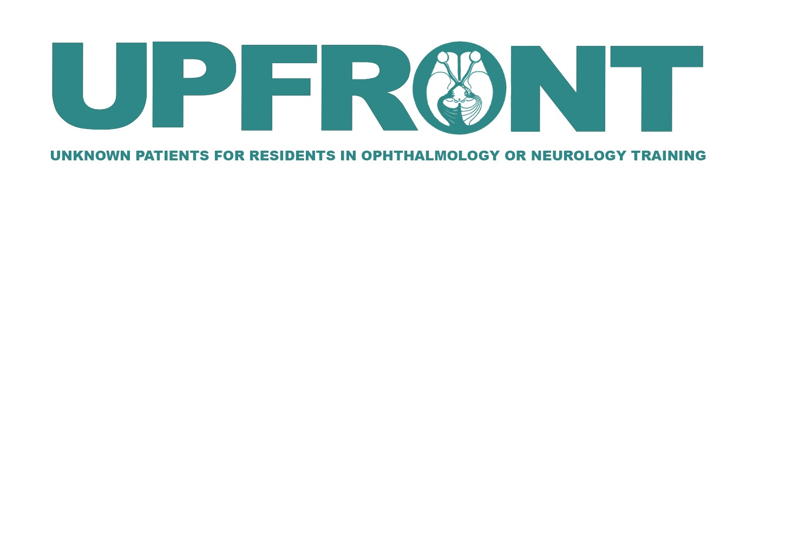
Premature Closure:
A Surprising Case of Papilledema
Mark J. Phillips, MD^{1,3}
Ryan Gise, MD¹⁻³
Boston Children’s Hospital, Department of Ophthalmology
Massachusetts Eye and Ear, Department of Ophthalmology
Harvard Medical School

Slide 2
Chief Complaint
7-year-old girl who presents with:
double vision
recent headache associated with vomiting
2

Slide 3
Medical Hx
Ocular Hx
Birth Hx
Sickle cell trait
Obesity (BMI 29.13 kg/m2)
H/o UTI
Anisometropia
Amblyopia suspect OD
Full term
No maternal infections
No relevant perinatal events
Surgical Hx
Family Hx
None
Mother – idiopathic intracranial hypertension (dx age 16, treated with acetazolamide)
Medications
Social Hx
Keflex
Non-contributory
3
3

Slide 4
Ocular Vitals
 | OD | OS
Distance VA (sc) | 20/30 | 20/25
IOP (palpation) | Soft | Soft
Pupils | RR OU, no rAPD
Ductions
-0.5
-0.5
4

Slide 5
Sensorimotor and Ancillary Exam
Alternate Prism Cover Test Nsc: E(T)’ 4
Alternate Prism Cover Test Dsc:
Abnormal Head Posture: None
Nystagmus: None
Stereo: Fly +, 2/3 animals, unable circles
Ishihara Color Plates: 15/16 OU
E(T) 4
E(T) 6
E(T) 4
E(T) 4
E(T) 4
5

Slide 6
Summary
7-year-old girl with history of obesity
Headache with vomiting, binocular diplopia
Bilateral abduction deficit with intermittent esotropia
What is essential to check during the remainder of the neuro-ophthalmic evaluation?
6

Slide 7
Slit Lamp Exam
 | OD | OS
Orbits/Adnexa | Within normal limits | Within normal limits
Lids/Lashes | Within normal limits | Within normal limits
Conjunctiva/Sclera | White and quiet | White and quiet
Cornea | Clear | Clear
Anterior Chamber | Deep and quiet | Deep and quiet
Iris | Flat, round pupil | Flat, round pupil
Lens | Clear | Clear
Anterior Vitreous | Quiet | Quiet
7

Slide 8
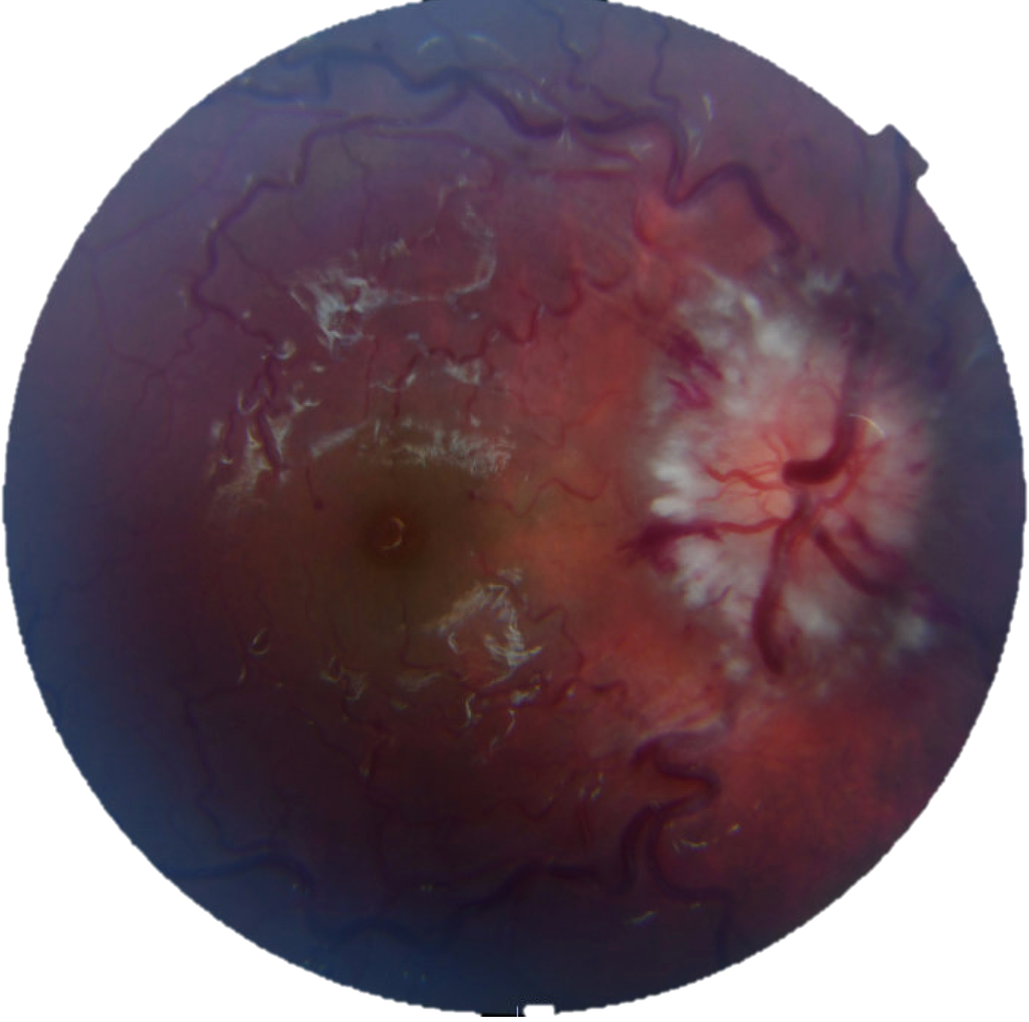
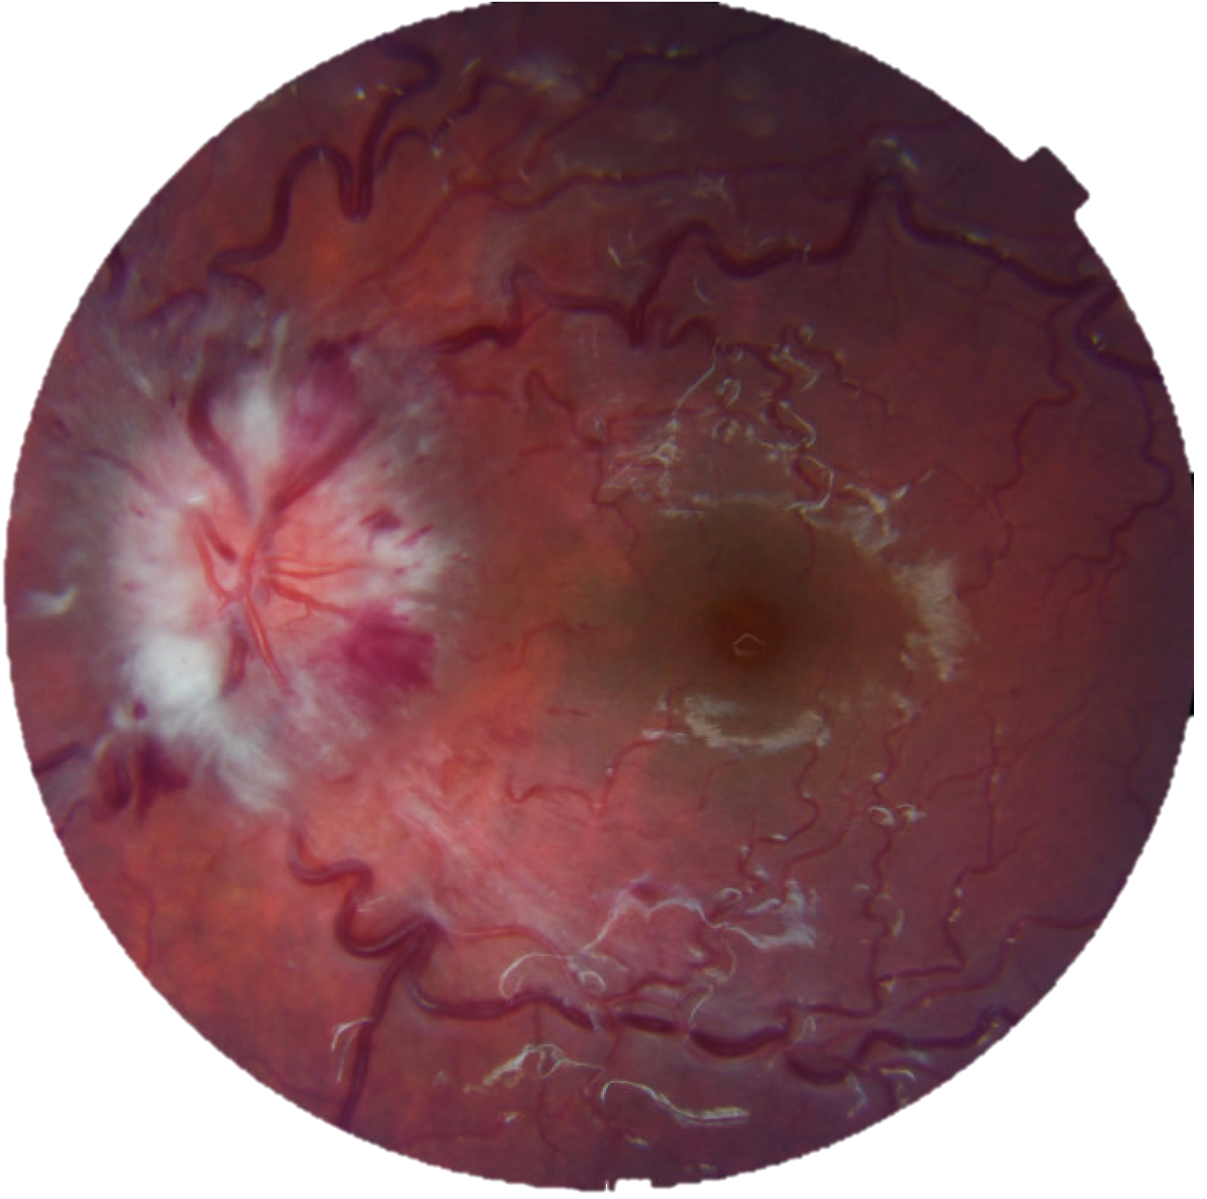
Fundus Exam
8

Slide 9
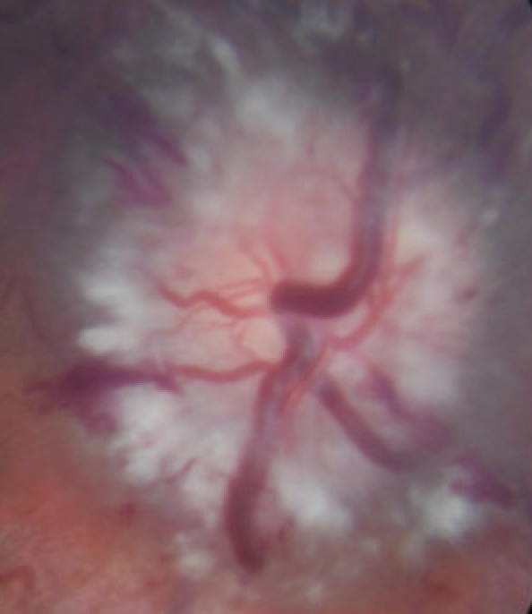
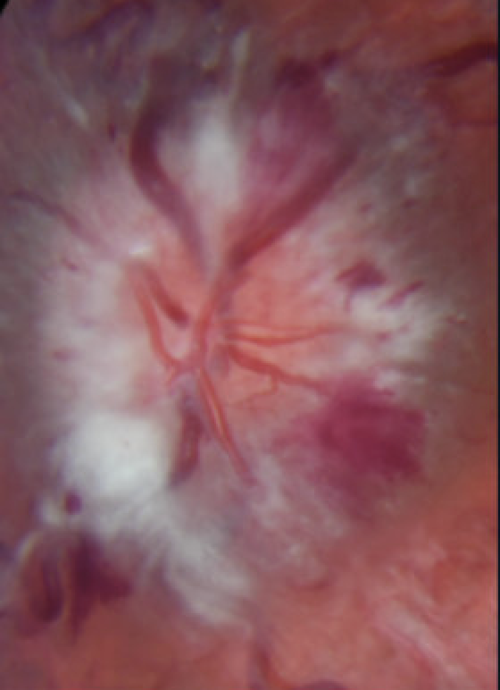
Fundus Exam
What are the key features of the optic nerves and what category of papilledema is this?
OD OS
9

Slide 10
Next Steps
Concern for papilledema
What would you like to do next?
10

Slide 11
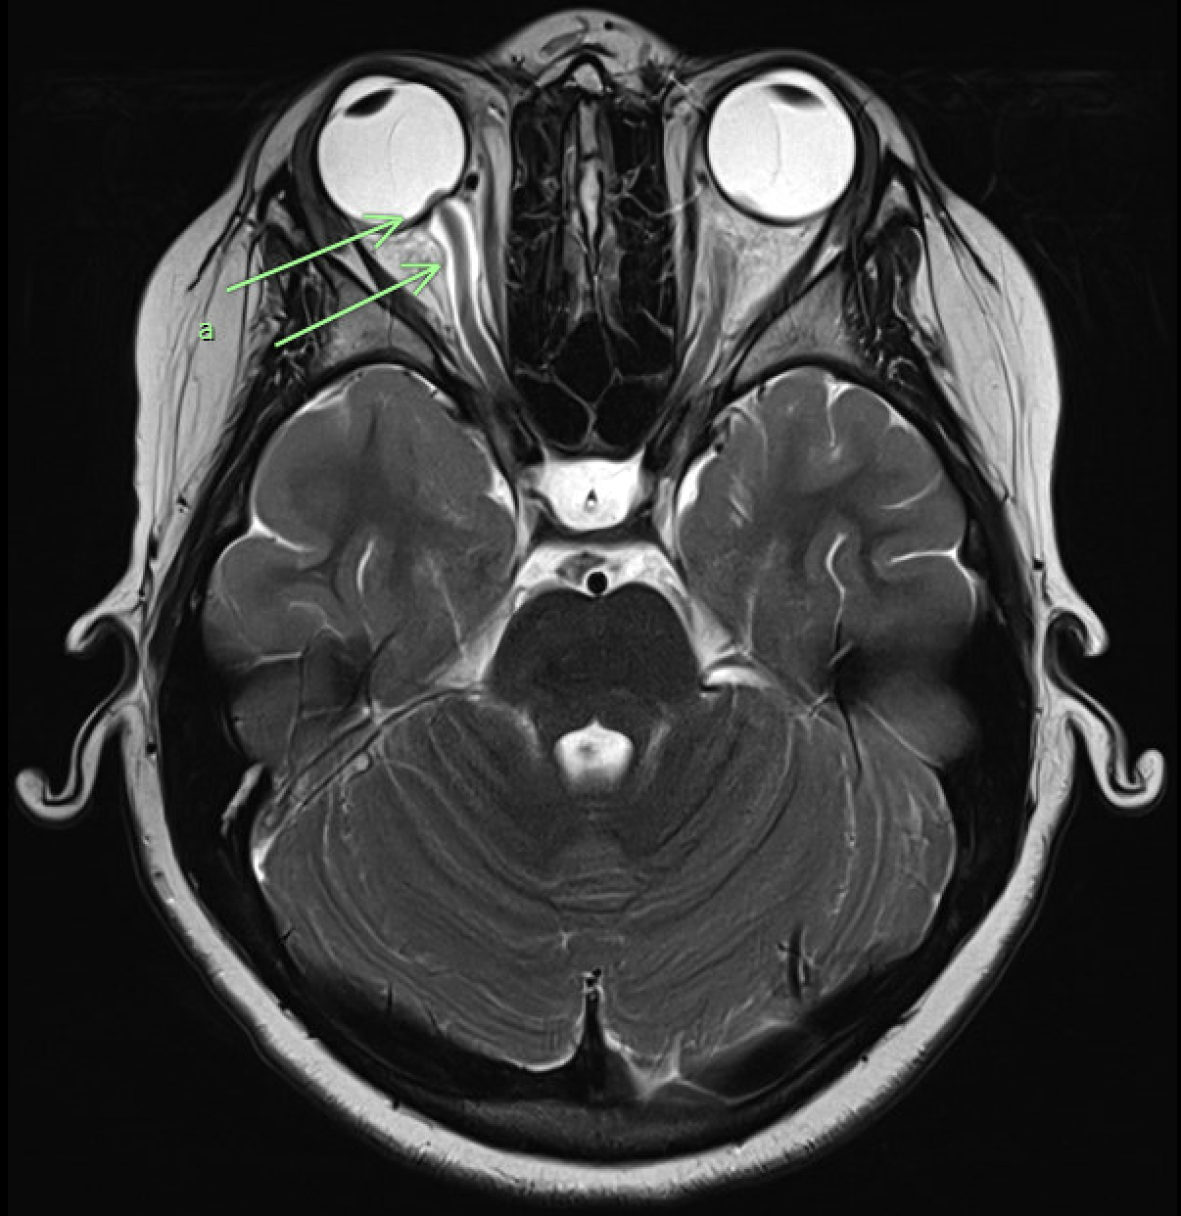
MRI Brain
11

Slide 12
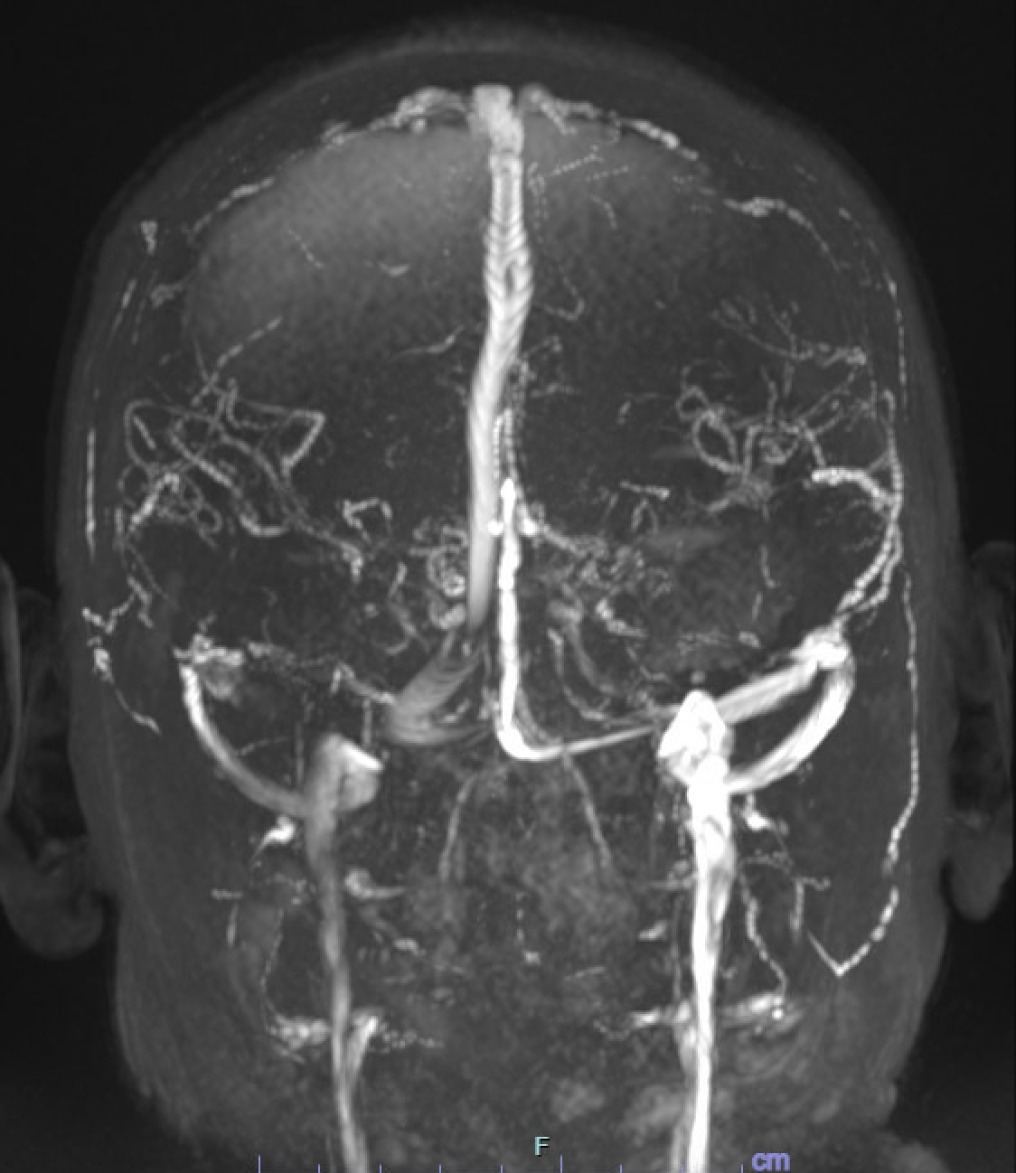
MRV
12

Slide 13
Lumbar Puncture Results
Opening Pressure: >55 cm H₂O (beyond highest manometer reading)
CSF
Appearance: clear
Color: colorless
WBC: 0 cells/high-powered field
RBC: 0 cells/high-powered field
Protein: 14.5 mg/dL
Glucose: 63 mg/dL
For a sedated lumbar puncture in children, what is the upper limit of normal for opening pressure?
13

Slide 14
Summary of Clinic Features
Severe bilateral disc edema in the setting of elevated ICP = Frisen grade 5 papilledema
Bilateral CN6 palsy with intermittent esotropia
  No other cranial neuropathies
No mass or other space-occupying lesion in CNS
CSF composition bland
Initial diagnosis: idiopathic intracranial hypertension
14

Slide 15
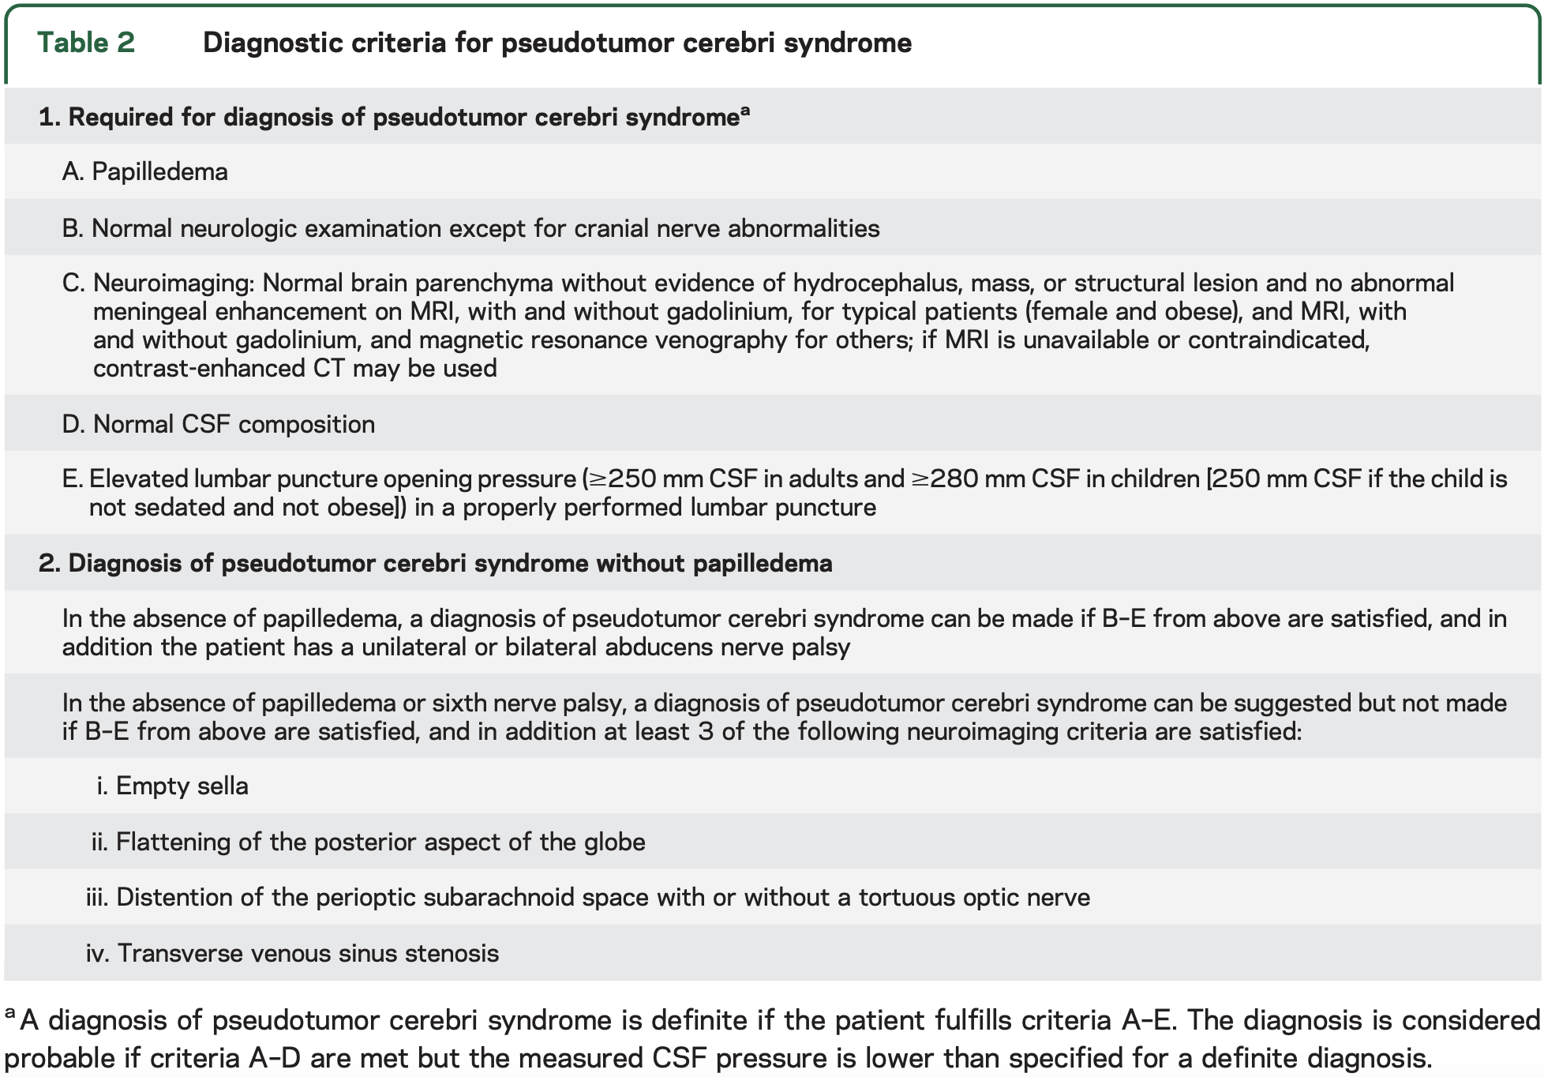
Diagnostic Criteria for
Pseudotumor Cerebri Syndrome (PTCS)
Friedman et al. 2013
15

Slide 16
Clinical Course
Patient started on acetazolamide and admitted to hospital for placement of lumbar drain.
Started on pulse-dose IV methylprednisolone x3 days. Found to have evidence of obstructive sleep apnea.
Discharged 8 days after admission with improving papilledema.
16
16

Slide 17
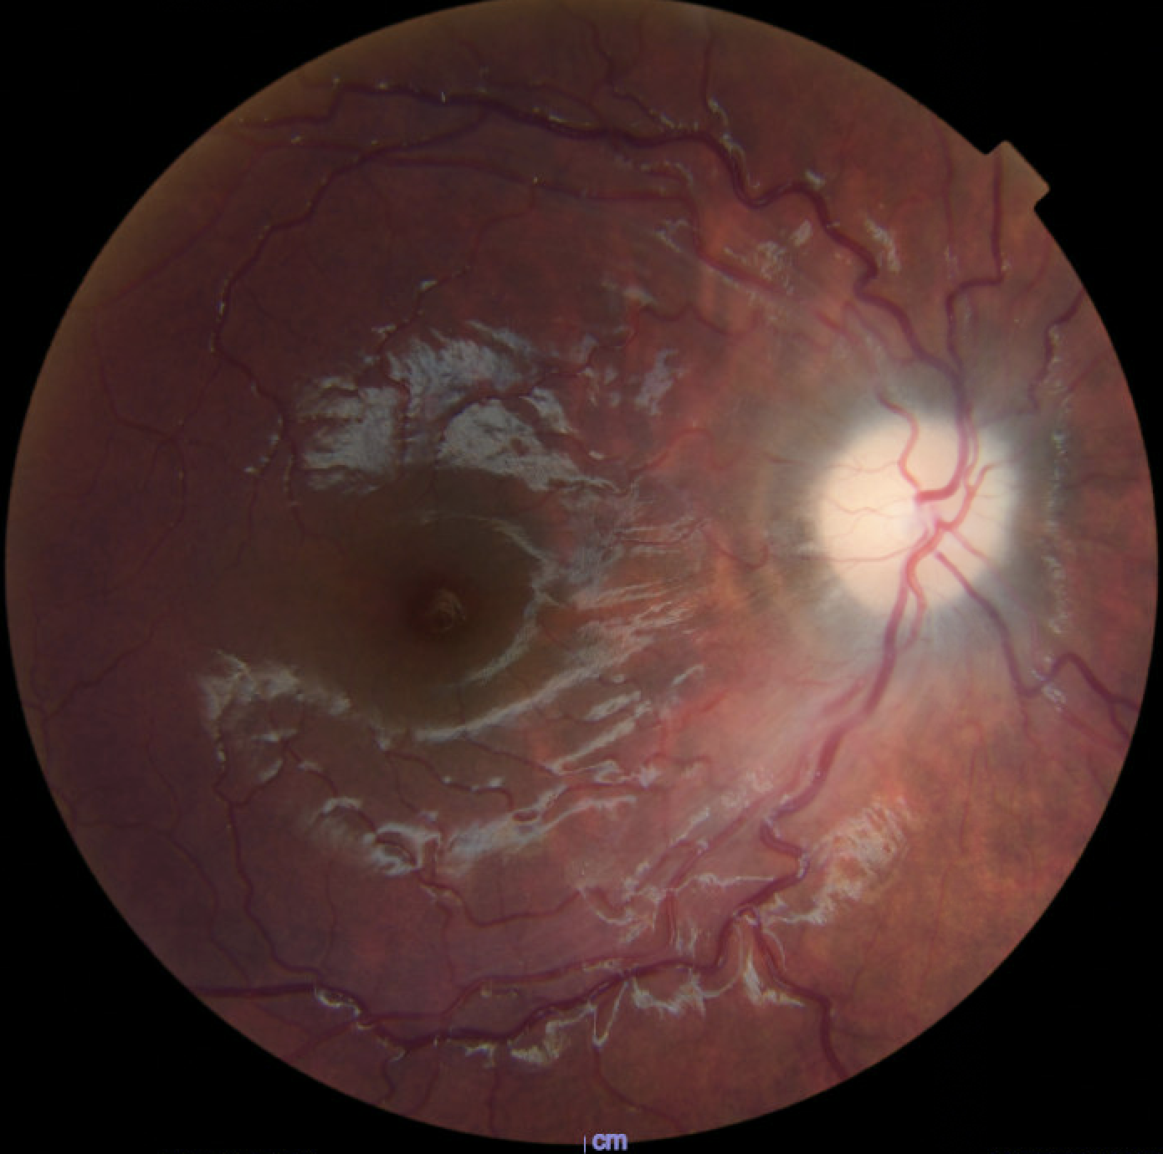
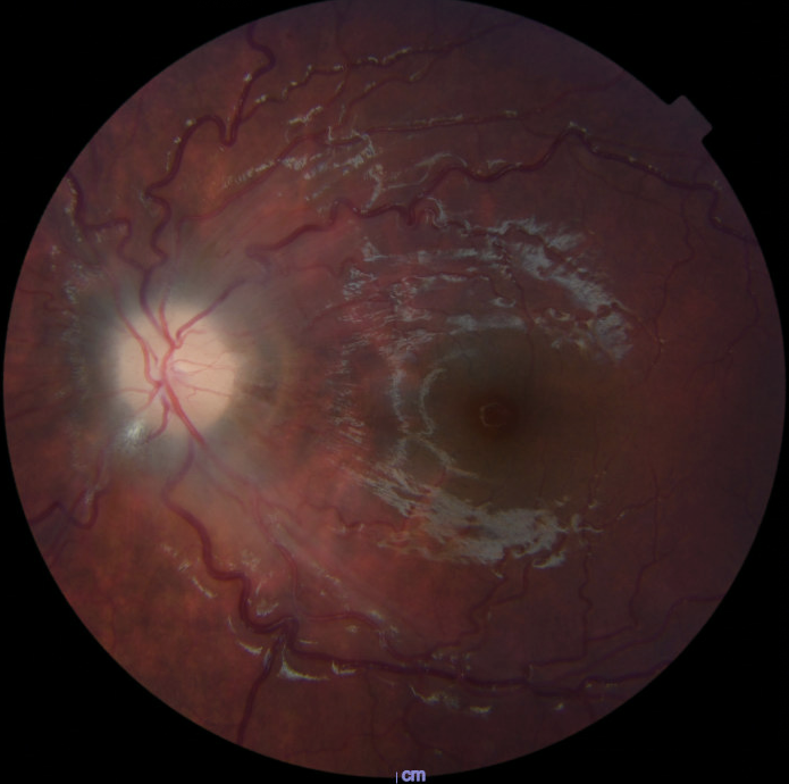
Interval Fundus Exam
17
17

Slide 18
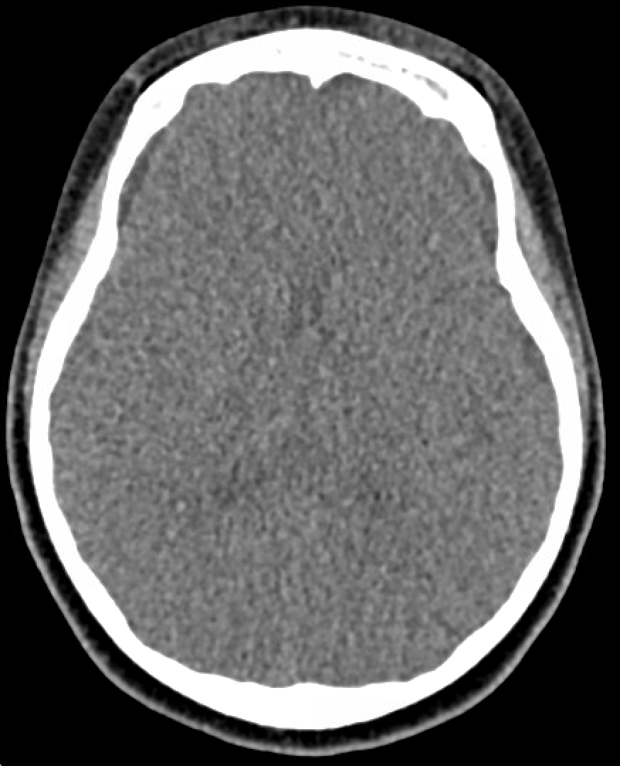
CT Head
18

Slide 19
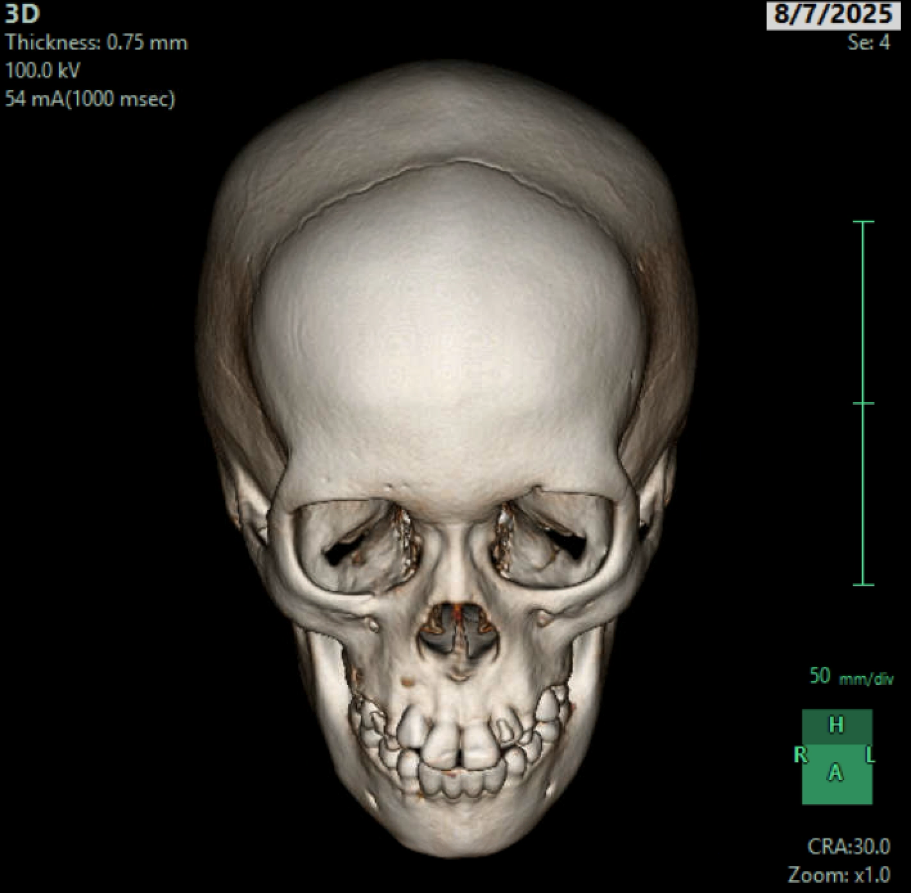
19

Slide 20
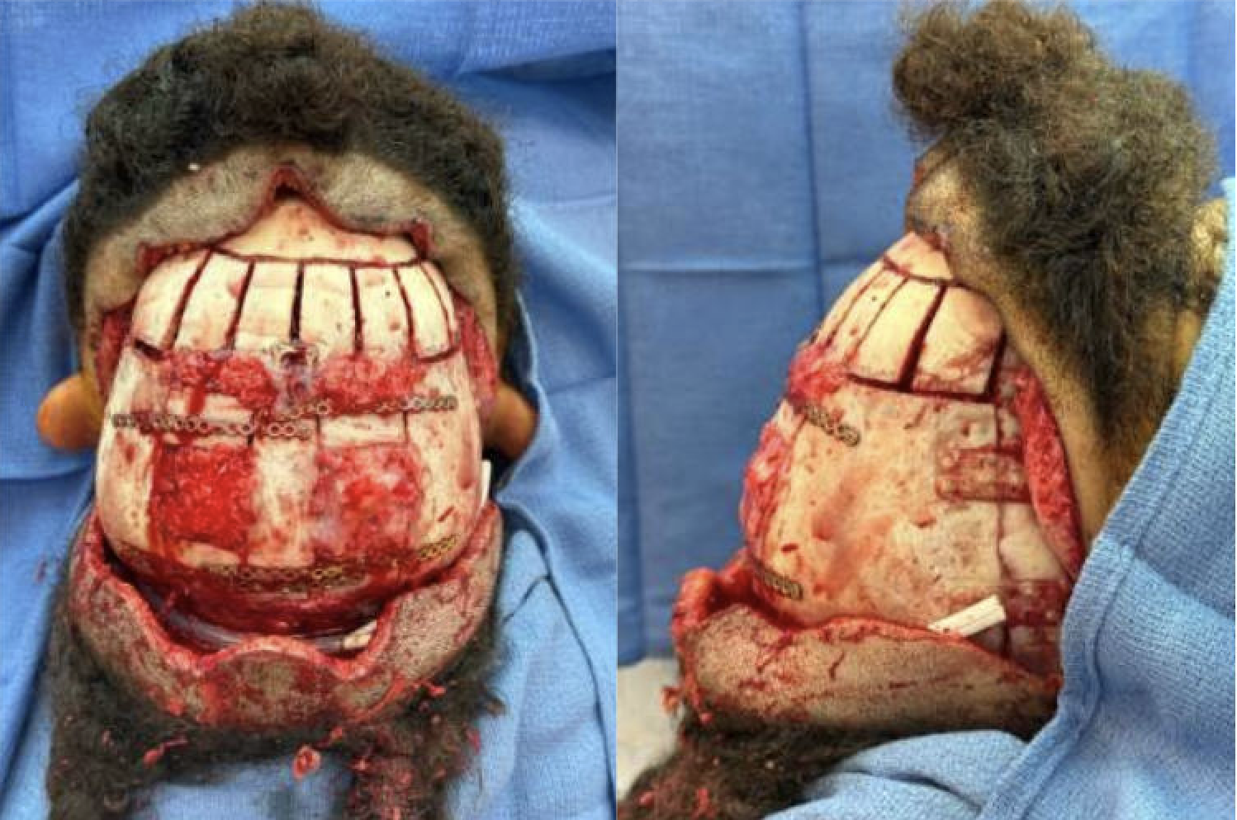
20

Slide 21
Final Diagnosis:
Craniosynostosis-Associated Papilledema
21

Slide 22
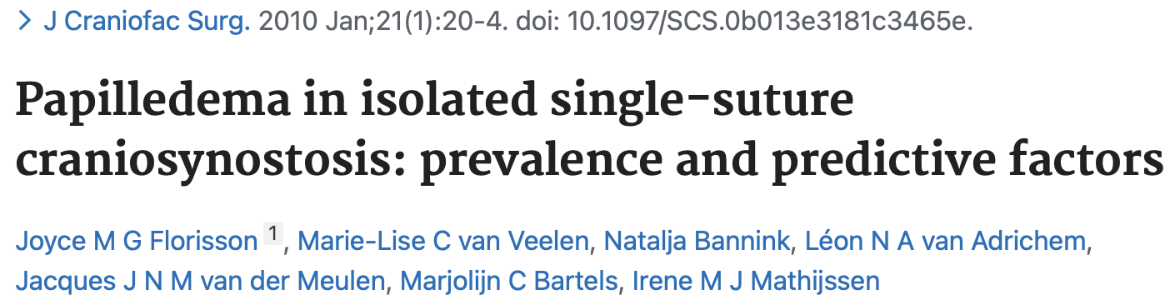
Craniosynostosis-Associated Papilledema
205 children with single-suture craniosynostosis, papilledema prevalence was 7%
9.7% of patients with scaphocephaly with papilledema
5.6% of patients with trigonocephaly with papilledema
22
22

Slide 23
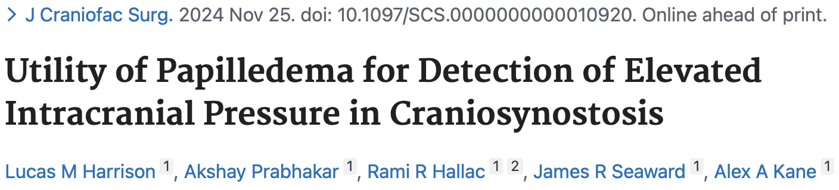
Craniosynostosis-Associated Papilledema
Papilledema rate 2.12%
Single-suture rate 1.15%, multi-suture rate 5.81%
Higher rates in syndromic craniosynostosis-–especially Crouzon syndrome
23

Slide 24
Summary
7-year-old girl initially diagnosed with idiopathic intracranial hypertension, later diagnosed with multi-suture craniosynostosis (sagittal and metopic sutures)
Evidence of chronicity: scalloping of the inner table of the frontal bones and pallor/gliosis on papilledema resolution
Treatments: acetazolamide, pulse-dose intravenous steroids, lumbar drain, and cranial vault expansion surgery.
Papilledema is most common in multi-suture craniosynotosis; in single-suture disease with papilledema, premature fusion of the sagittal suture is most common
24

Slide 25
References
Friedman DI, Liu GT, Digre KB. Revised diagnostic criteria for the pseudotumor cerebri syndrome in adults and children. Neurology. 2013;81(13):1159-1165. doi:10.1212/WNL.0b013e3182a55f17
Wall M. Update on Idiopathic Intracranial Hypertension. Neurol Clin. 2017;35(1):45-57. doi:10.1016/j.ncl.2016.08.004
Liu G. Papilledema from Idiopathic Intracranial Hypertension: A Girl with Headaches and Diplopia. In: Fundamentals of Pediatric Neuro-Ophthalmology. Springer International Publishing AG; 2023:35-38.
Florisson JM, van Veelen ML, Bannink N, et al. Papilledema in isolated single-suture craniosynostosis: prevalence and predictive factors. J Craniofac Surg. 2010;21(1):20-24. doi:10.1097/SCS.0b013e3181c3465e
Harrison LM, Prabhakar A, Hallac RR, Seaward JR, Kane AA. Utility of Papilledema for Detection of Elevated Intracranial Pressure in Craniosynostosis. J Craniofac Surg. Published online November 25, 2024. doi:10.1097/SCS.0000000000010920
25

