Slide 1
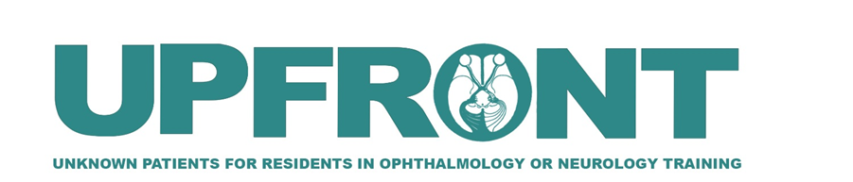

Double Double Trouble
Aretha Zhu, MD; John Gelles, OD; Larry Frohman, MD
Institute of Ophthalmology and Visual Science, Rutgers New Jersey Medical School
Notes:
This case highlights an interesting presentation of coexisting binocular and monocular diplopia

Slide 2
Chief complaint
77-year-old F presenting with diplopia for 2 years and blurry vision OD for 4 months
Notes:
A 77-year-old woman presents with two years of diplopia and four months of blurry vision in the right eye.

Slide 3
History of presenting illness
77-year-old F presenting with:
  Diplopia for 2 years – “double and lopsided”
  Blurry vision OD for 4 months with “shadow” in OD
  Feels “head is swimming”
First noticed approximately 1 year post-cataract extraction with intraocular lens implantation (CEIOL) OU
Prior trials of various prisms and refractions were unsuccessful
Several consultations were unrevealing as to etiology
Referred by outside ophthalmologist for evaluation
Notes:
She describes her vision as “double and lopsided,” along with a “shadow” in the right eye.
She also reports a sensation that her “head is swimming.”
Symptoms began approximately one year after bilateral cataract extraction with intraocular lens implantation.
She has undergone multiple refractions and prism trials without improvement, and prior consultations did not identify a clear etiology.

Slide 4
History
Medical history:
HTN
Monoclonal gammopathy
Hx of vestibular disease causing the swimming sensation, currently being treated by a neuro-otologist
Ocular history:
Cataract extraction with IOL OU (2 years prior to presentation)
Review of symptoms:
(-) ptosis, difficulty swallowing, extremity weakness
(-) anorexia, jaw claudication, scalp tenderness
Notes:
Her medical history includes hypertension, monoclonal gammopathy, and vestibular dysfunction currently managed by neuro-otology.
Ocular history is notable for prior cataract surgery in both eyes.
Review of systems is negative for features suggestive of myasthenia gravis or giant cell arteritis.

Slide 5
Prior workup
MRI brain with and without contrast negative
Notes:
MRI of the brain with and without contrast was unremarkable.

Slide 6
Exam
 | OD | OS
VA | 20/60 ph 20/40 | 20/25 ph 20/20
IOP | 15 | 13
Pupils | 6mm, (-) APD | 6mm, (-) APD
Color plates | 10/10 | 10/10
External | Left head tilt; present for decades as confirmed by photographs and husband

Slide 7
Exam
SLE | OD | OS
Lids/lashes | Normal | Normal
Conjunctiva/sclera | White and quiet | White and quiet
Cornea | Clear; (-) Fleischer ring, Munson sign | Clear; (-) Fleischer ring, Munson sign
Anterior chamber | Shallow, quiet | Shallow, quiet
Iris | Normal, round and reactive | Normal, round and reactive
Lens | Posterior chamber IOL | Posterior chamber IOL
Vitreous | Clear | Clear

Slide 8
Exam
DFE | OD | OS
Optic nerve | Normal | Normal
CDR | 0.7 x 0.5 | 0.6 x 0.6
Macula | Normal, flat | Normal, flat
Vessels | Normal caliber | Normal caliber
Periphery | Normal | Normal

Slide 9
Exam
Saccades: Normal
Pursuits: Full; vertical pursuits somewhat saccadic
Other tests:
  No glabellar tap sign, i.e., patient able to suppress glabellar reflex.*
  No apraxia of eyelid opening*
  No extensor neck rigidity*
  No ptosis, lid lag, stare
*These are tests to look for signs of progressive supranuclear palsy (PSP)
Worth 4-dot:
  Near: suppresses OD
  Distance: suppresses OD
MRx:
  BCVA 20/25 -2 OD with +2.50 -3.50 x112
  OS pinholes 20/20, not
  re-refracted
Notes:
Ocular motility testing revealed:
Normal saccades
Full pursuits, though vertical pursuits were mildly saccadic
No signs suggestive of progressive supranuclear palsy, including:
No glabellar reflex persistence
No eyelid opening apraxia
No axial rigidity
Worth 4-dot testing demonstrated suppression of the right eye at both near and distance, suggesting chronicity.
Best-corrected visual acuity was 20/25 in the right eye.

Slide 10
Alternate prism cover test
 | RHT 2
RHT 3 | RHT 3 | RHT 3
RHT 3 | RHT 3 | RHT 3
Right head tilt: RHT 2 | Left head tilt: R hyper flick
Notes:
Prism cover testing showed a right hypertropia, worse in:
Right head tilt
This pattern is consistent with a right superior oblique palsy.

Slide 11
With a right hyper worse on right head tilt, this is a long-standing right superior oblique palsy with spread of comitance
  With the long-standing head tilt documented on the retrospectoscope (old family photos), this is likely congenital or at least long-standing.
  A physical exam clinical pearl: in congenital or chronic IV nerve palsy, patients may have a hypertrophied sternocleidomastoid muscle on the side that they tilt their head to.
Notes:
Historical photographs revealed a long-standing head tilt, suggesting this is likely congenital or longstanding rather than acute.
A key clinical pearl:
Patients with chronic fourth nerve palsy may develop hypertrophy of the sternocleidomastoid muscle on the side of head tilt.
With a right hyper worse on right head tilt, this is a
long-standing right superior oblique palsy
with spread of comitance
In R SO palsy, you would also see worse on L gaze, but due to the chronicity and spread of comitance, this was not seen in this patient

Slide 12
3-step head tilt test
Useful for identifying relatively acute superior oblique palsies
Over time, there is a phenomenon called spread of comitance
  A long-standing, initially incomitant (unequal in different gaze directions) strabismus becomes comitant (similar in all directions) over time due to chronic muscle adaptation
  This is why this patient’s measurements are so similar in various gazes.
  Therefore, the three step head tilt test may not apply in a longstanding fourth nerve palsy.
  The key finding in this patient is that she had a right hyper worse in right tilt.
Notes:
While the three-step test is useful in acute vertical palsies, its utility decreases in chronic cases.
This is due to spread of comitance, where initially incomitant deviations become more comitant over time due to adaptive changes.
Thus, measurements may appear similar across gaze positions in longstanding disease.

Slide 13
Example of a 3-step test for vertical muscle palsy in a theoretical patient with an acute right hyper worse in left gaze and worse in right tilt
1. RHT
RSR
RIO
LIO
LSR
Right
gaze
Left
gaze
RIR
RSO
LSO
LIR
Notes:
What’s being circled are the muscles that could be weak to allow for the deviation:
a right hyper (Depressors of right eye, elevator of left eye)
rt hyper worse in gaze left
rt hyper worse in rt tilt

Slide 14
Example of a 3-step test for vertical muscle palsy in a theoretical patient with an acute right hyper worse in left gaze and worse in right tilt
2. RHT worse on L gaze
RSR
RIO
LIO
LSR
Right
gaze
Left
gaze
RIR
RSO
LSO
LIR
Notes:
What’s being circled are the muscles that could be weak to allow for:
a right hyper
rt hyper worse in gaze left
rt hyper worse in rt tilt

Slide 15
Example of a 3-step test for vertical muscle palsy in a theoretical patient with an acute right hyper worse in left gaze and worse in right tilt
3. RHT worse on R tilt
RSR
RIO
LIO
LSR
Right
gaze
Left
gaze
RSO
LSO
LIR
RIR
RSO
Notes:
What’s being circled are the muscles that could be weak to allow for:
a right hyper
rt hyper worse in gaze left
rt hyper worse in rt tilt

Slide 16
Congenital superior oblique (SO) palsy
Clinical features:
  Hypertropia increases with contralateral gaze and ipsilateral head tilt
  Compensatory head tilt away from affected side, often manifesting <1yr of age
  May have hypertrophied sternocleidomastoid muscle and facial asymmetry
  Large vertical fusional amplitudes (56% of cases, Ivanir and Trobe 2017)
Structural tendon abnormalities (87% of congenital cases vs. 8% of acquired cases, Helveston et al. 1992)
MRI showing SO muscle hypoplasia in congenital SO palsy patients (Sato et al. 1998)
Congenital cases may be occult for decades if they have good fusional vergence and may present in adulthood
  Dosunmu et al. 2018 found presentation of presumed congenital cases peaked in the 4th and 2nd decade
Notes:
Congenital fourth nerve palsy may:
Present late due to large vertical fusional amplitudes
Be associated with structural tendon abnormalities
Show superior oblique hypoplasia on imaging
Patients can remain compensated for decades before decompensating.

Slide 17
Further workup
MRI images examined: review of fourth nerve reveals it is normal
Exam to rule out ocular signs of myasthenia gravis negative
  No seesaw sign, no lid twitch sign, no fatigue, good orbicularis tone
No further external testing required
Notes:
Further evaluation showed:
Normal fourth nerve on imaging
No evidence of ocular myasthenia gravis
No additional neurologic workup was indicated.

Slide 18
But with a nearly comitant deviation, why could she not be corrected with prisms?
Notes:
Despite identifying a nearly comitant vertical deviation, the patient failed multiple prism trials.
This raises a key question:
Why was her diplopia not correctable with prisms?

Slide 19
Diagnosis
Recall patient also complained of blurry vision OD with “shadow”
This was monocular diplopia!
She had both undiagnosed binocular diplopia from the long-standing right fourth nerve palsy and monocular diplopia in the right eye!
Prisms could only help the binocular diplopia.
Notes:
The answer lies in her second complaint:
Blurry vision with a “shadow” in the right eye.
This represents monocular diplopia, which persists even when the fellow eye is occluded.
Thus, this patient had:
Binocular diplopia from fourth nerve palsy
Monocular diplopia from a separate ocular pathology
Prisms can only correct binocular diplopia.

Slide 20
DDx of monocular diplopia
Corneal
  Corneal ectasia (keratoconus, keratoglobus)
  Refractive error
  Dry eye disease
  Pterygium
Lenticular
  Cataract
  Lens subluxation
  IOL malposition
  Posterior capsular opacification
Posterior segment
  Epiretinal membrane
  Macular edema
  Macular hole
Other
  Corectopia
  Ocular migraine
  Palinopsia mimicking monocular diplopia
Notes:
Monocular diplopia can arise from:
Corneal pathology, including keratoconus
Lenticular abnormalities
Posterior segment disease

Slide 21
Exam
What test did we not perform that might clarify the trouble correcting her diplopia with prisms?
Retinoscopy, which demonstrated…
Scissoring reflex OD!
Notes:
A key test had not yet been performed: retinoscopy.
This demonstrated a scissoring reflex in the right eye, highly suggestive of keratoconus.

Slide 22
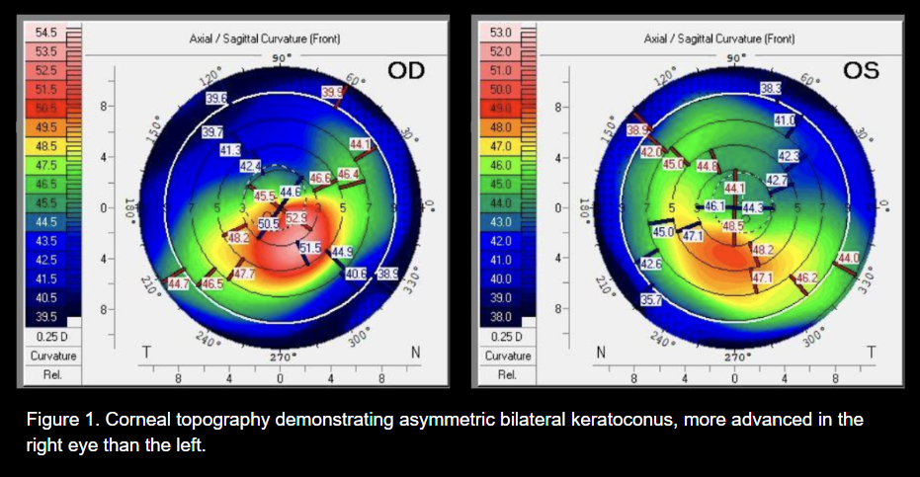
Corneal topography

Slide 23
Key findings and clinical course
78F with monocular diplopia and binocular diplopia
  Binocular diplopia 2/2 previously undiagnosed congenital right superior oblique palsy
  Monocular diplopia 2/2 undiagnosed keratoconus
Patient referred to corneal specialist for keratoconus management.
Notes:
This patient had dual pathology:
Binocular diplopia due to longstanding congenital right superior oblique palsy
Monocular diplopia due to keratoconus

Slide 24
What could you do for this woman with keratoconus and binocular diplopia?
You could fit her with rigid contacts (corneal RGP lenses or scleral lenses) to correct the monocular diplopia caused by keratoconus and then give her prism glasses on top of them.
But then she needs both contacts and glasses.
What else might you do?
Notes:
Rigid gas-permeable or scleral lenses could address the corneal irregularity.
However, this would still require separate prism glasses to correct the binocular misalignment.

Slide 25
Prism contact lenses!
Prism incorporated right into the contact lens!
  But how?
Prism Incorporated Ocular Impression Based Scleral Lens (pibSL)
  Scleral lens = large diameter rigid contact lens, rests on sclera, vaults over cornea, space between posterior lens and corneal surface contains saline, commonly used to correct vision in patients with irregular corneas and treat severe ocular surface disease
  Ocular impression performed, impression is 3D scanned, 3D modeled, and lenses are designed to mirror 3D surface
  Lenses approximately match the ocular surface shape providing stability = critical for maintaining prism orientation
  Designed with 6 prism diopters (PD) of vertical prism and 2 PD of base out prism with prism split evenly between 2 eyes
Notes:
A more elegant approach:
Prism incorporated scleral lenses.
These lenses
Vault the cornea and correct irregular astigmatism
Incorporate prism directly into the lens
Provide rotational stability via scleral alignment

Slide 26
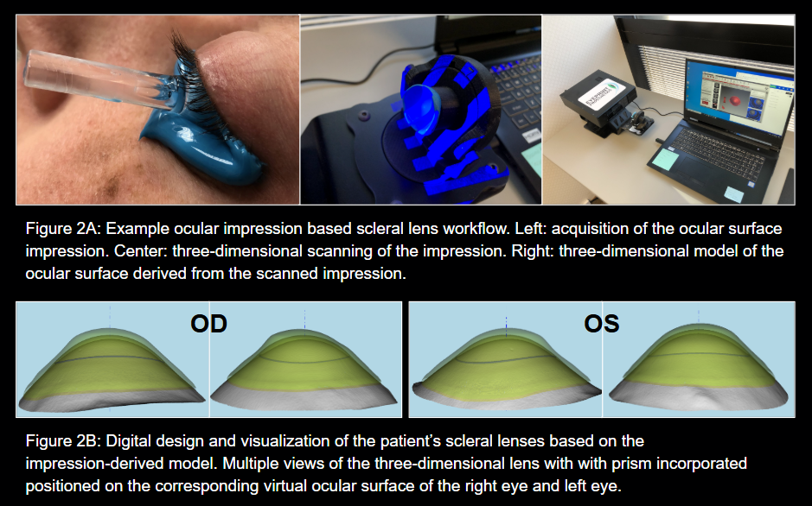
Prism contact lenses!
Notes:
The lenses were designed using ocular surface impression and 3D modeling, allowing precise prism incorporation.

Slide 27
Result?
Binocular diplopia resolved
But… patient still unhappy as only corrected to 20/25- OD, with complaints of persistent monocular diplopia
What to do?
Notes:
Despite resolution of binocular diplopia, the patient continued to experience monocular diplopia

Slide 28
Wavefront aberrometry
Aberrometry data, measured while wearing the pibSL, was used to evaluate the persistent monocular diplopia
Data showed elevated higher order aberration (HOA)
Custom higher order aberration (HOA) correcting scleral lens optics were designed OD to address the monocular diplopia
Notes:
due to higher-order aberrations.
Wavefront analysis revealed elevated higher-order aberrations.
Custom optics were designed to neutralize these aberrations using wavefront-guided correction.

Slide 29
Wavefront guided optics
The process is similar in concept to noise cancelling headphones
  Measure the HOA while wearing the scleral lens
  Design and manufacture equal and opposite HOA in the scleral lens optics
  By destructive interference, the HOA’s are effectively cancelled, reducing HOA and providing maximum clarity
Unique to this case is the combination of prism correction to address binocular diplopia with HOA correcting optics to ensure best focusing of the image upon the right macula
Notes:
This approach is analogous to noise-canceling headphones:
Aberrations are measured
Opposing optical patterns are introduced
Resulting in cancellation and improved image clarity

Slide 30
After incorporating wavefront guided correction into the prism scleral lenses…
Optimum clarity achieved!
Monocular diplopia eliminated by using scleral lens with wavefront guided optics
Binocular diplopia corrected by prisms (PibSL)
Notes:
With combined prism and wavefront-guided scleral lenses:
Monocular diplopia resolved
Binocular alignment achieved
Visual acuity improved to 20/20

Slide 31
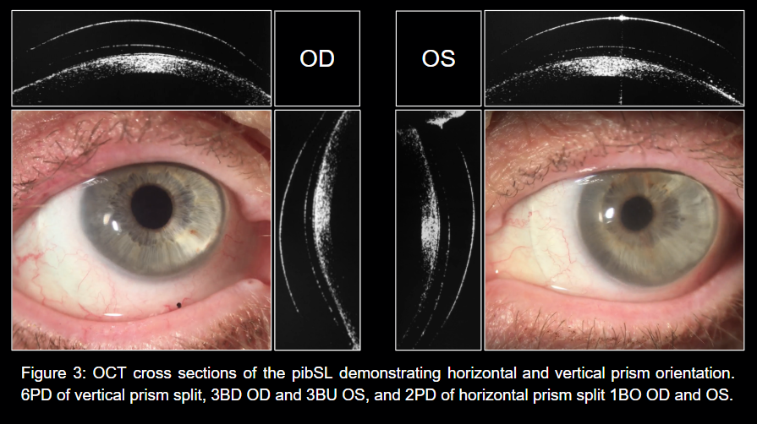
Our patient wearing scleral lenses with incorporated prisms

Slide 32
Follow-up after > 2 years
With scleral lens in place, patient had no diplopia at distance
20/20 OU
Fused on Worth 4-dot testing
Orthophoric in all cardinal gazes!
Notes:
At over two years:
No diplopia at distance
Fusion restored
Orthophoric in all gazes
Key teaching points of this case include:
Important to distinguish btwn monocular vs binocular diplopia, pt can have both
Longstanding fourth nerve palsy may appear comitant
Retinoscopy can be a high-yield test
Advanced optical solutions can address complex, layered pathology

Slide 33
References
We acknowledge that a summary of this case has been published as part of a case series:
Gelles, John D. O.D.; Weng, Angelina O.D.; Vought, Victoria B.A.; Vought, Rita M.D.; Zhang, Isis M.D.; Frohman, Larry P. M.D.; Greenstein, Steven A. M.D. Management of Binocular Diplopia With Prism Incorporated Ocular Impression-Based Scleral Lenses With and Without Wavefront-Guided Optics. Eye & Contact Lens: May 1, 2026. | DOI: 10.1097/ICL.0000000000001275"
https://eyewiki.org/Three_Step_Test_for_Cyclovertical_Muscle_Palsy
https://pubmed.ncbi.nlm.nih.gov/609280
https://pubmed.ncbi.nlm.nih.gov/9886737/
https://pubmed.ncbi.nlm.nih.gov/29102606/
https://pubmed.ncbi.nlm.nih.gov/27787462
https://pubmed.ncbi.nlm.nih.gov/1454330
https://pubmed.ncbi.nlm.nih.gov/38693011/
https://pubmed.ncbi.nlm.nih.gov/39661442/
https://pubmed.ncbi.nlm.nih.gov/35916554/

