Slide 1
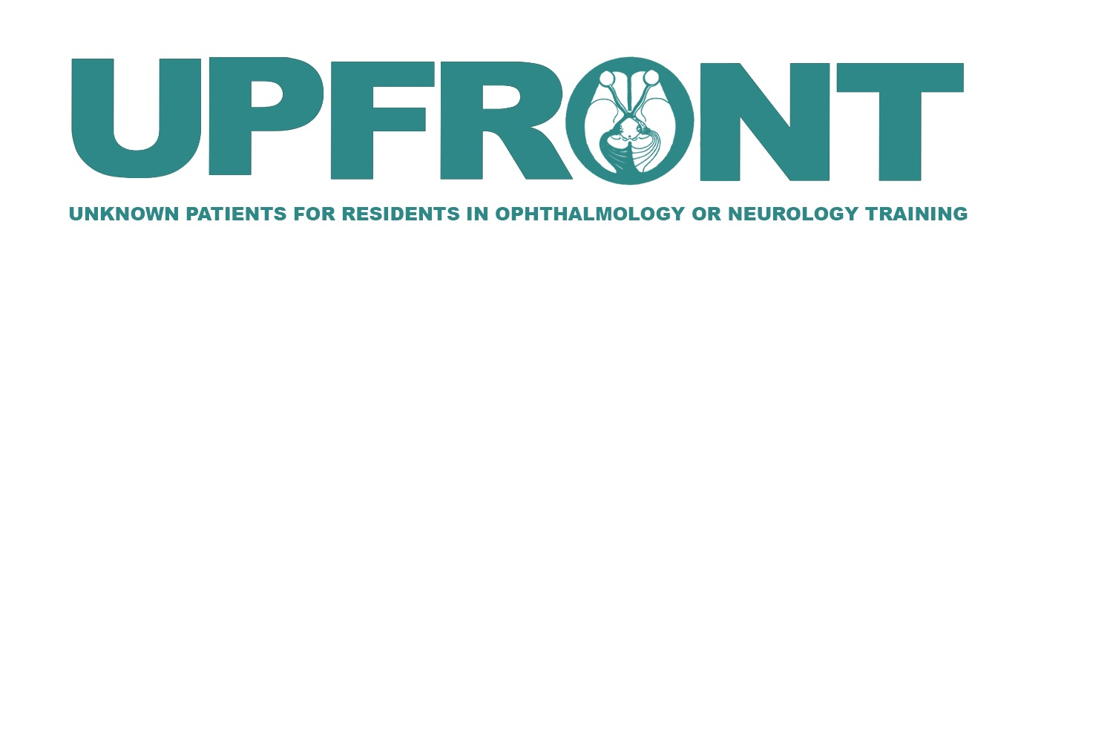

See-Saw Nystagmus
Luis Martinez-Velazquez^{1,2}
Sandy Samuel ¹
Ryan Gise^{1,3}
1) Harvard Medical School
2) Massachusetts Eye and Ear Infirmary, Department of Ophthalmology
3) Boston Children’s Hospital, Department of Ophthalmology

Slide 2
Chief Concern
8-year-old female referred to neuro-ophthalmology from optometry for evaluation of “torsional nystagmus.”

Slide 3
History of present illness
Recently passed school vision screening and was seen by her regular optometrist. ​
Exam was notable for new “torsional nystagmus” and decreased acuity. ​
Patient with history of strabismus and amblyopia of the right eye. Patching the left eye 1.5 hours per day. ​
Mother had noticed that the eyes have been both “drifting out and crossing” and that she had been sensitive to light. Recently, she had needed to hold books closer to her eyes. ​
She had also had difficulty going down the stairs and needed to hang on to railings since age 5. ​
Denies any known changes to her general health.​
Denies headaches.

Slide 4
Past ocular history
Hyperopic astigmatism
Anisometropic amblyopia in the right eye
Intermittent exotropia

Slide 5
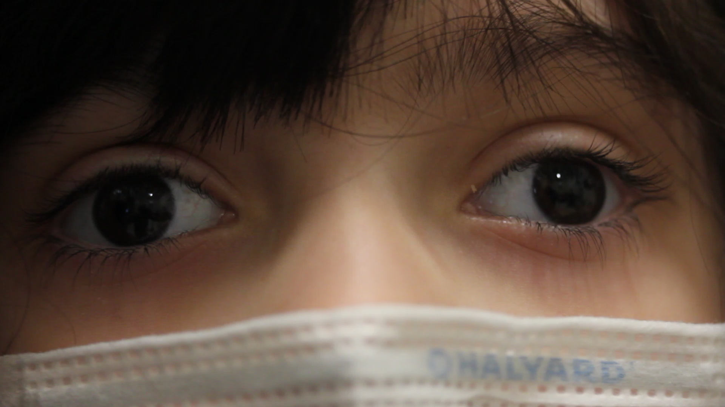
Examination of her eye movements
Notes:
Video included with patient and family’s consent.
See-saw nystagmus: small amplitude and moderate frequency
Increases in frequency on upgaze

Slide 6
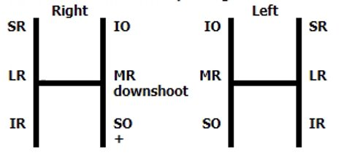
Extraocular muscle motility exam
Nystagmus comments:​
See-saw nystagmus​
Small amplitude and moderate
frequency. ​
Increases in frequency in upgaze.

Slide 7
Neuro-ophthalmic Examination
Neurologic exam: wide based gait, decreased sensation in toes bilaterally
Ophthalmologic exam:
Visual Acuity: 20/50 OD, 20/30 OS
Color vision (Ishihara) 7/10 OD and 5/10 (decreased)
No relative afferent pupillary defect (rAPD)
External Exam: see-saw nystagmus
Slit Lamp Examination: normal
Visual Fields: bitemporal hemianopia
Fundus Examination: temporal optic disc pallor OU
Notes:
Decreased color plates with relatively preserved central acuity is suggestive of an optic neuropathy.
Absence of a relative afferent pupillary defect is possible if a bilateral optic neuropathy is present.

Slide 8
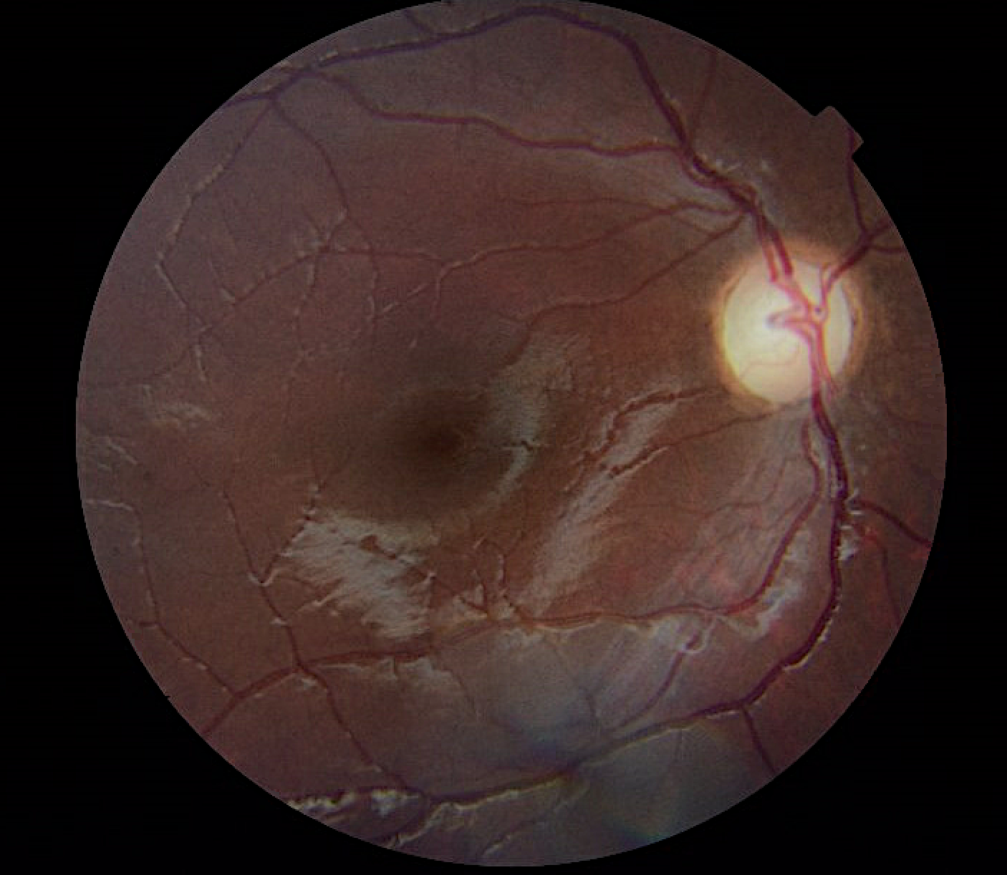
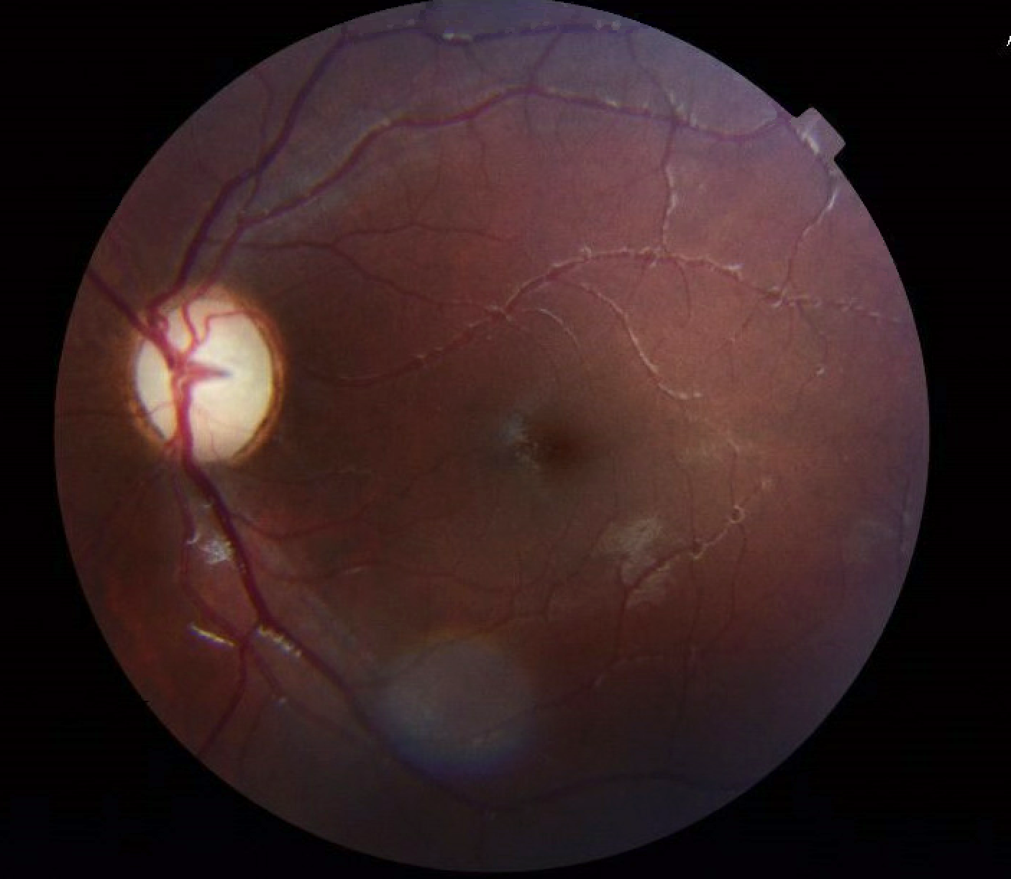
Posterior Segment Examination

Slide 9
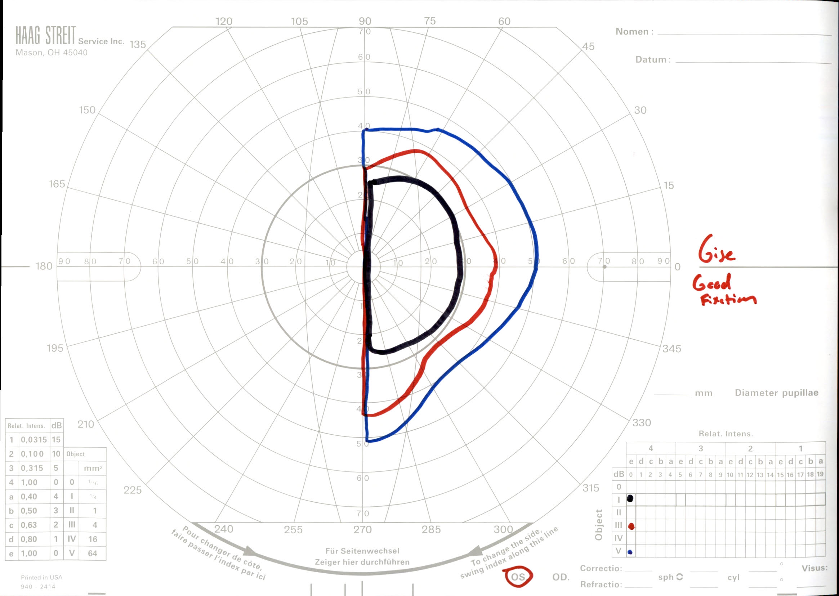
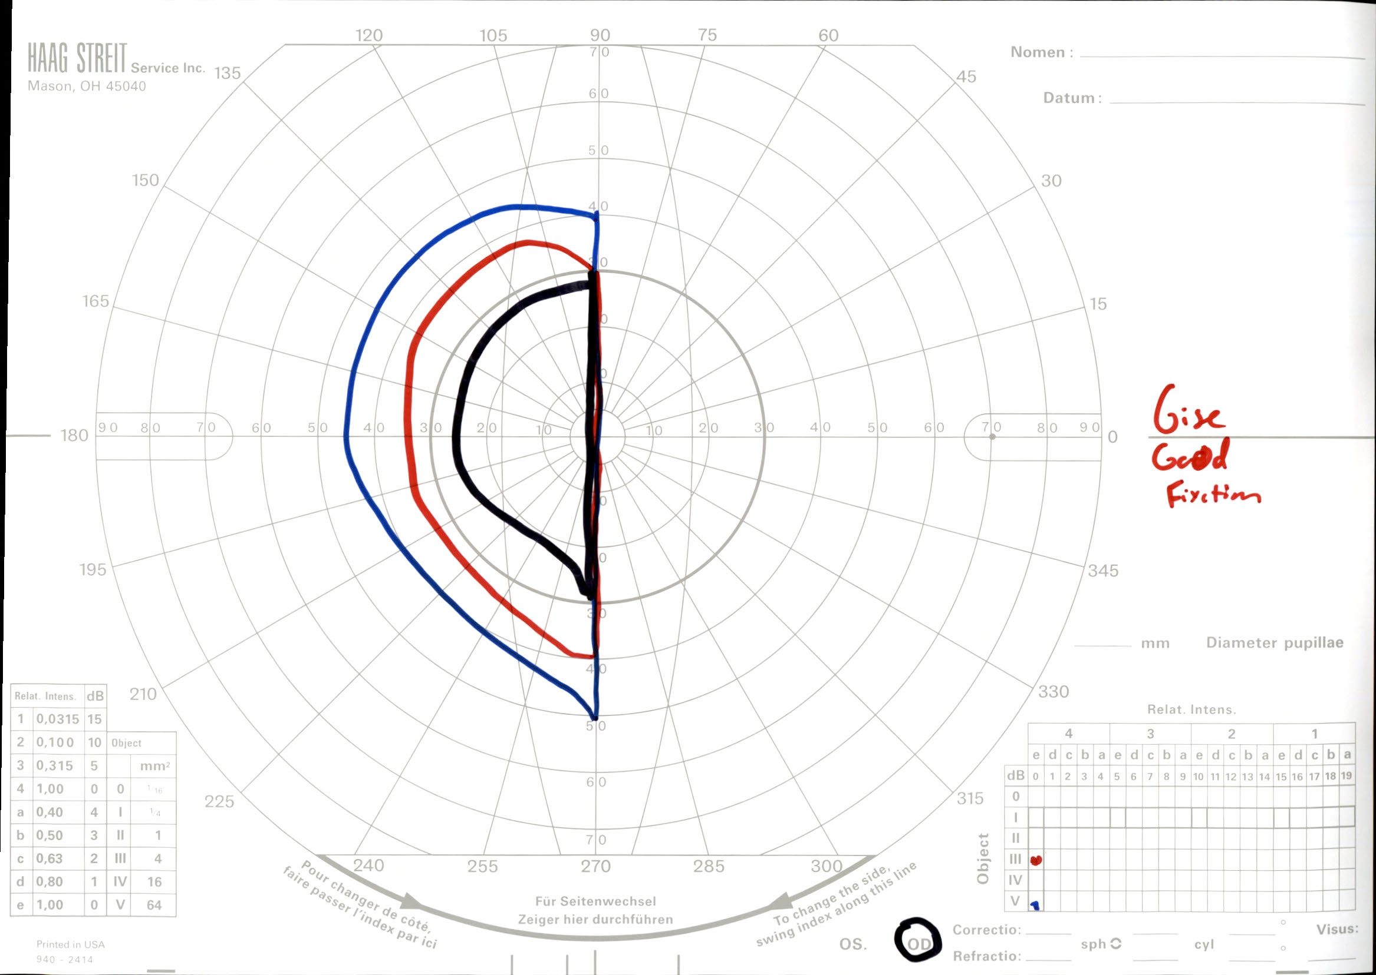
Visual Fields – Goldmann static perimetry
Notes:
Dynamic perimetry performed using the Goldmann perimeter documented bitemporal hemianopia. Colored tracings mark her visible field. The different colors denote the stimulus used.

Slide 10
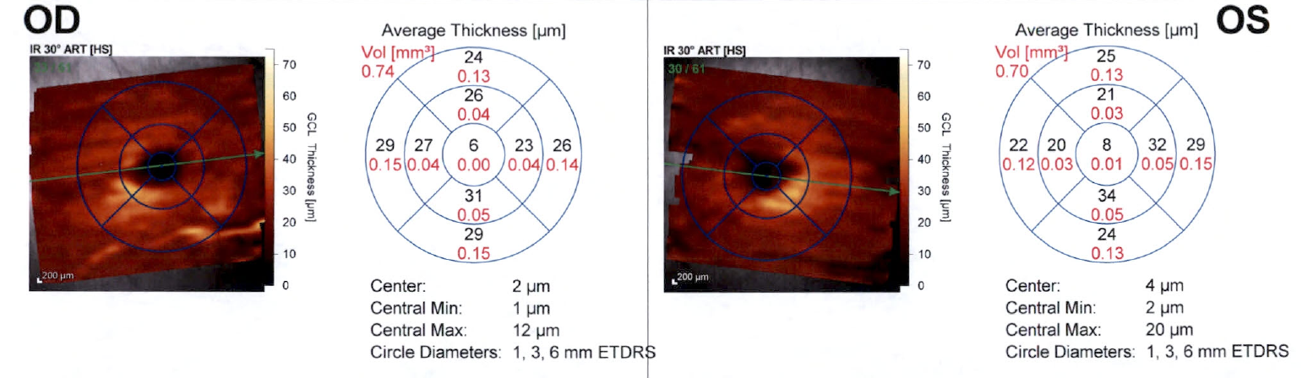
Optical Coherence Tomography (OCT):
Retinal ganglion cell layer
Notes:
OCT demonstrates thinning of the retinal ganglion cell layers bilaterally (predominantly nasally), suggesting that the cause of the optic neuropathy is chronic and consistent with the observed bitemporal hemianopia.

Slide 11
What is the differential diagnosis for see-saw nystagmus?
Parasellar tumors (epidermoid cysts, craniopharyngioma, adenoma, glioma)
Brainstem stroke
Mesodiencephalic lesions
Head trauma
Multiple sclerosis
Arnold-Chiari malformation
Congenital
  Lack or loss of crossing fibers in the optic chiasm
Iatrogenic
  Whole brain irradiation
  Intrathecal methotrexate
Notes:
Quisling and Kardon. “See-Saw Nystagmus.” 2005.

Slide 12
Pathophysiology of See-Saw Nystagmus
Pendular see-saw nystagmus may result from associated visual field defects or secondary to midbrain compression
Jerk or hemi see-saw nystagmus may be related to the ocular-tilt reaction (OTR) due to unilateral interruption of otolithic inputs from one labyrinth to the contralateral Interstitial Nucleus of Cajal, or more generally, an imbalance in the vestibular pathways
Notes:
Helmchen C, Rambold H, Fuhry L, Buttner U. Deficits in vertical and torsional eye movements after uni- and bilateral muscimol inactivation of the interstitial nucleus of Cajal of the alert monkey. Exp Brain Res 1998;119:436-452.
Rambold H, Helmchen C, Buttner U. Vestibular influence on the binocular control of vertical-torsional nystagmus after lesions in the interstitial nucleus of Cajal. Neuroreport, 2000;11:779-784.

Slide 13
Summary ​
8-year-old female with a history of refractive amblyopia and strabismus, who now presents with see-saw nystagmus, found to have decreased VA, bitemporal hemianopia, and optic atrophy. ​
Where is the lesion localized?​
Does the data support acute onset?

Slide 14
Next Steps?
Findings suggest a chiasmal lesion
  bitemporal hemianopia
  presence of optic nerve atrophy with predominantly nasal ganglion cell loss. ​
Patient denied oscillopsia, and her OCT demonstrated optic nerve atrophy suggesting that this process must have been present for at least several months. ​
What would you do next?
Notes:
MRI brain with and without contrast

Slide 15
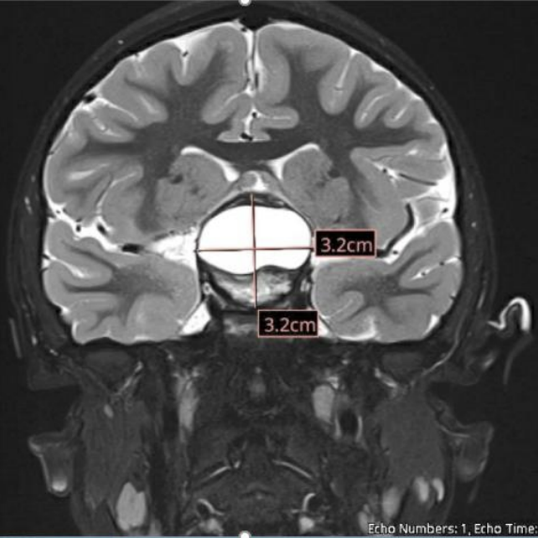
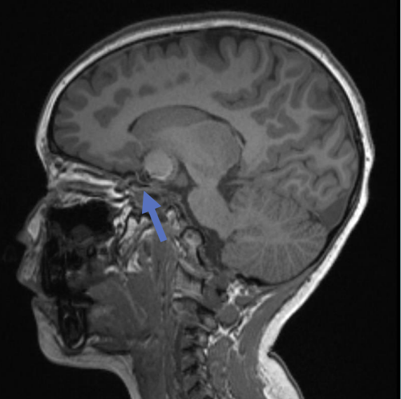
MRI Brain
She was sent to the Emergency Room for urgent neuroimaging
MRI demonstrated a 3.5 cm sellar/suprasellar mass with mixed solid and cystic components
Evaluated by neurosurgery
Endocrinology was consulted given concern for pituitary/hypothalamic dysfunction based on the nature of the lesion.
Coronal T2 Gat Suppressed Post-Contrast
Sagital T2 fat-suppressed pre-contrast.
Blue arrow marks the optic chiasm.

Slide 16
Treatment
Resection of the suprasellar mass is indicated if it is found to be causing compression of the optic nerves
Neuroendocrinology consult is essential given associated hormonal derangements

Slide 17
Endocrine workup
Prolactin: Normal prolactin level, low concern for prolactinoma
Thyroid: biochemically euthyroid
Gonadal axis: Possible early puberty based on ratio of LH/FSH levels
Growth hormone: IGF1 levels
Antidiuretic hormone: Will be monitored for Diabetes Insipidus following surgery.

Slide 18
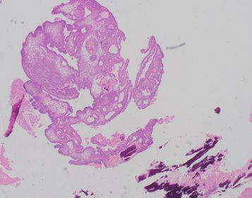
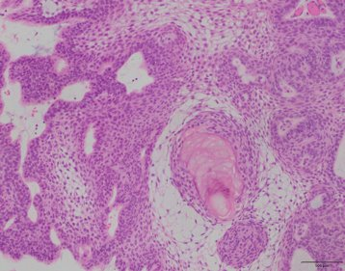
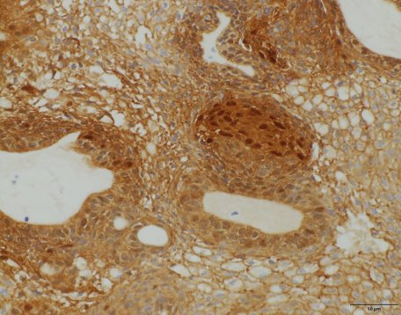
Mass was surgically resected and submitted to pathology.
Beta-catenin stain
Gross pathology and presence of nuclear beta-catenin stain consistent with adamantinomatous craniopharyngioma (predominant pediatric variant).
Courtesy of Dr. Hart Lidov at Boston Children’s Hospital

Slide 19
Craniopharyngioma
A rare and slow growing CNS tumor that arises from the remnants of Rathke’s pouch
Incidence is approximately 1/500,000
A bimodal distribution, with one peak in children aged 5–14 years, and a second peak in adults aged 65–74 years
Two subtypes by histology: Adamantinomatous (ACP) and Papillary (PCP)
Presenting symptoms can include headache, nausea/vomiting and vision loss
Craniopharyngioma mainly causes visual impairment by direct infiltration and/or compression of the visual pathway
Notes:
Martinez-Gutierrez JC, D'Andrea MR, Cahill DP, Santagata S, Barker FG 2nd, Brastianos PK. Diagnosis and management of craniopharyngiomas in the era of genomics and targeted therapy. Neurosurg Focus. 2016 Dec;41(6):E2. doi: 10.3171/2016.9.FOCUS16325. PMID: 27903124.

Slide 20
Visual recovery
Wan et al evaluated a cohort of children with craniopharyngiomas noted significant visual decline after diagnosis in about 30% of the patients. Much of the visual decline occurred shortly after diagnosis, but the vision could continue deteriorating over the course of years.
Risk factors for visual decline include:
Younger age at diagnosis (<10 years)
Optic nerve edema
Tumor recurrence
Notes:
Nuijts MA, Veldhuis N, Stegeman I, van Santen HM, Porro GL, Imhof SM, Schouten–van Meeteren AY. Visual functions in children with craniopharyngioma at diagnosis: a systematic review. PloS one. 2020 Oct 1;15(10).
Wan MJ, Zapotocky M, Bouffet E, Bartels U, Kulkarni AV, Drake JM. Long-term visual outcomes of craniopharyngioma in children. Journal of neuro-oncology. 2018 May;137(3):645-51.

Slide 21
Clinical course
Developed multiple endocrinopathies after her surgery and was started on hormone replacement
  Diabetes insipidus, adrenal insufficiency, central hypothyroidism, and growth hormone deficiencies.
Visual acuity improved to 20/25 bilaterally. She had stable bitemporal hemianopia and stable nystagmus.

Slide 22
Summary
See-saw nystagmus accompanied by bitemporal hemianopia can be the presenting sign for a chiasmal lesion such as a craniopharyngioma
There are bimodal peaks for age of presentation in childhood and adulthood
Endocrine evaluation is essential given frequently associated hormonal dysregulation. This is a source of morbidity and mortality
Visual recovery after resection is associated with chronicity and presence of optic atrophy
Notes:
https://www.nature.com/articles/s41582-020-0359-x

Slide 23
References
Helmchen C, Rambold H, Fuhry L, Buttner U. Deficits in vertical and torsional eye movements after uni- and bilateral muscimol inactivation of the interstitial nucleus of Cajal of the alert monkey. Exp Brain Res 1998;119:436-452.
Martinez-Gutierrez JC, D'Andrea MR, Cahill DP, Santagata S, Barker FG 2nd, Brastianos PK. Diagnosis and management of craniopharyngiomas in the era of genomics and targeted therapy. Neurosurg Focus. 2016 Dec;41(6):E2.
Nuijts MA, Veldhuis N, Stegeman I, van Santen HM, Porro GL, Imhof SM, Schouten–van Meeteren AY. Visual functions in children with craniopharyngioma at diagnosis: a systematic review. PloS one. 2020 Oct 1;15(10).
Quisling S, Kardon RH. See-Saw Nystagmus: 64-year-old male who first noted the onset of oscillopsia five months prior to presentation. EyeRounds.org. February 21, 2005; Available from: http://webeye.ophth.uiowa.edu/eyeforum/case23.htm.
Rambold H, Helmchen C, Buttner U. Vestibular influence on the binocular control of vertical-torsional nystagmus after lesions in the interstitial nucleus of Cajal. Neuroreport, 2000;11:779-784.
Wan MJ, Zapotocky M, Bouffet E, Bartels U, Kulkarni AV, Drake JM. Long-term visual outcomes of craniopharyngioma in children. Journal of neuro-oncology. 2018 May;137(3):645-51.

