Slide 1
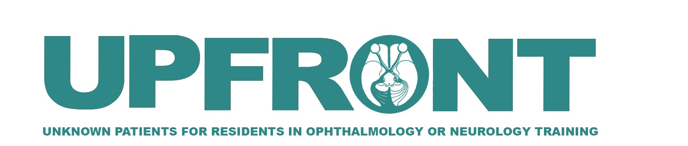

A Challenging Case of Progressive Bilateral Optic Neuropathy
Marko Oydanich, MD, MS
Roger E. Turbin, MD
Larry Frohman, MD
Department of Ophthalmology & Visual Science,
Rutgers New Jersey Medical School

Slide 2
53 year-old female presenting with right then left eye blurry vision & diplopia
Initially presented with right then left-sided blurry vision roughly separated by two weeks
Right eye blurry vision started as a lateral, right-sided scotoma that progressively worsened
Did not have any pain with extraocular movements, headaches, neck pain, or pulsatile tinnitus
Believed to have optic neuritis at the time and treated with high-dose IV steroids before being referred to neuro-ophthalmology

Slide 3
53 year old female with bilateral vision loss
PMH: heart murmur
POH: none
Medications: Ritalin
Family Hx: Father with history of cancer, mother with iron deficiency anemia. Many members with diabetes. No family history of vision loss or multiple sclerosis
Social Hx: Works as secretary, denies alcohol, tobacco, or illicit drug use

Slide 4
53 year old female with bilateral vision loss
ROS
(+) Diplopia
(+) Muscle cramps
(-) Headache
(-) Eye pain
(-) Lethargy
(-) Weakness
(-) Fevers
(-) Transient visual
obscurations

Slide 5
Initial Evaluation by Neuro-Ophthalmology
Visual acuity (best-corrected): 20/30+, 20/100+
Pupils: +1 left RAPD
IOP: 15, 15
Ishihara Color plates: R: 5/6, L: 4/6
EOMs: Full ductions, no pathologic nystagmus
Alternative cover: normal with flick of exotropia in up-gaze in right eye, otherwise orthophoric
Slit-lamp exam:
  R: Normal lids, white and quiet conjunctiva, basement membrane changes, deep and quiet AC, iris normal, lens clear
  L: Normal lids, white and quiet conjunctiva, basement membrane changes, deep and quiet AC, iris normal, lens clear
Dilated fundus exam:
  R: Vitreous cells present, optic pallor with hazy elevation, venous sheathing, inferiorly displaced peripheral white spots
  L: Vitreous cells present, optic pallor with hazy elevation, hard exudates present in macula, venous sheathing, peripheral white spots

Slide 6
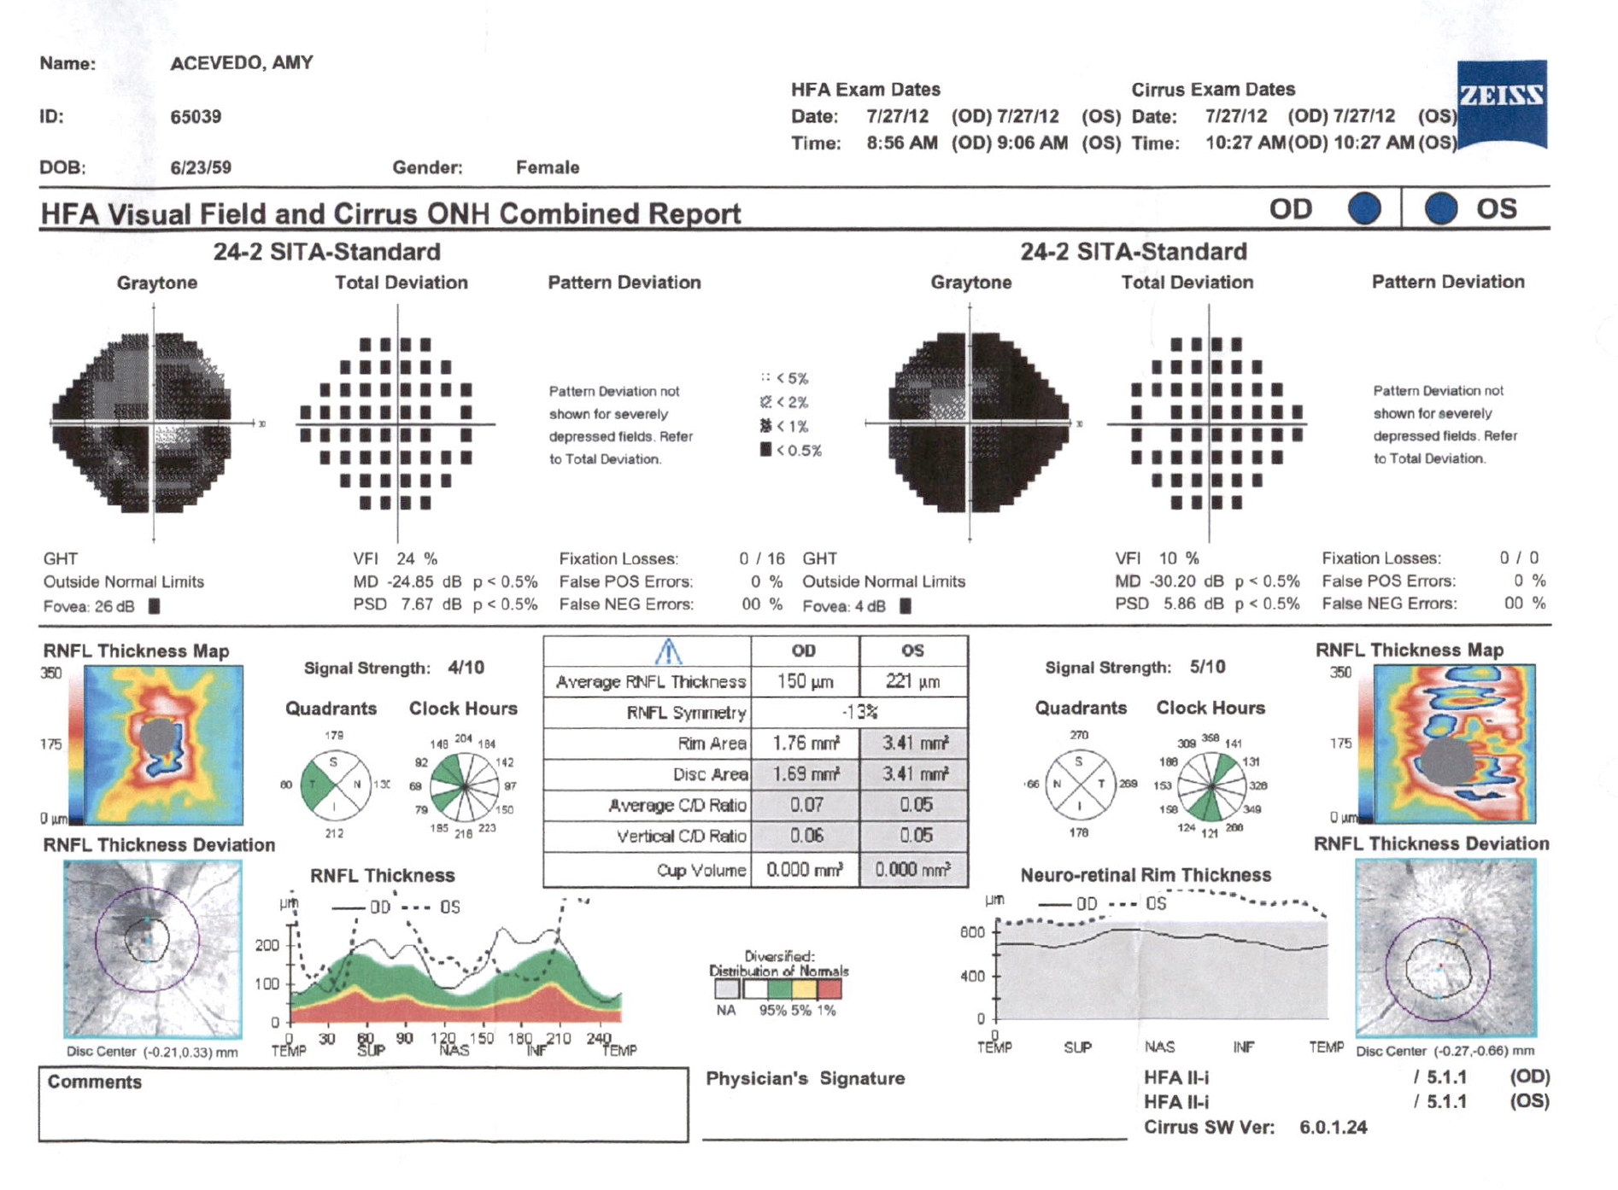
Initial HVF & OCT Testing
Significant visual field depression of both eyes associated with optic disc elevation as shown by RNFL thickness

Slide 7
What is the differential diagnosis of this case?

Slide 8
Differential Diagnoses
Infectious
  Bartonella (Cat-Scratch Disease)
  Tuberculosis
  Neurosyphilis
  Lyme
Autoimmune
  Sarcoid optic neuropathy / Neurosarcoidosis
  Lupus optic neuropathy
Vasculitis
  Giant cell arteritis
  Granulomatosis with polyangiitis
Lymphoproliferative disease
  Infiltrative optic neuropathy
  EBV associated lymphomatous granulomatosis
Given this differential, what workup would you order?

Slide 9
Lab Results
PT/PTT: 14.7 (ref:11.9 - 14.1)
INR: 1.18 (ref: 0.89 – 1.11)
ACE: 56 (normal)
Lyme: negative
RPR: negative
Vitamin B12: 784 (normal)
Folate: 19.2 (normal)
NMO: negative
ANA: negative
SSA/SSB: negative
Anti-dsDNA: negative
Anticardiolipin Ab: negative
Beta-2-glycoprotein: negative
Quantiferon gold: negative
Any neuroimaging?

Slide 10
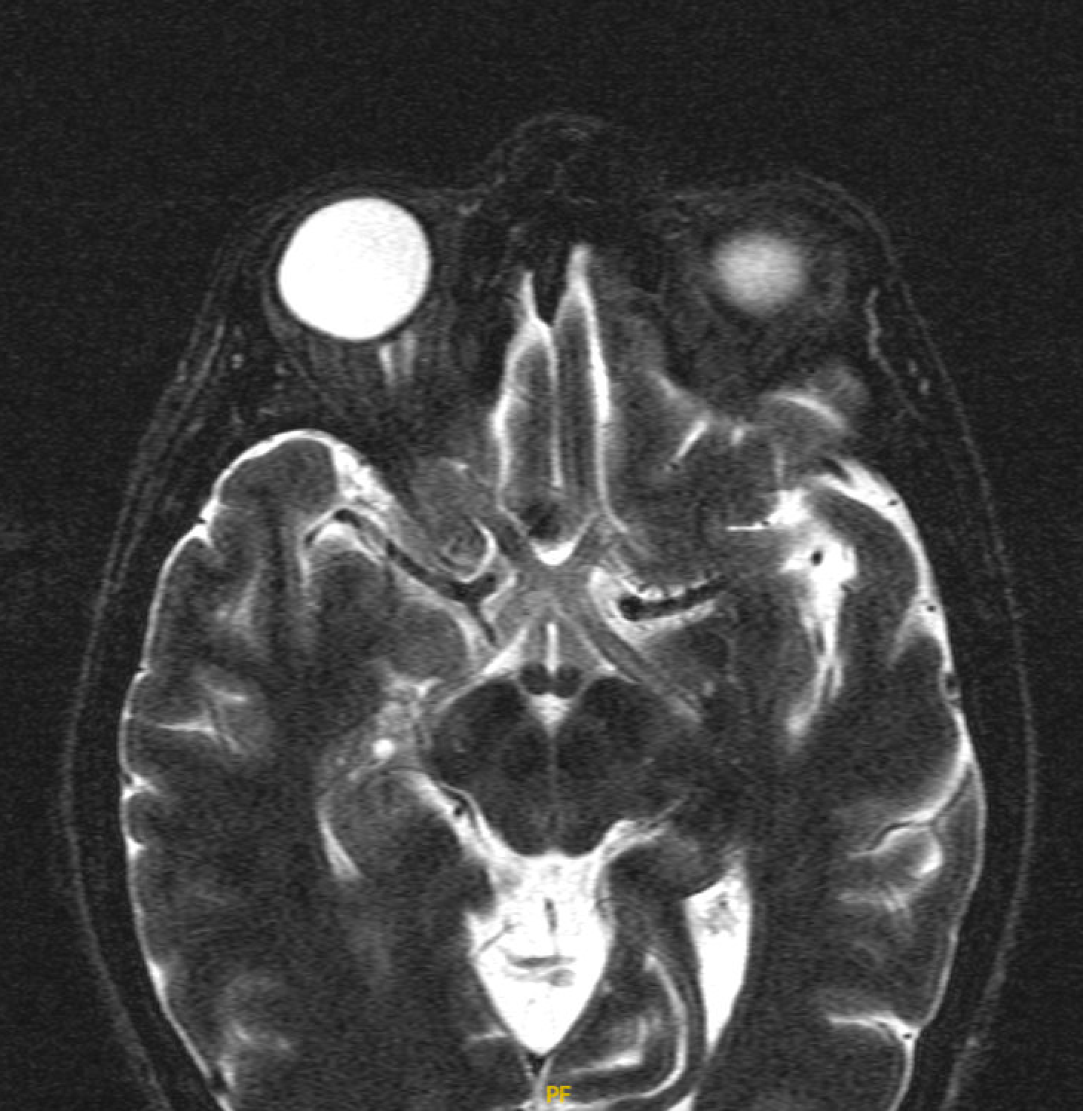
Imaging: MRI Orbits With & Without Contrast
There was increased T2 signaling of pre-chiasmal optic nerves, optic chiasm, and optic tracts.

Slide 11
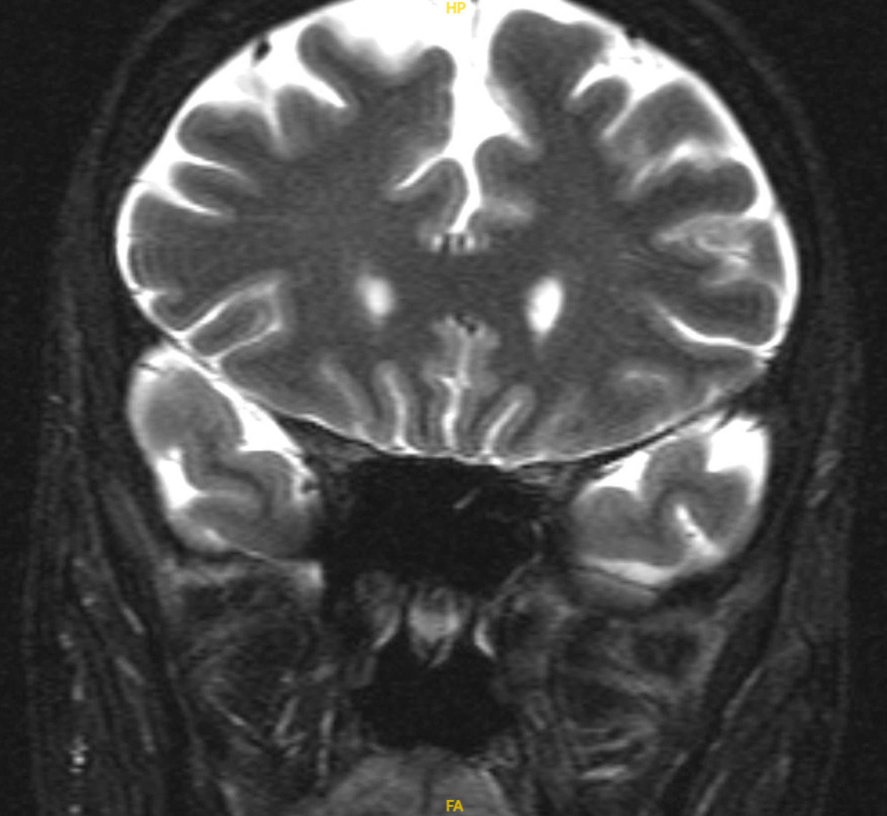
Imaging: MRI Orbits With & Without Contrast
There was mild enhancement along the periphery of the optic chiasm and along the intraconal right optic sheath. Lacrimal glands were symmetric and normal in size.

Slide 12
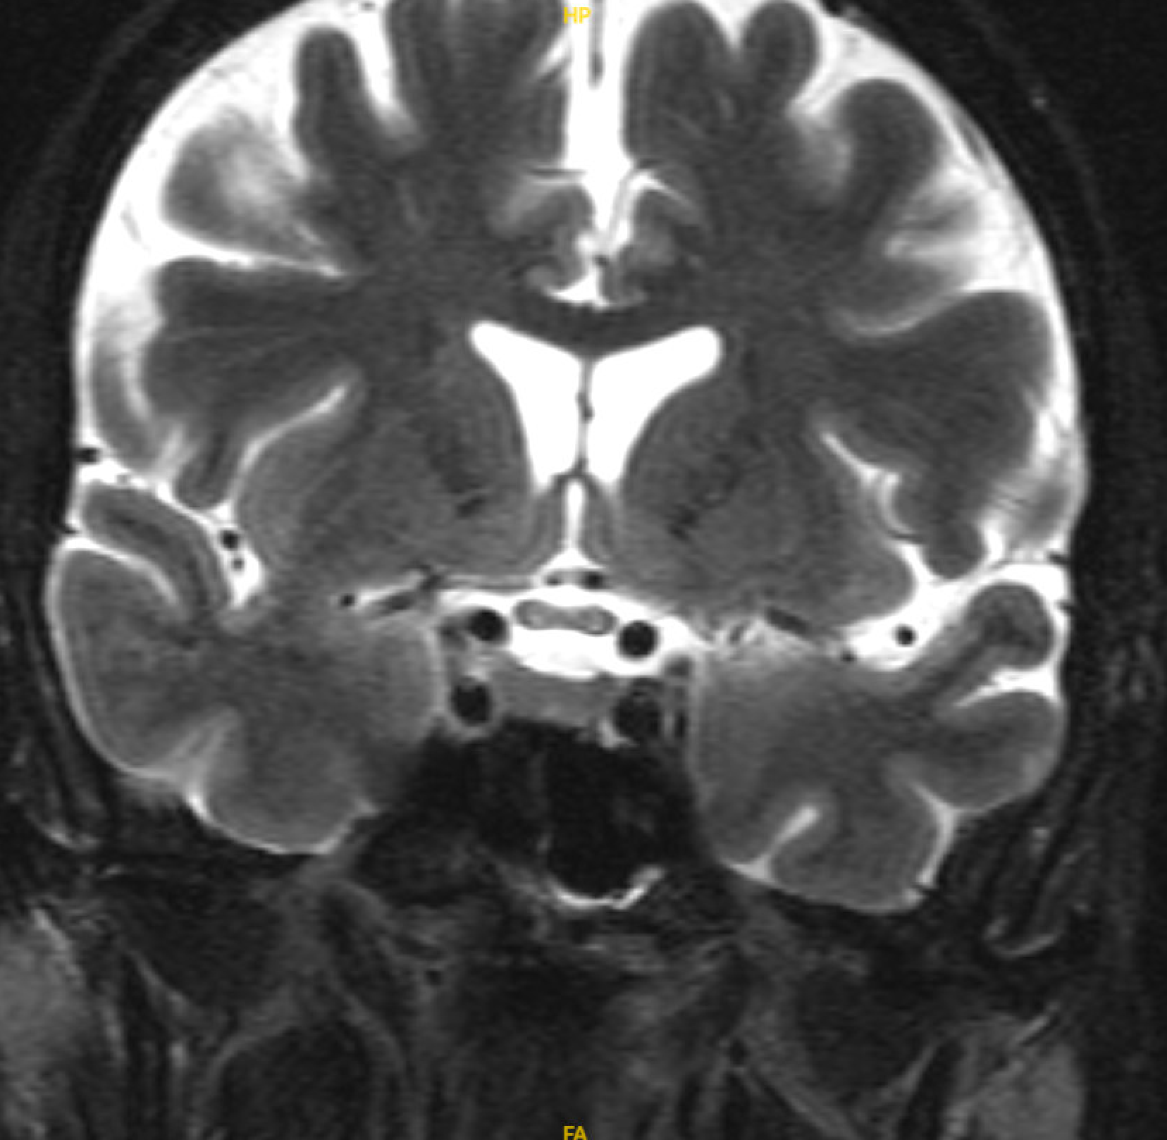
Imaging: MRI Orbits With & Without Contrast
Given the findings of this MRI study, what other tests do you want to get?

Slide 13
Lumbar Puncture
Opening pressure not measured
CSF
  Appearance: Clear
  Color: Colorless
  RBC: 1
  WBC: 4
  Glucose: 56 (ref: 50-80)
  Protein: 38 (ref: 15-45)
  Basic myelin protein: 1.12 (ref: 0.00-1.10)
  IgG: No oligoclonal bands
Overall unremarkable lumbar puncture
Any other testing?

Slide 14
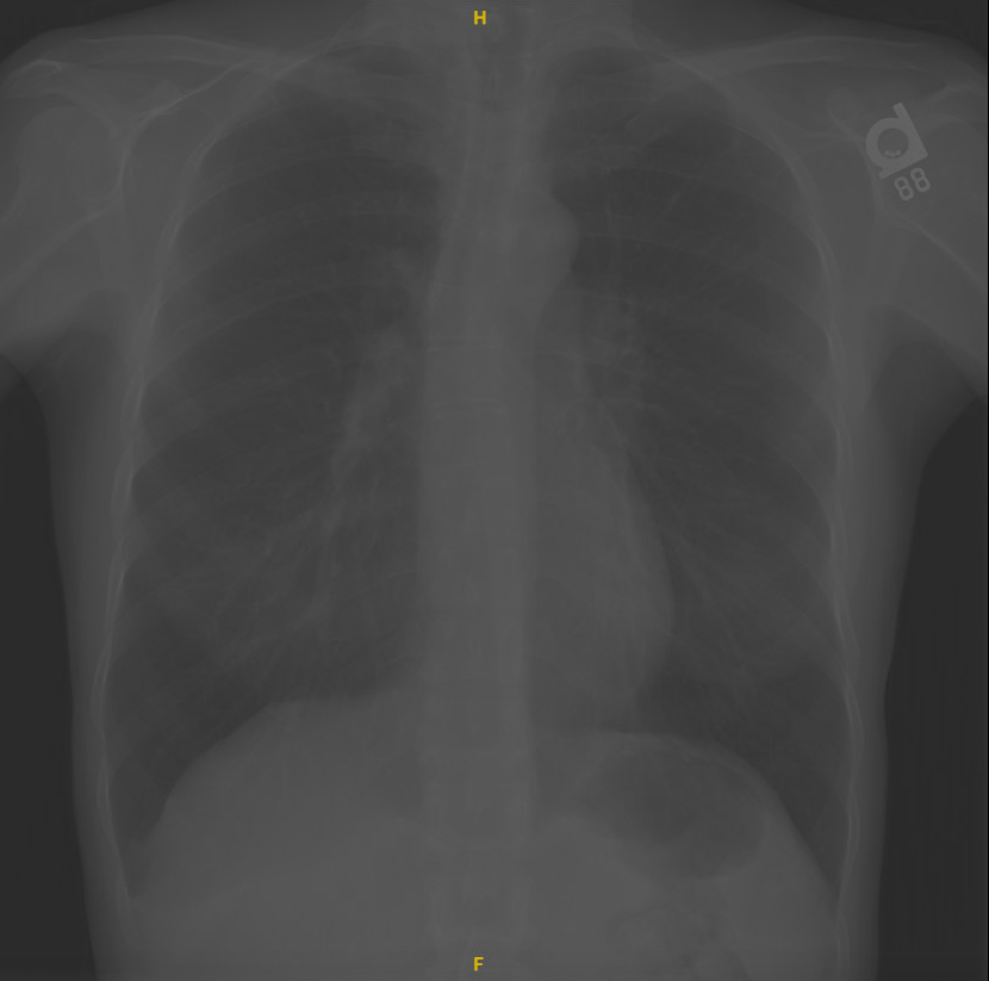
Chest X-Ray
No evidence of hilar or mediastinal lymphadenopathy. Normal cardiac silhouette. No evidence pulmonary consiolidation, pneumothorax, or pleural effusion.
What other testing would you like to get?

Slide 15
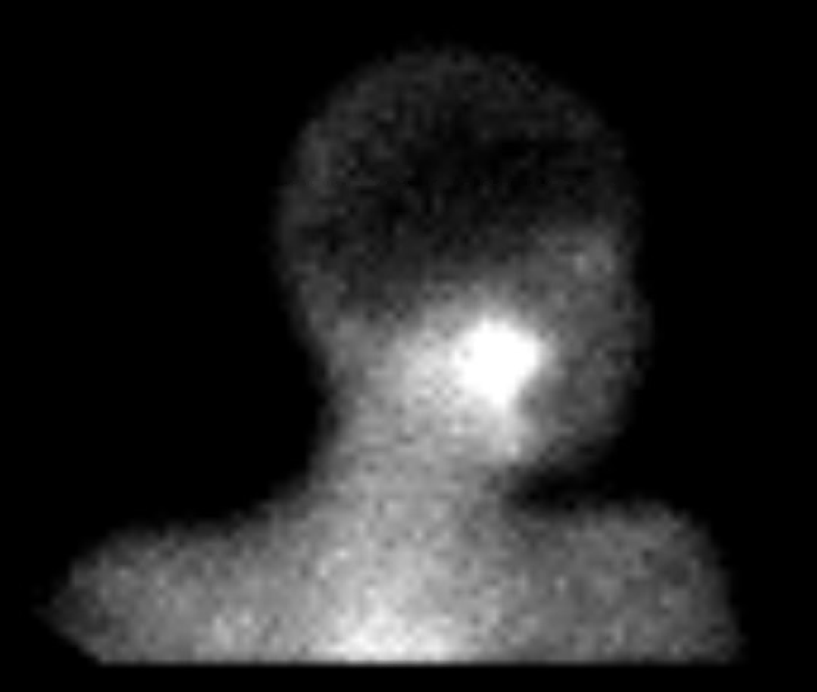
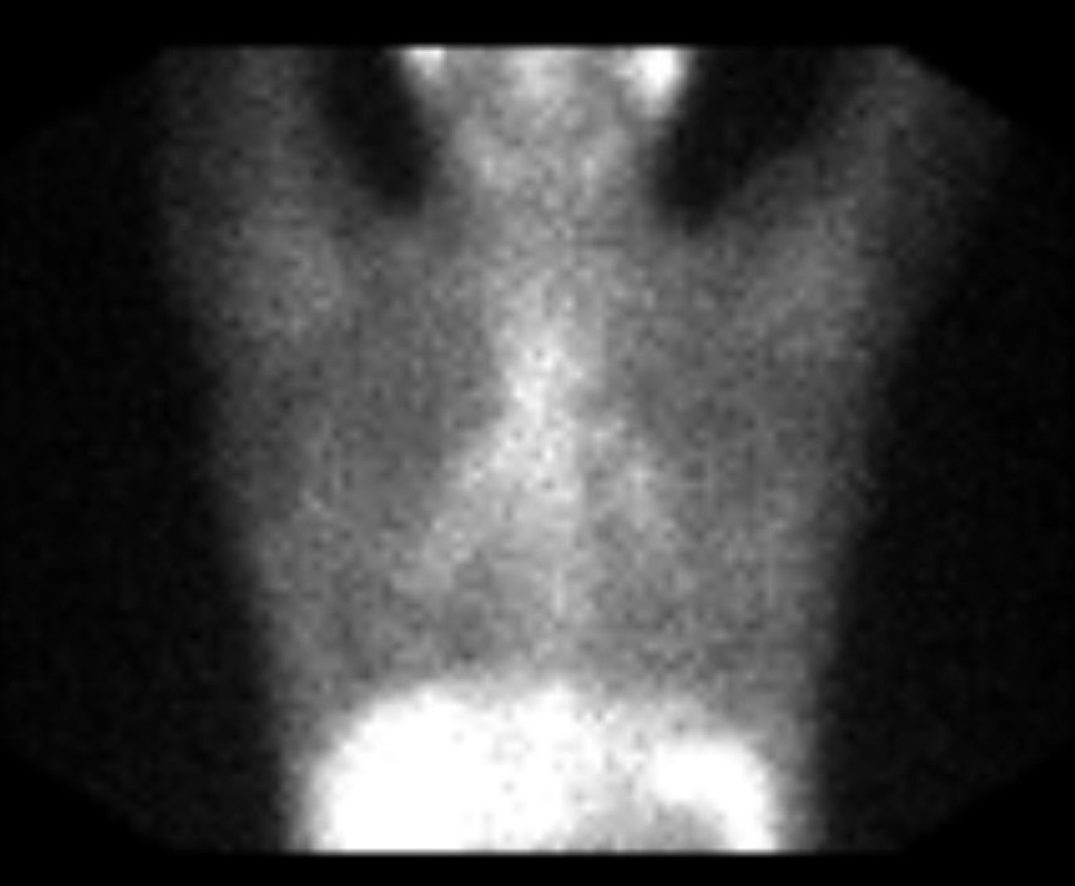
Gallium Scan
Moderately increased radiotracer uptake in parotid and submandibular glands. Intense radiotracer uptake in the right paratracheal and bilateral hilar lymph nodes. Given all this information, what is your differential diagnosis?

Slide 16
Final Diagnosis
Sarcoid Optic Neuropathy

Slide 17
Hospital Course
Plan:
  Given results of the gallium scan, patient was referred to a pulmonologist with expertise in sarcoidosis with plans to proceed with ultrasonographic biopsy of the parotid glands. However, tissue was unable to be harvested from the parotid gland and plans were subsequently made to proceed with a mediastinal biopsy
  On close follow-up, patient was found to have worsening VF MD in her left eye (-25.63 to -29.48) with no change in visual acuity or worsening optic disc edema and was started on 120mg of prednisone for 3 days then decreased to 80mg with follow-up in one week
  At follow-up patient’s clinical status was stabilized and was kept on 80mg of prednisone until the mediastinal biopsy was successfully completed

Slide 18
Hospital Course
Plan:
  While awaiting the results of the mediastinal lymph node biopsy, the patient presented with worsening vision in the left eye (now CF). The patient was urgently sent to the ED for treatment
  In emergent cases like this it is typical to use either cyclophosphamide or infliximab for a rapid response. IV cyclophosphamide was ultimately used to treat the underlying optic neuropathy due to insurance coverage
  Upon follow-up, she was deemed clinically stable, and referred to rheumatology
  She was placed on a prednisone taper and was started on oral cyclophosphamide with stability of her clinical exam for the next 5 months
  She was ultimately transitioned to oral mycophenolate while being maintained on low dose prednisone

Slide 19
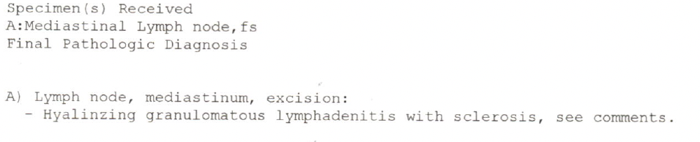
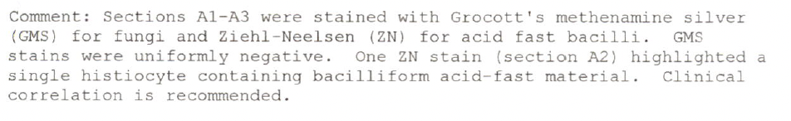
Biopsy Results
Biopsy of the mediastinal lymph node with confirmation of granulomatous reaction with sclerosis, consistent with sarcoidosis.
There was concern for possible TB due to one stain of acid-fast bacteria, however, this was subsequently ruled out due to lack of clinical correlation.

Slide 20
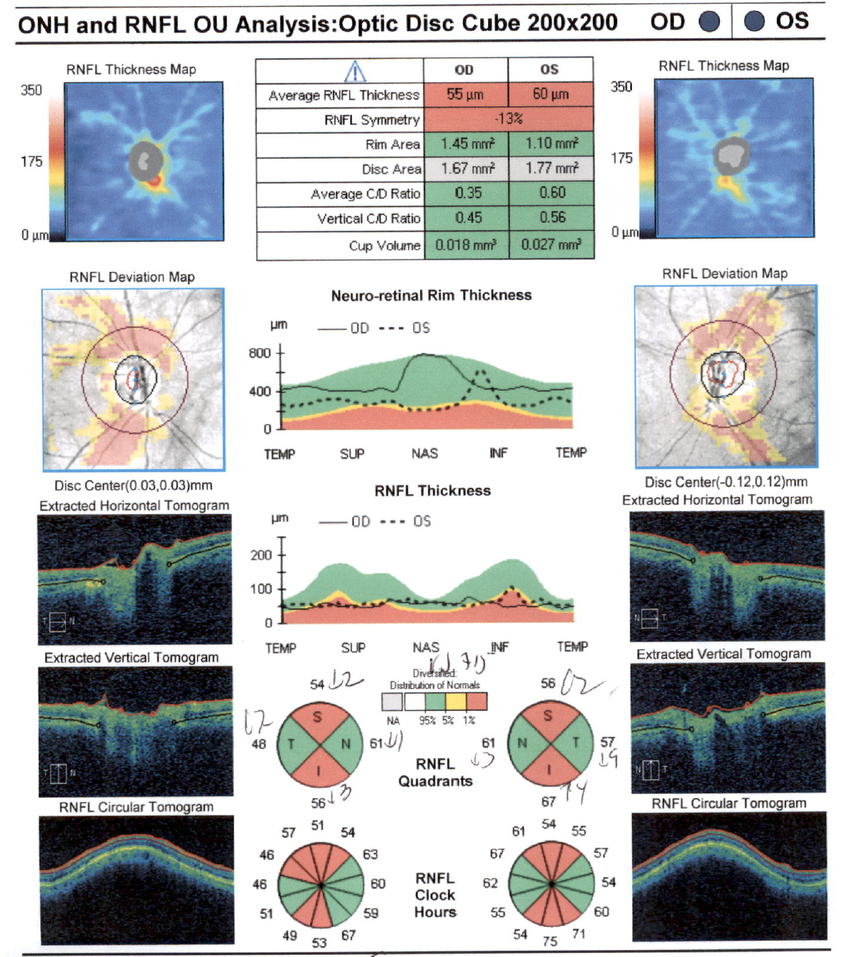
Post-Treatment Clinical Testing
Regression of optic disc elevation is appreciated, now with superior and inferior RNFL atrophy. Atrophy has stabilized over the last several OCT-n exams

Slide 21
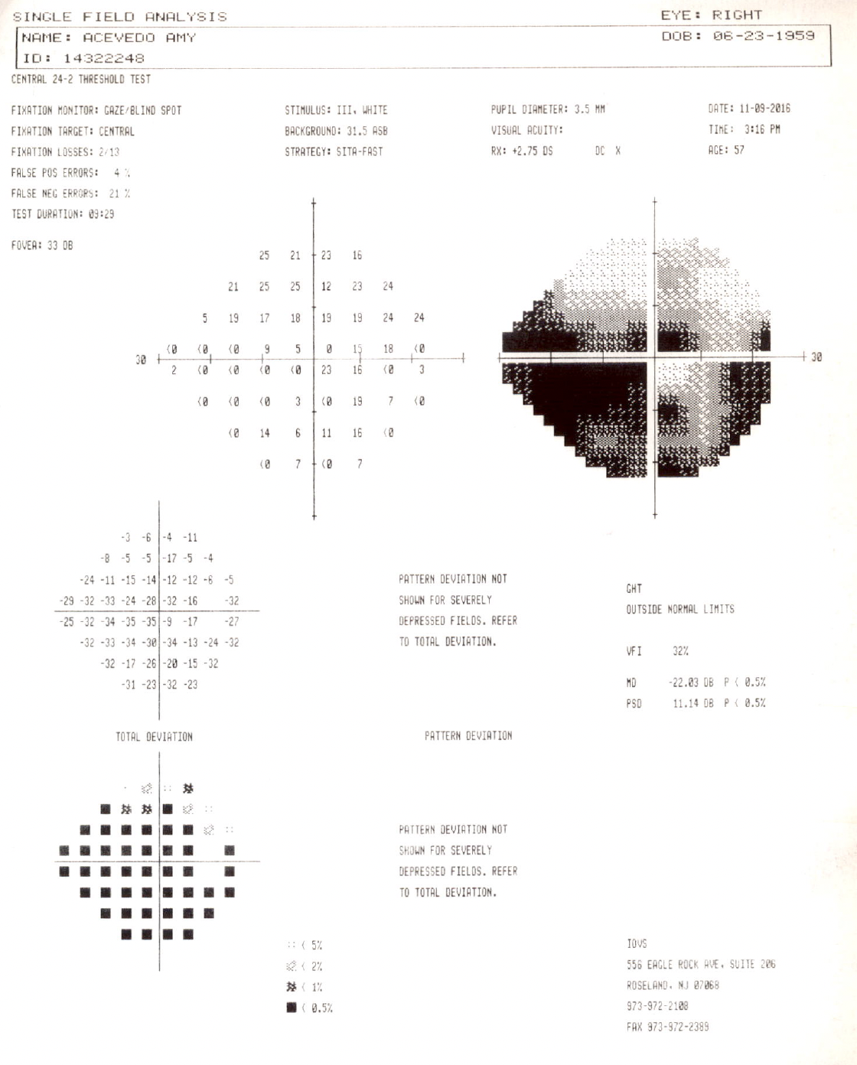
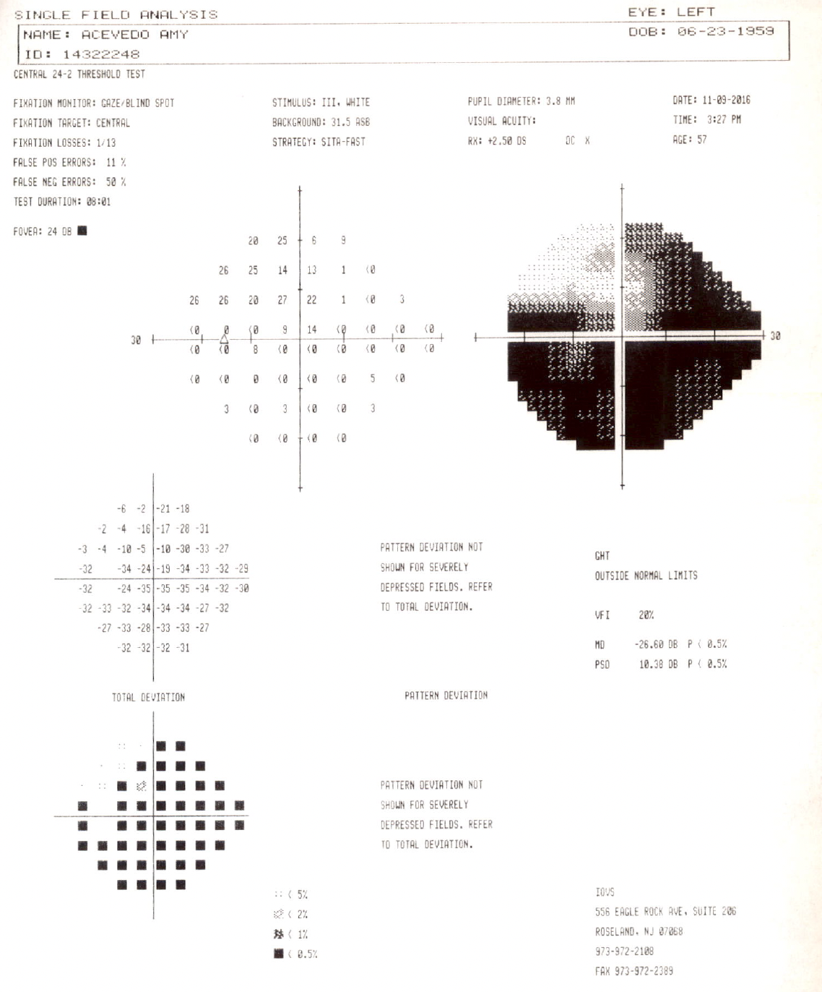
Post-Treatment Clinical Testing
Improved visual field results following treatment with no progression since treatment.

Slide 22
Neurosarcoidosis & Sarcoid Optic Neuropathy
Sarcoidosis is a chronic, autoimmune condition characterized by non-caseating granulomas that can affect many organs. When it affects the CNS, it is termed neurosarcoidosis
Ocular involvement: anterior uveitis, intermediate uveitis, periphlebitis, cranial neuropathies (CN VII is most common)
Recent consensus and agreement amongst uveitis specialists has established extensive criteria for the the diagnosis of ocular sarcoidosis involving clinical, radiographic, and tissue factors (Mochizuki et al. 2019)

Slide 23
Etiology & Epidemiology
Etiology: unknown but involves formation of non-caseating granulomas due to autoimmune, abnormal activation of Th1 cells
Incidence in U.S.
  Caucasian: 11 in 100,000
  African American: 36 in 100,000
  Most commonly seen in African-American females
Often presents in 3rd – 5th decade of life
5-10% of patient has some form of neurological involvement, including both CNS and PNS

Slide 24
Management & Treatment of
Sarcoid Optic Neuropathy
Usually requires multidisciplinary management including neuro-ophthalmologists, rheumatologists, and pulmonologists
First-line treatment involves oral corticosteroids, IV corticosteroids are reserved for severe presentations
If resistant or clinically worsening, can use short-term dosing of either cyclophosphamide or infliximab for a rapid response. Long term use of these medications, especially cyclophosphamide, is not advised given possibility for harmful side effects
Further treatment can include methotrexate, azathioprine, TNF-⍺ inhibitors (infliximab/adalimumab), IL-6 inhibitors (tocilizumab), and JAK inhibitors (tofacitinib)
Many argue that neurosarcoidosis often requires a two drug treatment with both steroids and another well-tolerated immunosuppressive agent such as azathioprine, methotrexate, or mycophenolate

Slide 25
Use of Cyclophosphamide (Cytoxan) to Treat Sarcoid Optic Neuropathy
Cyclophosphamide has been shown to be effective as a short-term treatment in a small cohort of patients with refractory ocular sarcoidosis (Doty et al. 2003)
Cyclophosphamide followed by a short course of infliximab has been shown to clinically stabilize one patient with intracranial relapse of neurosarcoidosis and worsening of her optic neuropathy(Kidd et al. 2016)
Overall, given that most patients respond well to corticosteroids, use of cyclophosphamide is a rather rare occurrence in an already rare ophthalmic disease

Slide 26
Back to the case: Clinical Course
After being clinically stable for over a year on mycophenolate & prednisone, patient was slowly tapered off both of those agents without any further progression of disease
Ultimately, she moved out of state but a phone conversation after 12 years indicated that her vision had remained stable with no further attacks

Slide 27
Summary: Sarcoid optic neuropathy can present and progress rapidly requiring decisive treatment and transitioning to other agents if no clinical stability is observed
Cyclophosphamide (Cytoxan) can be used in patients with steroid-resistant neurosarcoidosis for a rapid treatment response with transition to more tolerable immuno-suppressants after stabilization of symptoms and the state of the disease

Slide 28
References
Iannuzzi MC, Fontana Jr. Sarcoidosis: clinical presentation, immunopathogenesis, and therapeutics. JAMA. 2011;305:391-9.
Rybicki BA, Iannuzzi MC. Epidemiology of sarcoidosis: recent advances and future prospects. Semin Respir Crit Care Med. 2007;28:22-35
Pirau L, Lui F. Neurosarcoidosis. [Updated 2023 Jul 3]. In: StatPearls [Internet]. Treasure Island (FL): StatPearls Publishing; 2024 Jan-. Available from: https://www.ncbi.nlm.nih.gov/books/NBK534768/
Segal B. Neurosarcoidosis: diagnostic approaches and therapeutic strategies. Curr Opin Nuerol. 2013;26(3):307-13.
Tana C, Wegener S, et al. Challenges in the diagnosis and treatment of neurosarcoidosis. Ann med. 2015;47(7):576-91.
Michael J. Bradshaw, Siddharama Pawate, Laura L. Koth, Tracey A. Cho, Jeffrey M. GelfandNeurol Neuroimmunol Neuroinflamm Nov 2021, 8 (6) e1084; DOI: 10.1212/NXI.0000000000001084
Kidd DP, Burton BJ, Graham EM, Plant GT. Optic neuropathy associated with systemic sarcoidosis. Neurol Neuroimmunol Neuroinflamm. 2016 Aug 2;3(5):e270. doi: 10.1212/NXI.0000000000000270. PMID: 27536707; PMCID: PMC4972000.
Doty JD, Mazur JE, Judson MA. Treatment of corticosteroid-resistant neurosarcoidosis with a short-course cyclophosphamide regimen. Chest. 2003 Nov;124(5):2023-6. doi: 10.1378/chest.124.5.2023. PMID: 14605084.
Frohman, L. Treatment of neuro-ophthalmic sarcoidosis. J Neuroophthalmol. 2015 Mar;35(1):65-72.
Mochizuki M, Smith JR, Takase H, Kaburaki T, Acharya NR, Rao NA; International Workshop on Ocular Sarcoidosis Study Group. Revised criteria of International Workshop on Ocular Sarcoidosis (IWOS) for the diagnosis of ocular sarcoidosis. Br J Ophthalmol. 2019 Oct;103(10):1418-1422. doi: 10.1136/bjophthalmol-2018-313356. Epub 2019 Feb 23. PMID: 30798264.
Notes:
Added a reference

