Slide 1

Screening eye exam in a 9-year-old female with congenital renal dysplasia
UPFRONT CASE
Jebgy V. Vargas, BS
California University of Science and Medicine
Dhruva (Drew) Gupta, BS
Harvard Medical School
Catherine S. Choi, MD
Boston Medical Center / Boston University School of Medicine
Eric D. Gaier, MD, PhD
Boston Children’s Hospital / Harvard Medical School
Notes:
This UPFRONT case is titled “Screening Eye Exam in a 9-year-old Female with Congenital Renal Dysplasia”.
My name is Jebgy Vargas, and I am a medical student at California University of Science and Medicine.

Slide 2
9-year-old girl with history of congenital renal dysplasia presents for neuro-ophthalmic evaluation
Patient was born with bilateral cystic kidneys
She developed stage II chronic kidney disease
Pediatric ophthalmology screening revealed an optic nerve abnormality
She was later referred to neuro-ophthalmology for consultation
Notes:
A 9-year-old girl with a history of congenital renal dysplasia was born with bilateral cystic kidneys and developed stage 2 chronic kidney disease.
On a screening ophthalmic examination, an optic nerve abnormality was found, and this lead to a referral for neuro-ophthalmic consultation.

Slide 3
Past History
Past Ocular History
Hyperopia (OU)
Birth History
Prematurity, born at 31 weeks gestation due to premature rupture of membranes
Past Medical History
Congenital hip dysplasia
Failure to thrive
Facial dysplasia
Gross motor delay
Past Surgical History
Gastrostomy tube
Hernia repair
Tonsillectomy & adenoidectomy
Past Family History
Mother: Developmental hip dysplasia
Maternal Grandfather: Retinitis pigmentosa
Notes:
Her past ocular history includes bilateral hyperopia. She was born prematurely at 31 weeks. She has a history of congenital hip dysplasia, failure to thrive, gross motor delay. She is status post gastrostomy, hernia repair, tonsillectomy, and adenoidectomy. The patient’s mother also has developmental hip dysplasia, and her maternal grandfather has retinitis pigmentosa.

Slide 4
Initial Exam
 | Right Eye | Left Eye
Visual Acuity | 20/20 - 1 | 20/20 -2
Cycloplegic Refraction | +1.50 sphere | +1.50 sphere
Ishihara | 8/8 | 8/8
External Exam | Unremarkable
Pupils | Equal, round, and reactive to light with no relative afferent pupillary defect
Confrontation Visual Fields | Full to confrontation
Sensorimotor Exam | Unremarkable
Anterior Exam | Unremarkable
Notes:
Her initial exam was notable for low hyperopia in both eyes; the rest of her exam was unremarkable with full Ishihara color plate testing.

Slide 5
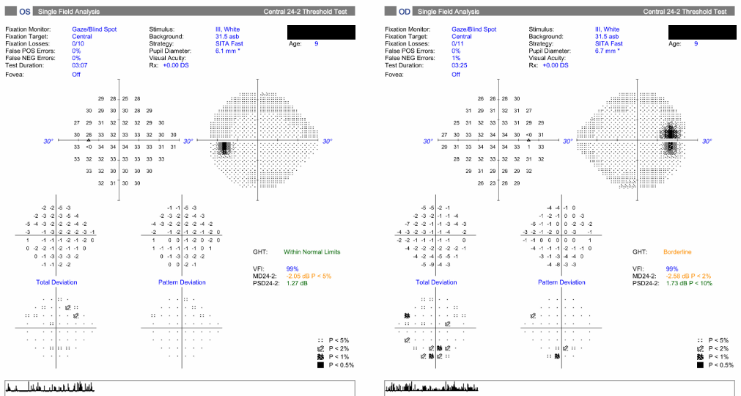
Visual Fields
Impression:
Reliable, both eyes
OD: mildly enlarged blind spot with mildly decreased sensitivity primarily inferiorly
OS: mildly decreased sensitivity diffusely
Notes:
Her visual fields were reliable, with the Right eye having a mildly enlarged blind spot and mild decreased sensitivity primarily inferiorly, and the Left eye having mild decreased sensitivity diffusely.

Slide 6
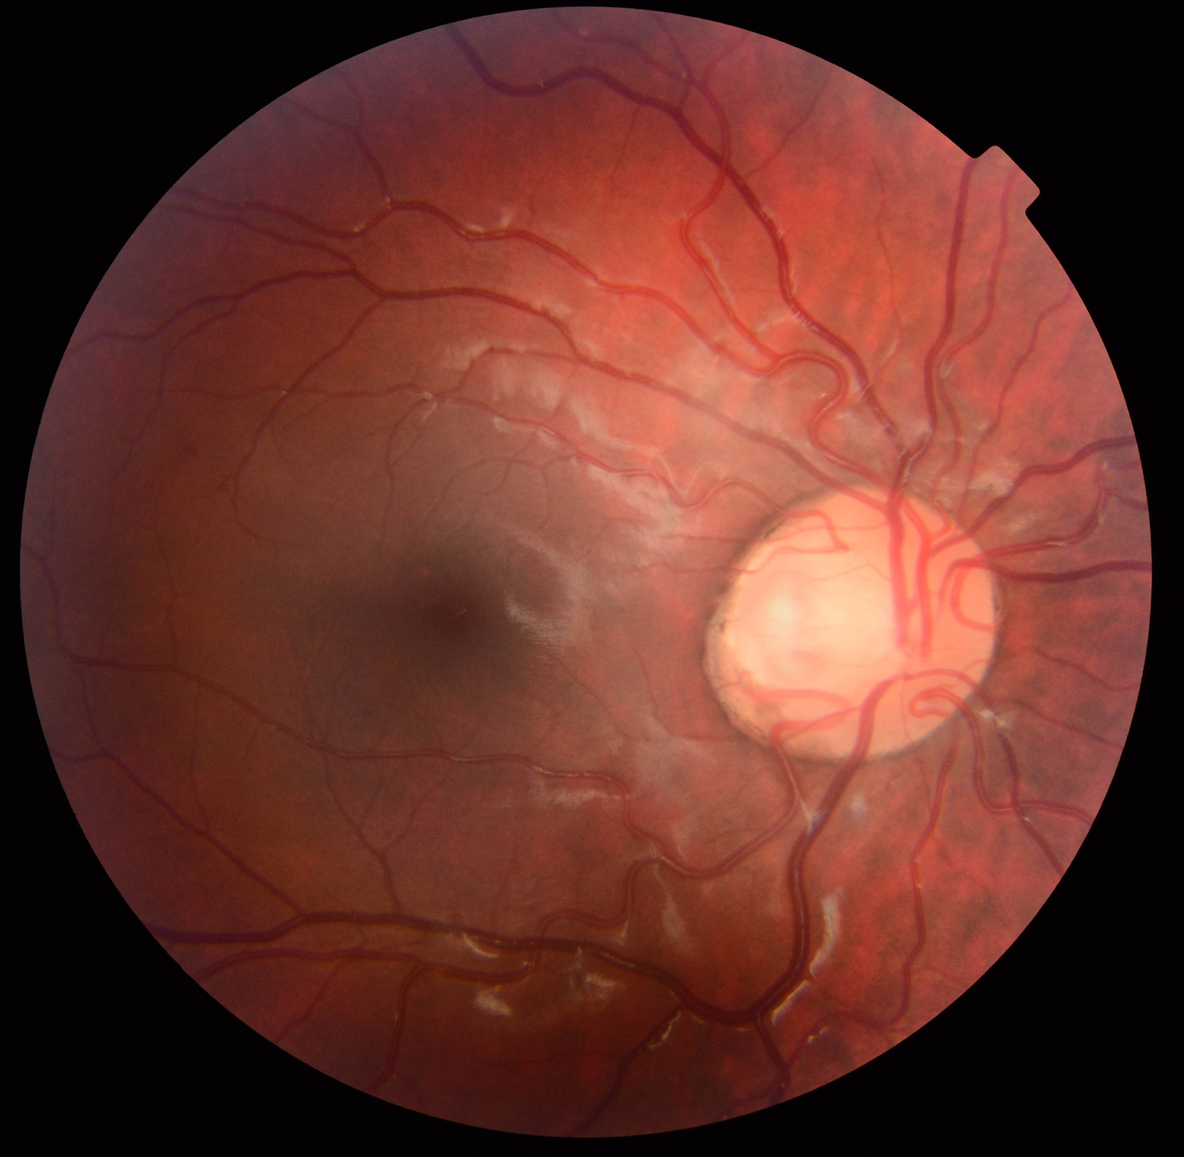
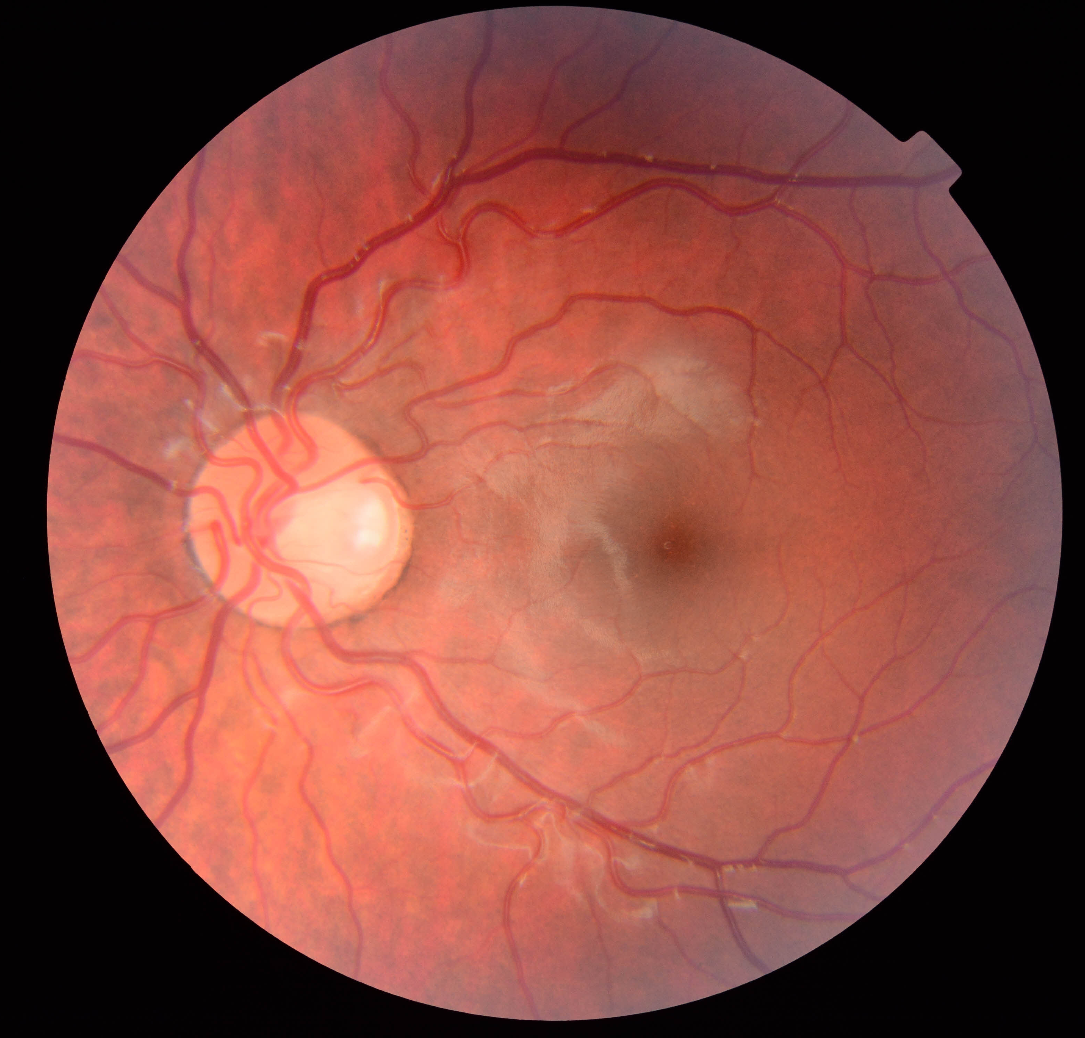
Fundus Photo
OD
OS
Notes:
Her optic discs, depicted here, both had large diameters with focal and deep areas of excavation temporally.

Slide 7
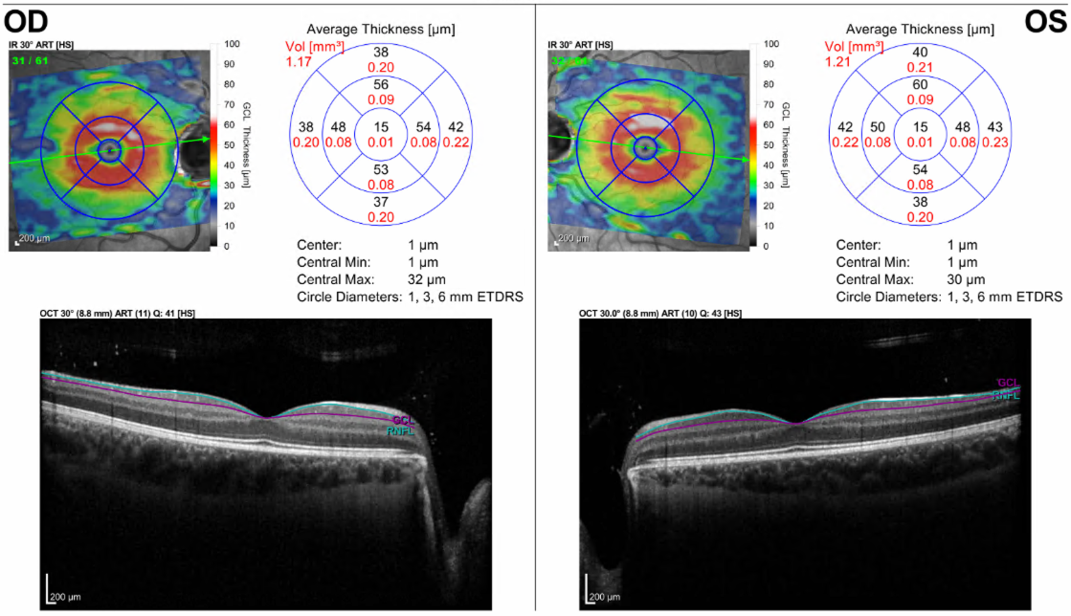
Optical Coherence Tomography
Macular Ganglion Cell Layer - Normal
(Retinal nerve fiber layer thickness measurement unreliable due to segmentation error)
Notes:
Her ganglion cell layer, segmented on OCT of the macula, was normal in both eyes.

Slide 8
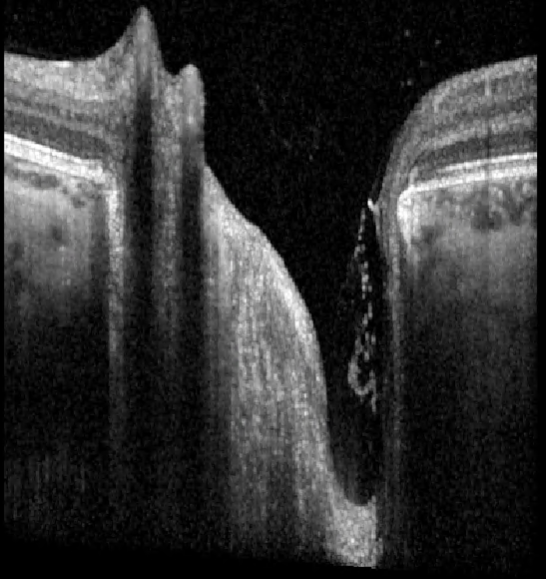
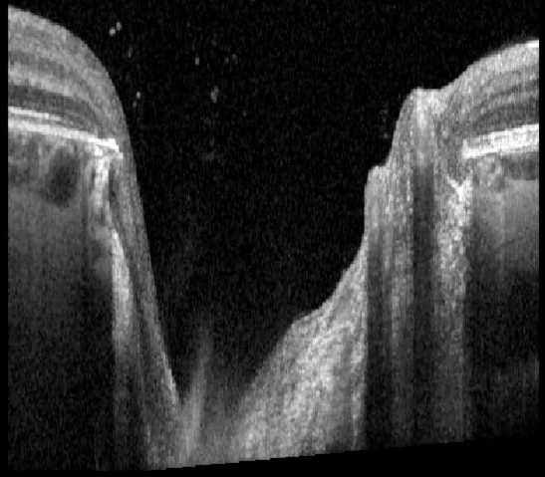
Optical Coherence Tomography
B-scan through the optic nerve head with enhanced depth of imaging
What is the optic nerve abnormality?
Notes:
OCT through the optic nerve heads with enhanced depth of imaging captured these foci of excavation, depicted in the b-scan images here.
What is the anatomic abnormality seen?
(pause for a few seconds)

Slide 9
Anatomic Diagnosis
Bilateral Optic Disc Pits
Notes:
The patient has bilateral optic disc pits.

Slide 10
Differential Diagnosis
Papillorenal Syndrome
Senior Løken Syndrome
Ciliopathies such as:
  Joubert Syndrome
  Bardet-Biedl Syndrome
What is the next step in the work-up?
Notes:
What underlying diagnoses could contribute to bilateral posterior pole abnormalities and congenital renal dysplasia?
Some possibilities include papillorenal syndrome, Senior Løken syndrome, and ciliopathies such as Joebert syndrome and Bardet-Biedl syndrome. Those ciliopathies are typically associated with retinal dystrophy, however, optic disc pits and/or coloboma can also be seen in some of these conditions.
What is the next step in the workup?

Slide 11
Genetic Testing
GeneDx PAX2 Sequencing and deletion/duplication analysis
Heterozygous c.79 T>C (Exon 2, NM_003990.3), p_Phe27Leu
In silico analysis supports this missense variant has a deleterious effect on protein structure/function; not previously published
Variant also seen on NextGen sequencing
Variant not identified in parents or other large database
Interpretation:
Novel, de novo, “likely pathogenic” variant
“The presence of this variant is consistent with the clinical features reported in this individual”
(Exome sequencing revealed no additional variants)
Notes:
A specific underlying genetic cause was suspected and confirmed through PAX2 sequencing and deletion duplication analysis which revealed a novel, de novo, heterozygous variant causing a missense change in Exon 2, predicted to be deleterious and likely pathogenic. This variant is consistent with the patient's clinical features.

Slide 12
Final Diagnosis
PAX2-related Papillorenal Syndrome with Bilateral Optic Disc Pits
Notes:
The final diagnosis is PAX2-related Papillorenal syndrome with bilateral optic disc pits.

Slide 13
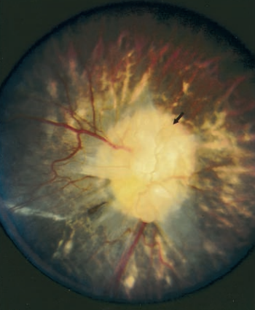
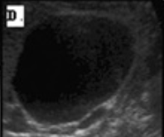

Papillorenal Syndrome
Source: Parsa CF, Silva ED, Sundin OH, Goldberg MF, De Jong MR, Sunness JS, Zeimer R, Hunter DG. Redefining papillorenal syndrome: an underdiagnosed cause of ocular and renal morbidity. Ophthalmology. 2001 Apr;108(4):738-49. doi: 10.1016/s0161-6420(00)00661-8. PMID: 11297491.
Autosomal dominant condition
Ophthalmologic Manifestations
  Wide range of visual impairments
  Superonasal visual field defects
  Optic disc abnormality is often the most reliable finding
Renal Manifestations
  Commonly develop end-stage renal disease
  Also hypoplastic kidneys, vesicoureteral reflux, and renal cysts
Source: Fletcher J, Hu M, Berman Y, Collins F, Grigg J, McIver M, Jüppner H, Alexander SI. Multicystic dysplastic kidney and variable phenotype in a family with a novel deletion mutation of PAX2. J Am Soc Nephrol. 2005 Sep;16(9):2754-61. doi: 10.1681/ASN.2005030239. Epub 2005 Jul 27. PMID: 16049068.
Renal ultrasound of an example patient showing increased size of a single cyst in a multicystic dysplastic kidney
Notes:
Papillorenal syndrome is an autosomal dominant condition with a wide range of visual consequences including superonasal visual field defects from developmental optic disc anomalies. Patients with papillorenal syndrome often develop end stage renal disease, hypoplastic kidneys, vesicoureteral reflux, and renal cysts.

Slide 14
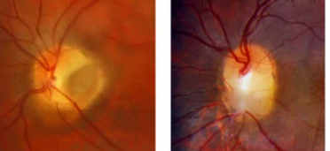
Optic Disc Anomalies in Papillorenal Syndrome
Example of Optic Disc Pit (P) and Optic Disc Coloboma (C)
Optic disc pit or coloboma
Excavation akin to “Morning Glory Disc Anomaly"
  Peripheral blood vessel emergence radiating outwards from disc
Abnormal central retinal vessels
  Absent or underdeveloped
Optic Disc Cyst
  Less common
P
C
Source: Cennamo G, Rinaldi M, Concilio M, Costagliola C. Congenital Optic Disc Anomalies: Insights from Multimodal Imaging. J Clin Med. 2024 Mar 6;13(5):1509. doi: 10.3390/jcm13051509. PMID: 38592429; PMCID: PMC10932420.
Notes:
Optic disc anomalies seen in papillorenal syndrome include optic disc pit or colobomas, excavations akin to "morning glory disc anomaly", absent or underdeveloped central retinal vessels, and less commonly, optic disc cysts.

Slide 15
Pathophysiology of Optic Disc Pit
Dysplastic retina overlying optic nerve that extends through defect in lamina cribrosa
Etiology
  Atypical coloboma vs excessive cupping
Associated with intraretinal fluid with multiple potential sources:
  Cerebral spinal fluid from retrobulbar subarachnoid space
  Vitreo-papillary traction
  Leaky blood vessels
Notes:
Optic disc pits are characterized by dysplastic retina overlying the optic nerves that extend through defects in the lamina cribrosa. The pathophysiology of optic disc pits is unknown, but may related to a form of coloboma or excessive cupping. Pits are associated with intraretinal fluid, the source of which is also unclear but could include cerebrospinal fluid from the retrobulbar subarachnoid space, vitreo-papillary traction, or leaky blood vessels.

Slide 16
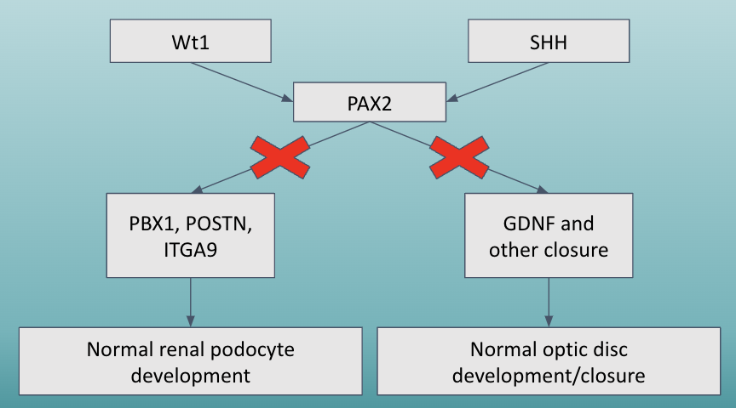
PAX2
Papillorenal syndrome is often caused by pathogenic variants in the PAX2 gene, which codes for a transcription factor
PAX2 is responsible for normal embryonic development, especially the eyes and kidneys
Notes:
Papillorenal syndrome is often caused by pathogenic variants on the PAX2 Gene which codes for a transcription factor. PAX2 is responsible for normal embryonic development, including of normal renal podocyte development and normal optic disc development and closure.

Slide 17
PAX2 Variants
>40 PAX2 variants have been identified and associated with papillorenal syndrome
  Nonsense, frameshift, and splice site variants; many are unique
  The insertion/frameshift mutation 619insG has been found in three separate, unrelated de novo cases, affecting the siblings but not the parents, suggesting germline mosaicism
    This region of 7 guanines is considered a mutation hotspot
Six identified variants were found in exon 2, such as in the patient in this case and the aforementioned 619insG mutation cases
  However, the variant of our patient is at a different position than those previously reported
Notes:
More than 40 PAX2 variants have been identified and associated with papillorenal syndrome, which lead to nonsense, frameshift, and splice site variants. There have been three unrelated de novo cases of insertions or frameshifts suggestive of germline mosaicism. Six identified variants were in Exon 2 such as in this patient and the three aforementioned cases. However, the variant in our patient is at a different position.

Slide 18
Genetic Heterogeneity
While commonly associated with PAX2 variants, papillorenal syndrome is a genetically heterogeneous condition
Prior studies revealed constellation of ocular and renal abnormalities in patients without PAX2 variants
Pathogenic variants in other genes, particularly those associated with vascular dysgenesis, have been linked to papillorenal syndrome
Notes:
Although commonly associated with PAX2 variants, papillorenal syndrome is a genetically heterogeneous condition. Prior studies have revealed a constellation of ocular and renal abnormalities in patients without PAX2 variants. Pathogenic variants in other genes, particularly those associated with vascular dysgenesis have also been linked to papillorenal syndrome.

Slide 19
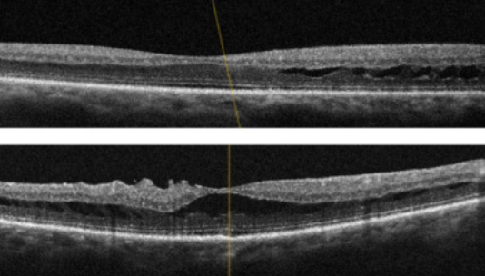
Management
Regularly monitoring for maculopathy
Manage hypertension and vesico-ureteral reflux to mitigate risk of renal failure
With end-stage renal disease, consider dialysis or renal transplant
Monitor for other symptoms including hearing loss, joint and ligament laxity, and developmental abnormalities
Source: Ng B, De Silva S, Bindra M. Papillorenal syndrome: a systemic diagnosis not to be missed on funduscopy. BMJ Case Rep. 2021 Jul 20;14(7):e241708. doi: 10.1136/bcr-2021-241708. PMID: 34285019; PMCID: PMC829272
Notes:
Management for papillorenal syndrome includes regular ophthalmic monitoring for maculopathy, managing systemic hypertension and vesicoureteral reflux with possible dialysis or renal transplant, and monitoring for involvement of other symptoms including hearing loss, joint and ligament laxity and developmental abnormalities.

Slide 20
Key Takeaways
Papillorenal syndrome is an autosomal dominant disorder predominantly characterized by ocular and renal abnormalities
Diversity of optic disc appearances is associated, but optic nerve anomaly is a reliable sign for papillorenal syndrome
Management involves regular monitoring for complications such as maculopathy and end-stage renal disease
Papillorenal syndrome is a genetically heterogeneous condition in which PAX2 variants are a common cause
Notes:
Our key takeaways are that papillorenal syndrome is an autosomal dominant disorder characterized by ocular and renal abnormalities. There is a diversity of optic disc anomalies associated, but the presence of bilateral optic nerve anomalies could be a reliable sign for papillorenal syndrome. Management includes regular monitoring for ocular and systemic manifestations and complications. Lastly, papillorenal syndrome is a genetically heterogeneous condition in which PAX2 variants are a common cause.

Slide 21
References
Information
Parisi MA. Clinical and molecular features of Joubert syndrome and related disorders. Am J Med Genet C Semin Med Genet. 2009 Nov 15;151C(4):326-40. doi: 10.1002/ajmg.c.30229. PMID: 19876931; PMCID: PMC2797758.
Forsythe E, Beales PL. Bardet-Biedl syndrome. Eur J Hum Genet. 2013 Jan;21(1):8-13. doi: 10.1038/ejhg.2012.115. Epub 2012 Jun 20. PMID: 22713813; PMCID: PMC3522196.
Kaur A, Dhir SK, Goyal G, Mittal N, Goyal RK. Senior Loken Syndrome. J Clin Diagn Res. 2016 Nov;10(11):SD03-SD04. doi: 10.7860/JCDR/2016/21832.8816. Epub 2016 Nov 1. PMID: 28050464; PMCID: PMC5198417.
Usman N, Sur M. CHARGE Syndrome. [Updated 2023 Mar 6]. In: StatPearls [Internet]. Treasure Island (FL): StatPearls Publishing; 2024 Jan-. Available from: https://www.ncbi.nlm.nih.gov/books/NBK559199/
Parsa, C. F., Silva, E. D., Sundin, O. H., Goldberg, M. F., De Jong, M. R., Sunness, J. S., Zeimer, R., & Hunter, D. G. (2001). Redefining papillorenal syndrome: an underdiagnosed cause of ocular and renal morbidity. Ophthalmology, 108(4), 738–749. https://doi.org/10.1016/s0161-6420(00)00661-8
Koulouri, Ismini, et al. “Double Optic Disc Pit With Glial Plugs Imaged By Wide-Field Optical Coherence Tomography.” Ophthalmic Surgery, Lasers and Imaging Retina, vol. 49, no. 1, Jan. 2018, pp. 52–54, https://doi.org/10.3928/23258160-20171215-08.
Favor J, Sandulache R, Neuhäuser-Klaus A, Pretsch W, Chatterjee B, Senft E, Wurst W, Blanquet V, Grimes P, Spörle R, Schughart K. The mouse Pax2(1Neu) mutation is identical to a human PAX2 mutation in a family with renal-coloboma syndrome and results in developmental defects of the brain, ear, eye, and kidney. Proc Natl Acad Sci U S A. 1996 Nov 26;93(24):13870-5. doi: 10.1073/pnas.93.24.13870. PMID: 8943028; PMCID: PMC19453.
Okumura T, Furuichi K, Higashide T, Sakurai M, Hashimoto S, Shinozaki Y, Hara A, Iwata Y, Sakai N, Sugiyama K, Kaneko S, Wada T. Association of PAX2 and Other Gene Mutations with the Clinical Manifestations of Renal Coloboma Syndrome. PLoS One. 2015 Nov 16;10(11):e0142843. doi: 10.1371/journal.pone.0142843. PMID: 26571382; PMCID: PMC4646464.
Azzam D, Bordoni B. Embryology, Optic Fissure. [Updated 2023 Apr 3]. In: StatPearls [Internet]. Treasure Island (FL): StatPearls Publishing; 2024 Jan-. Available from: https://www.ncbi.nlm.nih.gov/books/NBK554433/
Sehgal R, Sheibani N, Rhodes SJ, Belecky Adams TL. BMP7 and SHH regulate Pax2 in mouse retinal astrocytes by relieving TLX repression. Dev Biol. 2009 Aug 15;332(2):429-43. doi: 10.1016/j.ydbio.2009.05.579. Epub 2009 Jun 6. PMID: 19505455; PMCID: PMC2917894.
Torres M., Gómez-Pardo E., Gruss P., Pax2 contributes to inner ear patterning and optic nerve trajectory. Development 122, 3381–3391 (1996).
Yamamura, Y., Furuichi, K., Murakawa, Y. et al. Identification of candidate PAX2-regulated genes implicated in human kidney development. Sci Rep 11, 9123 (2021). https://doi.org/10.1038/s41598-021-88743-1
Schimmenti, L. A. (2009). Genetic and developmental basis of renal coloboma (papillorenal) syndrome. Expert Review of Ophthalmology, 4(2), 135–144. https://doi.org/10.1586/eop.09.3
Koeberle PD, Ball AK. Effects of GDNF on retinal ganglion cell survival following axotomy. Vision Res. 1998 May;38(10):1505-15. doi: 10.1016/s0042-6989(97)00364-7. PMID: 9667015.
Notes:
And here are our references.

Slide 22
References
Images:
Parsa CF, Silva ED, Sundin OH, Goldberg MF, De Jong MR, Sunness JS, Zeimer R, Hunter DG. Redefining papillorenal syndrome: an underdiagnosed cause of ocular and renal morbidity. Ophthalmology. 2001 Apr;108(4):738-49. doi: 10.1016/s0161-6420(00)00661-8. PMID: 11297491.
Fletcher J, Hu M, Berman Y, Collins F, Grigg J, McIver M, Jüppner H, Alexander SI. Multicystic dysplastic kidney and variable phenotype in a family with a novel deletion mutation of PAX2. J Am Soc Nephrol. 2005 Sep;16(9):2754-61. doi: 10.1681/ASN.2005030239. Epub 2005 Jul 27. PMID: 16049068.
Ng B, De Silva S, Bindra M. Papillorenal syndrome: a systemic diagnosis not to be missed on funduscopy. BMJ Case Rep. 2021 Jul 20;14(7):e241708. doi: 10.1136/bcr-2021-241708. PMID: 34285019; PMCID: PMC8292727.
Notes:
Thank you!

