Slide 1


Unmasking the Diagnosis of an Orbital Mass
Vasiliki P Giannakakos MD, Ophthalmology Resident, PGYIV, Montefiore Medical Center/ Albert Einstein College of Medicine, Bronx, New York.
Robert S Sacchi MD, Department of Radiology, Jacobi Medical Center, Bronx, New York.
Gregory J Parnes MD, Department of Radiology, Jacobi Medical Center, Bronx, New York.
Yan L Zhang MD, PhD, Department of Pathology, Jacobi Medical Center, Bronx, New York.
Sofya Gindina MD, PhD, Ophthalmology Resident, PGYIII, Montefiore Medical Center/ Albert Einstein College of Medicine, Bronx, New York.
Joyce N Mbekeani MD, FRCS, FRCOphth, Department of Surgery (Ophthalmology), Jacobi Medical Center, Bronx, New York.
Notes:
Hello my name is Vasiliki Giannakakos and we present, “unmasking the diagnosis of an orbital mass,” an Upfront case presentation brought to you by the North American Neuro-Ophthalmology Society and the Journal of Neuro-ophthalmology

Slide 2
Financial Disclosure
All authors have no financial disclosures or conflicts of interest.
Notes:
We have no financial disclosures

Slide 3
53-year-old male with right maxillary pain
CC: right facial pain associated with intermittent blurred vision following dental self-extraction
HPI:
  Presented to ED with oral pain, right facial numbness and right blurred vision following last extraction of loose upper incisor 3 weeks prior to presentation.
  ~15 lbs weight loss over previous 6 months.
  No associated eye pain, redness or other ocular symptoms. No fevers or headaches and no neurological symptoms.
POHx: None
PMHx: Gingivitis and prior self-extractions without event.
Social Hx: Smokes, social drinker; has a wife and children; no recent international travel or drug abuse
Notes:
The case is a 53 year old male who presented to the emergency room with right facial pain and intermittent blurred vision after extracting a loose tooth 3 weeks prior to presentation. His review of systems was negative for eye pain or other ocular symptoms, fevers, or headaches. He did endorse 15 pounds of weight loss over the previous 6 months. He was a smoker with a history of gingivitis but otherwise had an unremarkable medical history.

Slide 4
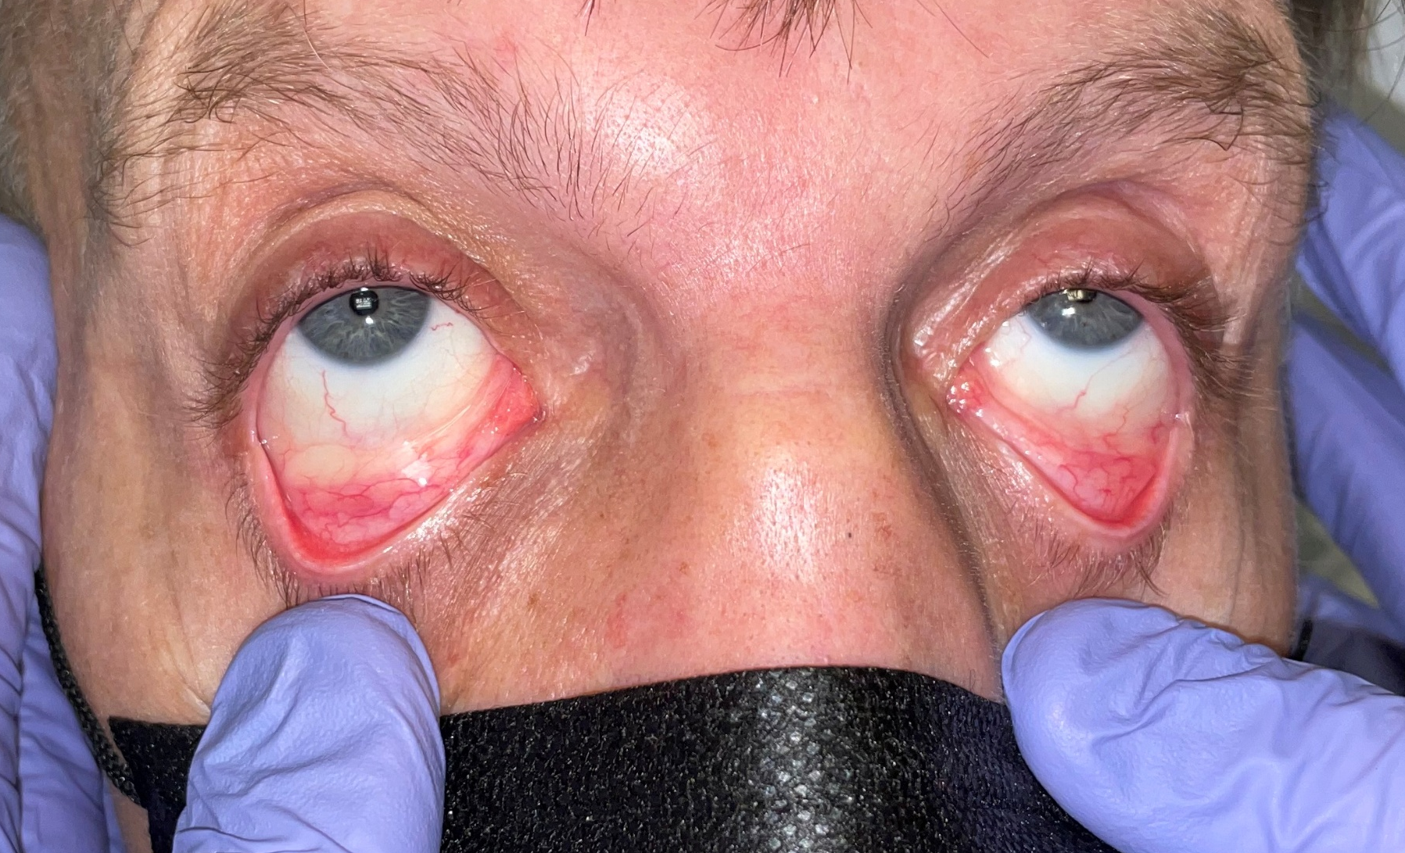
Ophthalmology exam
Right infraorbital hypesthesia
Mild proptosis right eye
Hertel’s measurement:
  Base 95mm, right eye 18mm, left eye 14.5mm
Notes:
On exam there was notable right infraorbital hypesthesia and proptosis with a 4 mm difference by Hertel’s measurement.

Slide 5
Ophthalmology exam
Right infraorbital hypesthesia
Mild proptosis right eye
Hertel’s measurement:
  Base 95 mm, right eye 18 mm, left eye 14.5 mm
Right inferior fornix appeared blanched
Notes:
Additionally, we noted that the right inferior fornix appeared blanched, as shown in this image

Slide 6
Ophthalmology Exam
 | OD | OS
VA near cc | 20/25-1 | 20/25-2
Pupils | RR, no RAPD | RR, no RAPD
IOP | 8 mmHg | 8 mmHg
cVF | Full | Full
Color (Ishihara) | 11/11 | 11/11
EOM | Full, Ortho | Full, Ortho
External | Infraorbital hypoesthesia, right eye slightly elevated and proptotic compared to left | WNL
Slit Lamp Exam | WNL | WNL
Disc | Sharp & Pink, C/D 0.3 | Sharp & Pink, C/D 0.3
Dilated Fundus Exam | WNL | WNL
Notes:
Ocular exam was otherwise unremarkable with a normal visual acuity and visual function, normal tonometry, and a sharp and pink optic nerve.

Slide 7
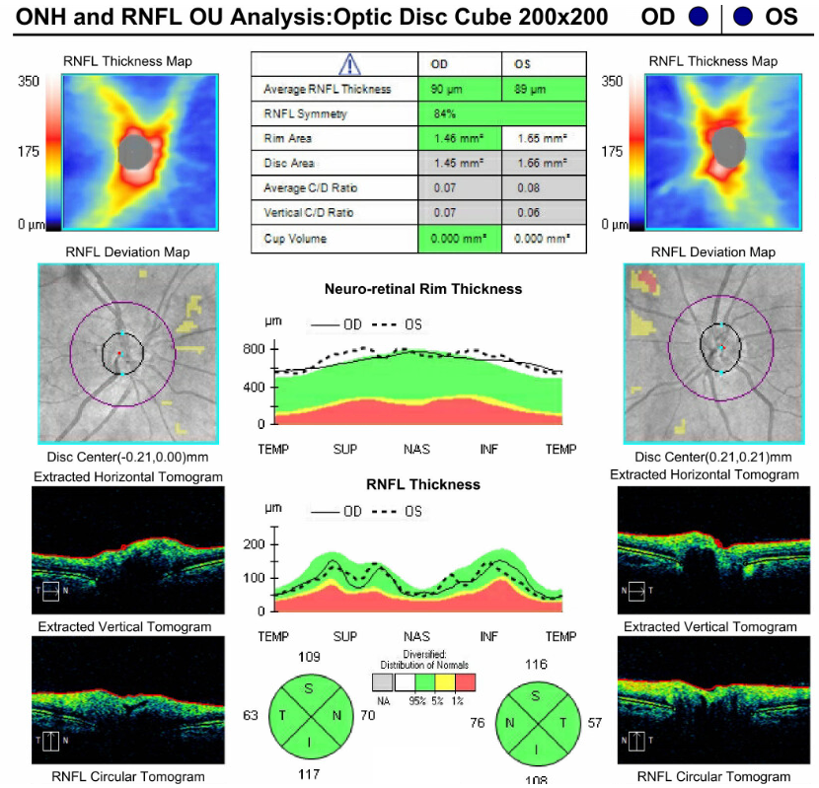
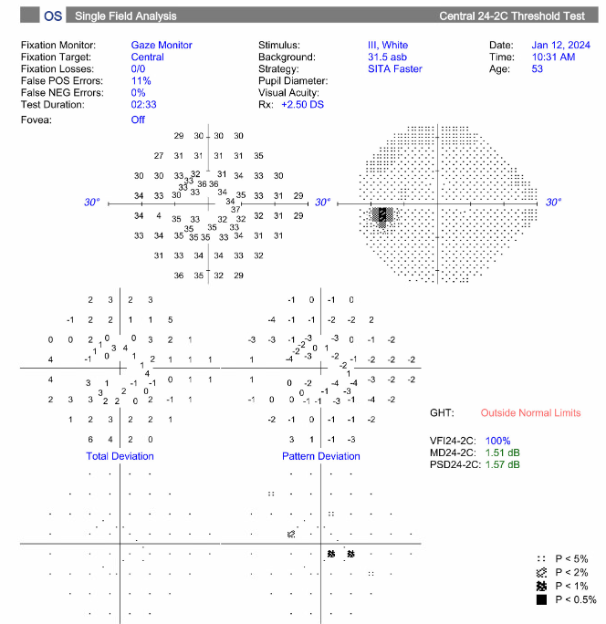
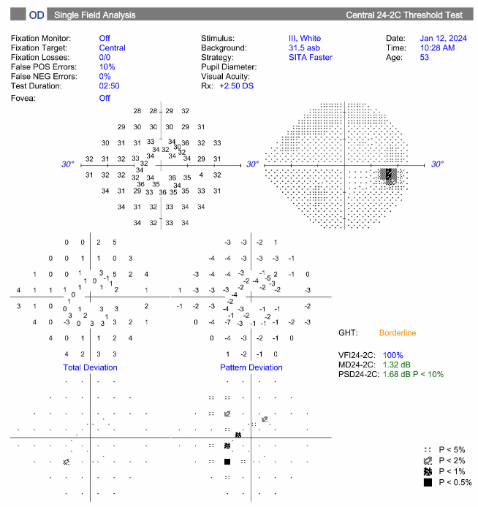
OCT and Humphrey Visual Fields - Normal
Notes:
His OCT and Humphrey visual field testing was also unremarkable.

Slide 8
Next Steps?
Notes:
Given this information, what would be your next step in the patient’s workup?

Slide 9
Next Steps?
Imaging:
CT scan maxillofacial with/without contrast
MRI brain and orbits with/without contrast
Notes:
We decided to pursue imaging with a maxillofacial CT with and without contrast first, then an MRI brain and orbits with and without contrast

Slide 10
Next Steps?
Imaging:
CT scan maxillofacial with/without contrast
MRI brain and orbits with/without contrast
Labs:
CBC and differential, ESR, CRP
Infections - syphilis, tuberculosis (by QuantiFERON), HIV
Inflammatory - rheumatoid factor, anti-nuclear antibody, angiotensin converting enzyme, IgG subclasses, and lysozyme
Notes:
We also ordered labs to assess for infectious and inflammatory etiologies for this patient’s painful proptosis, such as syphilis, tuberculosis, angiotensin converting enzyme, and IgG subclasses

Slide 11
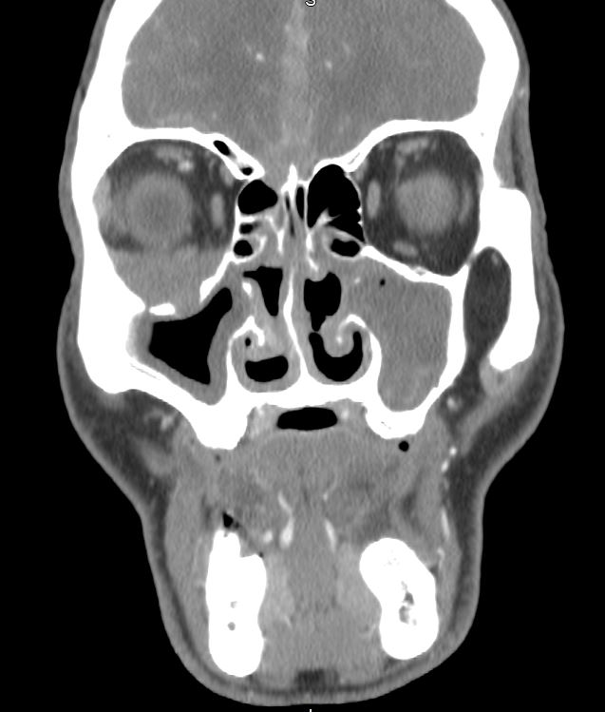
CT Maxillofacial
A right orbital mass was identified on contrast-enhanced CT scan.
Notes:
The CT maxillofacial revealed a right orbital mass as shown here

Slide 12
CT Maxillofacial
Infiltration of lesion into falx (note same density)
A right orbital mass was identified on contrast-enhanced CT scan.
Erosion of lateral lamella of the cribriform plate
Orbital floor destruction
Mucosal thickening in the maxillary sinuses left greater than right. There is inspissated mucus on the left.
Notes:
Furthermore, we identified erosion of the lateral lamella of the cribiform plate, orbital floor bony destruction, mucosal thickening in the maxillary sinuses, and abnormal infiltration of the falx with a lesion of the same density as the identified orbital mass.

Slide 13
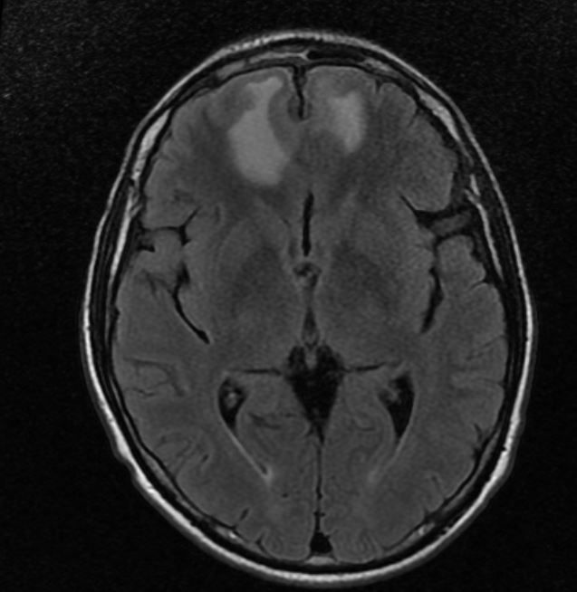
MRI brain and orbit
Axial T2-weighted image:
Bifrontal brain edema with hyperintense foci right greater than left
Notes:
The MRI further highlighted the cerebral abnormalities with an axial T2 image showing bifrontal brain edema with hyperintense foci

Slide 14
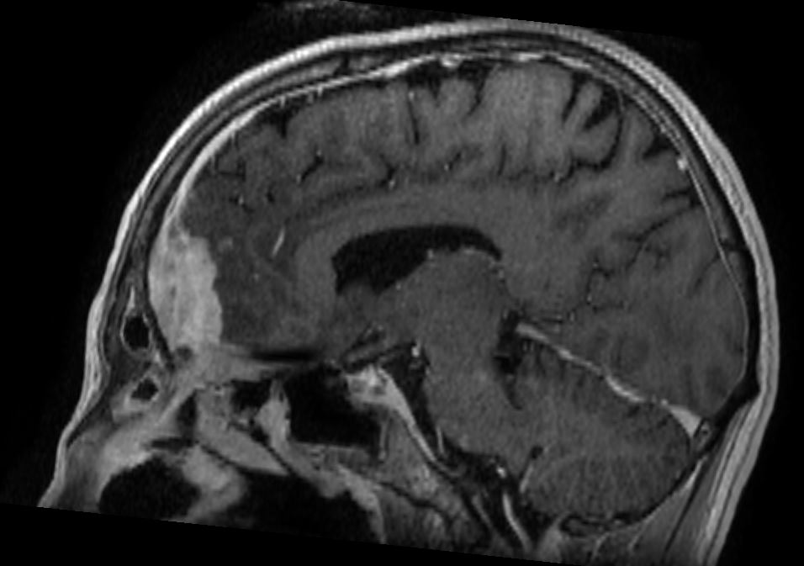
MRI brain and orbit
Sagittal T1 post contrast image:
Prominent enhancement along the falx
Notes:
The sagittal T1 post contrast image showed prominent enhancement along the falx cerebri

Slide 15
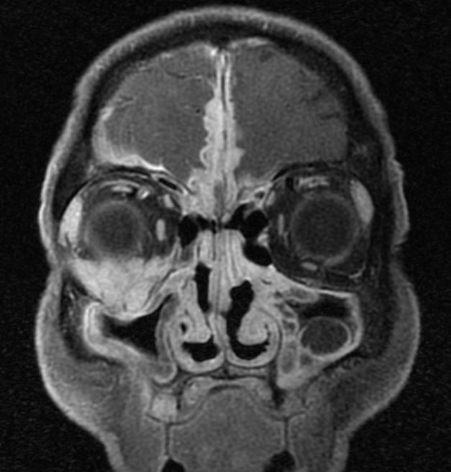
MRI brain and orbit
Coronal contrast-enhanced T1 –weighted image:
How would you describe this?
Notes:
We also obtained a coronal contrast-enhanced T1 image with impressive results. How would you describe these findings on the MRI?

Slide 16
MRI brain and orbit
Coronal contrast-enhanced T1 –weighted image:
Large enhancing inferior right orbital mass at mid-orbit level.
Nodular tissue enhancement along the falx bilaterally with extension through the lateral lamella.
Notes:
We interpreted this image as a large enhancing inferior right orbital mass at the mid-orbital level associated with nodular tissue enhancement along the falx bilaterally and extension through the lateral lamella

Slide 17
How would you summarize this presentation?
Notes:
With all this new imaging results, how would you summarize the case presentation so far?

Slide 18
How would you summarize this presentation?
Middle-aged male with an orbito-maxillary-falcine enhancing mass associated with bony erosion and hypertrophic pachymeningitis continuous with orbital inflammation and sinusitis and no ocular functional compromise
Notes:
We described a middle-aged male with an orbito-maxillary-falcine enhancing mass with associated bony erosion and hypertrophic pachymeningitis continuous with orbital inflammation and sinusitis with no ocular functional compromise

Slide 19
What is the differential diagnosis of orbital mass?
Notes:
What is your differential diagnosis of this atypical orbital mass?

Slide 20
Orbital Masses
Infection
Inflammation
Vascular Lesion
Malignant Tumors
Benign Tumors
Staph
Strep
Fungus
HIV
IgG4
Idiopathic (IOI)
Sarcoid
Granulomatosis with polyangiitis (GPA)
Cavernous Venous Malformation
Lymphangioma
AV malformation
Varices
CST
CCF
Lymphoma
Rhabdomyo-sarcoma
Optic glioma
Metastases
Schwannoma
Neurofibroma
Optic nerve sheath meningioma
Notes:
The differential diagnosis of orbital masses is broad and includes infections, inflammatory or autoimmune diseases, vascular lesions, malignancies, or benign tumors

Slide 21
What would you do now?
Notes:
What would you do next?

Slide 22
Tissue is the issue!
Tissue biopsy prior to expanded serologic investigations
Orbital mass was most accessible for biopsy
Patient underwent right orbitotomy for mass biopsy with Oculoplastics division
Notes:
Tissue is the issue! Despite the informative imaging results we obtained, histopathologic evaluation of the mass would give us more specific findings that would help guide our diagnosis and treatment. We felt that the orbital mass with the visible blanching on exam was the most accessible site for biopsy and so the patient underwent right orbitotomy with our oculoplastics team.

Slide 23
Histopathology
What would you expect to see if it was lymphoma?
What would you expect to see if it was GPA?
Notes:
Thinking further about histopathology, what would you expect to see if this mass was a lymphoma? And how would that compare to if the mass was granulomatosis with polyangiitis (or GPA)?

Slide 24
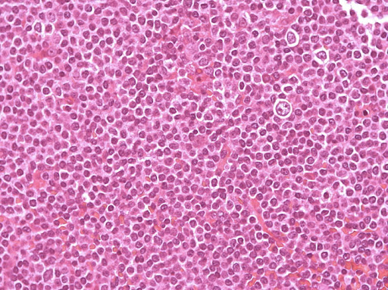
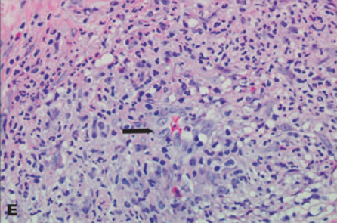
Histopathology
Most common lymphoma in the orbit is mucosa-associated lymphoid tissue (MALT)
Sheet of monomorphic B-cells positive for CD19 and CD20
What would you expect to see if it was lymphoma?
http://atlasgeneticsoncology.org/
Granulomas with proliferation of macrophages and multinucleated giant cells
Vasculitis at arterioles and venules
Focal necrosis
What would you expect to see if it was GPA?
Orbital Granulomatosis With Polyangiitis (Wegener Granulomatosis): Clinical and Pathologic Findings - PMC
Notes:
Well, lymphoma in the orbit is most commonly mucosa-associated lymphoid tissue which is characterized by sheets of monomorphic B-cells positive for CD19 and CD20. Whereas in GPA you would expect to see granulomas with proliferation of macrophages and multinucleated giant cells associated with vasculitis at arterioles and venules and focal necrosis

Slide 25
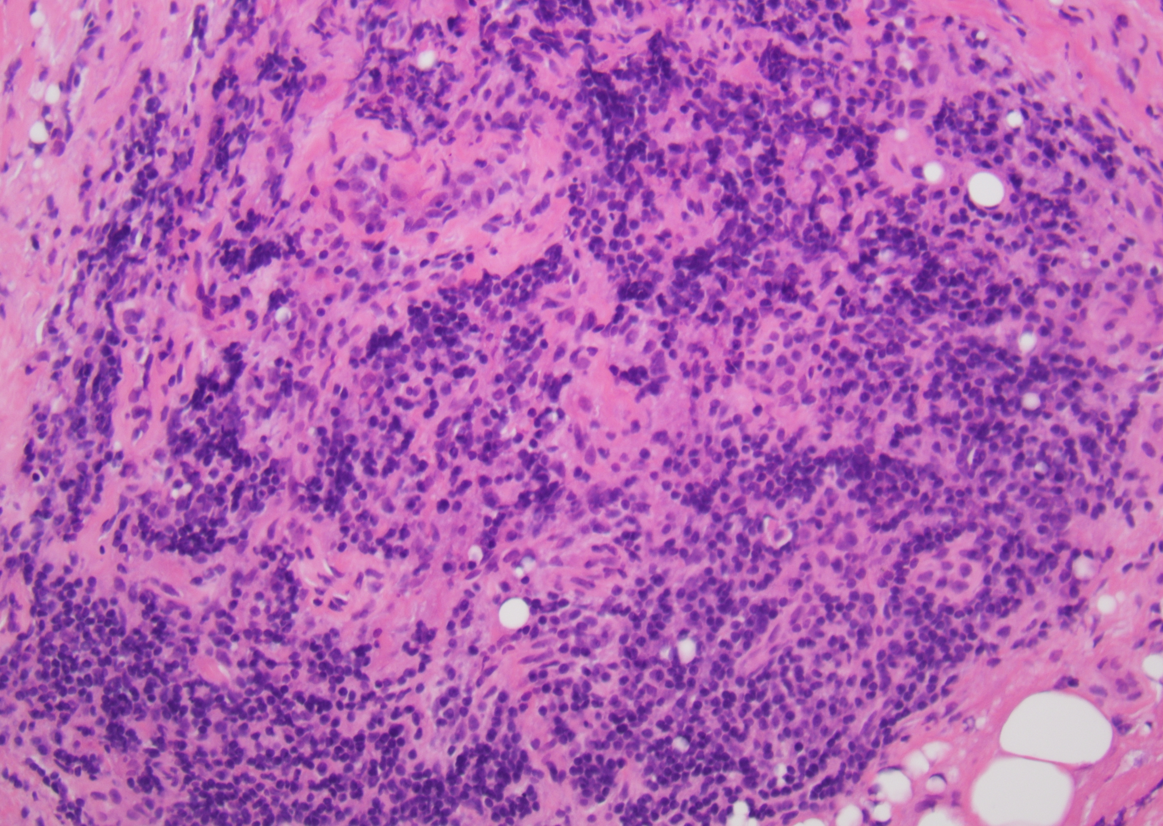
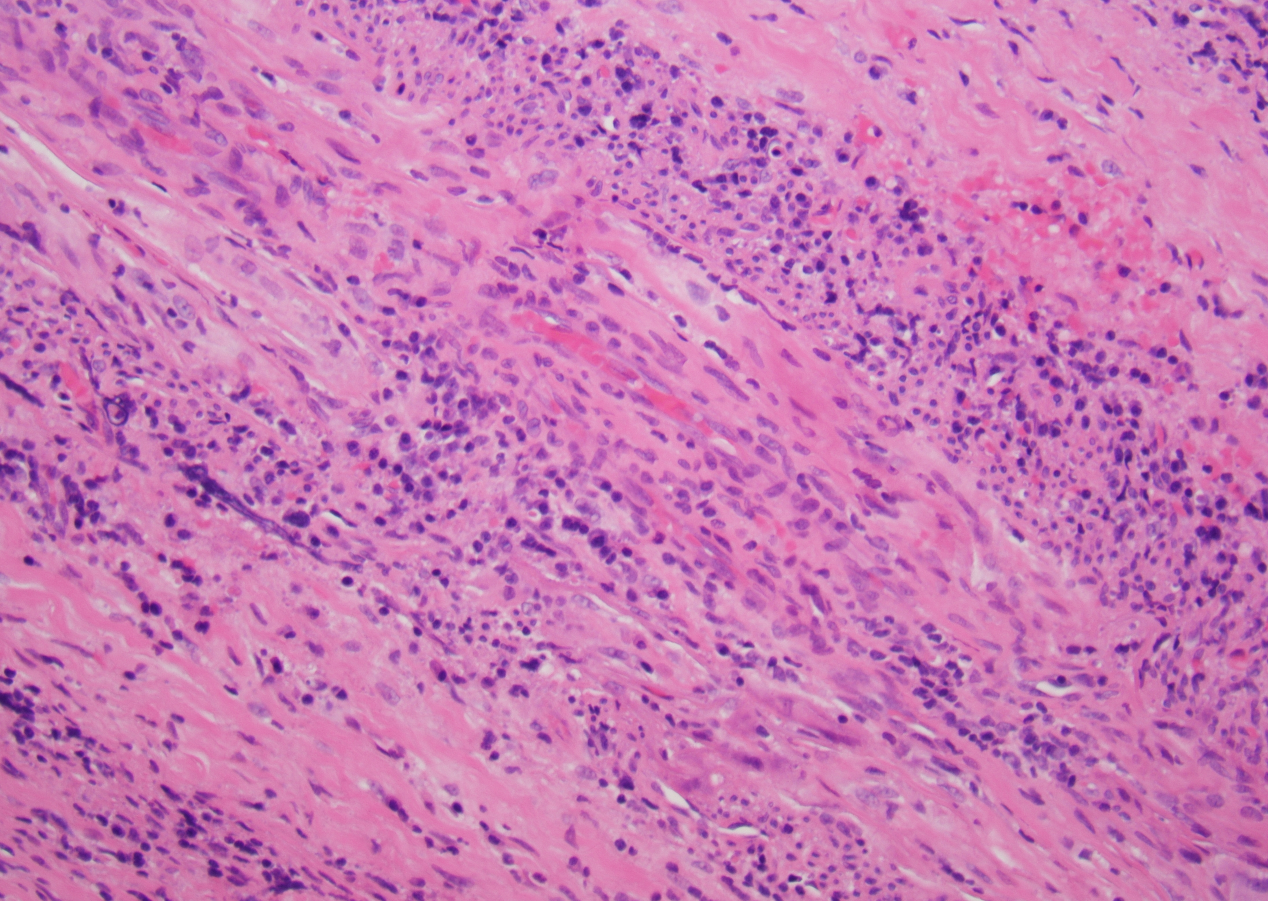
Histopathology of biopsy specimen
Large perivascular inflammatory focus with sclerosing fibrosis, focal phlebitis, and atypical lymphoplasmacytic infiltrates including kappa predominant atypical plasma cells
No granulomas
Flow cytometry negative for lymphoma
Plasma and lymphoid cells
Sclerosing fibrosis
Blood vessel
Notes:
In our patient, we found a large perivascular inflammatory focus with sclerosing fibrosis, focal phlebitis, and atypical lymphoplasmacytic infiltrates including kappa predominant atypical plasma cells. We did not find any granulomas and the flow cytometry was negative for lymphoma

Slide 26
Follow up post-biopsy visit
Biopsy site was healing well
Ophthalmic examination was unchanged and benign
Biopsy findings described to patient as non-specific inflammation and unlikely lymphoma
Outlined details of further investigations vs empiric steroid therapy trail and referral for second opinion
Notes:
At our follow up after the biopsy the patient was doing well without further changes in his symptoms or exam and we discussed the next steps in his management

Slide 27
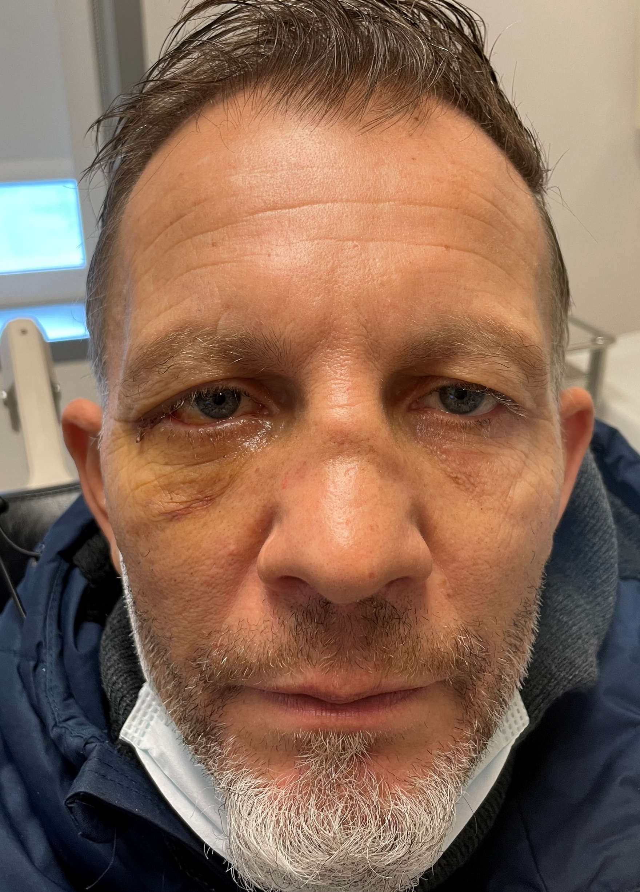
On closer inspection of face with the mask down…
What is this exam finding called?
Notes:
In this office follow up we repeated our exam, this time with the mask down and found an abnormality with his nose. What is this exam finding called?

Slide 28
On closer inspection of face with the mask down…
What conditions is it associated with?
What is this exam finding called?
Saddle-nose deformity
Notes:
This was a saddle-nose deformity. So what conditions can it be associated with?

Slide 29
On closer inspection of face with the mask down…
What conditions is it associated with?
Trauma
Congenital syphilis
Granulomatosis with polyangiitis (GPA)
Cocaine abuse
Saddle-nose deformity
What further studies would you order? What do you do next?
Notes:
It can be found in trauma, congenital syphilis, GPA, and cocaine abuse. Given this new information and the history so far, what further studies would you order?

Slide 30
Laboratory testing
Positive for c-ANCA at 1:160 dilution
Strongly positive proteinase 3 antibody (75.9 units by EIA)
  Highly sensitive and specific for GPA
ESR 27 (borderline), CRP 1.2 (high)
CBC HgB 10.7g/dL (low), HCT 32.5% (low), RBC 3.85 (low), WBC 8.25/nL (normal) - normal percentages of WBC types including eosinophils, 2.2%.
Negative: HIV, Syphilis, Quantiferon, Hep B Viral Load, Hep B surface antibody/antigen, Hep C antibody, Coccidioides antibody, Blastomyces antibody, Strongyloides antibody, ANA (including SSB, SSA, Scl-70, Jo 1, dsDNA, centromere, histone), angiotensin converting enzyme (ACE), lysozyme, RhF, Cyclic Citrullinated Peptide (CCP) antibody, C3/C4 complement, glomerular basement membrane antibody, IgG4, Myeloperoxidase (MPO) antibody
Notes:
We sent out anti-neutrophil cytoplasmic antibody testing (or ANCA) to test for GPA and this patient’s c-ANCA antibodies were abnormally high. On confirmatory testing he was indeed positive for proteinase 3 antibody. Along with elevated CRP, this result is highly sensitive and specific for GPA. The remainder of his extensive laboratory workup was negative.

Slide 31
Case Summary
Middle aged man with chronic gingivitis
Neuroimaging for oral pain after dental self-extraction disclosed: orbital mass, chronic sinusitis, and pachymeningeal inflammatory thickening associated with cerebral edema
No associated ophthalmic or neurologic symptoms/signs
Non-specific histopathology without evidence of granuloma or neoplasm
Saddle nose raised suspicion destructive autoimmune disease
c-ANCA (+)
Diagnosis: Granulomatosis and Polyangiitis (GPA)
with orbital inflammation and hypertrophic pachymeningitis
Notes:
In summary, this middle-aged male who presented with chronic gingivitis and oral pain, was found to have orbital mass, chronic sinusitis, and pachymeningeal inflammatory thickening with cerebral edema and non-specific inflammatory histopathology. However, because of his saddle nose deformity, we discovered he was c-ANCA positive and therefore diagnosed him with granulomatosis with polyangiitis (or GPA)

Slide 32
Granulomatosis and Polyangiitis (GPA)
GPA is the most common of 3 ANCA-associated vasculitides*
Autoimmune process with necrotizing vasculitis of small to medium vessels
Affects upper respiratory tract, lower respiratory tract and renal system with formation of poorly-formed granulomas and necrosis
Oral inflammation including gingivitis can be the initial manifestation
Saddle-nose deformity from inflammatory nasal cartilage and bony destruction
Orbital GPA is common; CNS GPA is rare
Rarely, may involve the meninges or result in cerebral vasculitis
Most clinical and radiologic findings are non-specific, therefore biopsy and laboratory testing should be done to support diagnosis
*3 ANCA – associated vasculitides: GPA, microscopic polyangiitis, and Churg Strauss syndrome
Notes:
GPA is the most common of the three ANCA-associated vasculidities and is an autoimmune process with necrotizing vasculitis of small to medium vessels. It typically affects the upper and lower respiratory tract, as well as the renal system, with evidence of formation of granulomas and necrosis. The oral inflammation or gingivitis can be an initial manifestation. Saddle-nose deformity can also develop due to inflammation of the nasal cartilage and bony destruction. Orbital GPA is common, whereas central nervous system GPA is rare, including the involvement of the meninges or presence of cerebral vasculitis. Most clinical and radiologic findings are non-specific and therefore biopsy and laboratory testing should be done to support the diagnosis

Slide 33
Ophthalmic Manifestations of GPA
GPA can affect all eye structures:
  Scleritis and episcleritis
  Peripheral ulcerative keratitis
  Orbit and optic nerve
      Extraconal orbital mass with sinonasal involvement
  Uncommon manifestations: uveitis, CRAO, retinal vasculitis
Can be isolated or associated with renal or pulmonary disease
Notes:
GPA can affect many different parts of the eye, resulting in scleritis or episcleritis, peripheral ulcerative keratitis, orbital mass with possible implications on the optic nerve, uveitis, central retinal artery occlusion, or retinal vasculitis. Orbital GPA can be isolated or associated with renal or pulmonary disease

Slide 34
Orbits in GPA
Common manifestation of GPA
  Typically present with orbital pain, diplopia, decreased vision, and proptosis
Thought to originate from paranasal sinuses
Locally invasive to neighboring bone and cartilage with meningeal infiltration
Pachymeningitis is rare in GPA and may be contiguous spread from orbit or de novo inflammation
Both are more refractory forms – radiotherapy/immunotherapy
Blindness is usually due to optic nerve compression or vasculitic effects
Acute phase reactants usually (+); ANCA may be (-)
Notes:
When GPA involves the orbit specifically, it may present with pain, diplopia, decreased visual function, and proptosis. It is thought to originate from the paranasal sinuses and can be locally invasive to the neighboring bone and cartilage and even the meninges. Pachymeningitis is rare in GPA and may be either from contiguous spread or de novo. Orbital and meningeal involvement tends to be harder to treat, needing a combination of radiotherapy and immunotherapy. Blindness can result from optic nerve compression or vasculitic damage. In orbital GPA, acute phase reactants are usually positive but anti-neutrophil cytoplasmic antibodies many be negative

Slide 35
What immunomodulatory therapy should be used?
Notes:
What immunomodulatory therapy should be used in the management of GPA?

Slide 36
Treatment
Commonly treated with glucocorticoid and cyclophosphamide induction, followed by additional antimetabolites such as methotrexate or azathioprine
Rheumatology initiated this patient on:
  Prednisone 60 mg PO daily
  Rituximab 375 mg/m2 induction IV for four doses administered weekly
    Targets CD20 B cells
  Avacopan 30 mg PO twice daily
    Complement 5a receptor antagonist
    Inhibits neutrophil activation
Repeat laboratory testing 7 months post-therapy revealed negative anti-proteinase 3 antibodies
Notes:
GPA is commonly treated with glucocorticoids and cyclophosphamide induction, followed by additional antimetabolites sech as methotrexate or azathioprine.
In this case presentation, the patient was started on prednisone 60 mg by mouth daily. He was also treated with weekly rituximab intravenous induction for 4 doses, which targets CD20 B cells. And additionally, he was started on a more novel treatment called avacopan, which is a complement 5a receptor antagonist that inhibits neutrophil activation. 7 months after this treatment, his repeat laboratory testing was negative for anti-proteinase 3 antibodies, suggesting a good response.

Slide 37
Conclusions
Granulomatosis with polyangiitis (GPA) may present with gingivitis.
Associated orbital mass can rarely spread contiguously to involve the meninges with resulting hypertrophic pachymeningitis.
Saddle-nose deformity is highly suggestive of GPA in the context of gingivitis and orbital mass.
c-ANCA helps to support this diagnosis.
Avacopan, a novel and effective treatment for GPA, in combination with rituximab and glucocorticoids, can be used with good effect.
Notes:
In conclusion, GPA may present with gingivitis and orbital mass, which can rarely spread contiguously to involve the meninges and result in hypertrophic pachymeningitis. In this context, saddle-nose deformity is highly suggestive of GPA. And finally, avacopan is a novel and effective treatment for GPA when used in combination with rituximab and steroids.

Slide 38
References
Cleary JO, Sivarasan N, Burd C, Connor SEJ. Head and neck manifestations of granulomatosis with polyangiitis. Br J Radiol. 2021;94(1119):20200914. doi:10.1259/bjr.20200914
Dammacco R, Biswas J, Mohanan-Earatt A, et al. The eye is a common site of granulomatosis with polyangiitis. A collaborative study. BMC Ophthalmol. 2023;23:26. doi:10.1186/s12886-022-02743-x
Graf J. Central Nervous System Disease in Antineutrophil Cytoplasmic Antibodies–Associated Vasculitis. Rheumatic Disease Clinics of North America. 2017;43(4):573-578. doi:10.1016/j.rdc.2017.06.006
Jayne DRW, Merkel PA, Schall TJ, Bekker P. Avacopan for the Treatment of ANCA-Associated Vasculitis. N Engl J Med. 2021;384(7):599-609. doi:10.1056/NEJMoa2023386
Mei L, Wang L, Yan H. Updates of ocular involvement in granulomatosis with polyangiitis. Graefes Arch Clin Exp Ophthalmol. 2023;261(6):1515-1523. doi:10.1007/s00417-022-05918-w
Muller K, Lin JH. Orbital Granulomatosis With Polyangiitis (Wegener Granulomatosis). Arch Pathol Lab Med. 2014;138(8):1110-1114. doi:10.5858/arpa.2013-0006-RS
Notes:
And here are some relevant references. Thank you.

