Slide 1




More Than Meets the Eye: A Case
of Delayed Sequential Bilateral
Vision Loss
• Patrick Hughes, MD
• Larry Frohman, MD
• Department of Ophthalmology
• Rutgers-New Jersey Medical School

Slide 2

History of Present Illness
32 year old left-handed woman with PMHx hypertension, typ e 2
diabetes, and hyperlip id em ia referred by neurosurgery and orbit
services for painful, slowly progressive visu a l loss of right eye
o ver 6 months attributed to a supposed meningioma. Associated
with severe headache symptoms. Asymptomatic in the left eye.
Subj ectively reported right esotropia beginning at onset of visu a l
loss.
No family history of visu a l loss.
No personal history of strabismus, amblyopia, ocular inj ury or
surgery.

Slide 3
MRI Orbits non-contrast w ith FS- Outside Read of
MRI from 4 months before our initial visit
“Cylindric al enlargemen t of the right optic n erve which is
approximately three times the diameter of the left optic nerve.
This extends from the posterior aspect of the globe and
extends into the optic foramen where it narrows down but
again enlarges in the pre-chiasmatic optic n erve and extends
into the right side of the optic chiasm. This shows increased
signal intensity on the T2 weighted images.
Extraocular muscles on both sides appear to be normal.”

Slide 4
Q's For Neuro-Ophthalmology
Suspected meningioma of the right optic nerve:
- How to plan for tissue- yield ing resection?
- Orbital approach?
- Transcranial?
- Dual approach?
- Ocular signs of neurofibromatosis?
- How best to protect the left eye?

Slide 5
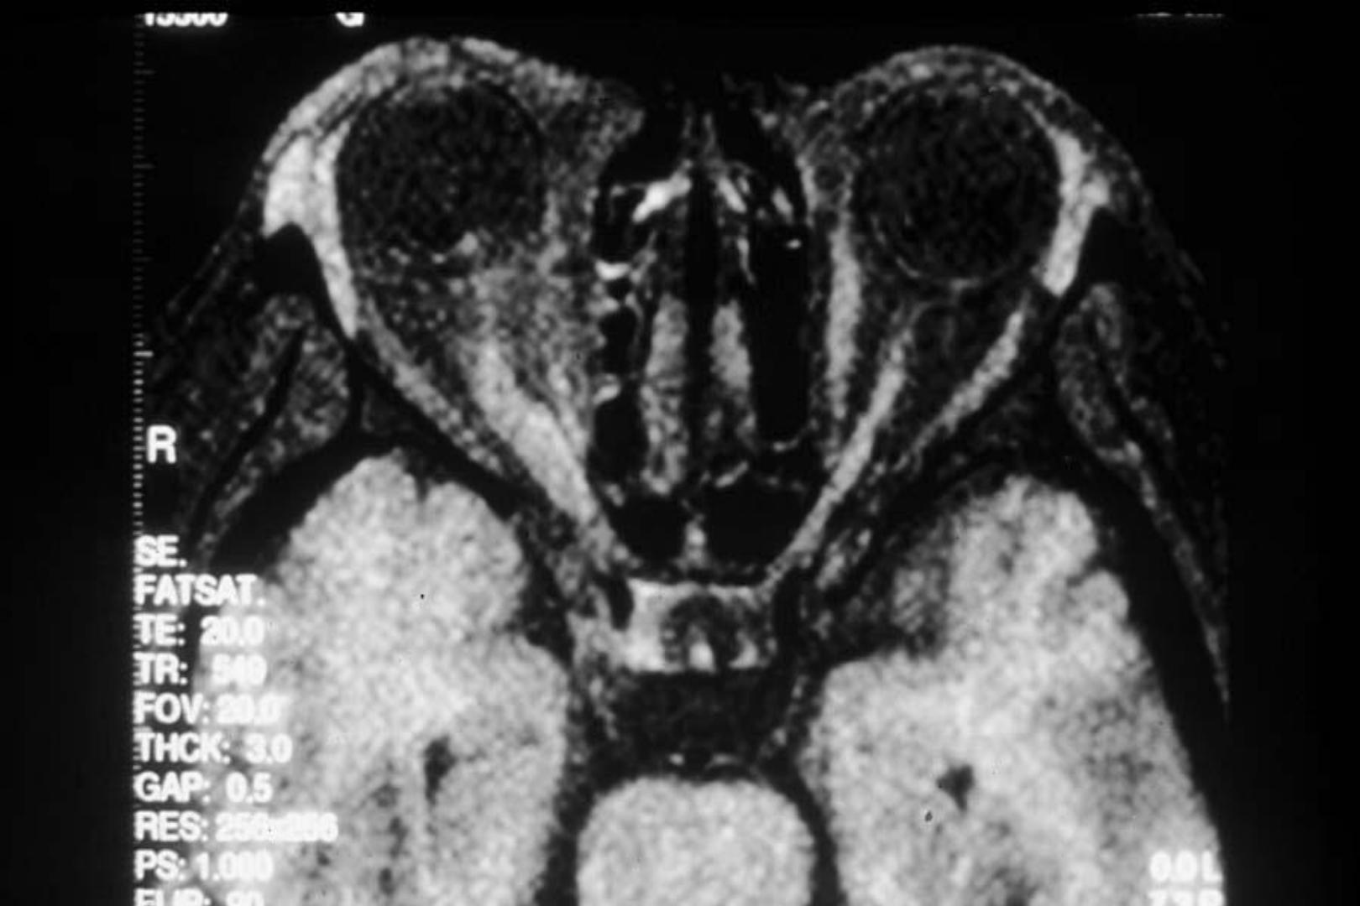

5

Slide 6
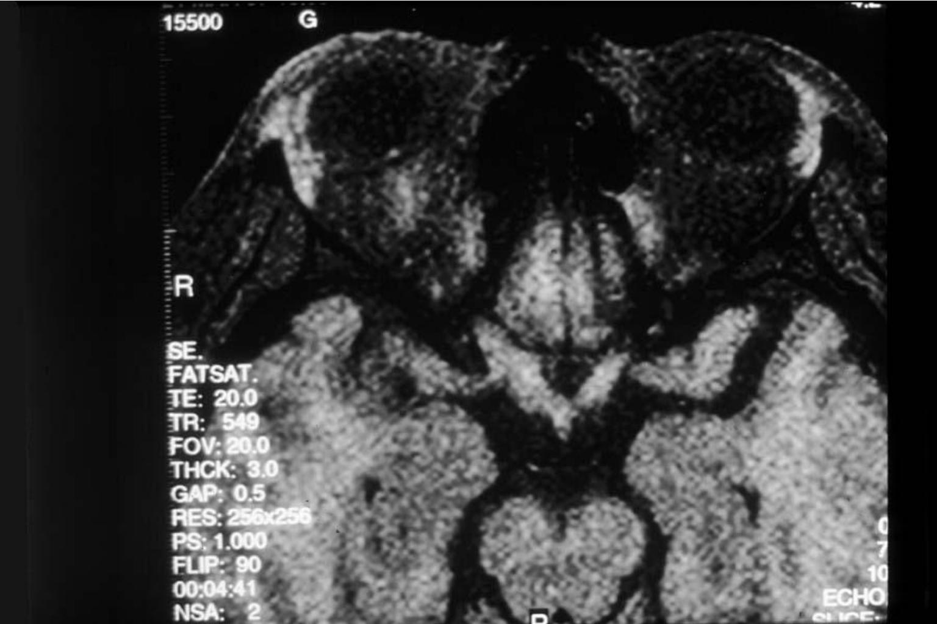
6

Slide 7
Our Initial Examination
VA sc
OD NLP
OS 20/20
Pupils
IOP 5 OD, 3 OS
OD Amaur ot ic , 6 mm, dens e rAPD
OS Round, r eac tive at 6 mm
Lid fissures
OD 8 mm (primary), 10 mm (upgaze)
OS 10 mm (primary), 11.5 mm (upgaze)
Cranial ner ves other wis e nor mal including oc ular r ot at ions

Slide 8
Examination
Right esotropia of 15 PD at distance, 30 PD at near
Slit lamp examin at io n normal without Lisch nodules.
Incidental iris nevus 0.5 mm x 0.3 mm at 3 o'clock OD.
No evid en c e of anterior or intermediate uveitis.
Threshold VF OS and color plates OS both normal.

Slide 9
Fundus exam
OD
OS
Markedly swollen optic nerve with 3
optociliary shunt vessels
Normal optic nerve with 0.2 cup to
disc ratio.
Circumferential exudate around
nerve extending 2-3 disc diameters
Macula, vessels, and periphery
normal, likewise without
periphlebitis
Disc atrophy
Sheathed arteries and veins
surrounding ONH
Peripheral bone spicules

Slide 10

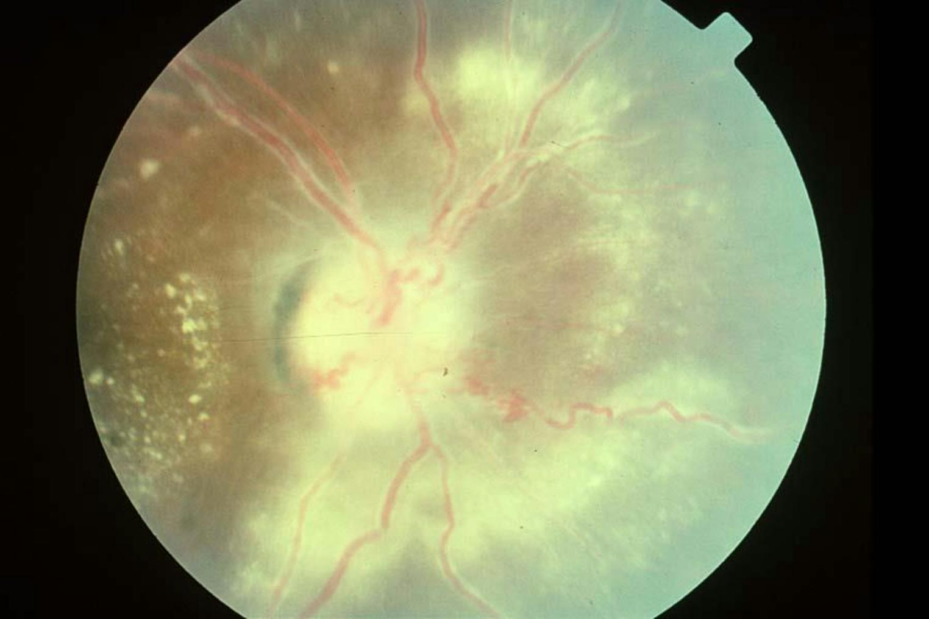
neuro day 2024
10

Slide 11
What do you think?
• Transcranially?
• Transorbital?
• Dual approach?
• Some other idea?
neuro day 2024
11

Slide 12
Rethinking Diagnosis
• Is this presentation consistent with a
suspected meningioma?
• Are there supportive findings of NF?
• Should we consider an alternative diagnosis?
• Additional testing?

Slide 13
What diagnosis might be consistent with
the fundus findings and the MRI scan?
• A lesion looking lik e an optic n erve meningioma and
periphlebitis could be caused by sarcoidosis of the optic
n erve

Slide 14
Planned Wor kup
Better MRI scan with and without contrast:
- CBC
- ACE
- CXR
- VDRL
- FTA
- PPD
- Anergy panel
- LP
- Tissue biopsy to be considered after results of above

Slide 15
Pause
Despite recommendation to pursue work-up, patient declined and was lost
to follow up until she returned 2 months later, now symptomatic in the left
eye with return of severe headaches.

Slide 16
Déjà vu
VAsc
OD NLP
OS 20/25-
Fundus OS: Disc swelling
HVF OS --> superior arcuate visu a l field loss
Sent for repeat FA MRI

Slide 17
IVFA
Transit OD
Normal arm-eye time with leakage from the ONH vasc ulatur e
of the right eye with hyper-fluorescenc e throughout the
posterior pole with staining in late frames

Slide 18
Do we gain any clues with this new history?
Unilateral vs bilateral?
More likely neoplastic, infectious, or inflammatory?
Any conclusions from blood work or imaging?

Slide 19
Differential Diagnosis
Meningioma
Optic neuritis / neuropathy (infectious, inflammatory)
Compressive neuropathy
Infiltr at ive

Slide 20
Optic Nerve Sheath Meningioma
• Uncommon, benign neoplasms arising from meningothelial
cells of optic n erve
oPrimary (1-2% of meningiomas) vs secondary; account for 33% of
primary optic nerve tumors
oW omen >>> Men (3x)
oIncidental detection on neuroimaging vs indolent symptoms
(gradual, painless monocular vision loss)
• Variab le VA , color deficienc y, field loss, optic atrophy, shunt
vessels in 30% (with chronicity)
• Tx: Observat ion, radiation >>>> surgery (Turbin et al. 2002)

Slide 21
Other Optic Neuropathies
Infectious
- Syphilis, Tuber c ulos is , Bar t onell a, EBV, Lyme
Infiltrative
- Lymphoma, Leukemia
Inflammatory
- Multiple sclerosis, s arc oidos is , gr anulomat os is with polyang iit is
Hereditary
- Leber, Dominant
Other
- Nutritional, t oxic , t r aumat ic

Slide 22
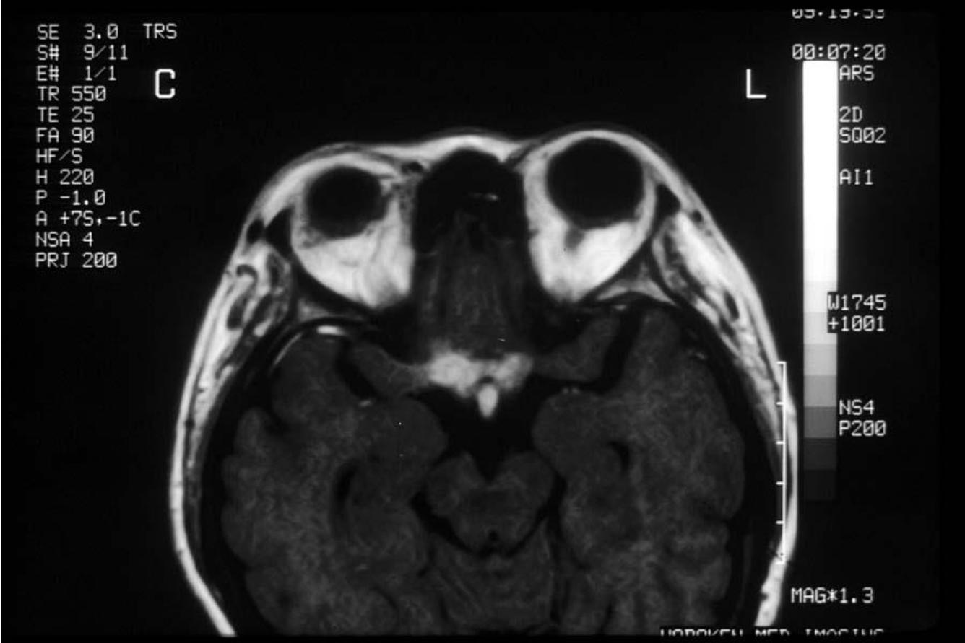
REPEAT MRI

Slide 23
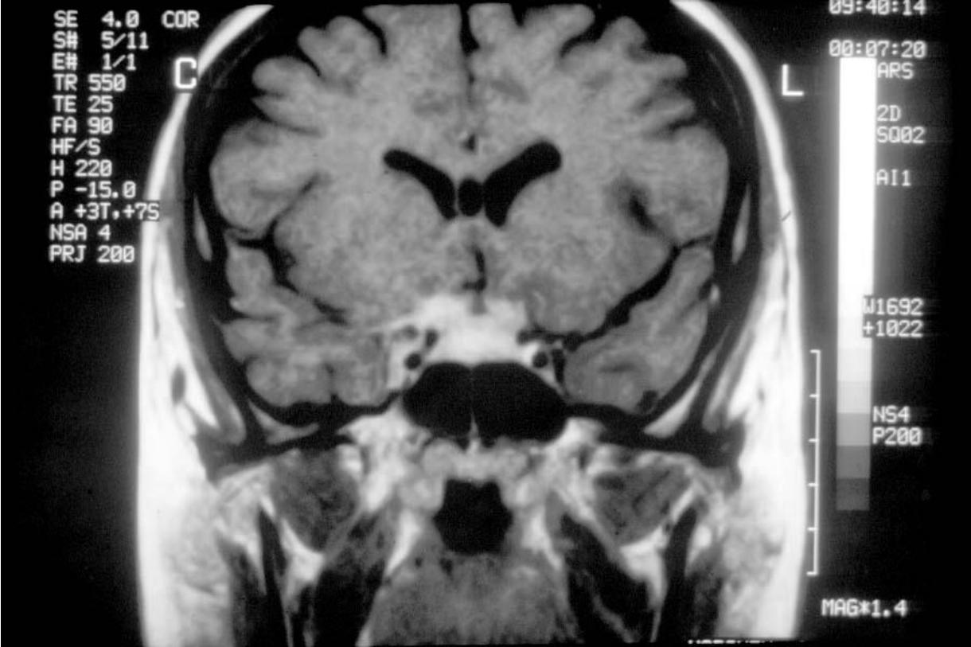
Note the obvious bilateral involvement

Slide 24

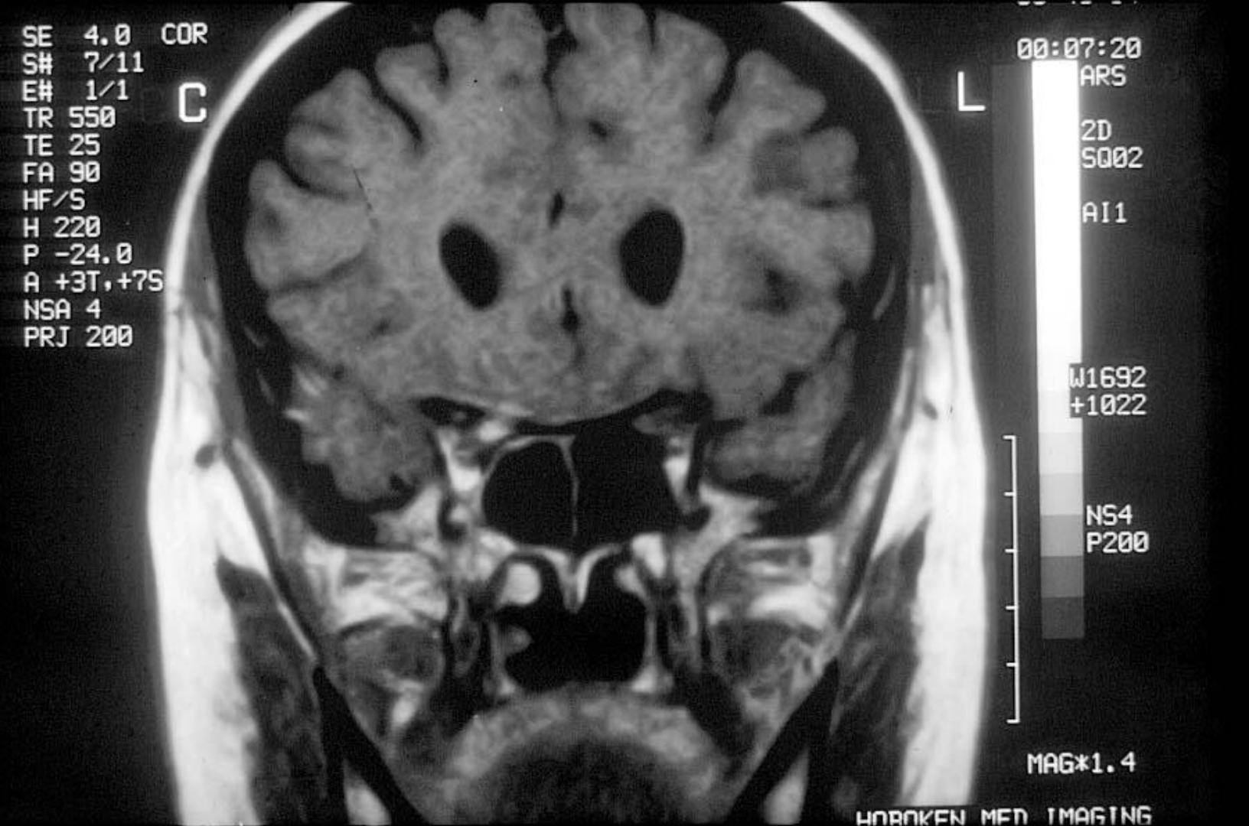


Slide 25
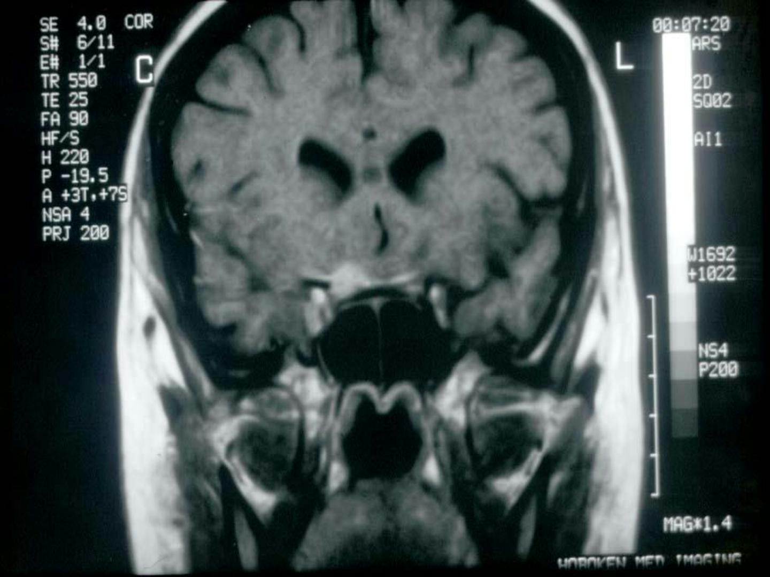

25

Slide 26


What are the yellow arrows pointing out?
neuro day 2024
26

Slide 27
MRI Orbits
Enhancing mass in the right optic n erve larger than study
from six months ago.
In the left eye, the posterior optic n erve demonstrated
enlargement with an enhancing mass. The chiasm, pituitary
stalk, and tentorial edges all demonstrated enhancement.
Suspicious, g iven clinical picture, for neurosarcoidosis
in vo lvin g the optic nerves and chiasm
The arrows are pointing out the enhancement of the basilar
meninges

Slide 28
Patient delayed her w orkup until following
week, despite pain and second eye
involvement.
• W hen she was finally admitted, her visio n in the left seeing
eye had declined to 20/200, and her field defect was much
larg er.

Slide 29
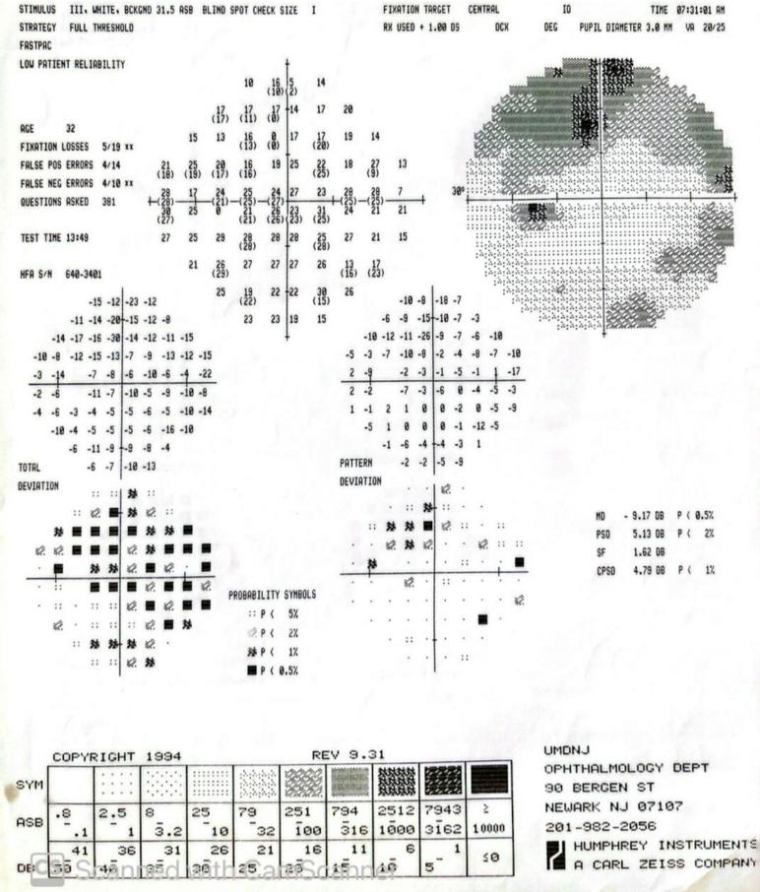

Slide 30
Serologic Workup
Serum
BUN 7
Na 134
K 4.7
Cl 102
CO2 17 (L)
Glu 77
WBC 6.4
RBC 4.82
Hgb 13.2
MCV 85.0
Cr 0.7
Ca 9.7
TPro 7.0
A lb 4.7

Slide 31
CSF RESULTS
• WBC 216 (H) (0-5)
• Neut 0%
• Culture: No Growth
• Gram: Few PMNs
• VDRL (-)
• Lymph 97%
• Mono 3%
• H. influenzae (-)
• S. pneumoniae (-)
• N. meningitidis (-)
• Group B Strep (-)
• Glu 46
• Lactic acid 2.6 (H) (0-2.2)
• Protein 134 (H) (14-45)

Slide 32
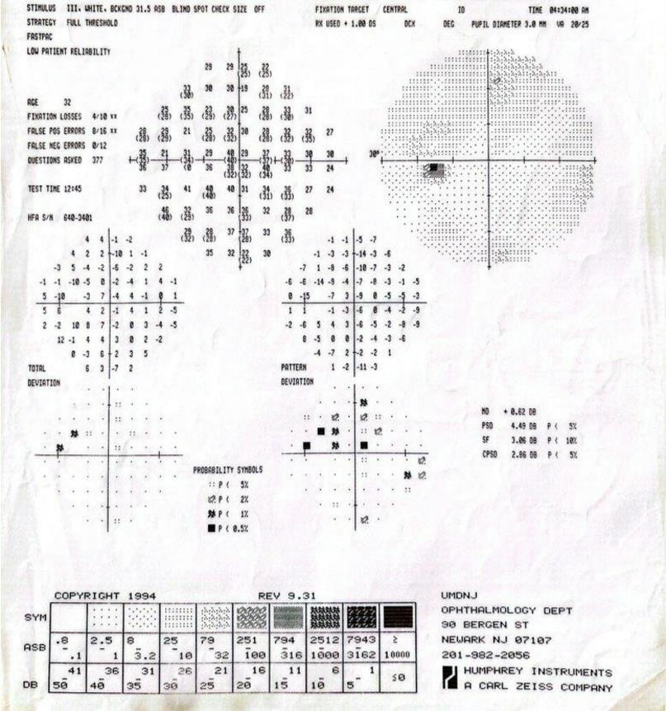
During admission for left-sided
visu a l loss and acute field deficit,
she was treated with intravenou s
doses of Solumedrol 250 mg
every 6 hours and vision returned
to 20/20 OS with normal color
plates after 24 hours. After
another 24 hours, her visu a l field
normalized.

Slide 33
Besides biopsying the optic nerve (which
patient did not want) what else might we do
to establish a diagnosis?

Slide 34
FURTHER DIAGNOSTIC TESTING FOR
SARCOID
• PFT with DLCO
• Anergy Panel
• 24 hr Urine Calc iu m
• Gallium or PET Scan

Slide 35
We know she has a lymphocytic
pleocytosis on her Spinal Tap
• But also:
• CXR and ACE W NL, but…
• PFTs: DLCO reduced to 72% of normal
• Anergic with negative PPD
• E levat ed 24 hour urine c alc ium
• And…

Slide 36
Gallium scan
Increase in uptake in the bilateral lung parenchyma more
than the lower lobes. There is also evid en c e of increased
uptake in the salivary glands and parotids. No increase in
uptake in the mediastinal region.

Slide 37
Patient Refused Bronchoscopy, but with
• Cons is tent Fundus
• Cons is tent MRI ( br ain now als o has lesions suggesting s arc oid)
• Lymphocytic pleoc yt os is
• Anergy
• Elevated 24 hr urine c alc ium
• Abnormal PFT’s (DLCO)
• Gallium scan abnor mal in lungs, par otids , and s alivar y glands…
• DIAGNOSIS = SARCOIDOSIS

Slide 38
Neurosarcoidosis
Chronic system ic disease characterized pathologically by
non-caseating granulomas affecting one or multiple organs
In the United States, most commonly and most severel y
affects African American women with higher rates of multi-
organ involvem ent and mortality
Immune dysregulation due to excessive ac tivit y of T-cell and
macrophages resulting in granuloma formation

Slide 39
Neurosarcoidosis
• Both ocular and neurosarcoidosis may occur in the absence
of system ic sarcoidosis
• Of the cranial neuropathies, most common is VII
• Optic nerve about 1% of cases
• Other ocular signs:
Anterior uveit is , granulomatous keratic precipitates, iris
nodules, vitreous snowballs, chorioretinitis, panuveit is, optic
n erve / chiasmal granulomas

Slide 40
Diagnosis
E levat ed serum ACE, lysozym e
Chest x-ray --> bilateral hilar lymphadenopath y
Negative Tuberculin testing
Lumbar puncture --> lymphocyt ic pleocytosis
Neuroimaging
PDG-PET, g alliu m scan
Tissue biopsy (ocular vs elsewhere)

Slide 41
Treatment
Steroids (oral and IV)
Biologics
Immunomodulatory
Steroid-sparing agents
Combination therapy may be required in severe or refractory
cases⁸
Collaboration with rheumatology

Slide 42
Our Case
• IV s teroids while admitted, t r ans it ioned to or al s teroids as
outpatient
o Caution steroids: osteopenia, hyperglycem ia, mood symptoms, weight
gain, growth restriction (in pediatric)
o DEXA, regular laboratory testing, GI and bone prophyl axi s vi a PCP
• Maintained on Prednisone 60 mg --> 5 mg with only t r ans ient
subj ective r epor t of c hanges to vision, oc c as ionally requiring
s mall inc r eas es
• MTX added 5 year s into t her apy, which r educ ed headac h es , and
per mit t ed r educ t ion of or al s teroids
• St er oids inc r eas ed PRN per rheumatology driven by non-
ophthalmic symptoms

Slide 43
References
1.
2.
3.
Frohman L. Therapy of Neuro-Ophthalmic Sarcoidosis. J. Neuro-ophthalmology, 35(1):65-72, 2015 Sohan Singh Hayreh, Ischemic optic
neuropathy, In Progress in Retinal and Eye Research 2009; Volume 28, Issue 1, pp. 34-62,
Beck RW, Servais GE, and Hayreh SS: Anterior ischemic optic neuropathy. IX. Cup-to-disc ratio and its role in pathogenesis. Ophthalmology 1987;
94: pp. 1503-1508
Hattenhauer MG, Leavitt JA, Hodge DO, Grill R, Gray DT. Incidence of nonarteritic anterior ischemic optic neuropathy. Am J Ophthalmol. Jan
1997;123(1):103-107.
4.
5.
6.
7.
8.
9.
Tana C, Wegener S, et al. Challenges in the diagnosis and treatment of neurosarcoidosis. Ann med. 2015;47(7):576-91.
Iannuzzi MC , Fontana Jr. Sarcoidosis: clinical presentation, immunopathogenesis, and therapeutics. JAMA. 2011;305:391-9.
Rybicki BA, Iannuzzi MC. Epidemiology of sarcoidosis: recent advances and future prospects. Semin Respir Crit Care Med. 2007;28:22-35
Nozaki K, Judson M. Neurosarcoidosis. Curr Treat Options Neurol. 2013;15(4):492-504.
Scott T, Yandora K, et al. Aggressive therapy for neurosarcoidosis: long-term follow-up of 48 treated patients. Arch Neurol. 2007;64(5):691-6.
Turbin RE, Thompson CR, Kennerdell JS, et al. A long-term visual outcome comparison in patients with optic nerve sheath meningioma managed
with observation, surgery, radiotherapy, or surgery and radiotherapy. Ophthalmology. 2002;109:890-899.

