Slide 1


Headaches in a Patient with Turner Syndrome
Xavier Mortensen, MD
Duy Huynh, BS
Jennifer Law, MD, MSCR
Maja Kostic, MD, MPH, PhD

Slide 2
7-Year-Old girl with Turner Syndrome and New Headaches
Started Somatroptin (Norditropin FlexPro) 15 mg/ 1.5 mL 1.1 mg nightly (0.35 mg/kg/wk)
1 week later, onset of headaches that improved with Tylenol
Patient stopped GH therapy due to persistent severe HA
Patient with no visual complaints
Contacted endocrinologist who recommended stopping GHT and referred for Neuro-ophthalmology evaluation
Why would you refer to ophthalmology for headaches?

Slide 3
Neuro-Ophthalmology Evaluation
Patient still has headaches but not as severe
  +pulsatile tinnitus
No subjective vision changes
Exam:
  VA 20/40 OD 20/30 OS
  Color plates 11/11 OU
  Grade 3 disc edema with heme OU
Key detail: at this point, it has been 2 months since initiation of GHT and month since stopping it

Slide 4
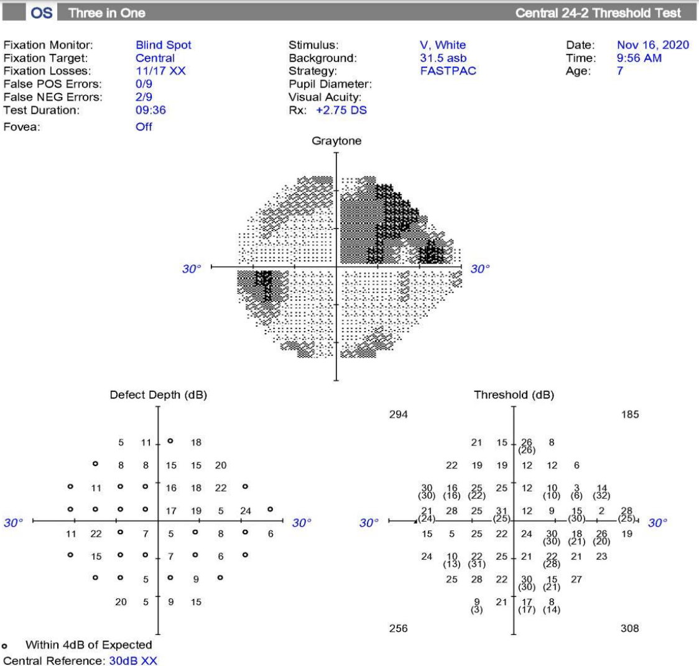
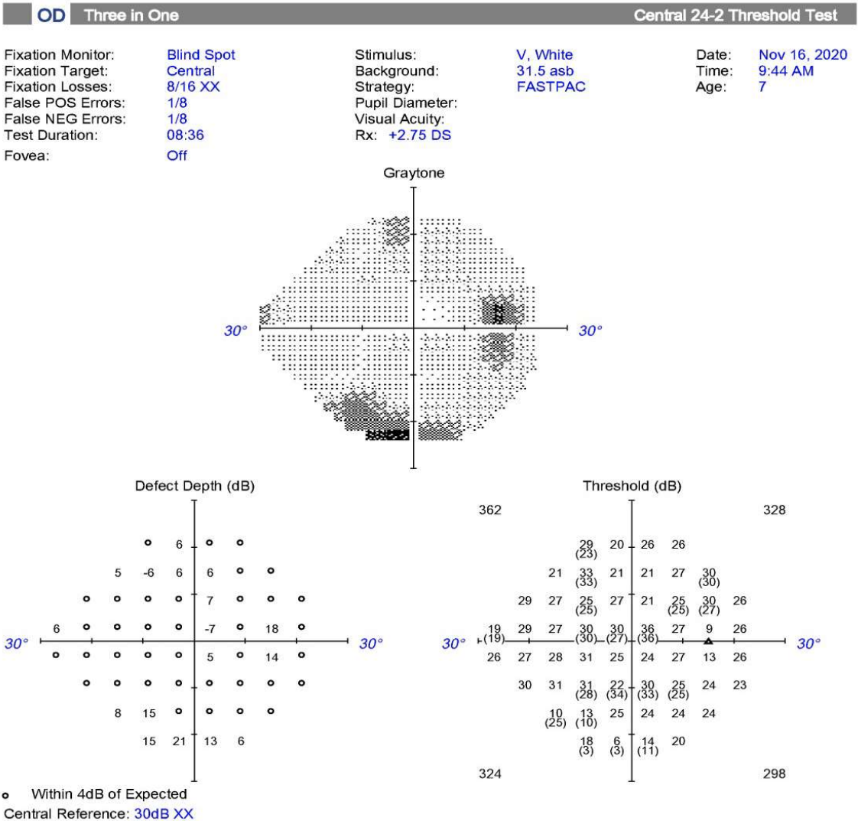
24-2 Size 5 Humphrey Visual Field
OS: superonasal deficit respecting horizontal and vertical midline. Small peripheral deficits, enlarged blind spot
OD: inferior deficits, enlarged blind spot
*Note poor test reliability OU*

Slide 5
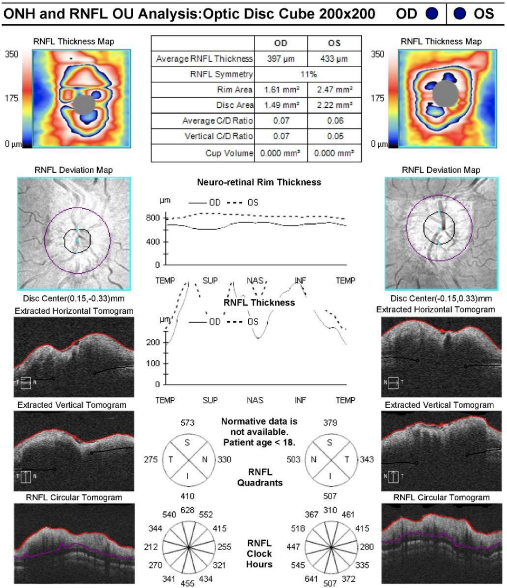
OCT Retinal Nerve Fiber Layer
Significant disc edema of both eyes
Average thickness:
397 μm OD, 433 μm OS
Reference range: 117.11±9.15 um

Slide 6
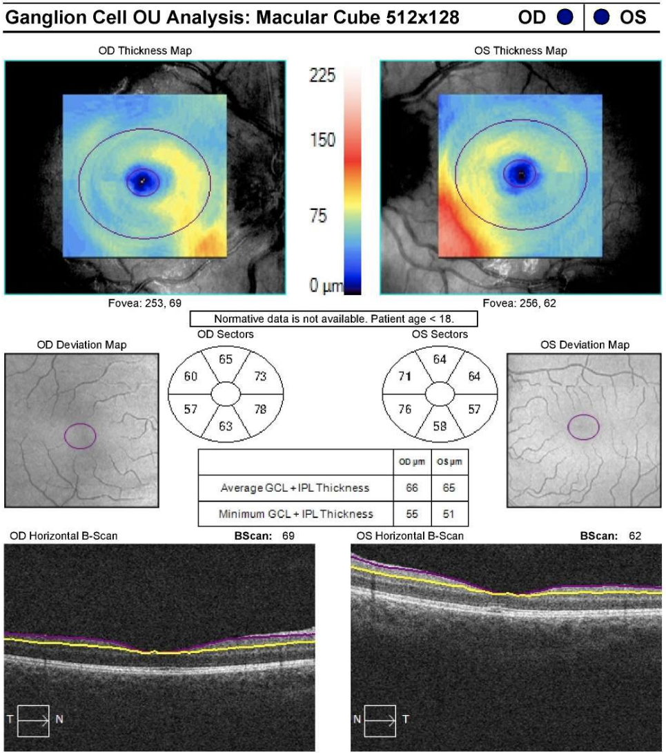
OCT Ganglion Cell Complex analysis
Notable thinning of ganglion cell layer Average thickness:
66 μm OD, 65 μm OS
Reference range: 95.31±7.67 µm

Slide 7
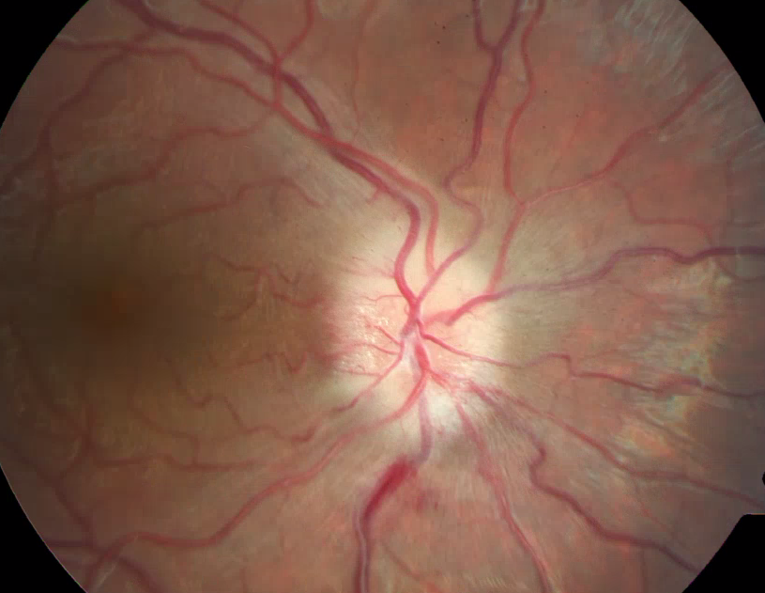
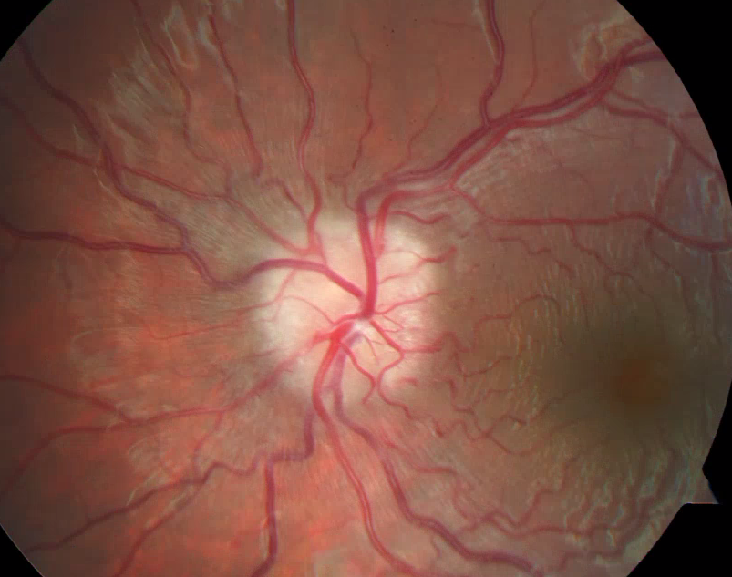
Fundus photos

Slide 8
Differential for Bilateral Optic Disc Edema
Mass lesion
Dural venous sinus thrombosis
Meningitis/encephalitis
Idiopathic intracranial hypertension
Pseudopapilledema
Ischemic optic neuropathy
Medication induced
Anemia
Hypercarbia
Adrenal Insufficiency
Hypertensive optic neuropathy
Diabetic papillopathy
Central retinal vein occlusion
Optic neuritis
Infection
Toxic optic neuropathy
Infiltrative optic neuropathy
Leber’s hereditary optic neuropathy
Ocular hypotony
Space flight associated neuro-ocular syndrome

Slide 9
What is the next best step?
A. CT scan
B. Continue to monitor
C. Urgent evaluation in ED (Labs, MRI)
D. Optic sheath fenestration
E. Contact patient’s endocrinologist

Slide 10
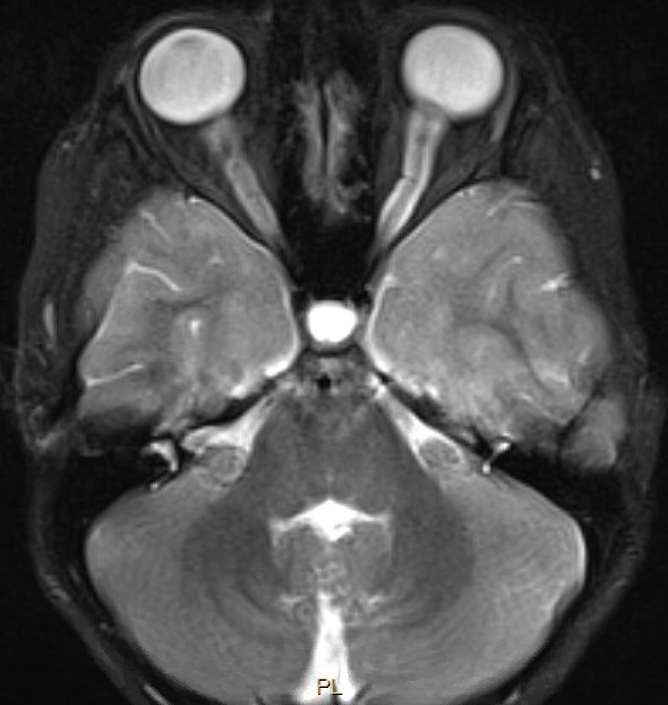
Patient’s MRI: T2 Axial with fat suppression
Flattening of the posterior globe
What ocular radiographic findings are seen in this MRI that are often found in IIH?
Tortuosity of the optic nerve

Slide 11
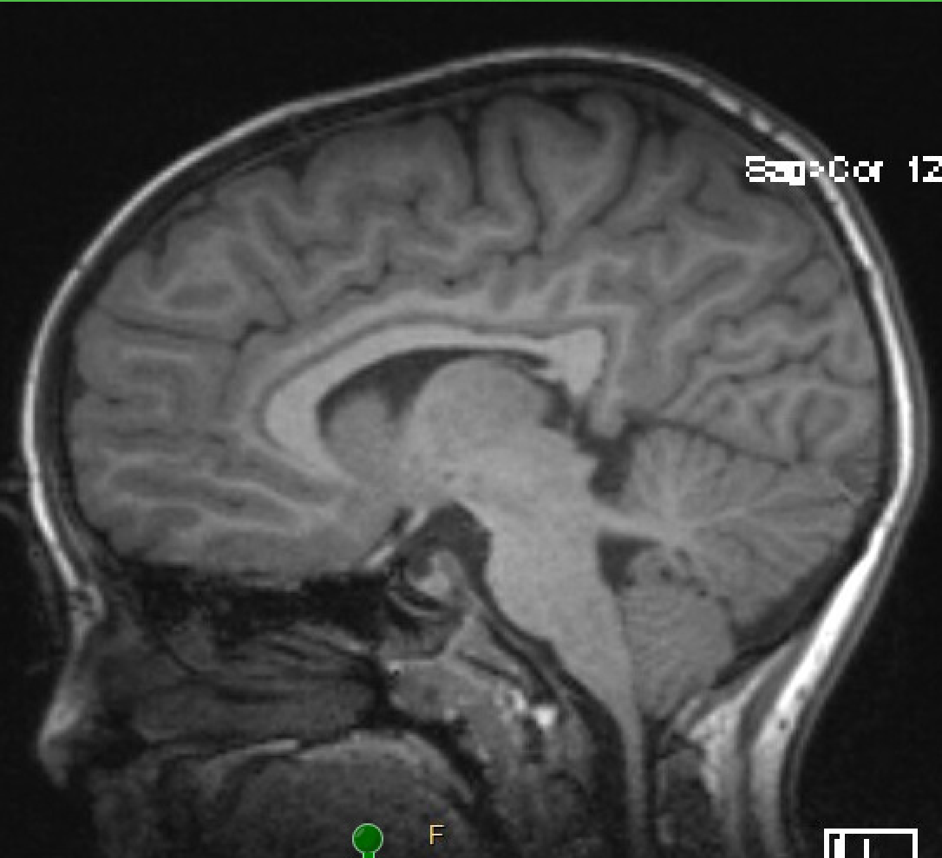
Patient’s MRI: T1 Sagittal
What radiographic finding is seen in this MRI that is often found in IIH?
What other unique finding is seen here?
(Partial) Empty Sella
Cerebellar ectopia
Same as Chiari 1 malformation?
Not necessarily...

Slide 12
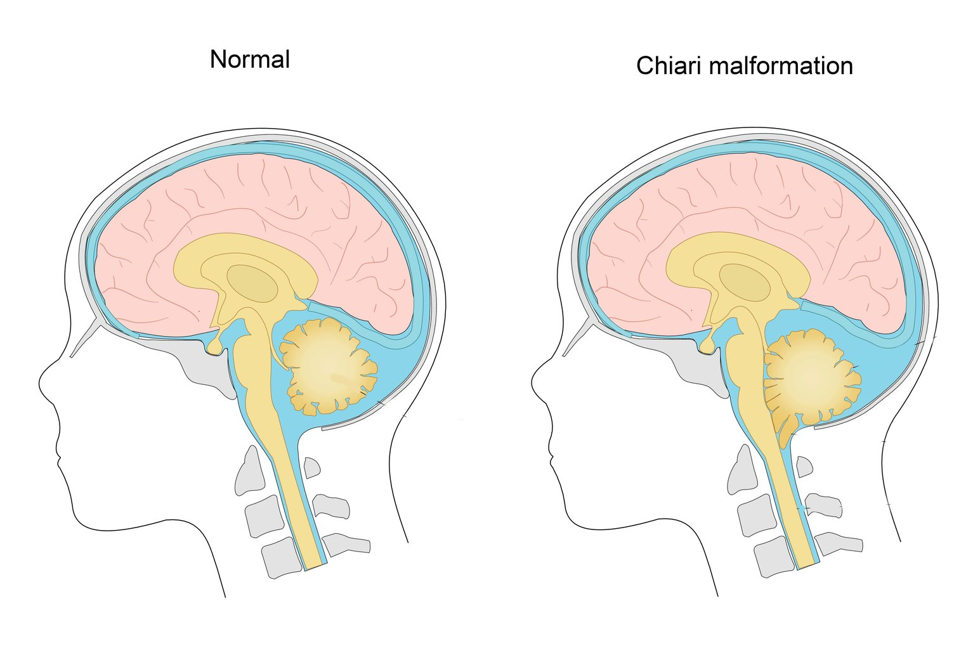
Cerebellar Ectopia and Chiari Malformation
Normal
Cerebellar Ectopia
Cerebellar ectopia is the position of cerebellum characterized by downward displacement cerebellar tonsils through foramen magnum
Chiari malformation is congenital cerebellar ectopia
Image from: nhs.uk. “Chiari Malformation,” October 18, 2017. https://www.nhs.uk/conditions/chiari-malformation/.
Aiken, A.H., J.A. Hoots, A.M. Saindane, and P.A. Hudgins. “Incidence of Cerebellar Tonsillar Ectopia in Idiopathic Intracranial Hypertension: A Mimic of the Chiari I Malformation.” AJNR: American Journal of Neuroradiology 33, no. 10 (November 2012): 1901–6. https://doi.org/10.3174/ajnr.A3068.

Slide 13
Cerebellar Ectopia and Chiari Malformation
Normal
Cerebellar Ectopia
Cerebellar ectopia can also be acquired
(Aiken 2012): 21% IIH patients compared to 2% control with ≥ 5 mm tonsillar ectopia. 8/9 responded to medical treatment alone for IIH.
Image from: nhs.uk. “Chiari Malformation,” October 18, 2017. https://www.nhs.uk/conditions/chiari-malformation/.
Aiken, A.H., J.A. Hoots, A.M. Saindane, and P.A. Hudgins. “Incidence of Cerebellar Tonsillar Ectopia in Idiopathic Intracranial Hypertension: A Mimic of the Chiari I Malformation.” AJNR: American Journal of Neuroradiology 33, no. 10 (November 2012): 1901–6. https://doi.org/10.3174/ajnr.A3068.

Slide 14
Findings and Impression
MRI Brain w/wo Contrast, CNII protocol:
  Partially empty sella
  Cerebellar ectopia
  Prominent subarachnoid space surrounding the optic nerves
  Mild tortuosity of the left optic nerve
  Bilateral posterior scleral buckling with mild intra-articular protrusion of the optic nerve head on the right
  No other abnormalities in the optic nerves, chiasm, or tracts.
MRV Brain
  Mild narrowing of bilateral distal transverse sinuses
  No evidence of venous sinus thrombosis
  No abnormal enhancement.

Slide 15
Lumbar Puncture
What is considered an elevated opening pressure?
  >25 cm H₂O in adults, > 28 cm H₂O in children
Our patient’s opening pressure: 43.5 cm H₂O
  Normal CSF analysis
Avery, Robert A., Samir S. Shah, Daniel J. Licht, Jeffrey A. Seiden, Jimmy W. Huh, Jan Boswinkel, Michael D. Ruppe, Amber Chew, Rakesh D. Mistry, and Grant T. Liu. “Reference Range for Cerebrospinal Fluid Opening Pressure in Children.” The New England Journal of Medicine 363, no. 9 (August 26, 2010): 891–93. https://doi.org/10.1056/NEJMc1004957.

Slide 16
What are common risk factors for pediatric intracranial hypertension?
Pre-pubertal children
  Risk is equally distributed across gender and BMI
Post-pubertal children
  Obesity
  Female gender
Also, systemic Illnesses:
  Obstructive Sleep Apnea
  Anemia

Slide 17
What are treatment options for secondary intracranial hypertension in children?
Remove inciting factor
Medications
  First line: Acetazolamide
  Second line: Topiramate, Furosemide
Surgical
  Optic nerve sheath fenestration
  Shunt (ventriculoperitoneal or lumboperitoneal)
  Dural venous sinus stenting (currently limited data for children)

Slide 18
Medications
Acetazolamide
  Reduces CSF production by carbonic anhydrase inhibition
  Generalized improvements in signs and symptoms of IIH over periods of 6-36 months but long-term efficacy and remission have not been clearly defined
Topiramate
  Carbonic anhydrase inhibition
  Weight loss association
  Effective for migraines
Furosemide
  Also inhibits CSF production
  Has been used with anecdotal evidence
  Adjunct to acetazolamide in patients on maximal therapy and worsening symptoms (8 children case series)
(See full summary of references at end slide (Wall et all, Piper et al, Celebisoy et al, Matthews et al))

Slide 19
Surgical Interventions
Optic nerve sheath fenestration
  Small window cut in optic nerve sheath to allow CSF flow into orbit
  Case series on 86 patients/158 cases
    Stabilized or improved VA in 94% of cases
    Stabilized or improved VF in 88% of cases
  Effective and safe in children
Shunts
  Ventriculoperitoneal (VPS) preferred to lumboperitoneal (LPS)
  Outcomes can be mixed, 50-95% of patients with remission of symptoms
  LPS failure requiring revision rate is ~50%
(See full summary of references at end slide (Banta et al, Lee et al, Thuente et al, McGirt et al, Fonseca et al), Feldon et al, Burgett et al, Biousse et al, Eggenberger et al))

Slide 20
Surgical Interventions
Venous sinus stenting
  143 case review: 99% procedure success rate, 6% complications
  87-97% improvement of symptoms (Headaches, papilledema, visual symptoms, pulsatile tinnitus)
  Still a relatively new procedure compared to other options
Serial LP – not recommended due to limited effects, associated complications
  Exception is for pregnant patients due to contraindications and to avoid medical therapy
Puffer RC, Mustafa W, Lanzino G. Venous sinus stenting for idiopathic intracranial hypertension: a review of the literature. J Neurointerv Surg. 2013;5(5):483-486. doi:10.1136/neurintsurg-2012-010468
Huna-Baron R, Kupersmith MJ. Idiopathic intracranial hypertension in pregnancy. J Neurol. 2002;249(8):1078-1081. doi:10.1007/s00415-002-0791-4
Evans RW, Friedman DI. Expert opinion: the management of pseudotumor cerebri during pregnancy. Headache. 2000;40(6):495-497. doi:10.1046/j.1526-4610.2000.00076.x
Digre KB, Varner MW, Corbett JJ. Pseudotumor cerebri and pregnancy. Neurology. 1984;34(6):721-729. doi:10.1212/wnl.34.6.721

Slide 21
Back to our Patient…
Plan:
  Discussion with family and neurosurgery regarding options for lumbar drain or VP shunt vs medical therapy
  Family opted for more conservative medical management
  Start acetazolamide 30 mg/kg/day (divided TID) and titrate up to 80/mg/kg/day over 3 days as tolerated

Slide 22
Follow up 4 days later in clinic….
Patient reports no headaches, however, has had worsening shortness of breath over the last few days

Slide 23
What labs or tests will likely confirm the cause of her new symptoms?
A. Blood gas
B. CBC/CMP
C. Chest X-ray
D. CT scan
E. MRI

Slide 24
Results
Hg 14.1, Hct 40.7. CBC otherwise normal
VBG (or ABG)
  pH: 7.27
  CO₂: 13.0
Metabolic acidosis secondary to acetazolamide therapy

Slide 25
Treatment
Decreased acetazolamide to 60mg/kg/day divided TID
Sodium bicarbonate ~1mEq/kg BID (1300 mg BID) while on higher dosing of acetazolamide
Metabolic acidosis resolved
Acetazolamide later decreased to 30 mg/kg/day

Slide 26
OCT RNFL and GCC

Slide 27
Follow up 3 months after initial presentation
Papilledema resolved and had tapered off acetazolamide
Notable pallor of optic nerves
VA 20/40 and continued to be stable over next 6 months

Slide 28
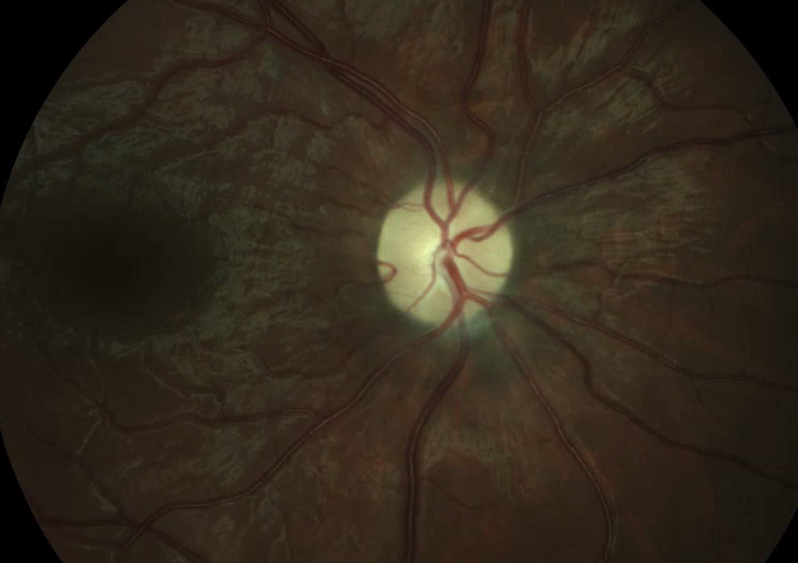
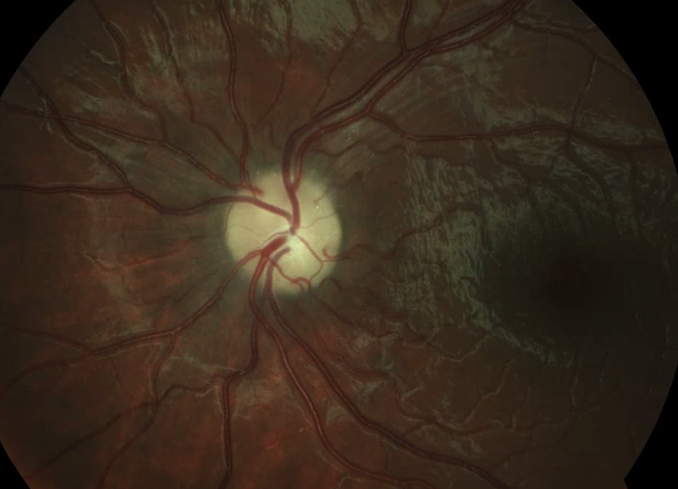
3 months after initial presentation

Slide 29
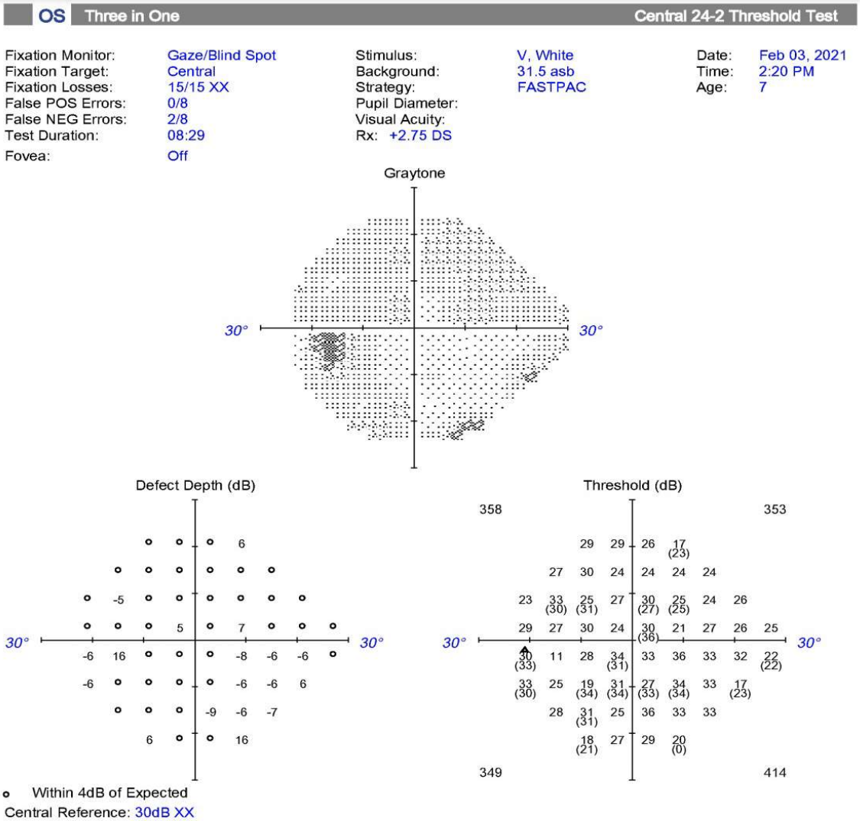
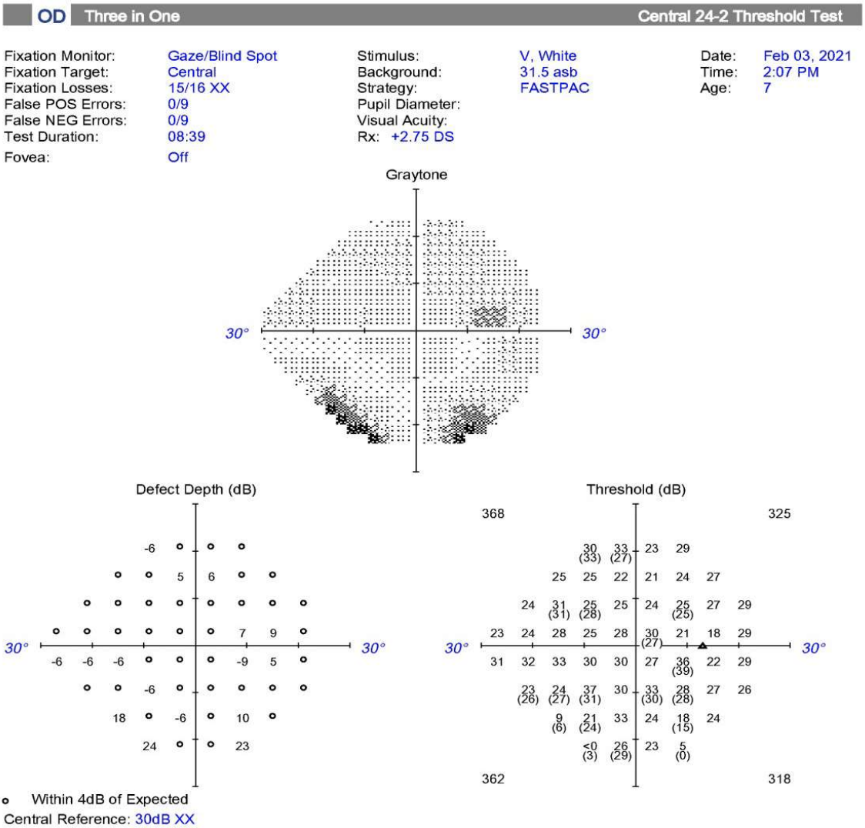
24-2 Size 5 Humphrey Visual Field
(3 months after presentation)
Significant improvement from previously,
with non-specific peripheral deficits
*Note poor test reliability OU*

Slide 30
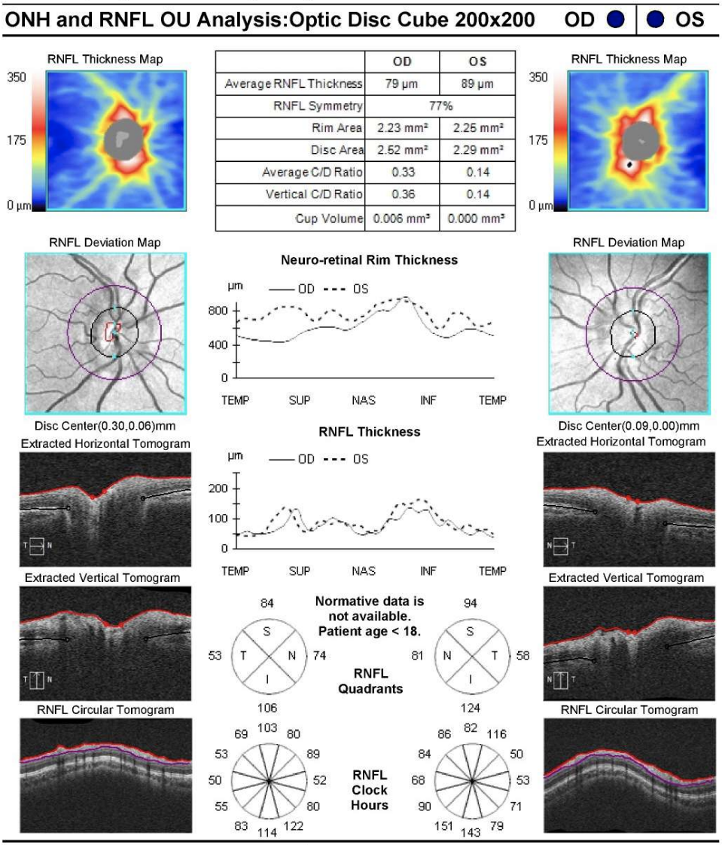
OCT RNFL
(3 months after presentation)
Significant thinning of RNFL OU
Average thickness OD 79 µm, OS 89 µm
Reference range: 117.11±9.15 um

Slide 31
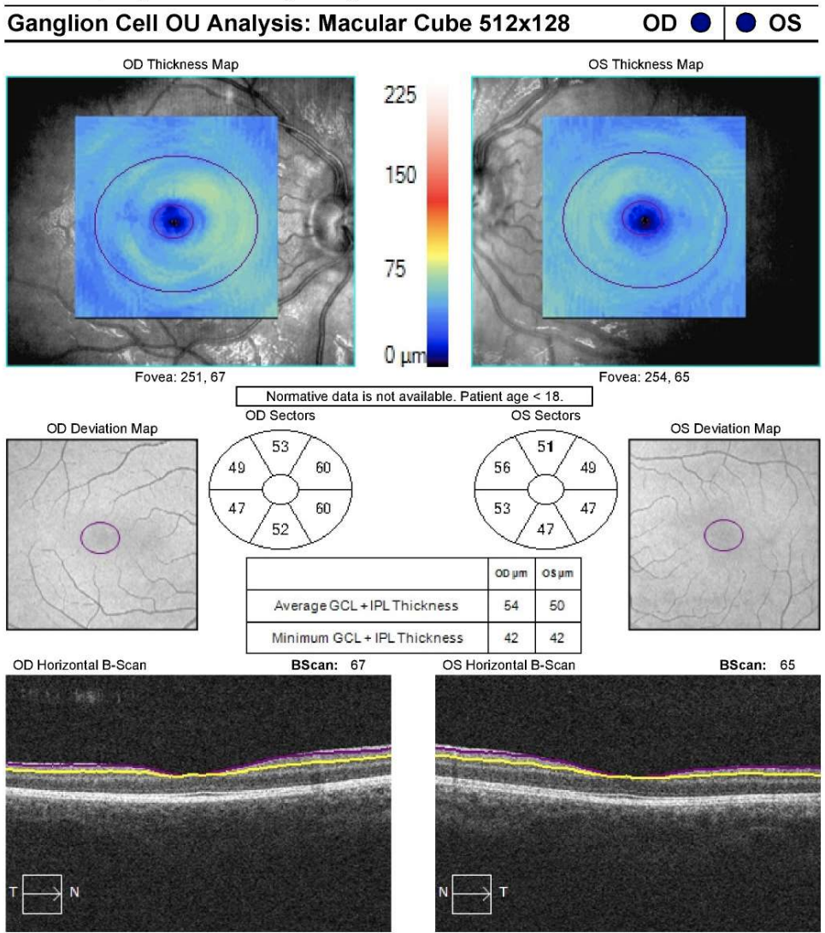
OCT GCC
(3 months after presentation)
Significant ganglion cell layer atrophy
Average Thickness:
OD 54 µm, OS 50 µm
Reference range: 95.31±7.67 µm

Slide 32
Growth Hormone Therapy-related Intracranial Hypertension
MOA
  unclear, but possibly due to GH’s effect on IGF1 -> increased CSF production in choroid plexus
Incidence
  13 per 100,000 treatment years in children
  56.4 per 100,000 treatment years in Turner syndrome
  Increased with renal insufficiency
Darendeliler F, Karagiannis G, Wilton P. Headache, idiopathic intracranial hypertension and slipped capital femoral epiphysis during growth hormone treatment: a safety update from the KIGS database. Horm Res. 2007;68 Suppl 5:41-7. doi: 10.1159/000110474. Epub 2007 Dec 10. PMID: 18174706.)
Malozowski S, Tanner LA, Wysowski DK, Fleming GA, Stadel B V. Benign intracranial hypertension in children with growth hormone deficiency treated with growth hormone. J Pediatr. 1995;126(6):996-999. doi:https://doi.org/10.1016/S0022-3476(95)70232-6
Wall M. Idiopathic Intracranial Hypertension. Neurol Clin. 2010;28(3):593-617. doi:https://doi.org/10.1016/j.ncl.2010.03.003
Crock PA, McKenzie JD, Nicoll AM, et al. Benign intracranial hypertension and recombinant growth hormone therapy in Australia and New Zealand. Acta Paediatr. 1998;87(4):381-386. doi:https://doi.org/10.1111/j.1651-2227.1998.tb01463.x

Slide 33
What other medications are associated with increased risk for intracranial hypertension?
Vitamin A derivatives
Tetracyclines
Lithium
Recombinant growth hormone
Cyclosporine
Nalidixic acid
Anabolic steroids
Adrenal insufficiency
Glucocorticoid withdrawal
Others
Tan, Marcus G., Brandon Worley, Whan B. Kim, Martin Ten Hove, and Jennifer Beecker. “Drug‑Induced Intracranial Hypertension: A Systematic Review and Critical Assessment of Drug‑Induced Causes.” American Journal of Clinical Dermatology 21, no. 2 (April 2020): 163–72. http://dx.doi.org/10.1007/s40257-019-00485-z.

Slide 34
Growth Hormone Therapy
The Drug and Therapeutics, and Ethics Committees of the Pediatric Endocrine Society have published guidelines that recommend initiation of treatment at a dose of 0.16-0.25 mg/kg/wk¹
Our patient started on 0.35mg/kg/wk
1. Grimberg A, Sara D, Polychronakos C, et al. Guidelines for Growth Hormone and Insulin-Like Growth Factor-I Treatment in Children and Adolescents: Growth Hormone Deficiency, Idiopathic Short Stature, and Primary Insulin-Like Growth Factor-I Deficiency. Horm Res Paediatr. 2016;86(6):361-397. doi:10.1159/000452150

Slide 35
Summary of literature review
23 publications of about 150 cases
(PubMed search criteria – keywords IIH, growth hormone therapy, papilledema, turner syndrome, pediatric, pseudotumor cerebri)
45 Females, 78 Males
Age range 1.3 y to 42 y
  average age around 7-14 years old
11 cases with asymptomatic papilledema
1 case of metabolic acidosis with acetazolamide
6 with CN VI, double vision, or esotropia
(See full summary of references at end slide)

Slide 36
Summary of literature review: Treatment
Most all cases: Symptomatic Pts given medical treatment + cessation of GHT
Some cases describe improvement in disc edema with cessation of GHT alone
Can resume GHT, but may have recurrence, lower doses recommended (decreased dose recommended)
  9/33 cases with recurrence
(See full summary of references at end slide)

Slide 37
Acetazolamide dosing in children
One study proposes that high-dose treatment up to 60 mg/kg/day is required for decreasing CSF production¹.
Our patient was quickly escalated from 30 mg/kg/day to 80 mg/kg/day over 2 days; likely too quick/high for her tolerance.
Literature suggests initiation at 25 mg/kg/day and increasing by 25/mg/kg/day up to total of 100 mg/kg/day, as tolerated by the child²
In practice, many don’t tolerate higher than 30 mg/kg/day
1. Baker RS, Baumann RJ, Buncic JR. Idiopathic intracranial hypertension (pseudotumor cerebri) in pediatric patients. Pediatr Neurol. 1989;5(1):5-11. doi:https://doi.org/10.1016/0887-8994(89)90002-7
2. Matthews YY. Drugs used in childhood idiopathic or benign intracranial hypertension. Arch Dis Child - Educ &amp;amp; Pract Ed. 2008;93(1):19 LP - 25. doi:10.1136/adc.2006.107326

Slide 38
Important points to remember
Bilateral optic disc edema carries a broad differential
  Urgent work-up is essential to rule out life and vision-threatening causes
Several medications including growth hormone are associated with increased risk of developing intracranial hypertension
Cessation of offending agent alone is unlikely sufficient without prompt medical therapy
Caution with rapid titration of acetazolamide with risk of metabolic acidosis, especially in children

Slide 39
Conclusion
Careful coordination with pediatric endocrinologist and neuro-ophthalmologist is recommended with patients using GHT to prevent irreversible vision loss.

Slide 40
References
Aiken, A.H., J.A. Hoots, A.M. Saindane, and P.A. Hudgins. “Incidence of Cerebellar Tonsillar Ectopia in Idiopathic Intracranial Hypertension: A Mimic of the Chiari I Malformation.” AJNR: American Journal of Neuroradiology 33, no. 10 (November 2012): 1901–6. https://doi.org/10.3174/ajnr.A3068.
Avery, Robert A., Samir S. Shah, Daniel J. Licht, Jeffrey A. Seiden, Jimmy W. Huh, Jan Boswinkel, Michael D. Ruppe, Amber Chew, Rakesh D. Mistry, and Grant T. Liu. “Reference Range for Cerebrospinal Fluid Opening Pressure in Children.” The New England Journal of Medicine 363, no. 9 (August 26, 2010): 891–93. https://doi.org/10.1056/NEJMc1004957.
Tornese, G., Tonini, G., Patarino, F.,Parentin, F., & Marchetti, F. (2009). Double adverse drug reaction: Recombinant human growth hormone and idiopathic intracranial hypertension - acetazolamide and metabolic acidosis: a case report. Cases Journal, 2, 6534. https://doi.org/10.4076/1757-1626-2-6534
Malozowski, S., Tanner, L. A., Wysowski, D. K., Fleming, G. A., & Stadel, B. V. (1995). Benign intracranial hypertension in children with growth hormone deficiency treated with growth hormone. The Journal of Pediatrics, 126(6), 996–999. https://doi.org/https://doi.org/10.1016/S0022-3476(95)70232-6
Malozowski MD, PhD, S., Tanner RPh, MPH, L. A., Wysowski PhD, D., & Fleming MD, G. A. (1993). Growth Hormone, Insulin-like Growth Factor I, and Benign Intracranial Hypertension: [Letter]. The New England Journal of Medicine, 329(9), 665–666. https://doi.org/http://dx.doi.org/10.1056/NEJM199308263290917
Otten B J, Rottevel JJ, Cruysberg JRM. Pseudotumor cerebri following treatment with growth hormone [Abstract]. Horm Res 1992; 37:16.
Obinata, K., Kamata, A., Kinoshita, K., Nakazawa, T., Haruna, H., Hosaka, A., & Shimizu, T. (2010). Prolonged Intracranial Hypertension after Recombinant Growth Hormone Therapy due to Impaired CSF Absorption. Clinical Pediatric Endocrinology : Case Reports and Clinical Investigations : Official Journal of the Japanese Society for Pediatric Endocrinology, 19(2), 39–44. https://doi.org/10.1297/cpe.19.39
Loukianou, E., Tasiopoulou, A., Demosthenous, C., & Brouzas, D. (2016). Pseudotumor Cerebri in a Child with Idiopathic Growth Hormone Insufficiency Two Months after Initiation of Recombinant Human Growth Hormone Treatment. Case Reports in Ophthalmological Medicine, 2016, 4756894. https://doi.org/10.1155/2016/4756894
Blethen, S. L., Allen, D. B., Graves, D., August, G., Moshang, T., & Rosenfeld, R. (1996). Safety of recombinant deoxyribonucleic acid-derived growth hormone: The National Cooperative Growth Study experience. The Journal of Clinical Endocrinology & Metabolism, 81(5), 1704–1710. https://doi.org/10.1210/jcem.81.5.8626820
Crock, P. A., McKenzie, J. D., Nicoll, A. M., Howard, N. J., Cutfield, W., Shield, L. K., & Byrne, G. (1998). Benign intracranial hypertension and recombinant growth hormone therapy in Australia and New Zealand. Acta Paediatrica, 87(4), 381–386. https://doi.org/https://doi.org/10.1111/j.1651-2227.1998.tb01463.x
Kanner, L. A., Klein, J., Gaffar, M., Pomeranz, H., & Frank, G. (2018). New-Onset Isolated Asymptomatic Papilledema in Two Patients Treated With Recombinant Growth Hormone. Clinical Pediatrics, 57(4), 471–474. https://doi.org/10.1177/0009922817698808
Francois, I., Casteels, I., Silberstein, J., Casaer, P., & de Zegher, F. (1996). Empty sella, growth hormone deficiency and pseudotumour cerebri: effect of initiation, withdrawal and resumption of growth hormone therapy. European Journal of Pediatrics, 156(1), 69–70. https://doi.org/10.1007/s004310050556
Nieves, M.-B., Mogas, E., Wolley Dod, C., Alarcón, S., Clemente, M., Campos-Martorell, A., … Yeste, D. (2020). Growth Hormone Treatment and Papilledema: a Prospective Pilot Study. J Clin Res Pediatr Endocrinol, Oct 2. https://doi.org/10.4274/jcrpe.galenos.2020.2020.0007
Reeves G.D., & Doyle D.A. (n.d.). Growth Hormone Treatment and Pseudotumor Cerebri: Coincidence or Close Relationship? Journal of Pediatric Endocrinology and Metabolism, 15(Supplement), 723–730. https://doi.org/https://doi.org/10.1515/JPEM.2002.15.S2.723
Koller, E. A., Stadel, B. V, & Malozowski, S. N. (1997). Papilledema in 15 renally compromised patients treated with growth hormone. Pediatric Nephrology, 11(4), 451–454. https://doi.org/10.1007/s004670050315
Price, D. A., Clayton, P. E., & Lloyd, I. C. (1995). Benign intracranial hypertension induced by growth hormone treatment. The Lancet, 345(8947), 458–459. https://doi.org/https://doi.org/10.1016/S0140-6736(95)90444-
Mahon, M., & Cody, D. (2019). Benign Intracranial Hypertension Necessitating Ventriculoperitoneal Shunt Insertion Secondary to Growth Hormone Therapy. Irish medical journal, 112(5), 936.
Noto, R., Maneatis, T., Frane, J., Alexander, K., Lippe, B., & Davis, D. A. (n.d.). Intracranial hypertension in pediatric patients treated with recombinant human growth hormone: data from 25 years of the Genentech National Cooperative Growth Study. Journal of Pediatric Endocrinology and Metabolism, 24(9–10), 627–631. https://doi.org/https://doi.org/10.1515/JPEM.2011.319
Fine, R. N., Ho, M., Tejani, A., & Blethen, S. (2003). Adverse events with rhGH treatment of patients with chronic renal insufficiency and end-stage renal disease. The Journal of Pediatrics, 142(5), 539–545. https://doi.org/https://doi.org/10.1067/mpd.2003.189
Obinata K, Kamata A, Kinoshita K, et al. Prolonged Intracranial Hypertension after Recombinant Growth Hormone Therapy due to Impaired CSF Absorption. Clin Pediatr Endocrinol. 2010;19(2):39-44. doi:10.1297/cpe.19.39
Krumova S, Sivkova N, Marinov V, Koleva-Georgieva D, Voynikova D. Normal Reference Ranges of Optical Coherence Tomography Parameters in Children. Folia Med (Plovdiv). 2020;62(2):338-344. doi:10.3897/folmed.62.e46678

Slide 41
References
Wingenfeld, P., Schmidt, B., Hoppe, B., Querfeld, U., Schönau, E., Moritz, C., & Michalk, D. (1995). Acute glaucoma and intracranial hypertension in a child on long-term peritoneal dialysis treated with growth hormone. Pediatric Nephrology, 9(6), 742–745. https://doi.org/10.1007/BF00868727
Rogers, A. H., Rogers, G. L., Bremer, D. L., & McGregor, M. Lou. (1999). Pseudotumor cerebri in children receiving recombinant human growth hormone. Ophthalmology, 106(6), 1186–1190. https://doi.org/https://doi.org/10.1016/S0161-6420(99)90266-X
Besch, D., Makowski, C., Steinborn, M. M., Bonfig, W., & Sadowski, B. (2013). Visual loss without headache in children with pseudotumor cerebri and growth hormone treatment. Neuropediatrics, 44(4), 203–207. https://doi.org/10.1055/s-0032-1330855Full Text unavailable
Sebestyen, J., & Warady, B. A. (2010). Pseudotumor cerebri in a toddler receiving recombinant human growth hormone. Peritoneal dialysis international : journal of the International Society for Peritoneal Dialysis, 30(4), 477–478. https://doi.org/10.3747/pdi.2009.00134
Tan, Marcus G., Brandon Worley, Whan B. Kim, Martin Ten Hove, and Jennifer Beecker. “Drug‑Induced Intracranial Hypertension: A Systematic Review and Critical Assessment of Drug‑Induced Causes.” American Journal of Clinical Dermatology 21, no. 2 (April 2020): 163–72. http://dx.doi.org/10.1007/s40257-019-00485-z.
Vischi, A., Guerriero, S., Giancipoli, G., Lorusso, V., & Sborgia, G. (2006). Delayed onset of pseudotumor cerebri syndrome 7 years after starting human recombinant growth hormone treatment. European journal of ophthalmology, 16(1), 178–180. https://doi.org/10.1177/112067210601600131
Parentin, F., Marchetti, F., Faleschini, E., Tonini, G., & Pensiero, S. (2009). Acute comitant esotropia secondary to idiopathic intracranial hypertension in a child receiving recombinant human growth hormone. Canadian journal of ophthalmology. Journal canadien d'ophtalmologie, 44(1), 110–111. https://doi.org/10.3129/i08-158
Sacco M, Di Giorgio G. Recurrent intracranial hypertension induced by growth hormone therapy. J Pediatr Endocrinol Metab. 2006 Apr;19(4):545. PMID: 16759042.
Smith, J. Whence Pseudotumor Cerebri?, Journal of Clinical Neuro-Ophthalmology: March 1985 - Volume 5 - Issue 1 - p 55-56
Banta JT, Farris BK. Pseudotumor cerebri and optic nerve sheath decompression. Ophthalmology. 2000;107(10):1907-1912. doi:10.1016/s0161-6420(00)00340-7
Lee AG, Patrinely JR, Edmond JC. Optic nerve sheath decompression in pediatric pseudotumor cerebri. Ophthalmic Surg Lasers. 1998;29(6):514-517.
Darendeliler F, Karagiannis G, Wilton P. Headache, idiopathic intracranial hypertension and slipped capital femoral epiphysis during growth hormone treatment: a safety update from the KIGS database. Horm Res. 2007;68 Suppl 5:41-7. doi: 10.1159/000110474. Epub 2007 Dec 10. PMID: 18174706.)
Thuente DD, Buckley EG. Pediatric optic nerve sheath decompression. Ophthalmology. 2005;112(4):724-727. doi:10.1016/j.ophtha.2004.11.049
McGirt MJ, Woodworth G, Thomas G, Miller N, Williams M, Rigamonti D. Cerebrospinal fluid shunt placement for pseudotumor cerebri-associated intractable headache: predictors of treatment response and an analysis of long-term outcomes. J Neurosurg. 2004;101(4):627-632. doi:10.3171/jns.2004.101.4.0627
Fonseca PL, Rigamonti D, Miller NR, Subramanian PS. Visual outcomes of surgical intervention for pseudotumour cerebri: optic nerve sheath fenestration versus cerebrospinal fluid diversion. Br J Ophthalmol. 2014;98(10):1360-1363. doi:10.1136/bjophthalmol-2014-304953
Feldon SE. Visual outcomes comparing surgical techniques for management of severe idiopathic intracranial hypertension. Neurosurg Focus. 2007;23(5):E6. doi:10.3171/FOC-07/11/E6
Burgett RA, Purvin VA, Kawasaki A. Lumboperitoneal shunting for pseudotumor cerebri. Neurology. 1997;49(3):734-739. doi:10.1212/wnl.49.3.734
Eggenberger ER, Miller NR, Vitale S. Lumboperitoneal shunt for the treatment of pseudotumor cerebri. Neurology. 1996;46(6):1524-1530. doi:10.1212/wnl.46.6.1524
Johnston I, Besser M, Morgan MK. Cerebrospinal fluid diversion in the treatment of benign intracranial hypertension. J Neurosurg. 1988;69(2):195-202. doi:10.3171/jns.1988.69.2.0195
Chumas PD, Kulkarni AV, Drake JM, Hoffman HJ, Humphreys RP, Rutka JT. Lumboperitoneal shunting: a retrospective study in the pediatric population. Neurosurgery. 1993;32(3):376-383. doi:10.1227/00006123-199303000-00007
Puffer RC, Mustafa W, Lanzino G. Venous sinus stenting for idiopathic intracranial hypertension: a review of the literature. J Neurointerv Surg. 2013;5(5):483-486. doi:10.1136/neurintsurg-2012-010468
Biousse V, Bruce BB, Newman NJ. Update on the pathophysiology and management of idiopathic intracranial hypertension. J Neurol Neurosurg Psychiatry. 2012;83(5):488-494. doi:10.1136/jnnp-2011-302029
Puffer RC, Mustafa W, Lanzino G. Venous sinus stenting for idiopathic intracranial hypertension: a review of the literature. J Neurointerv Surg. 2013;5(5):483-486. doi:10.1136/neurintsurg-2012-010468
Huna-Baron R, Kupersmith MJ. Idiopathic intracranial hypertension in pregnancy. J Neurol. 2002;249(8):1078-1081. doi:10.1007/s00415-002-0791-4
Evans RW, Friedman DI. Expert opinion: the management of pseudotumor cerebri during pregnancy. Headache. 2000;40(6):495-497. doi:10.1046/j.1526-4610.2000.00076.x
Digre KB, Varner MW, Corbett JJ. Pseudotumor cerebri and pregnancy. Neurology. 1984;34(6):721-729. doi:10.1212/wnl.34.6.721
Wang X, Li SM, Liu L, et al. An analysis of macular ganglion cell complex in 7-year-old children in China: the Anyang Childhood Eye Study. Transl Pediatr. 2021;10(8):2052-2062. doi:10.21037/tp-21-323

