Slide 1


Progressive cranial neuropathies
Alexander S Fein, MD
Scott N Grossman, MD
Cinthi Pillai, MD
Doria M Gold, MD
Department of Neurology
New York University Grossman School of Medicine

Slide 2
30-year-old woman with one day of photophobia and blurred vision maximal at near​
Vision disturbance was accompanied by 2-3 days of nausea/vomiting, dysphagia, hoarseness​
Presented to the Emergency Department (ED)​

Slide 3
30-year-old woman with one day of photophobia and blurred vision maximal at near​
6 weeks prior she had cosmetic botox with onabotulinum toxin A​
4-5 weeks before symptom onset was in camp in the Poconos where she had an insect bite​, did not have persistent rash
3 weeks before symptom onset she had a mild case of COVID-19​
1 week before symptom onset had traveled to Connecticut from NYC​
PMHx only notable for polycystic ovary syndrome​

Slide 4
Day 1 - Initial examination ​
 | OD | OS
Visual Acuity (near) | 20/200, PH to 20/20-1 | 20/200, PH to 20/20-1
Pupils | Round, 5 mm and unreactive to light, no APD | Irregular, 4.5 mm and minimally reactive to light, no APD
Visual Fields | Full to confrontation | Full to confrontation
Color | 7/7 | 7/7
EOM | Limited supraduction | Limited supraduction
Fundoscopy | Sharp disc margins, no pallor | Sharp disc margins, no pallor
Lids | No ptosis | No ptosis
General neurologic examination normal. Brisk reflexes and full strength noted.​
She was admitted to the inpatient neurology service for further workup​

Slide 5
Day 2
Overnight, she developed binocular oblique diplopia, worse when looking laterally to both left and right​
 | OD | OS
Visual Acuity | 20/200, PH to 20/20-1 | 20/200, PH to 20/20-1
Pupils | Irregular, 6 mm and unreactive to light | Irregular, 6.5 mm and minimally reactive to light
EOM | Limited supraduction, abduction and adduction. Slowed saccades to the right | Limited supraduction, abduction and adduction. Slowed saccades to the right
Fundoscopy | Sharp disc margins, no pallor | Sharp disc margins, no pallor
Lids | No ptosis | No ptosis

Slide 6
Symptoms progressed over the next several days, examination evolved to: ​
Pupils 6 mm OU with no reaction to light or accommodation
Ptosis OU of 1-2 mm
Left hypertropia, large esotropia
Mild bilateral lower motor neuron facial weakness
Dysphagia requiring liquid and puree diet

Slide 7
What is in your differential diagnosis?

Slide 8
Differential diagnosis - Progressive ophthalmoplegia, bulbar symptoms, and pupillary involvement​
Botulism
AIDP/Miller Fisher Syndrome (MFS)
Bickerstaff encephalitis
Neuromuscular junction disorders (MG, LEMS)
Organophosphate poisoning
Heavy metal intoxication
Poliomyelitis
West Nile virus
Tetrodotoxin poisoning
Wernicke’s encephalopathy

Slide 9
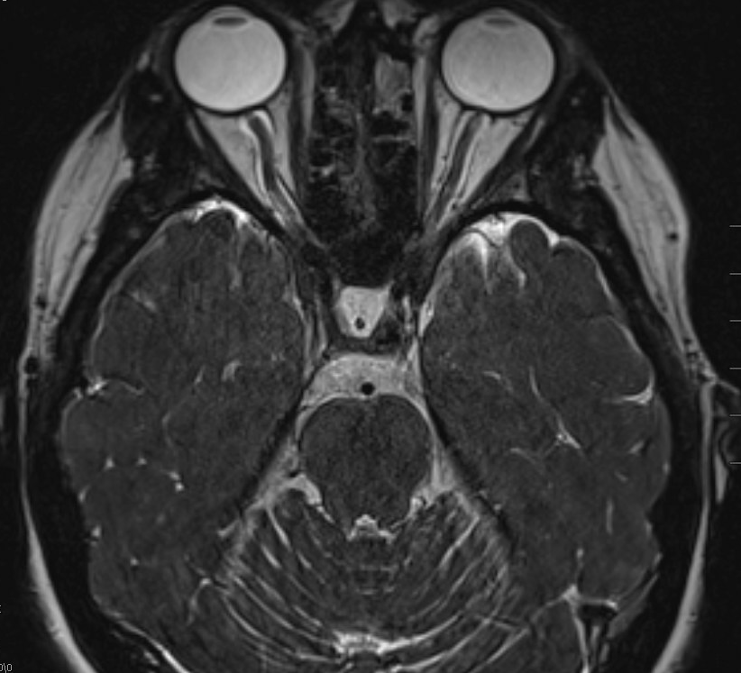
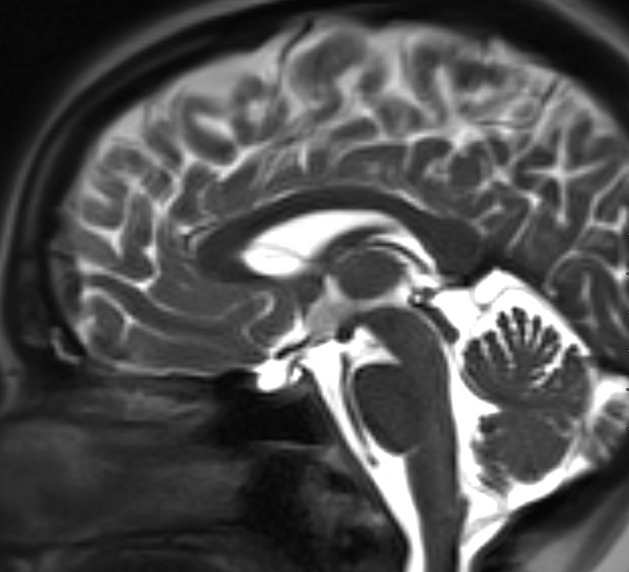
Imaging​
MRI brain and orbit with and without contrast:
  Partial empty sella, focal indentation of posterior globes, mild tortuosity of optic nerves with mild enlargement of CSF spaces surrounding the nerves
  Otherwise unremarkable
MRI cervical spine with and without contrast:
  Unremarkable

Slide 10
What testing would you want next?

Slide 11
Labs - CSF
Opening pressure 23 cm H₂O
Clear, colorless
Normal cell counts, glucose, protein
Culture with no growth
Meningitis/encephalitis panel negative
VDRL negative
Lyme PCR negative
WNV PCR negative
ACE negative

Slide 12
Labs - Serum
ESR 20, CRP 7.5​
ANA negative​
Ganglioside abs negative​
AChR abs negative​
MOG, AQP4 ab negative​
HIV negative​
Treponemal ab negative​
Quantiferon TB negative​
Rickettsia ab negative​
Ehrlichia ab negative​
CMV PCR negative​
Anaplasma ab negative​
Parasite immunoassay negative​
Lyme PCR negative​
ACE negative​
Lysozyme negative​
​

Slide 13
What can we rule out from our differential?

Slide 14
Differential diagnosis - Progressive ophthalmoplegia, bulbar symptoms, and pupillary involvement​
Botulism
AIDP/Miller Fisher Syndrome (MFS)
Bickerstaff encephalitis
Neuromuscular junction disorders (MG, LEMS)
Organophosphate poisoning
Heavy metal intoxication
Poliomyelitis
West Nile virus
Tetrodotoxin poisoning
Wernicke’s encephalopathy
Notes:
bickerstaff - ataxia, encephalopathy, and ophthalmoplegia
NMJ - would not involve pupils
organophosphate, heavy metal, tetrodotoxin - no clear history of exposure
Poliomyelitis
West nile virus
Wernickes - no clear risk factors, pupillary involvement would be atypical

Slide 15
 | Botulism | Miller-Fisher Syndrome
Oculobulbar symptoms | Present (early) | Present
Pupils | Mydriasis | Classically normal, but may be mydriatic
Trend of neuroparalysis | Descending | Descending
Deep tendon reflexes | Reduced or Normal | Absent
Coordination | Normal | Ataxia
Paresthesias | Absent | Present
Symmetry of neurological symptoms | Yes | Yes
Dysautonomia | Present | Present
CSF | Normal | Elevated protein
EMG/NCS (no pathognomonic pattern) | Absent H reflex; slowed conduction velocities; reduced SNAPs (but can be normal) | Normal sensory nerve action potentials; low amplitude, short duration and abundant motor unit action potentials. Small evoked muscle action potentials.

Slide 16
 | Botulism | Miller-Fisher Syndrome
Oculobulbar symptoms | Present (early) | Present
Pupils | Mydriasis | Classically normal, but may be mydriatic
Trend of neuroparalysis | Descending | Descending
Deep tendon reflexes | Reduced or Normal | Absent
Coordination | Normal | Ataxia
Paresthesias | Absent | Present
Symmetry of neurological symptoms | Yes | Yes
Dysautonomia | Present | Present
CSF | Normal | Elevated protein
EMG/NCS (no pathognomonic pattern) | Absent H reflex; slowed conduction velocities; reduced SNAPs (but can be normal) | Normal sensory nerve action potentials; low amplitude, short duration and abundant motor unit action potentials. Small evoked muscle action potentials.
Red = differentiating features in our patient

Slide 17
How would you treat this patient?

Slide 18
Management
Treated with one dose botulinum antitoxin (though she denied eating any canned foods)
Received three day course of IVIG for possible AIDP/MFS
She did not have any clinical improvement with treatment while in the hospital
Discharged with neuro-ophthalmology follow up, with working diagnoses of botulism vs MFS
Until…

Slide 19
Until she received a call the following day…
Botulinum toxin B returned positive in the serum
Readmitted for respiratory monitoring, did not require escalation of care
Stool toxin testing eventually returned positive for botulinum toxin B by mass spectroscopy
Health department investigation was unable to determine the source of her exposure
Final diagnosis: botulism

Slide 20
Follow up in office 1 month later
VA 20/20 at distance, at near J5 OU PH to J1+
Pupils slightly sluggish but constrict fully to light and near
Trace left ptosis
Ductions full, saccades and pursuits normal
Alignment orthophoric

Slide 21
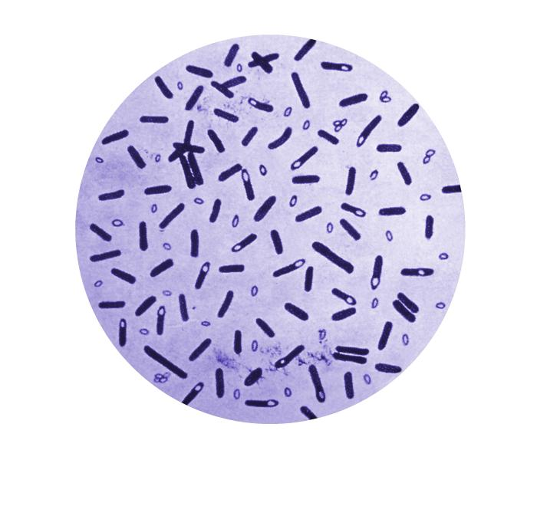
Botulism
A rare neuromuscular junction disease caused by neurotoxins produced by Clostridium botulinum
C. botulinum
  Gram positive bacilli, spore-forming, obligate anaerobe
  Ubiquitous in the environment, heat resistant
  In proper conditions, spores germinate to produce toxin-producing bacilli
  Eight subtypes of toxin (A-H) - A, B and E most commonly cause human disease
Public Health Image Library(PHIL) (cdc.gov)

Slide 22
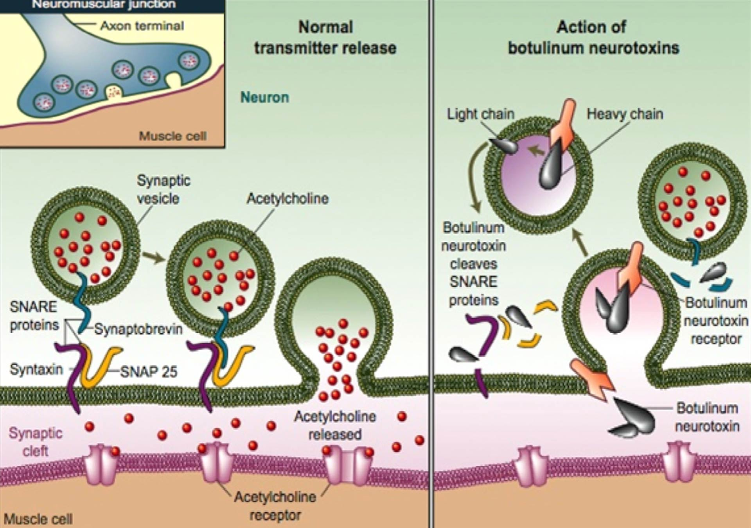
Botulism
Pathophysiology of botulinum neurotoxin
Toxin is delivered via vascular system to presynaptic cholinergic nerve terminals
Endocytosed into neuron, followed by translocation into cytosol
Toxin acts as endopeptidase, cleaving proteins necessary for neurotransmitter release
Botulinum antitoxin consists of equine-derived polyclonal antibody fragments that bind free botulinum neurotoxin (types A-G), preventing the toxin from being endocytosed
  It will not reverse paralysis but will stop progression
Al-Ghamdi AS, Alghanemy N, Joharji H, Al-Qahtani D, Alghamdi H. Botulinum toxin: Non cosmetic and off-label dermatological uses.
Journal of Dermatology & Dermatologic Surgery. 2015 19:1; 1-8. https://doi.org/10.1016/j.jdds.2014.06.002

Slide 23
Epidemiology
Approximately 200 cases per year in the US
Infant botulism (70-75%)
Foodborne botulism (20-25%)
Wound botulism (5-10%)
Iatrogenic (rare)

Slide 24
Iatrogenic botulism
4 cases reported to CDC in 2004 related to unlicensed use of highly concentrated cosmetic Botox
  Presented with progressive weakness and cranial neuropathies, required mechanical ventilation
  Following antitoxin administration, all four patients survived
In 2023-2024, clusters of 22 people in 11 U.S. states reported adverse effects related to counterfeit or mishandled botulinum toxin injections
  All females aged 22-59
  Administered by unlicensed or untrained individuals or in non-healthcare settings
  Symptoms began within 3 days of injections and included blurred vision, ptosis, dysarthria, dyspnea, fatigue, and generalized weakness
In our case, cosmetic Botox injection was likely a red herring given the timecourse
Notes:
while we were unable to determine the type of botulinum toxin that the patient received, and there was no clear foodborn source in her case, we felt it was unlikely that her cosmetic injections were related to her presentation, given her injections were 6 weeks prior to her onset of symptoms unlike the patients in these case series, and she tested positive for botulinum toxin B, while cosmetic injections most commonly involve the use of onabotulinum toxin a

Slide 25
Clinical presentation
Acute onset bilateral cranial neuropathies followed by descending weakness
  Can have blurred vision due to accommodative dysfunction
  Pupils may be sluggish and dilated round or irregular (due to asymmetric/incomplete paresis of pupillary sphincter), and eventually unreactive
  No sensory deficits
  No fever
  Normal mental status
  Normal or slow HR, normal BP
  Reflexes are typically normal unless muscle group is completely paralyzed
  May be preceded by GI upset
Foodborne - symptoms usually within 12-36 hours of ingestion, though may be delayed up to 2 weeks
Respiratory compromise (related to diaphragmatic paralysis) may be rapid, within 48 hours of symptom onset

Slide 26
Diagnosis
Consider antitoxin treatment if clinical presentation supports presumptive diagnosis
  Coordination with public health officials is required
  CDC criteria for suspicion:
    At least one specific symptom of cranial neuropathy (blurred/double vision, dysarthria, dysphagia, hoarseness)
    At least one specific sign of neuropathy (ptosis, EOM palsy, fixed pupils, facial weakness, descending paralysis)
    Lack of fever
Send specimens from serum, stool, gastric fluid/aspirate, and suspected food source (if available); wound specimens if applicable
Treatment should be given before results return

Slide 27
Treatment
Supportive care and monitoring
  Immediate hospitalization for close respiratory monitoring
  Consider intubation for worsening respiratory status and VC <30%
  Swallow evaluation
Antitoxin
  In a meta-analysis of 61 adult cases, antitoxin shown to have significant reduction in mortality (odds ratio [OR] 0.22, 95% CI 0.17-0.29)
  Equine botulinum antitoxin for adults - administered IV
  Human-derived botulism immune globulin for infant botulism
  Obtained through state health departments

Slide 28
Take home points
In patients with multiple cranial neuropathies, consider botulism even if no clear exposure
When differentiating between botulism and Miller Fisher Syndrome, pupillary involvement, lack of sensory symptoms, normal coordination and preservation of reflexes should raise suspicion for botulism
Treatment with botulinum antitoxin should be initiated empirically when suspicion is high and before testing returns

Slide 29
References
Al-Ghamdi AS, Alghanemy N, Joharji H, Al-Qahtani D, Alghamdi H. Botulinum toxin: Non cosmetic and off-label dermatological uses. Journal of Dermatology & Dermatologic Surgery. 2015 19:1; 1-8.
Chatham-Stephens K, Fleck-Derderian S, Johnson SD, Sobel J, Rao AK, Meaney-Delman D. Clinical Features of Foodborne and Wound Botulism: A Systematic Review of the Literature, 1932-2015. Clin Infect Dis. 2017 Dec 27;66(suppl_1):S11-S16.
Chertow DS, Tan ET, Maslanka SE, Schulte J, Bresnitz EA, Weisman RS, Bernstein J, Marcus SM, Kumar S, Malecki J, Sobel J, Braden CR. Botulism in 4 adults following cosmetic injections with an unlicensed, highly concentrated botulinum preparation. JAMA. 2006 Nov 22;296(20):2476-9.
Lonati D, Schicchi A, Crevani M, Buscaglia E, Scaravaggi G, Maida F, Cirronis M, Petrolini VM, Locatelli CA. Foodborne Botulism: Clinical Diagnosis and Medical Treatment. Toxins (Basel). 2020 Aug 7;12(8):509.
O'Horo JC, Harper EP, El Rafei A, Ali R, DeSimone DC, Sakusic A, Abu Saleh OM, Marcelin JR, Tan EM, Rao AK, Sobel J, Tosh PK. Efficacy of Antitoxin Therapy in Treating Patients With Foodborne Botulism: A Systematic Review and Meta-analysis of Cases, 1923-2016. Clin Infect Dis. 2017 Dec 27;66(suppl_1):S43-S56.

