Slide 1


Bilateral insidious visual loss in an adult man
Juan Manuel García Gómez, MD
Resident Physician in Neuro-ophthalmology
Asociación Para Evitar la Ceguera en México, I. A. P.
Jorge Cárdenas-Belaunzarán, MD, MSc
Professor of Neuro-ophthalmology
Asociación Para Evitar la Ceguera en México, I. A. P.

Slide 2
58-Year-Old man with bilateral vision loss
Noted painless mild visual decline 1 month prior to presentation
Underwent refraction test one week prior to first contact
New pair of glasses did not help

Slide 3
Past Medical History
PMH (+) for type 2 diabetes mellitus
  Medical treatment: metformin
Denies smoking or alcohol abuse
Occasional use of d-amphetamine pro-drug
No abnormal diet or nutritional habits
Denies other medications
Could any of these cause bilateral visual loss?
If so, how?

Slide 4
Possible visual loss mechanism in patient’s medical history
Type 2 Diabetes mellitus:
  Cataract, diabetic macular edema, diabetic retinopathy
  Uncontrolled metabolic status: Lens edema and myopic shift
  Higher risk for vascular occlusion (CRVO, BRVO, NAION)
D-amphetamine prodrug:
  Toxic optic neuropathy, drug-induced retinopathy

Slide 5
First contact relevant ophthalmic examination
OD |  | OS
20/50 | BCVA | 20/30
Healthy Mild nuclear slcerosis | Anterior segment | Healthy Mild nuclear slcerosis
Brisk reaction No RAPD | Pupillary reflexes | Brisk reaction No RAPD
Healthy retina Optic nerve: Pink, sharp, flat | Posterior segment | Healthy retina Optic nerve: Pink, sharp, flat
Would you consider cataract as the cause of vision loss?

Slide 6
Therapeutic approach
Myopic shift due to uncontrolled metabolic status?
Cataract enough to cause vision loss?
Complete blood count
Metabolic panel
Preoperative blood tests

Slide 7
58-Year-Old man with bilateral vision loss
Missed first follow up
Sought a second opinion
  Underwent brain MRI reported as normal
  Underwent electrophysiological studies of the retina

Slide 8
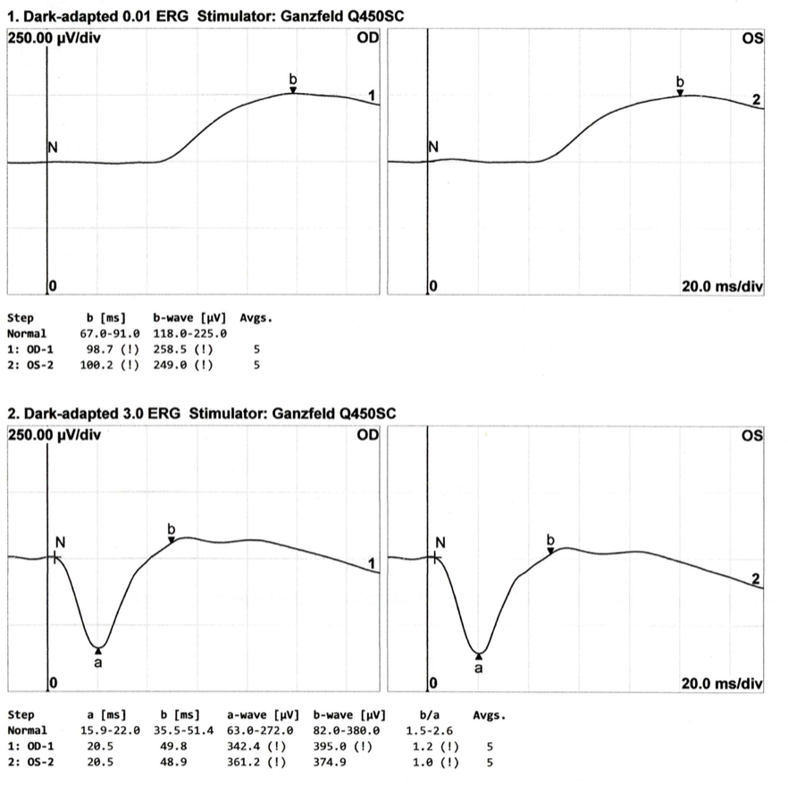
Dark-adapted Electroretinogram

Slide 9
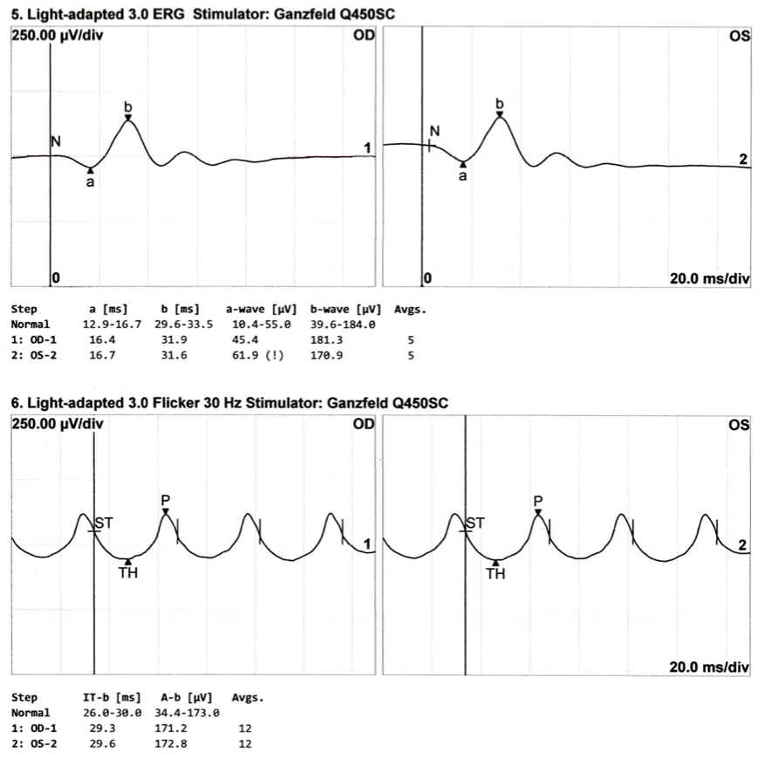
Light-adapted Electroretinogram

Slide 10
Follow up: 3 Months after first contact
4 months after initial symptoms noted
Progressive visual loss
  Slow
  Bilateral
  Painless
  No other symptoms

Slide 11
Follow up relevant ophthalmic examination
OD |  | OS
Hand motion | VA | Counting fingers
Healthy Mild nuclear slcerosis | Anterior segment | Healthy Mild nuclear slcerosis
Sluggish contraction No RAPD No light-near dissociation | Pupillary reflexes | Sluggish contraction No RAPD No light-near dissociation
Sharp, flat, temporal pallor | Optic nerve | Sharp, flat, temporal pallor
What studies would you consider ordering?

Slide 12
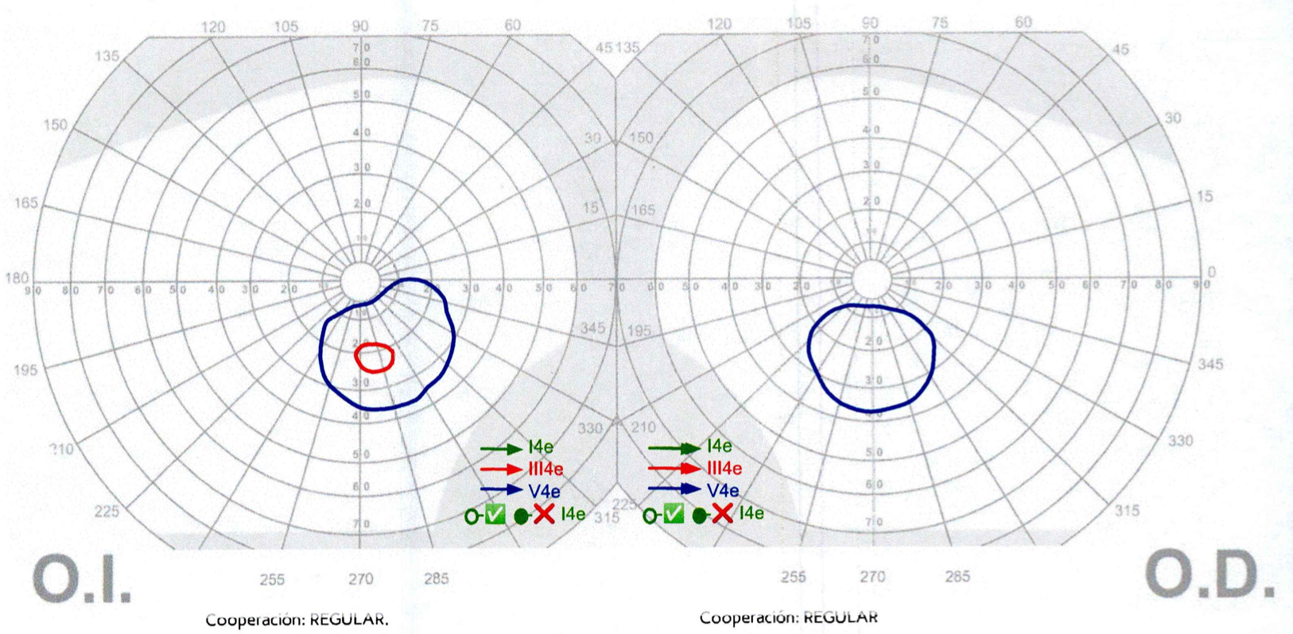
Goldmann visual fields
OS
OD

Slide 13
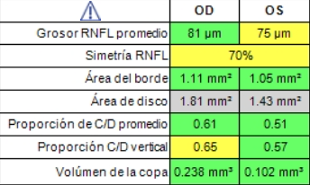
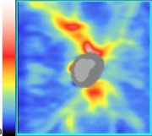
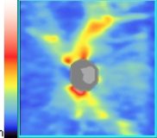
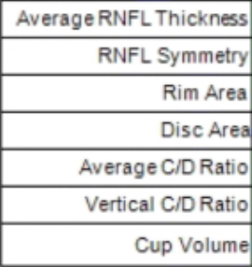
Nerve fiber layer OCT

Slide 14
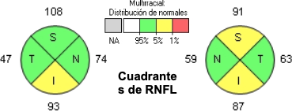
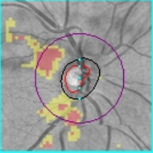
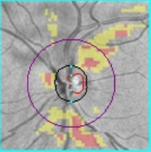
Nerve fiber layer OCT

Slide 15
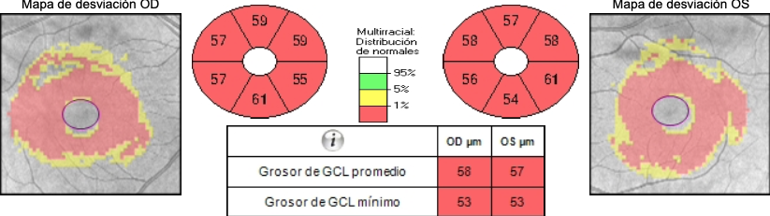
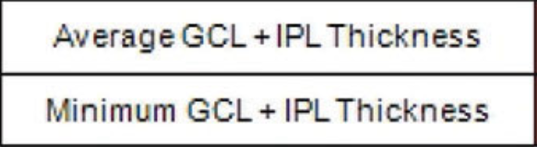
Ganglion cell layer OCT

Slide 16
Potential Neuro-Ophthalmic Differential
Bilateral optic atrophy
Progressive painless visual loss
What causes should be ruled out first?

Slide 17
Potential Neuro-Ophthalmic Differential
Painless, bilateral, progressive vision loss
Compressive optic neuropathy
Infiltrative/neoplastic optic neuropathy
  Paraneoplastic optic neuropathy/retinopathy
Inflammatory optic neuropathy (atypical)
Hereditary / Toxic / Nutritional optic neuropathy
Infectious optic neuropathy
What would you do next?

Slide 18
Painless, bilateral, progressive vision loss
Diagnostic process
MRI (brain and orbits)
Blood tests
  CBC, metabolic
  ESR, CRP
  B12 Vitamin (cobalamin), serum folate
  FTA-ABS, VDRL, TST

Slide 19
Follow up with results: 2 weeks later
OD |  | OS
Light perception | VA | Hand motion
Healthy Mild nuclear slcerosis | Anterior segment | Healthy Mild nuclear slcerosis
Sluggish contraction No RAPD No light-near dissociation | Pupillary reflexes | Sluggish contraction No RAPD No light-near dissociation
Sharp, flat, temporal pallor | Optic nerve | Sharp, flat, temporal pallor

Slide 20
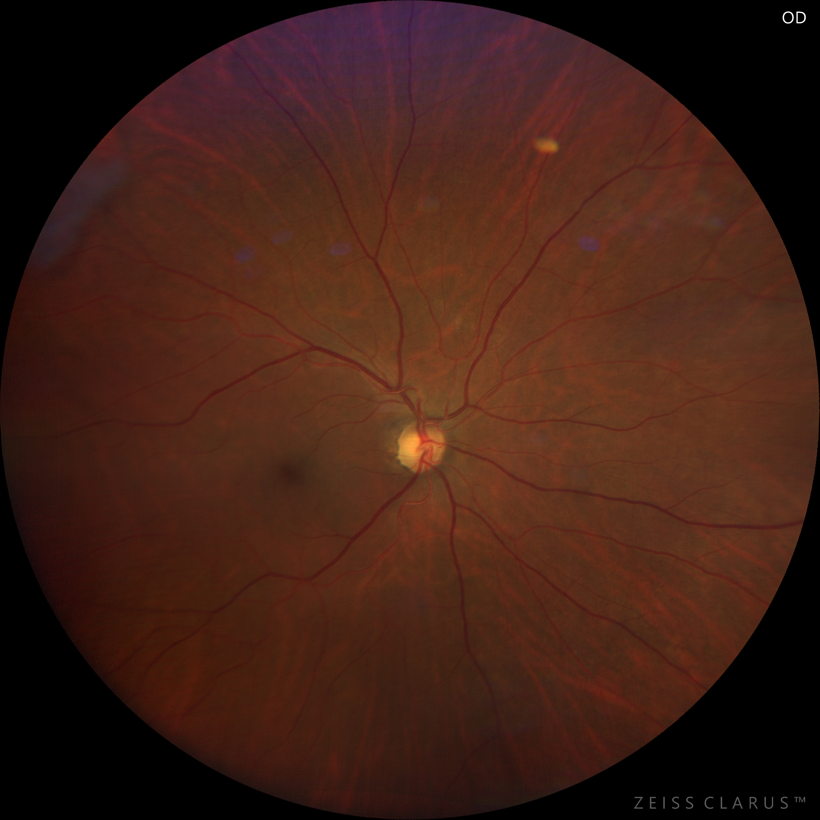
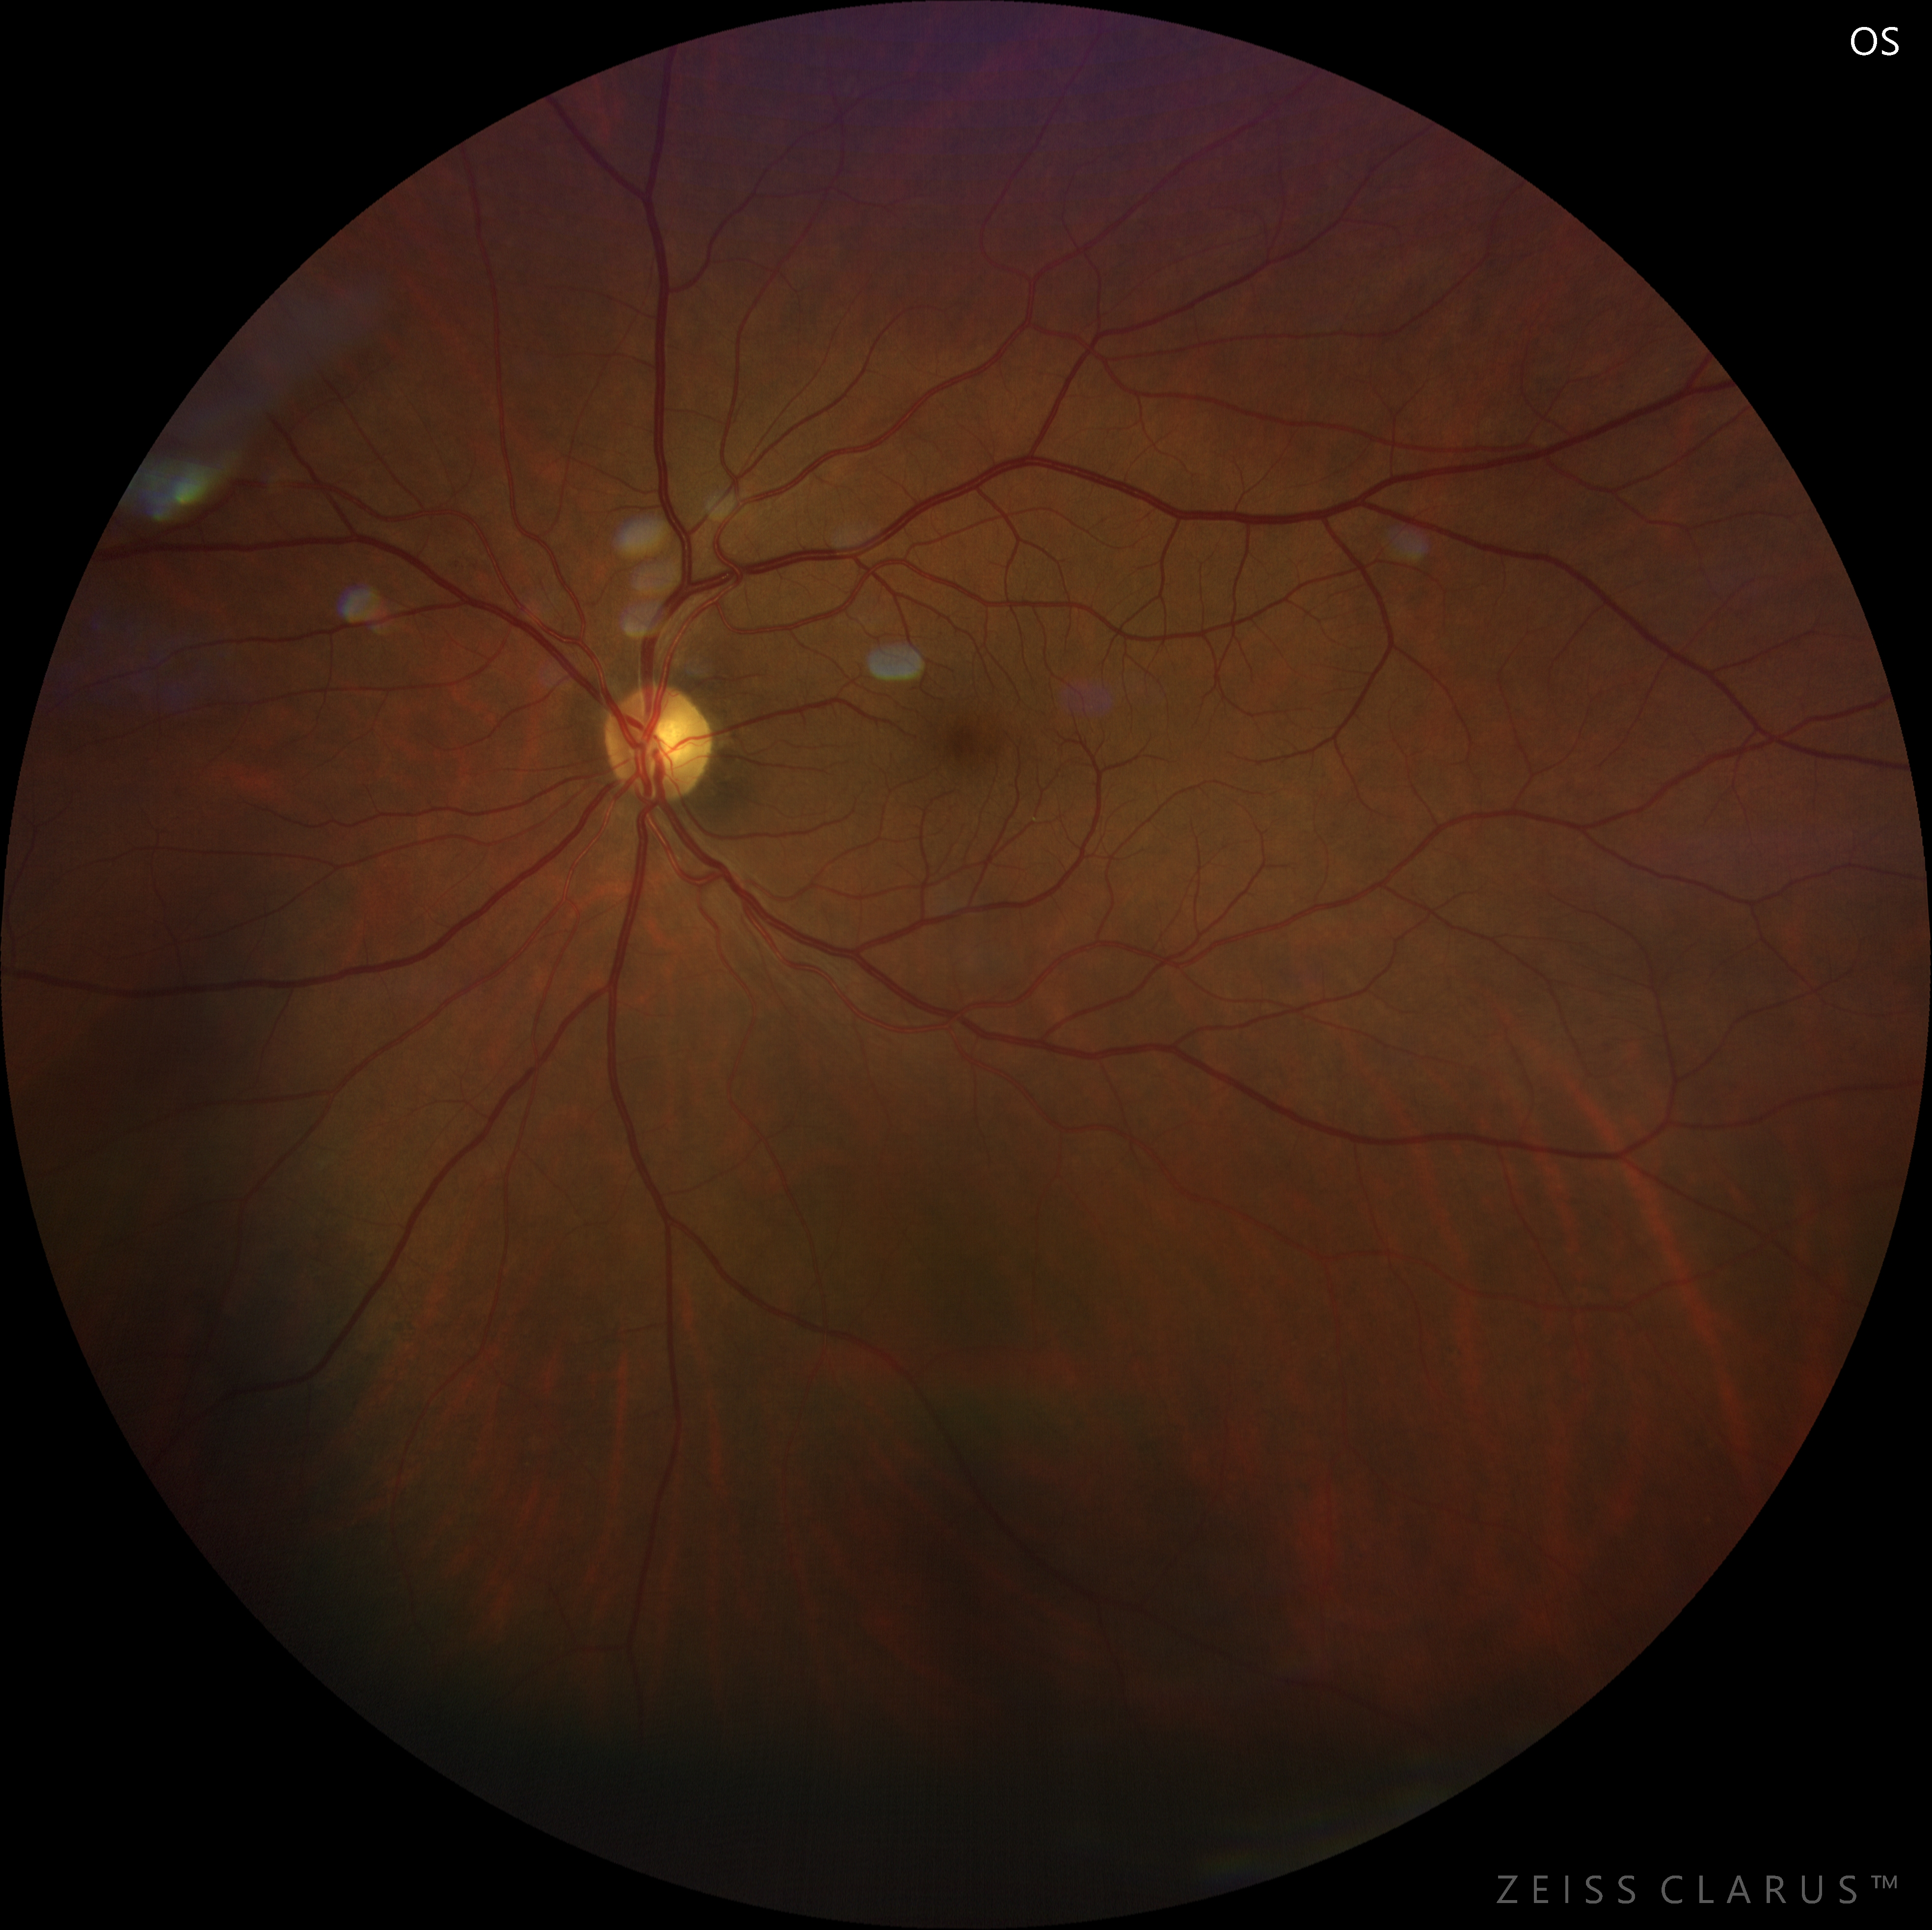
Follow up with results: 2 weeks later

Slide 21
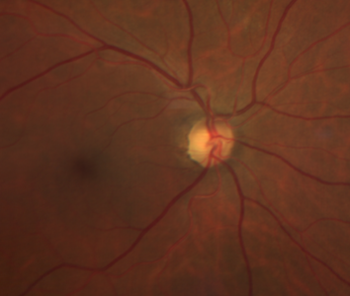
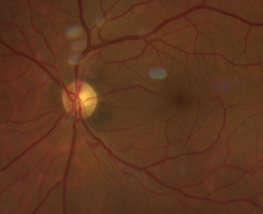
Follow up with results: 2 weeks later
OD |  | OS
Light perception | VA | Hand motion
Healthy Cataract NO2 | Anterior segment | Healthy Cataract NO2
Sluggish contraction | Pupillary reflexes | Sluggish contraction
Sharp, flat, temporal pallor | Optic nerve | Sharp, flat, temporal pallor

Slide 22
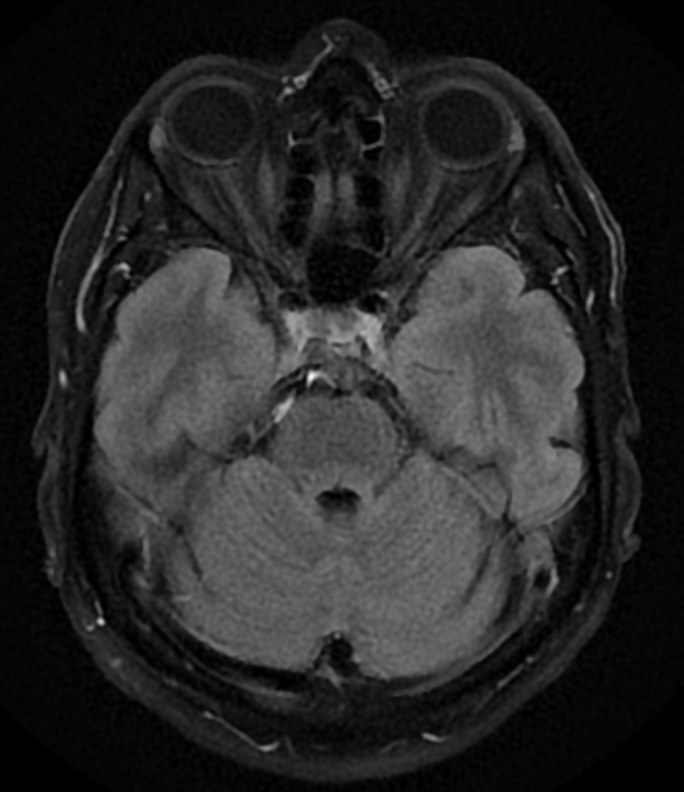
Brain and orbits MRI
Axial T2 FLAIR Gd-

Slide 23
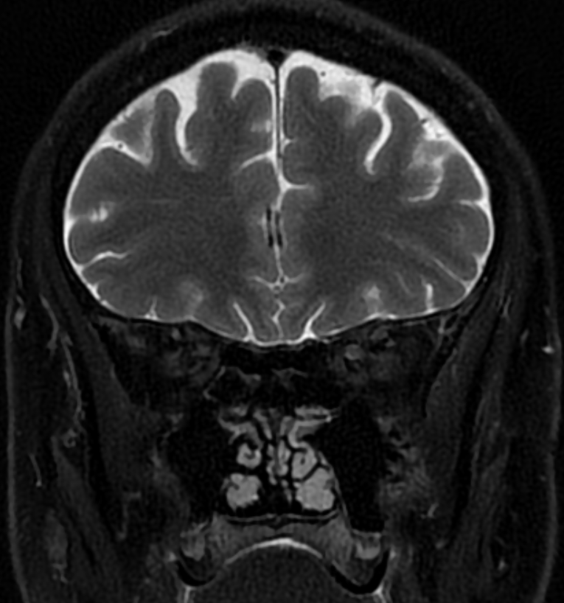
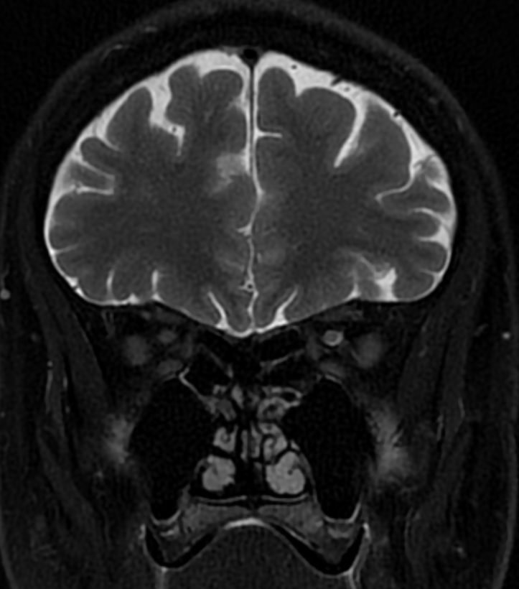
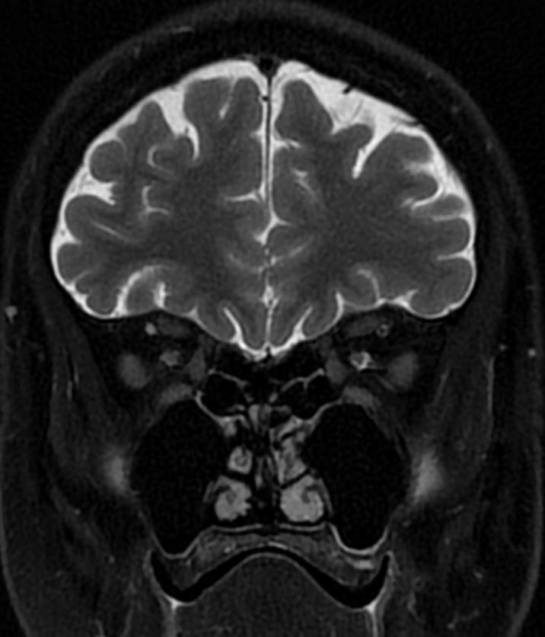
Brain and orbits MRI
Coronal T2 Gd-

Slide 24
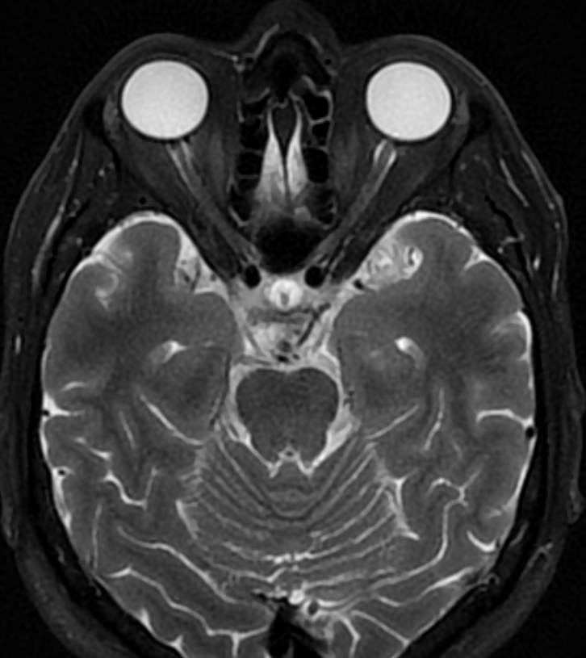
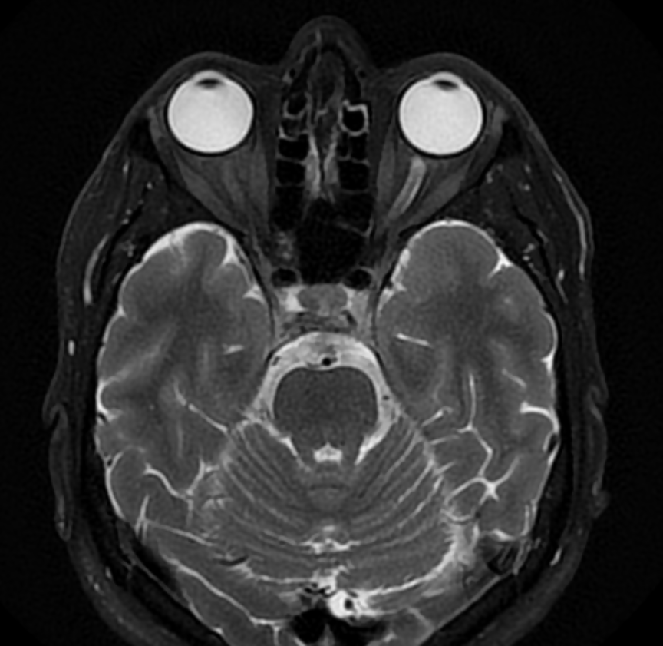
Brain and orbits MRI
Axial T2 Gd-

Slide 25
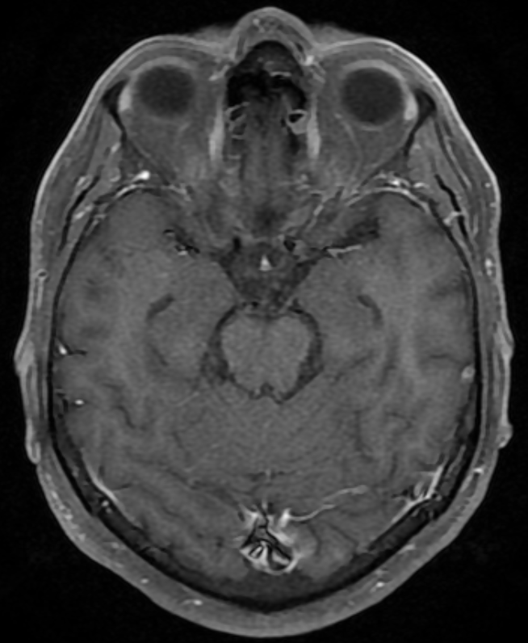
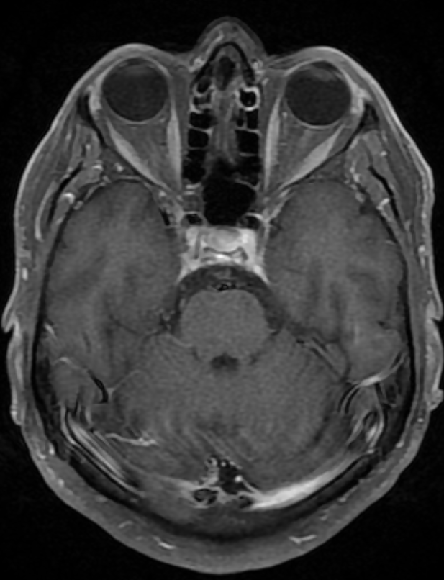
Brain and orbits MRI
Axial T1 Gd+

Slide 26
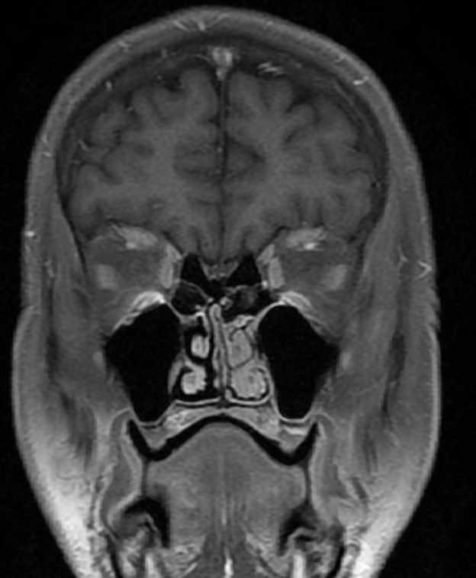
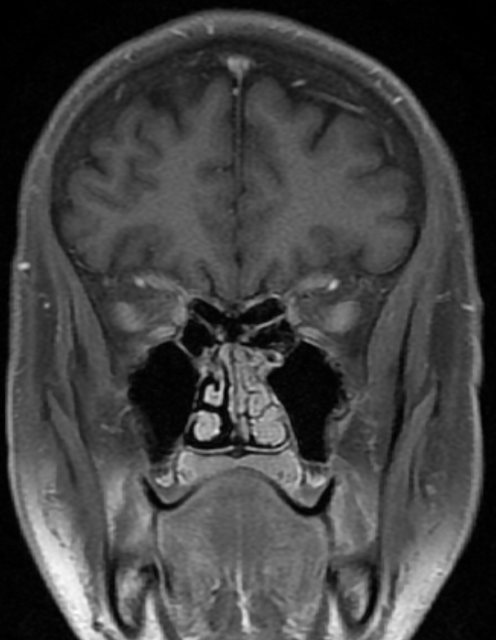
Brain and orbits MRI
Normal optic nerve
Coronal T1 + Gd

Slide 27
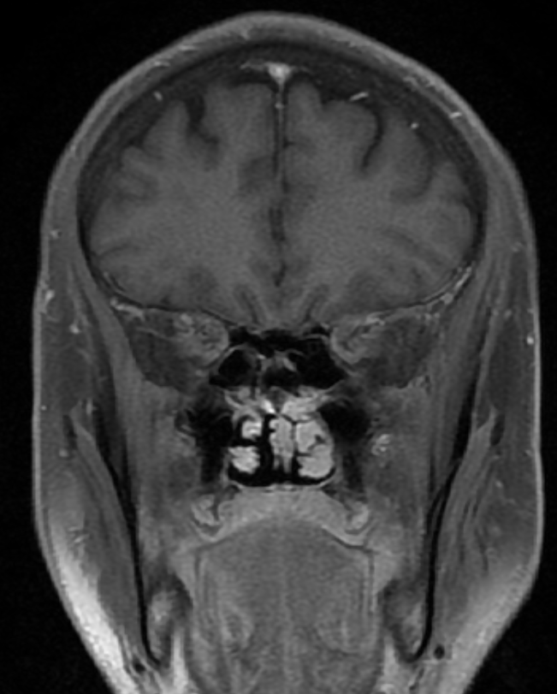
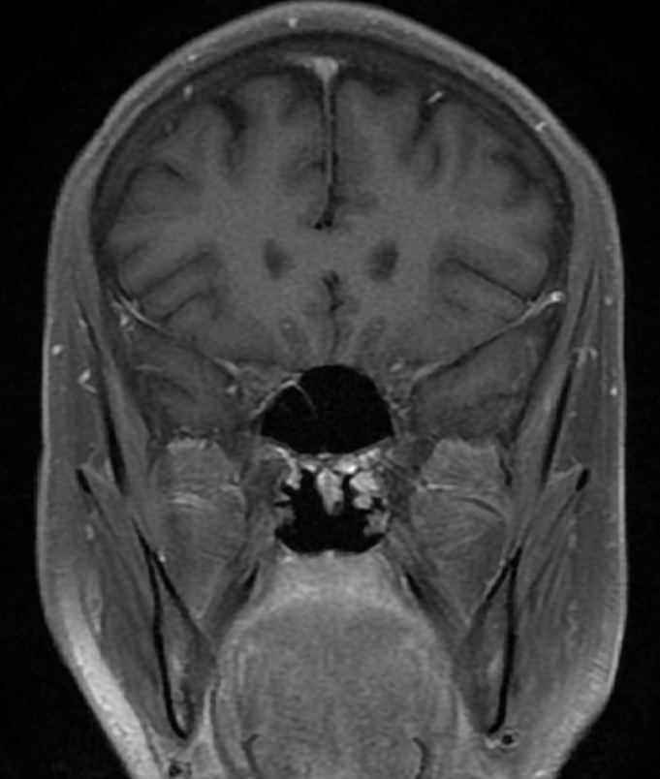
Brain and orbits MRI
Normal optic nerve
Coronal T1 + Gd

Slide 28
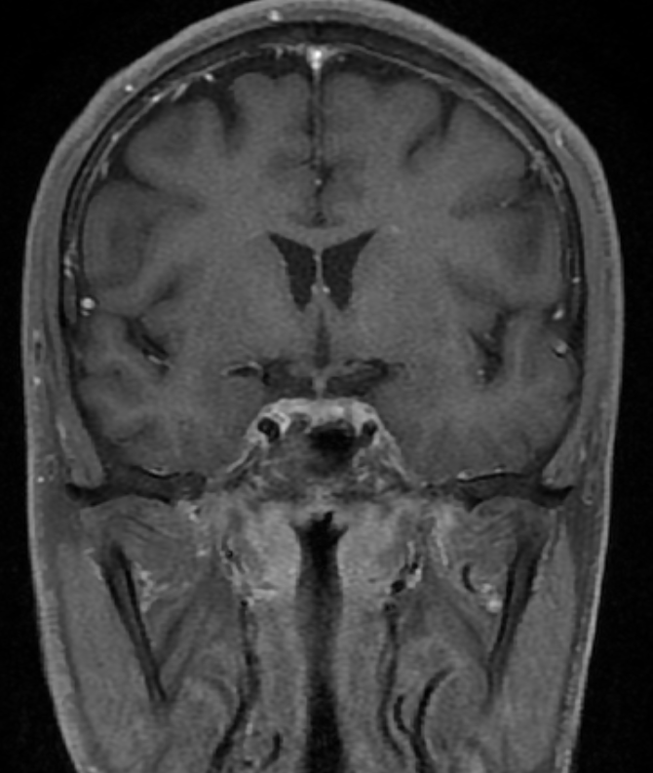
Brain and orbits MRI
Normal optic chiasm
Coronal T1 Gd+

Slide 29
Potential Neuro-Ophthalmic Differential
Painless, bilateral, progressive vision loss
Compressive optic neuropathy
Infiltrative/neoplastic optic neuropathy
Inflammatory optic neuropathy (atypical)
Nutritional optic neuropathy
Toxic optic neuropathy
Infectious optic neuropathy
Can you eliminate anything from our differential at this point?

Slide 30
Laboratory Results
CBC — within normal limits
Metabolic panel — within normal limits
B12 (cobalamin) — 400 (211-946 pg/mL)
B9 (Folic Acid) — 18.1 (>3 ng/mL)
FTA-ABs: Reactive
VDRL: Reactive

Slide 31
Potential Neuro-Ophthalmic Differential
Painless, bilateral, progressive vision loss
Compressive optic neuropathy
Infiltrative/neoplastic optic neuropathy
Inflammatory optic neuropathy (atypical)
Nutritional optic neuropathy
Toxic optic neuropathy
Infectious optic neuropathy

Slide 32
Painless, bilateral, progressive vision loss
Isolated Infectious bilateral retrobulbar optic neuropathy
  Without intraocular involvement
  No neurologic signs or symptoms

Slide 33
Management
IV Crystalline penicillin G
  24 million U / day
Methylprednisolone
  1g / day
  48h after antibiotic started
Infectious work up
  HIV serology (Non reactive)
  Lumbar puncture (Not done)

Slide 34
Syphilis
Treponema pallidum infection
Historic low 2000-01
  Yearly increase
    + 28.6% 2020-21

Slide 35
Syphilitic optic neuropathy
Optic nerve invasion
  Ocular syphilis
  Neurosyphilis
  Isolated

Slide 36
Syphilitic optic neuropathy
Uveitis
Choroiditis
Scleritis
Retinitis
Neuroretinitis
Vasculitis
Others
Optic nerve invasion
  Ocular syphilis
  Neurosyphilis
  Isolated

Slide 37
Syphilitic optic neuropathy
Meningitis
Meningovascular syphilis
Encephalitis
Stroke
Tabes dorsalis
General paresis
Optic nerve invasion
  Ocular syphilis
  Neurosyphilis
  Isolated

Slide 38
Syphilitic optic neuropathy
Optic nerve invasion
  Ocular syphilis
  Neurosyphilis
  Isolated
Optic neuritis
Papilitis
Optic perineuritis

Slide 39
Syphilitic optic neuropathy - clinical forms
 | Optic Neuritis | Optic perineuritis | Papilledema | Papillitis | Neuroretinitis
Laterality | Unilateral | Unilateral | Bilateral | +/- Bilateral | Unilateral
Visual acuity | Severely diminished | Preserved or mild affection | Preserved | Normal ➔ Incipient papillitis Abnormal ➔ Papillitis | Diminished
Pain | Ocular, retro-ocular and with eye movements | Severe retro-ocular pain, exacerbates with eye movements | Headache | Painless | Painless
Chromatic vision | Abnormal | Abnormal | Preserved until late stages | Preserved | Normal/Abnormal
Optic disc | Anterior: Edema Retrobulbar: Normal | Edema | Edema | Edema | Edema + macular star
Visual fields | Central or cecocentral scotoma | Paracentral or arcuate defects | Blind spot enlargement, progressive peripheral loss in late stage | Blind spot enlargement | Blind spot enlargement
MRI | Optic nerve enhancement | Train track sign, donut sign | No optic nerve enhancement. IIH signs | Normal | Normal

Slide 40
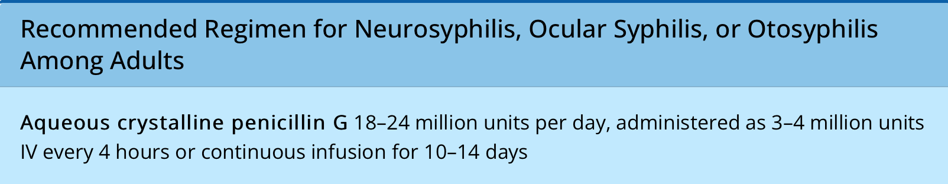
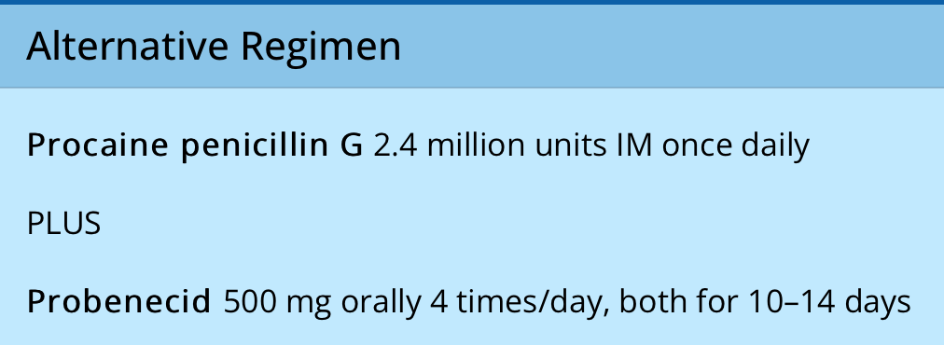
Syphilitic optic neuropathy
Treatment
  Same as neurosyphilis
Adjunctive corticosteroid
  ¿Benefit?

Slide 41
Syphilitic optic neuropathy
Treatment
  Same as neurosyphilis
Penicillin allergy
  Desensitization required

Slide 42
Syphilitic optic neuropathy
Treatment
  Same as neurosyphilis
Always test for HIV
Treatment should be multidisciplinary
  Neurologist
  Infectious disease specialist

Slide 43
References
Kiss, S., F.M. Damico, and L.H. Young, Ocular manifestations and treatment of syphilis. Semin Ophthalmol, 2005. 20(3): p. 161-7.
Dutta Majumder P, Chen EJ, Shah J, Ching Wen Ho D, Biswas J, See Yin L, Gupta V, Pavesio C, Agrawal R. Ocular Syphilis: An Update. Ocul Immunol Inflamm. 2019;27(1):117-125. doi: 10.1080/09273948.2017.1371765.
Smith GT, Goldmeier D, Migdal C. Neurosyphilis with optic neuritis: an update. Postgrad Med J. 2006 Jan;82(963):36-9. doi: 10.1136/pgmj.2004.020875. PMID: 16397078; PMCID: PMC2563717. Apinyawasisuk S, Poonyathalang A, Preechawat P, Vanikieti K. Syphilitic Optic Neuropathy: Re-emerging Cases Over a 2-Year Period. Neuroophthalmology. 2016 Feb 22;40(2):69-73. doi: 10.3109/01658107.2015.1134586. PMID: 27928388; PMCID: PMC5123058.
Division of STD Prevention (July 22, 2021). Neurosyphilis, Ocular Syphilis, and Otosyphilis. Centers for Disease Control and Prevention. https://www.cdc.gov/std/treatment-guidelines/neurosyphilis.htm

